Slide 1

Robotic Arms Library – HW 1 – DH Parameters

Slide 2












2D – 1 – RR (modified DH)

Slide 3
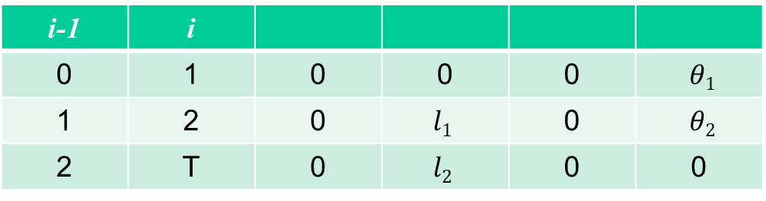
2D – 1 – RR - Modified Form Table
i-1 | i
0 | 1 | 0 | 0 | 0 | $θ1$
1 | 2 | 0 | $$l1$$ | 0 | $θ2$
2 | T | 0 | $$l2$$ | 0 | 0

Slide 4


2D – 1 – RR (standard DH)
$$y_{1}$$
$$x_{1}$$

Slide 5
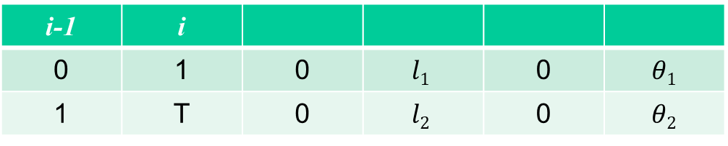
2D – 1 – RR - Standard Form Table
i-1 | i
0 | 1 | 0 | $$l1$$ | 0 | $θ1$
1 | T | 0 | $$l2$$ | 0 | $$θ2$$

Slide 6




2D – 2 – RRR (modified DH)

Slide 7
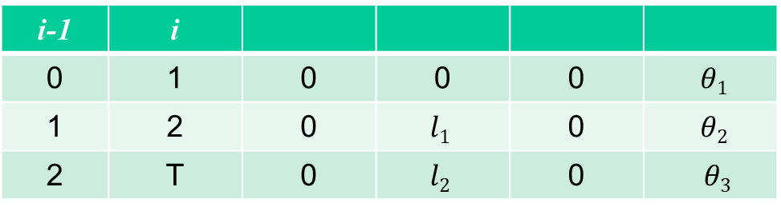
2D – 2 – RRR - Modified Form Table
i-1 | i
0 | 1 | 0 | 0 | 0 | $θ1$
1 | 2 | 0 | $$l1$$ | 0 | $θ2$
2 | T | 0 | $$l2$$ | 0 | $$θ3$$

Slide 8




2D – 2 – RRR (standard DH)
$$x_{2}$$
$$y_{2}$$
$$y_{1}$$
$$x_{1}$$

Slide 9
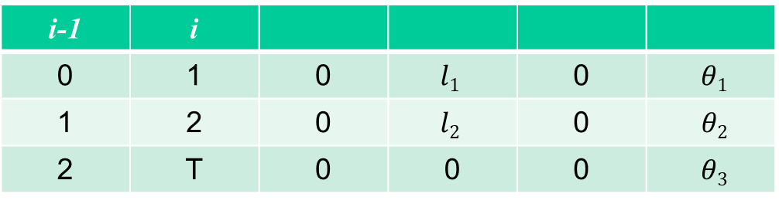
2D – 2 – RRR - Standard Form Table
i-1 | i
0 | 1 | 0 | $$l1$$ | 0 | $θ1$
1 | 2 | 0 | $$l2$$ | 0 | $$θ2$$
2 | T | 0 | 0 | 0 | $θ3$

Slide 10
















3D – 1 – RRR (modified DH)

Slide 11
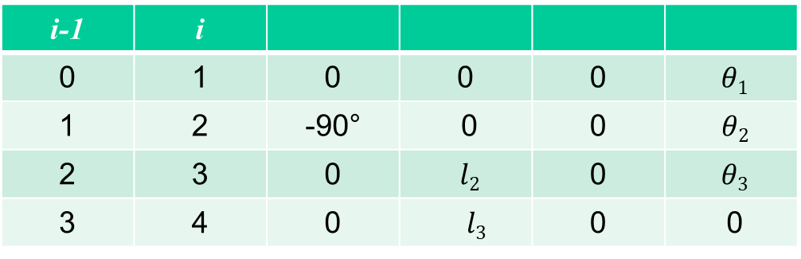
3D – 1 – RRR - Modified Form Table
i-1 | i
0 | 1 | 0 | 0 | 0 | $θ1$
1 | 2 | -90° | $\text{0}$ | 0 | $$θ2$$
2 | 3 | 0 | $l2$ | 0 | $θ3$
3 | 4 | 0 | $$l3$$ | 0 | 0

Slide 12







3D – 1 – RRR (standard DH)
$$z_{1}$$
$$z_{2}$$
$$x_{0}$$
$$x_{1}$$
$$x_{2}$$
$$z_{3}$$
$$x_{3}$$

Slide 13
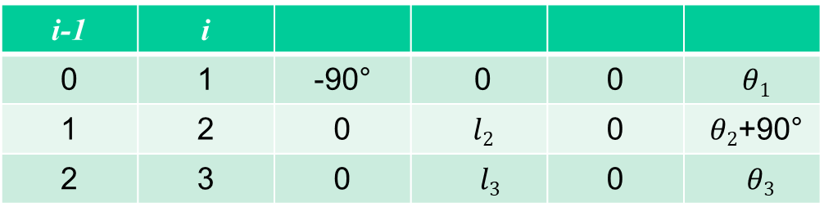
3D – 1 – RRR - Standard Form Table
i-1 | i
0 | 1 | -90° | $\text{0}$ | 0 | $$θ1$$
1 | 2 | 0 | $l2$ | 0 | $θ2$+90°
2 | 3 | 0 | $$l3$$ | 0 | $θ3$

Slide 14













3D – 2 – RRP (modified DH)

Slide 15
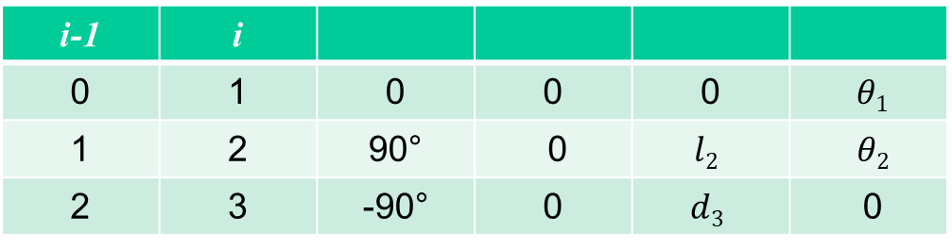
3D – 2 – RRP - Modified Form Table
i-1 | i
0 | 1 | 0 | 0 | 0 | $θ1$
1 | 2 | 90° | $\text{0}$ | $$l2$$ | $$θ2$$
2 | 3 | -90° | 0 | $$d3$$ | 0

Slide 16





3D – 2 – RRP (standard DH)
$$z_{2}$$
$$d_{3}$$
$$z_{1}$$
$$x_{1}$$
$$x_{2}$$

Slide 17
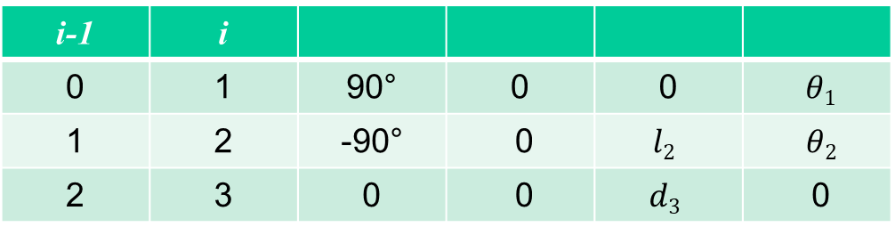
3D – 2 – RRP - Standard Form Table
i-1 | i
0 | 1 | 90° | 0 | 0 | $θ1$
1 | 2 | -90° | $\text{0}$ | $$l2$$ | $$θ2$$
2 | 3 | 0 | 0 | $$d3$$ | 0

Slide 18











3D – 4 – RPP (Cylindrical Robot, modified DH)

Slide 19
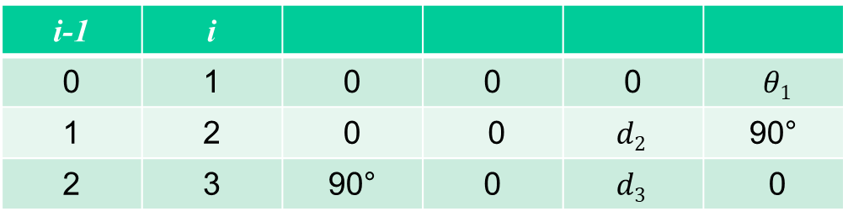
3D – 4 – RPP - Modified Form Table
i-1 | i
0 | 1 | 0 | 0 | 0 | $θ1$
1 | 2 | 0 | $\text{0}$ | $$d2$$ | 90°
2 | 3 | 90° | 0 | $$d3$$ | 0

Slide 20







3D – 4 – RPP (Cylindrical Robot, standard DH)
$$x_{2}$$
$$x_{3}$$
$$z_{2}$$
$$z_{3}$$
$$z_{1}$$
$$x_{1}$$
$$d_{1}$$

Slide 21
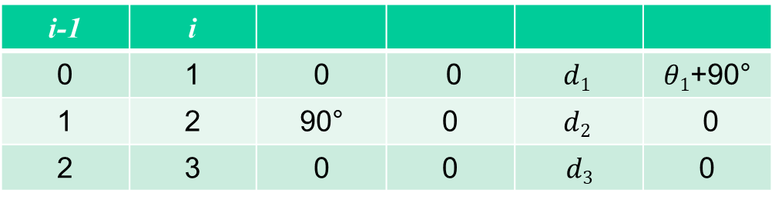
3D – 4 – RPP - Standard Form Table
i-1 | i
0 | 1 | 0 | $\text{0}$ | $$d1$$ | $θ1$+90°
1 | 2 | 90° | 0 | $$d2$$ | 0
2 | 3 | 0 | 0 | $$d3$$ | 0

Slide 22



















3D – 4 – RRR (Spherical Wrist, modified DH)
$$x_{T}$$
$$z_{T}$$
$$y_{T}$$
$$x_{0}$$
$$d_{T}$$
$$z_{0}$$
$$y_{0}$$

Slide 23
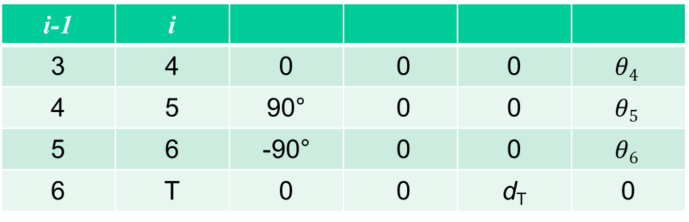
3D – 4 – RRR - Modified Form Table
i-1 | i
3 | 4 | 0 | $\text{0}$ | 0 | $$θ4$$
4 | 5 | 90° | 0 | 0 | $$θ5$$
5 | 6 | -90° | 0 | 0 | $$θ6$$
6 | T | 0 | $\text{0}$ | d_{T} | 0

Slide 24










3D – 4 – RRR (Spherical Wrist, standard DH)
$$x_{4}$$
$$z_{4}$$
$$z_{5}$$
$$x_{6}$$
$$y_{5}$$
$$y_{4}$$
$$θ_{6}$$
$$z_{6}$$
$$y_{6}$$
$$x_{0}$$
$$d_{6}$$
$$z_{0}$$
$$y_{0}$$

Slide 25
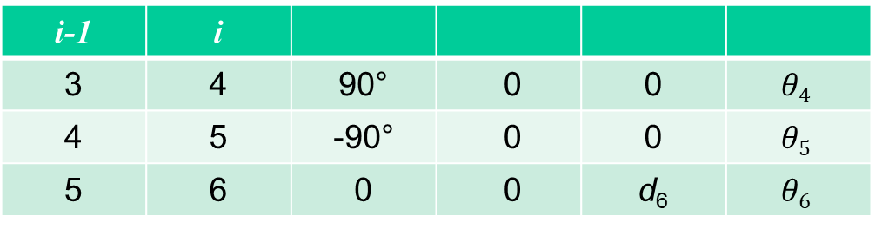
3D – 4 – RRR - Standard Form Table
i-1 | i
3 | 4 | 90° | 0 | 0 | $$θ4$$
4 | 5 | -90° | 0 | 0 | $$θ5$$
5 | 6 | 0 | $\text{0}$ | d₆ | $$θ6$$

Slide 26
















3D – 5 – RRRP (modified DH)

Slide 27
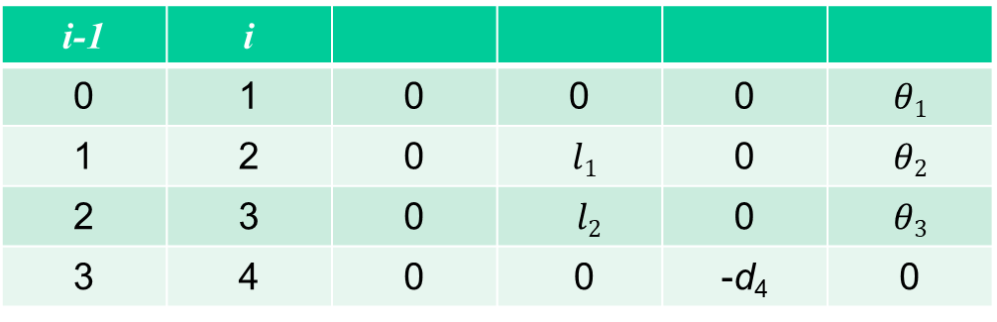
3D – 5 – RRRP - Modified Form Table
i-1 | i
0 | 1 | 0 | 0 | 0 | $$θ1$$
1 | 2 | 0 | $l1$ | 0 | $$θ2$$
2 | 3 | 0 | $$l2$$ | 0 | $$θ3$$
3 | 4 | 0 | 0 | -d₄ | 0

Slide 28






3D – 5 – RRRP (standard DH)
$$z_{1}$$
$$z_{2}$$
$$x_{1}$$
$$x_{2}$$
$$z_{3}$$
$$x_{3}$$

Slide 29
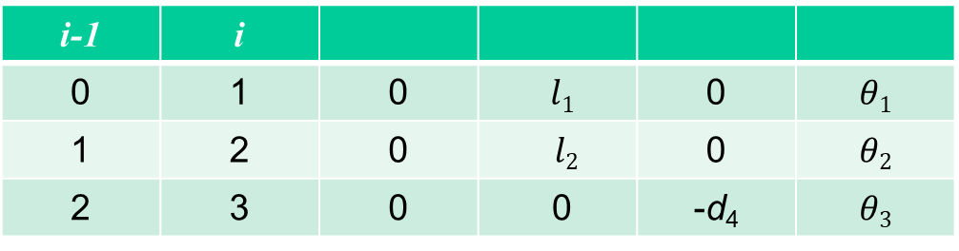
3D – 5 – RRRP - Standard Form Table
i-1 | i
0 | 1 | 0 | $l1$ | 0 | $$θ1$$
1 | 2 | 0 | $$l2$$ | 0 | $$θ2$$
2 | 3 | 0 | 0 | -d₄ | $$θ3$$

Slide 30




















3D – 6 – PRRR (modified DH)
$$l_{1}$$
Instructor: Jacob Rosen
Advanced Robotic - MAE 263D - Department of Mechanical & Aerospace Engineering - UCLA
Notes:
30

Slide 31
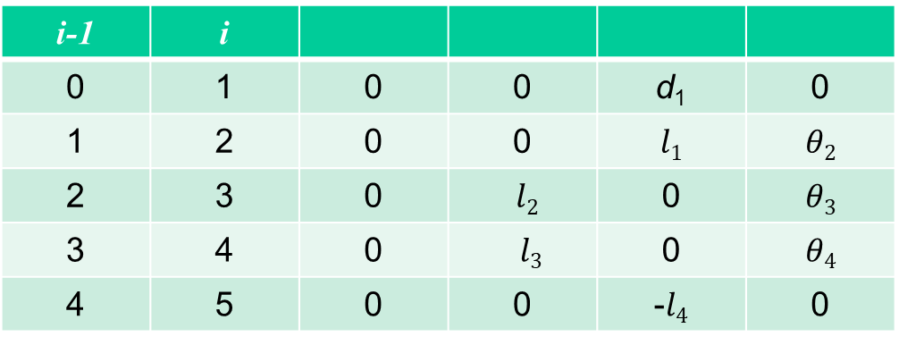
3D – 6 – PRRR - Modified Form Table
i-1 | i
0 | 1 | 0 | 0 | d₁ | 0
1 | 2 | 0 | 0 | $$l1$$ | $$θ2$$
2 | 3 | 0 | $l2$ | 0 | $$θ3$$
3 | 4 | 0 | $$l3$$ | 0 | $$θ4$$
4 | 5 | 0 | 0 | -$l4$ | 0

Slide 32









3D – 6 – PRRR (standard DH)
$$z_{1}$$
$$z_{2}$$
$$z_{3}$$
$$x_{1}$$
$$x_{2}$$
$$x_{3}$$
$$l_{1}$$
$$z_{4}$$
$$x_{4}$$
Instructor: Jacob Rosen
Advanced Robotic - MAE 263D - Department of Mechanical & Aerospace Engineering - UCLA
Notes:
32

Slide 33
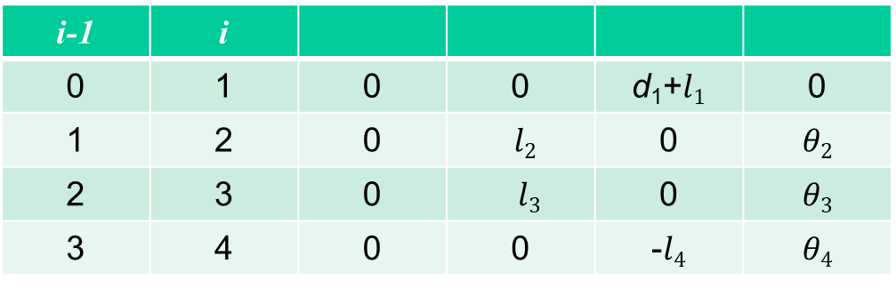
3D – 6 – PRRR - Standard Form Table
i-1 | i
0 | 1 | 0 | 0 | d₁+$l1$ | 0
1 | 2 | 0 | $l2$ | 0 | $$θ2$$
2 | 3 | 0 | $$l3$$ | 0 | $$θ3$$
3 | 4 | 0 | 0 | -$l4$ | $$θ4$$

Slide 34




DH Parameters - Summary
If the link frame have been attached to the links according to our convention, the following definitions of the DH parameters are valid:
Standard form:
- The distance from to measured along
- The angle between and measured about
- The distance from to measured along
- The angle between and measured about
Modified form:
- The distance from to measured along
- The angle between and measured about
- The distance from to measured along
- The angle between and measured about
Note: are signed quantities

Slide 35
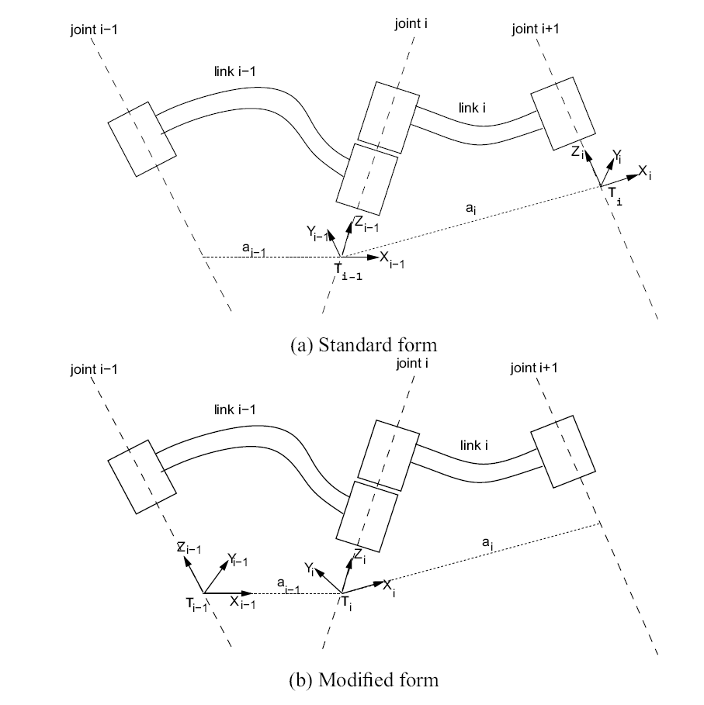
DH Parameters – Standard / Modified Approach

