Slide 1

Robotic Control
PID Controller

Slide 2
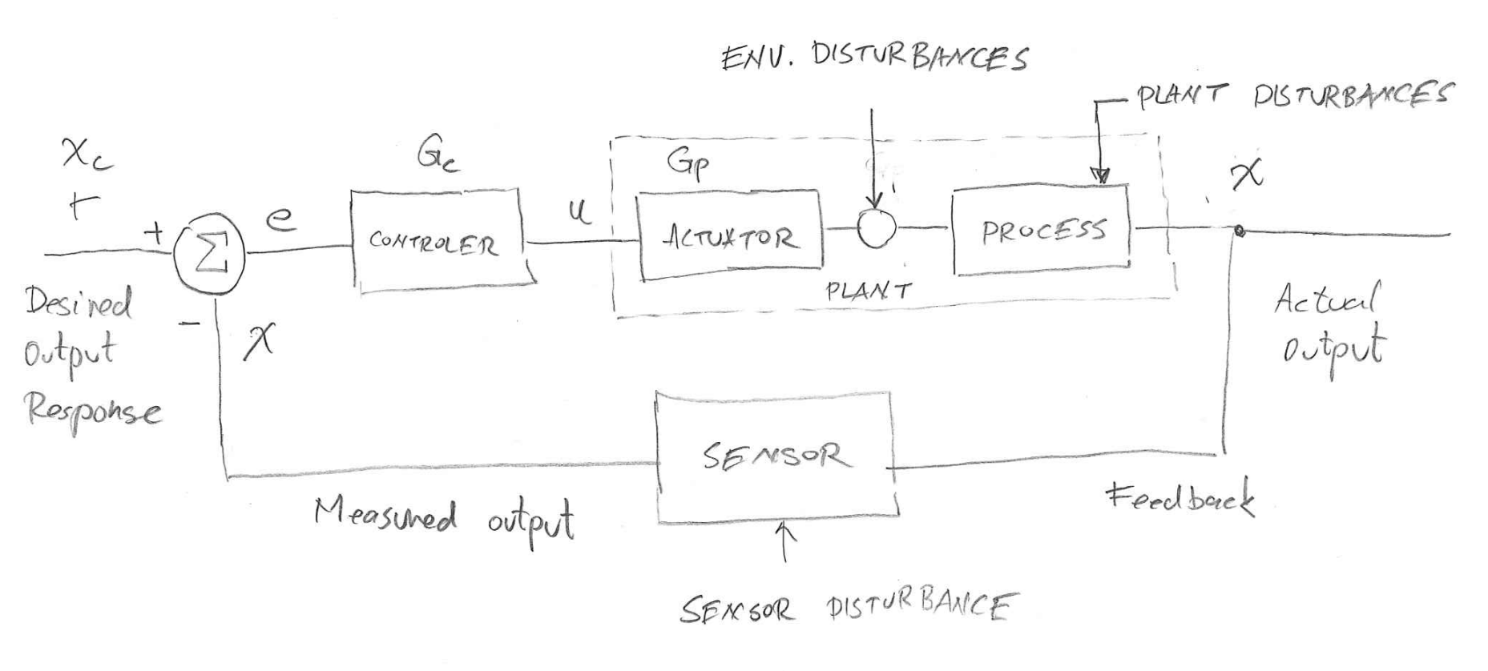
Close Loop Feedback Control – Block Diagram

Slide 3
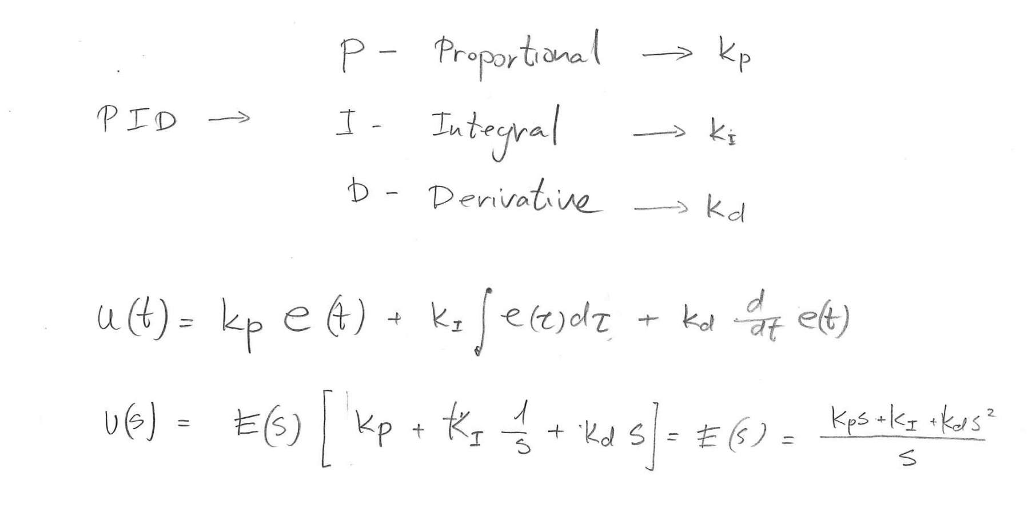
PID Controller – Definition

Slide 4
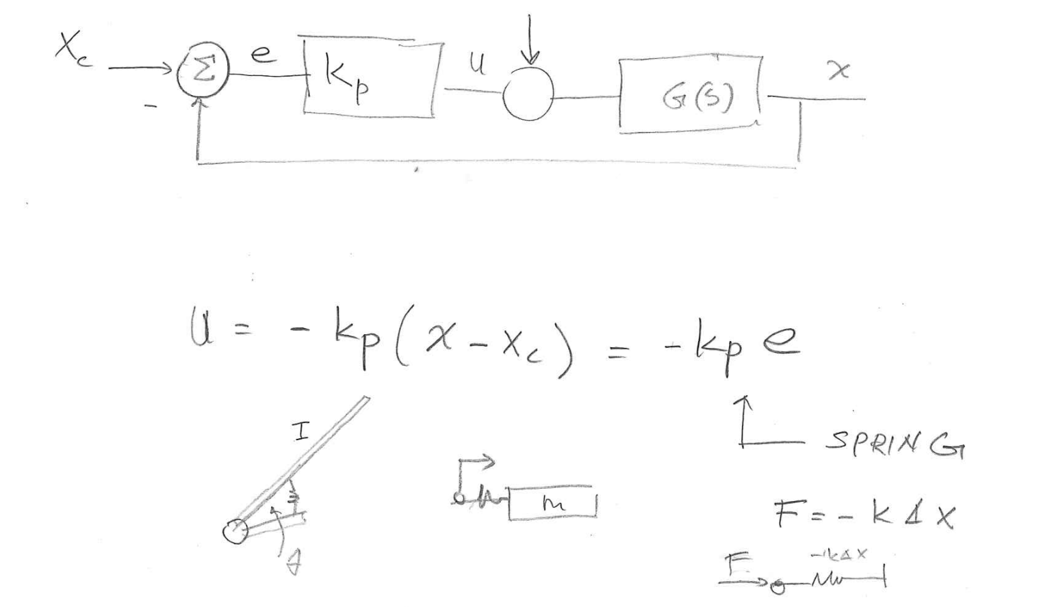
PID Controller – – Proportional Control
P

Slide 5
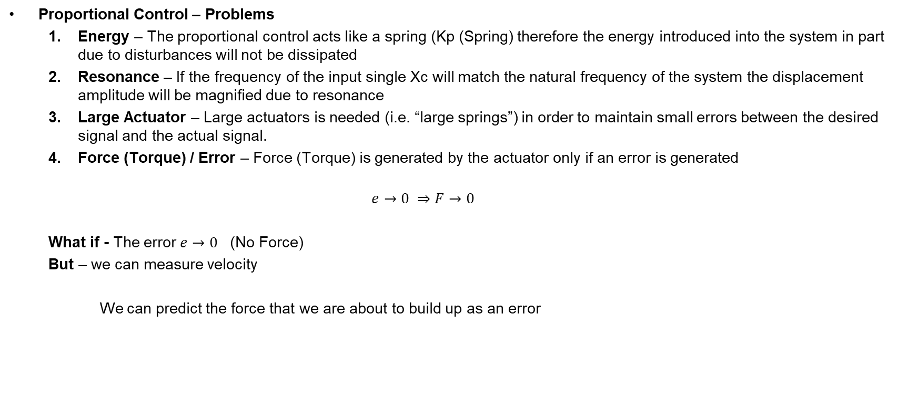
PID Controller – – Proportional Control
P
!

Slide 6
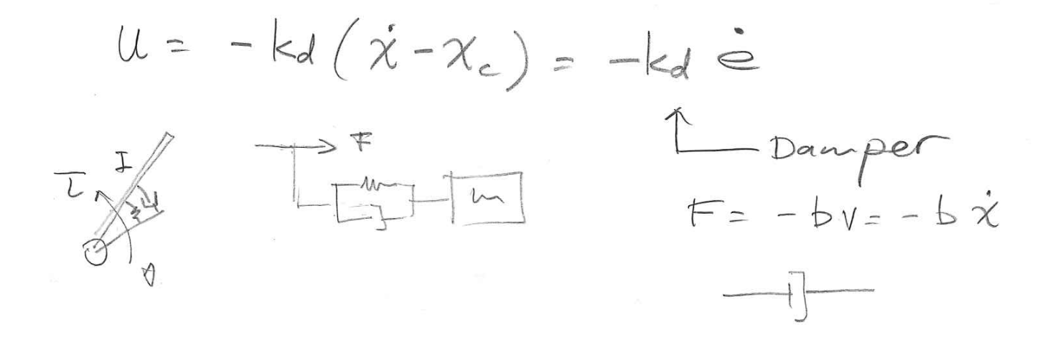
PID Controller – – Derivative Control
D
Advantages
  Prediction – Predict the building up of a Force (i.e. anticipating the motion) based on velocity (derivative of the position)
  Energy – Absorb energy over time due to the introduction of a “damper”

Slide 7
PID Controller – – Proportional Derivative Control
PD
Proportional Derivative Controller Behavior – Summary
  Kp -> Spring (F=KpX) – No force is applied until the system moves out of equilibrium
  Kd -> Damper (F=bv) – Anticipate motion by differentiating the position (velocity)

Slide 8
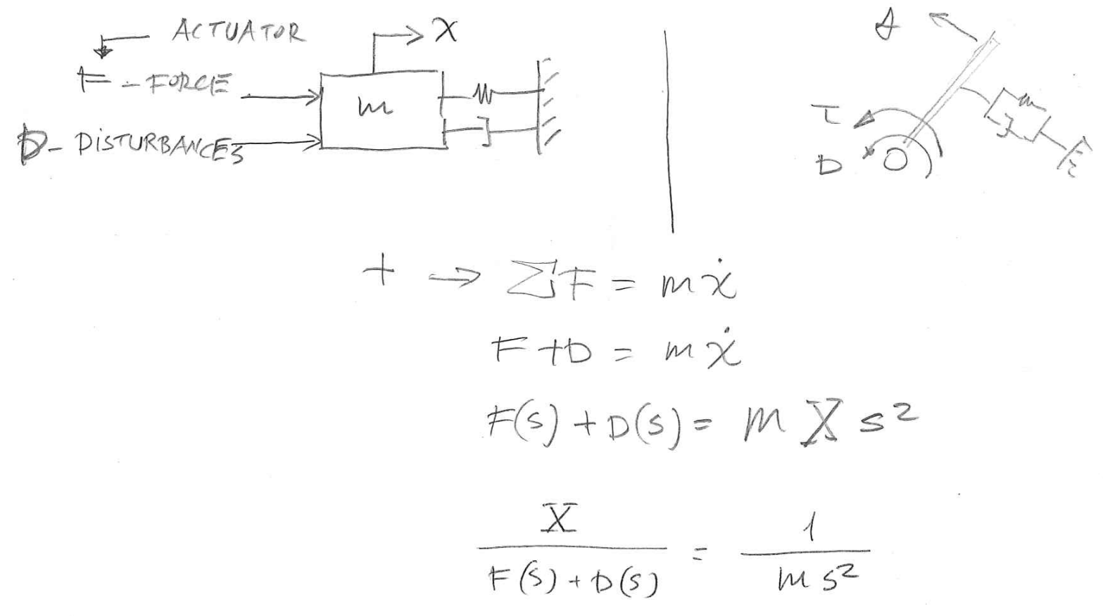
PID Controller – – Proportional Derivative Control
PD

Slide 9
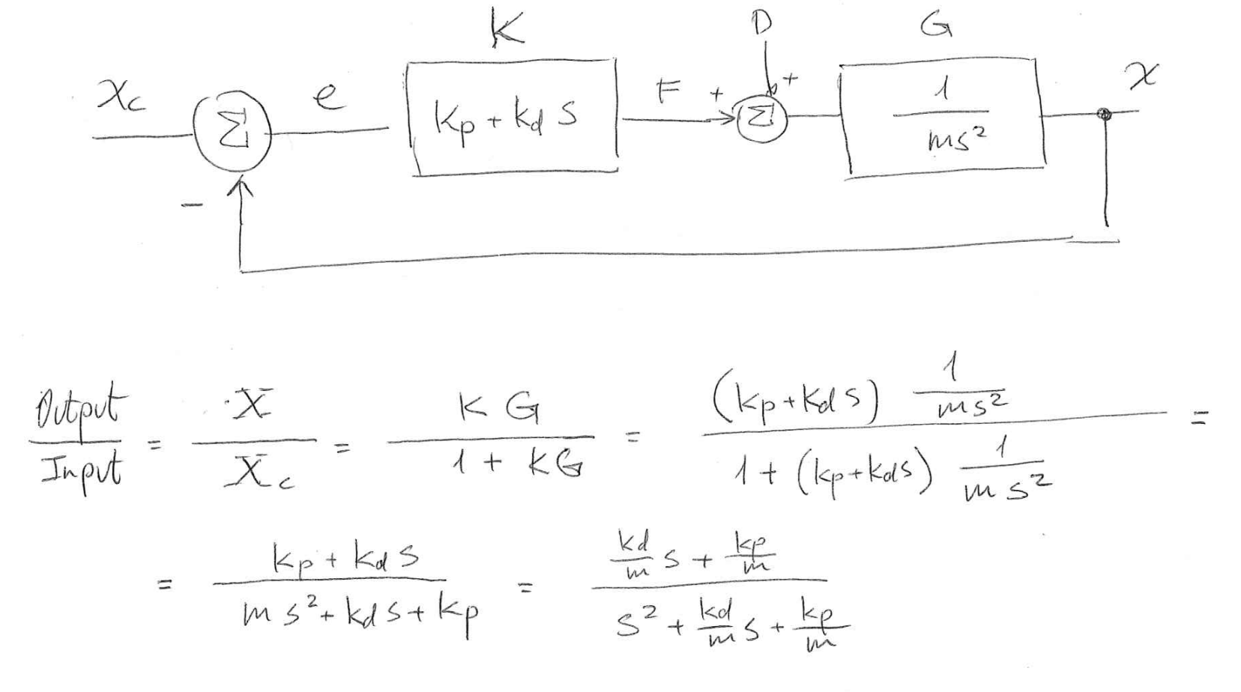
PID Controller – – Proportional Derivative Control
PD

Slide 10
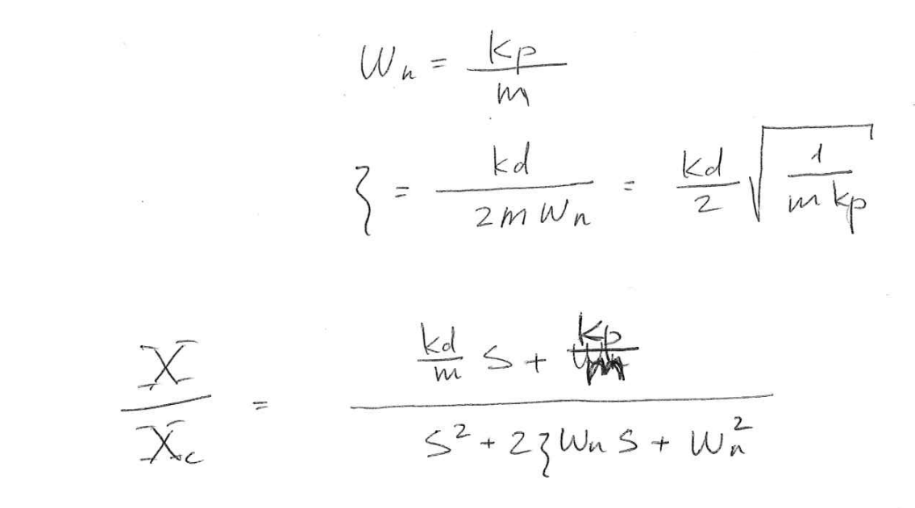
PID Controller – – Proportional Derivative Control
PD

Slide 11
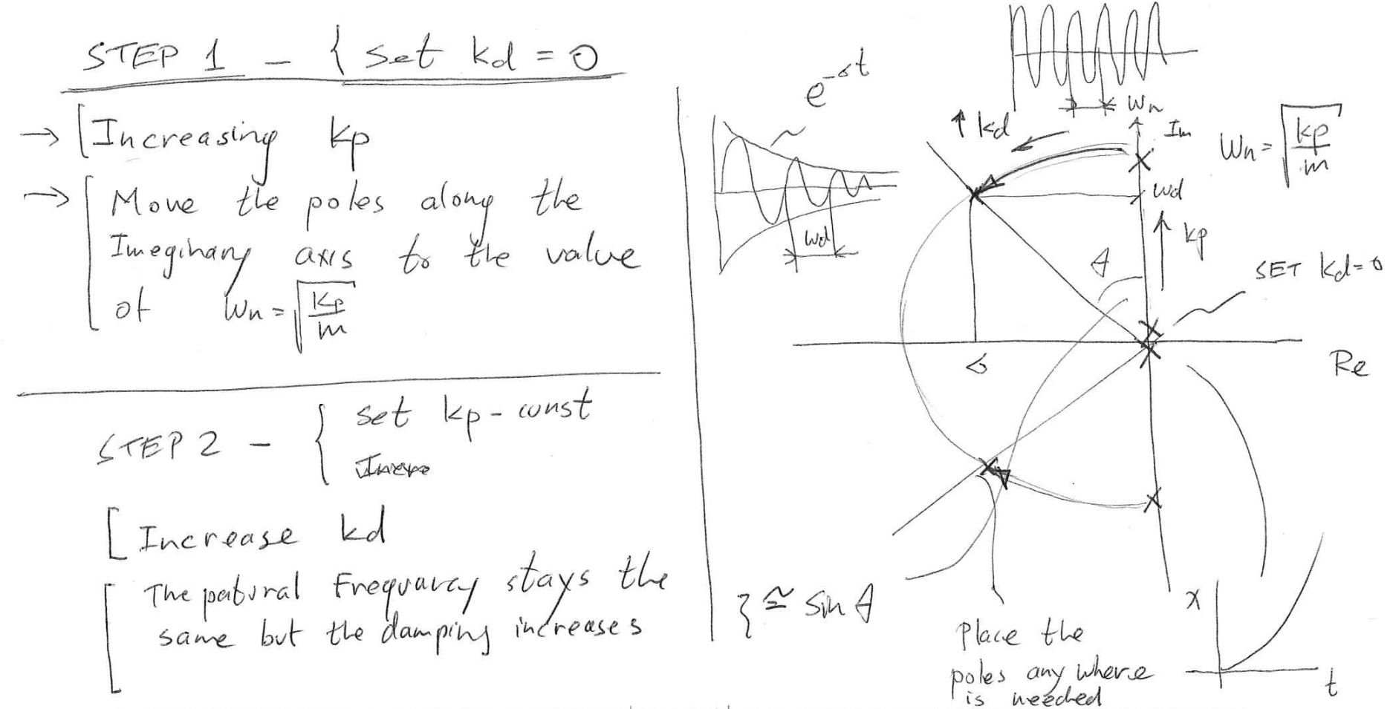
PID Controller – – Proportional Derivative Control
PD

Slide 12
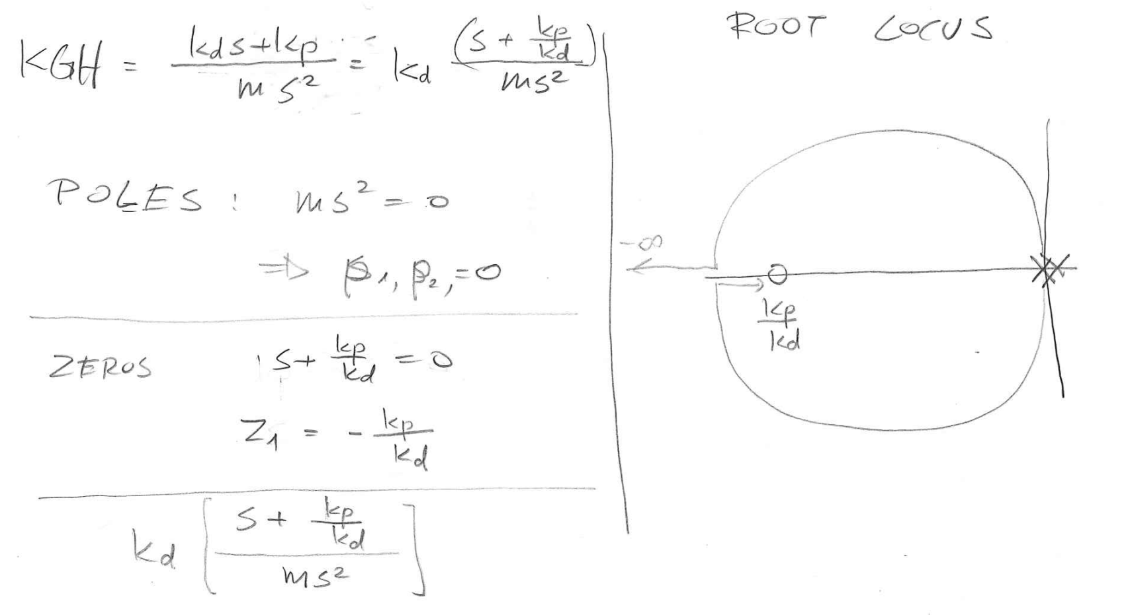
PID Controller – – Proportional Derivative Control
PD

Slide 13
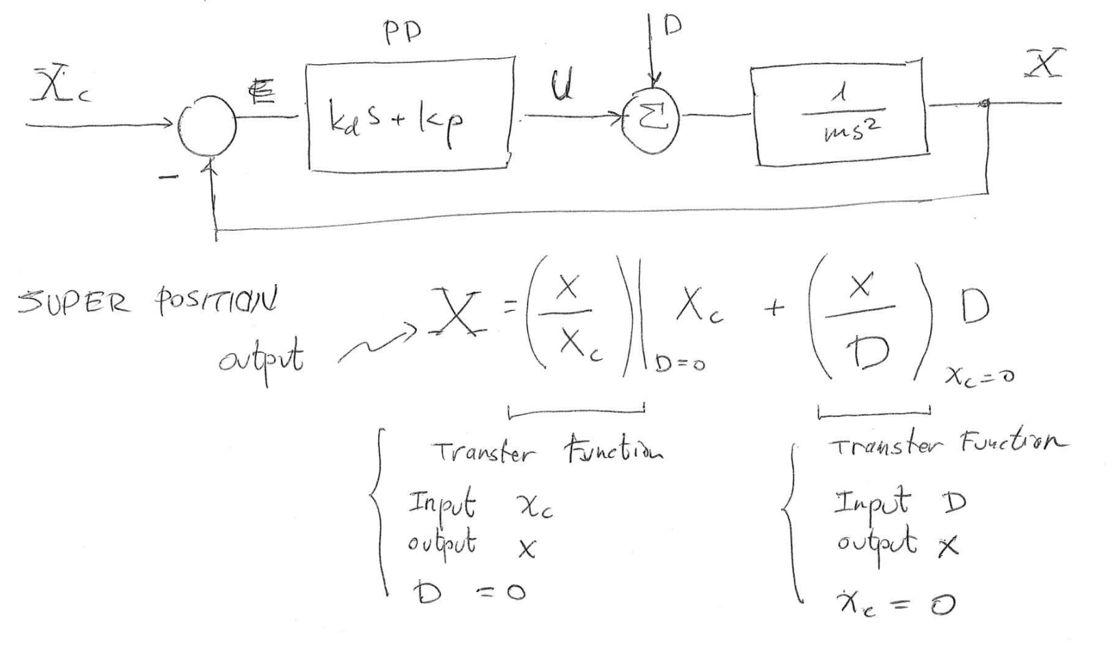
PID Controller – – Integral
I

Slide 14
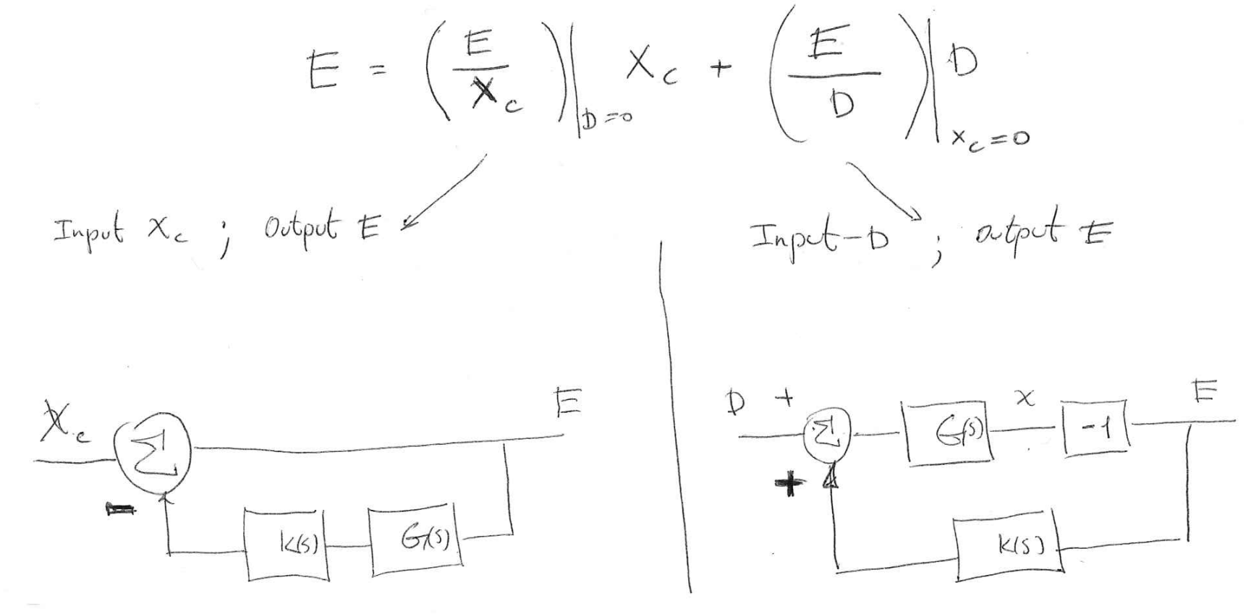
PID Controller – – Integral
I

Slide 15
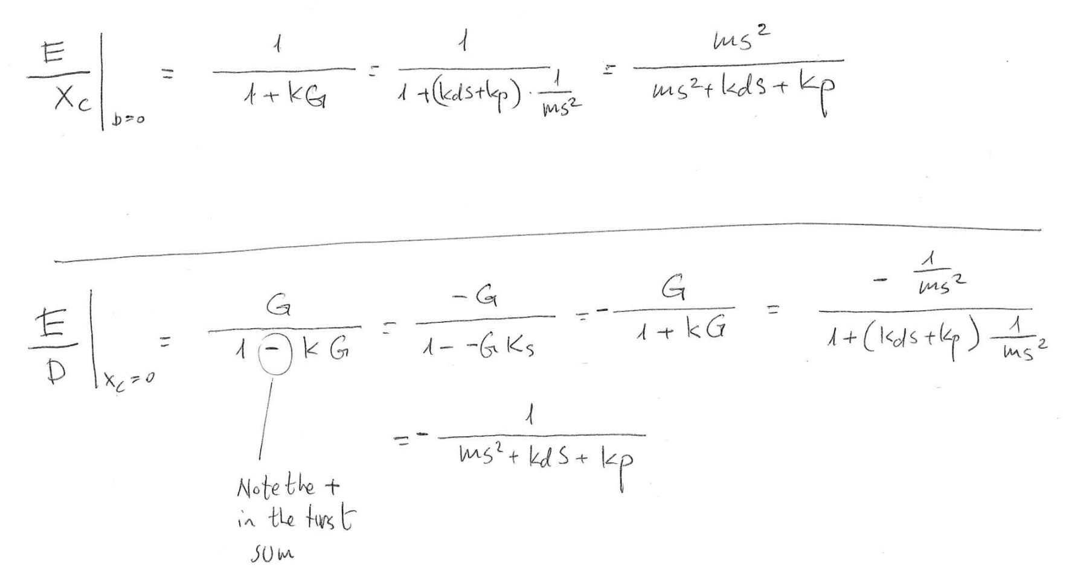
PID Controller – – Integral
I

Slide 16
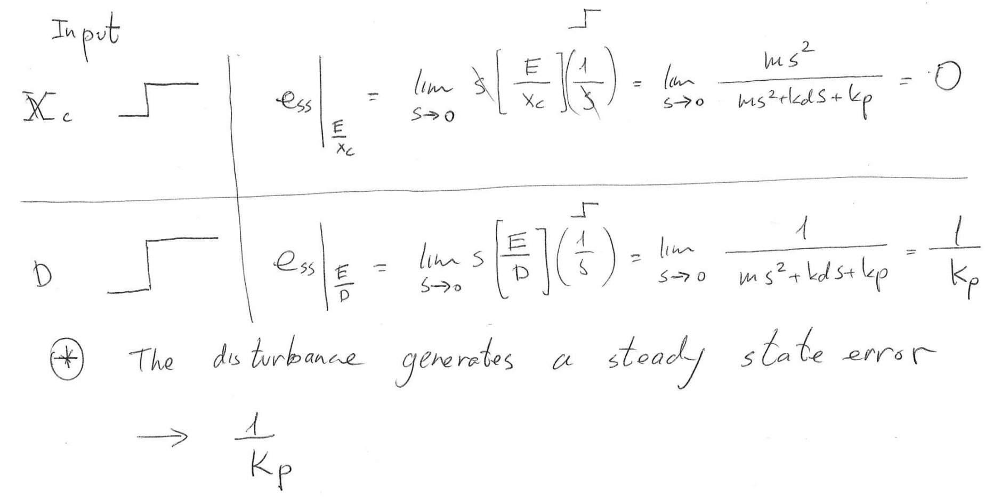
PID Controller – – Integral
I

Slide 17
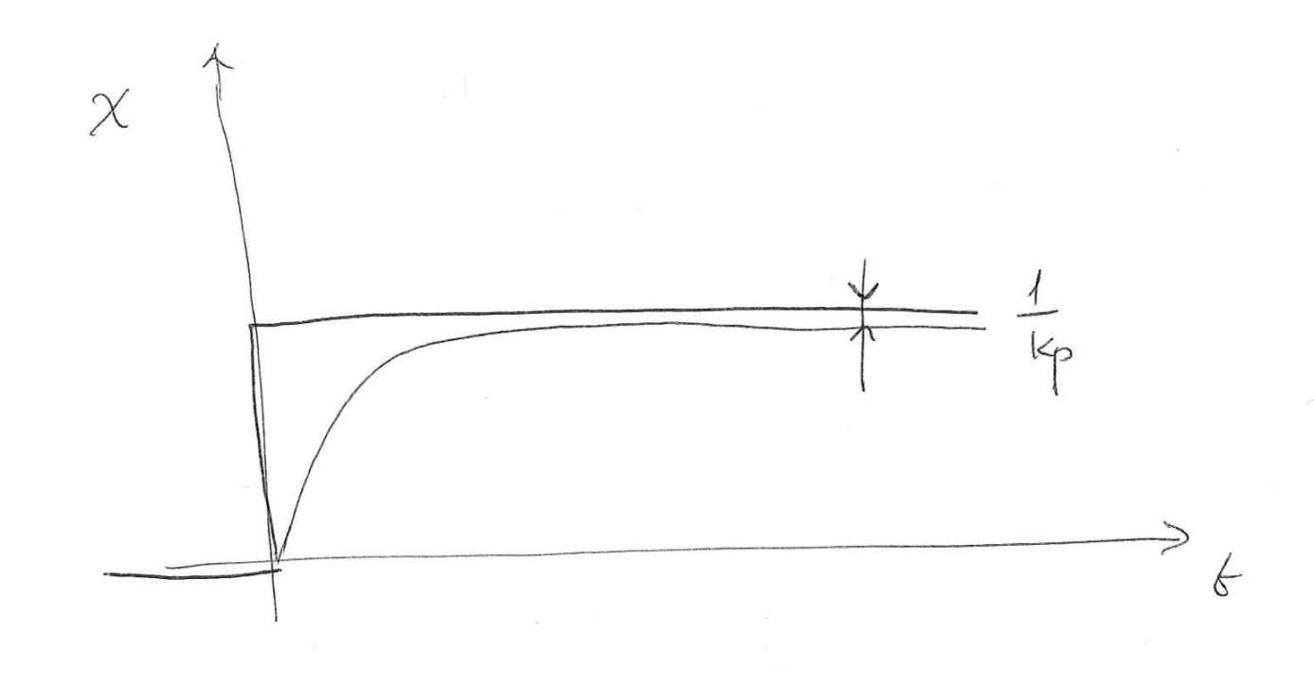
PID Controller – – Integral
I

Slide 18
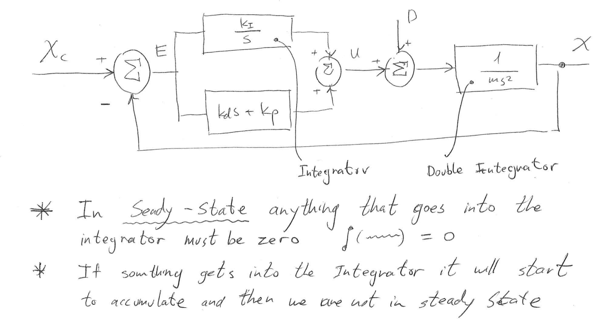
PID Controller – – Integral
I

Slide 19
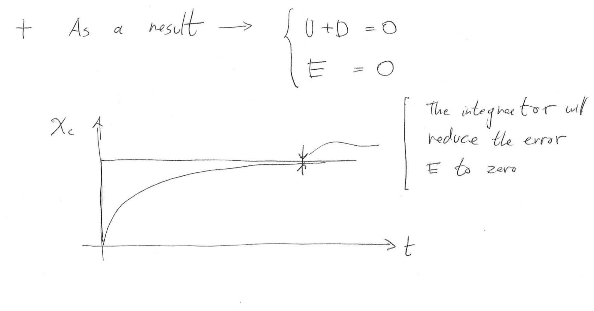
PID Controller – – Integral
I

Slide 20
PID Controller – – Integral
I
Value of Ki - In general the value of the integral gain Ki should be small – Approximately 1/100 (1%) of Kd and Kp
Pole – The integral is a Pole. Adding a pole to the system can make it unstable.

Slide 21
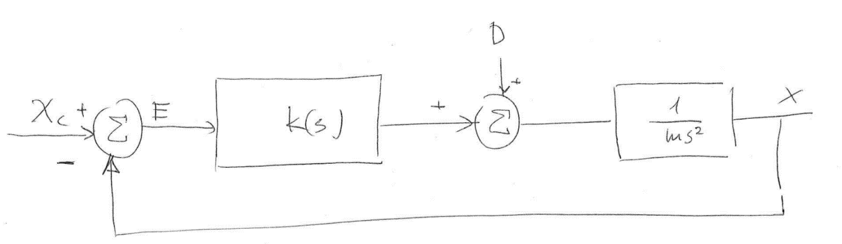
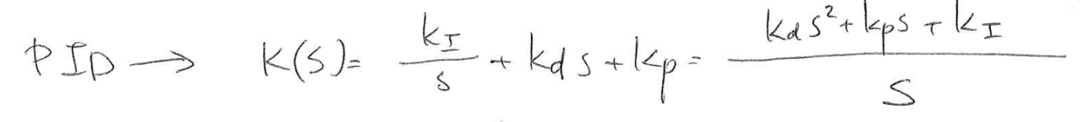
PID Controller – – Proportional Derivative Integral Control
PID

Slide 22
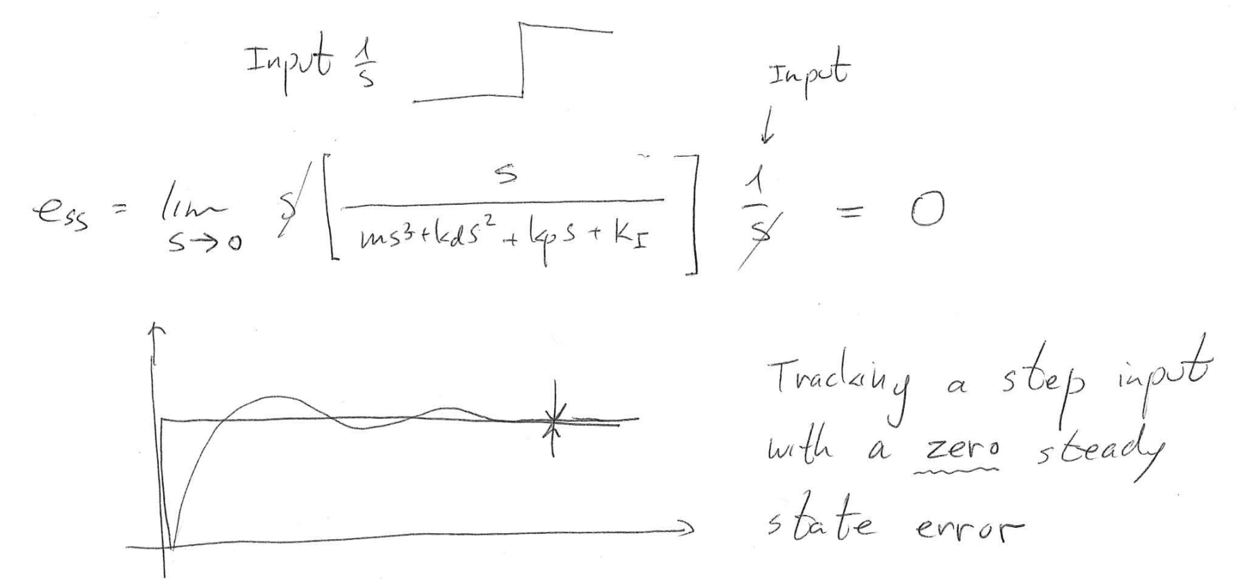
PID Controller – – Proportional Derivative Integral Control
PID

Slide 23
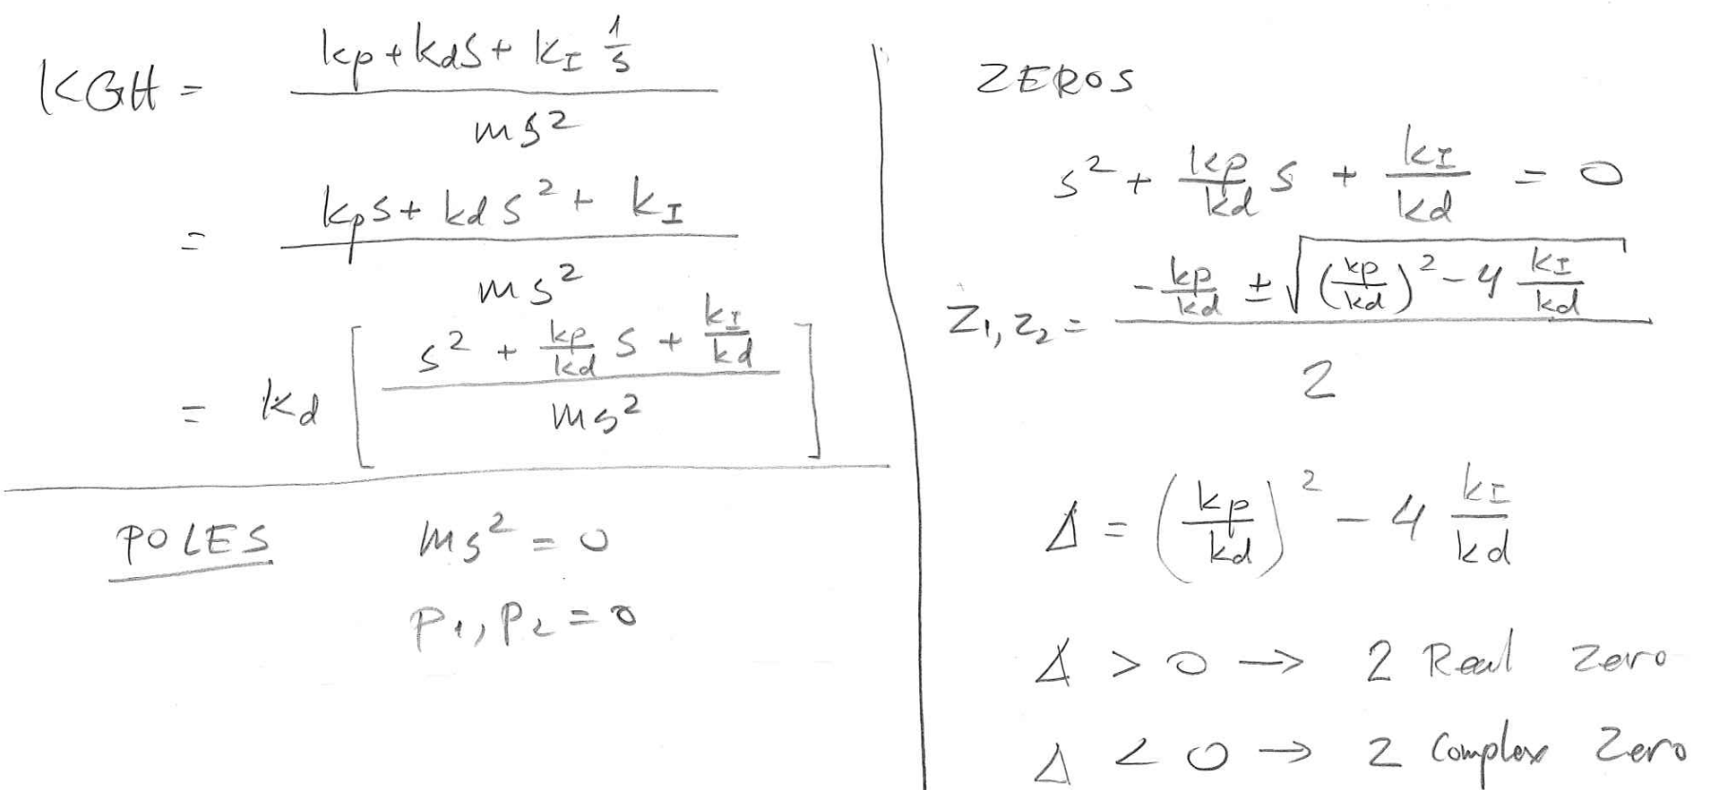
PID Controller – – Proportional Derivative Integral Control
PID
Root Locus

Slide 24
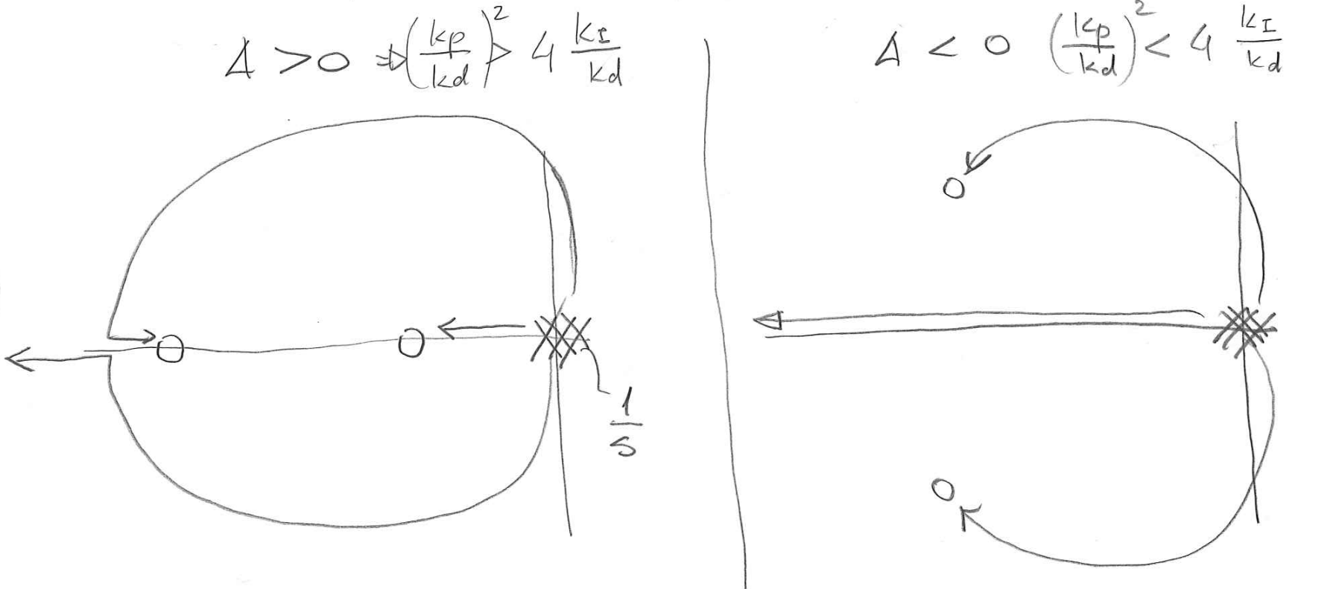
PID Controller – – Proportional Derivative Integral Control
PID

Slide 25
Methodologies
Design versus Tuning
PID Controller

Slide 26
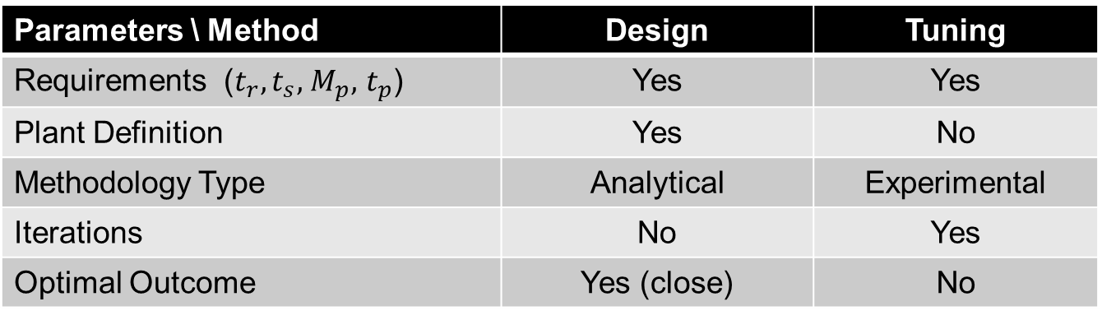
PID Controller – – Design Versus Tuning
PID
Parameters \ Method | Design | Tuning
Requirements ($t_{r},t_{s},$ $M_{p},$ $t_{p}$) | Yes | Yes
Plant Definition | Yes | No
Methodology Type | Analytical | Experimental
Iterations | No | Yes
Optimal Outcome | Yes (close) | No

Slide 27
Design – Analytical Approach
PID Controller

Slide 28
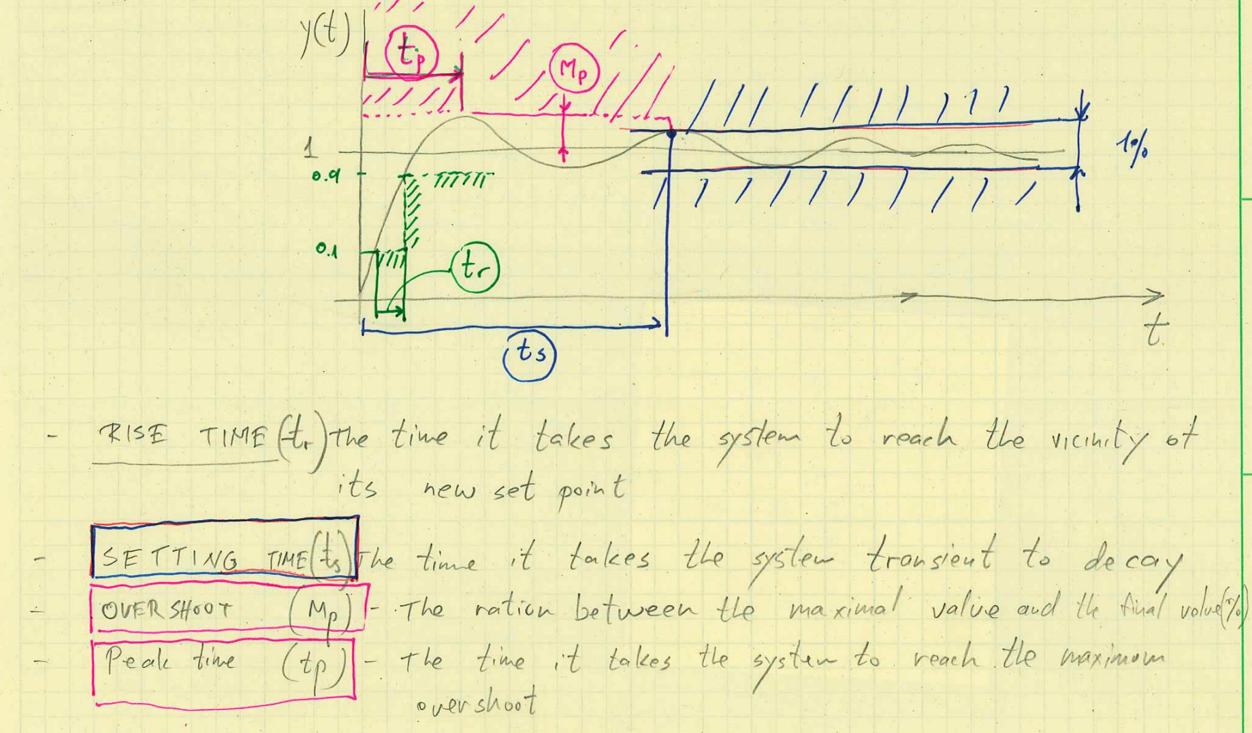
PID Controller – – Design – Time Domain / Frequency Domain
PID
Design – Time Domain Specification

Slide 29
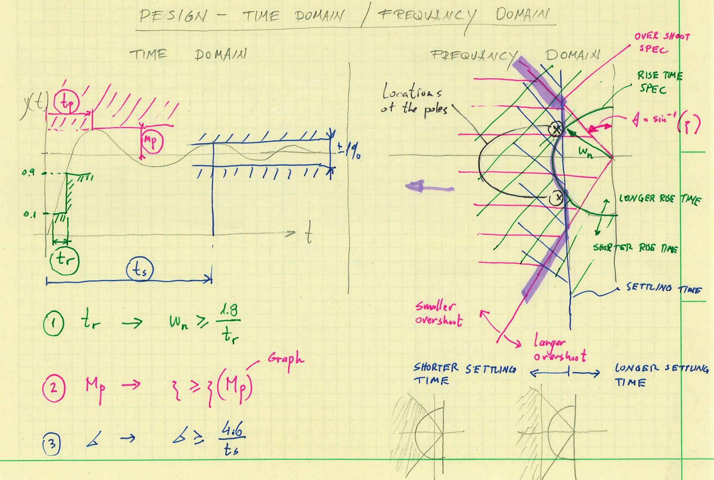
PID Controller – – Design – Time Domain / Frequency Domain
PID

Slide 30
Tuning – Experimental Approach
PID Controller

Slide 31
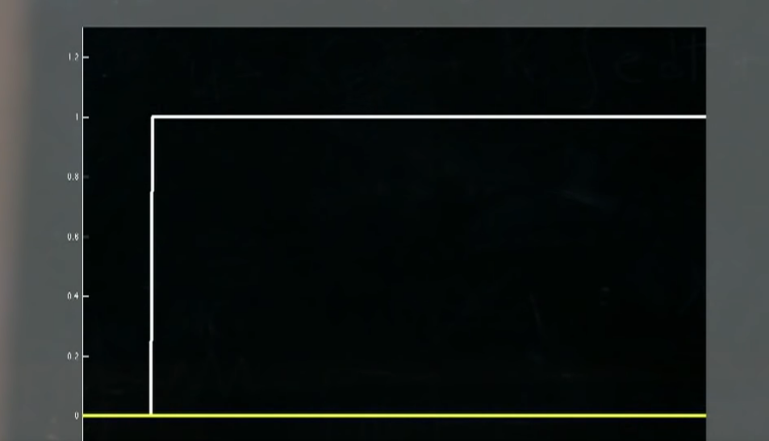
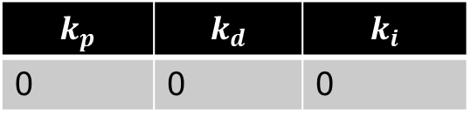
PID Controller – – Tuning – Time Domain
PID
$$k_{p}$$ | $$k_{d}$$ | $$k_{i}$$
0 | 0 | 0
Notes:
White – Step Inputs
Yellow – Controlled Signal (e.g. joint angle)

Slide 32
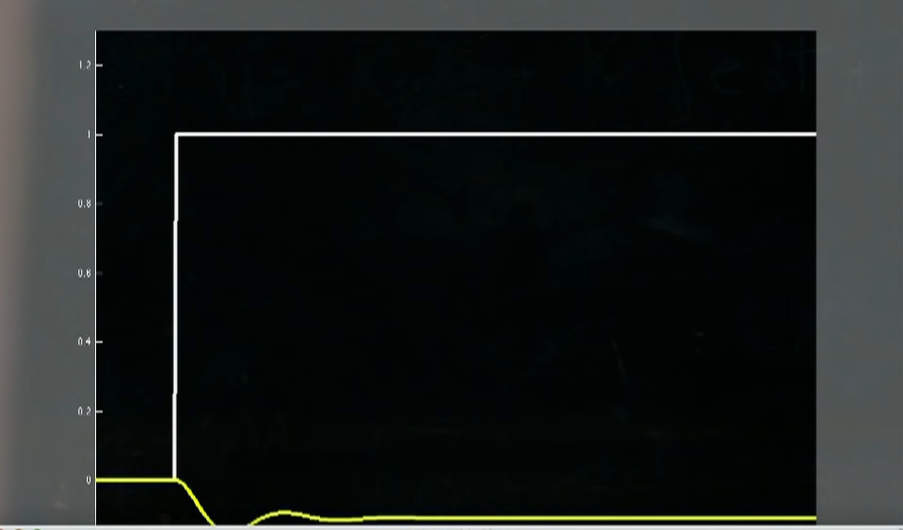
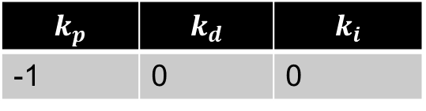
PID Controller – – Tuning – Time Domain
PID
$$k_{p}$$ | $$k_{d}$$ | $$k_{i}$$
-1 | 0 | 0

Slide 33
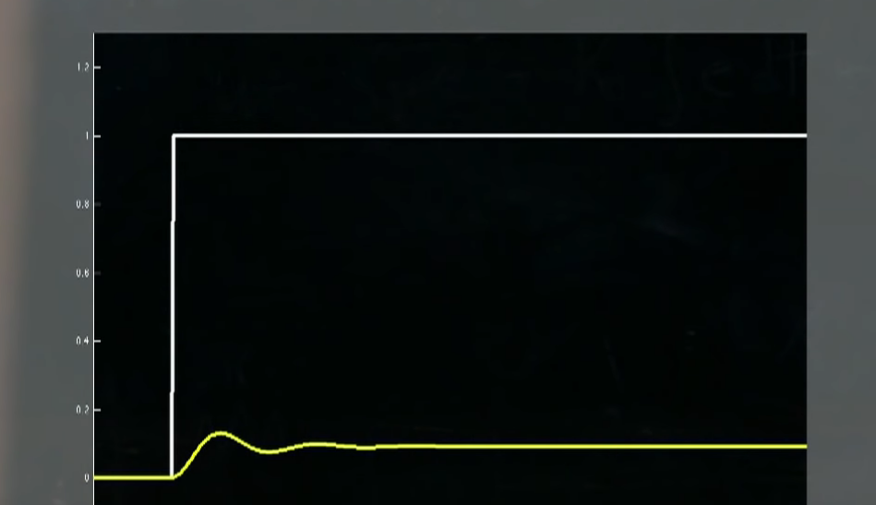
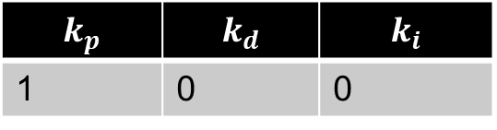
PID Controller – – Tuning – Time Domain
PID
$$k_{p}$$ | $$k_{d}$$ | $$k_{i}$$
1 | 0 | 0

Slide 34
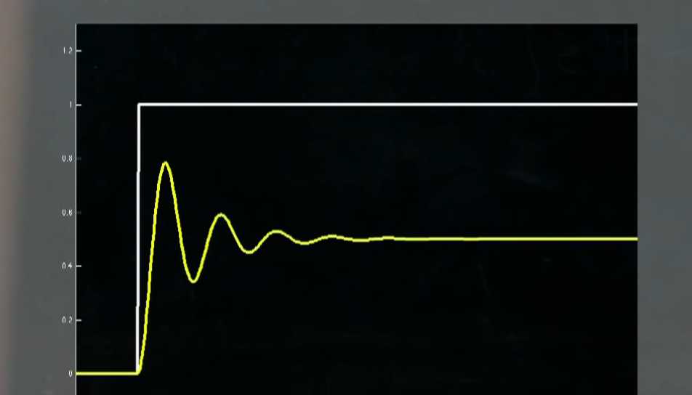
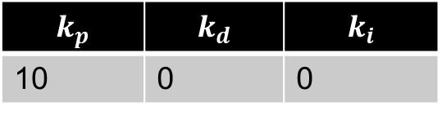
PID Controller – – Tuning – Time Domain
PID
$$k_{p}$$ | $$k_{d}$$ | $$k_{i}$$
10 | 0 | 0

Slide 35
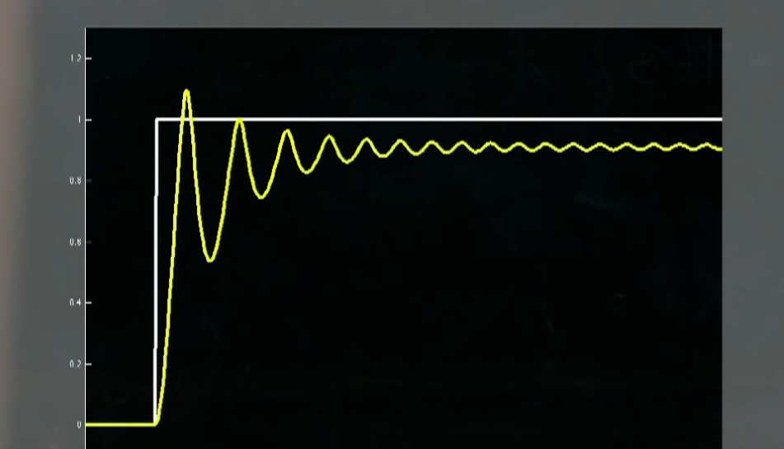
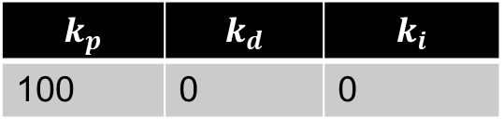
PID Controller – – Tuning – Time Domain
PID
$$k_{p}$$ | $$k_{d}$$ | $$k_{i}$$
100 | 0 | 0

Slide 36
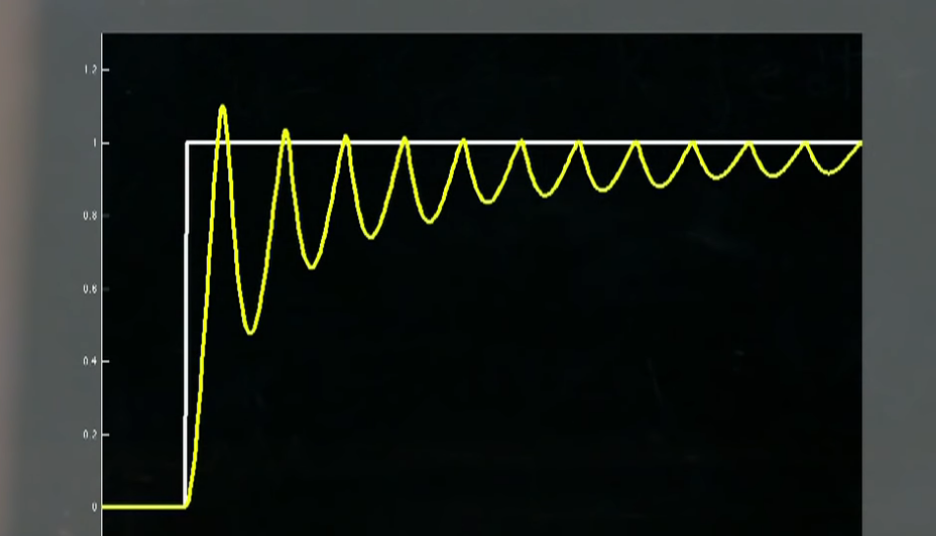
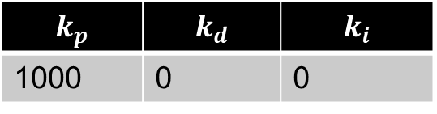
PID Controller – – Tuning – Time Domain
PID
$$k_{p}$$ | $$k_{d}$$ | $$k_{i}$$
1000 | 0 | 0

Slide 37
PID Controller – – Tuning – Time Domain
PID
$$k_{p}$$ | $$k_{d}$$ | $$k_{i}$$
100 | 0 | 0

Slide 38
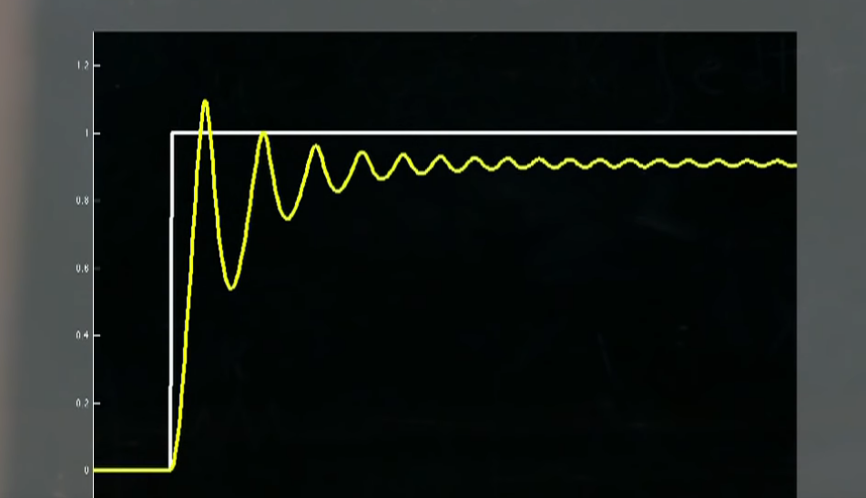
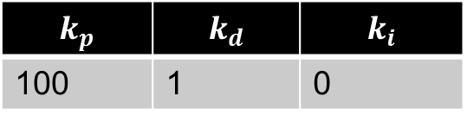
PID Controller – – Tuning – Time Domain
PID
$$k_{p}$$ | $$k_{d}$$ | $$k_{i}$$
100 | 1 | 0

Slide 39

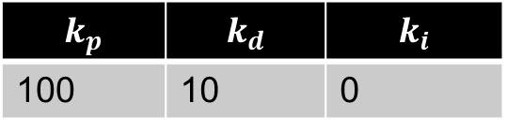
PID Controller – – Tuning – Time Domain
PID
$$k_{p}$$ | $$k_{d}$$ | $$k_{i}$$
100 | 10 | 0

Slide 40
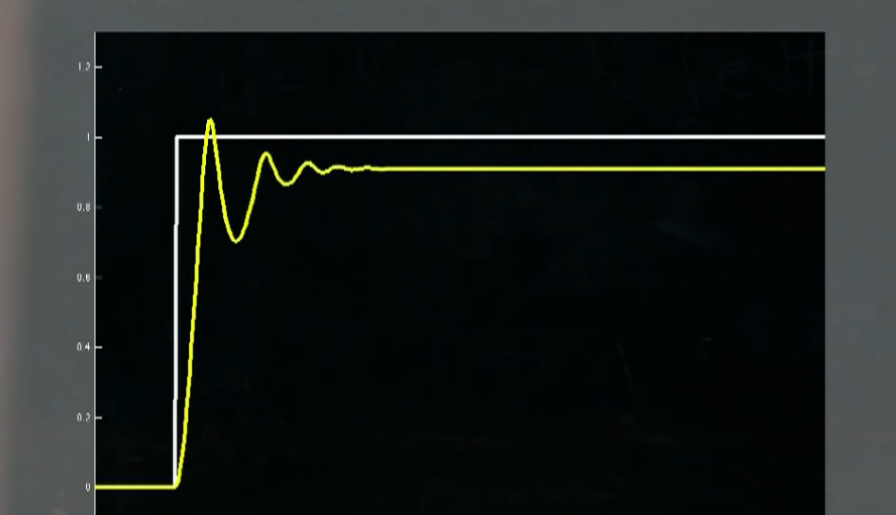
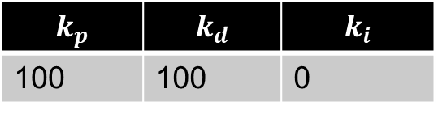
PID Controller – – Tuning – Time Domain
PID
$$k_{p}$$ | $$k_{d}$$ | $$k_{i}$$
100 | 100 | 0

Slide 41
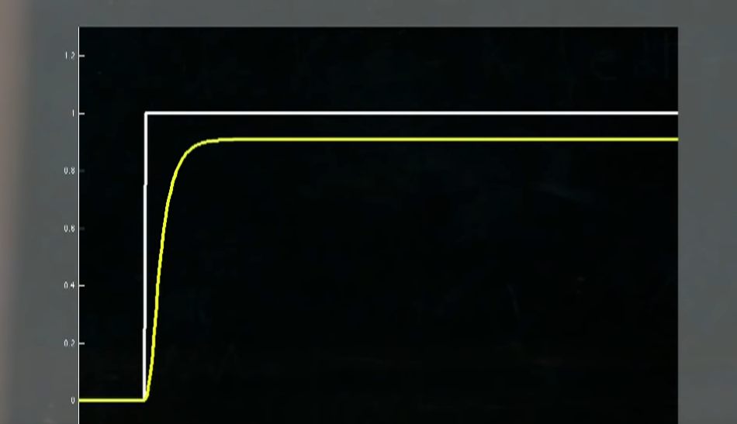
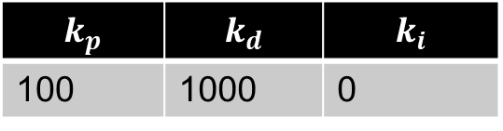
PID Controller – – Tuning – Time Domain
PID
$$k_{p}$$ | $$k_{d}$$ | $$k_{i}$$
100 | 1000 | 0

Slide 42
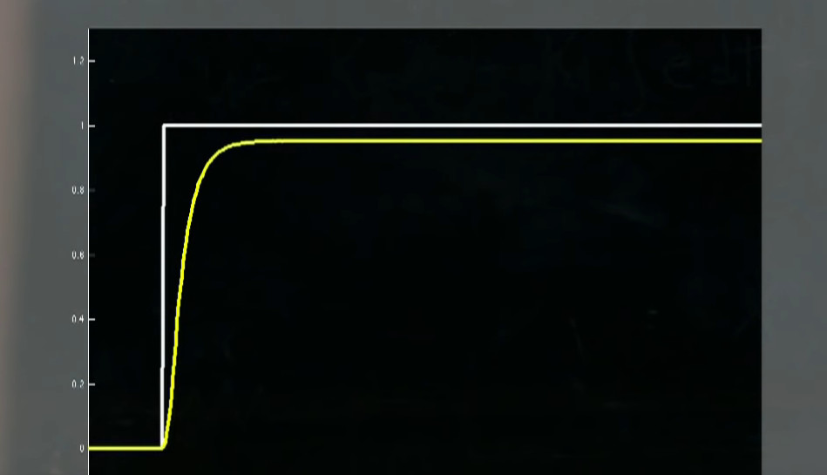
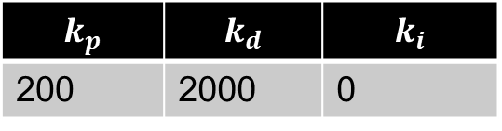
PID Controller – – Tuning – Time Domain
PID
$$k_{p}$$ | $$k_{d}$$ | $$k_{i}$$
200 | 2000 | 0

Slide 43
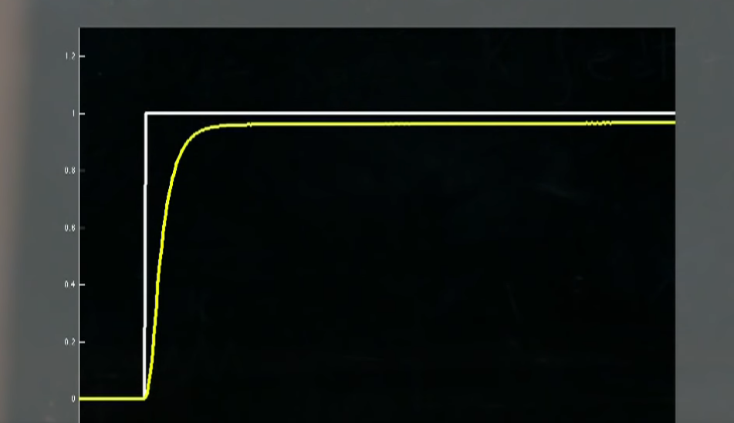
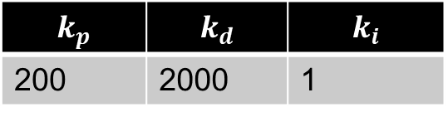
PID Controller – – Tuning – Time Domain
PID
$$k_{p}$$ | $$k_{d}$$ | $$k_{i}$$
200 | 2000 | 1

Slide 44
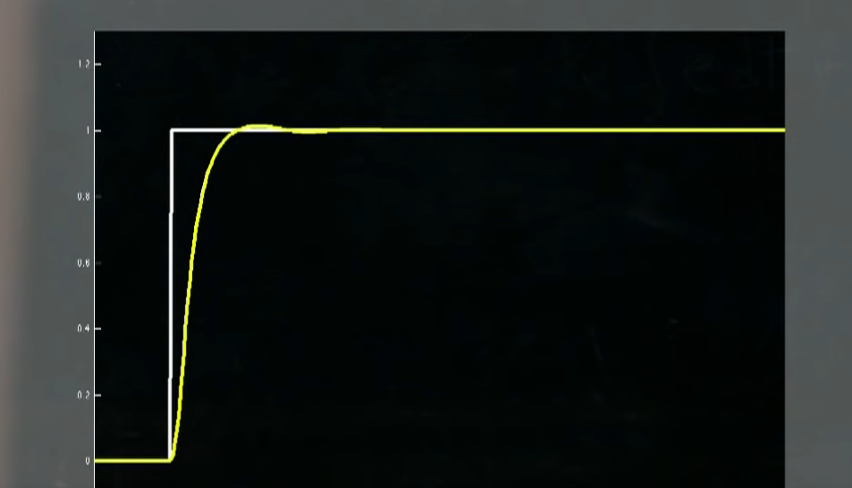
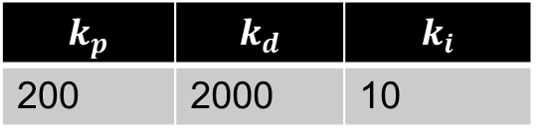
PID Controller – – Tuning – Time Domain
PID
$$k_{p}$$ | $$k_{d}$$ | $$k_{i}$$
200 | 2000 | 10

Slide 45


PID Controller – – Tuning – Time Domain
PID
$$k_{p}$$ | $$k_{d}$$ | $$k_{i}$$
200 | 2000 | 100

Slide 46


PID Controller – – Tuning – Time Domain
PID
$$k_{p}$$ | $$k_{d}$$ | $$k_{i}$$
200 | 2000 | 5

