Slide 1
Manipulator Dynamics 4
Instructor: Jacob Rosen
Advanced Robotic - MAE 263D - Department of Mechanical & Aerospace Engineering - UCLA

Slide 2
Lagrange Method
Introduction
Instructor: Jacob Rosen
Advanced Robotic - MAE 263D - Department of Mechanical & Aerospace Engineering - UCLA

Slide 3
Lagrangian Formulation of Manipulator Dynamics - Summary
1. Define a set of generalized coordinates for i=1,2,3…N.
These coordinates can be chosen arbitrarily as long as they provide a set of independent variables that map the system in a 1-to-1 manner. The usual variable set for serial manipulators is:
2. Define a set of generalized velocities ${\dot{q}}_{i}$ for i=1,2,3…N
3. Define a set of generalized forces (and moments) $Q_{i}$ for i=1,2,3…N
The generalized forces must satisfy $Q_{i}δq_{i}=δW$
where $δq_{i}$ is a small change in the generalized coordinate and $δW$ is the work done corresponding to that small change, $τ$ is the joint torque vector generated by the actuators, $J^{T}$ is the Jacobian matrix transposed, $ℱ_{e}^{ }$ is the vector of the external forces and torques applied on the end effector, and $τ_{fr}$ is the friction torque vector generated at the joints
$$q_{i}=\left\{\begin{aligned}&θ_{i} \text{R}\text{evolute} \text{Joint} \\ &d_{i} \text{P}\text{rismatic} \text{Joint}\end{aligned}\right.$$
$$Q=τ+J^{T}ℱ_{e}^{ }−τ_{fr}$$
Instructor: Jacob Rosen
Advanced Robotic - MAE 263D - Department of Mechanical & Aerospace Engineering - UCLA

Slide 4
Langrangian Formulation of Manipulator Dynamics 2/
4. Write the equations describing the kinetic and potential energies as functions of the generalized coordinates as well as the resulting Lagrangian.
Let KE denote the expression describing the kinetic energy. Where $KE=f\left(q_{i}, {\dot{q}}_{i}, t\right)$
Let PE denote the expression describing the potential energy, where $P=f\left(q_{i}, t\right)$
Let L denote the Lagrangian given by:
L = KE - PE
$$KE=\frac{1}{2}\sum_{i=1}^{n}{({}_{ }^{0}{{V_{c}}_{i}^{T}}m_{i}{}_{ }^{0}{{V_{c}}_{i}^{ }}+{}_{ }^{0}{{ω_{ }}_{i}^{T}}{}_{ }^{0}{{I_{i}}_{c}{}_{ }^{0}{{ω_{ }}_{i}^{ }}})}$$
$$P=f\left(q_{i}, t\right)$$
$$PE=−\sum_{i=1}^{n}{m_{i}g^{T}{P_{c}}_{i}}$$
Instructor: Jacob Rosen
Advanced Robotic - MAE 263D - Department of Mechanical & Aerospace Engineering - UCLA

Slide 5
Langrangian Formulation of Manipulator Dynamics 3/
5. The equations of motion are given by
or, more practically, by
$$Q_{i}=\frac{d}{dt}\left(\frac{∂L}{∂{\dot{q}}_{i}}\right)−\frac{∂L}{∂q_{i}}$$
$$L=KE−PE$$
0
$\frac{d}{dt}\left(\frac{∂L}{∂{\dot{q}}_{i}}\right)=\frac{d}{dt}$($\frac{∂KE}{∂{\dot{q}}_{i}}$ - $\frac{∂PE}{∂{\dot{q}}_{i}}$)
$$\frac{∂L}{∂q_{i}}=\left[\begin{matrix}\frac{∂(KE −PE)}{∂q_{i}}\end{matrix}\right]=\left[\begin{matrix}\frac{∂KE }{∂q_{i}} −\frac{∂PE }{∂q_{i}}\end{matrix}\right]$$
$$Q_{i}=\frac{d}{dt}\left(\frac{∂KE}{∂{\dot{q}}_{i}}\right)−\frac{∂KE}{∂q_{i}}+\frac{∂PE}{∂q_{i}}$$
Instructor: Jacob Rosen
Advanced Robotic - MAE 263D - Department of Mechanical & Aerospace Engineering - UCLA

Slide 6
Gravity Effects - Langrangian Formulation
$$\begin{matrix}τ_{i}=\frac{d}{dt}\left(\frac{∂KE(θ,\dot{θ})}{∂{\dot{θ}}_{i}}\right)−\frac{∂KE(θ,\dot{θ})}{∂θ_{i}}+\frac{∂PE(θ)}{∂θ_{i}} \\ \end{matrix}$$
$$τ=M\left(θ\right)\ddot{θ}+V\left(θ,\dot{θ}\right)+G\left(θ\right)$$
Instructor: Jacob Rosen
Advanced Robotic - MAE 263D - Department of Mechanical & Aerospace Engineering - UCLA

Slide 7
Manipulators – Non Linear Control Problem
$$τ=M\left(θ\right)\ddot{θ}+V\left(θ,\dot{θ}\right)+G\left(θ\right)+F\left(θ,\dot{θ}\right)$$
Instructor: Jacob Rosen
Advanced Robotic - MAE 263D - Department of Mechanical & Aerospace Engineering - UCLA

Slide 8
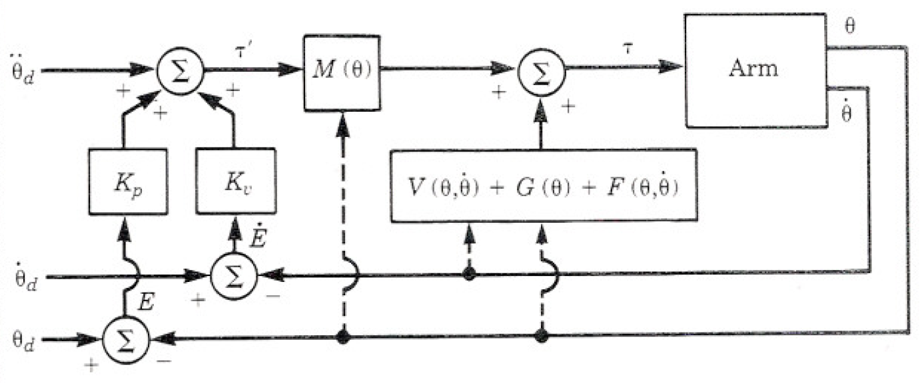
Manipulators – Non Linear Control Problem
$$τ=M\left(θ\right)\ddot{θ}+V\left(θ,\dot{θ}\right)+G\left(θ\right)+F\left(θ,\dot{θ}\right)$$
Instructor: Jacob Rosen
Advanced Robotic - MAE 263D - Department of Mechanical & Aerospace Engineering - UCLA

Slide 9
Lagrange Method
General Approach – Formal Derivation
Instructor: Jacob Rosen
Advanced Robotic - MAE 263D - Department of Mechanical & Aerospace Engineering - UCLA

Slide 10
Lagrangian Formulation of Manipulator Dynamics
Lagrangian function- The difference between kinetic and potential energy of a mechanical system:
Where:
$L$- Lagrangian
$KE$ – kinetic energy of a mechanical system
$PE$ – Potential energy of a mechanical system
The kinetic energy is function of the position and velocity of the link
The potential energy is a function of the position of the link
$$L=KE −PE$$
$$K=f(P,V)$$
$$P=f(P)$$
Instructor: Jacob Rosen
Advanced Robotic - MAE 263D - Department of Mechanical & Aerospace Engineering - UCLA

Slide 11
Lagrangian Formulation of Manipulator Dynamics
Lagrange’s equation of motion is
Where:
$q$- vector of generalized coordinates $q={\left[q_{1},q_{2},…q_{n}\right]}^{T}$
$Q$ – vector of generalized forces $Q={\left[Q_{1},Q_{2},…Q_{n}\right]}^{T}$
$$\frac{d}{dt}\left(\frac{∂L}{∂{\dot{q}}_{i}}\right)−\frac{∂L}{∂q_{i}}=Q_{i}$$
Instructor: Jacob Rosen
Advanced Robotic - MAE 263D - Department of Mechanical & Aerospace Engineering - UCLA

Slide 12
Lagrangian Formulation of Manipulator Dynamics
Kinetic Energy
Where:
${}_{ }^{0}{{I_{i}}_{c}}$is the inertia matrix of link i about its CM and expressed in the base frame (Frame 0)
${}_{ }^{i}{{I_{i}}_{c}}$ is the inertia matrix of link i about its CM and expressed in the link frame
${}_{ }^{0}{{V_{c}}_{i}^{ }}$ is the linear velocity of the CM of link i expressed in the base frame (Frame 0)
${}_{ }^{0}{{ω_{ }}_{i}^{ }}$ is the angular velocity of the CM of link i expressed in the base frame (Frame 0)
Note – The kinetic equation of each individual link is expressed with respect to base frame (Frame 0). The implication is that the velocities and the tensor of inertia should use the reference frame as frame 0
$$KE=\frac{1}{2}\sum_{i=1}^{n}{({}_{ }^{0}{{V_{c}}_{i}^{T}}m_{i}{}_{ }^{0}{{V_{c}}_{i}^{ }}+{}_{ }^{0}{{ω_{ }}_{i}^{T}}{}_{ }^{0}{{I_{i}}_{c}{}_{ }^{0}{{ω_{ }}_{i}^{ }}})}$$
Instructor: Jacob Rosen
Advanced Robotic - MAE 263D - Department of Mechanical & Aerospace Engineering - UCLA

Slide 13
Lagrangian Formulation of Manipulator Dynamics
Kinetic Energy – Tensor of Inertia (Expressed in the Base Frame)
Rotating the moment of inertia of the link ${}_{ }^{i}{{I_{i}}_{c}}$ expressed in the i’th coordinate CM to the base frame ${}_{ }^{0}{I_{icm}}$
Where:
${}_{ }^{0}{{I_{i}}_{c}}$is the inertia matrix of link i about its CM and expressed in the base frame
${}_{ }^{i}{{I_{i}}_{c}}$ is the inertia matrix of link i about its CM and expressed in the link frame
Note:
${}_{ }^{i}{{I_{i}}_{c}}$- Time Invariant
${}_{ }^{0}{{I_{i}}_{c}}$- Depends on to the robot arm posture because it is expressed in the base frame and the orientation of the link i with respect to the base is a function of joint variables
$${}_{ }^{0}{{I_{i}}_{c} }= {}_{i}^{0}{R{}_{ }^{i}{I_{i}{\left[{}_{i}^{0}R\right]}^{T}}}$$
Instructor: Jacob Rosen
Advanced Robotic - MAE 263D - Department of Mechanical & Aerospace Engineering - UCLA

Slide 14
Lagrangian Formulation of Manipulator Dynamics
Kinetic Energy – Linear & Angular Velocity (Expressed in the Base Frame)
Methods for expressing the velocity of the CM at the base frame (Frame 0) ${}_{ }^{0}{{V_{c}}_{i}^{ }}$, ${}_{ }^{0}{{ω_{ }}_{i}^{ }}$
Method 1: Recursive method
Method 2: Partial Jacobian (Instantaneous screw motion) – Developed for each link as opposed to the previously defined Jacobian
$${}_{ }^{0}{{\dot{X}}_{ci}}={}_{ }^{0}{J_{i}\dot{{{}_{ }^{ }{{q_{ }}_{ }^{ }}}_{ }} }$$
$$\left[\begin{matrix}{}_{ }^{0}{{V_{c}}_{i}^{ }} \\ {}_{ }^{0}{{ω_{ }}_{i}^{ }}\end{matrix}\right]=\left[\begin{matrix}{}_{ }^{0}{J_{vi}} \\ {}_{ }^{0}{J_{ωi}}\end{matrix}\right][\dot{{{}_{ }^{ }{{q_{ }}_{ }^{ }}}_{ }}]$$
$$\left[{}_{ }^{0}{{V_{c}}_{i}^{ }}\right]=\left[{}_{ }^{0}{J_{vi}}\right][\dot{{{}_{ }^{ }{{q_{ }}_{ }^{ }}}_{ }}]$$
[${}_{ }^{0}{{ω_{ }}_{i}^{ }}$] = [${}_{ }^{0}{J_{ωi}}$]$[\dot{{{}_{ }^{ }{{q_{ }}_{ }^{ }}}_{ }}]$
Instructor: Jacob Rosen
Advanced Robotic - MAE 263D - Department of Mechanical & Aerospace Engineering - UCLA

Slide 15
Lagrangian Formulation of Manipulator Dynamics
Partial Jacobian (Example)
$$\left[{}_{ }^{0}{{V_{c}}_{1}^{ }}\right]=\left[{}_{ }^{0}{J_{v1}}\right]\left[\dot{{{}_{ }^{ }{{q_{ }}_{ }^{ }}}_{ }}\right]= \left[\begin{matrix} & 0 & 0 \\ {{}_{ }^{0}Z}_{1} ×{}_{ }^{0}{{P_{c}}_{1}^{1}} & 0 & 0 \\ & 0 & 0\end{matrix} \right]\left[\begin{matrix}\dot{θ_{1}} \\ \dot{θ_{2}} \\ \dot{θ_{3}}\end{matrix}\right]$$
[${}_{ }^{0}{{ω_{ }}_{i}^{ }}$] = [${}_{ }^{0}{J_{ω1}}$] $\left[\dot{{{}_{ }^{ }{{q_{ }}_{ }^{ }}}_{ }}\right]$ = $\left[\begin{matrix} & 0 & 0 \\ {{}_{ }^{0}Z}_{1} & 0 & 0 \\ & 0 & 0\end{matrix} \right]\left[\begin{matrix}\dot{θ_{1}} \\ \dot{θ_{2}} \\ \dot{θ_{3}}\end{matrix}\right]$
$$\left[{}_{ }^{0}{{V_{c}}_{2}^{ }}\right]=\left[{}_{ }^{0}{J_{v2}}\right]\left[\dot{{{}_{ }^{ }{{q_{ }}_{ }^{ }}}_{ }}\right]= \left[\begin{matrix} & & 0 \\ {{}_{ }^{0}Z}_{1} ×{}_{ }^{0}{{P_{c}}_{2}^{1}} & {{}_{ }^{0}Z}_{2} ×{}_{ }^{0}{{P_{c}}_{2}^{2}} & 0 \\ & & 0\end{matrix} \right]\left[\begin{matrix}\dot{θ_{1}} \\ \dot{θ_{2}} \\ \dot{θ_{3}}\end{matrix}\right]$$
[${}_{ }^{0}{{ω_{ }}_{2}^{ }}$] = [${}_{ }^{0}{J_{ω2}}$] $\left[\dot{{{}_{ }^{ }{{q_{ }}_{ }^{ }}}_{ }}\right]$ = $\left[\begin{matrix} & & 0 \\ {{}_{ }^{0}Z}_{1} & {{}_{ }^{0}Z}_{2} & 0 \\ & & 0\end{matrix} \right]\left[\begin{matrix}\dot{θ_{1}} \\ \dot{θ_{2}} \\ \dot{θ_{3}}\end{matrix}\right]$
$$\left[{}_{ }^{0}{{V_{c}}_{3}^{ }}\right]=\left[{}_{ }^{0}{J_{v3}}\right]\left[\dot{{{}_{ }^{ }{{q_{ }}_{ }^{ }}}_{ }}\right]= \left[\begin{matrix} & & \\ {{}_{ }^{0}Z}_{1} ×{}_{ }^{0}{{P_{c}}_{3}^{1}} & {{}_{ }^{0}Z}_{1} ×{}_{ }^{0}{{P_{c}}_{3}^{2}} & {{}_{ }^{0}Z}_{1} ×{}_{ }^{0}{{P_{c}}_{3}^{3}} \\ & & \end{matrix} \right]\left[\begin{matrix}\dot{θ_{1}} \\ \dot{θ_{2}} \\ \dot{θ_{3}}\end{matrix}\right]$$
[${}_{ }^{0}{{ω_{ }}_{3}^{ }}$] = [${}_{ }^{0}{J_{ω3}}$] $\left[\dot{{{}_{ }^{ }{{q_{ }}_{ }^{ }}}_{ }}\right]$ = $\left[\begin{matrix} & & \\ {{}_{ }^{0}Z}_{1} & {{}_{ }^{0}Z}_{2} & {{}_{ }^{0}Z}_{3} \\ & & \end{matrix} \right]\left[\begin{matrix}\dot{θ_{1}} \\ \dot{θ_{2}} \\ \dot{θ_{3}}\end{matrix}\right]$
Instructor: Jacob Rosen
Advanced Robotic - MAE 263D - Department of Mechanical & Aerospace Engineering - UCLA

Slide 16
Lagrangian Formulation of Manipulator Dynamics
Partial Jacobian (Example) – Notes (Observations)
Vectors Expressed in the Base Frame - The vectors placed in the partial Jacobian matrixes are expressed in the base frame (Frame 0)
In ${}_{ }^{0}{J_{vi}}$ the position vector ${}_{ }^{0}{{P_{c}}_{i}^{j}}$ is expressed with respect to frame 0
In ${}_{ }^{0}{J_{ωi}}$ The joint rotation axis ${}_{ }^{0}{{Z_{ }}_{i}^{j}}$ is expressed with respect to frame 0
Population of Vectors - The columns partial Jacobian $\left[{}_{ }^{0}{J_{vi}}\right]$ [${}_{ }^{0}{J_{ωi}}$] are populate with values for $j≤i$ and columns for which $j>i$ are populated with zero
$${}_{ }^{0}{{\dot{X}}_{ci}}={}_{ }^{0}{J_{i}\dot{{{}_{ }^{ }{{q_{ }}_{ }^{ }}}_{ }} }$$
$$\left[{}_{ }^{0}{{V_{c}}_{i}^{ }}\right]=\left[{}_{ }^{0}{J_{vi}}\right][\dot{{{}_{ }^{ }{{q_{ }}_{ }^{ }}}_{ }}]$$
[${}_{ }^{0}{{ω_{ }}_{i}^{ }}$] = [${}_{ }^{0}{J_{ωi}}$]$[\dot{{{}_{ }^{ }{{q_{ }}_{ }^{ }}}_{ }}]$
Instructor: Jacob Rosen
Advanced Robotic - MAE 263D - Department of Mechanical & Aerospace Engineering - UCLA

Slide 17
Lagrangian Formulation of Manipulator Dynamics
Since the motion of link i depends only on the joints 1 through i the two vectors $J_{vi}^{j} , J_{ωi}^{j}$in the matrix are set to zero for j>i
${}_{ }^{0}{J_{i}}$ = $\left[\begin{matrix}J_{vi}^{1}{ J}_{vi}^{2}{ J}_{vi}^{3} …J_{vi}^{j} , 0, 0, 0 …0 \\ J_{ωi}^{1}{ J}_{ωi}^{2 }{ J}_{ωi}^{3} …J_{ωi}^{j}, 0, 0, 0 …0\end{matrix}\right]$
Instructor: Jacob Rosen
Advanced Robotic - MAE 263D - Department of Mechanical & Aerospace Engineering - UCLA

Slide 18
Lagrangian Formulation of Manipulator Dynamics
Partial Jacobian – Generalized Interpretation
$$J_{vi}^{j}=\left\{\begin{aligned}{{}_{ }^{0}Z}_{J} ×{}_{ }^{0}{{P_{c}}_{i}^{j}}(Reveolute Joint) \\ {{}_{ }^{0}Z}_{J} (Prismatic Joint)\end{aligned}\right.$$
Instructor: Jacob Rosen
Advanced Robotic - MAE 263D - Department of Mechanical & Aerospace Engineering - UCLA

Slide 19
Lagrangian Formulation of Manipulator Dynamics
Partial Jacobian – Generalized Interpretation
$$J_{vi}^{j}=\left\{\begin{aligned}{{}_{ }^{0}Z}_{J} ×{}_{ }^{0}{{P_{c}}_{i}^{j}}(Reveolute Joint) \\ {{}_{ }^{0}Z}_{J} (Prismatic Joint)\end{aligned}\right.$$
$$J_{vi}^{j}=\left\{\begin{aligned}{{}_{ }^{0}Z}_{J} ×({}_{ }^{0}{{P_{c}}_{i}^{ }}−{}_{ }^{0}{{P_{ }}_{j}^{ }})(Reveolute Joint) \\ {{}_{ }^{0}Z}_{J} (Prismatic Joint)\end{aligned}\right.$$
Instructor: Jacob Rosen
Advanced Robotic - MAE 263D - Department of Mechanical & Aerospace Engineering - UCLA

Slide 20
Lagrangian Formulation of Manipulator Dynamics
Partial Jacobian – Generalized Interpretation
$$J_{ωi}^{j}=\left\{\begin{aligned}{{}_{ }^{0}Z}_{J}(Reveolute Joint) \\ 0 (Prismatic Joint)\end{aligned}\right.$$
Instructor: Jacob Rosen
Advanced Robotic - MAE 263D - Department of Mechanical & Aerospace Engineering - UCLA

Slide 21
Lagrangian Formulation of Manipulator Dynamics
${}_{ }^{0}{J_{i}}$- The link Jacobian matrix - A 6xN matrix that maps the instantaneous joint rates into the instantaneous velocity at the center of mass
${}_{ }^{0}{J_{vi}}$ ${}_{ }^{0}{J_{ωi}}$ - Two 3xN submatrices of ${}_{ }^{0}{J_{i}}$
${{}_{ }^{j}P}_{cmi}$ - Position vector defined from the origin of the J joint frame to the CM of link i
${}_{ }^{ }{J_{vi}^{j}}$ , ${}_{ }^{ }{J_{ωi}^{j}}$ - the j’th column vector of ${}_{ }^{0}{J_{vi}}$ ${}_{ }^{0}{J_{ωi}}$ respectivly
$$\left[\begin{matrix}{}_{ }^{i}{V_{ci}} \\ ω_{i}\end{matrix}\right]=\left[\begin{matrix}{}_{ }^{0}{J_{vi}} \\ {}_{ }^{0}{J_{ωi}}\end{matrix}\right][\dot{θ_{i}}]$$
${}_{ }^{0}{J_{i}}$ = $\left[\begin{matrix}{}_{ }^{0}{J_{vi}} \\ {}_{ }^{0}{J_{ωi}}\end{matrix}\right]=\left[\begin{matrix}∗ & ∗ \\ ∗ & ∗\end{matrix} \begin{matrix}J_{vi}^{j} & ∗ \\ J_{ωi}^{j} & ∗\end{matrix}\right]$
$$\left[{}_{ }^{0}{{V_{c}}_{i}^{ }}\right]=\left[{}_{ }^{0}{J_{vi}}\right][\dot{{{}_{ }^{ }{{q_{ }}_{ }^{ }}}_{ }}]$$
[${}_{ }^{0}{{ω_{ }}_{i}^{ }}$] = [${}_{ }^{0}{J_{ωi}}$]$[\dot{{{}_{ }^{ }{{q_{ }}_{ }^{ }}}_{ }}]$
$$J_{vi}^{j}=\left\{\begin{aligned}{{}_{ }^{0}Z}_{J} ×{}_{ }^{0}{{P_{c}}_{i}^{j}}(Reveolute Joint) \\ {{}_{ }^{0}Z}_{J} (Prismatic Joint)\end{aligned}\right.$$
$$J_{ωi}^{j}=\left\{\begin{aligned}{{}_{ }^{0}Z}_{J}(Reveolute Joint) \\ 0 (Prismatic Joint)\end{aligned}\right.$$
Instructor: Jacob Rosen
Advanced Robotic - MAE 263D - Department of Mechanical & Aerospace Engineering - UCLA

Slide 22
Lagrangian Formulation of Manipulator Dynamics
Rewriting the Kinetic Energy
$$KE=\frac{1}{2}\sum_{i=1}^{n}{\left({}_{ }^{0}{{V_{c}}_{i}^{T}}m_{i}{}_{ }^{0}{{V_{c}}_{i}^{ }}+{}_{ }^{0}{{ω_{ }}_{i}^{T}}{}_{ }^{0}{{I_{i}}_{c}{}_{ }^{0}{{ω_{ }}_{i}^{ }}}\right)=\frac{1}{2}\sum_{i=1}^{n}{[{\left({}_{ }^{0}{J_{vi}\dot{q}}\right)}^{T}m_{i}\left({}_{ }^{0}{J_{vi}\dot{q}}\right)+\left({}_{ }^{0}{J_{ωi}\dot{q}}\right){}_{ }^{0}{{I_{i}}_{c}\left({}_{ }^{0}{J_{ωi}\dot{q}}\right)}]}}=\frac{1}{2}{\dot{q}}^{T}[\sum_{i=1}^{n}{{}_{ }^{0}{J_{vi}^{T}}m_{i}{}_{ }^{0}{J_{vi}}+{}_{ }^{0}{J_{ωi}^{T}}{}_{ }^{0}{{I_{i}}_{c}}{}_{ }^{0}{J_{ωi}}]\dot{q}}$$
M
Instructor: Jacob Rosen
Advanced Robotic - MAE 263D - Department of Mechanical & Aerospace Engineering - UCLA

Slide 23
Lagrangian Formulation of Manipulator Dynamics
Define a nxn manipulator inertia matrix as
$$M=\sum_{i=1}^{n}{{}_{ }^{0}{J_{vi}^{T}}m_{i}{}_{ }^{0}{J_{vi}}+{}_{ }^{0}{J_{ωi}^{T}}{}_{ }^{0}{{I_{i}}_{c}}{}_{ }^{0}{J_{ωi} } }$$
The total kinetic energy of a robot arm can be expressed in terms of the manipulator inertia matrix and the vector of joint rates $KE=\frac{1}{2}{\dot{q}}^{T}M\dot{q}$
M is configuration dependent because $J_{v}$ and $J_{w}$ are configuration dependent as well
Properties of the mass matrix M:
Symmetric
Positive Definite
The quadratic form of the equation indicates that the kinetic energy is always positive unless the system is at rest
Instructor: Jacob Rosen
Advanced Robotic - MAE 263D - Department of Mechanical & Aerospace Engineering - UCLA

Slide 24
Lagrangian Formulation of Manipulator Dynamics
Potential Energy
Potential energy stores in a link is defined as the amount of work required to raise the center of mass of link $i$ from the horizontal reference plane to its present position under the influence of gravity
With reference to the inertial frame (frame 0), the work required to displace link $i$ to position ${P_{c}}_{i}$ is given by
$$PE=−\sum_{i=1}^{n}{m_{i}g^{T}{P_{c}}_{i}}$$
Instructor: Jacob Rosen
Advanced Robotic - MAE 263D - Department of Mechanical & Aerospace Engineering - UCLA

Slide 25
Lagrangian Formulation of Manipulator Dynamics
Generalized Forces
Grivation forces
Inertial forces
All the rest
All the forces acting on a robot arm that consistent with the mechanical constraints
The vector of generalized forces $Q={\left[Q_{1},Q_{2},…Q_{n}\right]}^{T}$ is defined by the principle of virtual work as
Actuators -> Force/Torque at the joint
External Forces/Moment -> End Effector
$$δW=Q^{T}δq$$
Instructor: Jacob Rosen
Advanced Robotic - MAE 263D - Department of Mechanical & Aerospace Engineering - UCLA

Slide 26
Lagrangian Formulation of Manipulator Dynamics
Where
$τ={\left[τ_{1}, τ_{2}, …τ_{n}\right]}^{T}$ - n dimensional vector of joint torques generated by the actuators
$δq={\left[τ_{1}, τ_{2}, …τ_{n}\right]}^{ }$ - n dimensional vector of joint displacement generated at the joint
$ℱ_{e}^{T}=[f_{e}^{T} n_{e}^{T}]$ – six dimensional vector of resultant force and moments exerted at the end effector
$δx$ – six dimensional virtual displacement vector of the end effector
$δW$ – virtual work
$$δW=τ^{T}δq+ℱ_{e}^{T}δx$$
Instructor: Jacob Rosen
Advanced Robotic - MAE 263D - Department of Mechanical & Aerospace Engineering - UCLA

Slide 27
Lagrangian Formulation of Manipulator Dynamics
Substituting
We have
$$δx=Jδq$$
$$Q^{T}δq=τ^{T}δq+ℱ_{e}^{T}Jδq$$
$$Q^{T}=τ^{T}+ℱ_{e}^{T}J$$
$${{(Q}^{T})}^{T}={\left(τ^{T}+ℱ_{e}^{T}J\right)}^{T}$$
$$Q=τ+J^{T}ℱ_{e}^{ }$$
Joint Torque
External Forces
Instructor: Jacob Rosen
Advanced Robotic - MAE 263D - Department of Mechanical & Aerospace Engineering - UCLA

Slide 28
Lagrangian Formulation of Manipulator Dynamics
Joint Frictions
Highly Non-linear
Grease/oil lubricated bearing – Types of frictions
Static friction
Boundary lubrication
Partial fluid lubrication
Full fluid lubrication
Full fluid lubrication
$f_{r}=[b_{1}{\dot{q}}_{1},b_{2}{\dot{q}}_{2}, …,b_{n}{\dot{q}}_{n}]$ – The frictional torques or forces in the joints. The minus sign indicates that the direction of the frictional torque or forces is always opposite to the joint velocity.
$$f_{r_{i}}=−b_{i} {\dot{q}}_{i}$$
Instructor: Jacob Rosen
Advanced Robotic - MAE 263D - Department of Mechanical & Aerospace Engineering - UCLA

Slide 29
Lagrangian Formulation of Manipulator Dynamics
Total Generalized forces including the joint’s fluid lubrication resulted in
$$Q=τ+J^{T}ℱ_{e}^{ }−f_{r}$$
Instructor: Jacob Rosen
Advanced Robotic - MAE 263D - Department of Mechanical & Aerospace Engineering - UCLA

Slide 30
Lagrangian Formulation of Manipulator Dynamics
General Form of Dynamical Equations
Expand the term for the kinetic energy into a sum of scalars
$M_{ij}$ - The (i,j) element of the manipulator inertia matrix M
$$L=KE−PE$$
$$L=\frac{1}{2}{\dot{q}}^{T}M\dot{q}+\sum_{i=1}^{n}{m_{i}g^{T}P_{c_{i}}}$$
$$L=\frac{1}{2}\sum_{i=1}^{n}{\sum_{j=1}^{n}{M_{ij}{\dot{q}}_{i}^{ }{\dot{q}}_{j}^{ }}}+\sum_{i=1}^{n}{m_{i}g^{T}P_{c_{i}}}$$
Instructor: Jacob Rosen
Advanced Robotic - MAE 263D - Department of Mechanical & Aerospace Engineering - UCLA

Slide 31
Lagrangian Formulation of Manipulator Dynamics
Take partial derivative of $L$ with respect to ${\dot{q}}_{i}$
Note that the potential energy does not depend on ${\dot{q}}_{i}$
Taking the derivative of $\frac{∂L}{∂{\dot{q}}_{i}}$ with respect to time
$$\frac{d}{dt}\left(\frac{∂L}{∂{\dot{q}}_{i}}\right)=\frac{1}{2}\sum_{J=1}^{n}{M_{ij}{\ddot{q}}_{j}+\frac{1}{2}\sum_{J=1}^{n}{{\frac{d}{dt}(M}_{ij}){\dot{q}}_{j}=\frac{1}{2}\sum_{J=1}^{n}{M_{ij}}{\ddot{q}}_{j}+\frac{1}{2}\sum_{J=1}^{n}{\left[\begin{matrix}\sum_{k=1}^{n}{\frac{∂M_{ij}}{∂q_{k}}}\end{matrix}\dot{q_{k}}\right]}}}\dot{q_{J}}$$
$$\frac{d}{dt}\left(\frac{∂L}{∂{\dot{q}}_{i}}\right)−\frac{∂L}{∂q_{i}}=Q_{i}$$
$$L=\frac{1}{2}\sum_{i=1}^{n}{\sum_{j=1}^{n}{M_{ij} }}{\dot{q}}_{i}^{ }{\dot{q}}_{j}^{ }+\sum_{i=1}^{n}{m_{i}g^{T}P_{c_{i}}}$$
$$\frac{∂L}{∂{\dot{q}}_{i}}=\frac{1}{2}\sum_{J=1}^{n}{M_{ij}\dot{q_{j}}}$$
Instructor: Jacob Rosen
Advanced Robotic - MAE 263D - Department of Mechanical & Aerospace Engineering - UCLA

Slide 32
Lagrangian Formulation of Manipulator Dynamics
$$L=\frac{1}{2}\sum_{i=1}^{n}{\sum_{j=1}^{n}{M_{ij} }}{\dot{q}}_{i}^{ }{\dot{q}}_{j}^{ }+\sum_{i=1}^{n}{m_{i}g^{T}P_{c_{i}}}$$
Taking the partial derivative $\frac{∂L}{∂q_{i}}$
$$\frac{∂L}{∂q_{i}}=\frac{1}{2}\frac{∂}{∂q_{i}}\left(\sum_{J=1}^{n}{\sum_{k=1}^{n}{M_{jk}}}{\dot{q}}_{j}{\dot{q}}_{k}\right)+\sum_{j}^{n}{m_{j}g^{T}(\frac{∂P_{cj}}{∂q_{i}})}$$
The ith column vector of the link Jacobian sub matrix ${}_{ }^{0}{J_{vi}}$
$$\frac{∂L}{∂q_{i}}=\frac{1}{2}\frac{∂}{∂q_{i}}\left(\sum_{i=1}^{n}{\sum_{j=1}^{n}{M_{ij} }}{\dot{q}}_{i}^{ }{\dot{q}}_{j}^{ }\right)+\sum_{i=1}^{n}{m_{i}g^{T}\left(\frac{∂P_{cj}}{∂q_{i}}\right)}$$
Instructor: Jacob Rosen
Advanced Robotic - MAE 263D - Department of Mechanical & Aerospace Engineering - UCLA

Slide 33
Lagrangian Formulation of Manipulator Dynamics
Substitute all the equation into the Lagrange Equation
$$\frac{d}{dt}\left(\frac{∂L}{∂{\dot{q}}_{i}}\right)−\frac{∂L}{∂q_{i}}=Q_{i}$$
$$\sum_{J=1}^{n}{M_{ij}}{\ddot{q}}_{j}+V_{i}+G_{i}=Q_{i}$$
$$\sum_{J=1}^{n}{M_{ij}}{\ddot{q}}_{j}+\sum_{J=1}^{n}{\left[\begin{matrix}\sum_{k=1}^{n}{\frac{∂M_{ij}}{∂q_{k}}}\end{matrix}\dot{q_{k}}\right]{\dot{q}}_{j}−\frac{1}{2}\frac{∂}{∂{\dot{q}}_{i}}\left(\sum_{J=1}^{n}{\sum_{k=1}^{n}{M_{jk}}}{\dot{q}}_{j}{\dot{q}}_{k}\right)+\sum_{j}^{n}{m_{j}g^{T}\left(\frac{∂P_{cj}}{∂q_{i}}\right)}=Q_{i}}$$
Instructor: Jacob Rosen
Advanced Robotic - MAE 263D - Department of Mechanical & Aerospace Engineering - UCLA

Slide 34
Lagrangian Formulation of Manipulator Dynamics
Substitute all the equation into the Lagrange Equation
$$\sum_{J=1}^{n}{M_{ij}}{\ddot{q}}_{j}+V_{i}+G_{i}=Q_{i}$$
Where
$\sum_{J=1}^{n}{M_{ij}}{\ddot{q}}_{j}$ - is the Inertia
$V_{i}=\sum_{J=1}^{n}{\sum_{k=1}^{n}{(\frac{∂M_{ij}}{∂q_{k}}}−\frac{1}{2}\frac{∂M_{jk}}{∂q_{i}})}{\dot{q}}_{k}{\dot{q}}_{j}$ - is the Coriolis and centrifugal force
$G_{i}=−\sum_{j=1}^{n}{m_{j}g^{T}(\frac{∂P_{cj}}{∂q_{i}})}$ - is the gravitational effects
Instructor: Jacob Rosen
Advanced Robotic - MAE 263D - Department of Mechanical & Aerospace Engineering - UCLA

Slide 35
Lagrange Method
2R - Example
Instructor: Jacob Rosen
Advanced Robotic - MAE 263D - Department of Mechanical & Aerospace Engineering - UCLA

Slide 36
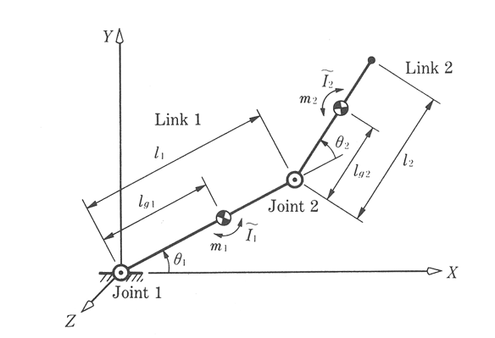
Lagrangian Formulation of Manipulator Dynamics
Example: 2DOF robot
Note: The link coordinate axes are aligned with the principal axes at each link
Instructor: Jacob Rosen
Advanced Robotic - MAE 263D - Department of Mechanical & Aerospace Engineering - UCLA

Slide 37
Lagrangian Formulation of Manipulator Dynamics
(a) Link Inertia Matrix: Assume that the length of the link is much longer than the radius of the link L>>r
Assume L>>r
$${}_{ }^{i}{I_{c_{i}}=\frac{1}{12}mL_{i}^{2}\left[\begin{matrix}0 & 0 & 0 \\ 0 & 1 & 0 \\ 0 & 0 & 1\end{matrix}\right]}$$
$${}_{ }^{0}{I_{i}={}_{i}^{0}{R{}_{ }^{i}{I_{c_{i}}{({}_{i}^{0}R)}^{T}}}}$$
$$i=1$$
$${}_{ }^{0}{I_{1}={}_{1}^{0}{R{}_{ }^{1}{I_{c_{1}}{({}_{1}^{0}R)}^{T}}}}$$
${}_{ }^{0}{I_{1}}=\left[\begin{matrix}c_{1} & −s_{1} & 0 \\ s_{1} & c_{1} & 0 \\ 0 & 0 & 1\end{matrix}\right]\frac{1}{12}mL_{i}^{2}\left[\begin{matrix}0 & 0 & 0 \\ 0 & 1 & 0 \\ 0 & 0 & 1\end{matrix}\right]\left[\begin{matrix}c_{1} & s_{1} & 0 \\ {−s}_{1} & c_{1} & 0 \\ 0 & 0 & 1\end{matrix}\right]= \frac{1}{12}mL_{i}^{2}\left[\begin{matrix}s_{1}^{2} & −c_{1}s_{1} & 0 \\ −c_{1}s_{1} & c_{1}^{2} & 0 \\ 0 & 0 & 1\end{matrix}\right]$
Instructor: Jacob Rosen
Advanced Robotic - MAE 263D - Department of Mechanical & Aerospace Engineering - UCLA

Slide 38
Lagrangian Formulation of Manipulator Dynamics
$$i=2$$
$${}_{ }^{0}{I_{2}={}_{2}^{0}{R{}_{ }^{1}{I_{c_{1}}{({}_{2}^{0}R)}^{T}}}}$$
$${}_{2}^{0}R={}_{1}^{0}R{}_{2}^{1}R=\left[\begin{matrix}c_{1} & −s_{1} & 0 \\ s_{1} & c_{1} & 0 \\ 0 & 0 & 1\end{matrix}\right]\left[\begin{matrix}c_{2} & −s_{2} & 0 \\ s_{2} & c_{2} & 0 \\ 0 & 0 & 1\end{matrix}\right]=\left[\begin{matrix}c_{1}c_{2}−s_{1}s_{2} & −c_{1}s_{2}−s_{1}c_{2} & 0 \\ s_{1}c_{2}+c_{1}s_{2} & {−s}_{1}s_{2}+c_{1}c_{2} & 0 \\ 0 & 0 & 1\end{matrix}\right]=\left[\begin{matrix}c_{12} & −s_{12} & 0 \\ s_{12} & c_{12} & 0 \\ 0 & 0 & 1\end{matrix}\right]$$
${}_{ }^{0}{I_{2}}=\left[\begin{matrix}c_{12} & −s_{12} & 0 \\ s_{12} & c_{12} & 0 \\ 0 & 0 & 1\end{matrix}\right]\frac{1}{12}mL_{i}^{2}\left[\begin{matrix}0 & 0 & 0 \\ 0 & 1 & 0 \\ 0 & 0 & 1\end{matrix}\right]\left[\begin{matrix}c_{12} & s_{12} & 0 \\ {−s}_{12} & c_{12} & 0 \\ 0 & 0 & 1\end{matrix}\right]$ = $\frac{1}{12}mL_{i}^{2} \left[\begin{matrix}c_{12} & −s_{12} & 0 \\ s_{12} & c_{12} & 0 \\ 0 & 0 & 1\end{matrix}\right] \left[\begin{matrix}0 & 0 & 0 \\ −s_{12} & c_{12} & 0 \\ 0 & 0 & 1\end{matrix}\right]$=$\frac{1}{12}mL_{i}^{2}\left[\begin{matrix}s_{12}^{2} & −s_{12}c_{12} & 0 \\ −s_{12}c_{12} & c_{12}^{2} & 0 \\ 0 & 0 & 1\end{matrix}\right]$
Instructor: Jacob Rosen
Advanced Robotic - MAE 263D - Department of Mechanical & Aerospace Engineering - UCLA

Slide 39
Lagrangian Formulation of Manipulator Dynamics
(b) Link Jacobian Matrix:
$${}_{ }^{0}{P_{1}}=\left[\begin{matrix}0 \\ 0 \\ 0\end{matrix}\right]$$
$${}_{ }^{0}{P_{2}}=\left[\begin{matrix}L_{1}c_{1} \\ L_{1}s_{1} \\ 0\end{matrix}\right]$$
$${{}_{ }^{0}{P_{ }}}_{2}={}_{1}^{0}T {{}_{ }^{1}{P_{ }}}_{2}=\left[\begin{matrix}c_{1} & −s_{1} & 0 & 0 \\ s_{1} & c_{1} & 0 & 0 \\ 0 & 0 & 1 & 0 \\ 0 & 0 & 0 & 1\end{matrix}\right]\left[\begin{matrix}L_{1} \\ 0 \\ 0 \\ 1\end{matrix}\right]=\left[\begin{matrix}L_{1}c_{1} \\ L_{1}s_{1} \\ 0 \\ 1\end{matrix}\right]$$
Instructor: Jacob Rosen
Advanced Robotic - MAE 263D - Department of Mechanical & Aerospace Engineering - UCLA

Slide 40
Lagrangian Formulation of Manipulator Dynamics
(b) Link Jacobian Matrix:
Position of the CM:
$${{}_{ }^{1}{P_{c}}}_{1}=\left[\begin{matrix}\frac{1}{2}L_{1} \\ 0 \\ 0\end{matrix}\right]$$
$${{}_{ }^{0}{P_{c}}}_{1}={}_{1}^{0}{T{{}_{ }^{1}{P_{c}}}_{1}=\left[\begin{matrix}c_{1} & −s_{1} & 0 & 0 \\ s_{1} & c_{1} & 0 & 0 \\ 0 & 0 & 1 & 0 \\ 0 & 0 & 0 & 1\end{matrix}\right]\left[\begin{matrix}\frac{1}{2}L_{1} \\ 0 \\ 0 \\ 1\end{matrix}\right]=\left[\begin{matrix}\frac{1}{2}L_{1}c_{1} \\ \frac{1}{2}L_{1}s_{2} \\ 0 \\ 1\end{matrix}\right]}$$
Instructor: Jacob Rosen
Advanced Robotic - MAE 263D - Department of Mechanical & Aerospace Engineering - UCLA

Slide 41
Lagrangian Formulation of Manipulator Dynamics
(b) Link Jacobian Matrix:
Position of the CM:
$${{}_{ }^{0}{P_{c}}}_{2}=\left[\begin{matrix}\frac{1}{2}L_{2}c_{12}+L_{1}c_{1} \\ \frac{1}{2}L_{2}s_{12}+L_{1}s_{1} \\ 0 \\ 1\end{matrix}\right]$$
$${{}_{ }^{2}{P_{c}}}_{2}=\left[\begin{matrix}\frac{1}{2}L_{2} \\ 0 \\ 0\end{matrix}\right]$$
${{}_{ }^{0}{P_{c}}}_{2}={}_{1}^{0}T{}_{2}^{1}T {{}_{ }^{2}{P_{c}}}_{2}={}_{2}^{0}T$ ${{}_{ }^{2}{P_{c}}}_{2}=\left[\begin{matrix}c_{1} & −s_{1} & 0 & 0 \\ s_{1} & c_{1} & 0 & 0 \\ 0 & 0 & 1 & 0 \\ 0 & 0 & 0 & 1\end{matrix}\right]\left[\begin{matrix}c_{2} & −s_{2} & 0 & L_{1} \\ s_{2} & c_{2} & 0 & 0 \\ 0 & 0 & 1 & 0 \\ 0 & 0 & 0 & 1\end{matrix}\right]\left[\begin{matrix}\frac{1}{2}L_{2} \\ 0 \\ 0 \\ 1\end{matrix}\right]$= $\left[\begin{matrix}c_{12} & −s_{12} & 0 & L_{1}c_{1} \\ s_{12} & c_{12} & 0 & L_{1}s_{1} \\ 0 & 0 & 1 & 0 \\ 0 & 0 & 0 & 1\end{matrix}\right]\left[\begin{matrix}\frac{1}{2}L_{2} \\ 0 \\ 0 \\ 1\end{matrix}\right]=\left[\begin{matrix}\frac{1}{2}L_{2}c_{12}+L_{1}c_{1} \\ \frac{1}{2}L_{2}s_{12}+L_{1}s_{1} \\ 0 \\ 1\end{matrix}\right]$
Instructor: Jacob Rosen
Advanced Robotic - MAE 263D - Department of Mechanical & Aerospace Engineering - UCLA

Slide 42
Lagrangian Formulation of Manipulator Dynamics
$$\left[\begin{matrix}{}_{ }^{i}{V_{ci}} \\ ω_{i}\end{matrix}\right]=\left[\begin{matrix}{}_{ }^{0}{J_{vi}} \\ {}_{ }^{0}{J_{ωi}}\end{matrix}\right][\dot{θ_{i}}]$$
${}_{ }^{0}{J_{i}}$ = $\left[\begin{matrix}{}_{ }^{0}{J_{vi}} \\ {}_{ }^{0}{J_{ωi}}\end{matrix}\right]=\left[\begin{matrix}∗ & ∗ \\ ∗ & ∗\end{matrix} \begin{matrix}J_{vi}^{j} & ∗ \\ J_{ωi}^{j} & ∗\end{matrix}\right]$
$$J_{vi}^{j}=\left\{\begin{aligned}{{}_{ }^{0}Z}_{J} ×({}_{ }^{0}{{P_{c}}_{i}^{ }}−{}_{ }^{0}{{P_{ }}_{j}^{ }})(Reveolute Joint) \\ {{}_{ }^{0}Z}_{J} (Prismatic Joint)\end{aligned}\right.$$
$$J_{ωi}^{j}=\left\{\begin{aligned}{{}_{ }^{0}Z}_{J}(Reveolute Joint) \\ 0 (Prismatic Joint)\end{aligned}\right.$$
Instructor: Jacob Rosen
Advanced Robotic - MAE 263D - Department of Mechanical & Aerospace Engineering - UCLA

Slide 43
Lagrangian Formulation of Manipulator Dynamics
$$i=1$$
$$J_{vi}^{j}=\left\{\begin{aligned}{{}_{ }^{0}Z}_{J} ×({}_{ }^{0}{{P_{c}}_{i}^{ }}−{}_{ }^{0}{{P_{ }}_{j}^{ }})(Reveolute Joint) \\ \end{aligned}\right.$$
${}_{ }^{0}{J_{v1}=\left[\begin{matrix}{{}_{ }^{0}Z}_{1} ×({}_{ }^{0}{P_{c1}^{ }}−{}_{ }^{0}{{P_{ }}_{1}^{ }}) & 0\end{matrix}\right]}=\left[\begin{matrix}\left|\begin{matrix}i & j & k \\ 0 & 0 & 1 \\ \frac{1}{2}L_{1}c_{1} & \frac{1}{2}L_{1}s_{1} & 0\end{matrix}\right| & 0\end{matrix}\right]=\left[\begin{matrix}−\frac{1}{2}L_{1}s_{1} & 0 \\ \frac{1}{2}L_{1}c_{1} & 0 \\ 0 & 0\end{matrix}\right]$
Instructor: Jacob Rosen
Advanced Robotic - MAE 263D - Department of Mechanical & Aerospace Engineering - UCLA

Slide 44
Lagrangian Formulation of Manipulator Dynamics
$$i=1$$
$$J_{ωi}^{j}=\left\{\begin{aligned}{{}_{ }^{0}Z}_{J}(Reveolute Joint) \\ \end{aligned}\right.$$
${}_{ }^{0}{J_{ω1}=}\left[\begin{matrix}{{}_{ }^{0}Z}_{1} & 0\end{matrix}\right]=\left[\begin{matrix}0 & 0 \\ 0 & 0 \\ 1 & 0\end{matrix}\right]$
Instructor: Jacob Rosen
Advanced Robotic - MAE 263D - Department of Mechanical & Aerospace Engineering - UCLA

Slide 45
Lagrangian Formulation of Manipulator Dynamics
$$i=2$$
$$J_{vi}^{j}=\left\{\begin{aligned}{{}_{ }^{0}Z}_{J} ×({}_{ }^{0}{{P_{c}}_{i}^{ }}−{}_{ }^{0}{{P_{ }}_{j}^{ }})(Reveolute Joint) \\ \end{aligned}\right.$$
$${}_{ }^{0}{J_{v2}=}\left[\begin{matrix}{{}_{ }^{0}Z}_{1} ×({}_{ }^{0}{P_{c2}^{ }}−{}_{ }^{0}{{P_{ }}_{1}^{ }}) & {{}_{ }^{0}Z}_{2} ×({}_{ }^{0}{P_{c2}^{ }}−{}_{ }^{0}{{P_{ }}_{2}^{ }})\end{matrix}\right]=\left[\begin{matrix}\left[\begin{matrix}0 \\ 0 \\ 1\end{matrix}\right]×\left[\left[\begin{matrix}\frac{1}{2}L_{2}c_{12}+L_{1}c_{1} \\ \frac{1}{2}L_{2}s_{12}+L_{1}s_{1} \\ 0\end{matrix}\right]−\left[\begin{matrix}0 \\ 0 \\ 0\end{matrix}\right]\right] & \left[\begin{matrix}0 \\ 0 \\ 1\end{matrix}\right]×\left[\left[\begin{matrix}\frac{1}{2}L_{2}c_{12}+L_{1}c_{1} \\ \frac{1}{2}L_{2}s_{12}+L_{1}s_{1} \\ 0\end{matrix}\right]−\left[\begin{matrix}L_{1}c_{1} \\ L_{1}s_{1} \\ 0\end{matrix}\right]\right]\end{matrix}\right]=\left[\begin{matrix}\left|\begin{matrix}i & j & k \\ 0 & 0 & 1 \\ \frac{1}{2}L_{2}c_{12}+L_{1}c_{1} & \frac{1}{2}L_{2}s_{12}+L_{1}s_{1} & 0\end{matrix}\right| & \left|\begin{matrix}i & j & k \\ 0 & 0 & 1 \\ \frac{1}{2}L_{2}c_{12} & \frac{1}{2}L_{2}s_{12} & 0\end{matrix}\right|\end{matrix}\right]= \left[\begin{matrix}−L_{1}s_{1}−\frac{1}{2}L_{2}s_{12} & −\frac{1}{2}L_{2}s_{2} \\ L_{1}c_{1}+\frac{1}{2}L_{2}c_{12} & \frac{1}{2}L_{2}c_{2} \\ 0 & 0\end{matrix}\right]$$
Instructor: Jacob Rosen
Advanced Robotic - MAE 263D - Department of Mechanical & Aerospace Engineering - UCLA

Slide 46
Lagrangian Formulation of Manipulator Dynamics
$$i=2$$
$$J_{ωi}^{j}=\left\{\begin{aligned}{{}_{ }^{0}Z}_{J}(Reveolute Joint) \\ \end{aligned}\right.$$
${}_{ }^{0}{J_{ω1}=}\left[\begin{matrix}{{}_{ }^{0}Z}_{1} & {{}_{ }^{0}Z}_{2}\end{matrix}\right]=\left[\begin{matrix}0 & 0 \\ 0 & 0 \\ 1 & 1\end{matrix}\right]$
Instructor: Jacob Rosen
Advanced Robotic - MAE 263D - Department of Mechanical & Aerospace Engineering - UCLA

Slide 47
Lagrangian Formulation of Manipulator Dynamics
(c) Manipulator Inertia Matrix:
$$M=J_{v1}^{T}m_{1}J_{v1}+J_{ω1}^{T}{}_{ }^{1}{{I_{1}}_{c}}J_{ω1}+J_{v2}^{T}m_{2}J_{v2}+J_{ω2}^{T}{}_{ }^{2}{{I_{2}}_{c}}J_{ω2}=$$
$$\left[\begin{matrix}−\frac{1}{2}L_{1}s_{1} & \frac{1}{2}L_{1}c_{1} & 0 \\ 0 & 0 & 0\end{matrix}\right]m_{1}\left[\begin{matrix}−\frac{1}{2}L_{1}s_{1} & 0 \\ \frac{1}{2}L_{1}c_{1} & 0 \\ 0 & 0\end{matrix}\right]+\left[\begin{matrix}0 & 0 & 0 \\ 0 & 0 & 1\end{matrix}\right]{\frac{1}{12}m}_{1}L_{1}^{2}\left[\begin{matrix}s_{12}^{2} & −s_{12}c_{12} & 0 \\ −s_{12}c_{12} & c_{12}^{2} & 0 \\ 0 & 0 & 1\end{matrix}\right]\left[\begin{matrix}0 & 0 \\ 0 & 0 \\ 1 & 0\end{matrix}\right]+\left[\begin{matrix}−L_{1}s_{1}−\frac{1}{2}L_{2}s_{12} & L_{1}c_{1}+\frac{1}{2}L_{2}c_{12} & 0 \\ −\frac{1}{2}L_{2}s_{2} & \frac{1}{2}L_{2}c_{2} & 0\end{matrix}\right]m_{2}\left[\begin{matrix}−L_{1}s_{1}−\frac{1}{2}L_{2}s_{12} & −\frac{1}{2}L_{2}s_{2} \\ L_{1}c_{1}+\frac{1}{2}L_{2}c_{12} & \frac{1}{2}L_{2}c_{2} \\ 0 & 0\end{matrix}\right]+\left[\begin{matrix}0 & 0 & 1 \\ 0 & 0 & 1\end{matrix}\right]{\frac{1}{12}m}_{2}L_{2}^{2}\left[\begin{matrix}s_{12}^{2} & −s_{12}c_{12} & 0 \\ −s_{12}c_{12} & c_{12}^{2} & 0 \\ 0 & 0 & 1\end{matrix}\right]\left[\begin{matrix}0 & 0 \\ 0 & 0 \\ 1 & 1\end{matrix}\right]$$
Instructor: Jacob Rosen
Advanced Robotic - MAE 263D - Department of Mechanical & Aerospace Engineering - UCLA

Slide 48
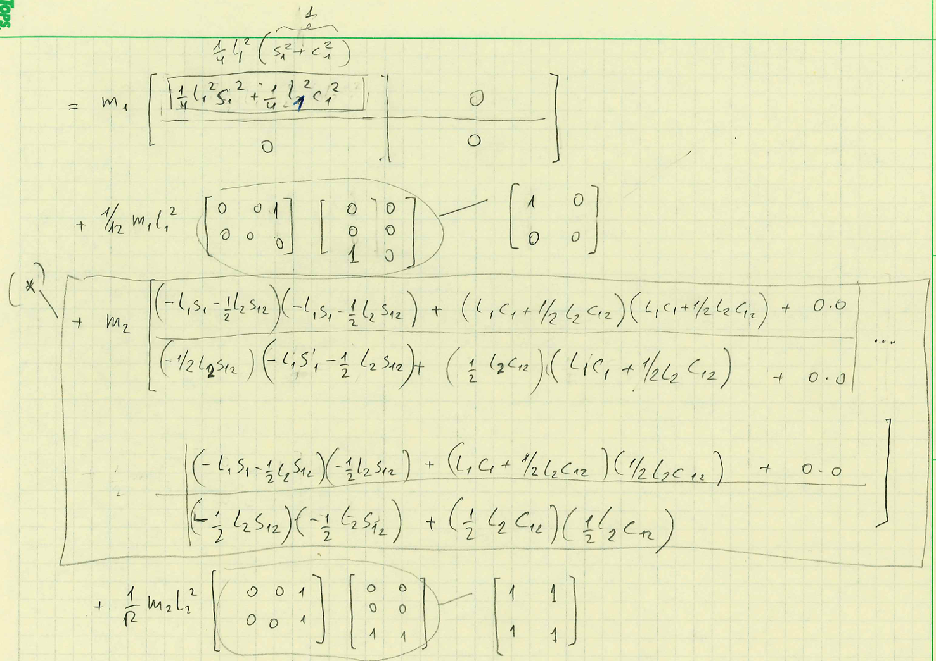
Lagrangian Formulation of Manipulator Dynamics
Instructor: Jacob Rosen
Advanced Robotic - MAE 263D - Department of Mechanical & Aerospace Engineering - UCLA

Slide 49
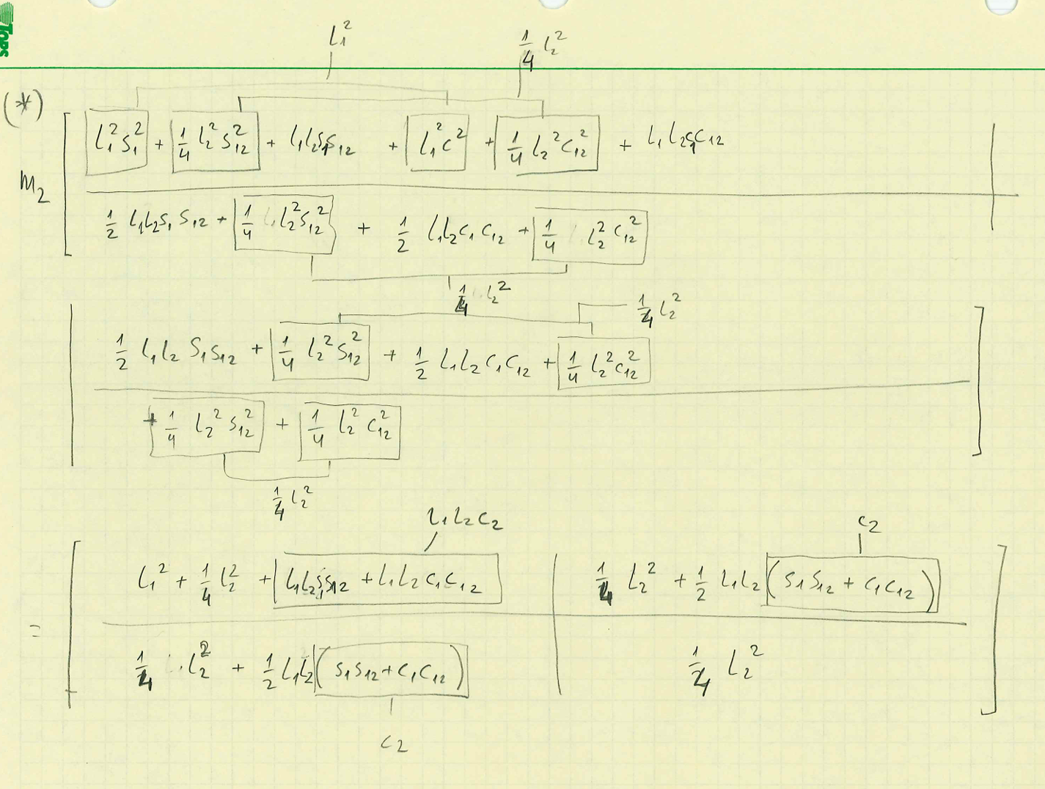
Lagrangian Formulation of Manipulator Dynamics
Instructor: Jacob Rosen
Advanced Robotic - MAE 263D - Department of Mechanical & Aerospace Engineering - UCLA

Slide 50
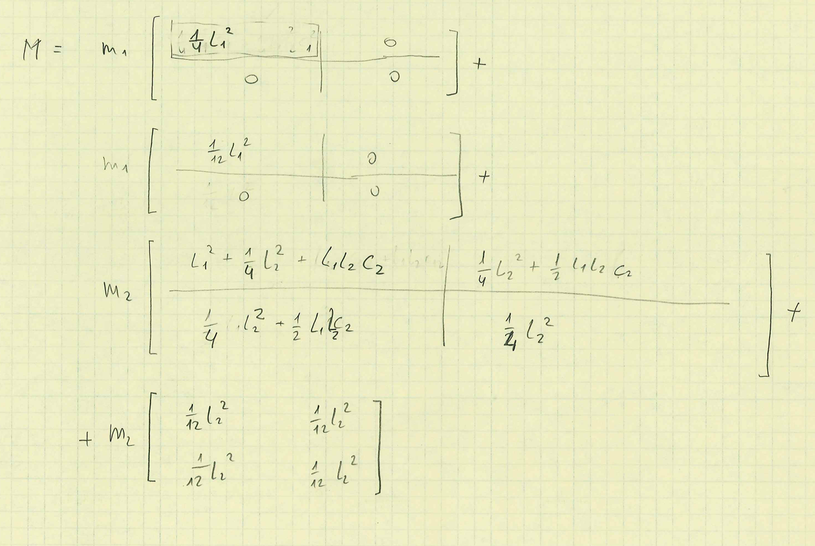
Lagrangian Formulation of Manipulator Dynamics
Instructor: Jacob Rosen
Advanced Robotic - MAE 263D - Department of Mechanical & Aerospace Engineering - UCLA

Slide 51
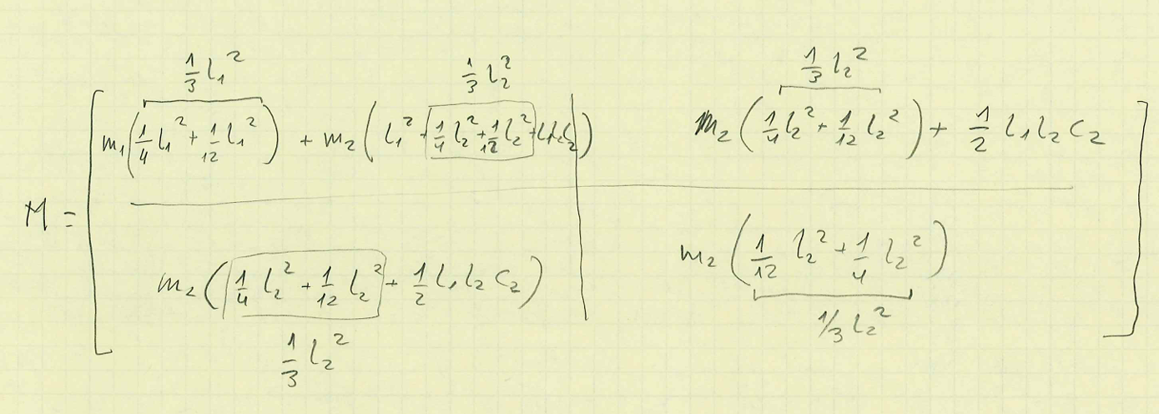
Lagangian Formulation of Manipulator Dynamics
Instructor: Jacob Rosen
Advanced Robotic - MAE 263D - Department of Mechanical & Aerospace Engineering - UCLA

Slide 52
Lagrangian Formulation of Manipulator Dynamics
$$M=J_{v1}^{T}m_{1}J_{v1}+J_{ω1}^{T}{}_{ }^{1}{{I_{1}}_{c}}J_{ω1}+J_{v2}^{T}m_{2}J_{v2}+J_{ω2}^{T}{}_{ }^{2}{{I_{2}}_{c}}J_{ω2}=$$
$$\left[\begin{matrix}\frac{1}{3}m_{1}L_{1}^{2}+m_{2}(L_{1}^{2}+L_{1}L_{2}c_{2}+\frac{1}{3}L_{2}^{2}) & m_{2}(\frac{1}{2}L_{1}L_{2}c_{2}+\frac{1}{3}L_{2}^{2}) \\ m_{2}(\frac{1}{2}L_{1}L_{2}c_{2}+\frac{1}{3}L_{2}^{2}) & \frac{1}{3}m_{2}L_{2}^{2}\end{matrix}\right]$$
Instructor: Jacob Rosen
Advanced Robotic - MAE 263D - Department of Mechanical & Aerospace Engineering - UCLA

Slide 53
Lagrangian Formulation of Manipulator Dynamics
(d) Velocity Coupling Vector:
$$V_{i}=\sum_{J=1}^{n}{\sum_{k=1}^{n}{(\frac{∂M_{ij}}{∂q_{k}}}−\frac{1}{2}\frac{∂M_{jk}}{∂q_{i}})}{\dot{q}}_{k}{\dot{q}}_{j}$$
$$V_{1}=\sum_{j=1}^{2}{\sum_{k=1}^{2}{\left(\frac{∂M_{1j}}{∂θ_{k}}−\frac{1}{2}\frac{∂M_{jk}}{∂θ_{1}}\right)=}}\left(\frac{∂M_{11}}{∂θ_{1}}−\frac{1}{2}\frac{∂M_{11}}{∂θ_{1}}\right){\dot{θ}}_{1}{\dot{θ}}_{1}+\left(\frac{∂M_{21}}{∂θ_{2}}−\frac{1}{2}\frac{∂M_{12}}{∂θ_{1}}\right){\dot{θ}}_{1}{\dot{θ}}_{2}+\left(\frac{∂M_{22}}{∂θ_{1}}−\frac{1}{2}\frac{∂M_{21}}{∂θ_{1}}\right){\dot{θ}}_{2}{\dot{θ}}_{1} +\left(\frac{∂M_{22}}{∂θ_{2}}−\frac{1}{2}\frac{∂M_{22}}{∂θ_{1}}\right){\dot{θ}}_{2}{\dot{θ}}_{2}=$$
$\left(0−\frac{1}{2}0\right){\dot{θ}}_{1}{\dot{θ}}_{1}+\left(−m_{2}L_{1}L_{2}s_{2}−\frac{1}{2}0\right){\dot{θ}}_{1}{\dot{θ}}_{2}+(0−\frac{1}{2}0){\dot{θ}}_{2}{\dot{θ}}_{1})+\left(−m_{2}{\frac{1}{2}L}_{1}L_{2}s_{2}−\frac{1}{2}0\right){\dot{θ}}_{2}{\dot{θ}}_{2}=−m_{2}L_{1}L_{2}s_{2}$(${\dot{θ}}_{1}{\dot{θ}}_{2}$- 1/2 ${\dot{θ}}_{2}^{2}$ )
$$V_{2}=\sum_{j=1}^{2}{\sum_{k=1}^{2}{\left(\frac{∂M_{2j}}{∂θ_{k}}−\frac{1}{2}\frac{∂M_{jk}}{∂θ_{2}}\right)=}}\left(\frac{∂M_{21}}{∂θ_{1}}−\frac{1}{2}\frac{∂M_{11}}{∂θ_{1}}\right){\dot{θ}}_{1}{\dot{θ}}_{1}+\left(\frac{∂M_{11}}{∂θ_{2}}−\frac{1}{2}\frac{∂M_{12}}{∂θ_{1}}\right){\dot{θ}}_{1}{\dot{θ}}_{2}+\left(\frac{∂M_{12}}{∂θ_{1}}−\frac{1}{2}\frac{∂M_{21}}{∂θ_{1}}\right){\dot{θ}}_{2}{\dot{θ}}_{1} +\left(\frac{∂M_{12}}{∂θ_{2}}−\frac{1}{2}\frac{∂M_{22}}{∂θ_{1}}\right){\dot{θ}}_{2}{\dot{θ}}_{2}=$$
$[0−\frac{1}{2}(−m_{2}L_{1}L_{2}s_{2})]{\dot{θ}}_{1}{\dot{θ}}_{1}+\left(−{\frac{1}{2}m}_{2}L_{1}L_{2}s_{2}+\frac{1}{2}m_{2}\frac{1}{2}L_{1}L_{2}s_{2}\right){\dot{θ}}_{1}{\dot{θ}}_{2}+(0+\frac{1}{2}(m_{2}\frac{1}{2}L_{1}L_{2}s_{2})){\dot{θ}}_{2}{\dot{θ}}_{1})+\left(0−\frac{1}{2}0\right){\dot{θ}}_{2}{\dot{θ}}_{2}={\frac{1}{2}m}_{2}L_{1}L_{2}s_{2}{{\dot{θ}}_{1}}^{2}$
Instructor: Jacob Rosen
Advanced Robotic - MAE 263D - Department of Mechanical & Aerospace Engineering - UCLA

Slide 54
Lagrangian Formulation of Manipulator Dynamics
(e) Gravitational Vector
$$G_{i}=−\sum_{j=1}^{n}{m_{j}g^{T}J_{vj}^{i}}$$
$$G_{1}=−m_{1}g^{T}J_{v1}^{1}−m_{2}g^{T}J_{v2}^{1}=−m_{1}\left[\begin{matrix}0 & −g & 0\end{matrix}\right]\left[\begin{matrix}−\frac{1}{2}L_{1}s_{1} \\ \frac{1}{2}L_{1}c_{1} \\ 0\end{matrix}\right]−m_{2}\left[\begin{matrix}0 & −g & 0\end{matrix}\right]\left[\begin{matrix}−L_{1}s_{1}−\frac{1}{2}L_{2}s_{12} \\ L_{1}c_{1}+\frac{1}{2}L_{2}c_{12} \\ 0\end{matrix}\right]$$
$$G_{1}=\frac{1}{2}m_{1}gL_{1}c_{1}+m_{2}gL_{1}c_{1}+\frac{1}{2}m_{2}gL_{2}s_{12}$$
$$i=1$$
Instructor: Jacob Rosen
Advanced Robotic - MAE 263D - Department of Mechanical & Aerospace Engineering - UCLA

Slide 55
Lagrangian Formulation of Manipulator Dynamics
(e) Gravitational Vector
$$G_{i}=\sum_{j=1}^{n}{m_{j}g^{T}J_{vj}^{i}}$$
$$G_{2}=−m_{1}G^{T}J_{v1}^{2}−m_{2}g^{T}J_{v2}^{2}=−m_{1}\left[\begin{matrix}0 & −g & 0\end{matrix}\right]\left[\begin{matrix}0 \\ 0 \\ 0\end{matrix}\right]−m_{2}\left[\begin{matrix}0 & −g & 0\end{matrix}\right]\left[\begin{matrix}−\frac{1}{2}L_{2}s_{12} \\ \frac{1}{2}L_{2}c_{12} \\ 0\end{matrix}\right]$$
$$G_{1}=\frac{1}{2}m_{2}L_{2}c_{12}$$
$$i=2$$
Instructor: Jacob Rosen
Advanced Robotic - MAE 263D - Department of Mechanical & Aerospace Engineering - UCLA

Slide 56
Lagrangian Formulation of Manipulator Dynamics
$\left[\begin{matrix}τ_{1} \\ τ_{2}\end{matrix}\right]=\left[\begin{matrix}\frac{1}{3}m_{1}L_{1}^{2}+m_{2}(L_{1}^{2}+L_{1}L_{2}c_{2}+\frac{1}{3}L_{2}^{2}) & \frac{1}{3}m_{2}L_{2}^{2}+{\frac{1}{2}m}_{2}L_{1}L_{2}c_{2} \\ m_{2}(\frac{1}{2}L_{1}L_{2}c_{2}+\frac{1}{3}L_{2}^{2}) & \frac{1}{3}m_{2}L_{2}^{2}\end{matrix}\right]$ $\left[\begin{matrix}{\ddot{θ}}_{1} \\ {\ddot{θ}}_{2}\end{matrix}\right]+$
$\left[\begin{matrix}0 & \frac{1}{2}L_{1}L_{2}s_{2} \\ {\frac{1}{2}m}_{2}L_{1}L_{2}s_{2} & 0\end{matrix}\right]$ $\left[\begin{matrix}{\dot{θ}}_{1}^{2} \\ {\dot{θ}}_{2}^{2}\end{matrix}\right]$ + $\left[\begin{matrix}−m_{2}L_{1}L_{2}s_{2} \\ 0\end{matrix}\right]θ_{1}θ_{2}$ +
$g\left[\begin{matrix}\frac{1}{2}m_{1}L_{1}c_{1}+m_{2}(L_{1}c_{1}+\frac{1}{2}L_{2}s_{12}) \\ \frac{1}{2}m_{2}L_{2}c_{12}\end{matrix}\right]$
Instructor: Jacob Rosen
Advanced Robotic - MAE 263D - Department of Mechanical & Aerospace Engineering - UCLA

Slide 57
Lagrange Method
Summary
Instructor: Jacob Rosen
Advanced Robotic - MAE 263D - Department of Mechanical & Aerospace Engineering - UCLA

Slide 58
Lagrangian Formulation of Manipulator Dynamics – Summary
Step 1: Define a set of generalized coordinates for i=1,2,3…N. The usual variable set for serial manipulators is:
Step 2: Define a set of generalized velocities ${\dot{q}}_{i}$ for i=1,2,3…N
Step 3: Define a set of generalized forces (and moments) $Q_{i}$
Step 4: Define the new tensor of inertia at the base frame (frame 0) by transforming the tensor of inertia of all the links form the links’ coordinate systems to the base coordinate system for i=1,2,3…N
$$q_{i}=\left\{\begin{aligned}&θ_{i} \text{R}\text{evolute} \text{Joint} \\ &d_{i} \text{P}\text{rismatic} \text{Joint}\end{aligned}\right.$$
$$Q=τ+J^{T}ℱ_{e}^{ }−f_{r}$$
$${}_{ }^{0}{I_{i}={}_{i}^{0}{R{}_{ }^{i}{I_{c_{i}}{({}_{i}^{0}R)}^{T}}}}$$
Instructor: Jacob Rosen
Advanced Robotic - MAE 263D - Department of Mechanical & Aerospace Engineering - UCLA

Slide 59
Lagrangian Formulation of Manipulator Dynamics – Summary
Step 5: Define the frame positions of the links with respect to the base frame ${}_{ }^{0}{P_{i}}$ as well as the positions of of the center of mass in their own coordinate systems ${{}_{ }^{i}{P_{c}}}_{i}$ for i=1,2,3…N. manipulators is:
Step 6: Define the element in the partial Jacobean matrix for i=1,2,3…N
Step 7: Define the inertia matrix
$${{}_{ }^{0}{P_{i}}=}_{ }{}_{ }^{0}{P_{ORG i}}$$
$${{}_{ }^{i}{P_{c}}}_{i}$$
$$J_{vi}^{j}=\left\{\begin{aligned}{{}_{ }^{0}Z}_{J} ×({}_{ }^{0}{{P_{c}}_{i}^{ }}−{}_{ }^{0}{{P_{ }}_{j}^{ }})(Reveolute Joint) \\ {{}_{ }^{0}Z}_{J} (Prismatic Joint)\end{aligned}\right.$$
$$J_{ωi}^{j}=\left\{\begin{aligned}{{}_{ }^{0}Z}_{J}(Reveolute Joint) \\ 0 (Prismatic Joint)\end{aligned}\right.$$
$$M=\sum_{i=1}^{n}{{}_{ }^{0}{J_{vi}^{T}}m_{i}{}_{ }^{0}{J_{vi}}+{}_{ }^{0}{J_{ωi}^{T}}{}_{ }^{0}{{I_{i}}_{c}}{}_{ }^{0}{J_{ωi} }= }J_{v1}^{T}m_{1}J_{v1}+J_{ω1}^{T}{}_{ }^{1}{{I_{1}}_{c}}J_{ω1}+J_{v2}^{T}m_{2}J_{v2}+J_{ω2}^{T}{}_{ }^{2}{{I_{2}}_{c}}J_{ω2}+…$$
Instructor: Jacob Rosen
Advanced Robotic - MAE 263D - Department of Mechanical & Aerospace Engineering - UCLA

Slide 60
Lagrangian Formulation of Manipulator Dynamics – Summary
Step 8: Calculate the velocity vector for i=1,2,3…N. as:
$$V_{i}=\sum_{J=1}^{n}{\sum_{k=1}^{n}{(\frac{∂M_{ij}}{∂q_{k}}}−\frac{1}{2}\frac{∂M_{jk}}{∂q_{k}})}{\dot{q}}_{k}{\dot{q}}_{j}$$
$$V_{1}=\sum_{j=1}^{n}{\sum_{k=1}^{n}{\left(\frac{∂M_{1j}}{∂θ_{k}}−\frac{1}{2}\frac{∂M_{jk}}{∂θ_{1}}\right)=}}\left(\frac{∂M_{11}}{∂θ_{1}}−\frac{1}{2}\frac{∂M_{11}}{∂θ_{1}}\right){\dot{θ}}_{1}{\dot{θ}}_{1}+\left(\frac{∂M_{21}}{∂θ_{2}}−\frac{1}{2}\frac{∂M_{12}}{∂θ_{1}}\right){\dot{θ}}_{1}{\dot{θ}}_{2}+\left(\frac{∂M_{22}}{∂θ_{1}}−\frac{1}{2}\frac{∂M_{21}}{∂θ_{1}}\right){\dot{θ}}_{2}{\dot{θ}}_{1} +\left(\frac{∂M_{22}}{∂θ_{2}}−\frac{1}{2}\frac{∂M_{22}}{∂θ_{1}}\right){\dot{θ}}_{2}{\dot{θ}}_{2}+…$$
$$V_{2}=\sum_{j=1}^{n}{\sum_{k=1}^{n}{\left(\frac{∂M_{2j}}{∂θ_{k}}−\frac{1}{2}\frac{∂M_{jk}}{∂θ_{2}}\right)=}}\left(\frac{∂M_{21}}{∂θ_{1}}−\frac{1}{2}\frac{∂M_{11}}{∂θ_{1}}\right){\dot{θ}}_{1}{\dot{θ}}_{1}+\left(\frac{∂M_{11}}{∂θ_{2}}−\frac{1}{2}\frac{∂M_{12}}{∂θ_{1}}\right){\dot{θ}}_{1}{\dot{θ}}_{2}+\left(\frac{∂M_{12}}{∂θ_{1}}−\frac{1}{2}\frac{∂M_{21}}{∂θ_{1}}\right){\dot{θ}}_{2}{\dot{θ}}_{1} +\left(\frac{∂M_{12}}{∂θ_{2}}−\frac{1}{2}\frac{∂M_{22}}{∂θ_{1}}\right){\dot{θ}}_{2}{\dot{θ}}_{2}+ …$$
Instructor: Jacob Rosen
Advanced Robotic - MAE 263D - Department of Mechanical & Aerospace Engineering - UCLA

Slide 61
Lagrangian Formulation of Manipulator Dynamics – Summary
Step 9: Calculate the gravity vector for i=1,2,3…N. as:
Note that the gravity is defined as
$$G_{i}=\sum_{j=1}^{n}{m_{j}g^{T}J_{vj}^{i}}$$
$$G_{1}=−m_{1}g^{T}J_{v1}^{1}−m_{2}g^{T}J_{v2}^{1}+…$$
$G_{2}=−m_{1}g^{T}J_{v1}^{2}−m_{2}g^{T}J_{v2}^{2}$ $+…$
$$g^{T}=\left[\begin{matrix}0 & −g & 0\end{matrix}\right]$$
Instructor: Jacob Rosen
Advanced Robotic - MAE 263D - Department of Mechanical & Aerospace Engineering - UCLA

Slide 62
Lagrangian Formulation of Manipulator Dynamics – Summary
Step 10: Define the equation of motion for i=1,2,3…N. as:
$$\sum_{J=1}^{n}{M_{ij}}{\ddot{q}}_{j}+V_{i}+G_{i}=Q_{i}$$
Instructor: Jacob Rosen
Advanced Robotic - MAE 263D - Department of Mechanical & Aerospace Engineering - UCLA

Slide 63
Equations of Motion in Various Spaces
Joint Space versus Task Space
Instructor: Jacob Rosen
Advanced Robotic - MAE 263D - Department of Mechanical & Aerospace Engineering - UCLA

Slide 64
Dynamic Equations - State Space Equation
It is often convenient to express the dynamic equations of a manipulator in a single equation
where
- Mass matrix (includes inertia terms) - nxn Matrix
- Centrifugal (square of joint velocity) and Coriolis (product of two different
joint velocities) terms - nx1 Vector
- gravitational terms - nx1 Vector.
$$τ=M\left(θ\right)\ddot{θ}+V\left(θ,\dot{θ}\right)+G\left(θ\right)$$
$$M\left(θ\right)$$
$$V\left(θ,\dot{θ}\right)$$
$$G\left(θ\right)$$
Instructor: Jacob Rosen
Advanced Robotic - MAE 263D - Department of Mechanical & Aerospace Engineering - UCLA

Slide 65
Dynamic Equations - Configuration Space Equation
By rewriting the velocity dependent term $V\left(θ,\dot{θ}\right)$ in a different form, we can write the dynamic equations as
where
$C\left(θ\right)$ - Centrifugal coefficients(square of joint velocity)
$B\left(θ\right)$ - Coriolis coefficients (product of two different joint velocities)
We may refer to this formulation as the configuration space equation or the joint space
$$τ=M\left(θ\right)\ddot{θ}+B\left(θ\right)\left[\dot{θ} \dot{θ}\right]+C\left(θ\right)\left[{\dot{θ}}^{2}\right]+G\left(θ\right)$$
Instructor: Jacob Rosen
Advanced Robotic - MAE 263D - Department of Mechanical & Aerospace Engineering - UCLA

Slide 66
Dynamic Equations - Cartesian State Space Equation
It can sometimes be desirable to have a relationship between the end effector’s Cartesian accelerations and the joint torques.
Beginning from the Configuration Space equation
we can substitute the joint moments using our definition of the Jacobian matrix:
By differentiation, we find
$$F=M_{x}\left(θ\right)\ddot{x}+V_{x}\left(θ,\dot{θ}\right)+G_{x}\left(θ\right)$$
$$τ=M\left(θ\right)\ddot{θ}+V\left(θ,\dot{θ}\right)+G\left(θ\right)$$
$$τ=J^{T}\left(θ\right)F$$
$$F=J^{−T}\left(θ\right)τ$$
$$\dot{x}=J\left(θ\right)\dot{θ}$$
$$\ddot{x}=\dot{J}\left(θ\right)\dot{θ}+J\left(θ\right)\ddot{θ}$$
Instructor: Jacob Rosen
Advanced Robotic - MAE 263D - Department of Mechanical & Aerospace Engineering - UCLA

Slide 67
Dynamic Equations - Cartesian State Space Equation
Solving for joint acceleration gives
Substitution yields
Where
This equation relates the forces and moments at the end effector to the Cartesian accelerations of the end effector and the manipulator joint positions and velocities.
$$\ddot{θ}=J^{−1}\ddot{x}−J^{−1}\dot{J}\dot{θ}$$
$$F=J^{−T}τ=J^{−T}M\left(θ\right)J^{−1}\ddot{x}−J^{−T}M\left(θ\right)J^{−1}\dot{J}\dot{θ}+J^{−T}V\left(θ,\dot{θ}\right)+J^{−T}G\left(θ\right)$$
$$F=M_{x}\left(θ\right)\ddot{x}+V_{x}\left(θ,\dot{θ}\right)+G_{x}\left(θ\right)$$
$$M_{x}\left(θ\right)=J^{−T}M\left(θ\right)J^{−1}$$
$$V_{x}\left(θ,\dot{θ}\right)=J^{−T}M\left(θ\right)J^{−1}\dot{J}\dot{θ}+J^{−T}V\left(θ,\dot{θ}\right)$$
$$G_{x}\left(θ\right)=J^{−T}G\left(θ\right)$$
Instructor: Jacob Rosen
Advanced Robotic - MAE 263D - Department of Mechanical & Aerospace Engineering - UCLA

