Slide 1
Manipulator Dynamics 2
Instructor: Jacob Rosen
Advanced Robotic - MAE 263 - Department of Mechanical & Aerospace Engineering - UCLA

Slide 2
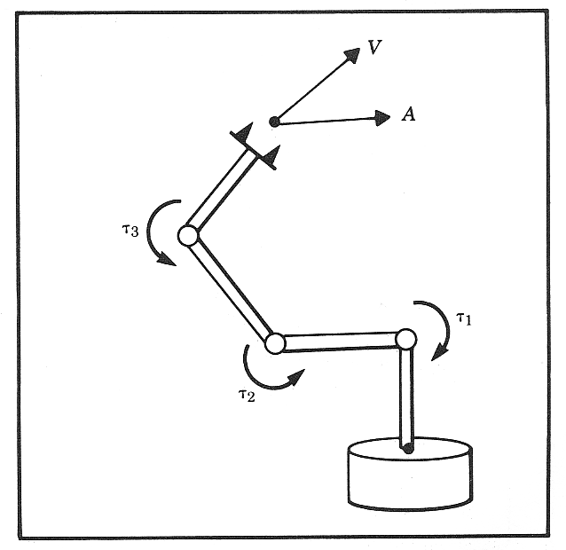
Forward Dynamics
$$\left\{\begin{aligned}&τ_{i} \\ &Link_{i}(x,y,z) \\ &m_{i} \\ &I_{i} \\ &P_{Ci} \\ &f_{i} \\ &n_{i}\end{aligned}\right.$$
Problem
Given: Joint torques and links
geometry, mass, inertia,
friction, joint torques
Compute: Angular acceleration of the
links (solve differential
equations)
Solution
solve a set of differential equations
Dynamic Equations - Newton-Euler method or Lagrangian Dynamics
$$\left\{\begin{aligned}&Θ \\ &\dot{Θ} \\ &\ddot{Θ}\end{aligned}\right.$$
$$τ=M(Θ)\ddot{Θ}+V(Θ,\dot{Θ})+G(Θ)+F(Θ,\dot{Θ})$$
Instructor: Jacob Rosen
Advanced Robotic - MAE 263 - Department of Mechanical & Aerospace Engineering - UCLA

Slide 3
Inverse Dynamics
Problem
Given: Angular acceleration, velocity and
angels of the links in addition to
the links geometry, mass, inertia,
friction
Compute: Joint torques
Solution
Solve a set of algebraic equations
Dynamic Equations - Newton-Euler method or Lagrangian Dynamics
$$\left\{\begin{aligned}&Θ \\ &\dot{Θ} \\ &\ddot{Θ} \\ &Link_{i}(x,y,z) \\ &m_{i} \\ &I_{i} \\ &P_{Ci} \\ &f_{i} \\ &n_{i}\end{aligned}\right.$$
$$\left\{τ\right.$$
$$τ=M(Θ)\ddot{Θ}+V(Θ,\dot{Θ})+G(Θ)+F(Θ,\dot{Θ})$$
Instructor: Jacob Rosen
Advanced Robotic - MAE 263 - Department of Mechanical & Aerospace Engineering - UCLA

Slide 4
Iterative Newton Euler Equations Steps of the Algorithm
$(i = 0→n−1$)
(1) Outward Iterations
Starting With velocities and accelerations of the base
Calculate velocities accelerations, along with forces and torques (at the CM)
(2) Inward Iteration
Starting with forces and torques (at the CM)
Calculate forces and torques at the joints
$$(i=0→n−1)$$
$$\left\{\begin{aligned}&ω \\ &\dot{ω} \\ &\dot{ν} \\ &{\dot{ν}}_{CM} \\ &F \\ &N\end{aligned}\right.$$
$${{}_{ }^{0}ω}_{0}=0, {\dot{{}_{ }^{0}ω}}_{0}=0, {{}_{ }^{0}ν}_{0}=0, {\dot{{}_{ }^{0}ν}}_{0}=+g\hat{z}$$
$$\left\{\begin{aligned}&{{}_{ }^{0}ω}_{0}=0 \\ &{\dot{{}_{ }^{0}ω}}_{0}=0 \\ &{{}_{ }^{0}ν}_{0}=0 \\ &{\dot{{}_{ }^{0}ν}}_{0}=+g\hat{z}\end{aligned}\right.$$
$$ω,\dot{ω},\dot{ν},{\dot{ν}}_{CM},F,N$$
$$(i=n→1)$$
$$(i=n→1)$$
$$\left\{\begin{aligned}&F \\ &N\end{aligned}\right.$$
$$F,N$$
$$f,n$$
Instructor: Jacob Rosen
Advanced Robotic - MAE 263B - Department of Mechanical & Aerospace Engineering - UCLA

Slide 5
Iterative Newton-Euler Equations - Solution Procedure Phase 1: Outward Iteration
Calculate the link velocities and accelerations iteratively from the robot’s base to the end effector
Calculate the force and torques applied on the CM of each link using the Newton and Euler equations
$$\text{Outward} \text{Iteration}\text{: }i : 0→5$$
$${{}_{ }^{i+1}ω}_{i+1}={}_{i}^{i+1}R{{}_{ }^{i}ω}_{i}+{\dot{θ}}_{i+1}{{}_{ }^{i+1}{\hat{Z}}}_{i+1}$$
$${{}_{ }^{i+1}{\dot{ω}}}_{i+1}={}_{i}^{i+1}R{{}_{ }^{i}{\dot{ω}}}_{i}+{}_{i}^{i+1}R{{}_{ }^{i}ω}_{i}×{\dot{θ}}_{i+1}{{}_{ }^{i+1}{\hat{Z}}}_{i+1}+{\ddot{θ}}_{i+1}{{}_{ }^{i+1}{\hat{Z}}}_{i+1}$$
$${{}_{ }^{i+1}{\dot{v}}}_{i+1}={}_{i}^{i+1}R({\dot{{}_{ }^{i}ω}}_{i} × {{}_{ }^{i}P}_{i+1}+{{}_{ }^{i}ω}_{i} × ({{}_{ }^{i}ω}_{i} × {{}_{ }^{i}P}_{i+1})+{{}_{ }^{i}{\dot{v}}}_{i})$$
$${{{}_{ }^{i+1}{\dot{v}}}_{C}}_{i+1}={{}_{ }^{i+1}{\dot{ω}}}_{i+1}× {{{}_{ }^{i+1}P}_{C}}_{i+1}+{{}_{ }^{i+1}ω}_{i+1}× ({{}_{ }^{i+1}ω}_{i+1}×{{{}_{ }^{i+1}P}_{C}}_{i+1}) + {{}_{ }^{i+1}{\dot{v}}}_{i+1}$$
$${{}_{ }^{i+1}F}_{i+1}=m_{i+1}{{{}_{ }^{i+1}{\dot{v}}}_{C}}_{i+1}$$
Instructor: Jacob Rosen
Advanced Robotic - MAE 263B - Department of Mechanical & Aerospace Engineering - UCLA

Slide 6
Iterative Newton-Euler Equations - Solution Procedure Phase 2: Inward Iteration
Use the forces and torques generated at the joints starting with forces and torques generating by interacting with the environment (that is, tools, work stations, parts etc.) at the end effector all the way the robot’s base.
$$\text{Inward} \text{Iteration}\text{: }i : 6→1$$
$${{}_{ }^{i}f}_{i}={}_{i+1}^{i}R{{}_{ }^{i+1}f}_{i+1}+{{}_{ }^{i}F}_{i}$$
$${{}_{ }^{i}n}_{i}={{}_{ }^{i}N}_{i}+{}_{i+1}^{i}R{{}_{ }^{i+1}n}_{i+1}+{{{}_{ }^{i}P}_{C}}_{i}×{{}_{ }^{i}F}_{i}+{{}_{ }^{i}P}_{i+1} ×{}_{i+1}^{i}R {{}_{ }^{i+1}f}_{i+1}$$
$$τ_{i}={{{}_{ }^{i+1}n}^{T}}_{i+1} {\hat{{}_{ }^{i}Z}}_{i}$$
Instructor: Jacob Rosen
Advanced Robotic - MAE 263B - Department of Mechanical & Aerospace Engineering - UCLA

Slide 7
Manipulator Dynamics – Newton Euler Equations
The Inertia Tensor (Moment of Inertia)
$${}_{ }^{c}I$$
Instructor: Jacob Rosen
Advanced Robotic - MAE 263B - Department of Mechanical & Aerospace Engineering - UCLA

Slide 8
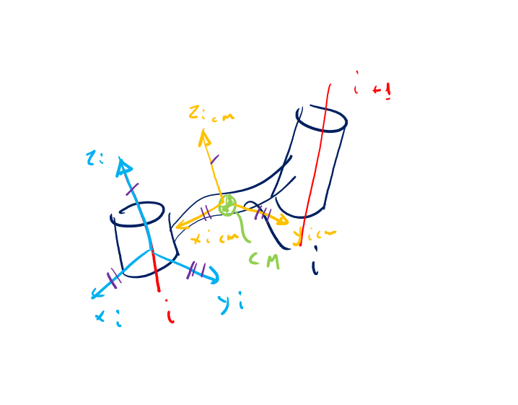
Dynamics - Newton-Euler Equations
To solve the Newton and Euler equations, we’ll need to develop mathematical terms for:
${\dot{v}}_{c}$ - The linear acceleration of the center of mass
$\dot{ω}$ - The angular acceleration
${}_{ }^{c}I$ - The Inertia tensor (moment of inertia)
$F$ - The sum of all the forces applied on the center of mass
$N$ - The sum of all the moments applied on the center of mass
$$F=m{\dot{v}}_{c}$$
$$N={}_{ }^{c}I\dot{ω}+ω×{}_{ }^{c}Iω$$
Instructor: Jacob Rosen
Advanced Robotic - MAE 263B - Department of Mechanical & Aerospace Engineering - UCLA

Slide 9
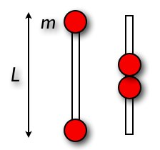
Moment of Inertia – Intuitive Understanding
$$F=m{\dot{v}}_{c}$$
$$N={}_{ }^{c}I\dot{ω}+ω×{}_{ }^{c}Iω$$
Instructor: Jacob Rosen
Advanced Robotic - MAE 263 - Department of Mechanical & Aerospace Engineering - UCLA

Slide 10
Moment of Inertia – Intuitive Understanding
Instructor: Jacob Rosen
Advanced Robotic - MAE 263 - Department of Mechanical & Aerospace Engineering - UCLA

Slide 11
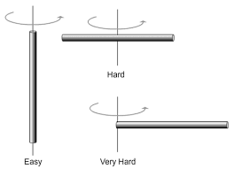
Moment of Inertia – Intuitive Understanding
Instructor: Jacob Rosen
Advanced Robotic - MAE 263 - Department of Mechanical & Aerospace Engineering - UCLA

Slide 12
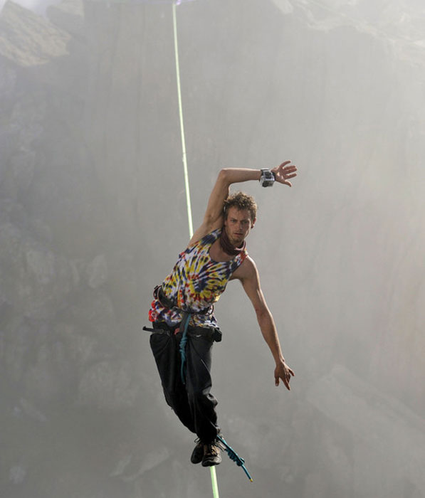
Moment of Inertia – Intuitive Understanding
Instructor: Jacob Rosen
Advanced Robotic - MAE 263 - Department of Mechanical & Aerospace Engineering - UCLA

Slide 13
Moment of Inertia – Intuitive Understanding
Instructor: Jacob Rosen
Advanced Robotic - MAE 263 - Department of Mechanical & Aerospace Engineering - UCLA

Slide 14
Moment of Inertia – Intuitive Understanding
Instructor: Jacob Rosen
Advanced Robotic - MAE 263 - Department of Mechanical & Aerospace Engineering - UCLA

Slide 15
Moment of Inertia – Intuitive Understanding
https://www.youtube.com/watch?v=9SaShn8OkJI
Instructor: Jacob Rosen
Advanced Robotic - MAE 263 - Department of Mechanical & Aerospace Engineering - UCLA

Slide 16
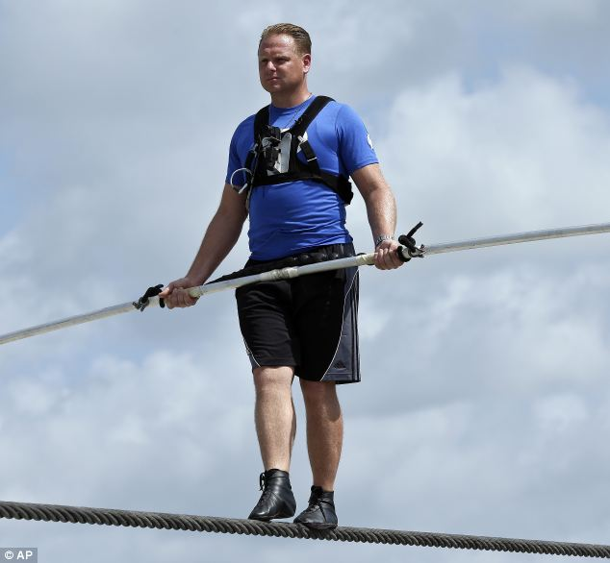
Moment of Inertia – Intuitive Understanding
Instructor: Jacob Rosen
Advanced Robotic - MAE 263 - Department of Mechanical & Aerospace Engineering - UCLA

Slide 17
Moment of Inertia – Particle – WRT Axis
$$I_{AA′}=r^{2}Δm$$
Instructor: Jacob Rosen
Advanced Robotic - MAE 263 - Department of Mechanical & Aerospace Engineering - UCLA

Slide 18
Moment of Inertia – Solid – WRT Axis
$$I_{AA′}=\sum_{i}{r_{i}^{2}Δm_{i}}$$
$$I_{AA′}=\int_{v}^{ }{r^{2}}dm=\iiint_{v}^{ }{r^{2}}ρdv$$
$$ρdv$$
Instructor: Jacob Rosen
Advanced Robotic - MAE 263 - Department of Mechanical & Aerospace Engineering - UCLA

Slide 19
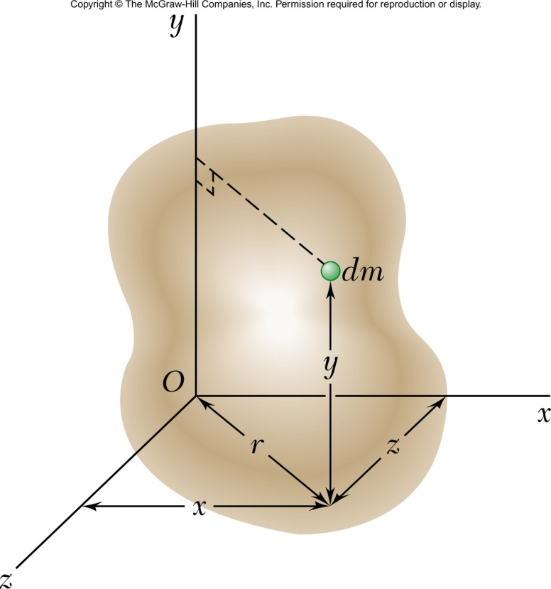
Moment of Inertia – Solid – WRT Coordinate Frame
$$I_{yy}=\int{r^{2}}dm=\int{\left(z^{2}+x^{2}\right)}dm=\iiint_{v}^{ }{\left(z^{2}+x^{2}\right)}ρdv$$
$$I_{xx}=\iiint_{v}^{ }{\left(z^{2}+y^{2}\right)}ρdv$$
$$I_{zz}=\iiint_{v}^{ }{\left(x^{2}+y^{2}\right)}ρdv$$
Instructor: Jacob Rosen
Advanced Robotic - MAE 263 - Department of Mechanical & Aerospace Engineering - UCLA

Slide 20
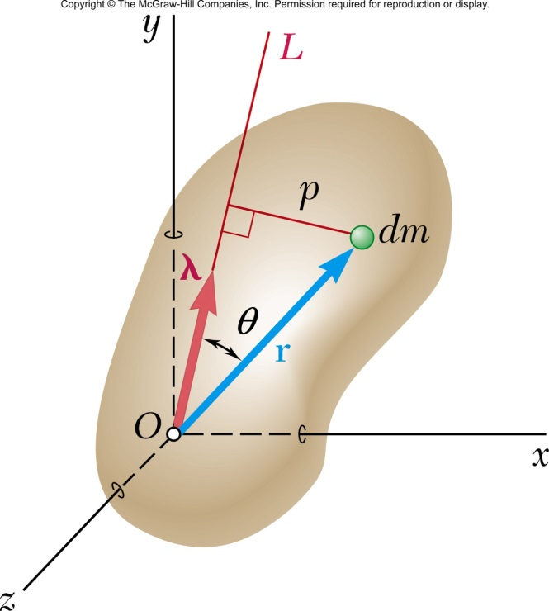
Moment of Inertia – Solid – WRT an Arbitrary Axis
$$p=rsinθ=λ×r$$
$$I_{OL}=\int{p^{2}}dm=\int{{\left(λ×r\right)}^{2}}dm=\int{{\left(λ×r\right)}^{T}\left(λ×r\right)}dm$$
$λ×r=\left|\begin{matrix}i & j & k \\ λ_{x} & λ_{y} & λ_{z} \\ x & y & z\end{matrix}\right|$= $i\left(λ_{y}z−λ_{z}y\right)+j\left(λ_{z}x−λ_{x}z\right)+k\left(λ_{x}y−λ_{y}x\right)$
$$I_{OL}=\int{{\left(λ_{x}y−λ_{y}x\right)}^{2}+{\left(λ_{y}z−λ_{z}y\right)}^{2}+{\left(λ_{z}x−λ_{x}z\right)}^{2}}dm$$
Instructor: Jacob Rosen
Advanced Robotic - MAE 263 - Department of Mechanical & Aerospace Engineering - UCLA

Slide 21
Moment of Inertia – Solid – WRT an Arbitrary Axis
$$I_{OL}=\int{{\left(λ_{x}y−λ_{y}x\right)}^{2}+{\left(λ_{y}z−λ_{z}y\right)}^{2}+{\left(λ_{z}x−λ_{x}z\right)}^{2}}dm$$
$$I_{xx}$$
$$I_{yy}$$
$$I_{ZZ}$$
$$I_{OL}=λ_{x}^{2}\int{\left(y^{2}+z^{2}\right)}dm+λ_{y}^{2}\int{\left(z^{2}+x^{2}\right)}dm+λ_{z}^{2}\int{\left(x^{2}+y^{2}\right)}dm$$
$$−2λ_{x}λ_{y}\int{xy}dm−2λ_{y}λ_{z}\int{yz}dm−2λ_{z}λ_{x}\int{zx}dm$$
$$I_{xy}$$
$$I_{yz}$$
$$I_{zx}$$
$$I_{OL}=I_{xx}λ_{x}^{2}+I_{yy}λ_{y}^{2}+I_{zz}λ_{z}^{2}−2I_{xy}λ_{x}λ_{y}−2I_{yz}λ_{y}λ_{z}−2I_{zx}λ_{z}λ_{x}$$
Instructor: Jacob Rosen
Advanced Robotic - MAE 263D - Department of Mechanical & Aerospace Engineering - UCLA

Slide 22
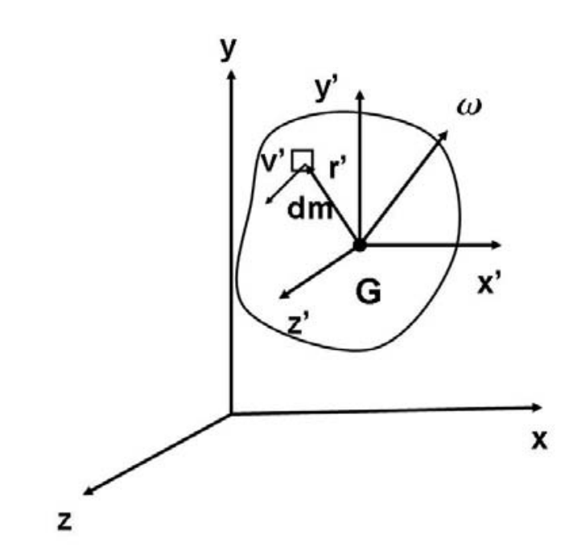
Inertia Tensor – WRT a Coordinate Frame at the CM
Expression of the angular momentum of a system of particles about the center of mass, the angular momentum $H_{G}$ is defined as
Where, ${r_{ }^{′}}_{ }$ is the position vector relative to the center of mass, ${v_{ }^{′}}_{ }$ is the velocity relative to the center of mass.
For a 3D continuum mass of a rigid body, the summation can be replaced by an integration over the entire mass.
Instructor: Jacob Rosen
Advanced Robotic - MAE 263 - Department of Mechanical & Aerospace Engineering - UCLA

Slide 23
Inertia Tensor – WRT a Coordinate Frame at the CM
For a 3D rigid body, the distance $r_{ }^{′}$ between infinitesimal mass ${dm}_{ }^{ }$ and the center of mass G remains constant, and the infinitesimal mass velocity $v_{ }^{′}$, relative to the center of mass G, due to the rotation of the rigid body by an angular velocity $ω$ is expressed by
Using the vector identity
the expression the angular momentum $H_{G}$ is rewritten as
Instructor: Jacob Rosen
Advanced Robotic - MAE 263 - Department of Mechanical & Aerospace Engineering - UCLA

Slide 24
Inertia Tensor – WRT a Coordinate Frame at the CM
For a 2D rigid body, rotating in its own plane the distance $r_{ }^{′}$ between infinitesimal mass ${dm}_{ }^{ }$ is perpendicular to the angular velocity $ω$ , therefore the term $r_{ }^{′}∙ω$ is zero, as a result the angular velocity vector $ω$ is parallel to the angular momentum $H_{G}$
In the three-dimensional case however, this simplification does not occur, and as a consequence, the angular velocity vector, $ω$, and the angular momentum vector, $H_{G}$, are in general, not parallel.
0
$$H_{G}=\int_{m}^{ }{(r_{ }^{′}∙r_{ }^{′})ω}$$
Instructor: Jacob Rosen
Advanced Robotic - MAE 263 - Department of Mechanical & Aerospace Engineering - UCLA

Slide 25
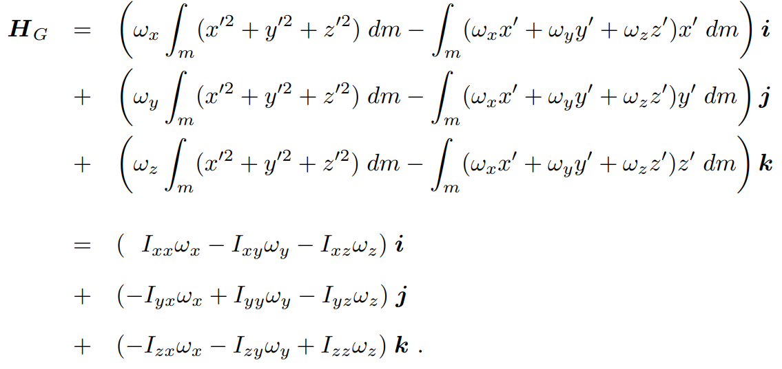
Inertia Tensor – WRT a Coordinate Frame at the CM
In cartesian coordinates, the distance $r_{ }^{′}$ between infinitesimal mass ${dm}_{ }^{ }$ and the center of mass G and the angular velocity vector, $ω$ are defined as
The expression for the the angular momentum $H_{G}$ can be expended to
Instructor: Jacob Rosen
Advanced Robotic - MAE 263 - Department of Mechanical & Aerospace Engineering - UCLA

Slide 26
Inertia Tensor – WRT a Coordinate Frame at the CM
The quantities $I_{xx}$, $I_{yy}$, and $I_{zz}$ are called the mass moments of inertia with respect to the x, y and z axis, respectively, and are given by
We observe that the quantity in the integrand is precisely the square of the distance to the x, y and z axis, respectively.
It is also clear, from their expressions, that the moments of inertia are always positive
$$\left.\begin{aligned}&I_{xx}=\int_{m}^{ }{\left(y^{′2}+z^{′2}\right)dm}=\iiint_{V}{(y^{′2}+z^{′2})}ρdv \\ &I_{yy}=\int_{m}^{ }{\left(x^{′2}+z^{′2}\right)dm}=\iiint_{V}{(x^{2}+z^{′2})}ρd \\ &I_{zz}=\int_{m}^{ }{\left(x^{′2}+y^{′2}\right)dm}=\iiint_{V}{(x^{′2}+y^{′2})}ρd\end{aligned}\right\} \text{Mass} \text{moments} \text{of} \text{inertia}$$
Instructor: Jacob Rosen
Advanced Robotic - MAE 263 - Department of Mechanical & Aerospace Engineering - UCLA

Slide 27
Inertia Tensor – WRT a Coordinate Frame at the CM
The quantities $I_{xy}$, $I_{yx}$, $I_{xz}$, $I_{zx}$, $I_{yz}$, and $I_{zy}$ are called mass products of inertia and they can be positive, negative, or zero, and are given by,
They are a measure of the imbalance in the mass distribution.
$$\left.\begin{aligned}&I_{xy}=I_{yx}=\int_{m}^{ }{\left(x^{′}y^{′}\right)dm}=\iiint_{V}{x^{′}y^{′}}ρd \\ &I_{xz}=I_{zx}=\int_{m}^{ }{\left(x^{′}z^{′}\right)dm}=\iiint_{V}{x^{′}z^{′}}ρd \\ &I_{yz}=I_{zy}=\int_{m}^{ }{\left(y^{′}z^{′}\right)dm}=\iiint_{V}{y^{′}z^{′}}ρd\end{aligned}\right\} \text{Mass} \text{products} \text{of} \text{inertia}$$
Instructor: Jacob Rosen
Advanced Robotic - MAE 263 - Department of Mechanical & Aerospace Engineering - UCLA

Slide 28
Inertia Tensor – WRT a Coordinate Frame at the CM
The angular momentum with respect to the center of mass G can be expressed in a matrix form as
Instructor: Jacob Rosen
Advanced Robotic - MAE 263 - Department of Mechanical & Aerospace Engineering - UCLA

Slide 29
Inertia Tensor – WRT an Arbitrary Coordinate Frame
For a rigid body that is free to move in a 3D space there are infinite possible rotation axes
The intertie tensor characterizes the mass distribution of the rigid body with respect to a specific coordinate system
The intertie Tensor relative to frame {A} is express as a matrix
$${}_{ }^{A}I=\left[\begin{matrix}I_{xx} & −I_{xy} & −I_{xz} \\ −I_{xy} & I_{yy} & −I_{yz} \\ −I_{xz} & −I_{yz} & I_{zz}\end{matrix}\right]$$
Instructor: Jacob Rosen
Advanced Robotic - MAE 263 - Department of Mechanical & Aerospace Engineering - UCLA

Slide 30
Inertia Tensor
$${}_{ }^{A}I=\left[\begin{matrix}I_{xx} & −I_{xy} & −I_{xz} \\ −I_{xy} & I_{yy} & −I_{yz} \\ −I_{xz} & −I_{yz} & I_{zz}\end{matrix}\right]$$
$$\left.\begin{aligned}&I_{xy}=\iiint_{V}{xy}ρd \\ &I_{xz}=\iiint_{V}{xz}ρd \\ &I_{yz}=\iiint_{V}{yz}ρd\end{aligned}\right\} \text{Mass} \text{products} \text{of} \text{inertia}$$
$$\left.\begin{aligned}&I_{xx}=\iiint_{V}{(y^{2}+z^{2})}ρdv \\ &I_{yy}=\iiint_{V}{(x^{2}+z^{2})}ρd \\ &I_{zz}=\iiint_{V}{(x^{2}+y^{2})}ρd\end{aligned}\right\} \text{Mass} \text{moments} \text{of} \text{inertia}$$
Instructor: Jacob Rosen
Advanced Robotic - MAE 263 - Department of Mechanical & Aerospace Engineering - UCLA

Slide 31
Tensor of Inertia – Example
This set of six independent quantities for a given body, depend on the position and orientation of the frame in which they are defined
We are free to choose the orientation of the reference frame. It is possible to cause the product of inertia to be zero
The axes of the reference frame when so aligned are called the principle axes and the corresponding mass moments are called the principle moments of intertie
$${}_{ }^{A}I=\left[\begin{matrix}I_{xx} & −I_{xy} & −I_{xz} \\ −I_{xy} & I_{yy} & −I_{yz} \\ −I_{xz} & −I_{yz} & I_{zz}\end{matrix}\right]$$
$$\left.\begin{aligned}&I_{xy}=0 \\ &I_{xz}=0 \\ &I_{yz}=0\end{aligned}\right\} \text{Mass} \text{products} \text{of} \text{inertia}$$
$${}_{ }^{A}I=\left[\begin{matrix}I_{xx} & 0 & 0 \\ 0 & I_{yy} & 0 \\ 0 & 0 & I_{zz}\end{matrix}\right]$$
Instructor: Jacob Rosen
Advanced Robotic - MAE 263 - Department of Mechanical & Aerospace Engineering - UCLA

Slide 32
Tensor of Inertia – Example
$$x:0→w$$
$$y:0→l$$
$$z:0→h$$
$$I_{xx}=\int_{0}^{h}{\int_{0}^{l}{\int_{0}^{w}{\left(y^{2}+z^{2}\right)}}}ρdxdydz=\int_{0}^{h}{\int_{0}^{l}{\left(y^{2}+z^{2}\right)}}wρdydz$$
$$=\left(\frac{{hl}^{3}w}{3}+\frac{h^{3}lw}{3}\right)ρ=ρhlw\frac{l^{2}}{3}phlw\frac{h^{2}}{3}=\int_{0}^{h}{\left(\frac{l^{3}}{3}+z^{2}l\right)}wρdz=\frac{m}{3}\left(l^{2}+h^{2}\right)$$
$$I_{yy}=\frac{m}{3}\left(w^{2}+h^{2}\right)$$
$$I_{zz}=\frac{m}{3}\left(l^{2}+w^{2}\right)$$
Instructor: Jacob Rosen
Advanced Robotic - MAE 263 - Department of Mechanical & Aerospace Engineering - UCLA

Slide 33
Tensor of Inertia – Example
$$I_{xy}=\int_{0}^{h}{\int_{0}^{l}{\int_{0}^{w}{xy}}}ρdxdydz=\int_{0}^{h}{\int_{0}^{l}{\frac{w^{2}}{2}y}}ρdydz=\int_{0}^{h}{\frac{w^{2}l^{2}}{4}}ρdz=\frac{w^{2}l^{2}h}{4}ρ=\left(wlhρ\right)\frac{wl}{4}=\frac{m}{4}wl$$
$$I_{xz}=\frac{m}{4}hw$$
$$I_{yz}=\frac{m}{4}hl$$
$${}_{ }^{A}I=\left[\begin{matrix}\frac{m}{3}\left(l^{2}+h^{2}\right) & −\frac{m}{4}wl & −\frac{m}{4}hw \\ −\frac{m}{4}wl & \frac{m}{3}\left(w^{2}+h^{2}\right) & −\frac{m}{4}hl \\ −\frac{m}{4}hw & −\frac{m}{4}hl & \frac{m}{3}\left(l^{2}+w^{2}\right)\end{matrix}\right]$$
Instructor: Jacob Rosen
Advanced Robotic - MAE 263 - Department of Mechanical & Aerospace Engineering - UCLA

Slide 34
Tensor of Inertia – Operations
Translations of the Inertia Tensor
Parallel Axis Theorem
Instructor: Jacob Rosen
Advanced Robotic - MAE 263 - Department of Mechanical & Aerospace Engineering - UCLA

Slide 35
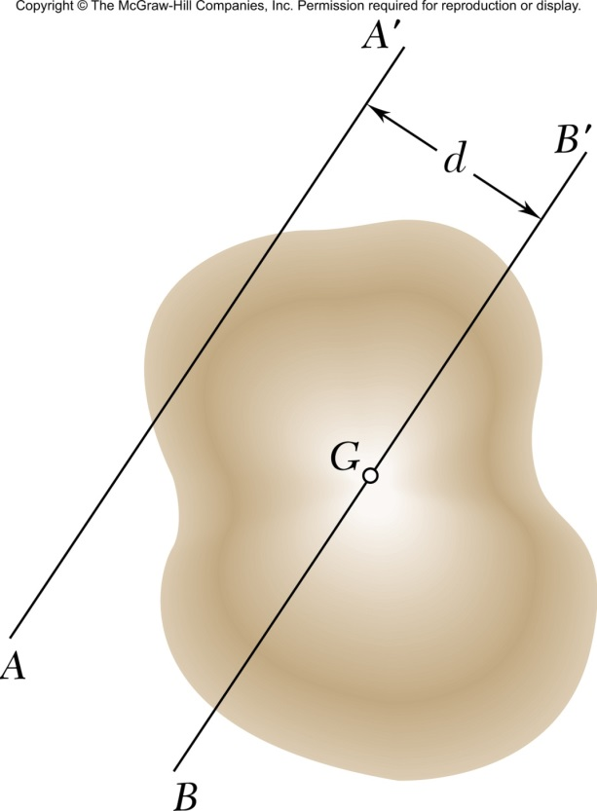
Parallel Axis Theorem – 1D
The inertia tensor is a function of the position and orientation of the reference frame
Parallel Axis Theorem – How the inertia tensor changes under translation of the reference coordinate system
Frame {C} – is located at the CM
Frame {A} – an arbitrarily translated frame
$${{}_{ }^{A}I}_{zz}={{}_{ }^{C}I}_{zz}+md^{2}$$
Instructor: Jacob Rosen
Advanced Robotic - MAE 263 - Department of Mechanical & Aerospace Engineering - UCLA

Slide 36
Parallel Axis Theorem – 3D
$${{}_{ }^{A}I}_{xx}={{}_{ }^{C}I}_{xx}+m\left(z_{c}^{2}+y_{c}^{2}\right)$$
$${{}_{ }^{A}I}_{yy}={{}_{ }^{C}I}_{yy}+m\left(x_{c}^{2}+z_{c}^{2}\right)$$
$${{}_{ }^{A}I}_{zz}={{}_{ }^{C}I}_{zz}+m\left(x_{c}^{2}+y_{c}^{2}\right)$$
$${{}_{ }^{A}I}_{xy}={{}_{ }^{C}I}_{xy}−mx_{c}y_{c}$$
$${{}_{ }^{A}I}_{xz}={{}_{ }^{C}I}_{xz}−mx_{c}z_{c}$$
$${{}_{ }^{A}I}_{yz}={{}_{ }^{C}I}_{yz}−my_{c}z_{c}$$
$P_{c}=\left[\begin{matrix}x_{c} \\ y_{c} \\ z_{c}\end{matrix}\right]$ - Location of the CM (origin of C) relative to frame [A]
Instructor: Jacob Rosen
Advanced Robotic - MAE 263 - Department of Mechanical & Aerospace Engineering - UCLA

Slide 37
Parallel Axis Theorem – 3D
$${}_{ }^{A}I={}_{ }^{C}I+m\left[\left(P∙P\right)I_{3}−P⊗P\right]$$
Outer Product
$$\left[\begin{matrix}1 & 0 & 0 \\ 0 & 1 & 0 \\ 0 & 0 & 1\end{matrix}\right]$$
$$\left[\begin{matrix}P_{x}P_{x} & P_{x}P_{y} & P_{x}P_{z} \\ P_{y}P_{x} & P_{y}P_{y} & P_{y}P_{z} \\ P_{z}P_{x} & P_{z}P_{y} & P_{z}P_{z}\end{matrix}\right]$$
$$\left(x_{c}^{2}+y_{c}^{2}+z_{c}^{2}\right)$$
$$\left[\begin{matrix}x_{c}^{2}+y_{c}^{2}+z_{c}^{2} & 0 & 0 \\ 0 & x_{c}^{2}+y_{c}^{2}+z_{c}^{2} & 0 \\ 0 & 0 & x_{c}^{2}+y_{c}^{2}+z_{c}^{2}\end{matrix}\right]$$
$${}_{ }^{A}I=\left[\begin{matrix}{{}_{ }^{C}I}_{xx}+m\left(y_{c}^{2}+z_{c}^{2}\right) & {{}_{ }^{C}I}_{xy}−mx_{c}y_{c} & {{}_{ }^{C}I}_{xz}−mx_{c}z_{c} \\ {{}_{ }^{C}I}_{xy}−mx_{c}y_{c} & {{}_{ }^{C}I}_{yy}+m\left(x_{c}^{2}+z_{c}^{2}\right) & {{}_{ }^{C}I}_{yz}−my_{c}z_{c} \\ {{}_{ }^{C}I}_{xz}−mx_{c}z_{c} & {{}_{ }^{C}I}_{yz}−my_{c}z_{c} & {{}_{ }^{C}I}_{zz}+m\left(x_{c}^{2}+y_{c}^{2}\right)\end{matrix}\right]$$
Instructor: Jacob Rosen
Advanced Robotic - MAE 263 - Department of Mechanical & Aerospace Engineering - UCLA

Slide 38
Tensor of Inertia – Example
$$P_{c}=\left[\begin{matrix}x_{c} \\ y_{c} \\ z_{c}\end{matrix}\right]=\frac{1}{2}\left[\begin{matrix}w \\ l \\ h\end{matrix}\right]$$
$${{}_{ }^{C}I}_{zz}={{}_{ }^{A}I}_{zz}−m\left(x_{c}^{2}+y_{c}^{2}\right)=\frac{m}{3}\left(l^{2}+w^{2}\right)−\frac{m}{4}\left(w^{2}+l^{2}\right)=\frac{m}{12}\left(w^{2}+l^{2}\right)$$
$${{}_{ }^{C}I}_{xy}={{}_{ }^{A}I}_{xy}+mx_{c}y_{c}=−\frac{mwl}{4}+m\frac{1}{2}w\frac{1}{2}l=0$$
$${}_{ }^{C}I=\frac{m}{12}\left[\begin{matrix}h^{2}+l^{2} & 0 & 0 \\ 0 & w^{2}+h^{2} & 0 \\ 0 & 0 & l^{2}+w^{2}\end{matrix}\right]$$
Instructor: Jacob Rosen
Advanced Robotic - MAE 263 - Department of Mechanical & Aerospace Engineering - UCLA

Slide 39
Tensor of Inertia – Operations
Rotation of the Inertia Tensor
Instructor: Jacob Rosen
Advanced Robotic - MAE 263 - Department of Mechanical & Aerospace Engineering - UCLA

Slide 40
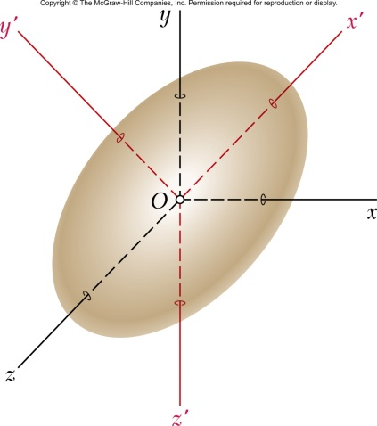
Rotation of the Inertia Tensor
Given:
The inertia tensor of the a body expressed in frame A
Frame B is rotated with respect to frame A
Note: Both frames are stationary in space
Calculate
The inertia tensor of the body expressed in frame B
Instructor: Jacob Rosen
Advanced Robotic - MAE 263 - Department of Mechanical & Aerospace Engineering - UCLA

Slide 41
Rotation of the Inertia Tensor
$${}_{ }^{A}{H={}_{ }^{A}I{}_{ }^{A}ω}$$
$${}_{ }^{B}{H={}_{ }^{B}I{}_{ }^{B}ω}$$
$\left(∗\right){}_{ }^{A}ω,{}_{ }^{A}H$ - angular velocity and momentum expressed in frame A
$\left(∗\right){}_{ }^{B}ω,{}_{ }^{B}H$ - angular velocity and momentum expressed in frame B
$${}_{ }^{A}{H={}_{B}^{A}R{}_{ }^{B}H}$$
$${}_{ }^{A}{ω={}_{B}^{A}R{}_{ }^{B}ω}$$
$${}_{ }^{A}{H={}_{B}^{A}R{}_{ }^{B}I{}_{ }^{B}ω}$$
$${}_{ }^{A}{H={}_{B}^{A}R{}_{ }^{B}I({{}_{B}^{A}R}^{−1}{}_{B}^{A}R){}_{ }^{B}ω}$$
$${}_{ }^{A}{H={}_{B}^{A}R{}_{ }^{B}I{{}_{B}^{A}R}^{−1}{}_{ }^{A}ω}$$
$$I_{A}={}_{B}^{A}R{}_{ }^{B}I{{}_{B}^{A}R}^{−1}={}_{B}^{A}R{}_{ }^{B}I{{}_{B}^{A}R}^{T}$$
Instructor: Jacob Rosen
Advanced Robotic - MAE 263 - Department of Mechanical & Aerospace Engineering - UCLA

Slide 42
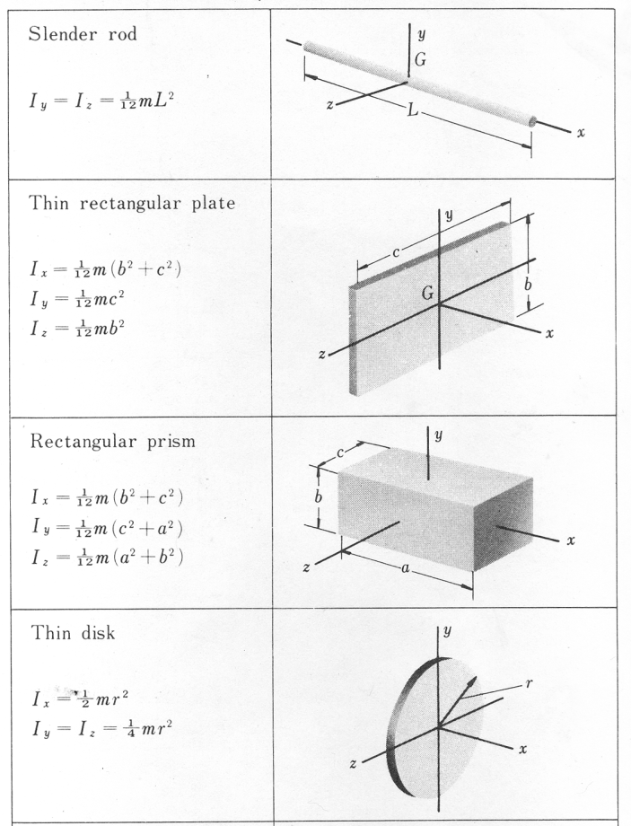
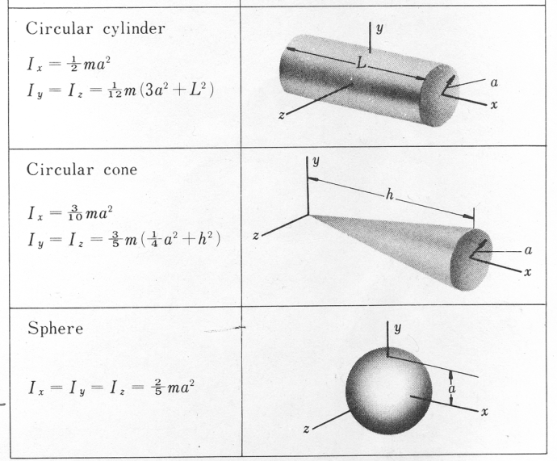
Inertia Tensor 2/
The elements for relatively simple shapes can be solved from the equations describing the shape of the links and their density. However, most robot arms are far from simple shapes and as a result, these terms are simply measured in practice.
Instructor: Jacob Rosen
Advanced Robotic - MAE 263 - Department of Mechanical & Aerospace Engineering - UCLA

Slide 43
Inertia Tensor 2/
Instructor: Jacob Rosen
Advanced Robotic - MAE 263 - Department of Mechanical & Aerospace Engineering - UCLA

Slide 44
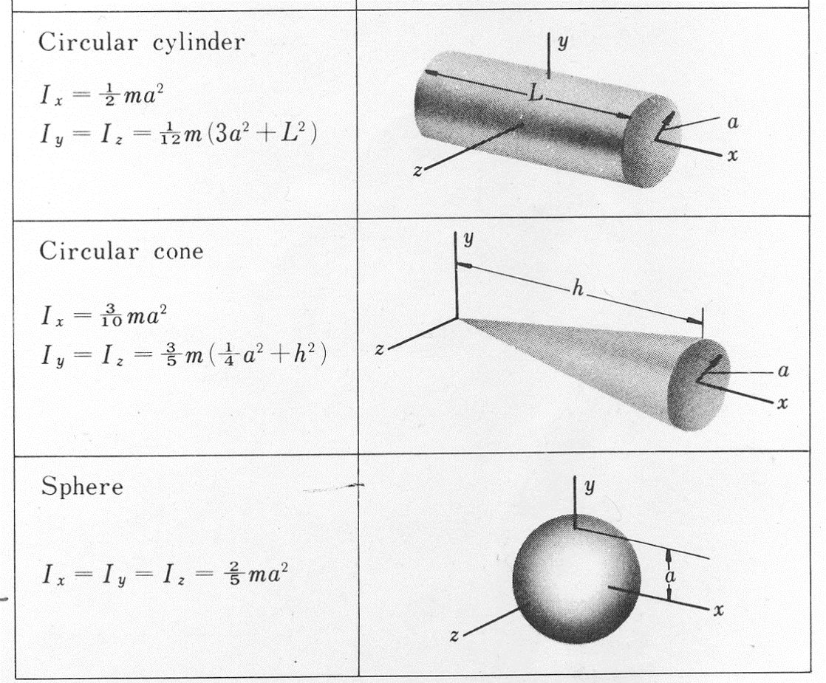
Inertia Tensor 2/
Instructor: Jacob Rosen
Advanced Robotic - MAE 263D - Department of Mechanical & Aerospace Engineering - UCLA

Slide 45
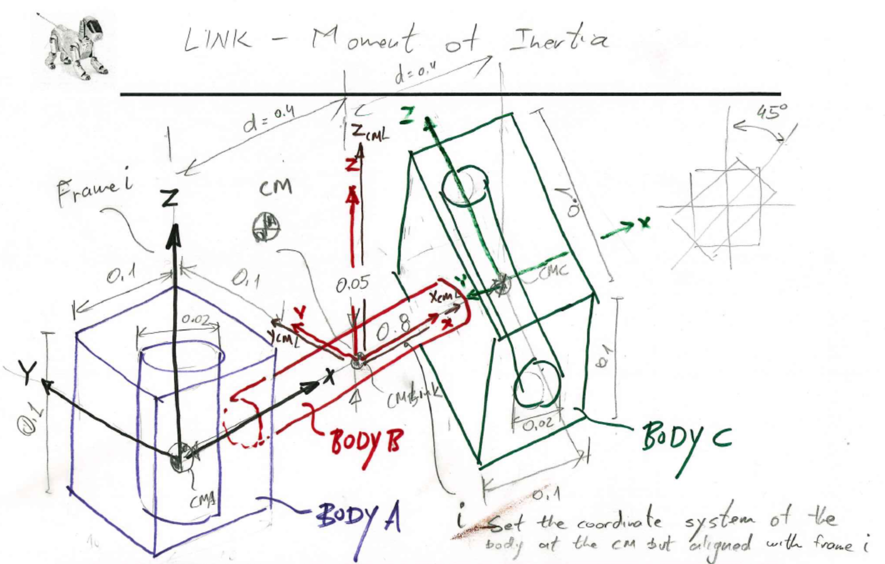
Inertia Tensor – Robotic Links
Instructor: Jacob Rosen
Advanced Robotic - MAE 263 - Department of Mechanical & Aerospace Engineering - UCLA

Slide 46
Inertia Tensor – Robotic Links
$${}_{ }^{CM}I=\frac{m}{12}\left[\begin{matrix}h^{2}+l^{2} & 0 & 0 \\ 0 & w^{2}+h^{2} & 0 \\ 0 & 0 & l^{2}+h^{2}\end{matrix}\right]$$
$${}_{ }^{CM}I=\left[\begin{matrix}\frac{1}{12}m\left(3r^{2}+h^{2}\right) & 0 & 0 \\ 0 & \frac{1}{12}m\left(3r^{2}+h^{2}\right) & 0 \\ 0 & 0 & \frac{mr^{2}}{2}\end{matrix}\right]$$
Instructor: Jacob Rosen
Advanced Robotic - MAE 263 - Department of Mechanical & Aerospace Engineering - UCLA

Slide 47
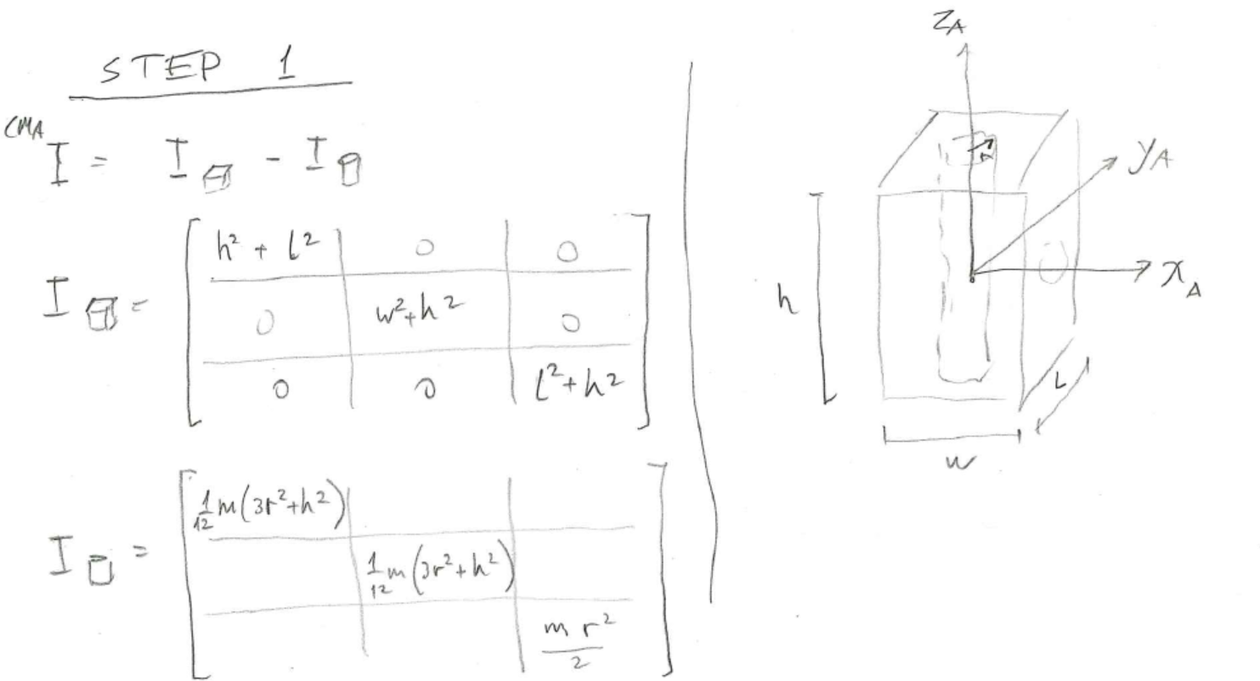
Inertia Tensor – Robotic Links
Body A
$$I_{box}=\frac{m}{12}\left[\begin{matrix}h^{2}+l^{2} & 0 & 0 \\ 0 & w^{2}+h^{2} & 0 \\ 0 & 0 & l^{2}+h^{2}\end{matrix}\right]$$
$$I_{cyl}=\left[\begin{matrix}\frac{1}{12}m\left(3r^{2}+h^{2}\right) & 0 & 0 \\ 0 & \frac{1}{12}m\left(3r^{2}+h^{2}\right) & 0 \\ 0 & 0 & \frac{mr^{2}}{2}\end{matrix}\right]$$
Instructor: Jacob Rosen
Advanced Robotic - MAE 263 - Department of Mechanical & Aerospace Engineering - UCLA

Slide 48
Inertia Tensor – Robotic Links
Body A
STEP 2 – Translate from frame A to the frame at the CoM of the link
$${}_{ }^{CM,link}I={}_{ }^{CM,A}I+m[P_{c}^{T}P_{c}I_{3}−P⊗P]$$
$$={}_{ }^{CM,A}I+m\left[\left[\begin{matrix}−d & 0 & 0\end{matrix}\right]\left[\begin{matrix}−d \\ 0 \\ 0\end{matrix}\right]I_{3}−\left[\begin{matrix}d^{2} & 0 & 0 \\ 0 & 0 & 0 \\ 0 & 0 & 0\end{matrix}\right]\right]$$
Instructor: Jacob Rosen
Advanced Robotic - MAE 263 - Department of Mechanical & Aerospace Engineering - UCLA

Slide 49
Inertia Tensor – Robotic Links
Body B
$${}_{ }^{B}I=\left[\begin{matrix}\frac{mr^{2}}{2} & 0 & 0 \\ 0 & \frac{1}{12}m\left(3r^{2}+h^{2}\right) & 0 \\ 0 & 0 & \frac{1}{12}m\left(3r^{2}+h^{2}\right)\end{matrix}\right]$$
The frame of body B is aligned with the frame of the CM of the entire body
Instructor: Jacob Rosen
Advanced Robotic - MAE 263 - Department of Mechanical & Aerospace Engineering - UCLA

Slide 50
Inertia Tensor – Robotic Links
Body C
STEP 1
$${}_{ }^{C}I=I_{box}−I_{cyl}$$
See body A
Instructor: Jacob Rosen
Advanced Robotic - MAE 263 - Department of Mechanical & Aerospace Engineering - UCLA

Slide 51
Inertia Tensor – Robotic Links
Body C
STEP 2 – Rotate about $x_{c}$ by $−α$
$${}_{CMC}^{CM,link}R=Rot\left({\hat{x}}_{c},−α\right)$$
$${}_{ }^{CM,link}I={}_{CMC}^{CM,link}R{}_{ }^{CMC}I{{}_{CMC}^{CM,link}R}^{T}$$
Instructor: Jacob Rosen
Advanced Robotic - MAE 263 - Department of Mechanical & Aerospace Engineering - UCLA

Slide 52
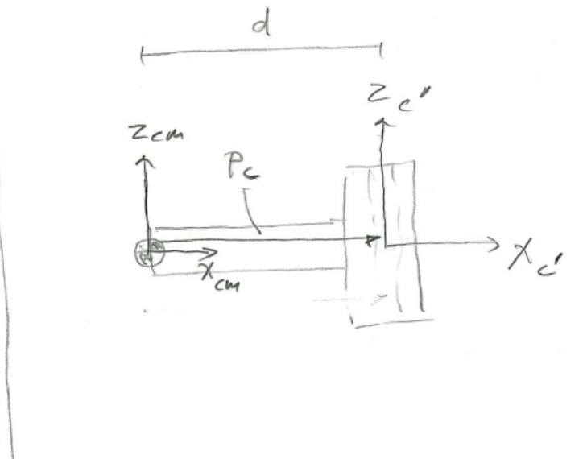
Inertia Tensor – Robotic Links
Body C
STEP 3 – translate to the CM of the link
$$P_{c}=\left[\begin{matrix}d \\ 0 \\ 0\end{matrix}\right]$$
See body A
Instructor: Jacob Rosen
Advanced Robotic - MAE 263 - Department of Mechanical & Aerospace Engineering - UCLA

Slide 53
Summary
Instructor: Jacob Rosen
Advanced Robotic - MAE 263 - Department of Mechanical & Aerospace Engineering - UCLA

Slide 54
Inertia Tensor – WRT a Coordinate Frame at the CM
The angular momentum with respect to the center of mass G can be expressed in a matrix form as
$$\left.\begin{aligned}&I_{xx}=\int_{m}^{ }{\left(y^{′2}+z^{′2}\right)dm}=\iiint_{V}{(y^{′2}+z^{′2})}ρdv \\ &I_{yy}=\int_{m}^{ }{\left(x^{′2}+z^{′2}\right)dm}=\iiint_{V}{(x^{2}+z^{′2})}ρd \\ &I_{zz}=\int_{m}^{ }{\left(x^{′2}+y^{′2}\right)dm}=\iiint_{V}{(x^{′2}+y^{′2})}ρd\end{aligned}\right\}$$
$$\left.\begin{aligned}&I_{xy}=I_{yx}=\int_{m}^{ }{\left(x^{′}y^{′}\right)dm}=\iiint_{V}{x^{′}y^{′}}ρd \\ &I_{xz}=I_{zx}=\int_{m}^{ }{\left(x^{′}z^{′}\right)dm}=\iiint_{V}{x^{′}z^{′}}ρd \\ &I_{yz}=I_{zy}=\int_{m}^{ }{\left(y^{′}z^{′}\right)dm}=\iiint_{V}{y^{′}z^{′}}ρd\end{aligned}\right\}$$
Instructor: Jacob Rosen
Advanced Robotic - MAE 263 - Department of Mechanical & Aerospace Engineering - UCLA

Slide 55
Inertia Tensor
The elements for relatively simple shapes can be solved from the equations describing the shape of the links and their density. However, most robot arms are far from simple shapes and as a result, these terms are simply measured in practice.
Instructor: Jacob Rosen
Advanced Robotic - MAE 263 - Department of Mechanical & Aerospace Engineering - UCLA

Slide 56
Parallel Axis Theorem – 3D
$${{}_{ }^{A}I}_{xx}={{}_{ }^{C}I}_{xx}+m\left(z_{c}^{2}+y_{c}^{2}\right)$$
$${{}_{ }^{A}I}_{yy}={{}_{ }^{C}I}_{yy}+m\left(x_{c}^{2}+z_{c}^{2}\right)$$
$${{}_{ }^{A}I}_{zz}={{}_{ }^{C}I}_{zz}+m\left(x_{c}^{2}+y_{c}^{2}\right)$$
$${{}_{ }^{A}I}_{xy}={{}_{ }^{C}I}_{xy}−mx_{c}y_{c}$$
$${{}_{ }^{A}I}_{xz}={{}_{ }^{C}I}_{xz}−mx_{c}z_{c}$$
$${{}_{ }^{A}I}_{yz}={{}_{ }^{C}I}_{yz}−my_{c}z_{c}$$
$P_{c}=\left[\begin{matrix}x_{c} \\ y_{c} \\ z_{c}\end{matrix}\right]$ - Location of the CM (origin of C) relative to frame [A]
Instructor: Jacob Rosen
Advanced Robotic - MAE 263 - Department of Mechanical & Aerospace Engineering - UCLA

Slide 57
Rotation of the Inertia Tensor
$$I_{A}={}_{B}^{A}R{}_{ }^{B}I{{}_{B}^{A}R}^{T}$$
Instructor: Jacob Rosen
Advanced Robotic - MAE 263 - Department of Mechanical & Aerospace Engineering - UCLA

