Slide 1

Manipulator Dynamics 1
Instructor: Jacob Rosen
Advanced Robotic - MAE 263B - Department of Mechanical & Aerospace Engineering - UCLA

Slide 2
Introduction
Forward / Inverse Dynamics
Instructor: Jacob Rosen
Advanced Robotic - MAE 263B - Department of Mechanical & Aerospace Engineering - UCLA

Slide 3
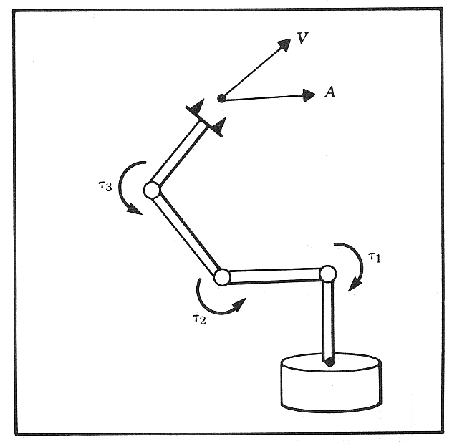



Forward Dynamics
Problem
Given: Joint torques and links
geometry, mass, inertia,
friction, joint torques
Compute: Angular acceleration of the
links (solve differential
equations)
Solution
solve a set of differential equations
Dynamic Equations –
  Newton-Euler method
  Lagrangian Dynamics
$$\left\{\begin{aligned}&τ_{i} \\ &Link_{i}(x,y,z) \\ &m_{i} \\ &I_{i} \\ &P_{Ci} \\ &f_{i} \\ &n_{i}\end{aligned}\right.$$
$$\left\{\begin{aligned}&Θ \\ &\dot{Θ} \\ &\ddot{Θ}\end{aligned}\right.$$
$$τ=M(Θ)\ddot{Θ}+V(Θ,\dot{Θ})+G(Θ)+F(Θ,\dot{Θ})$$
Instructor: Jacob Rosen
Advanced Robotic - MAE 263B - Department of Mechanical & Aerospace Engineering - UCLA

Slide 4



Inverse Dynamics
Problem
Given: Angular acceleration, velocity and
angels of the links in addition to
the links geometry, mass, inertia,
friction
Compute: Joint torques
Solution
Solve a set of algebraic equations
Dynamic Equations –
  Newton-Euler method
  Lagrangian Dynamics
$$\left\{\begin{aligned}&Θ \\ &\dot{Θ} \\ &\ddot{Θ} \\ &Link_{i}(x,y,z) \\ &m_{i} \\ &I_{i} \\ &P_{Ci} \\ &f_{i} \\ &n_{i}\end{aligned}\right.$$
$$\left\{τ\right.$$
$$τ=M(Θ)\ddot{Θ}+V(Θ,\dot{Θ})+G(Θ)+F(Θ,\dot{Θ})$$
Instructor: Jacob Rosen
Advanced Robotic - MAE 263B - Department of Mechanical & Aerospace Engineering - UCLA

Slide 5
Applications
Human Arm Dynamics – Exoskeleton Design
Control
Instructor: Jacob Rosen
Advanced Robotic - MAE 263B - Department of Mechanical & Aerospace Engineering - UCLA

Slide 6
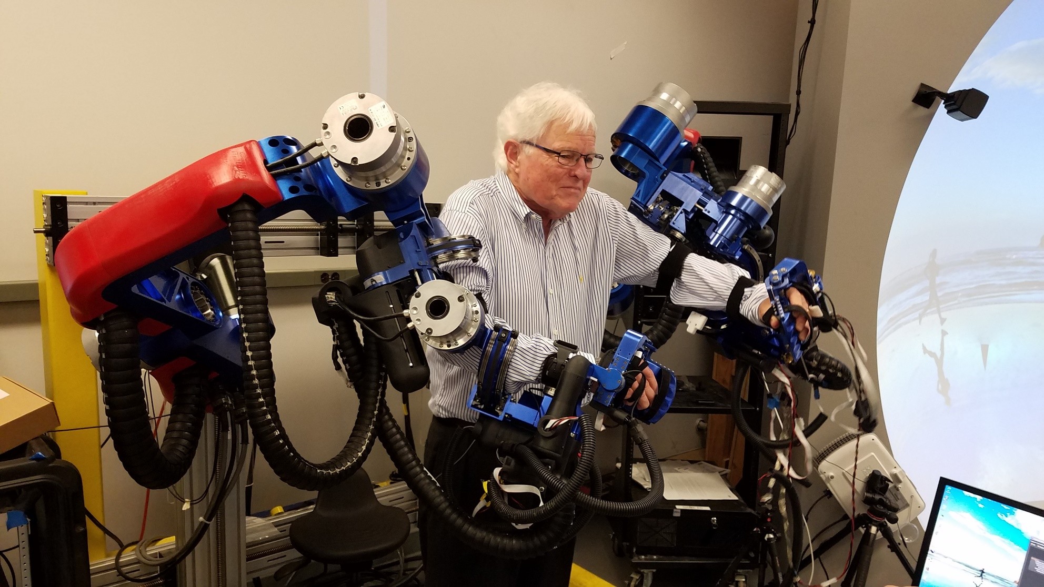
Dynamics Modeling Application – Motivation
Exoskeleton Design
Instructor: Jacob Rosen
Advanced Robotic - MAE 263B - Department of Mechanical & Aerospace Engineering - UCLA

Slide 7
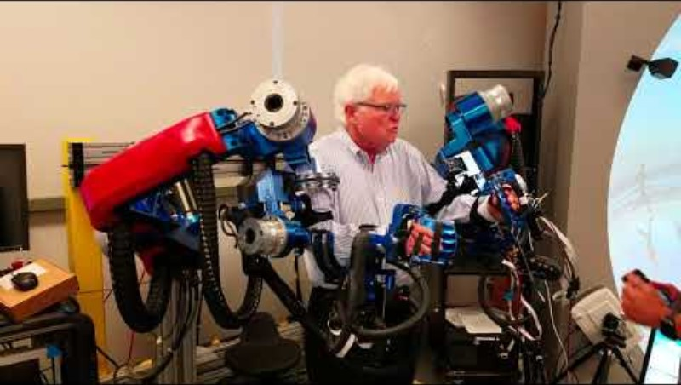

Slide 8
Dynamics Modeling Application – Motivation
Exoskeleton Design
Activities of Daily Living
    1. Arm in lap
    2. Arm reach to head level
    3. Arm reach to right, head level
    4. Arm reach to left, head level
    5. Arm reach right, move object to left side
    6. Open door
    7. Open Drawer/Close Drawer
    8. Move object at waist level
    9. Pick up phone on table/hang up
    10. Pick up phone on wall/hang up
    11. Eat with fork
    12. Eat with spoon
    13. Eat with hands
14. Drink with cup
15. Eat with spoon
16. Pour from bottle
17. Brush teeth
18. Comb hair
19. Wash face
20. Wash neck
21. Shave
22. Eat with fork (power – disabled grasp)
23. Eat with spoon (power – disabled grasp)
24. Full workspace motion
[ CP19] Rosen Jacob, Joel C. Perry, Nathan Manning, Stephen Burns, Blake Hannaford,
The Human Arm Kinematics and Dynamics During Daily Activities – Toward a 7 DOF Upper Limb Powered Exoskeleton, -
ICAR 2005 – Seattle WA, July 2005
Instructor: Jacob Rosen
Advanced Robotic - MAE 263B - Department of Mechanical & Aerospace Engineering - UCLA

Slide 9
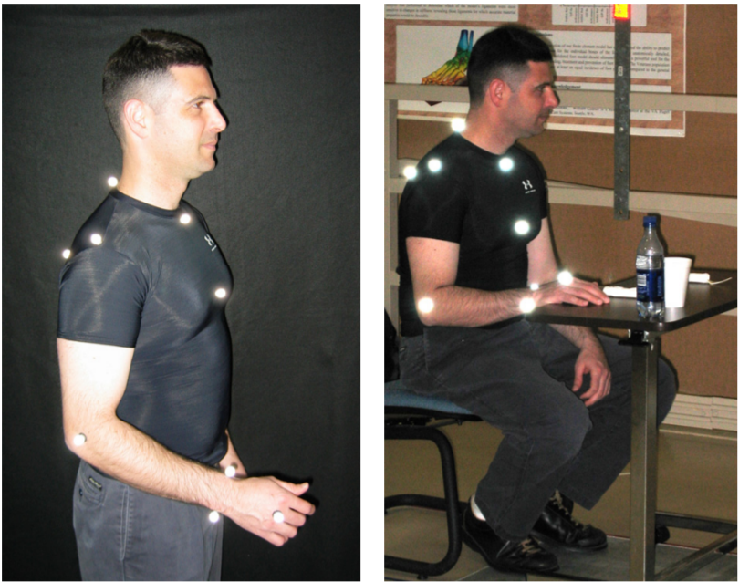
Dynamics Modeling Application – Motivation
Exoskeleton Design
[ CP19] Rosen Jacob, Joel C. Perry, Nathan Manning, Stephen Burns, Blake Hannaford,
The Human Arm Kinematics and Dynamics During Daily Activities – Toward a 7 DOF Upper Limb Powered Exoskeleton, -
ICAR 2005 – Seattle WA, July 2005
Instructor: Jacob Rosen
Advanced Robotic - MAE 263B - Department of Mechanical & Aerospace Engineering - UCLA

Slide 10
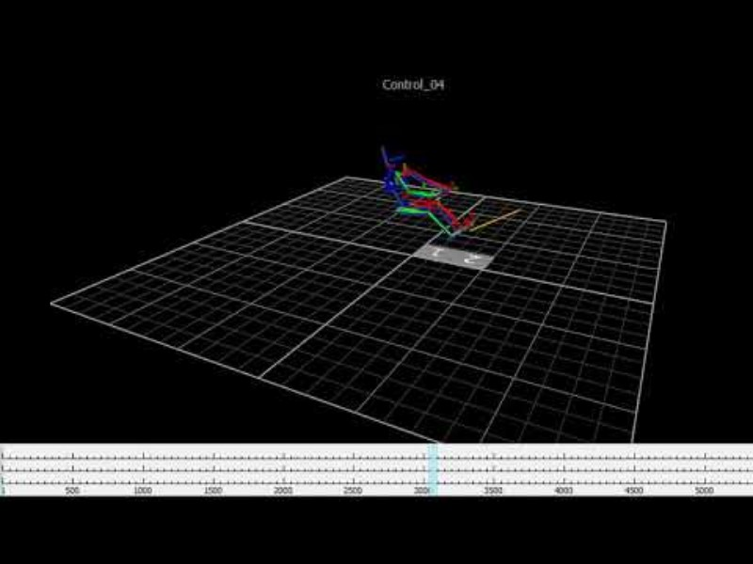

Slide 11


Slide 12
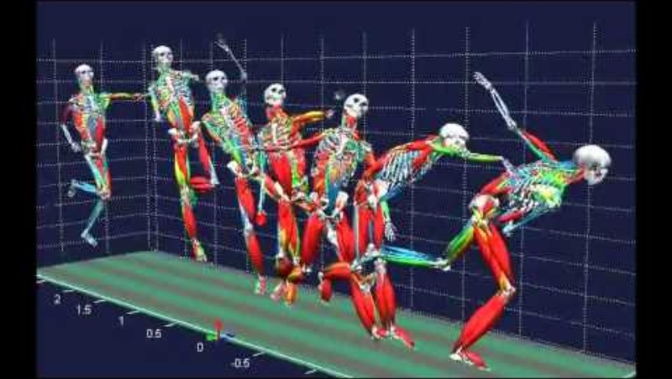

Slide 13
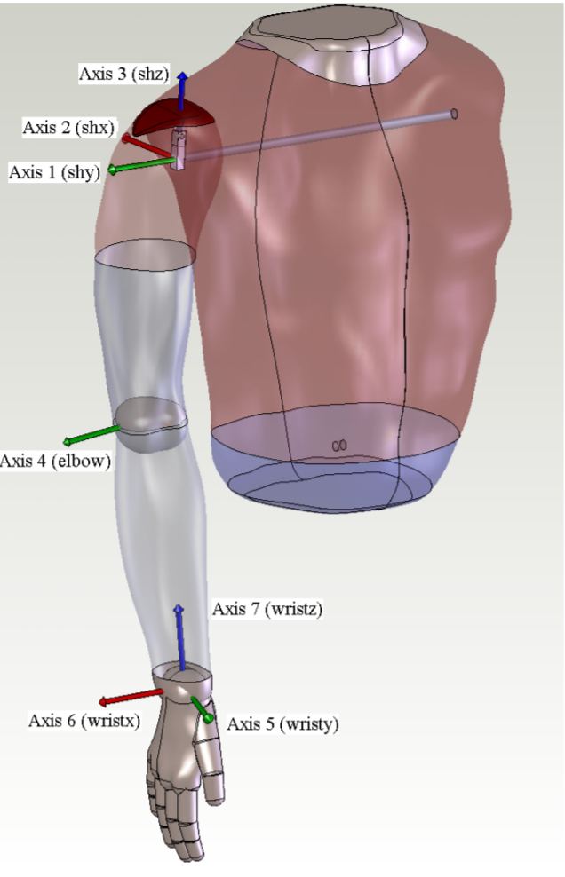
Dynamics Modeling Application – Motivation
Exoskeleton Design
[ CP19] Rosen Jacob, Joel C. Perry, Nathan Manning, Stephen Burns, Blake Hannaford,
The Human Arm Kinematics and Dynamics During Daily Activities – Toward a 7 DOF Upper Limb Powered Exoskeleton, -
ICAR 2005 – Seattle WA, July 2005
Instructor: Jacob Rosen
Advanced Robotic - MAE 263B - Department of Mechanical & Aerospace Engineering - UCLA

Slide 14
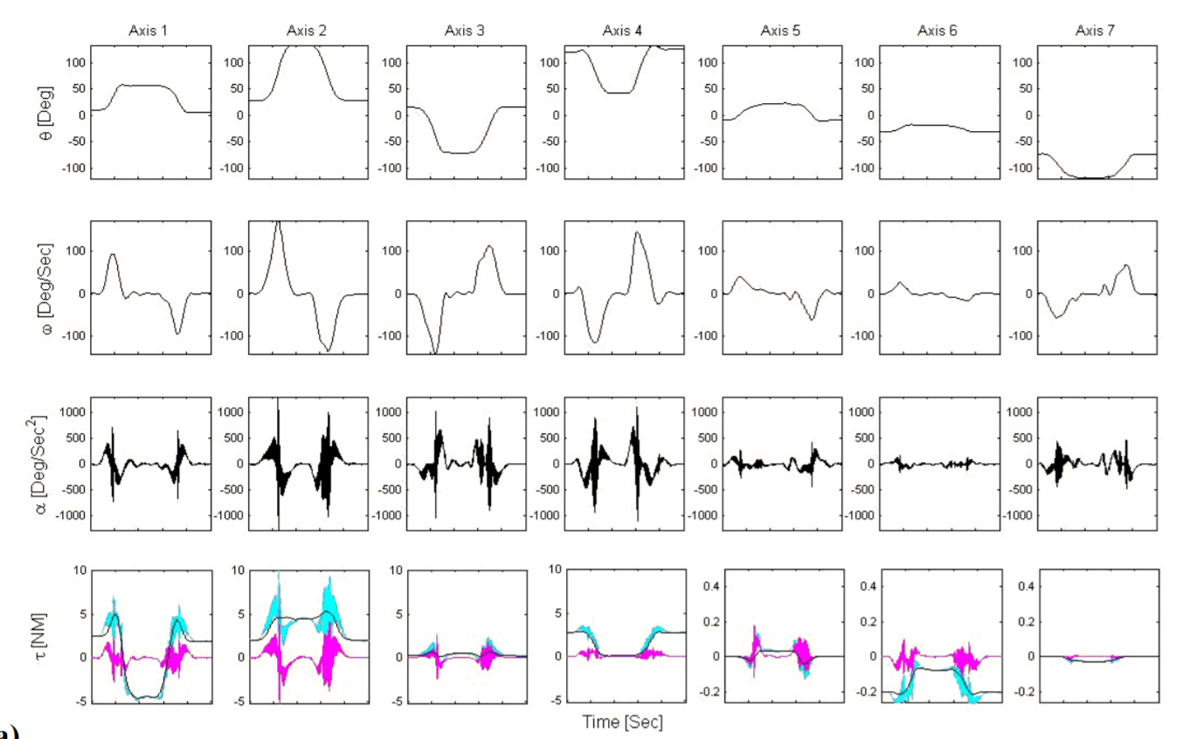
Dynamics Modeling Application – Motivation
Exoskeleton Design
Time histories and statistics of the kinematics and
dynamics of the human arm during an arm reach to
head level (action 2): (a) Time histories of the joint
kinematics and dynamics (b) Statistical distribution
of the joint kinematics and dynamics. The three
torque curves in (a) illustrate the total joint axis
torque (cyan), in comparison to the gravitational
torque (black) and the combined torque due to
inertial, centrifugal, and coriolis terms (magenta).
The line box plots of (b) indicate the lower quartile,
median, and upper quartile values. The dashed
lines extend beyond the upper and lower quartiles
by one and a half times the interquartile range.
Data that lies outside of this range is displayed
with the symbol ‘x’.
[ CP19] Rosen Jacob, Joel C. Perry, Nathan Manning, Stephen Burns, Blake Hannaford,
The Human Arm Kinematics and Dynamics During Daily Activities – Toward a 7 DOF Upper Limb Powered Exoskeleton, -
ICAR 2005 – Seattle WA, July 2005
Instructor: Jacob Rosen
Advanced Robotic - MAE 263B - Department of Mechanical & Aerospace Engineering - UCLA

Slide 15
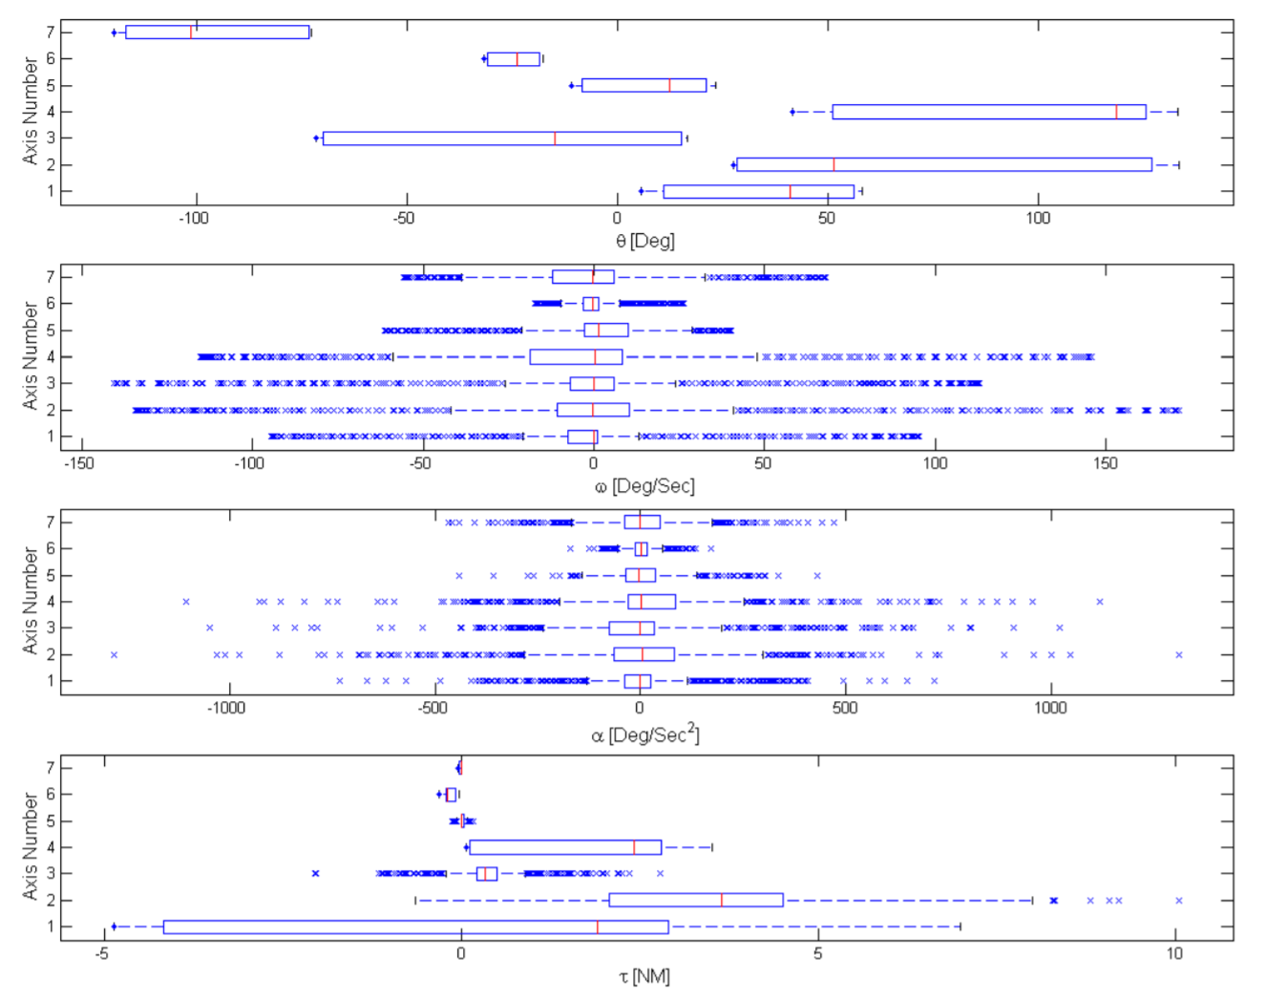
Dynamics Modeling Application – Motivation
Exoskeleton Design
Time histories and statistics of the kinematics and
dynamics of the human arm during an arm reach to
head level (action 2): (a) Time histories of the joint
kinematics and dynamics (b) Statistical distribution
of the joint kinematics and dynamics. The three
torque curves in (a) illustrate the total joint axis
torque (cyan), in comparison to the gravitational
torque (black) and the combined torque due to
inertial, centrifugal, and coriolis terms (magenta).
The line box plots of (b) indicate the lower quartile,
median, and upper quartile values. The dashed
lines extend beyond the upper and lower quartiles
by one and a half times the interquartile range.
Data that lies outside of this range is displayed
with the symbol ‘x’.
[ CP19] Rosen Jacob, Joel C. Perry, Nathan Manning, Stephen Burns, Blake Hannaford,
The Human Arm Kinematics and Dynamics During Daily Activities – Toward a 7 DOF Upper Limb Powered Exoskeleton, -
ICAR 2005 – Seattle WA, July 2005
Instructor: Jacob Rosen
Advanced Robotic - MAE 263B - Department of Mechanical & Aerospace Engineering - UCLA

Slide 16
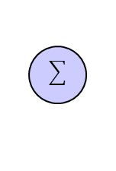
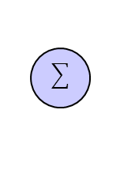
Dynamics Model Application – Motivation
Position Control
Friction
Model
Feedforward
System
Model
External
Forces
Torque
Trajectory
Planning
Trajectory
Generation
K
Controller
D
Driver
E-M-G
Actuator
G
Plant (Robot)
Instructor: Jacob Rosen
Advanced Robotic - MAE 263B - Department of Mechanical & Aerospace Engineering - UCLA

Slide 17
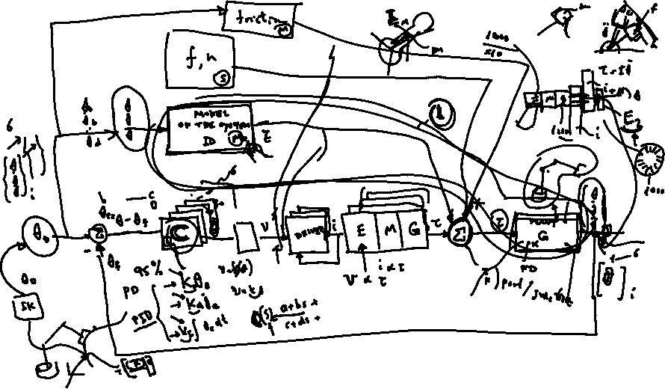
Dynamics Model Application – Motivation
Position Control
Instructor: Jacob Rosen
Advanced Robotic - MAE 263B - Department of Mechanical & Aerospace Engineering - UCLA

Slide 18
Manipulator Dynamics – Newton Euler Equations
Instructor: Jacob Rosen
Advanced Robotic - MAE 263B - Department of Mechanical & Aerospace Engineering - UCLA

Slide 19
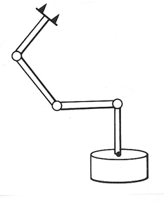

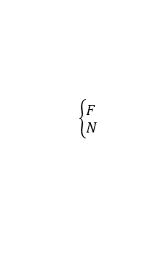




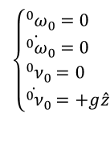




Iterative Newton Euler Equations
Steps of the Algorithm
$(i = 0→n−1$)
(1) Outward Iterations
  Starting With velocities and accelerations of the base
  Calculate velocities accelerations, along with forces and torques (at the CM)
(2) Inward Iteration
  Starting with forces and torques (at the CM)
  Calculate forces and torques at the joints
$$(i=0→n−1)$$
$$\left\{\begin{aligned}&ω \\ &\dot{ω} \\ &\dot{ν} \\ &{\dot{ν}}_{CM} \\ &F \\ &N\end{aligned}\right.$$
$${{}_{ }^{0}ω}_{0}=0, {\dot{{}_{ }^{0}ω}}_{0}=0, {{}_{ }^{0}ν}_{0}=0, {\dot{{}_{ }^{0}ν}}_{0}=+g\hat{z}$$
$$\left\{\begin{aligned}&{{}_{ }^{0}ω}_{0}=0 \\ &{\dot{{}_{ }^{0}ω}}_{0}=0 \\ &{{}_{ }^{0}ν}_{0}=0 \\ &{\dot{{}_{ }^{0}ν}}_{0}=+g\hat{z}\end{aligned}\right.$$
$$ω,\dot{ω},\dot{ν},{\dot{ν}}_{CM},F,N$$
$$(i=n→1)$$
$$(i=n→1)$$
$$\left\{\begin{aligned}&F \\ &N\end{aligned}\right.$$
$$F,N$$
$$f,n$$
Instructor: Jacob Rosen
Advanced Robotic - MAE 263B - Department of Mechanical & Aerospace Engineering - UCLA

Slide 20



Iterative Newton-Euler Equations - Solution Procedure
Phase 1: Outward Iteration
Calculate the link velocities and accelerations iteratively from the robot’s base to the end effector
Calculate the force and torques applied on the CM of each link using the Newton and Euler equations
$$\text{Outward} \text{Iteration}\text{: }i : 0→5$$
$${{}_{ }^{i+1}ω}_{i+1}={}_{i}^{i+1}R{{}_{ }^{i}ω}_{i}+{\dot{θ}}_{i+1}{{}_{ }^{i+1}{\hat{Z}}}_{i+1}$$
$${{}_{ }^{i+1}{\dot{ω}}}_{i+1}={}_{i}^{i+1}R{{}_{ }^{i}{\dot{ω}}}_{i}+{}_{i}^{i+1}R{{}_{ }^{i}ω}_{i}×{\dot{θ}}_{i+1}{{}_{ }^{i+1}{\hat{Z}}}_{i+1}+{\ddot{θ}}_{i+1}{{}_{ }^{i+1}{\hat{Z}}}_{i+1}$$
$${{}_{ }^{i+1}{\dot{v}}}_{i+1}={}_{i}^{i+1}R({\dot{{}_{ }^{i}ω}}_{i} × {{}_{ }^{i}P}_{i+1}+{{}_{ }^{i}ω}_{i} × ({{}_{ }^{i}ω}_{i} × {{}_{ }^{i}P}_{i+1})+{{}_{ }^{i}{\dot{v}}}_{i})$$
$${{{}_{ }^{i+1}{\dot{v}}}_{C}}_{i+1}={{}_{ }^{i+1}{\dot{ω}}}_{i+1}× {{{}_{ }^{i+1}P}_{C}}_{i+1}+{{}_{ }^{i+1}ω}_{i+1}× ({{}_{ }^{i+1}ω}_{i+1}×{{{}_{ }^{i+1}P}_{C}}_{i+1}) + {{}_{ }^{i+1}{\dot{v}}}_{i+1}$$
$${{}_{ }^{i+1}F}_{i+1}=m_{i+1}{{{}_{ }^{i+1}{\dot{v}}}_{C}}_{i+1}$$
Instructor: Jacob Rosen
Advanced Robotic - MAE 263B - Department of Mechanical & Aerospace Engineering - UCLA

Slide 21



Iterative Newton-Euler Equations - Solution Procedure
Phase 2: Inward Iteration
Use the forces and torques generated at the joints starting with forces and torques generating by interacting with the environment (that is, tools, work stations, parts etc.) at the end effector all the way the robot’s base.
$$\text{Inward} \text{Iteration}\text{: }i : 6→1$$
$${{}_{ }^{i}f}_{i}={}_{i+1}^{i}R{{}_{ }^{i+1}f}_{i+1}+{{}_{ }^{i}F}_{i}$$
$${{}_{ }^{i}n}_{i}={{}_{ }^{i}N}_{i}+{}_{i+1}^{i}R{{}_{ }^{i+1}n}_{i+1}+{{{}_{ }^{i}P}_{C}}_{i}×{{}_{ }^{i}F}_{i}+{{}_{ }^{i}P}_{i+1} ×{}_{i+1}^{i}R {{}_{ }^{i+1}f}_{i+1}$$
$$τ_{i}={{{}_{ }^{i+1}n}^{T}}_{i+1} {\hat{{}_{ }^{i}Z}}_{i}$$
Instructor: Jacob Rosen
Advanced Robotic - MAE 263B - Department of Mechanical & Aerospace Engineering - UCLA

Slide 22



Dynamics - Newton-Euler Equations
To solve the Newton and Euler equations, we’ll need to develop mathematical terms for:
  ${\dot{v}}_{c}$ - The linear acceleration of the center of mass
  $\dot{ω}$ - The angular acceleration
  ${}_{ }^{c}I$ - The Inertia tensor (moment of inertia)
$F$ - The sum of all the forces applied on the center of mass
$N$ - The sum of all the moments applied on the center of mass
$$F=m{\dot{v}}_{c}$$
$$N={}_{ }^{c}I\dot{ω}+ω×{}_{ }^{c}Iω$$
Instructor: Jacob Rosen
Advanced Robotic - MAE 263B - Department of Mechanical & Aerospace Engineering - UCLA

Slide 23
Newton Euler Equations
Derivation Based on Momentum
Instructor: Jacob Rosen
Advanced Robotic - MAE 263B - Department of Mechanical & Aerospace Engineering - UCLA

Slide 24
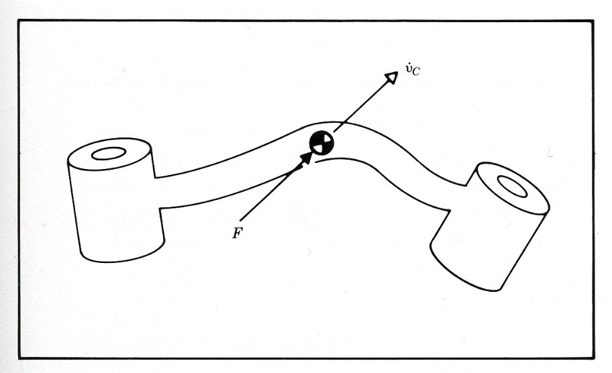
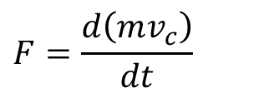

Dynamics - Newton-Euler Equations
Newton Equation
For a rigid body (like a robot link) whose center of mass is experiencing an acceleration, the force acting at the center of mass that caused the acceleration is given by Newton’s equation
For our robot manipulators, whose link masses are constant, this equation simplifies to
$$F=\frac{d\left(mv_{c}\right)}{dt}$$
$$F=m{\dot{v}}_{C}=ma_{C}$$
Instructor: Jacob Rosen
Advanced Robotic - MAE 263B - Department of Mechanical & Aerospace Engineering - UCLA

Slide 25
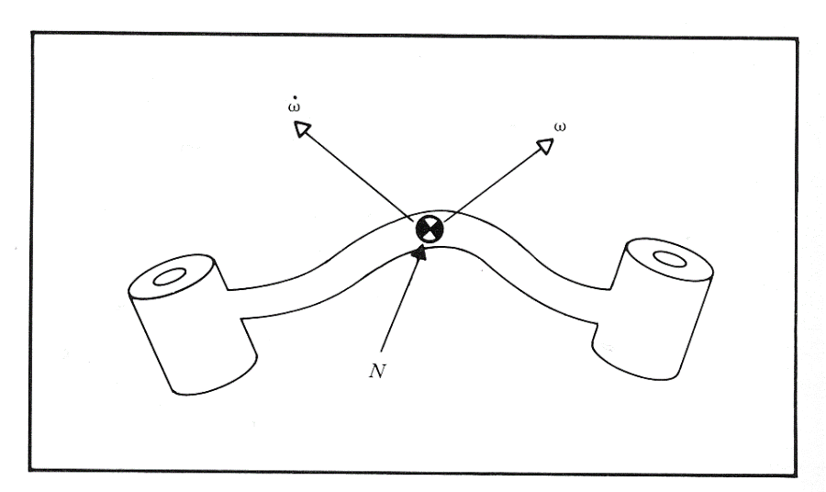


Dynamics - Newton-Euler Equations
Eular Equation
For a rotating rigid body, the moment that causes an angular acceleration is given by Euler’s equation
For our robot manipulators, whose link moment of inertia is constant, this equation simplifies to
The second term on the right will be non-zero when the link’s angular velocity vector is not coincident with the link’s principle axis of inertia.
$$N=\frac{d\left({}_{ }^{c}Iω\right)}{dt}$$
$$N={}_{ }^{c}I\dot{ω}+ω×{}_{ }^{c}Iω$$
Instructor: Jacob Rosen
Advanced Robotic - MAE 263B - Department of Mechanical & Aerospace Engineering - UCLA

Slide 26


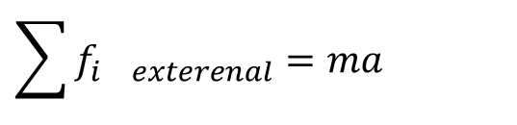
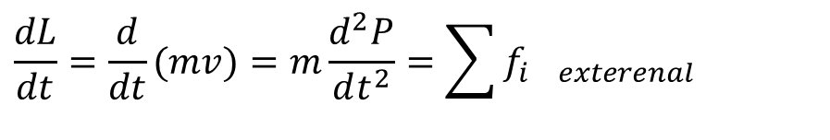

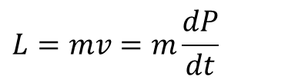
Linear Momentum – Particle
The liner momentum of a particle is defined as the mass of the particle times its linear velocity or the time derivative of its position
The time derivative of the linear momentum is equal to the sum of all the external forces applied on the particle
It is than van be summarized as Newton’s second law
$$L=mv=m\frac{dP}{dt}$$
$$\frac{dL}{dt}=\frac{d}{dt}(mv)=m\frac{d^{2}P}{dt^{2}}=\sum{f_{i exterenal}}$$
$$\sum{f_{i exterenal}=ma}$$
Instructor: Jacob Rosen
Advanced Robotic - MAE 263B - Department of Mechanical & Aerospace Engineering - UCLA

Slide 27
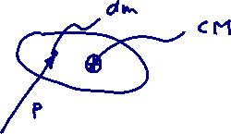

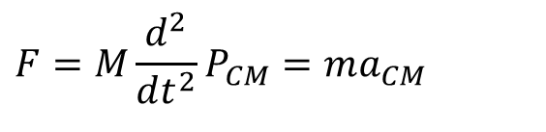

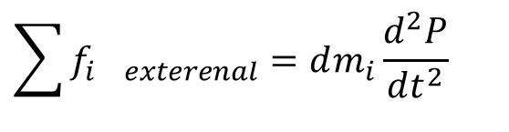
Linear Momentum – Rigid Body
In a similar fashion a rigid body can be view as an assembly of particles
Integrate over the entire volume of the rigid body is resulted in
$$\sum_{ }{f_{i exterenal}}=dm_{i}\frac{d^{2}P}{dt^{2}}$$
$$F=M\frac{d^{2}}{dt^{2}}\underset{P_{CM}}{\underbrace{\int_{V}{\frac{Pdm}{M}}}}$$
$$F=M\frac{d^{2}}{dt^{2}}P_{CM}=ma_{CM}$$
Instructor: Jacob Rosen
Advanced Robotic - MAE 263B - Department of Mechanical & Aerospace Engineering - UCLA

Slide 28
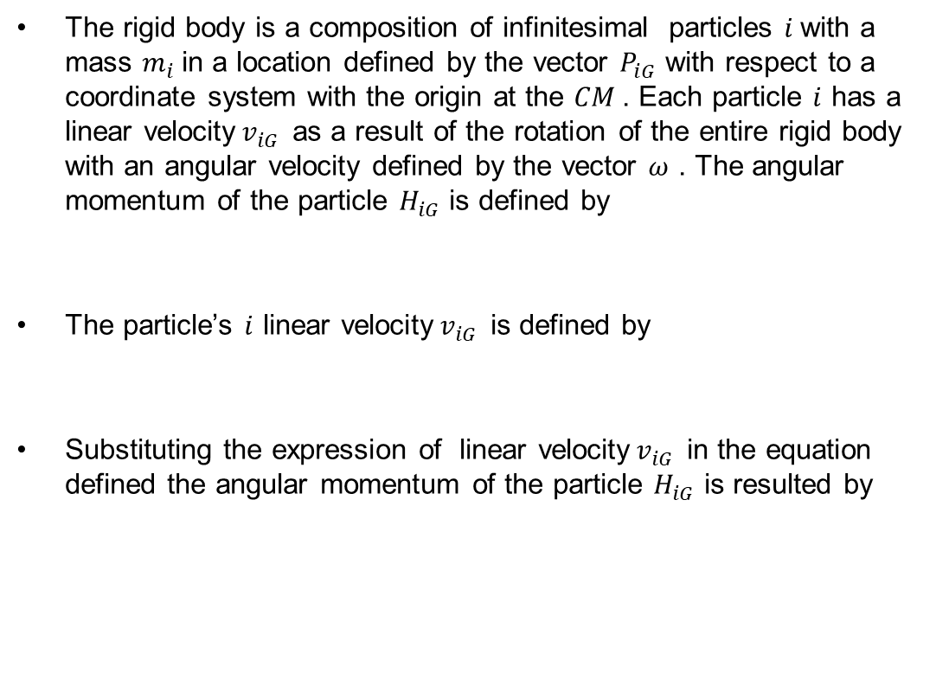



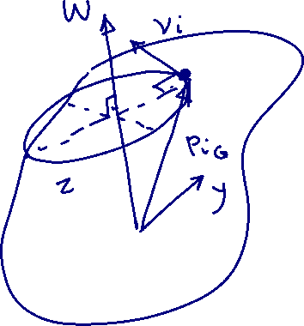

Angular Momentum – Particle
The rigid body is a composition of infinitesimal particles $i$with a mass $m_{i}$in a location defined by the vector $P_{iG}$ with respect to a coordinate system with the origin at the $CM$. Each particle $i$ has a linear velocity$v_{iG}$ as a result of the rotation of the entire rigid body with an angular velocity defined by the vector $ω$ . The angular momentum of the particle $H_{iG}$ is defined by
The particle’s $i$ linear velocity$v_{iG}$ is defined by
Substituting the expression of linear velocity$v_{iG}$ in the equation defined the angular momentum of the particle $H_{iG}$ is resulted by
$${\vec{H}}_{i_{G}}={\vec{P}}_{i_{G}}×m_{i}{\vec{v}}_{i_{G}}$$
$${\vec{v}}_{i_{G}}=\vec{ω}×{\vec{P}}_{i_{G}}$$
$${\vec{H}}_{i_{G}}={\vec{P}}_{i_{G}}×m_{i}\left(\vec{ω}×{\vec{P}}_{i_{G}}\right)=m_{i}{\vec{P}}_{i_{G}}×\left(\vec{ω}×{\vec{P}}_{i_{G}}\right)$$
Instructor: Jacob Rosen
Advanced Robotic - MAE 263B - Department of Mechanical & Aerospace Engineering - UCLA

Slide 29

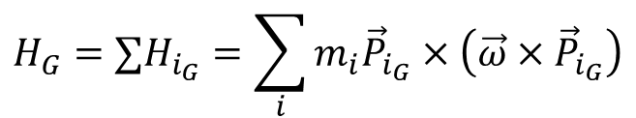



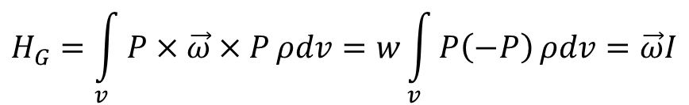

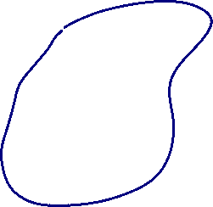



Angular Momentum – Rigid Body
$$H_{G}=∑H_{i_{G}}=\sum_{i}{m_{i}{\vec{P}}_{i_{G}}×\left(\vec{ω}×{\vec{P}}_{i_{G}}\right)}$$
$$m_{i}=ρdv$$
$$H_{G}=\int_{v}^{ }{P×\vec{ω}×P}ρdv=w\int_{v}^{ }{P\left(−P\right)}ρdv=\vec{ω}I$$
Instructor: Jacob Rosen
Advanced Robotic - MAE 263B - Department of Mechanical & Aerospace Engineering - UCLA

Slide 30


Angular Momentum – Rigid Body
$$∑τ=\frac{d}{dt}H_{G}=\frac{d}{dt}Iω$$
$$∑τ=I\dot{ω}+ω×Iω$$
Instructor: Jacob Rosen
Advanced Robotic - MAE 263B - Department of Mechanical & Aerospace Engineering - UCLA

Slide 31
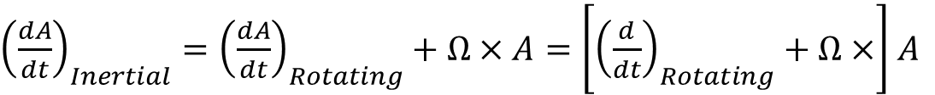
Transport Theorem –
Differentiation of a Vector in a Rotating Frame of Reference
The transport theorem is a vector equation that relates the time derivative of a Euclidean vector as evaluated in a non-rotating (inertial) coordinate system to its time derivative in a rotating frame.
Additional names
  transport equation,
  rate of change transport theorem
  basic kinematic equation
  Bour's formula, (Edmond Bour)
${\left(\frac{dA}{dt}\right)}_{Inertial}^{ }={\left(\frac{dA}{dt}\right)}_{Rotating}^{ }+Ω×A=\left[{\left(\frac{d}{dt}\right)}_{Rotating}^{ }+Ω×\right]$ $A$
Instructor: Jacob Rosen
Advanced Robotic - MAE 263B - Department of Mechanical & Aerospace Engineering - UCLA

Slide 32
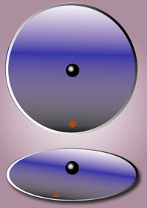
Transport Theorem –
Differentiation of a Vector in a Rotating Frame of Reference
A Euclidean vector represents a certain magnitude and direction in space that is independent of the coordinate system in which it is measured.
When taking a time derivative of such a vector one actually takes the difference between two vectors measured at two different times t and t+dt.
In a rotating coordinate system, the coordinate axes can have different directions at these two times, such that even a constant vector can have a non-zero time derivative.
As a consequence, the time derivative of a vector measured in a rotating coordinate system can be different from the time derivative of the same vector in a non-rotating reference system.
Instructor: Jacob Rosen
Advanced Robotic - MAE 263B - Department of Mechanical & Aerospace Engineering - UCLA

Slide 33

Transport Theorem –
Differentiation of a Vector in a Rotating Frame of Reference
The velocity vector of an airplane as evaluated using a coordinate system that is fixed to the earth (a rotating reference system) is different from its velocity as evaluated using a coordinate system that is fixed in space.
Instructor: Jacob Rosen
Advanced Robotic - MAE 263B - Department of Mechanical & Aerospace Engineering - UCLA

Slide 34
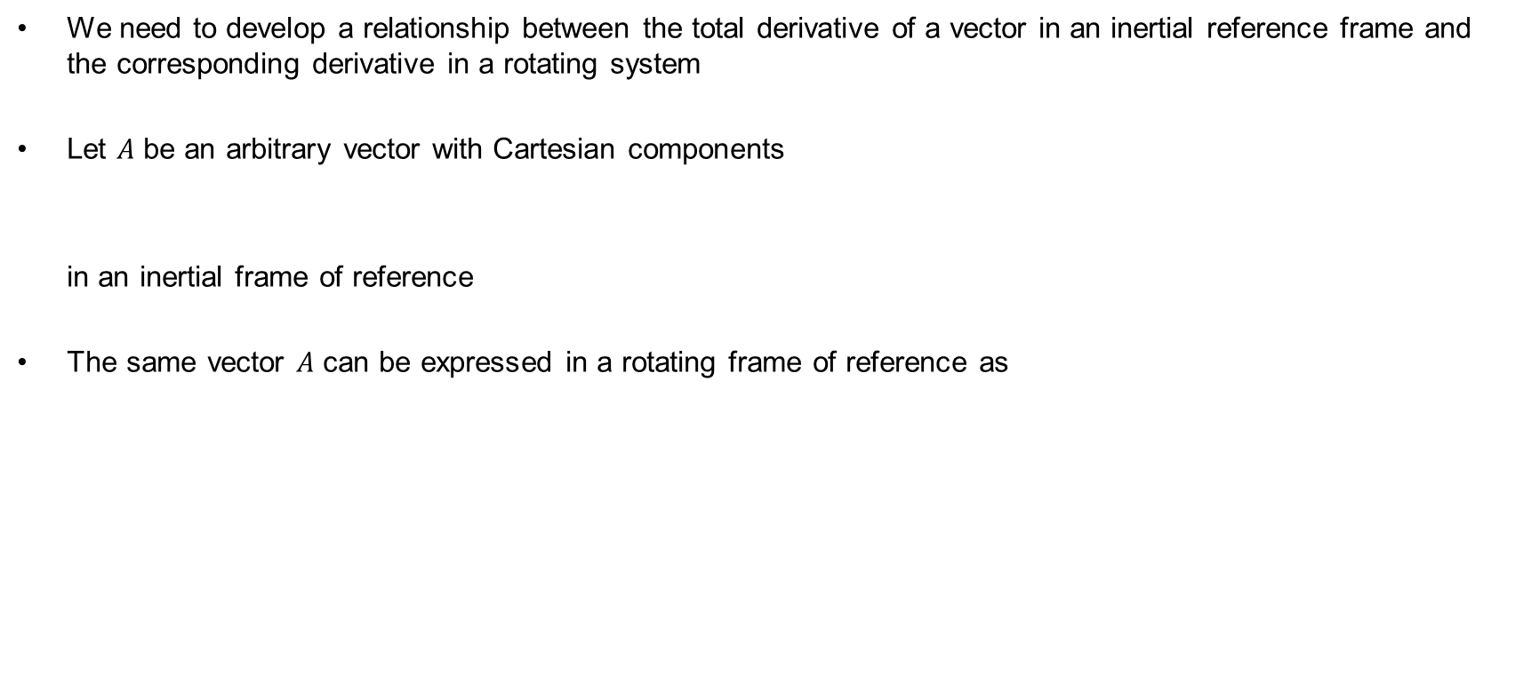


Transport Theorem – Derivation
We need to develop a relationship between the total derivative of a vector in an inertial reference frame and the corresponding derivative in a rotating system
Let $A$ be an arbitrary vector with Cartesian components
in an inertial frame of reference
The same vector $A$ can be expressed in a rotating frame of reference as
$${A=A}_{x}^{ }\hat{i}+A_{x}^{ }\hat{j}+A_{x}^{ }\hat{k}$$
${A=A_{x}^{′}}_{ }^{ }{\hat{i}}_{ }^{′}+{A_{y}^{′}}_{ }^{ }{\hat{j}}_{ }^{′}$ ${+A_{z}^{′}}_{ }^{ }{\hat{k}}_{ }^{′}$
Instructor: Jacob Rosen
Advanced Robotic - MAE 263B - Department of Mechanical & Aerospace Engineering - UCLA

Slide 35


Transport Theorem – Derivation
If the vector $A$ is an inertial frame of reference, then the time derivative of this vector is
Since the coordinate axes are in an inertial frame of reference the time derivative of the unite vectors are equal to zero,
$${\frac{dA}{dt}=\frac{d}{dt}(A}_{x}^{ }\hat{i}+A_{x}^{ }\hat{j}+A_{x}^{ }\hat{k})$$
$$\frac{dA}{dt}=\left(\frac{dA_{x}}{dt}\hat{i}+\frac{d\hat{i}}{dt}A_{x}\right)+\left(\frac{dA_{y}}{dt}\hat{j}+\frac{d\hat{j}}{dt}A_{y}\right)+\left(\frac{dA_{z}}{dt}\hat{k}+\frac{d\hat{k}}{dt}A_{z}\right)$$
$$\frac{d\hat{i}}{dt}=\frac{d\hat{j}}{dt}=\frac{d\hat{k}}{dt}=0$$
Instructor: Jacob Rosen
Advanced Robotic - MAE 263B - Department of Mechanical & Aerospace Engineering - UCLA

Slide 36
Transport Theorem – Derivation
Therefore the time derivative of this vector can be rewritten as
If the same vector is described in the rotated
Then the time derivative of this vector is
$$\frac{dA}{dt}=\frac{dA_{x}}{dt}\hat{i}+\frac{dA_{y}}{dt}\hat{j}+\frac{dA_{z}}{dt}\hat{k}$$
Eq. 1
${A=A_{x}^{′}}_{ }^{ }{\hat{i}}_{ }^{′}+{A_{y}^{′}}_{ }^{ }{\hat{j}}_{ }^{′}$ ${+A_{z}^{′}}_{ }^{ }{\hat{k}}_{ }^{′}$
$$\frac{dA}{dt}=\left(\frac{dA_{x}^{′}}{dt}{\hat{i}}_{ }^{′}+\frac{d{\hat{i}}_{ }^{′}}{dt}A_{x}^{′}\right)+\left(\frac{dA_{y}^{′}}{dt}{\hat{j}}_{ }^{′}+\frac{d{\hat{j}}_{ }^{′}}{dt}A_{y}^{′}\right)+\left(\frac{dA_{z}^{′}}{dt}{\hat{k}}_{ }^{′}+\frac{d{\hat{k}}_{ }^{′}}{dt}A_{z}^{′}\right)$$
Eq. 2
Instructor: Jacob Rosen
Advanced Robotic - MAE 263B - Department of Mechanical & Aerospace Engineering - UCLA

Slide 37
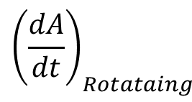
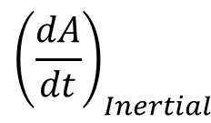
Transport Theorem – Derivation
Since the left hand sides of equation 1 and 2 are identical then we can equate the right and side of these to equations to form
Regrouping the terms
$\frac{dA_{x}}{dt}\hat{i}+\frac{dA_{y}}{dt}\hat{j}+\frac{dA_{z}}{dt}\hat{k}$= $\left(\frac{dA_{x}^{′}}{dt}{\hat{i}}_{ }^{′}+\frac{d{\hat{i}}_{ }^{′}}{dt}A_{x}^{′}\right)+\left(\frac{dA_{y}^{′}}{dt}{\hat{j}}_{ }^{′}+\frac{d{\hat{j}}_{ }^{′}}{dt}A_{y}^{′}\right)+\left(\frac{dA_{z}^{′}}{dt}{\hat{k}}_{ }^{′}+\frac{d{\hat{k}}_{ }^{′}}{dt}A_{z}^{′}\right)$
$\frac{dA_{x}}{dt}\hat{i}+\frac{dA_{y}}{dt}\hat{j}+\frac{dA_{z}}{dt}\hat{k}$= $\left(\frac{dA_{x}^{′}}{dt}{\hat{i}}_{ }^{′}+\frac{dA_{y}^{′}}{dt}{\hat{j}}_{ }^{′}\frac{dA_{z}^{′}}{dt}{\hat{k}}_{ }^{′}\right)+\left(A_{x}^{′}\frac{d{\hat{i}}_{ }^{′}}{dt}+A_{y}^{′}\frac{d{\hat{j}}_{ }^{′}}{dt}+A_{z}^{′}\frac{d{\hat{k}}_{ }^{′}}{dt}\right)$
$${\left(\frac{dA}{dt}\right)}_{Inertial}^{ }$$
$${\left(\frac{dA}{dt}\right)}_{Rotataing}^{ }$$
Effect of Rotation
Instructor: Jacob Rosen
Advanced Robotic - MAE 263B - Department of Mechanical & Aerospace Engineering - UCLA

Slide 38


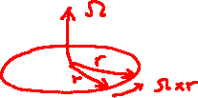



Transport Theorem – Derivation
In order to provide an interpretation to the terms
Assume that each unite vector ${\hat{i}}_{ }^{′} ,{\hat{j}}_{ }^{′},{\hat{k}}_{ }^{′}$ is a position vector $r$ rotating with an angular velocity $Ω$
Thus
$$A_{x}^{′}\frac{d{\hat{i}}_{ }^{′}}{dt}+A_{y}^{′}\frac{d{\hat{j}}_{ }^{′}}{dt}+A_{z}^{′}\frac{d{\hat{k}}_{ }^{′}}{dt}$$
$v=\frac{dr}{dt}=Ω×$r
$$\frac{d{\hat{i}}_{ }^{′}}{dt}=Ω×{\hat{i}}_{ }^{′}$$
$$\frac{d{\hat{j}}_{ }^{′}}{dt}=Ω×{\hat{j}}_{ }^{′}$$
$$\frac{d{\hat{k}}_{ }^{′}}{dt}=Ω×{\hat{k}}_{ }^{′}$$
Instructor: Jacob Rosen
Advanced Robotic - MAE 263B - Department of Mechanical & Aerospace Engineering - UCLA

Slide 39
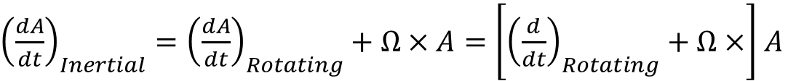

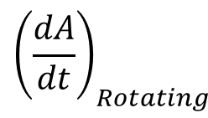
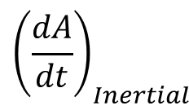
Transport Theorem – Derivation
The combined equation can be rewritten as
$\frac{dA_{x}}{dt}\hat{i}+\frac{dA_{y}}{dt}\hat{j}+\frac{dA_{z}}{dt}\hat{k}$= $\left(\frac{dA_{x}^{′}}{dt}{\hat{i}}_{ }^{′}+\frac{dA_{y}^{′}}{dt}{\hat{j}}_{ }^{′}\frac{dA_{z}^{′}}{dt}{\hat{k}}_{ }^{′}\right)+\left(A_{x}^{′}(Ω×{\hat{i}}_{ }^{′})+A_{y}^{′} (Ω×{\hat{j}}_{ }^{′})++A_{z}^{′} (Ω×{\hat{k}}_{ }^{′})\right)$
$${\left(\frac{dA}{dt}\right)}_{Inertial}^{ }$$
$${\left(\frac{dA}{dt}\right)}_{Rotating}^{ }$$
$$Ω×A$$
Effect of Rotation
${\left(\frac{dA}{dt}\right)}_{Inertial}^{ }={\left(\frac{dA}{dt}\right)}_{Rotating}^{ }+Ω×A=\left[{\left(\frac{d}{dt}\right)}_{Rotating}^{ }+Ω×\right]$ $A$
Instructor: Jacob Rosen
Advanced Robotic - MAE 263B - Department of Mechanical & Aerospace Engineering - UCLA

Slide 40
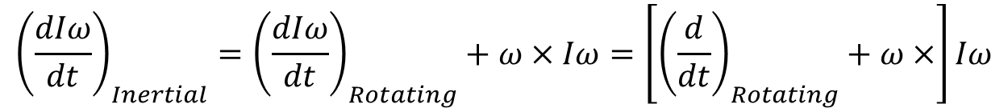




Transport Theorem – Derivation
Applying the Transport Theorem to the Euler Equation in case $A=Iω$ and $Ω=ω$
${\left(\frac{dA}{dt}\right)}_{Inertial}^{ }={\left(\frac{dA}{dt}\right)}_{Rotating}^{ }+Ω×A=\left[{\left(\frac{d}{dt}\right)}_{Rotating}^{ }+Ω×\right]$ $A$
$$∑τ=\frac{d}{dt}H_{G}=\frac{d}{dt}Iω$$
$${\left(\frac{dIω}{dt}\right)}_{Inertial}^{ }={\left(\frac{dIω}{dt}\right)}_{Rotating}^{ }+ω×Iω=\left[{\left(\frac{d}{dt}\right)}_{Rotating}^{ }+ω×\right]Iω$$
$$∑τ=I\dot{ω}+ω×Iω$$
Instructor: Jacob Rosen
Advanced Robotic - MAE 263B - Department of Mechanical & Aerospace Engineering - UCLA

Slide 41

Manipulator Dynamics – Newton Euler Equations
  The Angular Acceleration
$$\dot{ω}$$
Instructor: Jacob Rosen
Advanced Robotic - MAE 263B - Department of Mechanical & Aerospace Engineering - UCLA

Slide 42
Dynamics - Newton-Euler Equations
To solve the Newton and Euler equations, we’ll need to develop mathematical terms for:
  ${\dot{v}}_{c}$ - The linear acceleration of the center of mass
  $\dot{ω}$ - The angular acceleration
  ${}_{ }^{c}I$ - The Inertia tensor (moment of inertia)
$F$ - The sum of all the forces applied on the center of mass
$N$ - The sum of all the moments applied on the center of mass
$$F=m{\dot{v}}_{c}$$
$$N={}_{ }^{c}I\dot{ω}+ω×{}_{ }^{c}Iω$$
Instructor: Jacob Rosen
Advanced Robotic - MAE 263B - Department of Mechanical & Aerospace Engineering - UCLA

Slide 43
Deriving Angular Acceleration – Matrix Approach
$$\dot{ω}$$
(*) Review at home
Instructor: Jacob Rosen
Advanced Robotic - MAE 263B - Department of Mechanical & Aerospace Engineering - UCLA

Slide 44



Propagation of Acceleration – Angular
Matrix Approach
To derive a general formula for the angular acceleration, we will differentiate the angular velocity
Applying the chain rule, we find:
Recall that
Substitution of this result yields
$${{}_{ }^{i+1}ω}_{i+1}={}_{i}^{i+1}R{{}_{ }^{i}ω}_{i}+{\left[\begin{matrix}0 & 0 & {\dot{θ}}_{i+1}\end{matrix}\right]}^{T}$$
$${{}_{ }^{i+1}{\dot{ω}}}_{i+1}={}_{i}^{i+1}R{{}_{ }^{i}{\dot{ω}}}_{i}+{}_{i}^{i+1}{\dot{R} }{{}_{ }^{i}ω}_{i}+{\left[\begin{matrix}0 & 0 & {\ddot{θ}}_{i+1}\end{matrix}\right]}^{T}$$
$${}_{B}^{A}{\dot{R} }=\frac{d}{dt}\left[{}_{B}^{A}R\right]=\left[\begin{matrix}0 & −Ω_{z} & Ω_{y} \\ Ω_{z} & 0 & −Ω_{x} \\ −Ω_{y} & Ω_{x} & 0\end{matrix}\right]{}_{B}^{A}R={{}_{B}^{A}{\dot{R}}}_{Ω}{}_{B}^{A}R$$
Instructor: Jacob Rosen
Advanced Robotic - MAE 263B - Department of Mechanical & Aerospace Engineering - UCLA

Slide 45



Propagation of Acceleration - Angular
Matrix form (Revolute Joint)
Converting from matrix to vector form gives the angular acceleration vector
Vector form (Revolute Joint)
If joint i+1 is prismatic, the angular terms are zero ( ) and the above equation simplifies to:
Matrix form (Prismatic Joint)
$${{}_{ }^{i+1}{\dot{ω}}}_{i+1}={}_{i}^{i+1}R{{}_{ }^{i}{\dot{ω}}}_{i}+{{}_{i}^{i+1}{\dot{R}}}_{Ω}{}_{i}^{i+1}R{{}_{ }^{i}ω}_{i}+{\left[\begin{matrix}0 & 0 & {\ddot{θ}}_{i+1}\end{matrix}\right]}^{T}$$
$${{}_{ }^{i+1}{\dot{ω}}}_{i+1}={}_{i}^{i+1}R{{}_{ }^{i}{\dot{ω}}}_{i}+{}_{i}^{i+1}R{{}_{ }^{i}ω}_{i}×\left[\begin{matrix}0 \\ 0 \\ {\dot{θ}}_{i+1}\end{matrix}\right]+\left[\begin{matrix}0 \\ 0 \\ {\ddot{θ}}_{i+1}\end{matrix}\right]$$
$${\dot{θ}}_{i+1}={\ddot{θ}}_{i+1}=0$$
$${{}_{ }^{i+1}{\dot{ω}}}_{i+1}={}_{i}^{i+1}R{{}_{ }^{i}{\dot{ω}}}_{i}$$
Instructor: Jacob Rosen
Advanced Robotic - MAE 263B - Department of Mechanical & Aerospace Engineering - UCLA

Slide 46
Deriving Angular Acceleration – Vector Approach (*)
$$\dot{ω}$$
(*) Review at home
Instructor: Jacob Rosen
Advanced Robotic - MAE 263B - Department of Mechanical & Aerospace Engineering - UCLA

Slide 47









Propagation of Acceleration – Angular
Vector Approach
3 Frames {B} rotates relative to {A} with ${{}_{ }^{A}Ω}_{B}$
{C} rotates relative to {B} with ${{}_{ }^{B}Ω}_{C}$
Calculate ${{}_{ }^{A}{\dot{Ω}}}_{C}$
$${{}_{ }^{A}Ω}_{C}={{}_{ }^{A}Ω}_{B}+{}_{B}^{A}R{{}_{ }^{B}Ω}_{C} \left(∗\right)$$
$${{}_{ }^{A}{\dot{Ω}}}_{C}={{}_{ }^{A}{\dot{Ω}}}_{B}+\frac{d}{dt}\left({}_{B}^{A}R{{}_{ }^{B}Ω}_{C}\right)$$
${\left(\frac{dA}{dt}\right)}_{Inertial}^{ }={\left(\frac{dA}{dt}\right)}_{Rotating}^{ }+Ω×A=\left[{\left(\frac{d}{dt}\right)}_{Rotating}^{ }+Ω×\right]$ $A$
$$\frac{d}{dt}\left({}_{B}^{A}R{{}_{ }^{B}Ω}_{C}\right)={}_{B}^{A}R{{}_{ }^{B}{\dot{Ω}}}_{C}+{{}_{ }^{A}Ω}_{B}×{}_{B}^{A}R{{}_{ }^{B}Ω}_{C}$$
$$A→0$$
$${{}_{ }^{A}{\dot{Ω}}}_{C}={{}_{ }^{A}{\dot{Ω}}}_{B}+{}_{B}^{A}R{{}_{ }^{B}{\dot{Ω}}}_{C}+{{}_{ }^{A}Ω}_{B}×{}_{B}^{A}R{{}_{ }^{B}Ω}_{C}$$
$$B→i$$
$$C→i+1$$
Instructor: Jacob Rosen
Advanced Robotic - MAE 263B - Department of Mechanical & Aerospace Engineering - UCLA

Slide 48

Propagation of Acceleration – Angular
Vector Approach
$${{}_{ }^{0}{\dot{Ω}}}_{i+1}={{}_{ }^{0}{\dot{Ω}}}_{i}+{}_{i}^{0}R{{}_{ }^{i}{\dot{Ω}}}_{i+1}+{{}_{ }^{0}Ω}_{i}×{}_{i}^{0}R{{}_{ }^{i}Ω}_{i+1}$$
Multiply both side of the equation from the left by ${}_{0}^{i+1}R$
$${}_{0}^{i+1}R{{}_{ }^{0}{\dot{Ω}}}_{i+1}={}_{0}^{i+1}R{{}_{ }^{0}{\dot{Ω}}}_{i}+{}_{0}^{i+1}R{}_{i}^{0}R{{}_{ }^{i}{\dot{Ω}}}_{i+1}+{}_{0}^{i+1}R\left({{}_{ }^{0}Ω}_{i}×{}_{i}^{0}R{{}_{ }^{i}Ω}_{i+1}\right)$$
$${{}_{ }^{i+1}{\dot{ω}}}_{i+1}={{}_{ }^{i+1}{\dot{ω}}}_{i}+{}_{i}^{i+1}R{{}_{ }^{i}{\dot{Ω}}}_{i+1}+{}_{0}^{i+1}R{{}_{ }^{0}Ω}_{i}×{}_{0}^{i+1}R{}_{i}^{0}R{{}_{ }^{i}Ω}_{i+1}$$
$${{}_{ }^{i+1}{\dot{ω}}}_{i+1}={{}_{ }^{i+1}{\dot{ω}}}_{i}+{}_{i}^{i+1}R{{}_{ }^{i}{\dot{Ω}}}_{i+1}+{{}_{ }^{i+1}ω}_{i}×{}_{i}^{i+1}R{{}_{ }^{i}Ω}_{i+1}$$
$${{}_{ }^{i+1}{\dot{ω}}}_{i+1}={}_{i}^{i+1}R{{}_{ }^{i}{\dot{ω}}}_{i}+\left[\begin{matrix}0 \\ 0 \\ {\ddot{θ}}_{i+1}\end{matrix}\right]+{}_{i}^{i+1}R{{}_{ }^{i}ω}_{i}×\left[\begin{matrix}0 \\ 0 \\ {\dot{θ}}_{i+1}\end{matrix}\right]$$
Instructor: Jacob Rosen
Advanced Robotic - MAE 263B - Department of Mechanical & Aerospace Engineering - UCLA

Slide 49

Manipulator Dynamics – Newton Euler Equations
  The Liner Acceleration of the Center of Mass
$${\dot{v}}_{c}$$
Instructor: Jacob Rosen
Advanced Robotic - MAE 263B - Department of Mechanical & Aerospace Engineering - UCLA

Slide 50
Dynamics - Newton-Euler Equations
To solve the Newton and Euler equations, we’ll need to develop mathematical terms for:
  ${\dot{v}}_{c}$ - The linear acceleration of the center of mass
  $\dot{ω}$ - The angular acceleration
  ${}_{ }^{c}I$ - The Inertia tensor (moment of inertia)
$F$ - The sum of all the forces applied on the center of mass
$N$ - The sum of all the moments applied on the center of mass
$$F=m{\dot{v}}_{c}$$
$$N={}_{ }^{c}I\dot{ω}+ω×{}_{ }^{c}Iω$$
Instructor: Jacob Rosen
Advanced Robotic - MAE 263B - Department of Mechanical & Aerospace Engineering - UCLA

Slide 51




Propagation of Acceleration - Linear
Simultaneous Linear and Rotational Velocity
Vector Form
Matrix Form
$${{}_{ }^{A}V}_{Q}=f({{}_{ }^{B}P}_{Q}, {{}_{ }^{B}V}_{Q}, {{}_{ }^{A}V}_{BORG}, {{}_{ }^{A}Ω}_{B}\text{,} {}_{B}^{A}R)$$
$${{}_{ }^{A}V}_{Q}={{}_{ }^{A}V}_{BORG}+{}_{B}^{A}R{{}_{ }^{B}V}_{Q}+{{}_{ }^{A}Ω}_{B}×{}_{B}^{A}R{{}_{ }^{B}P}_{Q}$$
$${{}_{ }^{A}Ω}_{B}$$
$${{}_{ }^{B}P}_{Q}$$
$${{}_{ }^{A}V}_{Q}={{}_{ }^{A}V}_{BORG}+{}_{B}^{A}R{{}_{ }^{B}V}_{Q}+{{}_{B}^{A}{\dot{R}}}_{Ω}\left({}_{B}^{A}R{{}_{ }^{B}P}_{Q}\right)$$
Instructor: Jacob Rosen
Advanced Robotic - MAE 263B - Department of Mechanical & Aerospace Engineering - UCLA

Slide 52
Deriving Linear Acceleration – Matrix Approach
$${\dot{v}}_{c}$$
Instructor: Jacob Rosen
Advanced Robotic - MAE 263B - Department of Mechanical & Aerospace Engineering - UCLA

Slide 53



Propagation of Acceleration – Linear
Matrix Approach
To derive a general formula for the linear acceleration, we will differentiate the linear velocity. However, instead of differentiating the recursive equation like we did for the angular acceleration derivation, we’ll begin at a slightly earlier step. Recall the three-part expression:
Re-assigning the link frames ( ), we find
Differentiating using the chain rule gives:
$${{}_{ }^{A}V}_{Q}={{}_{B}^{A}{\dot{R}}}_{Ω}\left({}_{B}^{A}R{{}_{ }^{B}P}_{Q org}\right)+{{}_{ }^{A}V}_{B org}+{}_{B}^{A}R{{}_{ }^{B}V}_{Q}$$
$$A→0 B→i Q→i+1$$
$${{}_{ }^{0}V}_{i+1}={\dot{{}_{i}^{0}R}}_{Ω}\left({}_{i}^{0}R{{}_{ }^{i}P}_{i+1}\right)+{{}_{ }^{0}V}_{i}+{}_{i}^{0}R{{}_{ }^{i}V}_{i+1}$$
$${\dot{{}_{ }^{0}V}}_{i+1}={\ddot{{}_{i}^{0}R}}_{Ω}{}_{i}^{0}R{{}_{ }^{i}P}_{i+1}+{\dot{{}_{i}^{0}R}}_{Ω}{\dot{{}_{i}^{0}R}}_{Ω}{}_{i}^{0}R{{}_{ }^{i}P}_{i+1}+{\dot{{}_{i}^{0}R}}_{Ω}{}_{i}^{0}R{\dot{{}_{ }^{i}P}}_{i+1}+{\dot{{}_{ }^{0}V}}_{i}+{\dot{{}_{i}^{0}R}}_{Ω}{}_{i}^{0}R{{}_{ }^{i}V}_{i+1}+{}_{i}^{0}R{\dot{{}_{ }^{i}V}}_{i+1}$$
Instructor: Jacob Rosen
Advanced Robotic - MAE 263B - Department of Mechanical & Aerospace Engineering - UCLA

Slide 54


Propagation of Acceleration – Linear
Matrix Approach
Combining the two like terms, we find:
Pre-multiplying both sides of the equation by gives:
Expanding term ${}_{0}^{i+1}R$ into ${}_{i}^{i+1}R{}_{0}^{i}R$ gives
$${\dot{{}_{ }^{0}V}}_{i+1}={\ddot{{}_{i}^{0}R}}_{Ω}{}_{i}^{0}R{{}_{ }^{i}P}_{i+1}+{\dot{{}_{i}^{0}R}}_{Ω}{\dot{{}_{i}^{0}R}}_{Ω}{}_{i}^{0}R{{}_{ }^{i}P}_{i+1}+{\dot{{}_{i}^{0}R}}_{Ω}{}_{i}^{0}R{\dot{{}_{ }^{i}P}}_{i+1}+{\dot{{}_{ }^{0}V}}_{i}+{\dot{{}_{i}^{0}R}}_{Ω}{}_{i}^{0}R{{}_{ }^{i}V}_{i+1}+{}_{i}^{0}R{\dot{{}_{ }^{i}V}}_{i+1}$$
$${\dot{{}_{ }^{0}V}}_{i+1}={\ddot{{}_{i}^{0}R}}_{Ω}{}_{i}^{0}R{{}_{ }^{i}P}_{i+1}+{\dot{{}_{i}^{0}R}}_{Ω}{\dot{{}_{i}^{0}R}}_{Ω}{}_{i}^{0}R{{}_{ }^{i}P}_{i+1}+{\dot{{}_{ }^{0}V}}_{i}+2{\dot{{}_{i}^{0}R}}_{Ω}{}_{i}^{0}R{{}_{ }^{i}V}_{i+1}+{}_{i}^{0}R{\dot{{}_{ }^{i}V}}_{i+1}$$
$${}_{0}^{i+1}R$$
$${}_{0}^{i+1}R{\dot{{}_{ }^{0}V}}_{i+1}={}_{0}^{i+1}R{\ddot{{}_{i}^{0}R}}_{Ω}{}_{i}^{0}R{{}_{ }^{i}P}_{i+1}+{}_{0}^{i+1}R{\dot{{}_{i}^{0}R}}_{Ω}{\dot{{}_{i}^{0}R}}_{Ω}{}_{i}^{0}R{{}_{ }^{i}P}_{i+1}+{}_{0}^{i+1}R{\dot{{}_{ }^{0}V}}_{i}+2{}_{0}^{i+1}R{\dot{{}_{i}^{0}R}}_{Ω}{}_{i}^{0}R{{}_{ }^{i}V}_{i+1}+{}_{0}^{i+1}R{}_{i}^{0}R{\dot{{}_{ }^{i}V}}_{i+1}$$
$${}_{0}^{i+1}R{\dot{{}_{ }^{0}V}}_{i+1}={}_{i}^{i+1}R{}_{0}^{i}R{\ddot{{}_{i}^{0}R}}_{Ω}{}_{i}^{0}R{{}_{ }^{i}P}_{i+1}+{}_{i}^{i+1}R{}_{0}^{i}R{\dot{{}_{i}^{0}R}}_{Ω}{\dot{{}_{i}^{0}R}}_{Ω}{}_{i}^{0}R{{}_{ }^{i}P}_{i+1}+{}_{0}^{i+1}R{\dot{{}_{ }^{0}V}}_{i}+2{}_{i}^{i+1}R{}_{0}^{i}R{\dot{{}_{i}^{0}R}}_{Ω}{}_{i}^{0}R{{}_{ }^{i}V}_{i+1}+{}_{0}^{i+1}R{}_{i}^{0}R{\dot{{}_{ }^{i}V}}_{i+1}$$
Instructor: Jacob Rosen
Advanced Robotic - MAE 263B - Department of Mechanical & Aerospace Engineering - UCLA

Slide 55



Propagation of Acceleration – Linear
Matrix Approach
$${}_{0}^{i+1}R{\dot{{}_{ }^{0}V}}_{i+1}={}_{i}^{i+1}R{}_{0}^{i}R{\ddot{{}_{i}^{0}R}}_{Ω}{}_{i}^{0}R{{}_{ }^{i}P}_{i+1}+{}_{i}^{i+1}R{}_{0}^{i}R{\dot{{}_{i}^{0}R}}_{Ω}{\dot{{}_{i}^{0}R}}_{Ω}{}_{i}^{0}R{{}_{ }^{i}P}_{i+1}+{}_{0}^{i+1}R{\dot{{}_{ }^{0}V}}_{i}+2{}_{i}^{i+1}R{}_{0}^{i}R{\dot{{}_{i}^{0}R}}_{Ω}{}_{i}^{0}R{{}_{ }^{i}V}_{i+1}+{}_{0}^{i+1}R{}_{i}^{0}R{\dot{{}_{ }^{i}V}}_{i+1}$$
Simplifying the previous equation using (Note: )
we have
$${}_{0}^{i}R{\ddot{{}_{i}^{0}R}}_{Ω}{}_{i}^{0}R={}_{0}^{i}R{\ddot{{}_{i}^{0}R}}_{Ω}{{}_{0}^{i}R}^{T}={}_{0}^{i}R{\dot{{}_{ }^{0}Ω}}_{i}={}_{0}^{i}R{\dot{ω}}_{i}={{}_{ }^{i}{\dot{ω}}}_{i}$$
$${}_{0}^{i}R{\dot{{}_{i}^{0}R}}_{Ω}{\dot{{}_{i}^{0}R}}_{Ω}{}_{i}^{0}R={{}_{ }^{i}ω}_{i}×{{}_{ }^{i}ω}_{i}$$
$${}_{0}^{i+1}R{\dot{{}_{ }^{0}V}}_{i}={}_{i}^{i+1}R{}_{0}^{i}R{\dot{{}_{ }^{0}V}}_{i}={}_{i}^{i+1}R{{}_{ }^{i}{\dot{v}}}_{i}$$
$${}_{0}^{i}R{\dot{{}_{i}^{0}R}}_{Ω}{}_{i}^{0}R={}_{0}^{i}R{{}_{ }^{0}ω}_{i}={{}_{ }^{i}ω}_{i}$$
$${{}_{ }^{i+1}{\dot{v}}}_{i+1}={}_{i}^{i+1}R\left[{{}_{ }^{i}{\dot{ω}}}_{i}×{{}_{ }^{i}P}_{i+1}+{{}_{ }^{i}ω}_{i}×{{}_{ }^{i}ω}_{i}×{{}_{ }^{i}P}_{i+1}+{{}_{ }^{i}{\dot{v}}}_{i}\right]+2{{}_{ }^{i}ω}_{i}×{{}_{ }^{i+1}v}_{i+1}+{{}_{ }^{i+1}{\dot{v}}}_{i+1}$$
Instructor: Jacob Rosen
Advanced Robotic - MAE 263B - Department of Mechanical & Aerospace Engineering - UCLA

Slide 56


Propagation of Acceleration – Linear
Matrix Approach
This equation can be written equivalently as:
General form
If joint i+1 is revolute joint, the linear velocity terms are zero and the above equation simplifies to:
Revolute Joint
$${{}_{ }^{i+1}{\dot{v}}}_{i+1}={}_{i}^{i+1}R\left[{\dot{{}_{ }^{i}ω}}_{i}×{{}_{ }^{i}P}_{i+1}+{{}_{ }^{i}ω}_{i}×{{}_{ }^{i}ω}_{i}×{{}_{ }^{i}P}_{i+1}+{{}_{ }^{i}{\dot{v}}}_{i}\right]+2{{}_{ }^{i+1}ω}_{i+1}×{{}_{ }^{i+1}v}_{i+1}+{{}_{ }^{i+1}{\dot{v}}}_{i+1}$$
$${{}_{ }^{i+1}{\dot{v}}}_{i+1}={}_{i}^{i+1}R\left[{{}_{ }^{i}{\dot{ω}}}_{i}×{{}_{ }^{i}P}_{i+1}+{{}_{ }^{i}ω}_{i}×{{}_{ }^{i}ω}_{i}×{{}_{ }^{i}P}_{i+1}+{{}_{ }^{i}{\dot{v}}}_{i}\right]+2{{}_{ }^{i+1}ω}_{i+1}×\left[\begin{matrix}0 \\ 0 \\ {\dot{d}}_{i+1}\end{matrix}\right]+\left[\begin{matrix}0 \\ 0 \\ {\ddot{d}}_{i+1}\end{matrix}\right]$$
${{}_{ }^{i+1}{\dot{v}}}_{i+1}={}_{i}^{i+1}R\left[{\dot{{}_{ }^{i}ω}}_{i}×{{}_{ }^{i}P}_{i+1}+{{}_{ }^{i}ω}_{i}×{{}_{ }^{i}ω}_{i}×{{}_{ }^{i}P}_{i+1}+{{}_{ }^{i}{\dot{v}}}_{i}\right]$ + 0 + 0
Instructor: Jacob Rosen
Advanced Robotic - MAE 263B - Department of Mechanical & Aerospace Engineering - UCLA

Slide 57




Propagation of Acceleration – Linear
Matrix Approach
Note that frame {i} and the frame at the center of mass {C} are parallel to each other. Therefore the rotation matrix of frame {i} with respect to frame at the center of mass {C} is equal to identity ${}_{i}^{C_{i}^{ }}R=[I]$
Substituting in the above equation $i+1→i_{C}^{ }$ and multiplying both side by ${}_{C_{i}^{ }}^{i}R$ resulting in
Since
${{}_{ }^{i+1}{\dot{v}}}_{i+1}={}_{i}^{i+1}R\left[{{}_{ }^{i}{\dot{ω}}}_{i}×{{}_{ }^{i}P}_{i+1}+{{}_{ }^{i}ω}_{i}×{{}_{ }^{i}ω}_{i}×{{}_{ }^{i}P}_{i+1}+{{}_{ }^{i}{\dot{v}}}_{i}\right]$
${}_{C_{i}^{ }}^{i}R{{}_{ }^{C_{i }^{ }}{\dot{v}}}_{C_{i }^{ }}={}_{C_{i}^{ }}^{i}R{}_{i}^{C_{i}^{ }}R\left[{{}_{ }^{i}{\dot{ω}}}_{i}×{{}_{ }^{i}P}_{C_{i }^{ }}+{{}_{ }^{i}ω}_{i}×{{}_{ }^{i}ω}_{i}×{{}_{ }^{i}P}_{C_{i }^{ }}+{{}_{ }^{i}{\dot{v}}}_{i}\right]$
${}_{C_{i}^{ }}^{i}R{\dot{{}_{ }^{C_{i }^{ }}v}}_{{C_{i }^{ }}_{ }}$= ${\dot{{}_{ }^{i}v}}_{{C_{i }^{ }}_{ }}$
Instructor: Jacob Rosen
Advanced Robotic - MAE 263B - Department of Mechanical & Aerospace Engineering - UCLA

Slide 58


Propagation of Acceleration - Linear
From the general equation, we can also get the solution for the acceleration of the center of mass for link i. Appropriate frame substitution and elimination of prismatic terms gives we find:
Frame {C_{i}} attached to each link with its origin located at the Center of mass of the link, and with the same orientation as the link frame {i}
Increasing the index i by 1 to i+1 resulted in the equation used in the algorithm
$${{{}_{ }^{i}{\dot{v}}}_{C}}_{i}={{}_{ }^{i}{\dot{ω}}}_{i}×{{}_{ }^{i}P}_{C_{i }^{ }}+{{}_{ }^{i}ω}_{i}×{{}_{ }^{i}ω}_{i}×{{}_{ }^{i}P}_{C_{i }^{ }}+{{}_{ }^{i}{\dot{v}}}_{i}$$
$${{{}_{ }^{i+1}{\dot{v}}}_{C}}_{i+1}={{}_{ }^{i+1}{\dot{ω}}}_{i+1}× {{{}_{ }^{i+1}P}_{C}}_{i+1}+{{}_{ }^{i+1}ω}_{i+1}× ({{}_{ }^{i+1}ω}_{i+1}×{{{}_{ }^{i+1}P}_{C}}_{i+1}) + {{}_{ }^{i+1}{\dot{v}}}_{i+1}$$
Instructor: Jacob Rosen
Advanced Robotic - MAE 263B - Department of Mechanical & Aerospace Engineering - UCLA

Slide 59
Deriving Linear Acceleration – Vector Approach (*)
$${\dot{v}}_{c}$$
(*) Review at home
Instructor: Jacob Rosen
Advanced Robotic - MAE 263B - Department of Mechanical & Aerospace Engineering - UCLA

Slide 60

Propagation of Acceleration – Linear
Vector Approach
$${{}_{ }^{A}V}_{Q}={{}_{ }^{A}V}_{BORG}+{}_{B}^{A}R{{}_{ }^{B}V}_{Q}+{{}_{ }^{A}Ω}_{B}×{}_{B}^{A}R{{}_{ }^{B}P}_{Q}$$
(Eq. 1)
If the origins are coincident $V_{BORG}=0$
$${{}_{ }^{A}V}_{Q}=\frac{d}{dt}\left({}_{B}^{A}R{{}_{ }^{B}P}_{Q}\right)={}_{B}^{A}R{{}_{ }^{B}V}_{Q}+{{}_{ }^{A}Ω}_{B}×{}_{B}^{A}R{{}_{ }^{B}P}_{Q}$$
(Eq. 2a)
Differentiating the term ${}_{B}^{A}R{{}_{ }^{B}V}_{Q}$
$${}_{ }^{B}{\left({{}_{ }^{A}a}_{Q}\right)}={}_{ }^{B}{\left({{}_{ }^{A}{\dot{V}}}_{Q}\right)}=\frac{d}{dt}\left({}_{B}^{A}R{{}_{ }^{B}V}_{Q}\right)={}_{B}^{A}R{{}_{ }^{B}{\dot{V}}}_{Q}+{{}_{ }^{A}Ω}_{B}×{}_{B}^{A}R{{}_{ }^{B}V}_{Q}$$
(Eq. 2a)
Differentiating Eq. 1 (Assuming $V_{BORG}=0$ ) and applying Eq. 2 for the first and the third term
$${{}_{ }^{A}{\dot{V}}}_{Q}=\frac{d}{dt}\left({}_{B}^{A}R{{}_{ }^{B}V}_{Q}\right)+{{}_{ }^{A}{\dot{Ω}}}_{B}×{}_{B}^{A}R{{}_{ }^{B}P}_{Q}+{{}_{ }^{A}Ω}_{B}×\frac{d}{dt}\left({}_{B}^{A}R{{}_{ }^{B}P}_{Q}\right)$$
$${{}_{ }^{A}{\dot{V}}}_{Q}={}_{B}^{A}R{{}_{ }^{B}{\dot{V}}}_{Q}+{{}_{ }^{A}Ω}_{B}×{}_{B}^{A}R{{}_{ }^{B}V}_{Q}+{{}_{ }^{A}{\dot{Ω}}}_{B}×{}_{B}^{A}R{{}_{ }^{B}P}_{Q}+{{}_{ }^{A}Ω}_{B}×\left[{}_{B}^{A}R{{}_{ }^{B}V}_{Q}+{{}_{ }^{A}Ω}_{B}×{}_{B}^{A}R{{}_{ }^{B}P}_{Q}\right]$$
Instructor: Jacob Rosen
Advanced Robotic - MAE 263B - Department of Mechanical & Aerospace Engineering - UCLA

Slide 61
Propagation of Acceleration – Linear
Vector Approach
$${{}_{ }^{A}{\dot{V}}}_{Q}={}_{B}^{A}R{{}_{ }^{B}{\dot{V}}}_{Q}+2{{}_{ }^{A}Ω}_{B}×{}_{B}^{A}R{{}_{ }^{B}V}_{Q}+{{}_{ }^{A}{\dot{Ω}}}_{B}×{}_{B}^{A}R{{}_{ }^{B}P}_{Q}+{{}_{ }^{A}Ω}_{B}×\left({{}_{ }^{A}Ω}_{B}×{}_{B}^{A}R{{}_{ }^{B}P}_{Q}\right)$$
$${{}_{ }^{A}a}_{Q}={{}_{ }^{A}{\dot{V}}}_{Q}={{}_{ }^{A}{\dot{V}}}_{BORG}+{}_{B}^{A}R{{}_{ }^{B}{\dot{V}}}_{Q}+2{{}_{ }^{A}Ω}_{B}×{}_{B}^{A}R{{}_{ }^{B}V}_{Q}+{{}_{ }^{A}{\dot{Ω}}}_{B}×{}_{B}^{A}R{{}_{ }^{B}P}_{Q}+{{}_{ }^{A}Ω}_{B}×\left({{}_{ }^{A}Ω}_{B}×{}_{B}^{A}R{{}_{ }^{B}P}_{Q}\right)$$
${{}_{ }^{A}a}_{Q}={{}_{ }^{A}{\dot{V}}}_{Q}$ = Absolute acc. of point Q expressed in frame A
${{}_{ }^{A}{\dot{V}}}_{BORG}$ - Absolute acc. of the origin of frame B expressed in frame A
${}_{B}^{A}R{{}_{ }^{B}{\dot{V}}}_{Q}$ - Acc. of point Q with respect to frame B and expressed in frame A
$2{{}_{ }^{A}Ω}_{B}×{}_{B}^{A}R{{}_{ }^{B}V}_{Q}$(Coriolis Acc.) – Combined effect of point Q moving with a velocity ${{}_{ }^{B}V}_{Q}$ relative to frame B and the rotation of frame B wrt frame A
${{}_{ }^{A}{\dot{Ω}}}_{B}×{}_{B}^{A}R{{}_{ }^{B}P}_{Q}$ - Angular acc. effect caused by the rotation of frame B wrt frame A
${{}_{ }^{A}Ω}_{B}×\left({{}_{ }^{A}Ω}_{B}×{}_{B}^{A}R{{}_{ }^{B}P}_{Q}\right)$ - Centrifugal Acc. – Angular Acc. caused by the rotation of frame B wrt frame A
Instructor: Jacob Rosen
Advanced Robotic - MAE 263B - Department of Mechanical & Aerospace Engineering - UCLA

Slide 62



Propagation of Acceleration – Linear
Vector Approach
Special Case ${{}_{ }^{B}P}_{Q}$ is constant
$${{}_{ }^{B}{\dot{P}}}_{Q}={{}_{ }^{B}V}_{Q}=0$$
$${{}_{ }^{B}{\ddot{P}}}_{Q}={{}_{ }^{B}{\dot{V}}}_{Q}={{}_{ }^{B}a}_{Q}=0$$
0
0
$${{}_{ }^{A}a}_{Q}={{}_{ }^{A}{\dot{V}}}_{Q}={{}_{ }^{A}{\dot{V}}}_{BORG}+{}_{B}^{A}R{{}_{ }^{B}{\dot{V}}}_{Q}+2{{}_{ }^{A}Ω}_{B}×{}_{B}^{A}R{{}_{ }^{B}V}_{Q}+{{}_{ }^{A}{\dot{Ω}}}_{B}×{}_{B}^{A}R{{}_{ }^{B}P}_{Q}+{{}_{ }^{A}Ω}_{B}×\left({{}_{ }^{A}Ω}_{B}×{}_{B}^{A}R{{}_{ }^{B}P}_{Q}\right)$$
$${{}_{ }^{A}a}_{Q}={{}_{ }^{A}{\dot{V}}}_{Q}={{}_{ }^{A}{\dot{V}}}_{BORG}+{{}_{ }^{B}{\dot{Ω}}}_{Q}×{}_{B}^{A}R{{}_{ }^{B}P}_{Q}+{{}_{ }^{A}Ω}_{B}×\left({{}_{ }^{A}Ω}_{B}×{}_{B}^{A}R{{}_{ }^{B}P}_{Q}\right)$$
$${{}_{ }^{0}{\dot{V}}}_{i+1}={{}_{ }^{0}{\dot{V}}}_{i}+{{}_{ }^{0}{\dot{Ω}}}_{i}×{}_{i}^{0}R{{}_{ }^{i}P}_{i+1}+{{}_{ }^{0}Ω}_{i}×\left({{}_{ }^{0}Ω}_{i}×{}_{i}^{0}R{{}_{ }^{i}P}_{i+1}\right)$$
Multiply by ${}_{0}^{i+1}R$
$${}_{0}^{i+1}R{{}_{ }^{0}{\dot{V}}}_{i+1}={}_{0}^{i+1}R{{}_{ }^{0}{\dot{V}}}_{i}+{}_{0}^{i+1}R\left({{}_{ }^{0}{\dot{Ω}}}_{i}×{}_{i}^{0}R{{}_{ }^{i}P}_{i+1}\right)+{}_{0}^{i+1}R{{}_{ }^{0}Ω}_{i}×\left({{}_{ }^{0}Ω}_{i}×{}_{i}^{0}R{{}_{ }^{i}P}_{i+1}\right)$$
$${{}_{ }^{i+1}{\dot{V}}}_{i+1}={{}_{ }^{i+1}{\dot{V}}}_{i}+{}_{0}^{i+1}R{}_{i}^{0}R\left({}_{i}^{0}R{{}_{ }^{0}{\dot{R}}}_{i}×{{}_{ }^{i}P}_{i+1}\right)+{}_{0}^{i+1}R{}_{i}^{0}R\left[{}_{0}^{i}R{{}_{ }^{0}Ω}_{i}×{}_{0}^{i}R{{}_{ }^{0}Ω}_{i}×{{}_{ }^{i}P}_{i+1}\right]$$
$${{}_{ }^{i+1}{\dot{V}}}_{i+1}={{}_{ }^{i+1}R}_{i}[{{}_{ }^{i}{\dot{v}}}_{i}+{{}_{ }^{i}ω}_{i}×{{}_{ }^{i}P}_{i+1}]+{{}_{ }^{i}ω}_{i}×\left({{}_{ }^{i}ω}_{i}×{{}_{ }^{i}P}_{i+1}\right)$$

Slide 63




Manipulator Dynamics – Newton Euler Equations
  Forces & Torques
  Applied at the Center of Mass
  Applied at the Joints
$$F$$
$$N$$
$${{}_{ }^{i}f}_{i}$$
$${{}_{ }^{i}n}_{i}$$
Instructor: Jacob Rosen
Advanced Robotic - MAE 263B - Department of Mechanical & Aerospace Engineering - UCLA

Slide 64
Dynamics - Newton-Euler Equations
To solve the Newton and Euler equations, we’ll need to develop mathematical terms for:
  ${\dot{v}}_{c}$ - The linear acceleration of the center of mass
  $\dot{ω}$ - The angular acceleration
  ${}_{ }^{c}I$ - The Inertia tensor (moment of inertia)
$F$ - The sum of all the forces applied on the center of mass
$N$ - The sum of all the moments applied on the center of mass
$$F=m{\dot{v}}_{c}$$
$$N={}_{ }^{c}I\dot{ω}+ω×{}_{ }^{c}Iω$$
Instructor: Jacob Rosen
Advanced Robotic - MAE 263B - Department of Mechanical & Aerospace Engineering - UCLA

Slide 65







Expression of Force & Torque With Respect to the CM
Instructor: Jacob Rosen
Advanced Robotic - MAE 263B - Department of Mechanical & Aerospace Engineering - UCLA

Slide 66


Iterative Newton-Euler Equations
The Newton and Euler equations are re-written for the forces and moments at each link:
Where {C_{i}} is a frame who has its origin at the link’s center of mass and has the same orientation as the link frame {i}.
$${{}_{ }^{i}F}_{i}=m_{i}{\dot{{}_{ }^{i}v}}_{c i}$$
$${{}_{ }^{i}N}_{i}={{}_{ }^{c i}I}_{i}{\dot{{}_{ }^{i}ω}}_{i}+{{}_{ }^{i}ω}_{i}×{{}_{ }^{c i}I}_{i}{{}_{ }^{i}ω}_{i}$$
Instructor: Jacob Rosen
Advanced Robotic - MAE 263B - Department of Mechanical & Aerospace Engineering - UCLA

Slide 67

Sum of Forces and Moment on a Link
In addition to calculating the forces and torques arising from link accelerations, we also need to account for how they affect the neighboring links as well as the end effectors interactions with the environment.
Balancing the forces shown in the above figure, we can find the total force and torque on each link.
Instructor: Jacob Rosen
Advanced Robotic - MAE 263B - Department of Mechanical & Aerospace Engineering - UCLA

Slide 68











Sum of Forces and Moment on a Link
$$\sum{F_{cm}}={{}_{ }^{i}F}_{i}={{}_{ }^{i}f}_{i}−{{}_{ }^{i}f}_{i−1}={{}_{ }^{i}f}_{i}−{}_{i+1}^{i}R{{}_{ }^{i}f}_{i−1}$$
$\sum{N_{cm}}={{}_{ }^{i}N}_{i}={{}_{ }^{i}n}_{i}−{{}_{ }^{i}n}_{i−1}$+$\left(−{{}_{ }^{i}P}_{c_{i}}\right)×{{}_{ }^{i}f}_{i}−\left(−{{}_{ }^{i}P}_{c_{i}}+{{}_{ }^{i}P}_{i+1}\right)×{{}_{ }^{i}f}_{i+1}$
$$−f_{i−1}$$
$${{}_{ }^{i}P}_{i+1}$$
$$−n_{i−1}$$
$$−{{}_{ }^{i}P}_{ci}+{{}_{ }^{i}P}_{i+1}$$
$$−{{}_{ }^{i}P}_{ci}$$
Instructor: Jacob Rosen
Advanced Robotic - MAE 263B - Department of Mechanical & Aerospace Engineering - UCLA

Slide 69





Sum of Forces and Moment on a Link
$${{}_{ }^{i}F}_{i}=m{\dot{v}}_{ci}$$
$${{}_{ }^{i}N}_{i}={}_{ }^{ci}I{\dot{ω}}_{i}+ω_{i}×{}_{ }^{c}Iω_{i}$$
$${{}_{ }^{i}F}_{i}={{}_{ }^{i}f}_{i}−{{}_{ }^{i}f}_{i+1}={{}_{ }^{i}f}_{i}−{}_{i+1}^{i}R{{}_{ }^{i+1}f}_{i+1}$$
$${{}_{ }^{i}N}_{i}={{}_{ }^{i}n}_{i}−{{}_{ }^{i}n}_{i+1}+(−{{}_{ }^{i}P}_{ci})×{{}_{ }^{i}f}_{i}−(−{{}_{ }^{i}P}_{ci}+{{}_{ }^{i}P}_{i+1})×{{}_{ }^{i}f}_{i+1}$$
$${{}_{ }^{i}N}_{i}={{}_{ }^{i}n}_{i}−{}_{i+1}^{i}R{{}_{ }^{i+1}n}_{i+1}−{{}_{ }^{i}P}_{ci}×{{}_{ }^{i}f}_{i}+{{}_{ }^{i}P}_{ci}×{}_{i+1}^{i}R{{}_{ }^{i+1}f}_{i+1}−{{}_{ }^{i}P}_{i+1}×{}_{i+1}^{i}R{{}_{ }^{i+1}f}_{i+1}$$
$$−{{}_{ }^{i}P}_{ci}×({{}_{ }^{i}f}_{i}−{}_{i+1}^{i}R{{}_{ }^{i+1}f}_{i+1})$$
$$−{{}_{ }^{i}P}_{ci}×{{}_{ }^{i}F}_{i}$$
$${{}_{ }^{i}N}_{i}={{}_{ }^{i}n}_{i}−{}_{i+1}^{i}R{{}_{ }^{i+1}n}_{i+1}−{{}_{ }^{i}P}_{ci}×{{}_{ }^{i}F}_{i}−{{}_{ }^{i}P}_{i+1}×{}_{i+1}^{i}R{{}_{ }^{i+1}f}_{i+1}$$
Instructor: Jacob Rosen
Advanced Robotic - MAE 263B - Department of Mechanical & Aerospace Engineering - UCLA

Slide 70



Sum of Forces and Moment on a Link
Rearranging the force / torque equations so that they appear as iterative relationship from higher number neighbor to lower number neighbor. The total force and torque on each link.
Compare with the same equation for the static conditions
$${{}_{ }^{i}f}_{i}={}_{i+1}^{i}R{{}_{ }^{i+1}f}_{i+1}+{{}_{ }^{i}F}_{i}$$
$${{}_{ }^{i}n}_{i}={{}_{ }^{i}N}_{i}+{}_{i+1}^{i}R{{}_{ }^{i+1}n}_{i+1}+{{}_{ }^{i}P}_{c i}×{{}_{ }^{i}F}_{i}+{{}_{ }^{i}P}_{i+1}×{}_{i+1}^{i}R{{}_{ }^{i+1}f}_{i+1}$$
$${{}_{ }^{i}f}_{i}={}_{i+1}^{i}R {{}_{ }^{i+1}f}_{i+1}$$
$${{}_{ }^{i}n}_{i}={}_{i+1}^{i}R {{}_{ }^{i+1}n}_{i+1}+{{}_{ }^{i}P}_{i+1}×{{}_{ }^{i}f}_{i+1}$$
Instructor: Jacob Rosen
Advanced Robotic - MAE 263B - Department of Mechanical & Aerospace Engineering - UCLA

Slide 71

Sum of Forces and Moment on a Link
The joint torque is simply the component of torque that projects onto the joint axis (Z axis by definition)
$$τ_{i}={{}_{ }^{i}n}_{i}⋅\left[\begin{matrix}0 \\ 0 \\ 1\end{matrix}\right]$$
Instructor: Jacob Rosen
Advanced Robotic - MAE 263B - Department of Mechanical & Aerospace Engineering - UCLA

Slide 72




Sum of Forces and Moment on a Link
For a robot moving in free space
If the robot is contacting the environment, the forces/ torques due to this contact may be included in the equations
$${{}_{ }^{N+1}f}_{N+1}=0$$
$${{}_{ }^{N+1}n}_{N+1}=0$$
$${{}_{ }^{N+1}f}_{N+1}≠0$$
$${{}_{ }^{N+1}n}_{N+1}≠0$$
Instructor: Jacob Rosen
Advanced Robotic - MAE 263B - Department of Mechanical & Aerospace Engineering - UCLA

Slide 73
Manipulator Dynamics – Newton Euler Equations
  Equation Formulation Procedure
Instructor: Jacob Rosen
Advanced Robotic - MAE 263B - Department of Mechanical & Aerospace Engineering - UCLA

Slide 74

Iterative Newton Euler Equations
Steps of the Algorithm
$(i = 0→n−1$)
(1) Outward Iterations
  Starting With velocities and accelerations of the base
  Calculate velocities accelerations, along with forces and torques (at the CM)
(2) Inward Iteration
  Starting with forces and torques (at the CM)
  Calculate forces and torques at the joints
$$(i=0→n−1)$$
$$\left\{\begin{aligned}&ω \\ &\dot{ω} \\ &\dot{ν} \\ &{\dot{ν}}_{CM} \\ &F \\ &N\end{aligned}\right.$$
$${{}_{ }^{0}ω}_{0}=0, {\dot{{}_{ }^{0}ω}}_{0}=0, {{}_{ }^{0}ν}_{0}=0, {\dot{{}_{ }^{0}ν}}_{0}=+g\hat{z}$$
$$\left\{\begin{aligned}&{{}_{}^{0}ω}_{0}=0 \\ &{\dot{{}_{}^{0}ω}}_{0}=0 \\ &{{}_{}^{0}ν}_{0}=0 \\ &{\dot{{}_{}^{0}ν}}_{0}=+g\hat{z}\end{aligned}\right.$$
$$ω,\dot{ω},\dot{ν},{\dot{ν}}_{CM},F,N$$
$$(i=n→1)$$
$$(i=n→1)$$
$$\left\{\begin{aligned}&F \\ &N\end{aligned}\right.$$
$$F,N$$
$$f,n$$
Instructor: Jacob Rosen
Advanced Robotic - MAE 263B - Department of Mechanical & Aerospace Engineering - UCLA

Slide 75
Iterative Newton-Euler Equations - Solution Procedure
Phase 1: Outward Iteration
Calculate the link velocities and accelerations iteratively from the robot’s base to the end effector
Calculate the force and torques applied on the CM of each link using the Newton and Euler equations
$$\text{Outward} \text{Iteration}\text{: }i : 0→5$$
$${{}_{ }^{i+1}ω}_{i+1}={}_{i}^{i+1}R{{}_{ }^{i}ω}_{i}+{\dot{θ}}_{i+1}{{}_{ }^{i+1}{\hat{Z}}}_{i+1}$$
$${{}_{ }^{i+1}{\dot{ω}}}_{i+1}={}_{i}^{i+1}R{{}_{ }^{i}{\dot{ω}}}_{i}+{}_{i}^{i+1}R{{}_{ }^{i}ω}_{i}×{\dot{θ}}_{i+1}{{}_{ }^{i+1}{\hat{Z}}}_{i+1}+{\ddot{θ}}_{i+1}{{}_{ }^{i+1}{\hat{Z}}}_{i+1}$$
$${{}_{ }^{i+1}{\dot{v}}}_{i+1}={}_{i}^{i+1}R({\dot{{}_{ }^{i}ω}}_{i} × {{}_{ }^{i}P}_{i+1}+{{}_{ }^{i}ω}_{i} × ({{}_{ }^{i}ω}_{i} × {{}_{ }^{i}P}_{i+1})+{{}_{ }^{i}{\dot{v}}}_{i})$$
$${{{}_{ }^{i+1}{\dot{v}}}_{C}}_{i+1}={{}_{ }^{i+1}{\dot{ω}}}_{i+1}× {{{}_{ }^{i+1}P}_{C}}_{i+1}+{{}_{ }^{i+1}ω}_{i+1}× ({{}_{ }^{i+1}ω}_{i+1}×{{{}_{ }^{i+1}P}_{C}}_{i+1}) + {{}_{ }^{i+1}{\dot{v}}}_{i+1}$$
$${{}_{ }^{i+1}F}_{i+1}=m_{i+1}{{{}_{ }^{i+1}{\dot{v}}}_{C}}_{i+1}$$
Instructor: Jacob Rosen
Advanced Robotic - MAE 263B - Department of Mechanical & Aerospace Engineering - UCLA

Slide 76
Iterative Newton-Euler Equations - Solution Procedure
Phase 2: Inward Iteration
Use the forces and torques generated at the joints starting with forces and torques generating by interacting with the environment (that is, tools, work stations, parts etc.) at the end effector al the way the robot’s base.
$$\text{Inward} \text{Iteration}\text{: }i : 6→1$$
$${{}_{ }^{i}f}_{i}={}_{i+1}^{i}R{{}_{ }^{i+1}f}_{i+1}+{{}_{ }^{i}F}_{i}$$
$${{}_{ }^{i}n}_{i}={{}_{ }^{i}N}_{i}+{}_{i+1}^{i}R{{}_{ }^{i+1}n}_{i+1}+{{{}_{ }^{i}P}_{C}}_{i}×{{}_{ }^{i}F}_{i}+{{}_{ }^{i}P}_{i+1} ×{}_{i+1}^{i}R {{}_{ }^{i+1}f}_{i+1}$$
$$τ_{i}={{{}_{ }^{i+1}n}^{T}}_{i+1} {\hat{{}_{ }^{i}Z}}_{i}$$
Instructor: Jacob Rosen
Advanced Robotic - MAE 263B - Department of Mechanical & Aerospace Engineering - UCLA

Slide 77

Iterative Newton-Euler Equations - Solution Procedure
Error Checking - Check the units of each term in the resulting equations
Gravity Effect - The effect of gravity can be included by setting ${\dot{{}_{ }^{0}v}}_{0}=g$ . This is the equivalent to saying that the base of the robot is accelerating upward at 1 g. The result of this accelerating is the same as accelerating all the links individually as gravity does.
Instructor: Jacob Rosen
Advanced Robotic - MAE 263D - Department of Mechanical & Aerospace Engineering - UCLA

