Slide 1

Trajectory Generation (2/2)

Slide 2
Video
https://youtu.be/_96lcvIBCSA?si=OTvwHuashrGGVZGH

Slide 3
Task Space Schemes
General Discussion

Slide 4
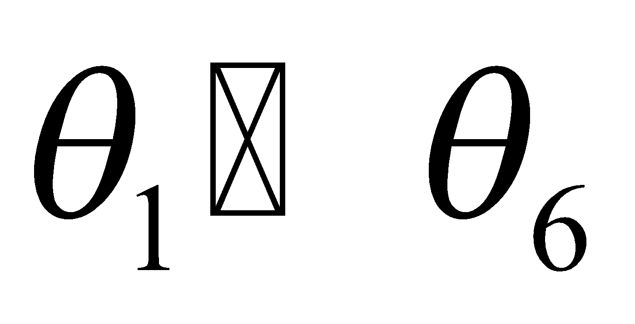
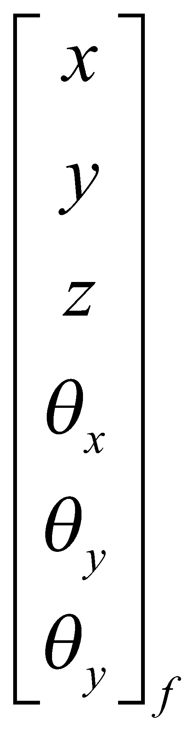
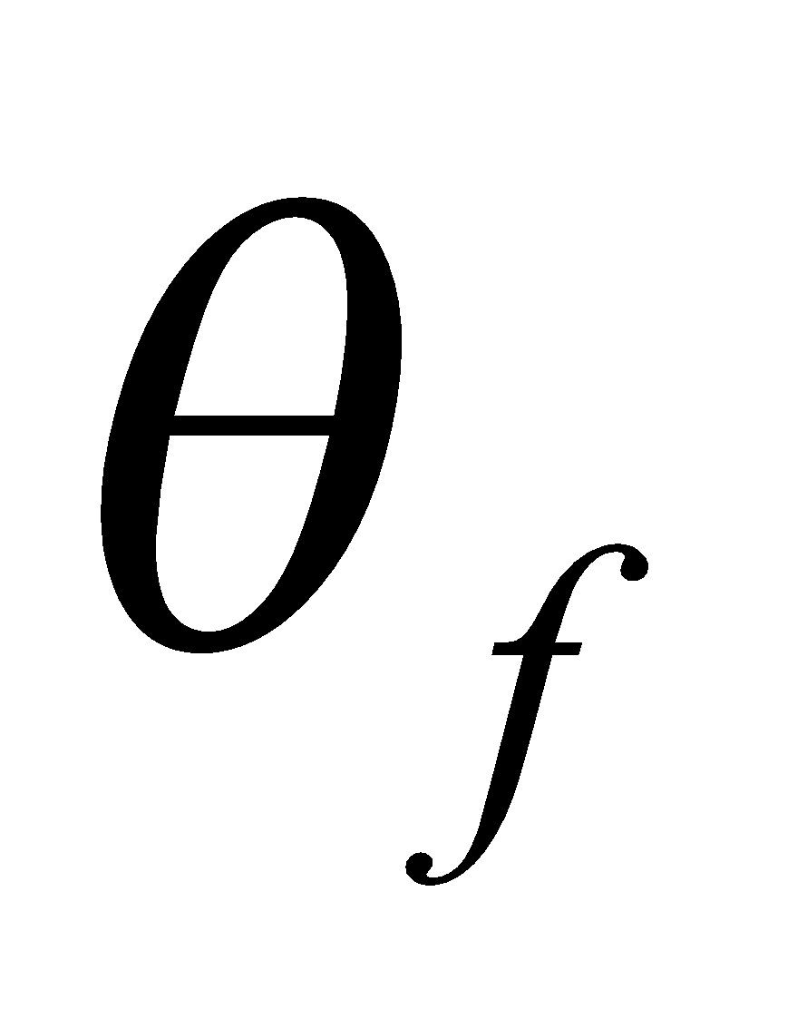
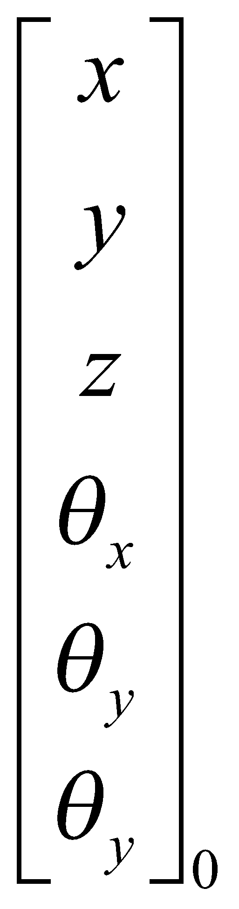
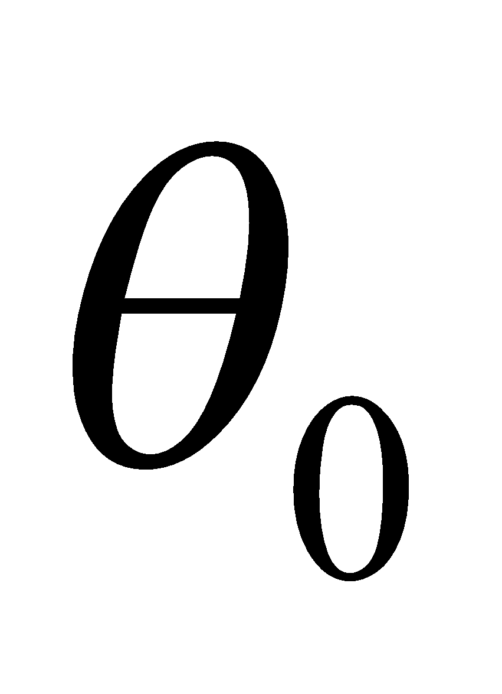
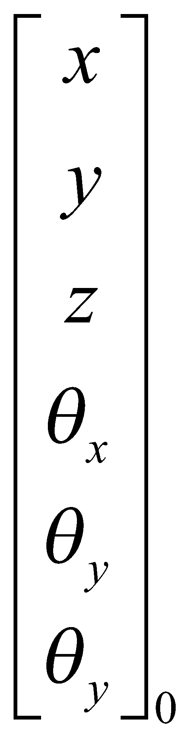
Task Space Versus Joint Space - Interpolations
Joint Space
Task Space
Inverse
Kinematics
Inverse
Kinematics
Inverse
Kinematics
Inverse
Kinematics
Inverse
Kinematics
Inverse
Kinematics
+
+
Interpolations at
the Joint Space
Inverse
Kinematics
Inverse
Kinematics
Inverse
Kinematics
Inverse
Kinematics
Inverse
Kinematics
Inverse
Kinematics
Inverse
Kinematics
+
+
Interpolations at
the Task Space

Slide 5
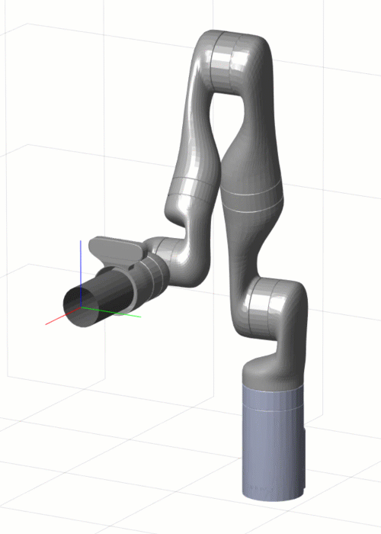
Task Space Scheme – Problem Definition
Orientation Problem

Slide 6
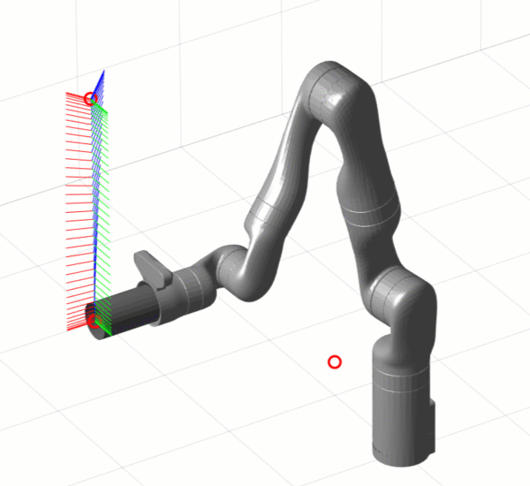
Task Space Scheme – Problem Definition
Position / Orientation Problem – Trapezoid Velocity

Slide 7
Join Space Versus Task Space – Comparison
Parameter | Joint Space | Task Space
Interpolation Space intermediate points along the trajectory | Joint Space | Task Space
Tool Trajectory Type / Length | Curved Line / Long | Straight Lines / Short
Invers Kinematics (IK) Usage | Low | High
Computation Expense (IK) | Low (IK for Start/Finish & Via Points ) | High (IK for every single point / time steo on the trajectory)
Passing through Via Points | No (Correction by establishing Pseudo Points) | Yes
Via Points Defined in the Task Space | No | Yes
Path Dependency on a Specific Manipulator | Yes | No
Notes:
7

Slide 8
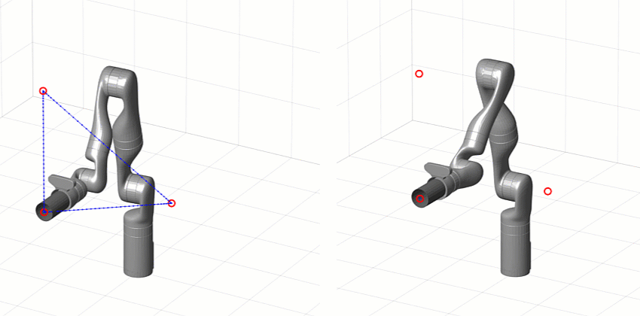
Cartesian Space Schemes – Introduction
Joint Space Schemes
  Advantages
    Path go through all the via and goal points
    Points can be specified by Cartesian frames.
  Disadvantages -
    End effector moves along a curved line (not a straight line - shortest distance).
    Path depends on the particular joint kinematics of the manipulator i.e. if the type of the manipulator changes the path between the via points will change too.
Notes:
8

Slide 9
Cartesian Space Schemes – Introduction
Cartesian Space Scheme
  Advantage
    Most common path is straight line (shortest). Other shapes can also be used.
  Disadvantage
    Computationally expansive to execute – At run time the inverse kinematics needs to be solved at path update rate (60-2000 Hz)
Notes:
9

Slide 10
Trajectory Generation – Roadmap Diagram
1st Order
Linear
Single Time
Interval
Polynomials
3^{ed} Order
Cubic
5th Order
Quantic
Linear Function with
Parabolic Blend
Joint Space
User Defined
Function
Trajectory
Generation
Multiple Time
Intervals (Via Points)
Heuristic
System Defined
Function
3^{ed} Order
Cubic
Linear Function with
Parabolic Blend
Task Space
Linear Function with
Parabolic Blend

Slide 11
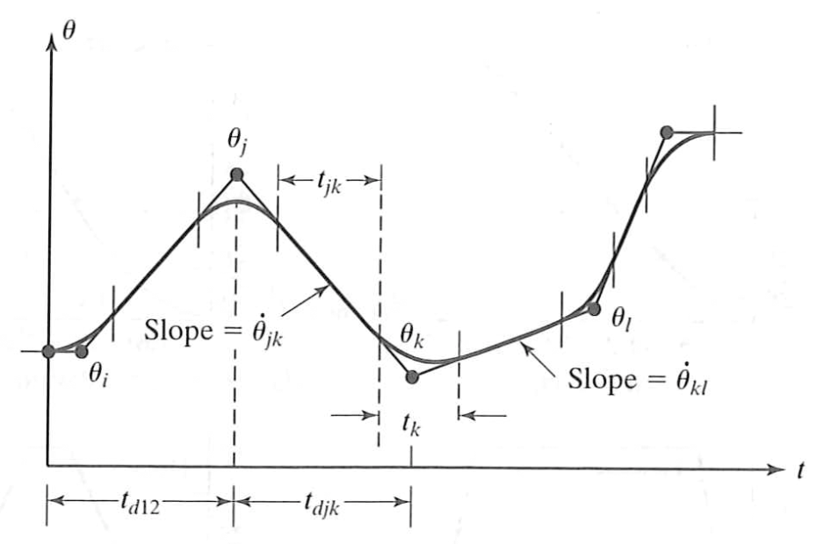
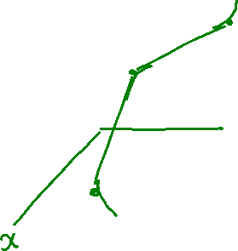
Cartesian Space Scheme – Cartesian Straight Line
General Approach - Define the path (in the Cartesian space) as
  Straight lines (linear functions)
  Parabolic lines (blends)

Slide 12
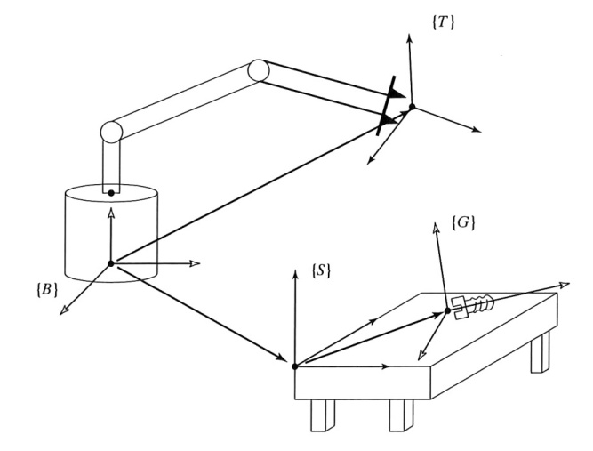
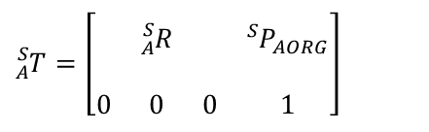
Task Space Scheme – Problem Definition
Position / Orientation Problem
General Approach (continue)
  Every point along the path is defined by position and orientation of the end effector
  End Effector Position – Vector – Easy interpolation
  End Effector Ordination – Matrix – Impossible to interpolate (interpolating the individual elements of the matrix violate the requirements that all column of the matrix must be orthogonal)
$${}_{A}^{S}T=\left[\begin{matrix} & & & \\ & {}_{A}^{S}R & & {{}_{ }^{S}P}_{AORG} \\ & & & \\ 0 & 0 & 0 & 1\end{matrix}\right]$$

Slide 13
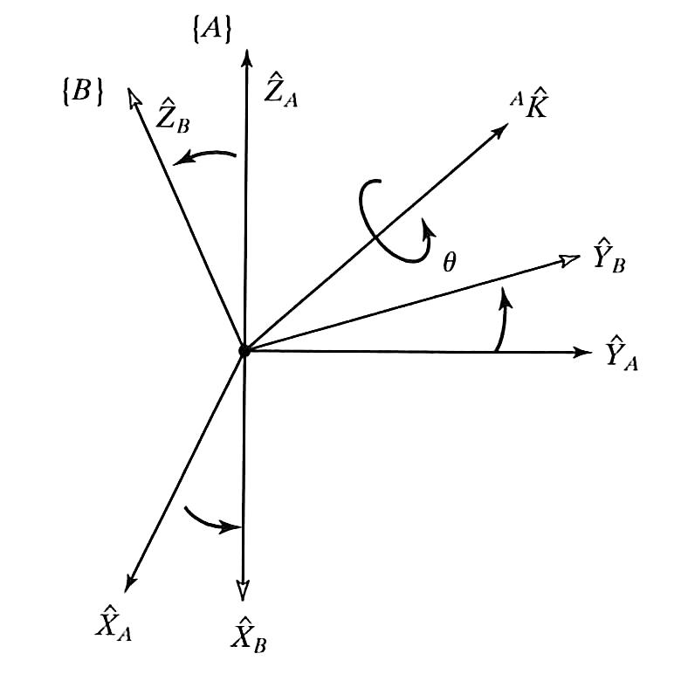


Task Space Scheme – Problem Definition
Orientation Problem - Equivalent Angle – Axis Representation
Euler's Rotation Theorem
  Any combination of rotations of a rigid body, is equivalent to a single rotation by $θ$ about some axis that runs through the fixed point$\hat{{}_{ }^{A}K}$.
  Equivalent Angle – Axis Representation
$${}_{B}^{A}R(\hat{K},θ) or R_{K}(θ)$$

Slide 14

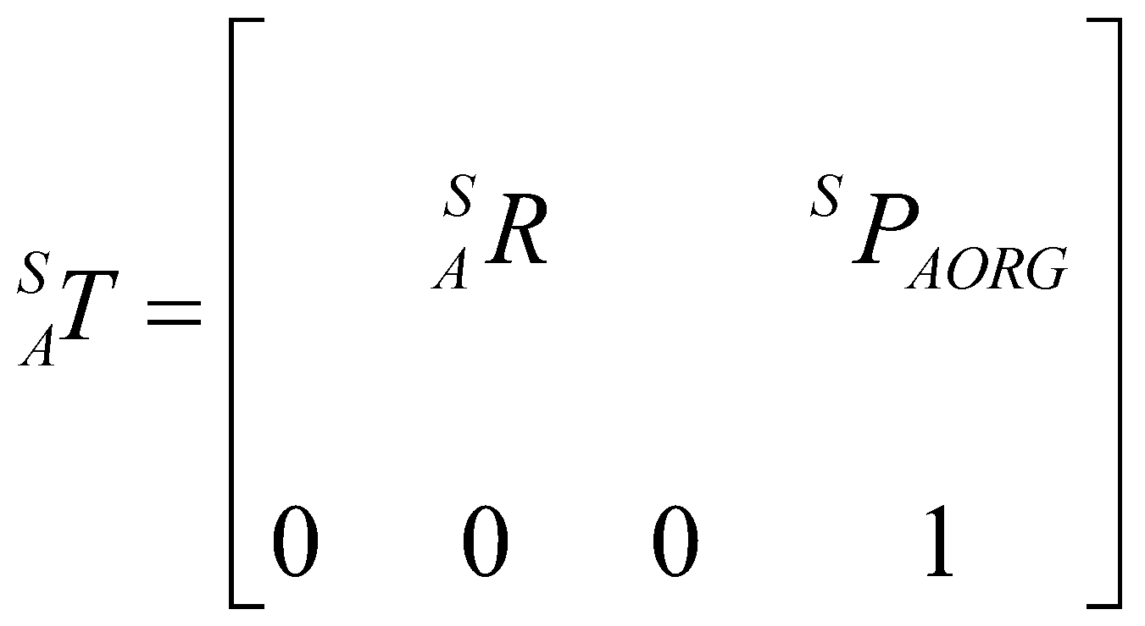


Task Space Scheme – Problem Definition
Position / Orientation Problem - Equivalent Angle – Axis Representation
Combining the angle-axis representation of orientation with the 3x1 Cartesian position representation we have a 6x1 representation of Cartesian position and orientation.
Consider a via point (Point A) specified relative to a station frame (S) as
  Frame {A} specifies a via point
    Position of the end effector given by
    Orientation of the end effector given by

Slide 15

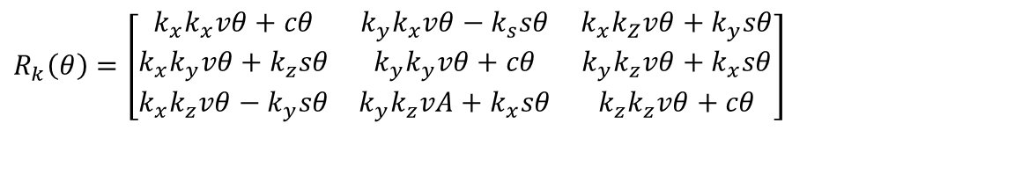
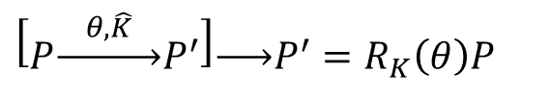
Task Space Scheme – Problem Definition
Orientation Problem - Equivalent Angle – Axis Representation
Conversion 1 - Conversion for single angle axis representation to rotation matrix representation
$$\left[P\underset{→}{ θ,\hat{K} }P^{′}\right]\underset{→}{ }P^{′}=R_{K}\left(θ\right)P$$
$$R_{k}\left(θ\right)=\left[\begin{matrix}k_{x}k_{x}vθ+cθ & k_{y}k_{x}vθ−k_{s}sθ & k_{x}k_{Z}vθ+k_{y}sθ \\ k_{x}k_{y}vθ+k_{z}sθ & k_{y}k_{y}vθ+cθ & k_{y}k_{z}vθ+k_{x}sθ \\ k_{x}k_{z}vθ−k_{y}sθ & k_{y}k_{z}vA+k_{x}sθ & k_{z}k_{z}vθ+cθ\end{matrix}\right]$$
$$\left\{\begin{matrix}cθ=\cos\left(θ\right) \\ sθ=\sin\left(θ\right) \\ vθ=1−\cos\left(θ\right)\end{matrix}\right.$$

Slide 16
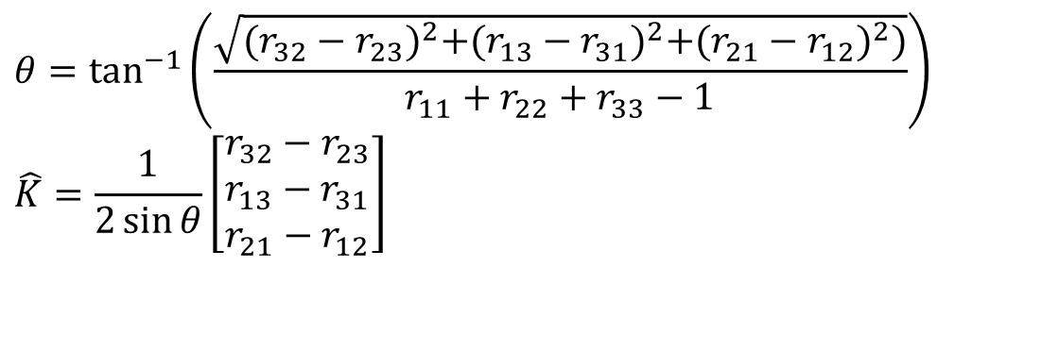
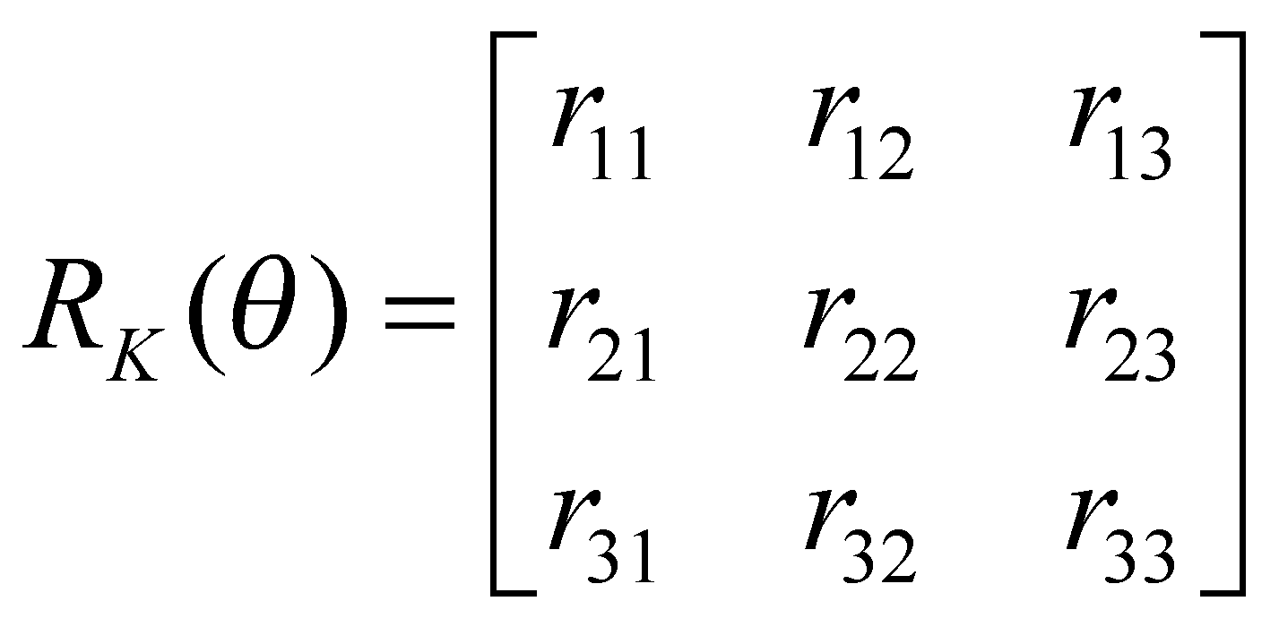

Task Space Scheme – Problem Definition
Orientation Problem - Equivalent Angle – Axis Representation
Conversion 2 – Conversion from a rotation matrix representation single axis represtation
$$P^{′}=R_{K}\left(θ\right)P\underset{→}{ }P\underset{→}{ θ,\hat{K} }P^{′}$$

Slide 17
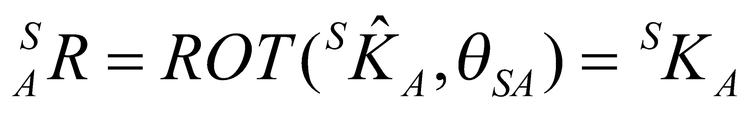
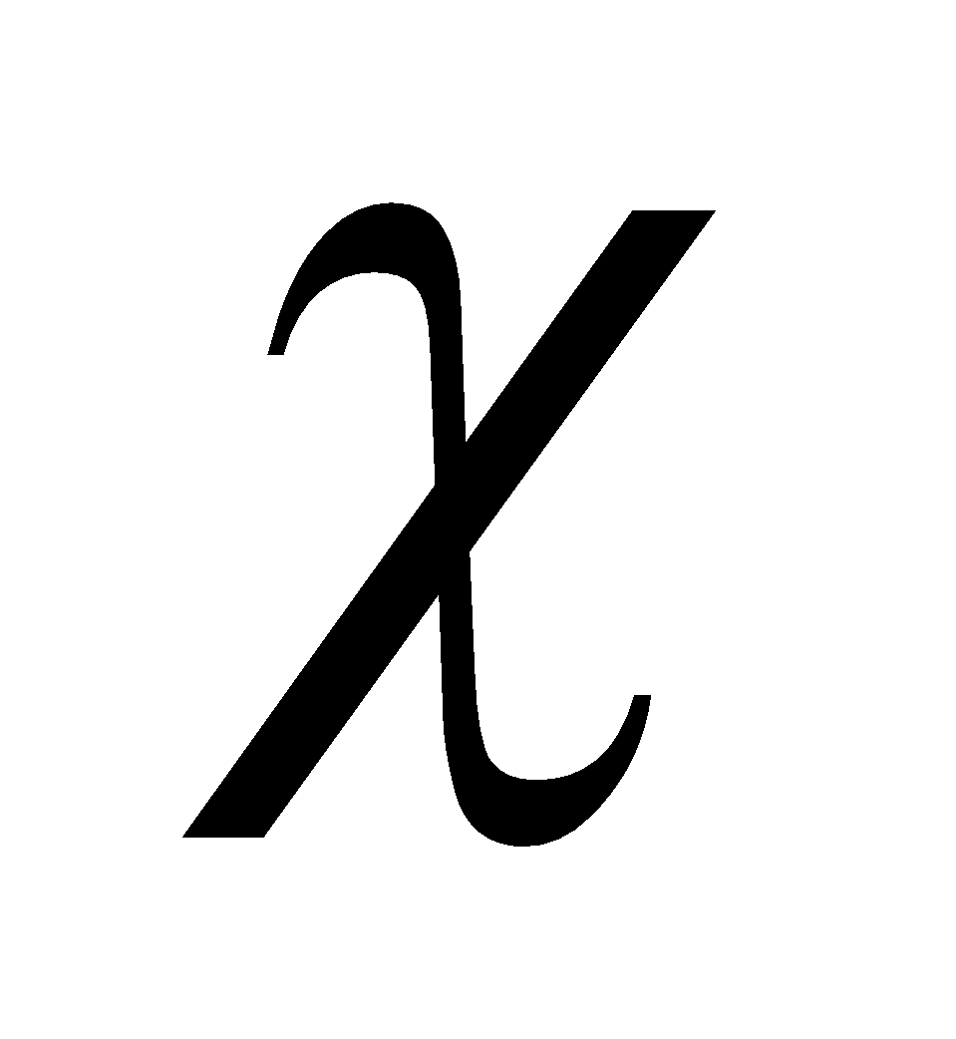
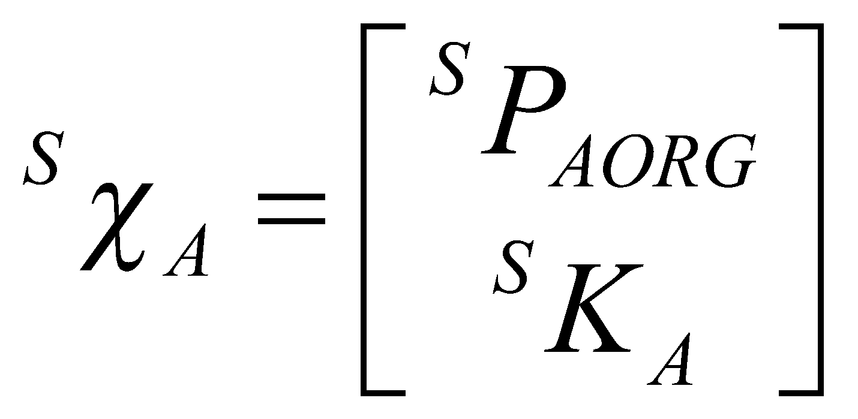
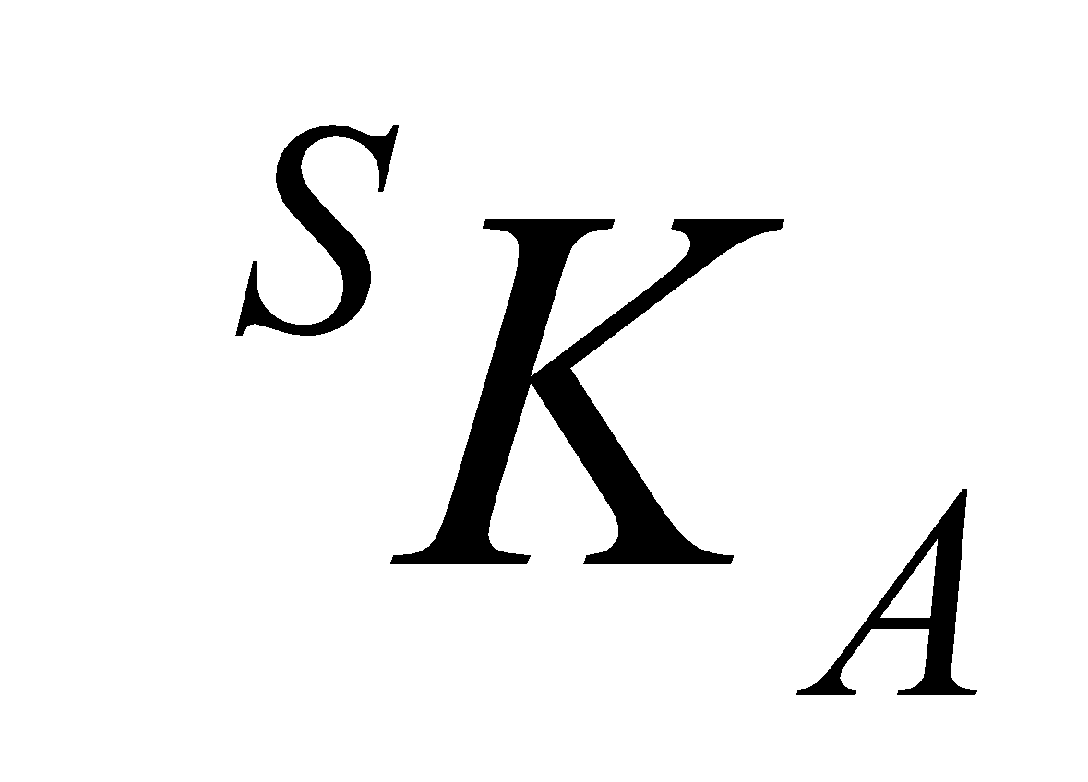
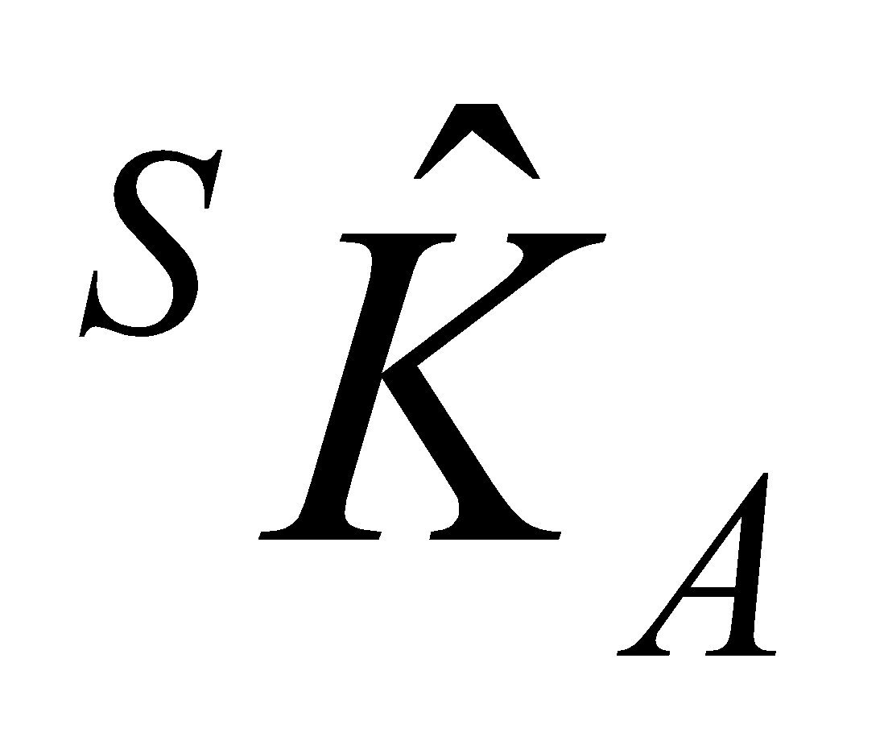
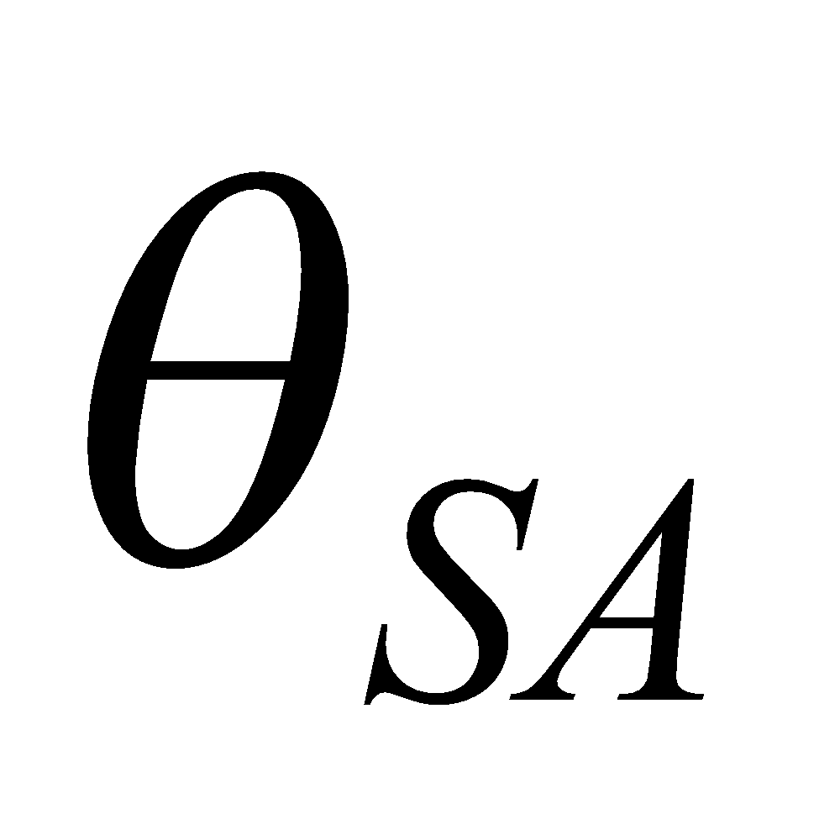
Task Space Scheme – Problem Definition
Position / Orientation Problem - Equivalent Angle – Axis Representation
Convert the rotation matrix into an angle axis representation
Use the symbol to represent 6x1 position and orientation
Where is formed by scaling the unite vector by the amount of rotation

Slide 18
Task Space Scheme – Cartesian Straight Line
Process - For a given trajectory we describe a spline function that smoothly vary these six quantities from path point to path point as a function of time.
Spline type - Once the vector is defined every single interpolation that is applicable at the Joint Space is also applicable in the task space
Common Spline - Linear Spline with parabolic bland

Slide 19
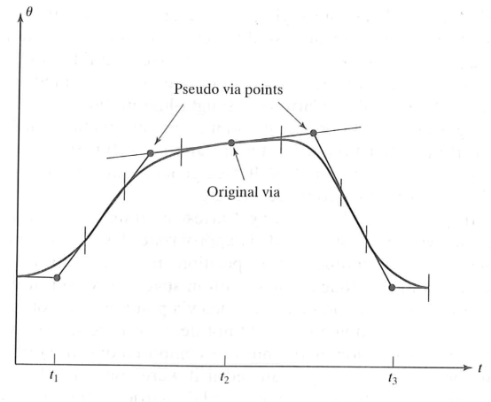
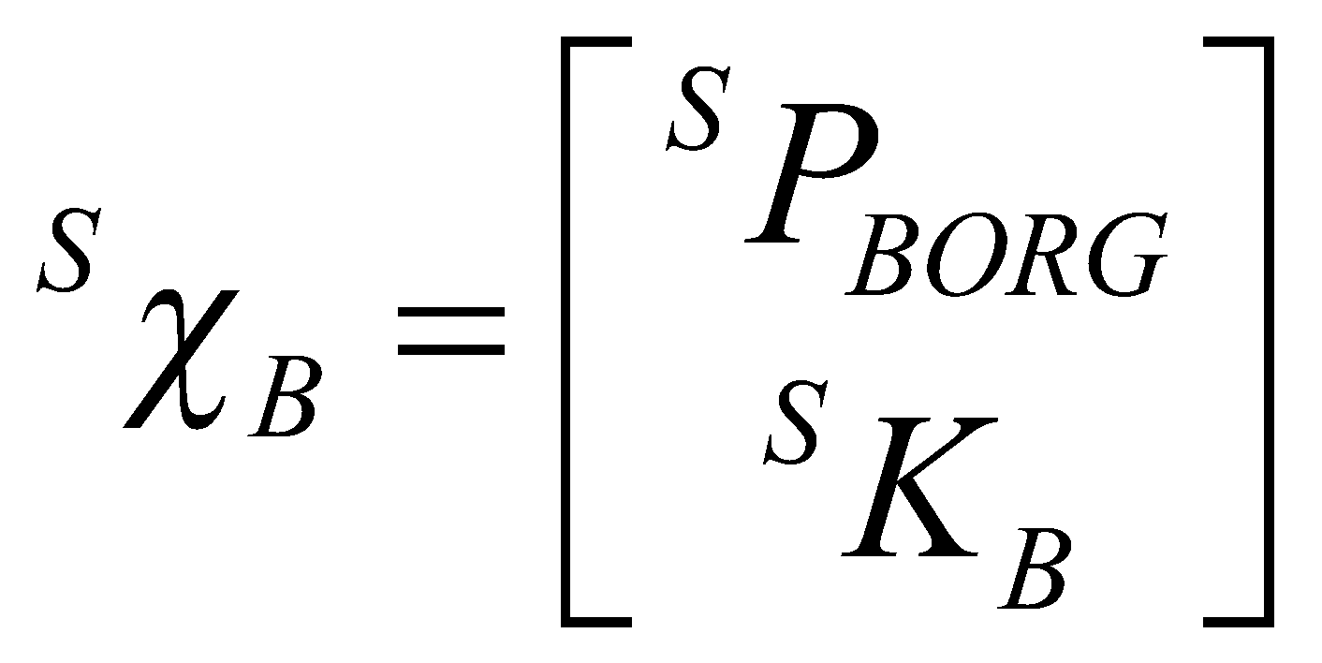
Task Space Scheme – Cartesian Straight Line
The splines are composed of linear and parabolic blend section
Constrain
  The transition between the linear segment and the parabolic segment for all the DOF must take place at the same time. Therefore using Pseudo via points in the task space is mandatory

Slide 20
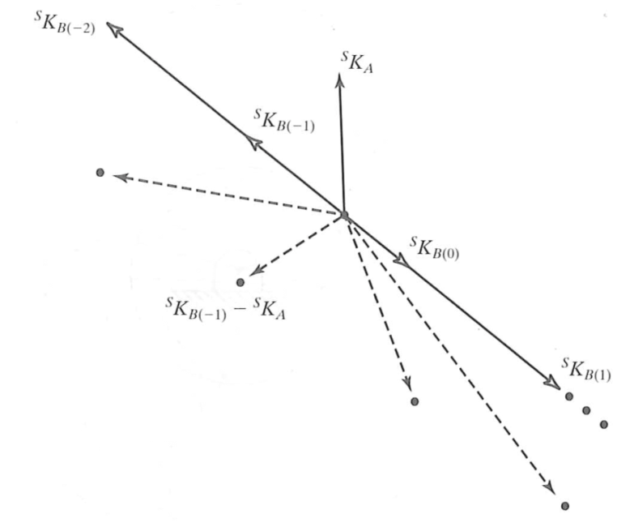
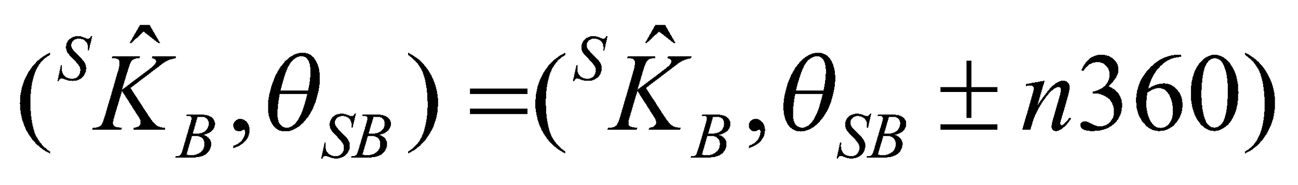
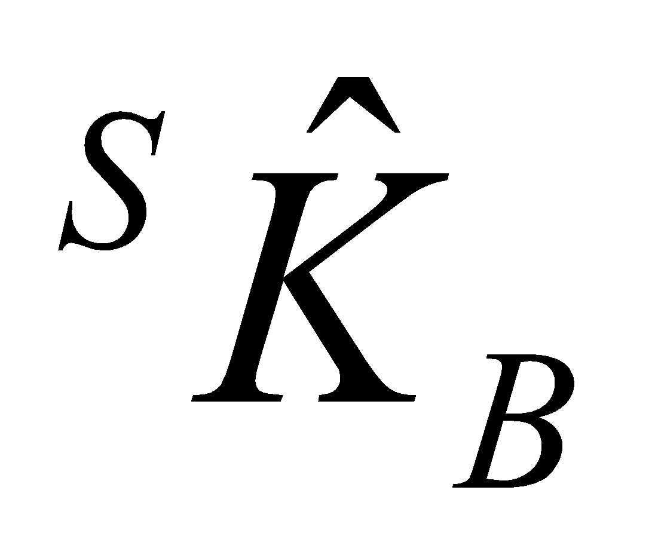
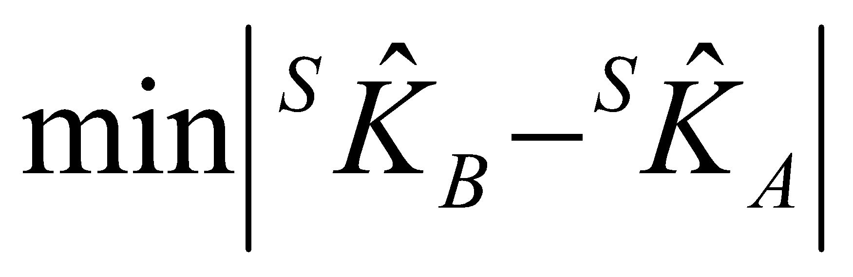
Task Space Scheme – Cartesian Straight Line
Complication – The angle-axis representation is not unique
In going from via point {A} to a via point {B}, the total amount of rotation should be minimized
Choose such that

Slide 21
Path Generation – Summary
Task Space

Slide 22
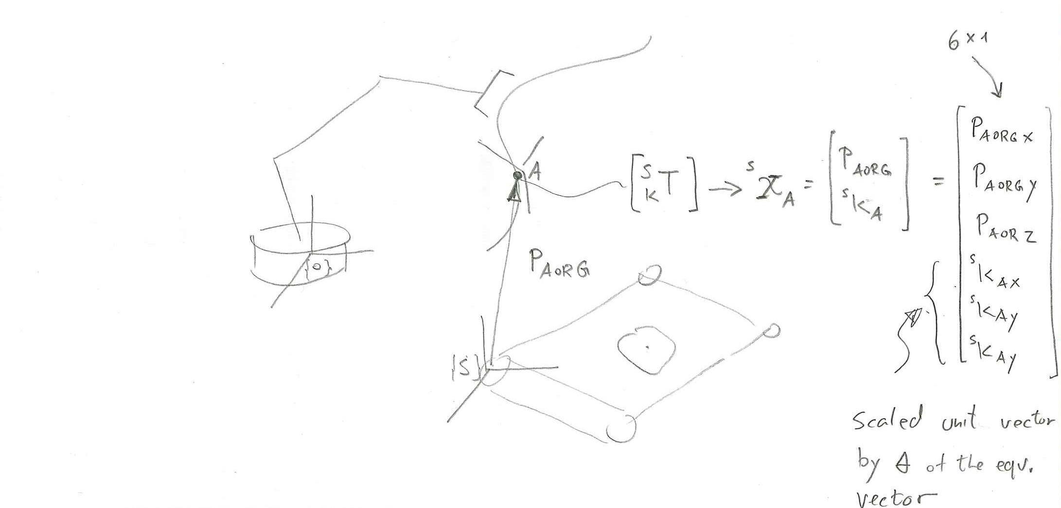
Task Generation at Run Time – Task Space

Slide 23


















Joint Space Schemes – Multiple Time Intervals – Via Points –
Linear Polynomials
$$θ\left(0\right)=θ_{0}$$
$$θ\left(t_{f}\right)=θ_{f}$$
$${θ_{j}}_{ }$$
$${θ_{n−1}}_{ }$$
$${θ_{2}}_{ }$$
$${θ_{l}}_{ }$$
Joint Angle - $θ$
$${θ_{k}}_{ }$$
Slope
$${{\dot{θ}}_{12}}_{ }$$
$${θ_{n}}_{ }$$
Slope
$${{\dot{θ}}_{jk}}_{ }$$
Slope
$${{\dot{θ}}_{kl}}_{ }$$
Slope
$${{\dot{θ}}_{\left(n−1\right)n}}_{ }$$
$${θ_{1}}_{ }$$
$${t_{d12}}_{ }$$
$${t_{djk}}_{ }$$
$${t_{dkl}}_{ }$$
$${t_{d\left(n−1\right)n}}_{ }$$
(+) Known - Time Duration between Start / Via / End Points
(+) Known – Joint Angles
Time - $t_{ }$
Notes:
23

Slide 24


Joint Space Schemes – Multiple Time Intervals – Via Points –
Linear Polynomials
$$θ=θ_{0}+\left(\frac{θ_{f}−θ_{0}}{t_{f}}\right)t$$
$$θ\left(0\right)=θ_{0}$$
$$θ\left(t_{f}\right)=θ_{f}$$

Slide 25














Joint Space Schemes – Multiple Time Intervals – Via Points –
Cubic Polynomials – Non Zero Velocity
$$θ(0)=θ_{0} \\ θ(t_{f})=θ_{f} \\ \dot{θ}(0)={\dot{θ}}_{0} \\ \dot{θ}(t_{f})={\dot{θ}}_{f}$$
$${θ_{2}}_{ }$$
$${\dot{θ}}_{2}$$
$${\begin{aligned}θ_{j} \\ {\dot{θ}}_{j}\end{aligned}}_{ }$$
$${θ_{n−1}}_{ }$$
$${\dot{θ}}_{\left(n−1\right)n}$$
$${θ_{l}}_{ }$$
$${\dot{θ}}_{k}$$
Joint Angle - $θ$
$${\begin{aligned}θ_{k} \\ {\dot{θ}}_{k}\end{aligned}}_{ }$$
$${θ_{n}}_{ }$$
$${\dot{θ}}_{\left(n−1\right)n}$$
Slope
$${{\dot{θ}}_{\left(n−1\right)n}}_{ }$$
$${θ_{1}}_{ }$$
$${\dot{θ}}_{1}$$
$${t_{d12}}_{ }$$
$${t_{djk}}_{ }$$
$${t_{dkl}}_{ }$$
$${t_{d\left(n−1\right)n}}_{ }$$
(+) Known - Time Duration between Start / Via / End Points
(+) Known – Joint Angles
(+) Known – Joint Velocities
Time - $t_{ }$
Notes:
25

Slide 26



Joint Space Schemes – Multiple Time Intervals – Via Points –
Cubic Polynomials – Non Zero Velocity
$$θ(t)=a_{0}+a_{1}t+a_{2}t^{2}+a_{3}t^{3} \\ \dot{θ}(t)=a_{1}+2a_{2}t+3a_{3}t^{2} \\ \ddot{θ}(t)=2a_{2}+6a_{3}t$$
$$θ(0)=θ_{0} \\ θ(t_{f})=θ_{f} \\ \dot{θ}(0)={\dot{θ}}_{0} \\ \dot{θ}(t_{f})={\dot{θ}}_{f}$$
$$a_{0}=θ_{0} \\ a_{1}={\dot{θ}}_{0} \\ a_{2}=\frac{3}{t_{f}^{2}}(θ_{f}−θ_{0})−\frac{2}{t_{f}}{\dot{θ}}_{0}−\frac{1}{t_{f}}{\dot{θ}}_{f} \\ a_{3}=−\frac{2}{t_{f}^{3}}(θ_{f}−θ_{0})+\frac{2}{t_{f}^{2}}({\dot{θ}}_{f}+{\dot{θ}}_{0})$$
Notes:
26

Slide 27







Joint Space Schemes – Multiple Time Intervals – Via Points –
Quantic Polynomials - Non Zero Acceleration
$$θ(0)=θ_{0} \\ θ(t_{f})=θ_{f} \\ \dot{θ}(0)={\dot{θ}}_{0} \\ \dot{θ}(t_{f})={\dot{θ}}_{f} \\ \ddot{θ}(0)={\ddot{θ}}_{0} \\ \ddot{θ}(t_{f})={\ddot{θ}}_{f}$$
$${θ_{2}}_{ }$$
$${\dot{θ}}_{2}$$
$${\begin{aligned}θ_{j} \\ {\dot{θ}}_{j}\end{aligned}}_{ }$$
$${θ_{n−1}}_{ }$$
$${\dot{θ}}_{\left(n−1\right)n}$$
$${θ_{l}}_{ }$$
$${\dot{θ}}_{k}$$
Joint Angle - $θ$
$${\begin{aligned}θ_{k} \\ {\dot{θ}}_{k}\end{aligned}}_{ }$$
$${θ_{n}}_{ }$$
$${\dot{θ}}_{\left(n−1\right)n}$$
Slope
$${{\dot{θ}}_{\left(n−1\right)n}}_{ }$$
$${θ_{1}}_{ }$$
$${\dot{θ}}_{1}$$
$${t_{d12}}_{ }$$
$${t_{djk}}_{ }$$
$${t_{dkl}}_{ }$$
$${t_{d\left(n−1\right)n}}_{ }$$
(+) Known - Time Duration between Start / Via / End Points
(+) Known – Joint Angles
(+) Known – Joint Velocities
(+) Known – Joint Acceleration
Time - $t_{ }$
Notes:
27

Slide 28


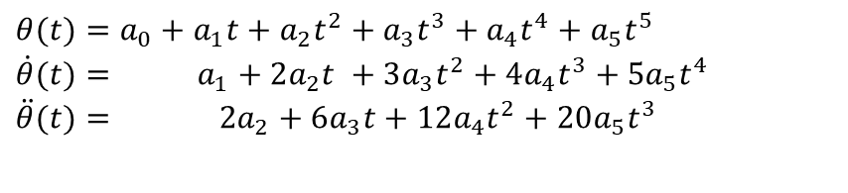
Joint Space Schemes – Multiple Time Intervals – Via Points –
Quantic Polynomials - Non Zero Acceleration
$$θ(t)=a_{0}+a_{1}t+a_{2}t^{2}+a_{3}t^{3}+a_{4}t^{4}+a_{5}t^{5} \\ \dot{θ}(t)= a_{1}+2a_{2}t^{ }+3a_{3}t^{2}+4a_{4}t^{3}+5a_{5}t^{4} \\ \ddot{θ}(t)= 2a_{2}+6a_{3}t+12a_{4}t^{2}+20a_{5}t^{3}$$
$$θ(0)=θ_{0} \\ θ(t_{f})=θ_{f} \\ \dot{θ}(0)={\dot{θ}}_{0} \\ \dot{θ}(t_{f})={\dot{θ}}_{f} \\ \ddot{θ}(0)={\ddot{θ}}_{0} \\ \ddot{θ}(t_{f})={\ddot{θ}}_{f}$$
$$a_{0}=θ_{0} \\ a_{1}={\dot{θ}}_{0} \\ a_{2}=\frac{{\ddot{θ}}_{0}}{2} \\ a_{3}=\frac{20θ_{f}−20θ_{0}−(8{\dot{θ}}_{f}+12{\dot{θ}}_{0})t_{f}−(3{\ddot{θ}}_{0}−{\ddot{θ}}_{f})t_{f}^{2}}{2t_{f}^{3}} \\ a_{4}=\frac{30θ_{0}−30θ_{f}+(14{\dot{θ}}_{f}+16{\dot{θ}}_{0})t_{f}+(3{\ddot{θ}}_{0}−2{\ddot{θ}}_{f})t_{f}^{2}}{2t_{f}^{4}} \\ a_{5}=\frac{12θ_{f}−12θ_{0}−(6{\dot{θ}}_{f}+6{\dot{θ}}_{0})t_{f}−({\ddot{θ}}_{0}−{\ddot{θ}}_{f})t_{f}^{2}}{2t_{f}^{5}}$$
Notes:
28

Slide 29
















Joint Space Schemes – Multiple Time Intervals – Via Points –
Linear Function With Parabolic Blend
$${t_{d12}−{\frac{t_{1}}{2}}_{ }}_{ }$$
$${t_{j}}_{ }$$
$${t_{l}}_{ }$$
${t_{d\left(n−1\right)n}}_{ }$- $\frac{t_{n}}{2}$
$${t_{12}}_{ }$$
$${θ_{j}}_{ }$$
$${t_{jk}}_{ }$$
$${t_{kl}}_{ }$$
$${θ_{n−1}}_{ }$$
$${t_{\left(n−1\right)n}}_{ }$$
$${θ_{2}}_{ }$$
$${θ_{l}}_{ }$$
Joint Angle - $θ$
$${θ_{k}}_{ }$$
Slope
$${{\dot{θ}}_{12}}_{ }$$
Slope
$${{\dot{θ}}_{jk}}_{ }$$
$${θ_{n}}_{ }$$
Slope
$${{\dot{θ}}_{kl}}_{ }$$
Slope
$${{\dot{θ}}_{\left(n−1\right)n}}_{ }$$
$${θ_{1}}_{ }$$
$${\frac{t_{1}}{2}}_{ }$$
$${\frac{t_{1}}{2}}_{ }$$
$${\frac{t_{n}}{2}}_{ }$$
$${\frac{t_{n}}{2}}_{ }$$
$${t_{k}}_{ }$$
$${t_{1}}_{ }$$
$${t_{n}}_{ }$$
$${t_{d12}}_{ }$$
$${t_{djk}}_{ }$$
$${t_{dkl}}_{ }$$
$${t_{d\left(n−1\right)n}}_{ }$$
(+) Known - Time Duration between Start / Via / End Points
(-) Unknown - Time Duration of the Parabolic Segment
(-) Unknown – Time Duration of the Linear Segment
Time - $t_{ }$
Notes:
29

Slide 30
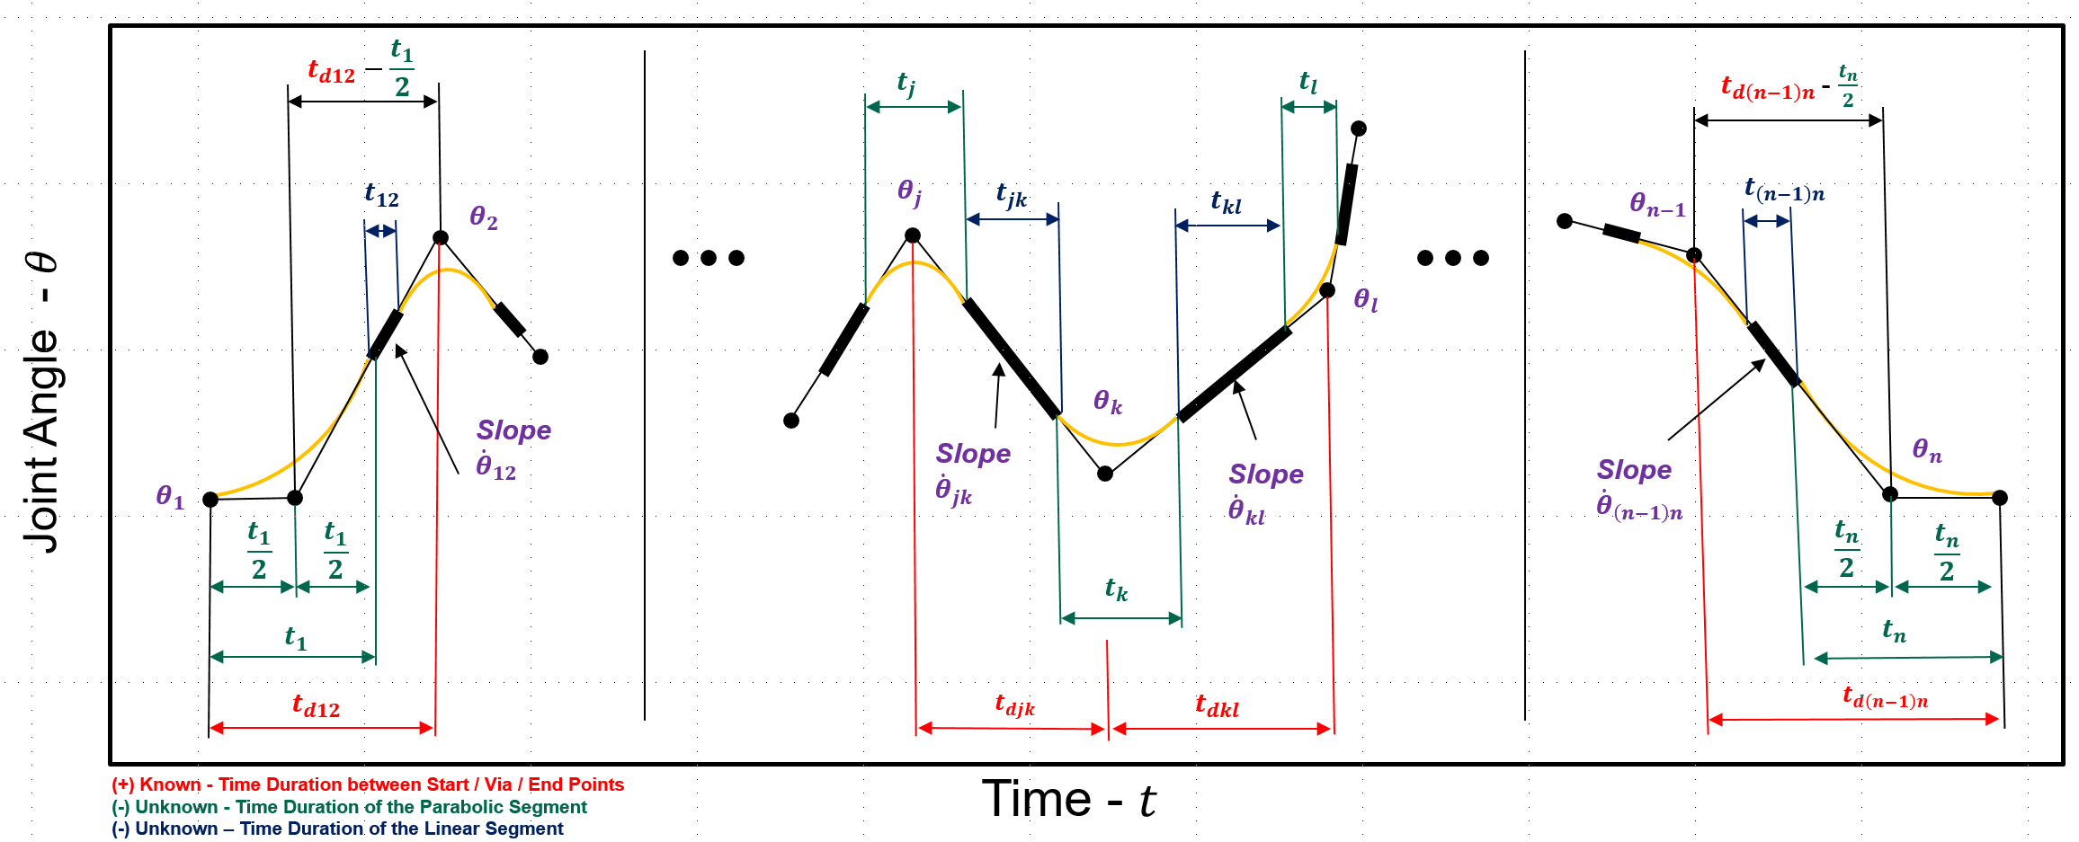
Joint Space Schemes – Multiple Time Intervals – Via Points –
Linear Function With Parabolic Blend
Tasks No. 1 – Time Intervals / Velocity / Acceleration
  Calculate the time intervals of the parabolic blending (marked in green)
  Calculate the time intervals of the linear functions (marked in blue)
  Calculate the direction of the acceleration during the linear bland
  Calculate the velocity during the linear spline
Task No. 2 – Functions
  Define the Linear Functions (marked in black)
  Defined the parabolic blend functions (marked in gray)
Assume 4 intervals
First Interval: 1→2
Intermediate Interval: 2 → 3
Last Interval: 2 → 3
Notes:
30

Slide 31

Joint Space Schemes – Multiple Time Intervals – Via Points –
Linear Function With Parabolic Blend
Tasks No. 1
  First Interval - 1→2
  $$t_{1}=t_{d12}−\sqrt{t_{d12}^{2}−\frac{2\left(θ_{2}−θ_{1}\right)}{{\ddot{θ}}_{1}}}$$
  ${\ddot{θ}}_{1}=SGN\left(θ_{2}−θ_{1}\right)\left|{\ddot{θ}}_{1}\right|$
  $${\dot{θ}}_{12}=\frac{θ_{2}−θ_{1}}{t_{d12}−\frac{1}{2}t_{1}}$$
Notes:
31

Slide 32

Joint Space Schemes – Multiple Time Intervals – Via Points –
Linear Function With Parabolic Blend
Tasks No. 1
  Intermediate Interval (Repeat for any intermediate interval ) - 2→3
${\dot{θ}}_{jk}=\frac{θ_{k}−θ_{j}}{t_{djk}}$
$\left\{\begin{aligned}j=2 \\ k=3\end{aligned}\right.$ $→{\dot{θ}}_{23}=\frac{θ_{3}−θ_{1}}{t_{d23}}$
${\ddot{θ}}_{k}=SIG\left({\dot{θ}}_{kl}−{\dot{θ}}_{jk}\right)\left|{\ddot{θ}}_{k}\right|$
$\left\{\begin{aligned}j=1 \\ k=2 \\ l=3\end{aligned}\right.→{\ddot{θ}}_{2}=SIG\left({\dot{θ}}_{23}−{\dot{θ}}_{12}\right)\left|{\ddot{θ}}_{2}\right|$
$t_{k}=\frac{{\dot{θ}}_{kl}−{\dot{θ}}_{jk}}{{\ddot{θ}}_{k}}$
$\left\{\begin{aligned}j=1 \\ k=2 \\ l=3\end{aligned}\right.→t_{2}=\frac{{\dot{θ}}_{23}−{\dot{θ}}_{12}}{{\ddot{θ}}_{2}}$
$$t_{d12}−t_{1}−\frac{1}{2}t_{2}$$
Notes:
32

Slide 33

Joint Space Schemes – Multiple Time Intervals – Via Points –
Linear Function With Parabolic Blend
Tasks No. 1
  Final Interval - 3→4
$${\ddot{θ}}_{n}=SGN\left(θ_{n−1}−θ_{n}\right)\left|{\ddot{θ}}_{n}\right|$$
  $$n=4→{\ddot{θ}}_{4}=SGN\left(θ_{3}−θ_{4}\right)\left|{\ddot{θ}}_{4}\right|$$
  $$t_{n}=t_{d\left(n−1\right)n}−\sqrt{t_{d\left(n−1\right)n}^{2}−\frac{2\left(θ_{n−1}−θ_{n}\right)}{{\ddot{θ}}_{n}}}$$
  $n=4→t_{4}=t_{d34}−\sqrt{t_{d34}^{2}−\frac{2\left(θ_{3}−θ_{4}\right)}{{\ddot{θ}}_{4}}}$
  $${\dot{θ}}_{\left(n−1\right)n}=\frac{θ_{n}−θ_{n−1}}{t_{d\left(n−1\right)n}−\frac{1}{2}t_{n}}$$
  $n=4→{\dot{θ}}_{34}=\frac{θ_{4}−θ_{3}}{t_{d34}−\frac{1}{2}t_{4}}$
Notes:
33

Slide 34

Joint Space Schemes – Multiple Time Intervals – Via Points –
Linear Function With Parabolic Blend
Tasks No. 1
  Final Interval - 3→4 (Continue)
  (Interval Prior to the final interval)
$${\ddot{θ}}_{k}=SGN\left({\dot{θ}}_{kl}−{\dot{θ}}_{jk}\right)\left|{\ddot{θ}}_{k}\right|$$
$\left\{\begin{aligned}j=2 \\ k=3 \\ l=4\end{aligned}\right.→{{\ddot{θ}}_{3}=SGN\left({\dot{θ}}_{34}−{\dot{θ}}_{23}\right)\left|{\ddot{θ}}_{3}\right| \atop }$
$t_{k}=\frac{{\dot{θ}}_{kl}−{\dot{θ}}_{jk}}{{\ddot{θ}}_{k}}$
$\left\{\begin{aligned}j=2 \\ k=3 \\ l=4\end{aligned}\right.→t_{3}=\frac{{\dot{θ}}_{34}−{\dot{θ}}_{23}}{{\ddot{θ}}_{3}}$
Notes:
34

Slide 35

Joint Space Schemes – Multiple Time Intervals – Via Points –
Linear Function With Parabolic Blend
Tasks No. 1
  Final Interval - 3→4 (Continue)
  (Interval Prior to final interval & Final Inetrval)
$$t_{jk}=t_{djk}−\frac{1}{2}t_{j}−\frac{1}{2}t_{k}$$
$\left\{\begin{aligned}j=2 \\ k=3\end{aligned}\right.→t_{23}=t_{d23}−\frac{1}{2}t_{2}−\frac{1}{2}t_{3}$
$t_{\left(n−1\right)n}=t_{d\left(n−1\right)n}−t_{n}−\frac{1}{2}t_{n−1}$
$n=4→t_{34}=t_{d34}−t_{4}−\frac{1}{2}t_{3}$
Notes:
35

Slide 36








Joint Space Schemes – Multiple Time Intervals – Via Points –
Linear Function With Parabolic Blend – Example
Tasks No. 2 – Linear & parabolic functions
  First Segment
$$θ=θ_{1}+{\dot{θ}}_{12}t$$
$$θ=θ_{0}+\frac{1}{2}\frac{{\dot{θ}}_{12}}{t_{1}}t^{2}$$
$t_{inb}$=t
  Mid Segment
$$θ=θ_{j}+{\dot{θ}}_{jk}t$$
$$θ=θ_{j}+{\dot{θ}}_{jk}\left(t−t_{inb}\right)+\frac{1}{2} {\ddot{θ}}_{k}^{2}t_{inb}$$
$$t_{inb}=t−\left(\frac{1}{2}t_{j}+t_{jk}\right)$$
  Last Segment
  $$θ=θ_{n−1}+{\dot{θ}}_{\left(n−1\right)n}t$$
  $$θ=θ_{inb}+θ_{\left(n−1\right)n}t_{inb}−\frac{1}{2}\frac{{\dot{θ}}_{\left(n−1\right)n}}{t_{inb}}t_{inb}^{2}$$
  $$t_{inb}=t−\left(\frac{1}{2}t_{n−1}+t_{\left(n−1\right)n}\right)$$
$$t_{inb}$$
$$t=0$$
$$t_{inb}$$
$$t=0$$
$$t_{inb}$$
$$t=0$$
Notes:
36

Slide 37
Path Generation & Run Time – Summary
Task Space

Slide 38


Task Generation at Run Time – Task/Joint Space Mapping

Slide 39





Task Generation at Run Time – Task/Joint Space Mapping

Slide 40
Task Space Schemes
Geometric Problems with Paths in Task Space

Slide 41

Geometric Problems – Cartesian Paths
Problem Type 1 – Unreachable Intermediate Points
The initial and the final point are in the reachable workspace however some point along the path may be out of the workspace.
Solution
  Joint space path – unreachable
  Cartesian straight Path – reachable

Slide 42

Geometric Problems – Cartesian Paths
Problem Type 2 – High Joint Rate Near Singularity.
In singularity the velocity of one or more joint approach infinity.
The velocity of the mechanism are upper bounded, approaching singularity results in the manipulator’s deviation form the desired path.
Solution
  Slow down the velocity such that all the joint velocities will remain in their bounded velocities

Slide 43

Geometric Problems – Cartesian Paths
Problem Type 3 – Start and Goal reachable in different solutions
Joint limits may restrict the number of solutions that the manipulator may use given a goal point.
Solution
  Switch between joint space (default) and Cartesian space trajectories (used only if needed)

Slide 44
Euler’s Theorem - Equivalent Axis
Derivation

Slide 45

Task Space Scheme – Problem Definition
Orientation Problem - Equivalent Angle – Axis Representation
Euler's Rotation Theorem
  Any combination of rotations of a rigid body, is equivalent to a single rotation by $θ$ about some axis ${}_{ }^{A}{\hat{K}}$ that runs through the fixed point.
  Equivalent Angle – Axis Representation
$${}_{B}^{A}R(\hat{K},θ) or R_{K}(θ)$$

Slide 46



Task Space Scheme – Problem Definition
Orientation Problem - Equivalent Angle – Axis Representation
Start with the frame coincident with a know frame {A}; then rotate frame {B} about a vector by an angle according to the right hand rule.
Equivalent Angle – Axis Representation
Vector is called the equivalent axis of a finite rotation.
The specification of requires two parameters since it length is always 1.
The angle specify the third parameter

Slide 47



Task Space Scheme – Problem Definition
Orientation Problem - Equivalent Angle – Axis Representation
Rotate a vector $P$ through an angle $θ$ about an arbitrary axis whose direction is represented by a unite vector $\hat{A}$
Types of Transformations
  Transformation for a vector/angle form to a matrix form
  Transformation from a matrix to a vector angle form
$$\left[P\underset{→}{ θ,\hat{A} }P^{′}\right]\underset{→}{ }P^{′}=R_{A}\left(θ\right)P$$
$$P^{′}=R_{A}\left(θ\right)P\underset{→}{ }P\underset{→}{ θ,\hat{A} }P^{′}$$

Slide 48

Task Space Scheme – Problem Definition
Orientation Problem - Equivalent Angle – Axis Representation
  Transformation for a vector/angle form to a matrix form
$$\left[P\underset{→}{ θ,\hat{A} }P^{′}\right]\underset{→}{ }P^{′}=R_{A}\left(θ\right)P$$

Slide 49


Task Space Scheme – Problem Definition
Orientation Problem - Equivalent Angle – Axis Representation
Decompose the vector P into two components that are:
  Parallel to A
  Perpendicular to A
$$co=P_{∥A}=\left(P⋅A\right)A=P\cos{α}$$
$$oa=P_{⊥A}=P−\left(P⋅A\right)A=P⋅\sin{α}$$

Slide 50



Task Space Scheme – Problem Definition
Orientation Problem - Equivalent Angle – Axis Representation
Scalar multiplied by A
Vector along A with a magnitude of the projection of P an A
Note: A is a unite vector
${\vec{P}}_{∥A}$ = $\left(\vec{P}⋅\vec{A}\right)$ $\vec{A}$
Dot product PA cosα (scallar)
Projection of vector P on vector A
$$\vec{P}={\vec{P}}_{⊥A}+{\vec{P}}_{∥A}$$
$${\vec{P}}_{⊥A}=\vec{P}−P_{∥A}=\vec{P}−\left(\vec{P}⋅\vec{A}\right)\vec{A}=\left\|P\right\|\sin{α}$$

Slide 51

Task Space Scheme – Problem Definition
Orientation Problem - Equivalent Angle – Axis Representation
The cross product A×P creates a vector that is perpendicular to the plane COA (including the two vectors A and P ) therefor by definition
$\left|A×P\right|$ $=P\sin{α}$
As indicated before magnitude of $\left|oa\right|=\left|P_{⊥A}\right|$
$$\left|oa\right|=\left|P_{⊥A}\right|=P\sin{α}$$
As a result we are allowed to equate the two terms
$\left|P_{⊥A}\right|$= $\left|A×P\right|$

Slide 52



Task Space Scheme – Problem Definition
Orientation Problem - Equivalent Angle – Axis Representation
Express the rotation of $P_{⊥A}$ through an angle $θ$ as
Base on the two expressions
$\left|P_{⊥A}\right|$= $\left|A×P\right|$
$${\vec{P}}_{⊥A}=\vec{P}−P_{∥A}=\vec{P}−\left(\vec{P}⋅\vec{A}\right)\vec{A}=\left\|P\right\|\sin{α}$$
We can rewrite the expression
$$P_{⊥A}=\boxed{P_{⊥A}}\cos{θ}+\boxed{P_{⊥A}}\sin{θ}$$
$$P_{⊥A}=ob=\boxed{\left[P−\left(P⋅A\right)A\right]}\cos{θ}+\boxed{\left(A×P\right)}\sin{θ}$$

Slide 53


Task Space Scheme – Problem Definition
Orientation Problem - Equivalent Angle – Axis Representation
Example: Multiplying a vector (P) by a unit vector (A) creates a vector that is perpendicular to the plane of vector (A) and (P) and has the some magnitude as (P)
$$A×P=\left|\begin{matrix}i & j & k \\ 0 & 1 & 0 \\ 5 & 0 & 0\end{matrix}\right|=0i+0j−5k$$
$$\left|A\right|\left|P\right|\sin{θ}=1⋅5⋅\sin\left(90°\right)=5$$

Slide 54


Task Space Scheme – Problem Definition
Orientation Problem - Equivalent Angle – Axis Representation
The new vector $P^{′}$ which results from rotating vector P by A is expressed as
Rearranging this expression resulted in
$$P^{′}=ob+P_{∥A}$$
$$P^{′}=\underset{ob}{\underset{⎵}{\left[P−\left(P⋅A\right)A\right]\cos{θ}+\left(A×P\right)\sin{θ}}}+\underset{P_{∥A}}{\underset{⎵}{\left(P⋅A\right)A}}$$
$$P^{′}=P\cos{θ}+\left(A×P\right)\sin{θ}+\left(P⋅A\right)A\left[1−\cos{θ}\right]$$

Slide 55



Task Space Scheme – Problem Definition
Orientation Problem - Equivalent Angle – Axis Representation
Cross Product of vector A with P (Matrix form)
Projection of vector P on vector A (Matrix Form)
Note: If A is a unit vector $\left\|A\right\|=1$
$$A×P=\left[\begin{matrix}0 & −A_{z} & A_{y} \\ A_{z} & 0 & −A_{x} \\ −A_{y} & A_{x} & 0\end{matrix}\right]\left[\begin{matrix}P_{x} \\ P_{y} \\ P_{z}\end{matrix}\right]$$
Project$\left(P\right)=\left(P⋅A\right)A=\frac{1}{{\left\|A\right\|}^{2}}\left[\begin{matrix}A_{x}^{2} & A_{x}A_{y} & A_{x}A_{z} \\ A_{x}A_{y} & A_{y}^{2} & A_{y}A_{z} \\ A_{x}A_{z} & A_{y}A_{z} & A_{z}^{3}\end{matrix}\right]\left[\begin{matrix}P_{x} \\ P_{y} \\ P_{z}\end{matrix}\right]$

Slide 56



Task Space Scheme – Problem Definition
Orientation Problem - Equivalent Angle – Axis Representation
Plugging the matrix definitions into the expression of
Setting
Combing the terms gives us the formulation for matrix $R_{A}\left(θ\right)$ that rotates a vector P by an angle $θ$ about the axis A
$$P^{′}=P\cos{θ}+\left(A×P\right)\sin{θ}+\left(P⋅A\right)A\left(1−\cos{θ}\right)$$
$$P^{′}=\left[\begin{matrix}1 & 0 & 0 \\ 0 & 1 & 0 \\ 0 & 0 & 1\end{matrix}\right]P\cos{θ}+\left[\begin{matrix}0 & −A_{z} & A_{y} \\ A_{z} & 0 & −A_{x} \\ −A_{y} & A_{x} & 0\end{matrix}\right]P\sin{θ}+\left[\begin{matrix}A_{x}^{2} & A_{x}A_{y} & A_{x}A_{z} \\ A_{x}A_{y} & A_{y}^{2} & A_{y}A_{z} \\ A_{x}A_{z} & A_{y}A_{z} & A_{z}^{2}\end{matrix}\right]P\left(1−\cos{θ}\right)$$
$$\left\{\begin{matrix}c=\cos{θ} \\ s=\sin{θ}\end{matrix}\right.$$

Slide 57


Task Space Scheme – Problem Definition
Orientation Problem - Equivalent Angle – Axis Representation
$$P^{′}=\underset{R_{A}\left(θ\right)}{\underset{⎵}{\left\{\left[\begin{matrix}1 & 0 & 0 \\ 0 & 1 & 0 \\ 0 & 0 & 1\end{matrix}\right]\cos{θ}+\left[\begin{matrix}0 & −A_{z} & A_{y} \\ A_{z} & 0 & −A_{x} \\ −A_{y} & A_{x} & 0\end{matrix}\right]\sin{θ}+\left[\begin{matrix}A_{x}^{2} & A_{x}A_{y} & A_{x}A_{z} \\ A_{x}A_{y} & A_{y}^{2} & A_{y}A_{z} \\ A_{x}A_{z} & A_{y}A_{z} & A_{z}^{2}\end{matrix}\right]\left(1−\cos{θ}\right)\right\}}}P$$
$$P^{′}=\underset{R_{A}\left(θ\right)}{\underset{⎵}{\left[\begin{matrix}c+\left(1−c\right)A_{x}^{2} & \left(1−c\right)A_{x}A_{y}−sA_{z} & \left(1−c\right)A_{x}A_{z}+SA_{y} \\ \left(1−c\right)A_{x}A_{y}+sA_{z} & c+\left(1−c\right)A_{y}^{2} & \left(1−c\right)A_{y}A_{z}−SA_{x} \\ \left(1−c\right)A_{x}A_{z}−sA_{y} & \left(1−c\right)A_{y}A_{z}+SA_{x} & c+\left(1−c\right)A_{z}^{2}\end{matrix}\right]}}P$$

Slide 58



Task Space Scheme – Problem Definition
Orientation Problem - Equivalent Angle – Axis Representation
Note: From the general rotation transformation around and arbitrary axis A we can obtain each one of the elementary rotation translation
$$R\left(x,θ\right)=R\overset{\hat{A}}{\overset{⎴}{\left(\begin{matrix}\begin{matrix}A_{x} & A_{y} & A_{z}\end{matrix} \\ \left[\begin{matrix}1, & 0, & 0\end{matrix}\right]\end{matrix},θ\right)}}=\left[\begin{matrix}c+\left(1−c\right)1 & 0 & 0 \\ 0 & c & −s \\ 0 & s & c\end{matrix}\right]=\left[\begin{matrix}1 & 0 & 0 \\ 0 & c & −s \\ 0 & s & c\end{matrix}\right]$$
$$R\left(y,θ\right)=R\left(\overset{\hat{A}}{\overset{⎴}{\left(0,1,0\right)}},θ\right)$$
$$R\left(z,θ\right)=R\left(\overset{\hat{A}}{\overset{⎴}{\left(0,0,1\right)}},θ\right)$$

Slide 59

Task Space Scheme – Problem Definition
Orientation Problem - Equivalent Angle – Axis Representation
  Transformation for a a matrix form to a vector/angle form
$$P^{′}=R_{A}\left(θ\right)P\underset{→}{ }P\underset{→}{ θ,\hat{A} }P^{′}$$

Slide 60



Task Space Scheme – Problem Definition
Orientation Problem - Equivalent Angle – Axis Representation
Given any arbitrary rotation transformation $(R )$ we can use the eq. expressing $(R_{A}\left(θ\right))$ to obtain an axis $k$ about which an equivalent rotation $θ$ by equating $(R )$ to $R(k,A)$
$$n_{x}={ k}_{x}^{2}vθ+c$$
$o_{y}$= $k_{y}^{2}vθ+c$
$a_{z}$= $k_{z}^{2}vθ+c$
$$\underset{given}{\underset{⎵}{\left[\begin{matrix}n_{x} & o_{x} & a_{x} \\ n_{y} & o_{y} & a_{y} \\ n_{z} & o_{z} & a_{z}\end{matrix}\right]}}=\underset{\text{find} k,θ}{\underset{⎵}{\left[\begin{matrix}k_{x}^{2}vθ+c & k_{x}k_{y}vθ−k_{z}s & k_{x}k_{z}vθ+k_{y}s \\ k_{x}k_{y}vθ+k_{z}s & k_{y}^{2}vθ+c & k_{y}k_{z}vθ−k_{x}s \\ k_{x}k_{z}vθ−k_{y}s & k_{y}k_{z}vθ+k_{x}s & k_{z}^{2}vθ+c\end{matrix}\right]}}$$
Eq. 1

Slide 61




Task Space Scheme – Problem Definition
Orientation Problem - Equivalent Angle – Axis Representation
Summing the diagonal terms of Eq. 1 we obtain
$\hat{k}$ is a Unit Vector
Solving for C i.e. the cosine of the angle of the rotation is resulted in
$$\left(1,1\right)+\left(2,2\right)+\left(3,3\right)→$$
$$n_{x}+o_{y}+a_{z}=\left(k_{x}^{2}vθ+c\right)+\left(k_{y}^{2}vθ+c\right)+\left(k_{z}^{2}vθ+c\right)$$
$$n_{x}+o_{y}+a_{z}=\underset{1}{\underbrace{\left(k_{x}^{2}+k_{y}^{2}+k_{z}^{2}\right)}}\underset{1−c}{\underbrace{vθ}}+3c=1+2c$$
$$c=\cos{θ}=\frac{1}{2}\left(n_{x}+o_{y}+a_{z}−1\right)$$

Slide 62





Task Space Scheme – Problem Definition
Orientation Problem - Equivalent Angle – Axis Representation
Differencing pairs of the off-diagonal terms in Eq. 1 we obtain
Squaring and adding the previous equations we obtain an expression for $\sin{θ}$ that we will further refer to as Eq. 2
$$\left(3,2\right)−\left(2,3\right)→o_{z}−a_{y}=2k_{x}s⇒k_{x}=\frac{o_{z}−a_{y}}{2s}$$
$$\left(1,3\right)−\left(3,1\right)→a_{x}−n_{z}=2k_{y}S⇒k_{y}=\frac{a_{x}−n_{z}}{2s}$$
Eq. 2
$$\left(2,1\right)−\left(1,2\right)→n_{y}−o_{x}=2k_{z}s⇒k_{z}=\frac{n_{y}−o_{x}}{2s}$$
$${\left(o_{z}−a_{y}\right)}^{2}+{\left(a_{x}−n_{z}\right)}^{2}+{\left(n_{y}−o_{x}\right)}^{2}=4\underset{1}{\underbrace{\left(k_{x}^{2}+k_{y}^{2}+k_{z}^{2}\right)}}s^{2}$$
$$s=\sin{θ}=±\frac{1}{2}\sqrt{{\left(o_{z}−a_{y}\right)}^{2}+{\left(a_{x}−n_{z}\right)}^{2}+{\left(n_{y}−o_{x}\right)}^{2}}$$
Eq. 3

Slide 63



Task Space Scheme – Problem Definition
Orientation Problem - Equivalent Angle – Axis Representation
We may define the rotation to be positive about the vector $\hat{k}$ such that $0<θ<180$.
In this case the ＋ sign is appropriate in Eq. 3 and thus the angle of the rotation θ is uniquely define as
$$c=\cos{θ}=\frac{1}{2}\left(n_{x}+o_{y}+a_{z}−1\right)$$
$$s=\sin{θ}=±\frac{1}{2}\sqrt{{\left(o_{z}−a_{y}\right)}^{2}+{\left(a_{x}−n_{z}\right)}^{2}+{\left(n_{y}−o_{x}\right)}^{2}}$$
$${\left.\tan{θ}\right|}_{0<θ<180}=\frac{\sqrt{{\left(o_{z}−a_{y}\right)}^{2}+{\left(a_{x}−n_{z}\right)}^{2}+{\left(n_{y}−o_{x}\right)}^{2}}}{n_{x}+o_{y}+a_{z}−1}$$

Slide 64

Task Space Scheme – Problem Definition
Orientation Problem - Equivalent Angle – Axis Representation
*
The component of k may be obtained from Eq. 2
$${\left.\left\{\begin{matrix}k_{x}=\frac{o_{z}−a_{y}}{2s} \\ k_{y}=\frac{a_{x}−n_{z}}{2s} \\ k_{z}=\frac{n_{y}−o_{x}}{2s}\end{matrix}\right.\right|}_{\text{For} 0<θ<90}$$
Eq. 4

Slide 65

Task Space Scheme – Problem Definition
Orientation Problem - Equivalent Angle – Axis Representation
；
Pathological Case 1 – Normalizing K for θ→0 or θ→180
  When the angle of rotation (A) approaches θ→0 or θ→180 the axis of rotation is physically not well defined due to the small magnitude of both the numerator and the dominator in Eq. 4
  The vector $\hat{k}$ should be renormalized to ensure that $\left|k\right|=1$
If θ→0; θ→180
Then
$$\left\|k\right\|=\sqrt{k_{x}^{2}+k_{y}^{2}+k_{z}^{2}}$$
$$\hat{k}=\frac{k_{x}}{\left\|k\right\|};\frac{k_{y}}{\left\|k\right\|};\frac{k_{z}}{\left\|k\right\|}$$
；

Slide 66

Task Space Scheme – Problem Definition
Orientation Problem - Equivalent Angle – Axis Representation
Pathological Case 2 – Singularity at θ=0 or θ=180
  At θ=0 or θ=180 Eq. 4 are taking the form of $\frac{0}{0}$ yielding no information at all about a physical defection vector k
  If θ=0 θ=180
  Then $\hat{k}=\left[\frac{0}{0};\frac{0}{0};\frac{0}{0}\right]$
↑
Undefined
  Resulting in Singularity

Slide 67


Task Space Scheme – Problem Definition
Orientation Problem - Equivalent Angle – Axis Representation
If the angle of rotation is greater than 0, $90<θ<180$, than we must follow a different approach in determining k otherwise we will get the same values since the sine has the same value in both regines.
Equating the diagonal elements of Eq 1
Solving for ${ k}_{x}^{ }, { k}_{y}^{ }, { k}_{z}^{ }$
$$n_{x}={ k}_{x}^{2}vθ+c={ k}_{x}^{2}(1−c)+c$$
$o_{y}$= $k_{y}^{2}vθ+c=$ $k_{y}^{2}(1−c)+c$
$a_{z}$= $k_{z}^{2}vθ+c=k_{z}^{2}(1−c)+c$

Slide 68

Task Space Scheme – Problem Definition
Orientation Problem - Equivalent Angle – Axis Representation
resulting in
What should be the sign
$${\left. \left\{\begin{matrix}k_{x}=±\sqrt{\frac{n_{x}−\cos{θ}}{1−\cos{θ}}} \\ k_{y}=±\sqrt{\frac{o_{y}−\cos{θ}}{1−\cos{A}}} \\ k_{z}=±\sqrt{\frac{a_{z}−\cos{θ}}{1−\cos{θ}}}\end{matrix}\right.\right|}_{\text{For} \text{90}\text{<}θ\text{<}\text{180}}$$
Eq. 5

Slide 69

Task Space Scheme – Problem Definition
Orientation Problem - Equivalent Angle – Axis Representation
The largest component of k defined by equation Eq. 5 corresponds to the most positive components of $n_{x},o_{y},a_{z}$.
For this largest element, the sign of the radical can be obtained from Eq. 2
As the sine of the angle of rotation θ must be positive, then the sign of the component of k defined by Eq. 2 must be the same as the left hand side of these equations.
Thus we may combined Eq. 5 with the information contained in Eq. 2 as follows

Slide 70



Task Space Scheme – Problem Definition
Orientation Problem - Equivalent Angle – Axis Representation
Since $θ→90→180$ The sine function is always positive $\sin{θ}>0$
Rewriting Eq. 5
$$\begin{matrix}k_{x}=\frac{o_{z}−a_{y}}{2s} & {\operatorname{sgn}{k}}_{x}=\operatorname{sgn}\left(o_{z}−a_{y}\right) \\ k_{y}=\frac{a_{x}−n_{z}}{2s} & {\operatorname{sgn}{k}}_{y}=\operatorname{sgn}\left(a_{x}−n_{z}\right) \\ k_{z}=\frac{n_{y}−o_{x}}{2s} & {\operatorname{sgn}{k}}_{z}=\operatorname{sgn}\left(n_{y}−o_{x}\right)\end{matrix}$$
$$\left.\left\{\begin{matrix}k_{x}=\operatorname{sgn}\left(o_{z}−a_{y}\right)\sqrt{\frac{n_{x}−\cos{θ}}{1−\cos{θ}}} \\ k_{y}=\operatorname{sgn}\left(a_{x}−n_{z}\right)\sqrt{\frac{o_{y}−\cos{θ}}{1−\cos{θ}}} \\ k_{z}=\operatorname{sgn}\left(n_{y}−o_{x}\right)\sqrt{\frac{a_{z}−\cos{θ}}{1−\cos{θ}}}\end{matrix}\right.\right|\begin{matrix}\operatorname{sgn}\left(e\right)=+1 \\ e>0 \\ \operatorname{sgn}\left(e\right)=−1 \\ e<0\end{matrix}$$
Eq. 6
Fine the largest component of K

Slide 71


Task Space Scheme – Problem Definition
Orientation Problem - Equivalent Angle – Axis Representation
Only the longest element of k is determined from Eq .6 corresponding to the most positive element of $n_{x},o_{y}$, and $a_{z}$.
The remaining element are more accurately determined by the following equations formed by summing pairs of off-diagonal element of Eq. 1
$$\left\{\begin{matrix}n_{y}+o_{x}=2k_{x}k_{y}vθ & \\ o_{z}+a_{y}=2k_{y}k_{z}vθ & \\ n_{z}+a_{x}=2k_{z}k_{x}vθ & \end{matrix}\right.$$
Eq. 71
Eq. 72
Eq. 73

Slide 72






Task Space Scheme – Problem Definition
Orientation Problem - Equivalent Angle – Axis Representation
$$\left\{\begin{matrix}k_{y}=\frac{n_{y}+o_{x}}{2k_{x}vθ} & \text{from} \text{E}\text{q} 71 \\ k_{z}=\frac{a_{x}+n_{z}}{2k_{x}vθ} & \text{from} \text{E}\text{q} 73\end{matrix}\right.$$
If is the largest
If is the largest
If is the largest
$$\boxed{k_{x}}$$
$$\left\{\begin{matrix}k_{x}=\frac{n_{y}+o_{x}}{2k_{y}vθ} & \text{from} \text{E}\text{q} 71 \\ k_{z}=\frac{o_{z}+a_{y}}{2k_{y}vθ} & \text{from} \text{E}\text{q} 72\end{matrix}\right.$$
$$\boxed{k_{y}}$$
$$\left\{\begin{matrix}k_{x}=\frac{a_{x}+n_{z}}{2k_{z}vθ} & \text{from} \text{E}\text{q} 73 \\ k_{y}=\frac{o_{z}+a_{y}}{2k_{z}vθ} & \text{from} \text{E}\text{q} 72\end{matrix}\right.$$
$$\boxed{k_{z}}$$

Slide 73




Task Space Scheme – Problem Definition
Orientation Problem - Equivalent Angle – Axis Representation
Example: Determine the equivalent axis $\left(\hat{k}\right)$ and angle $\left(θ\right)$ of the following rotation matrix
Step 1 - Determine $\cos\left(θ\right)$ and the $\sin\left(θ\right)$
$$\text{Rot}\left(y,90\right)\text{Rot}\left(z,90\right)=\left[\begin{matrix}0 & 0 & 1 \\ 1 & 0 & 0 \\ 0 & 1 & 0\end{matrix}\right]$$
$$c=\cos{θ}=\frac{1}{2}\left(n_{x}+o_{y}+a_{z}−1\right)=\frac{1}{2}\left(0+0+0−1\right)=−\frac{1}{2}$$
$$s=\sin{θ}=±\frac{1}{2}\sqrt{{\left(o_{z}−a_{y}\right)}^{2}+{\left(a_{x}−n_{z}\right)}^{2}+{\left(n_{y}−o_{x}\right)}^{2}}=±\frac{1}{2}\sqrt{{\left(1−0\right)}^{2}+{\left(1−0\right)}^{2}+{\left(1−0\right)}^{2}}=\frac{\sqrt{3}}{2}$$
$$θ={\tan^{−1}}\left(\frac{\sqrt{3}/2}{−1/2}\right)=120°$$

Slide 74



Task Space Scheme – Problem Definition
Orientation Problem - Equivalent Angle – Axis Representation
Step 2 - As θ>90, we determine the largest component of k corresponding to the largest element or the diagonal. As all the diagonal elements are equal in this example we may pick anyone of them
For the purpose of this example we will pick $k_{x}$ given in eq
$$k_{x}=\operatorname{sgn}\left(θ_{z}−a_{y}\right)\sqrt{\frac{n_{x}−\cos{θ}}{1−\cos{θ}}}$$
$$k_{x}=+\sqrt{\frac{0+0.5}{1+0.5}}=\frac{1}{\sqrt{3}}$$

Slide 75



Task Space Scheme – Problem Definition
Orientation Problem - Equivalent Angle – Axis Representation
Step 3 - Since we have selected $k_{x}$ to be than largest we may determine $k_{y}$ and $k_{z}$ respectively
$$k_{y}=\frac{n_{y}+o_{x}}{\underset{\underset{\left(1−c\right)}{↑}}{2k_{x}vθ}}=\frac{1+0}{2\frac{1}{\sqrt{3}}\left(1+0.5\right)}=\frac{1}{\frac{3}{\sqrt{3}}}=\frac{1}{\sqrt{3}}$$
$$k_{z}=\frac{a_{x}+n_{z}}{2k_{y}vθ}=\frac{1+0}{2\frac{1}{\sqrt{3}}\left(1+0.5\right)}=\frac{1}{\frac{3}{\sqrt{3}}}=\frac{1}{\sqrt{3}}$$

Slide 76

Task Space Scheme – Problem Definition
Orientation Problem - Equivalent Angle – Axis Representation
In summary then
$$\text{Rot}\left(y,90\right)\text{Rot}\left(z,90\right)=R\left(\overset{k}{\overset{⎴}{\left[\frac{1}{\sqrt{3}}i+\frac{1}{\sqrt{3}}j+\frac{1}{\sqrt{3}}k\right]}},\overset{\overset{θ}{↓}}{120}\right)$$

Slide 77

Task Space Scheme – Problem Definition
Orientation Problem - Equivalent Angle – Axis Representation
① Start with the frame {B} coincident with known from {A}
② Rotate {B} about the vector $\hat{k}$ by an angle (θ) according to the right rule (note $\hat{k}$ is a unit vector
$\sqrt{k_{x}^{2}+k_{y}^{2}+k_{z}^{2}}=1$ )

Slide 78



Equivalent Angle – Axis Representation – Summary
Conversion 1 - Conversion for single angle axis representation to rotation matrix representation
$$\left[P\underset{→}{ θ,\hat{K} }P^{′}\right]\underset{→}{ }P^{′}=R_{K}\left(θ\right)P$$

Slide 79





Equivalent Angle – Axis Representation – Summary
Conversion 2 – Compute and given a rotation a matrix
$$P^{′}=R_{K}\left(θ\right)P\underset{→}{ }P\underset{→}{ θ,\hat{K} }P^{′}$$
$$\underset{given}{\underset{⎵}{\left[\begin{matrix}n_{x} & o_{x} & a_{x} \\ n_{y} & o_{y} & a_{y} \\ n_{z} & o_{z} & a_{z}\end{matrix}\right]}}$$
$${\left.\tan{θ}\right|}_{0<θ<180}=\frac{\sqrt{{\left(o_{z}−a_{y}\right)}^{2}+{\left(a_{x}−n_{z}\right)}^{2}+{\left(n_{y}−o_{x}\right)}^{2}}}{n_{x}+o_{y}+a_{z}−1}$$
$$90<θ<180$$
$$0<θ<90$$

Slide 80






Equivalent Angle – Axis Representation – Summary
$$90<θ<180$$
$$0<θ<90$$
$$\left.\left\{\begin{matrix}k_{x}=\operatorname{sgn}\left(o_{z}−a_{y}\right)\sqrt{\frac{n_{x}−\cos{θ}}{1−\cos{θ}}} \\ k_{y}=\operatorname{sgn}\left(a_{x}−n_{z}\right)\sqrt{\frac{o_{y}−\cos{θ}}{1−\cos{θ}}} \\ k_{z}=\operatorname{sgn}\left(n_{y}−o_{x}\right)\sqrt{\frac{a_{z}−\cos{θ}}{1−\cos{θ}}}\end{matrix}\right.\right|\begin{matrix}\operatorname{sgn}\left(e\right)=+1 \\ e>0 \\ \operatorname{sgn}\left(e\right)=−1 \\ e<0\end{matrix}$$
$${\left.\left\{\begin{matrix}k_{x}=\frac{o_{z}−a_{y}}{2s} \\ k_{y}=\frac{a_{x}−n_{z}}{2s} \\ k_{z}=\frac{n_{y}−o_{x}}{2s}\end{matrix}\right.\right|}_{\text{For} 0<θ<90}$$
$${If k}_{x} is the largest \left\{\begin{matrix}k_{y}=\frac{n_{y}+o_{x}}{2k_{x}vθ} & \\ k_{z}=\frac{a_{x}+n_{z}}{2k_{x}vθ} & \end{matrix}\right.$$
$${If k}_{y} is the largest \left\{\begin{matrix}k_{x}=\frac{n_{y}+o_{x}}{2k_{y}vθ} & \\ k_{z}=\frac{o_{z}+a_{y}}{2k_{y}vθ} & \end{matrix}\right.$$
$${If k}_{Z} is the largest \left\{\begin{matrix}k_{x}=\frac{a_{x}+n_{z}}{2k_{z}vθ} & \\ k_{y}=\frac{o_{z}+a_{y}}{2k_{z}vθ} & \end{matrix}\right.$$

