Slide 1

Trajectory Generation (1/2)

Slide 2
Introduction

Slide 3
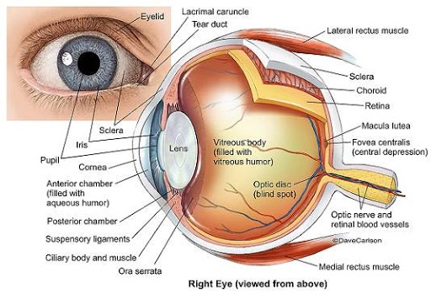
Motion Planning

Slide 4

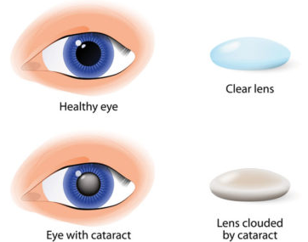
Motion Planning

Slide 5
Motion Planning
Routine Cataract Surgery
https://youtu.be/QbeI72QmFAU

Slide 6
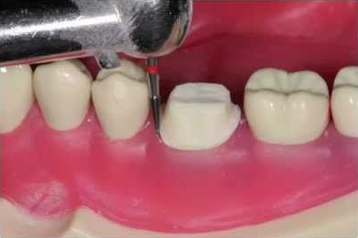
Motion Planning

Slide 7
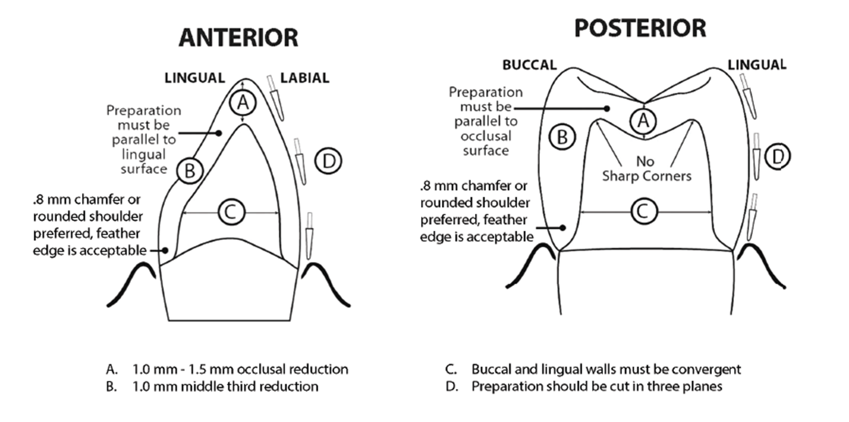
Motion Planning

Slide 8
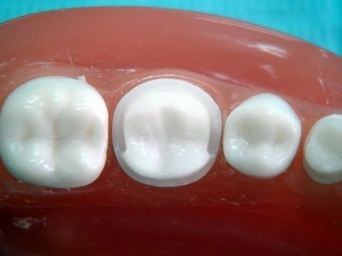
Motion Planning

Slide 9

Motion Planning

Slide 10
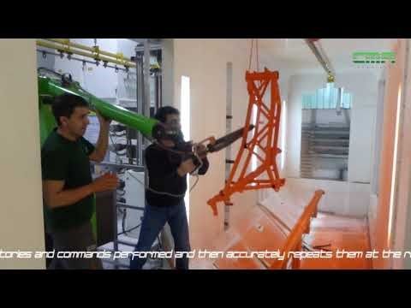
Motion Planning

Slide 11
Motion Planning
Problem Defenition

Slide 12
Motion Planning – Hierarchy
Trajectory planning is a subset of the overall problem that is navigation or motion planning. The typical hierarchy of motion planning is as follows:
  Task planning – Designing a set of high-level goals, such as “go pick up the object in front of you”.
  Path planning – Generating a feasible path from a start point to a goal point. A path usually consists of a set of connected waypoints.
  Trajectory planning – Generating a time schedule for how to follow a path given constraints such as position, velocity, and acceleration.
  Trajectory following – Once the entire trajectory is planned, there is a need for a control system that can execute the trajectory in a sufficiently accurate manner.
Q: What’s the difference between path planning and trajectory planning?
A: A trajectory is a description of how to follow a path over time

Slide 13
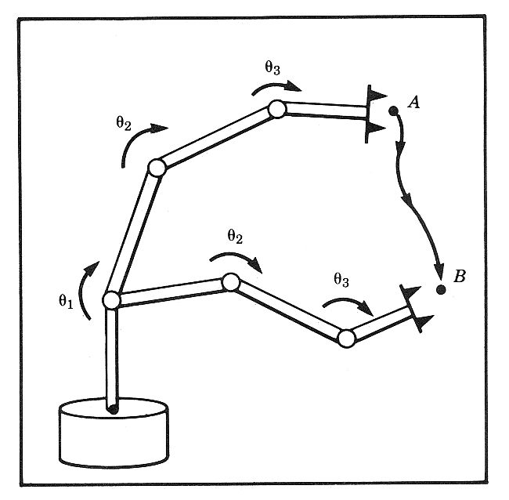
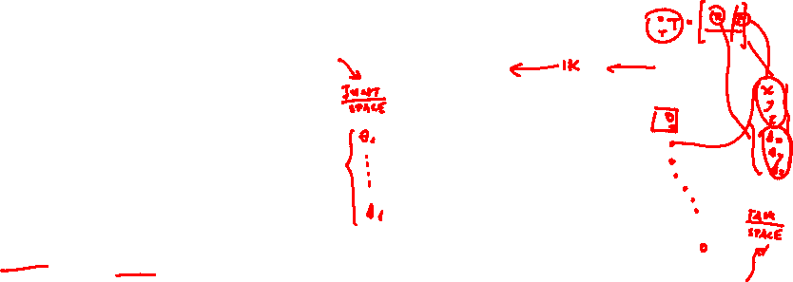
Trajectory Generation – Problem Definition
Problem
Given: Manipulator geometry, End Effector
Path (via point)
Compute: The trajectory of each joint such that
the end effector move in space
from point A to Point B
Solution (Domains)
Joint space / Task Space
Definitions
Trajectory (Definition) - Time history of position, velocity, and acceleration for each DOF.
Trajectory Generation – Methods of computing a trajectory that describes the desired motion of a manipulator in a multidimensional space

Slide 14
Task Space Versus Joint Space - Interpolations
Joint Space
Task Space
Inverse
Kinematics
Inverse
Kinematics
Inverse
Kinematics
Inverse
Kinematics
Inverse
Kinematics
Inverse
Kinematics
+
+
Interpolations at
the Joint Space
Inverse
Kinematics
Inverse
Kinematics
Inverse
Kinematics
Inverse
Kinematics
Inverse
Kinematics
Inverse
Kinematics
Inverse
Kinematics
+
+
Interpolations at
the Task Space

Slide 15
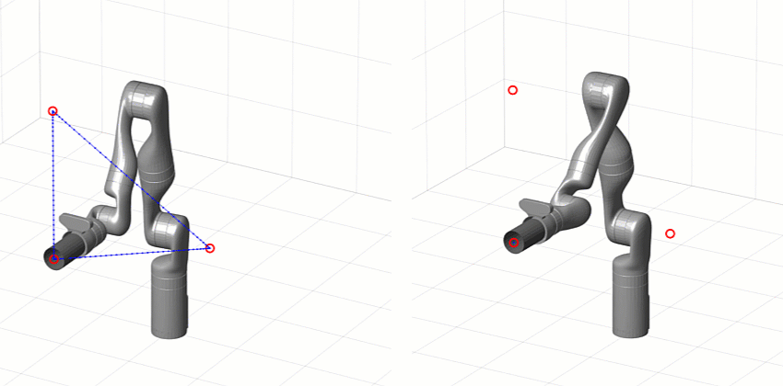
Task Space Versus Joint Space

Slide 16
Join Space Versus Task Space – Comparison
Parameter | Joint Space | Task Space
Interpolation Space intermediate points along the trajectory | Joint Space | Task Space
Tool Trajectory Type / Length | Curved Line / Long | Straight Lines / Short
Invers Kinematics (IK) Usage | Low | High
Computation Expense (IK) | Low (IK for Start/Finish & Via Points ) | High (IK for every single point / time steo on the trajectory)
Passing through Via Points | No (Correction by establishing Pseudo Points) | Yes
Via Points Defined in the Task Space | No | Yes
Path Dependency on a Specific Manipulator | Yes | No
Notes:
16

Slide 17
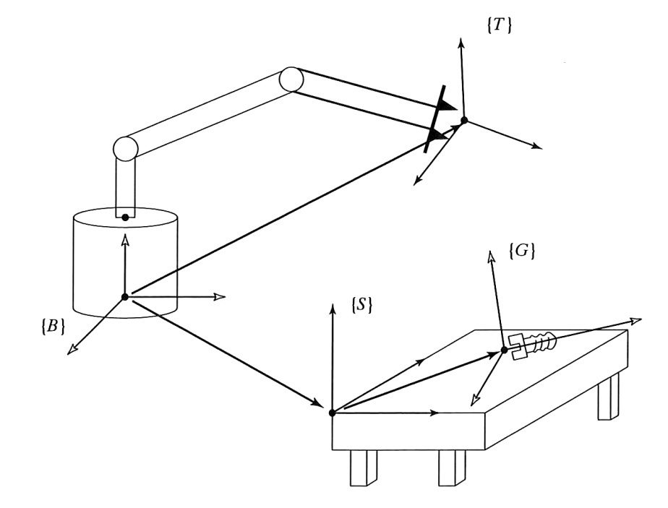



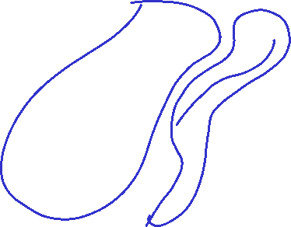

General Consideration
General approach for the motion of the manipulator
  Specify the path as a motion of the tool frame {T} relative to the station frame {S}. Frame {G} may change it position in time (e.g. conveyer belt)
Advantages
  Decouple the motion description from any particular robot, end effector, or workspace.
  Modularity – Use the same path with:
    Different robot
    Different tool size

Slide 18
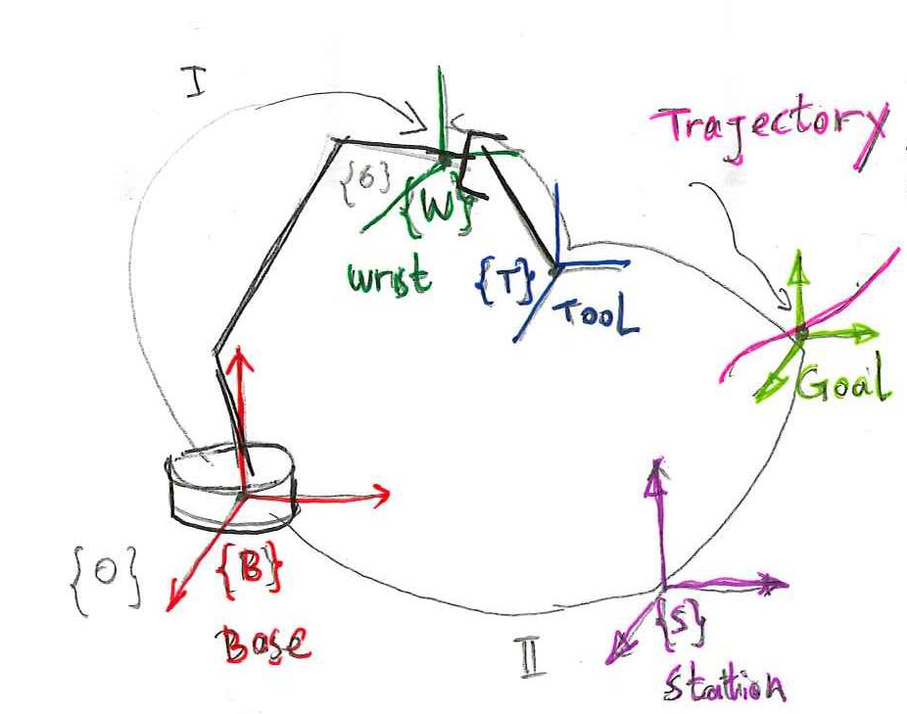
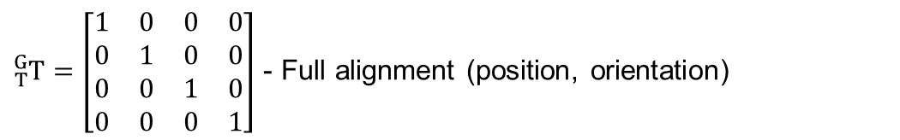

Trajectory Generation & Inverse Kinematics
Transforming from task space to joint space - General Approach
There are two pathways from the base frame {B} to the wrist frame {W} (Path I and Path II)
I
II
→ Desired position and orientation
$${}_{6}^{0}T={}_{W}^{B}T={}_{S}^{B}T{}_{G}^{S}T{}_{T}^{G}T{}_{W}^{T}T$$
${}_{6}^{0}T={}_{W}^{B}T$ - Forward kinematics
${}_{S}^{B}T$ - Location of the station with respect to the base
${}_{G}^{S}T$ - Definition of the trajectory (Goal Location - Known)
${}_{T}^{G}T=\left[\begin{matrix}1 & 0 & 0 & 0 \\ 0 & 1 & 0 & 0 \\ 0 & 0 & 1 & 0 \\ 0 & 0 & 0 & 1\end{matrix}\right]$ - Full alignment (position, orientation)
${}_{W}^{T}T$ - Location of the wrist with respect to the tool → usually given ${}_{T}^{W}T$

Slide 19
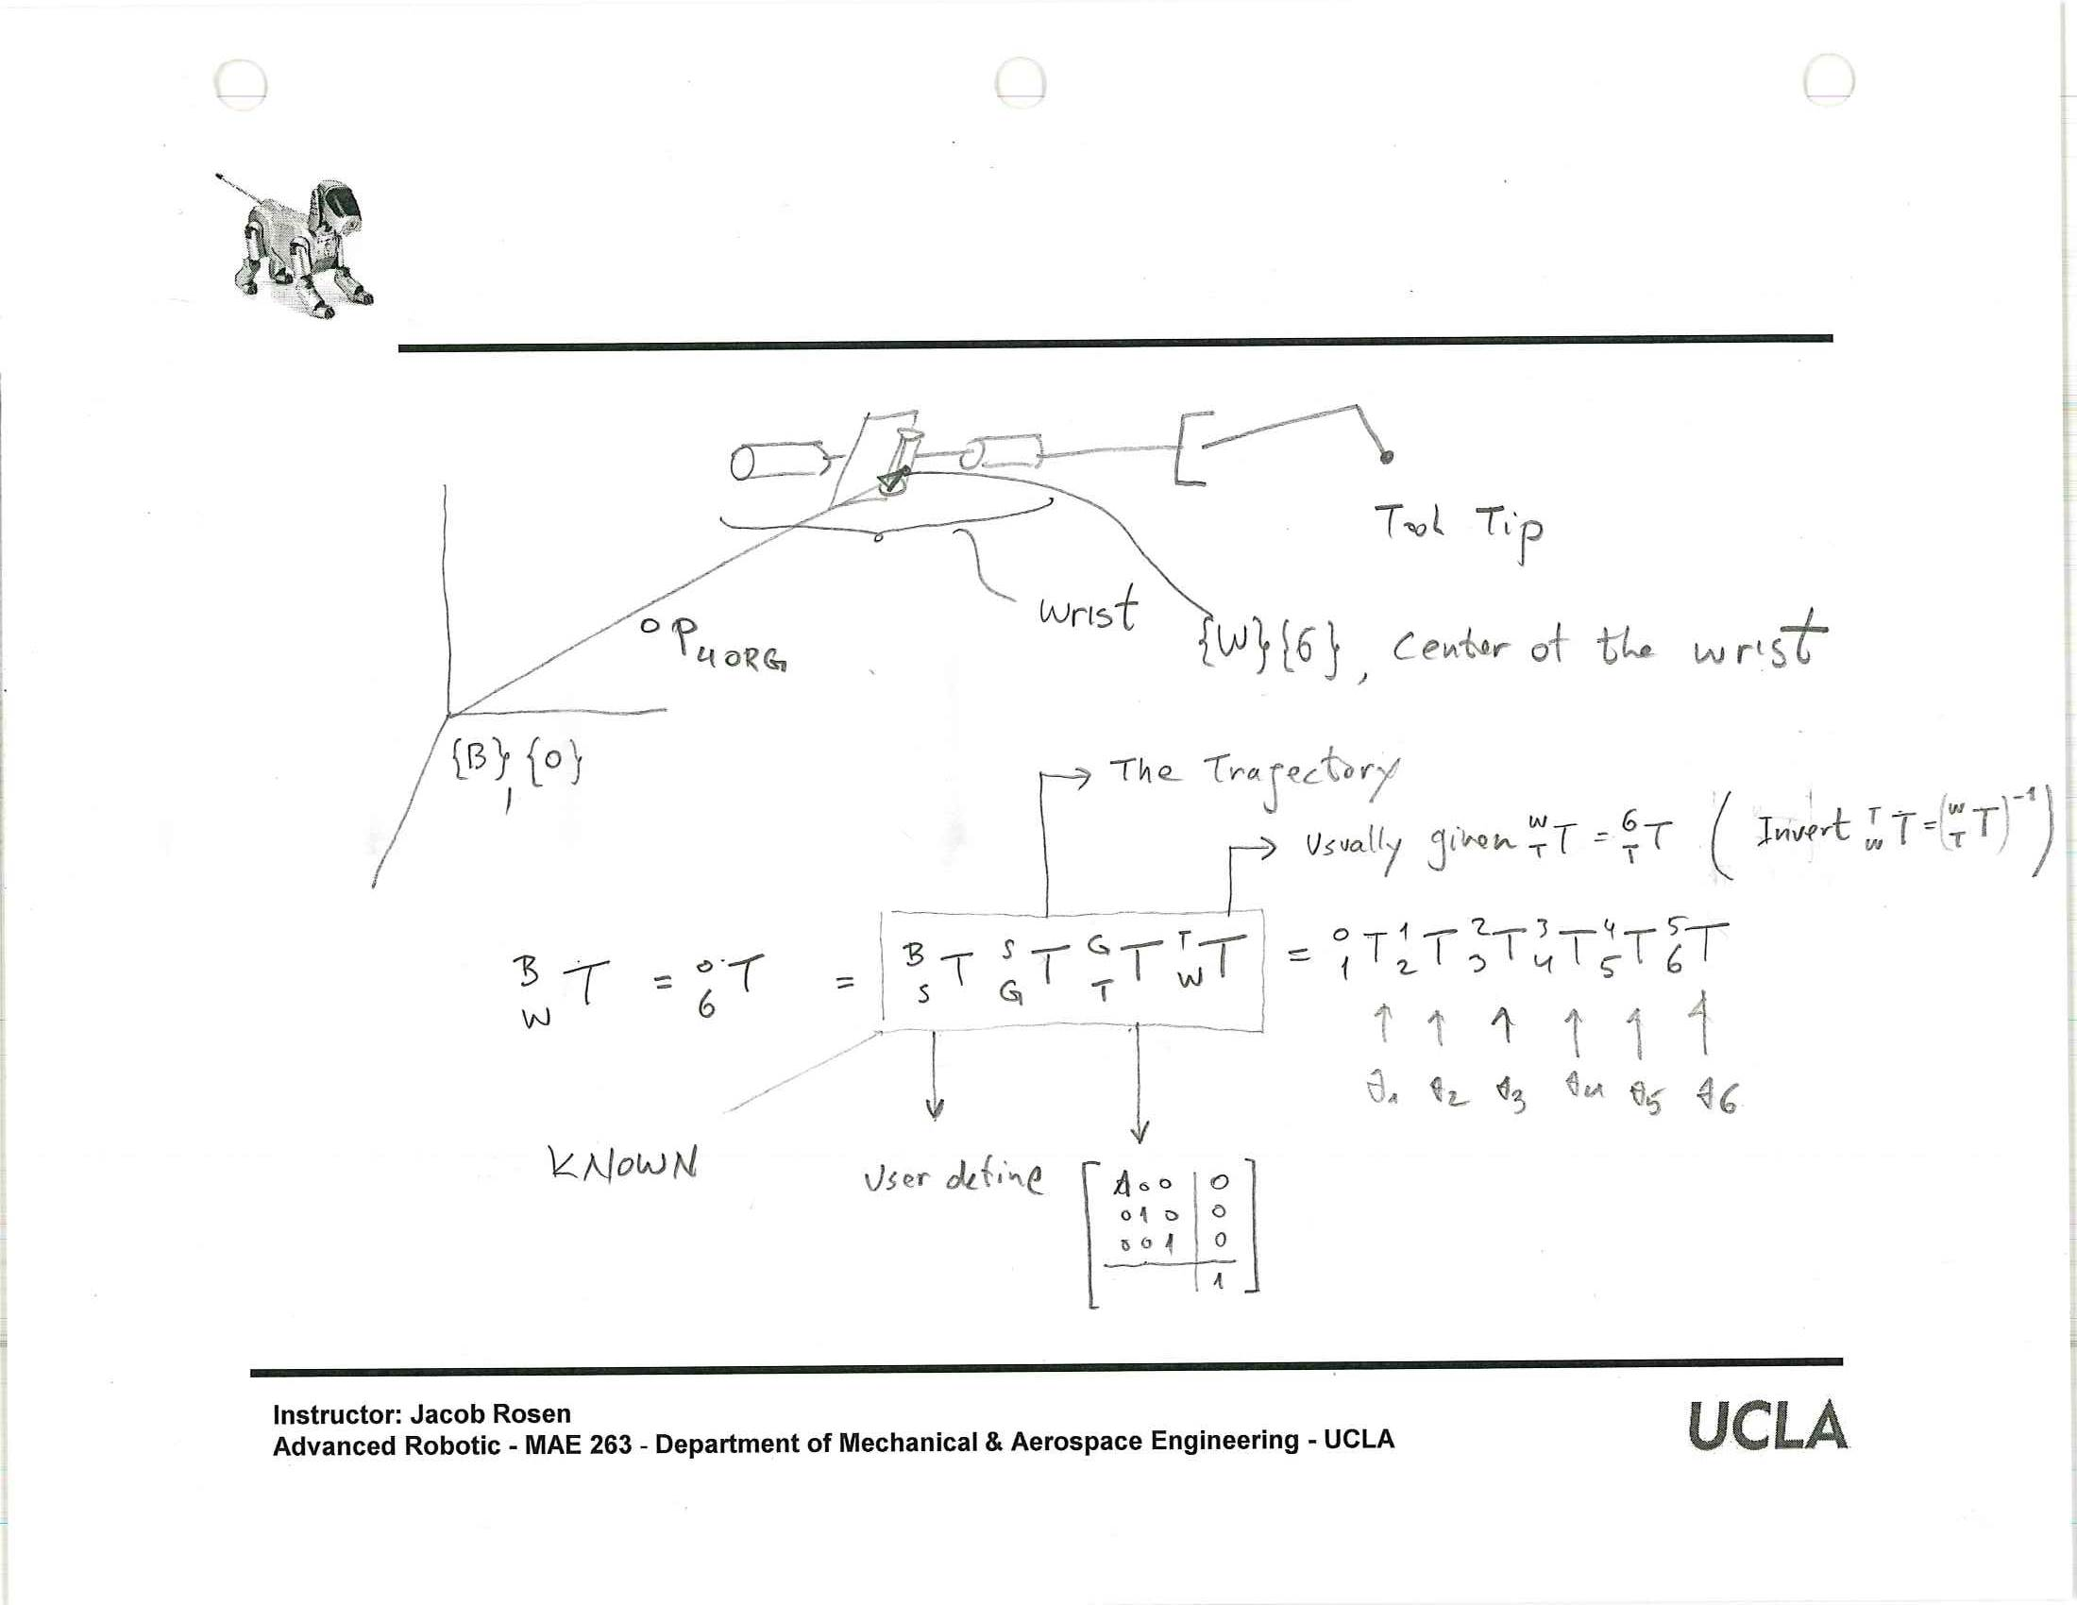
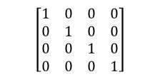
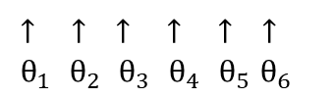
Trajectory Generation & Inverse Kinematics
Transforming from task space to joint space - General Approach
User Defined
The Trajectory
$$\left[\begin{matrix}1 & 0 & 0 & 0 \\ 0 & 1 & 0 & 0 \\ 0 & 0 & 1 & 0 \\ 0 & 0 & 0 & 1\end{matrix}\right]$$
Known
Usually given ${}_{T}^{W}T={}_{T}^{6}T$ (Invert ${}_{T}^{W}T={\left({}_{T}^{W}T\right)}^{−1}$)
$${}_{W}^{B}T={}_{6}^{0}T={}_{S}^{B}T {}_{G}^{S}T {}_{T}^{G}T {}_{W}^{T}T={}_{1}^{0}T {}_{2}^{1}T {}_{3}^{2}T {}_{4}^{3}T {}_{5}^{4}T {}_{6}^{5}T$$
↑ ↑ ↑ ↑ ↑ ↑
$θ_{1}$ $θ_{2}$ $θ_{3}$ $θ_{4}$ $θ_{5}$ $θ_{6}$

Slide 20
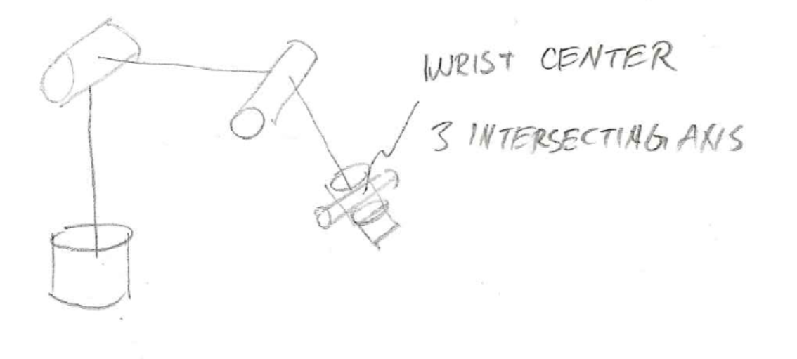

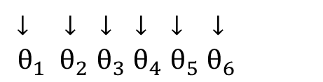
Trajectory Generation & Inverse Kinematics
Transforming from task space to joint space - General Approach
$${}_{6}^{0}T={}_{1}^{0}T {}_{2}^{1}T {}_{3}^{2}T {}_{4}^{3}T {}_{5}^{4}T {}_{6}^{5}T=\left[\begin{matrix}{}_{6}^{0}R & {}_{ }^{0}{P_{6}} \\ 0 & 1\end{matrix}\right]$$
↓ ↓ ↓ ↓ ↓ ↓
$θ_{1} θ_{2}$ $θ_{3}$ $θ_{4}$ $θ_{5}$ $θ_{6}$
Given
Given 3 intersecting axis 4, 5, 6 (origins of 4, 5, 6 are at the same point)
$${}_{ }^{0}{P_{6}}={}_{ }^{0}{P_{4}}$$

Slide 21

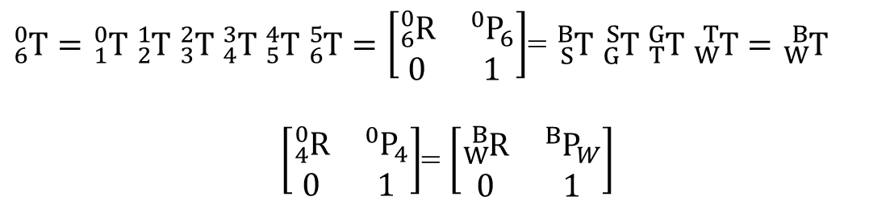

Trajectory Generation & Inverse Kinematics
Transforming from task space to joint space - General Approach
Solving Problem No. 1 - Solving for $θ_{1},θ_{2},θ_{3}$
  Given 3 intersecting axis 4, 5, 6 (origins of 4, 5, 6 are at the same point)
  Note that ${}_{ }^{0}{P_{6}}$ and ${}_{ }^{0}{P_{4}}$ are a function of $θ_{1},θ_{2},θ_{3}$
$${}_{ }^{0}{P_{6}}={}_{ }^{0}{P_{4}}$$
${}_{6}^{0}T={}_{1}^{0}T {}_{2}^{1}T {}_{3}^{2}T {}_{4}^{3}T {}_{5}^{4}T {}_{6}^{5}T=\left[\begin{matrix}{}_{6}^{0}R & {}_{ }^{0}{P_{6}} \\ 0 & 1\end{matrix}\right]$= ${}_{S}^{B}T {}_{G}^{S}T {}_{T}^{G}T {}_{W}^{T}T={}_{W}^{B}T$
$\left[\begin{matrix}{}_{4}^{0}R & {}_{ }^{0}{P_{4}} \\ 0 & 1\end{matrix}\right]$= $\left[\begin{matrix}{}_{W}^{B}R & {}_{ }^{B}{P_{W}} \\ 0 & 1\end{matrix}\right]$

Slide 22




Trajectory Generation & Inverse Kinematics
Transforming from task space to joint space - General Approach
$${}_{6}^{0}T={}_{1}^{0}T {}_{2}^{1}T {}_{3}^{2}T | {}_{4}^{3}T | {}_{5}^{4}T {}_{6}^{5}T$$
Problem No. 1
Position Problem
Problem No. 2
Orientation Problem
$$α_{3}$$
$$a_{3}$$
$$θ_{4}$$
$$d_{4}$$
$$\left\{Frame 3\right\}→\left\{Frame\left(R\right)\right\}→\left\{Frame\left(Q\right)\right\}→\left\{Frame\left(P\right)\right\}→\left\{Frame\left(4\right)\right\}$$
$R_{x3}\left(α_{3}\right)$ $D_{x3}\left(a_{3}\right)$ $R_{z4}\left(θ_{4}\right)$ $D_{z4}\left(d_{4}\right)$

Slide 23




Trajectory Generation & Inverse Kinematics
Transforming from task space to joint space - General Approach
$${}_{6}^{0}T={}_{1}^{0}T {}_{2}^{1}T {}_{3}^{2}TR_{x3}\left(α_{4}\right)D_{x3}\left(a_{3}\right)|R_{z4}\left(θ_{4}\right)D_{z4}\left(d_{4}\right){}_{5}^{4}T {}_{6}^{5}T$$
Problem No. 1
Position Problem
Problem No. 2
orientation problem
$$|{}_{4}^{3}T{\left.​\right|}_{α_{4}=0}{}_{5}^{4}T{}_{6}^{5}T$$
$${}_{6}^{0}T={}_{1}^{0}T {}_{2}^{1}T {}_{3}^{2}T{}_{4}^{3}T{\left.​\right|}_{θ_{4}=0}$$
↑
Set $θ_{4}=0$
↑
Set $α_{4}=0$

Slide 24


Trajectory Generation & Inverse Kinematics
Transforming from task space to joint space - General Approach
$${}_{6}^{0}R={}_{3}^{0}R {}_{4}^{3}R {}_{6}^{4}R$$
$${}_{6}^{0}R={}_{3}^{0}R\left(R\left(α_{3}\right)I R\left(θ_{4}\right)I\right){}_{6}^{4}R$$
$$D_{x3}\left(a_{3}\right)$$
$$D_{z4}\left(d_{4}\right)$$
$${}_{6}^{0}R=\left[{}_{6}^{0}RR_{x3}\left(α_{3}\right)\right] \left[R_{z4}\left(θ_{4}\right){}_{6}^{4}R\right]$$
Multiply both sides of the equation by ${\left[{}_{6}^{0}RR_{x3}\left(α_{3}\right)\right]}^{−1}$ results in
$$R_{z4}\left(θ_{4}\right){}_{6}^{4}R={\left[{}_{3}^{0}RR_{x3}\left(α_{3}\right)\right]}^{−1} {}_{6}^{0}R$$

Slide 25


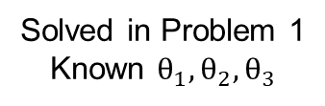
Trajectory Generation & Inverse Kinematics
Transforming from task space to joint space - General Approach
Solving Problem No. 2 - Solving for $θ_{4},θ_{5},θ_{6}$
  Solve for $θ_{4},θ_{5},θ_{6}$ using the Z-Y-Z problem
$$R_{z4}\left(θ_{4}\right){}_{6}^{4}R={\left[{}_{3}^{0}RR_{x3}\left(α_{3}\right)\right]}^{−1} {}_{6}^{0}R$$
Solved in Problem 1
Known $θ_{1},θ_{2},θ_{3}$
Desired orientation given for every point on the trajectory
$$R_{z4}\left(θ_{4}\right){}_{5}^{4}R\left(θ_{5}\right){}_{6}^{5}R\left(θ_{6}\right)=\overline{R_{D}}→$$
Desired orientation of the wrist taking into account the contribution of the first 3 angles to the orientation
$$\overline{R_{D}}$$
$$R_{z4}\left(θ_{4}\right){}_{5}^{4}R\left(θ_{5}\right){}_{6}^{5}R\left(θ_{6}\right)=\left[\begin{matrix}r_{11} & r_{12} & r_{13} \\ r_{21} & r_{22} & r_{23} \\ r_{31} & r_{32} & r_{33}\end{matrix}\right]$$

Slide 26
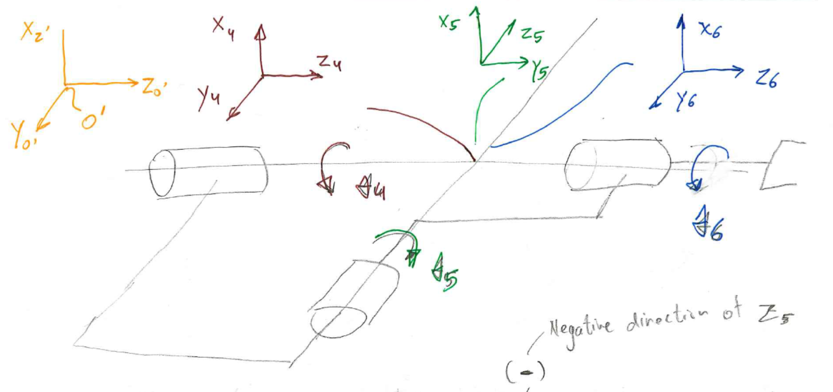
Trajectory Generation & Inverse Kinematics
General Approach
Negative direction of $z_{5}$
$$R_{Euler}=R_{z}\left(θ_{4}\right)R_{y4}\left(−θ_{5}\right)R_{z4}\left(θ_{6}\right)$$

Slide 27
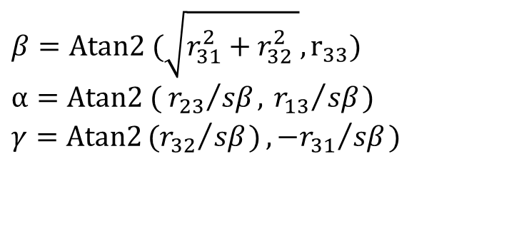
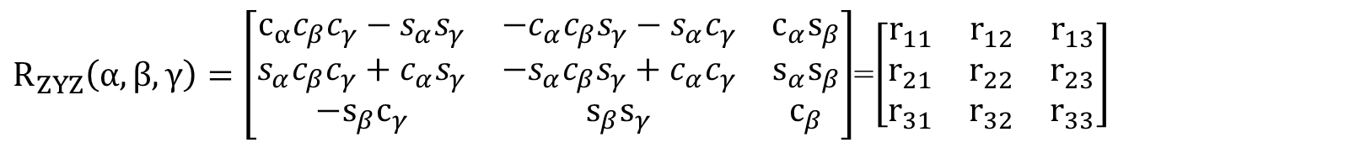

Trajectory Generation & Inverse Kinematics
General Approach
$$R_{ZYZ}\left(α,β,γ\right)=R_{Z}\left(α\right)R_{Y}\left(β\right)R_{Z}\left(γ\right)=\left[\begin{matrix}c_{α} & −s_{α} & 0 \\ s_{α} & c_{α} & 0 \\ 0 & 0 & 1\end{matrix}\right]\left[\begin{matrix}c_{β} & 0 & s_{β} \\ 0 & 1 & 0 \\ −s_{β} & 0 & c_{β}\end{matrix}\right]\left[\begin{matrix}c_{γ} & −s_{γ} & 0 \\ s_{γ} & c_{γ} & 0 \\ 0 & 0 & 1\end{matrix}\right]$$
$$θ_{4} −θ_{5} θ_{6}$$
$R_{ZYZ}\left(α,β,γ\right)=\left[\begin{matrix}c_{α}c_{β}c_{γ}−s_{α}s_{γ} & −c_{α}c_{β}s_{γ}−s_{α}c_{γ} & c_{α}s_{β} \\ s_{α}c_{β}c_{γ}+c_{α}s_{γ} & −s_{α}c_{β}s_{γ}+c_{α}c_{γ} & s_{α}s_{β} \\ −s_{β}c_{γ} & s_{β}s_{γ} & c_{β}\end{matrix}\right]$=$\left[\begin{matrix}r_{11} & r_{12} & r_{13} \\ r_{21} & r_{22} & r_{23} \\ r_{31} & r_{32} & r_{33}\end{matrix}\right]$
$${{β=Atan2 (\sqrt{{r_{31}^{2}+r_{32}^{2}}^{ }},r}_{33})}_{ }$$
$${{α=Atan2 (}_{ }{r_{23}}/{{sβ}_{ },}}_{ }{r_{13}}/{{sβ}_{ })}$$
$${{γ=Atan2{{({r_{32}}/{{sβ}_{ })},−r}_{31}}/{{sβ}_{ })}}_{ }}_{ }$$

Slide 28
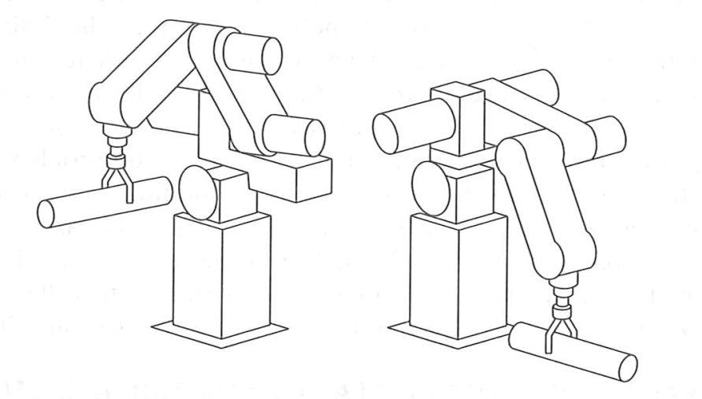

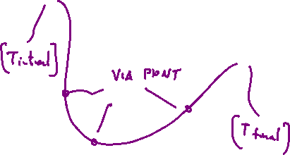

General Consideration – Via Points
Basic Problem – Move the tool frame {T} from its initial position / orientation {T_initial} to the final position / orientation {T_final}.
Specific Description
  Via Point – Intermediate points between the initial and the final end- effector locations that the end-effector mast go through and match it position and orientation along the trajectory.
  Each via point is defined by a frame defining the position/orientation of the tool with respect to the station frame
  Path Points – includes all the via points along with the initial and final points
  Point (Frame) – Every point on the trajectory is define by a frame (spatial description)

Slide 29
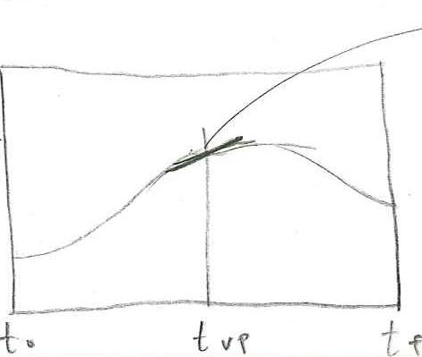
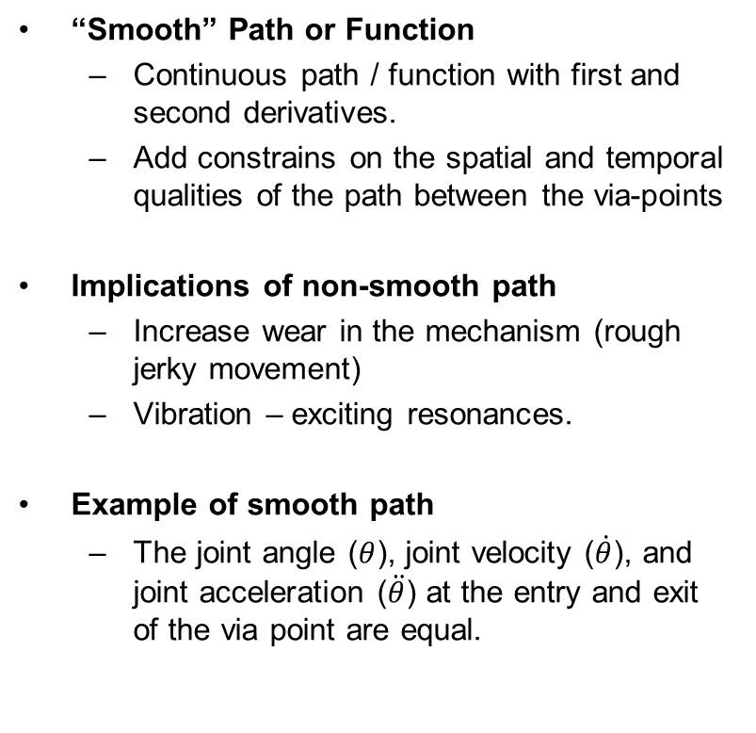
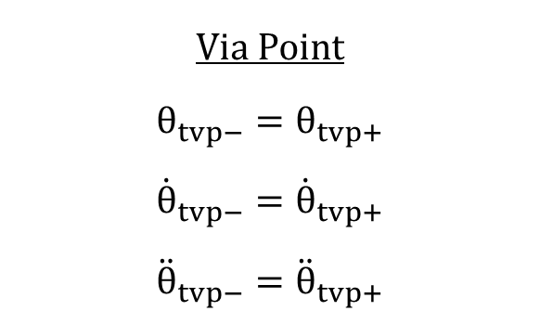
General Consideration – Smooth Path
“Smooth” Path or Function
  Continuous path / function with first and second derivatives.
  Add constrains on the spatial and temporal qualities of the path between the via-points
Implications of non-smooth path
  Increase wear in the mechanism (rough jerky movement)
  Vibration – exciting resonances.
Example of smooth path
  The joint angle ($θ$), joint velocity ($\dot{θ}$), and joint acceleration ($\ddot{θ}$) at the entry and exit of the via point are equal.
Via Point
$$θ_{tvp−}=θ_{tvp+}$$
$${\dot{θ}}_{tvp−}={\dot{θ}}_{tvp+}$$
$${\ddot{θ}}_{tvp−}={\ddot{θ}}_{tvp+}$$

Slide 30
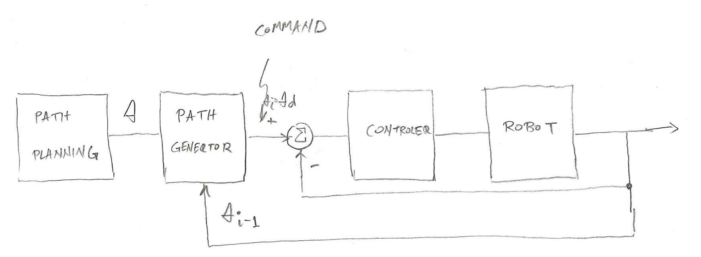
Trajectory Generation – Joint Space Control

Slide 31
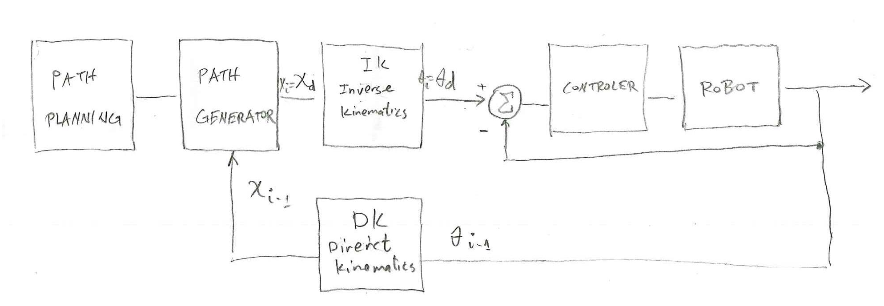
Trajectory Generation – Task Space Control

Slide 32
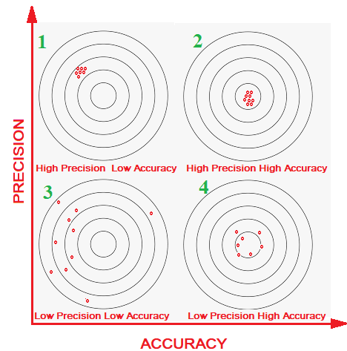
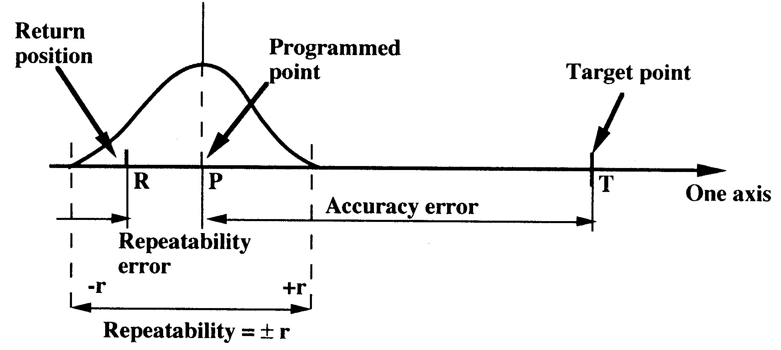
Precision / Repeatability versus Accuracy

Slide 33
Trajectory Generation – Roadmap Diagram
1st Order
Linear
Single Time
Interval
Polynomials
3^{ed} Order
Cubic
5th Order
Quantic
Linear Function with
Parabolic Blend
Joint Space
User Defined
Function
Trajectory
Generation
Multiple Time
Intervals (Via Points)
Heuristic
System Defined
Function
3^{ed} Order
Cubic
Linear Function with
Parabolic Blend
Task Space
Linear Function with
Parabolic Blend

Slide 34
Joint Space Schemes
Single Time Interval

Slide 35
Trajectory Generation – Roadmap Diagram
1st Order
Linear
Single Time
Interval
Polynomials
3^{ed} Order
Cubic
5th Order
Quantic
Linear Function with
Parabolic Blend
Joint Space
User Defined
Function
Trajectory
Generation
Multiple Time
Intervals (Via Points)
Heuristic
System Defined
Function
3^{ed} Order
Cubic
Linear Function with
Parabolic Blend
Task Space
Linear Function with
Parabolic Blend

Slide 36


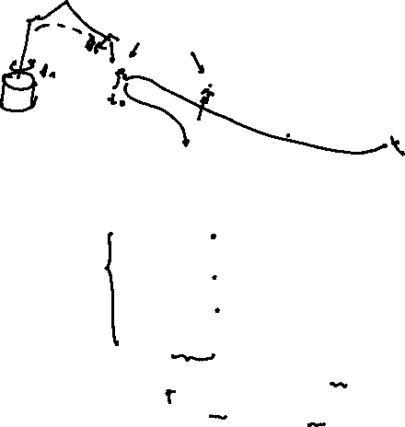
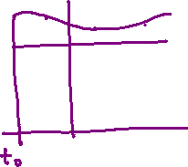



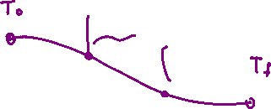


Joint Space Schemes
Joint space Schemes – Path shapes (in space and in time) are described in terms of functions in the joint space.
General process (Steps) given initial and target P/O
  Select a path point or via point (desired position and orientation of the tool frame {T} with respect to the base frame {s})
  Convert each of the “via point” into a set of joint angles using the invers kinematics
  Find a smooth function for each of the n joints that pass trough the via points, and end the goal point.
  Note 1: The time required to complete each segment is the same for each joint such that the all the joints will reach the via point at the same time. Thus resulting in the position and orientation of the frame {T} at the via point.
  Note 2: The joints move independently with only one time restriction (Note 1)

Slide 37
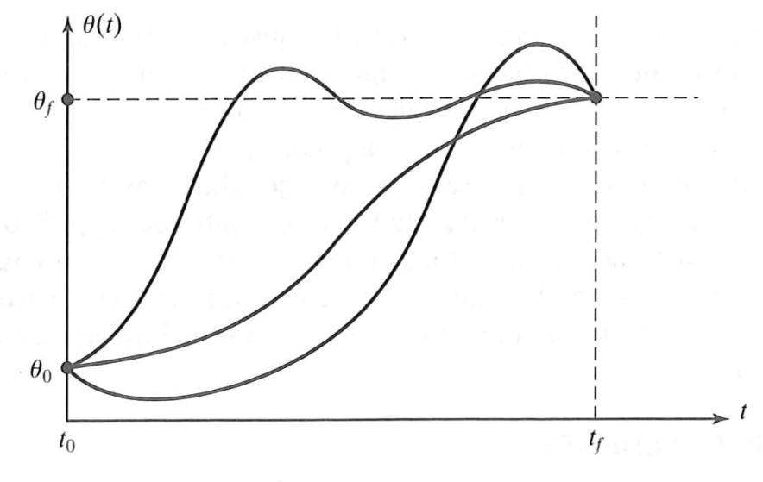
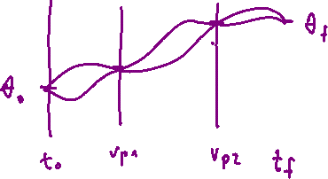
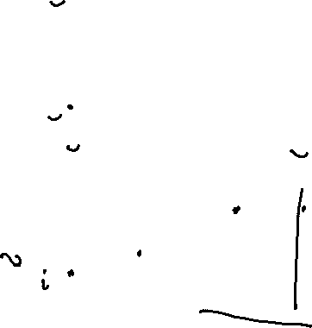
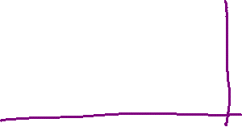
Joint Space Schemes
Define a function for each joint such that value at is the initial position of the joint and whose value at is the desire goal position of the joint
There are many smooth functions that may be used to interpolate the joint value.

Slide 38
Joint Space Schemes
Single Time Interval
Polynomials
First Order Polynomial

Slide 39
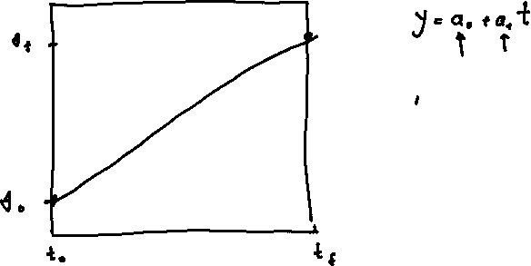
Joint Space Schemes

Slide 40
Trajectory Generation – Roadmap Diagram
1st Order
Linear
Single Time
Interval
Polynomials
3^{ed} Order
Cubic
5th Order
Quantic
Linear Function with
Parabolic Blend
Joint Space
User Defined
Function
Trajectory
Generation
Multiple Time
Intervals (Via Points)
Heuristic
System Defined
Function
3^{ed} Order
Cubic
Linear Function with
Parabolic Blend
Task Space
Linear Function with
Parabolic Blend

Slide 41
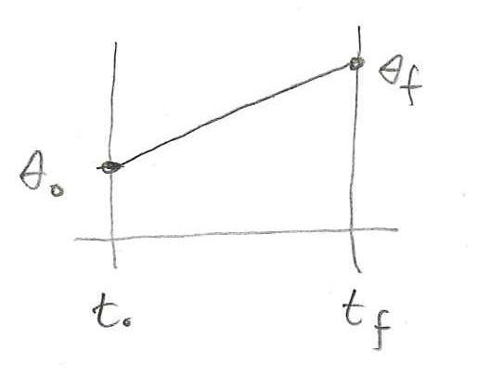

Joint Space Schemes – Linear Polynomials
Problem – Define a function for each joint such that its value at
  $t_{0}$ is the initial position of the joint
  $t_{f}$ is the desired goal position of the joint
Given – Constrains on $θ\left(t\right)$
$θ\left(0\right)=θ_{0}$
$θ\left(t_{f}\right)=θ_{f}$

Slide 42




Joint Space Schemes – Linear Polynomials
Solution – the two constraints can be satisfied by a first order polynomial
$$θ\left(t\right)=a_{0}+a_{1}t$$
Combined with the two desired constrains yields two equations in two unknown
$$θ_{0}\left(0\right)=a_{0}$$
$$θ_{f}\left(t\right)=a_{0}+a_{1}t_{f}$$
$θ_{0}=a_{0}$
$a_{1}=\frac{θ_{f}−θ_{0}}{t_{f}}$
$$θ=θ_{0}+\left(\frac{θ_{f}−θ_{0}}{t_{f}}\right)t$$

Slide 43
Joint Space Schemes
Single Time Interval
Polynomials
Cubic Order Polynomial

Slide 44
Joint Space Schemes

Slide 45
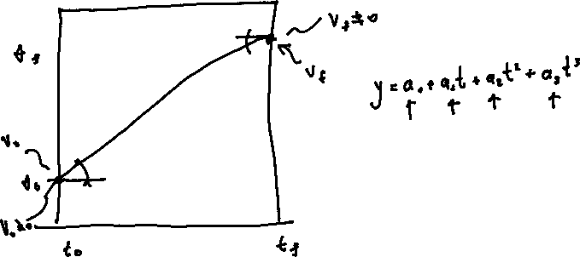
Joint Space Schemes

Slide 46
Trajectory Generation – Roadmap Diagram
1st Order
Linear
Single Time
Interval
Polynomials
3^{ed} Order
Cubic
5th Order
Quantic
Linear Function with
Parabolic Blend
Joint Space
User Defined
Function
Trajectory
Generation
Multiple Time
Intervals (Via Points)
Heuristic
System Defined
Function
3^{ed} Order
Cubic
Linear Function with
Parabolic Blend
Task Space
Linear Function with
Parabolic Blend

Slide 47
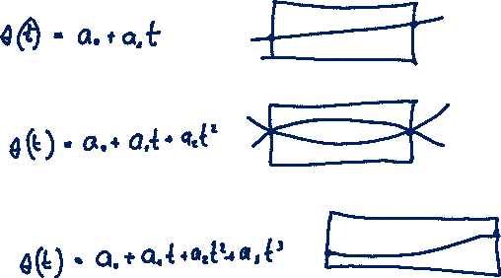
Joint Space Schemes – Order of the Polynomials
Notes:
47

Slide 48

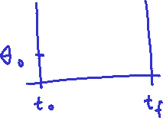


Joint Space Schemes – Cubic Polynomials - Zero Velocity
Problem - Define a function for each joint such that it value at
  is the initial position of the joint and at
  is the desired goal position of the joint
Given - Constrains on
What should be the order of the polynomial function to meet these constrains?
Notes:
48

Slide 49
Joint Space Schemes – Cubic Polynomials - Zero Velocity
Solution - The four constraints can be satisfied by a polynomial of at least third degree
The joint velocity and acceleration
Combined with the four desired constraints yields four equations in four unknowns

Slide 50

Joint Space Schemes – Cubic Polynomials - Zero Velocity
$a_{0} a_{1} a_{2} a_{3}$
↓ ↓ ↓ ↓
$$\left[\begin{matrix}θ_{0} \\ θ_{f} \\ \begin{aligned}0 \\ 0\end{aligned}\end{matrix}\right]=\left[\begin{matrix}1 & 0 & 0 & 0 \\ 1 & t_{f} & t_{f}^{2} & t_{f}^{3} \\ 0 & 1 & 0 & 0 \\ 0 & t_{f} & 2t_{f} & 3t_{f}^{2}\end{matrix}\right]\left[\begin{matrix}a_{0} \\ a_{1} \\ a_{2} \\ a_{3}\end{matrix}\right]$$

Slide 51





Joint Space Schemes – Cubic Polynomials - Zero Velocity
$θ_{f}=θ_{0}+a_{2}t_{f}^{2}+a_{3}t_{f}^{3}$
$0=2a_{2}t_{f}+3a_{3}t_{f}^{2}$
$$a_{2}=\frac{\left|\begin{matrix}θ_{f}−θ_{0} & t_{f}^{3} \\ 0 & 3t_{f}^{2}\end{matrix}\right|}{Δ}=\frac{3t_{f}^{2}\left(θ_{f}−θ_{0}\right)}{t_{f}^{4}}=\frac{3\left(θ_{f}−θ_{0}\right)}{t_{f}^{2}}$$
$a_{2}\left[t_{f}^{2}\right]+a_{3}\left[t_{f}^{3}\right]=θ_{f}−θ_{0}$
$a_{2}\left[2t_{f}\right]+a_{3}\left[3t_{f}^{2}\right]=0$
$$a_{3}=\frac{\left|\begin{matrix}t_{f}^{2} & θ_{f}−θ_{0} \\ 2t_{f} & 0\end{matrix}\right|}{Δ}=\frac{−2t_{f}\left(θ_{f}−θ_{0}\right)}{t_{f}^{4}}=\frac{−2\left(θ_{f}−θ_{0}\right)}{t_{f}^{3}}$$
$Δ=\left|\begin{matrix}t_{f}^{2} & t_{f}^{3} \\ 2t_{f} & 3t_{f}^{2}\end{matrix}\right|=3t_{f}^{4}−2t_{f}^{4}=t_{f}^{4}$

Slide 52
Joint Space Schemes – Cubic Polynomials - Zero Velocity
Solving these equations for the we obtain

Slide 53


Joint Space Schemes – Cubic Polynomials - Zero Velocity
${\dot{θ}}_{max}$ - max angular velocity at $\frac{t_{f}}{2}$
${\dot{θ}}_{max}\left(t=\frac{t_{f}}{2}\right)=\frac{6}{t_{f}^{2}}\left(θ_{f}−θ_{0}\right)\left[\frac{t_{f}}{2}\right]−\frac{6}{t_{f}^{3}}\left(θ_{f}−θ_{0}\right){\left[\frac{t_{f}}{2}\right]}^{2}=\frac{3\left(θ_{f}−θ_{0}\right)}{t_{f}}−\frac{6}{4}\frac{\left(θ_{f}−θ_{0}\right)}{t_{f}}=\frac{3}{2}\frac{θ_{f}−θ_{0}}{t_{f}}$
${\ddot{θ}}_{max}$ - max angular acceleration at $t=0$ and $t=t_{f}$
$${\ddot{θ}}_{max}=\frac{6}{t_{f}^{2}}\left(θ_{f}−θ_{0}\right)$$

Slide 54



Joint Space Schemes – Cubic Polynomials - Zero Velocity
$$\frac{3}{2}\frac{θ_{f}−θ_{0}}{t_{f}}$$
$$±6\frac{θ_{f}−θ_{0}}{t_{f}^{2}}$$

Slide 55



Joint Space Schemes – Cubic Polynomials - Zero Velocity
Example – A single-link robot with a rotary joint is motionless at degrees. It is desired to move the joint in a smooth manner to degrees in 3 seconds. Find the coefficient of the cubic polynomial that accomplish this motion and brings the manipulator to rest at the goal
$$θ(0)=15 \\ θ(t_{f})=75 \\ \dot{θ}(0)=0 \\ \dot{θ}(t_{f})=0$$
$$a_{0}=θ_{0}=15 \\ a_{1}=0 \\ a_{2}=\frac{3}{t_{f}^{2}}(θ_{f}−θ_{0})=\frac{3}{9}(75−15)=20 \\ a_{3}=−\frac{2}{t_{f}^{3}}(θ_{f}−θ_{0})=−\frac{2}{27}(75−15)=−4.44$$
$$θ(t)=15+20t^{2}−4.44t^{3} \\ \dot{θ}(t)=40t−13.33t^{2} \\ \ddot{θ}(t)=40+26.66t$$

Slide 56



Joint Space Schemes – Cubic Polynomials - Zero Velocity
The velocity profile of any cubic function is a parabola
The acceleration profile of any cubic function is linear

Slide 57



Joint Space Schemes – Cubic Polynomials – Non Zero Velocity
Previous Method - The manipulator comes to rest at each via point
General Requirement - Pass through a point without stopping
Problem - Define a function for each joint such that it value at
  is the initial position of the joint and at
  is the desire goal position of the joint
Given - Constrains on such that the velocities at the via points are not zero but rather some known velocities
Notes:
57

Slide 58
Joint Space Schemes – Cubic Polynomials – Non Zero Velocity
Solution - The four constraints can be satisfied by a polynomial
Combined with the four desired constraints yields four equations in four unknowns
Notes:
58

Slide 59

Joint Space Schemes – Cubic Polynomials – Non Zero Velocity
$$\left[\begin{matrix}θ_{0} \\ θ_{f} \\ {\dot{θ}}_{0} \\ {\dot{θ}}_{f}\end{matrix}\right]=\left[\begin{matrix}1 & 0 & 0 & 0 \\ 1 & t_{f} & t_{f}^{2} & t_{f}^{3} \\ 0 & 1 & 0 & 0 \\ 0 & t_{f} & 2t_{f} & 3t_{f}^{2}\end{matrix}\right]\left[\begin{matrix}a_{0} \\ a_{1} \\ a_{2} \\ a_{3}\end{matrix}\right]$$
Notes:
59

Slide 60


Joint Space Schemes – Cubic Polynomials – Non Zero Velocity
$a_{2}=\frac{\left|\begin{matrix}\left(θ_{f}−θ_{0}\right)−{\dot{θ}}_{0}t_{f} & t_{f}^{3} \\ \left({\dot{θ}}_{f}−{\dot{θ}}_{0}\right) & 3t_{f}^{2}\end{matrix}\right|}{Δ}$
$=\frac{3t_{f}^{2}\left(\left(θ_{f}−θ_{0}\right)−{\dot{θ}}_{0}t_{f}\right)−t_{f}^{3}\left({\dot{θ}}_{f}−{\dot{θ}}_{0}\right)}{t_{f}^{4}}$
$=\frac{3}{t_{f}^{2}}\left(θ_{f}−θ_{0}\right)−\frac{2}{t_{f}}{\dot{θ}}_{0}−\frac{1}{t_{f}}{\dot{θ}}_{f}$
$a_{3}=\frac{\left|\begin{matrix}t_{f}^{2} & \left(θ_{f}−θ_{0}\right)−{\dot{θ}}_{0}t_{f} \\ 2t_{f} & {\dot{θ}}_{f}−{\dot{θ}}_{0}\end{matrix}\right|}{Δ}$
$=\frac{t_{f}^{2}\left({\dot{θ}}_{f}−{\dot{θ}}_{0}\right)−2t_{f}\left[\left(θ_{f}−θ_{0}\right)−{\dot{θ}}_{0}t_{f}\right]}{t_{f}^{4}}$
$=−\frac{2}{t_{f}^{3}}\left(θ_{f}−θ_{0}\right)+\frac{2}{t_{f}^{2}}\left(θ_{f}+θ_{0}\right)$
$θ_{f}=θ_{0}+{\dot{θ}}_{0}t_{f}+a_{2}t_{f}^{2}+a_{3}t_{f}^{3}$
${\dot{θ}}_{f}={\dot{θ}}_{0}+2a_{2}t_{f}+3a_{3}t_{f}^{2}$
$a_{2}\left[t_{f}^{2}\right]+a_{3}\left[t_{f}^{3}\right]=\left(θ_{f}−θ_{0}\right)−{\dot{θ}}_{0}t_{f}$
$a_{2}\left[2t_{f}\right]+a_{3}\left[3t_{f}^{2}\right]=\left({\dot{θ}}_{f}−{\dot{θ}}_{0}\right)$
$Δ=\left|\begin{matrix}t_{f}^{2} & t_{f}^{3} \\ 2t_{f} & 3t_{f}^{2}\end{matrix}\right|=3t_{f}^{4}−2t_{f}^{4}=t_{f}^{4}$
Notes:
60

Slide 61
Joint Space Schemes – Cubic Polynomials – Non Zero Velocity
Solving these equations for the we obtain
Given - velocities at each via point are
Solution - Apply these equations for each segment of the trajectory.
Notes:
61

Slide 62
Joint Space Schemes – Cubic Polynomials – Non Zero Velocity
Note:
  The Cubic polynomials ensures the continuity of velocity but not the acceleration.
  Practically, the industrial manipulators are sufficiently rigid so this discontinuity in acceleration is filtered by the mechanical structure
  Therefore this trajectory is generally satisfactory for most applications
Notes:
62

Slide 63
Joint Space Schemes
Single Time Interval
Polynomials
Quantic Order Polynomial

Slide 64

Joint Space Schemes

Slide 65
Trajectory Generation – Roadmap Diagram
1st Order
Linear
Single Time
Interval
Polynomials
3^{ed} Order
Cubic
5th Order
Quantic
Linear Function with
Parabolic Blend
Joint Space
User Defined
Function
Trajectory
Generation
Multiple Time
Intervals (Via Points)
Heuristic
System Defined
Function
3^{ed} Order
Cubic
Linear Function with
Parabolic Blend
Task Space
Linear Function with
Parabolic Blend

Slide 66
Joint Space Schemes – Quantic Polynomials
Rational for Quantic Polynomials (high order)
  High Speed Robot
  Robot Carrying heavy/delicate load
  Non Rigid links
  For high speed robots or when the robot is handling heavy or delicate loads. It is worth insuring the continuity of accelerations as well as avoid excitation of the resonance modes of the mechanism
Notes:
66

Slide 67

Joint Space Schemes – Quantic Polynomials - Non Zero Acceleration
Problem - Define a function for each joint such that it value at
  is the time at the initial position
  is the time at the desired goal position
Given - Constrains on the position velocity and acceleration at the beginning and the end of the path segment
What should be the order of the polynomial function to meet these constrains?
Notes:
67

Slide 68

Joint Space Schemes – Quantic Polynomials - Non Zero Acceleration
Solution - The six constraints can be satisfied by a polynomial of at least fifth order
Combined with the six desired constraints yields six equations with six unknowns
Notes:
68

Slide 69

Joint Space Schemes – Quantic Polynomials - Non Zero Acceleration
$a_{0} a_{1} a_{2} a_{3} a_{4} a_{5}$
↓ ↓ ↓ ↓ ↓ ↓
$$\left[\begin{matrix}θ_{0} \\ θ_{f} \\ {\dot{θ}}_{0} \\ \dot{θ_{f}} \\ \ddot{θ_{0}} \\ \ddot{θ_{f}}\end{matrix}\right]=\left[\begin{matrix}1 & 0 & 0 & 0 & 0 & 0 \\ 1 & t_{f} & t_{f}^{2} & t_{f}^{3} & t_{f}^{4} & t_{f}^{5} \\ 0 & 1 & 0 & 0 & 0 & 0 \\ 0 & 1 & 2t_{f} & 3t_{f}^{2} & 4t_{f}^{3} & 5t_{f}^{4} \\ 0 & 0 & 2 & 0 & 0 & 0 \\ 0 & 0 & 2 & 6t_{f} & 12t_{f}^{2} & 20t_{f}^{3}\end{matrix}\right]\left[\begin{matrix}a_{0} \\ a_{1} \\ a_{2} \\ a_{3} \\ a_{4} \\ a_{5}\end{matrix}\right]$$
Notes:
69

Slide 70

Joint Space Schemes – Quantic Polynomials - Non Zero Acceleration
(2) $θ_{f}=θ_{0}+\dot{θ_{0}}t_{f}+\frac{{\ddot{θ}}_{0}}{2}t_{f}^{2}+a_{3}t_{f}^{3}+a_{4}t_{f}^{4}+a_{5}t_{f}^{5}$
(4) ${\dot{θ}}_{f}={\dot{θ}}_{0}+2\frac{{\ddot{θ}}_{2}}{2}t_{f}+3a_{3}t_{f}^{3}+4a_{4}t_{f}^{4}+5a_{5}t_{f}^{4}$
(6) ${\ddot{θ}}_{f}=2\frac{{\ddot{θ}}_{0}}{2}+6a_{3}t_{f}+12a_{4}t_{f}^{2}+20a_{5}t_{f}^{3}$
$\left[\begin{matrix}θ_{f}−θ_{0}−\dot{θ}t_{f}−\frac{{\ddot{θ}}_{0}}{2}t_{f}^{2} \\ {\dot{θ}}_{f}−{\dot{θ}}_{0}−{\ddot{θ}}_{0}t_{f} \\ {\ddot{θ}}_{f}−{\ddot{θ}}_{0}\end{matrix}\right]\left[\begin{matrix}t_{f}^{3} & t_{f}^{4} & t_{f}^{5} \\ 3t_{f}^{3} & 4t_{f}^{4} & 5t_{f}^{4} \\ 6t_{f} & 12t_{f}^{2} & 20t_{f}^{3}\end{matrix}\right]\left[\begin{matrix}a_{3} \\ a_{4} \\ a_{5}\end{matrix}\right]$
Notes:
70

Slide 71
Joint Space Schemes – Cubic Polynomials - Non Zero Acceleration
Solving these equations for the we obtain
Notes:
71

Slide 72

Joint Space Schemes – Quantic Polynomials - Non Zero Acceleration
For a generalized case where $t_{0}≠0$
$T=t_{f}−t_{0} ; h=θ_{f}−θ_{0}$
$a_{0}=θ_{0}$
$a_{1}={\dot{θ}}_{0}$
$a_{2}=\frac{1}{2}a_{0}$
$a_{3}=\frac{1}{2T^{3}}\left[20h−\left(8{\dot{θ}}_{f}+12{\dot{θ}}_{0}\right)T−\left(3a_{0}−a_{1}\right)T^{2}\right]$
$a_{4}=\frac{1}{2T^{4}}\left[−30h+\left(14{\dot{θ}}_{f}+16{\dot{θ}}_{0}\right)T+\left(3a_{0}−2a_{1}\right)T^{2}\right]$
$a_{5}=\frac{1}{2T^{5}}\left[12h−6\left({\dot{θ}}_{1}−{\dot{θ}}_{0}\right)T+\left(a_{1}−a_{0}\right)T^{2}\right]$
Notes:
72

Slide 73

Joint Space Schemes – Quantic Polynomials - Zero Acceleration
Notes:
73

Slide 74
Joint Space Schemes – Quantic Polynomials - Zero Acceleration
Solution - The six constraints can be satisfied by a polynomial of at least fifth order
Combined with the six desired constraints yields six equations with six unknowns
Notes:
74

Slide 75

Joint Space Schemes – Quantic Polynomials - Zero Acceleration
Notes:
75

Slide 76

Joint Space Schemes – Quantic Polynomials - Zero Velocity & Acceleration
Notes:
76

Slide 77

Joint Space Schemes – Quantic Polynomials - Zero Velocity & Acceleration
Solution - The six constraints can be satisfied by a polynomial of at least fifth order
Combined with the six desired constraints yields six equations with six unknowns
Notes:
77

Slide 78




Joint Space Schemes – Quantic Polynomials - Zero Velocity & Acceleration
$$=10\left[\frac{θ_{f}−θ_{0}}{t_{f}^{3}}\right]$$
$$=−15\left[\frac{θ_{f}−θ_{0}}{t_{f}^{4}}\right]$$
$$=6\left[\frac{θ_{f}−θ_{0}}{t_{f}^{5}}\right]$$
Notes:
78

Slide 79

Joint Space Schemes – Quantic Polynomials - Zero Velocity & Acceleration
$a_{0} a_{3} a_{4} a_{5}$
↓ ↓ ↓ ↓
$θ=θ_{0}+\left(10\frac{θ_{f}−θ_{0}}{t_{f}^{3}}\right)t^{3}−\left(15\frac{θ_{f}−θ_{0}}{t_{f}^{4}}\right)t^{4}+\left(6\frac{θ_{f}−θ_{0}}{t_{f}^{5}}\right)t^{5}$
$θ=a_{0}+a_{3}t^{3}+a_{4}t^{4}+a_{5}t^{5}$
$\dot{θ}=3a_{3}t^{2}+4a_{4}t^{3}+5a_{5}t^{4}$
$\ddot{θ}=6a_{3}+12a_{4}t^{2}+20a_{5}t^{3}$
$θ=θ_{0}+10\left(\frac{θ_{f}−θ_{0}}{t_{f}^{3}}\right)t^{3}−15\left(\frac{θ_{f}−θ_{0}}{t_{f}^{4}}\right)t^{4}+6\left(\frac{θ_{f}−θ_{0}}{t_{f}^{5}}\right)t^{5}$
$\dot{θ}=30\left(\frac{θ_{f}−θ_{0}}{t_{f}^{3}}\right)t^{2}−60\left(\frac{θ_{f}−θ_{0}}{t_{f}^{4}}\right)t^{3}+30\left(\frac{θ_{f}−θ_{0}}{t_{f}^{5}}\right)t^{4}$
$\ddot{θ}=60\left(\frac{θ_{f}−θ_{0}}{t_{f}^{3}}\right)t−180\left(\frac{θ_{f}−θ_{0}}{t_{f}^{4}}\right)t^{2}+120\left(\frac{θ_{f}−θ_{0}}{t_{f}^{5}}\right)t^{3}$
$\overset{⃛}{θ}=60\left(\frac{θ_{f}−θ_{0}}{t_{f}^{3}}\right)−360\left(\frac{θ_{f}−θ_{0}}{t_{f}^{4}}\right)t+360\left(\frac{θ_{f}−θ_{0}}{t_{f}^{5}}\right)t^{2}$
Notes:
79

Slide 80


Joint Space Schemes – Quantic Polynomials - Zero Velocity & Acceleration
${\dot{θ}}_{max}→at t=\frac{t_{f}}{2}$
${\dot{θ}}_{max}=\frac{15}{2}\left[\frac{θ_{f}−θ_{0}}{t_{f}}\right]−\frac{15}{2}\left[\frac{θ_{f}−θ_{0}}{t_{f}}\right]+\frac{15}{8}\left[\frac{θ_{f}−θ_{0}}{t_{f}}\right]=\frac{15}{8}\frac{θ_{f}−θ_{0}}{t_{f}}$
${\ddot{θ}}_{max}→at t=\frac{t_{f}}{4}$
$${\ddot{θ}}_{max}=15\left[\frac{θ_{f}−θ_{0}}{t_{f}^{2}}\right]−\frac{45}{4}\left[\frac{θ_{f}−θ_{0}}{t_{f}^{2}}\right]+\frac{15}{8}\left[\frac{θ_{f}−θ_{0}}{t_{f}^{2}}\right]=\left[15−\frac{75}{8}\right]\frac{θ_{f}−θ_{0}}{t_{f}^{2}}$$
Notes:
80

Slide 81

Joint Space Schemes – Quantic Polynomials - Zero Velocity & Acceleration
${\ddot{θ}}_{max}→at t=\frac{t_{f}}{4}$
$${\ddot{θ}}_{max}=15\left[\frac{θ_{f}−θ_{0}}{t_{f}^{2}}\right]−\frac{45}{4}\left[\frac{θ_{f}−θ_{0}}{t_{f}^{2}}\right]+\frac{15}{8}\left[\frac{θ_{f}−θ_{0}}{t_{f}^{2}}\right]=\left[15−\frac{75}{8}\right]\frac{θ_{f}−θ_{0}}{t_{f}^{2}}$$
Notes:
81

Slide 82


Joint Space Schemes – Quantic Polynomials - Zero Velocity & Acceleration
$\frac{15}{8}\frac{θ_{f}−θ_{0}}{t_{f}}$
$\frac{10}{\sqrt{3}}\frac{θ_{f}−θ_{0}}{t_{f}^{2}}$
Notes:
82

Slide 83
Joint Space Schemes
Single Time Interval
Polynomials
Linear Function with Parabolic Blend (Trapezoid Velocity Method)

Slide 84

Joint Space Schemes

Slide 85
Trajectory Generation – Roadmap Diagram
1st Order
Linear
Single Time
Interval
Polynomials
3^{ed} Order
Cubic
5th Order
Quantic
Linear Function with
Parabolic Blend
Joint Space
User Defined
Function
Trajectory
Generation
Multiple Time
Intervals (Via Points)
Heuristic
System Defined
Function
3^{ed} Order
Cubic
Linear Function with
Parabolic Blend
Task Space
Linear Function with
Parabolic Blend

Slide 86


Joint Space Schemes –
Linear Function With Parabolic Blend
Linear interpolation to move from the present joint position $θ_{0}\left(t=t_{0}\right)$ to the final position $θ_{f}\left(t=t_{f}\right)$
Note: Although the motion at each joint is linear, the end-effector in general does not move in a straight line in task space
Problem: Linear interpolation would cause the velocity to be discontinuous at the beginning/end
Solution: Parabolic blend region
Notes:
86

Slide 87



Joint Space Schemes –
Linear Function With Parabolic Blend
Challenge
  Find the relationship between the time duration of the parabolic blend and the acceleration
Notes:
87

Slide 88







Joint Space Schemes –
Linear Function With Parabolic Blend
Key Points
  Transition point between the paraboloid bland (identical velocity ) segment and the linear segment
  Mid point of the linear segment
  Stating point of the parabolic section (zero velocity)
Regions
  During the Blending section – Constant acceleration to change the velocity smoothly
  During the Linear Section – Zero Acceleration
Assumptions:
  The parabolic blend segments $\left(Δt_{1},Δt_{2}\right)$ have the same duration $Δt_{1}=Δt_{2}$
  The same constant acceleration is used during both blends
A
B
C
$$θ_{h}$$
B
$$θ_{b}$$
A
C
A
C
$$t_{h}$$
A
B
$$Δt_{1}$$
$$Δt_{2}$$
Linear
Interpolation
$$Δt_{1}=Δt_{2}$$
Constant Acceleration
Parabolic
Blanding
Parabolic
Blanding
Notes:
88

Slide 89





Joint Space Schemes –
Linear Function With Parabolic Blend
Conditions: Point C and Point A and the region (Point C to Point A)
  Constant acceleration during the blend (Point C to A) $\left(I\right)$
  Initial velocity is zero (Point C)
  (1) $θ_{b}=θ_{0}+v_{0}t+\frac{1}{2}\ddot{θ}t_{b}^{2} →constant acceleration$ $\left(I\right)$
  $v_{0}$ initial velocity = 0 $\left(II\right)$
  The slope at point A must be equal on both sides
  (2) $\ddot{θ}t_{b}=\frac{θ_{h}−θ_{b}}{t_{h}−t_{b}}$
$\ddot{θ}t_{b}$: velocity from the left $v_{in}$ (time derivative of eq. 1) $\left(III\right)$
$\frac{θ_{h}−θ_{b}}{t_{h}−t_{b}}$: velocity from the right $v_{out}$ $\left(IV\right)$
$$\left(II\right) v\left(t=0\right)=v_{0}=0$$
$$θ_{h}$$
$$θ_{b}$$
A
C
$$t_{h}$$
$\left(IV\right)$ velocity from the right $v_{out}$
(III) velocity from the left $v_{in}$
$\left(I\right)$Constant Acceleration
Notes:
89

Slide 90





Joint Space Schemes –
Linear Function With Parabolic Blend
Conditions at Point (B)
  Point B is at the middle of the segment
    In the time domain (V)
(3) $t_{h}=\frac{t}{2}$
    In the angle domain (VI)
(4) $θ_{h}=\frac{θ_{f}−θ_{0}}{2}+θ_{0}=\frac{θ_{f}−θ_{0}+2θ_{0}}{2}=\frac{θ_{f}+θ_{0}}{2}$
$$\frac{θ_{f}+θ_{0}}{2}$$
(VI)
$$θ_{h}$$
$$\frac{θ_{f}+θ_{0}}{2}$$
B
$$t_{h}$$
$$\frac{1}{2}t_{ }$$
$$\frac{1}{2}t_{ }$$
(V)
Notes:
90

Slide 91

Joint Space Schemes –
Linear Function With Parabolic Blend
Equation Summary
(1) $θ_{b}=θ_{0}+\frac{1}{2}\ddot{θ}t_{b}^{2}$
(2) $\ddot{θ}t_{b}=\frac{θ_{h}−θ_{b}}{t_{h}−t_{b}}$
(3) $t_{h}=\frac{t}{2}$
(4) $θ_{h}=\frac{θ_{f}+θ_{0}}{2}$
Plug
  $Eqn\left(4\right)→Eqn\left(2\right)$
  $Eqn\left(3\right)→Eqn(2)$
  Resulting in a relationship between the acceleration ($\ddot{θ}$) at the parabolic bland, the joint angles ($θ_{f} , θ_{0}$) and the time durations ($t_{ }$ , $t_{b}$)
$\ddot{θ}t_{b}=\frac{θ_{h}−θ_{b}}{t_{h}−t_{b}}=\frac{\frac{θ_{f}+θ_{0}}{2}−θ_{b}}{\frac{t}{2}−t_{b}}$
Notes:
91

Slide 92


Joint Space Schemes –
Linear Function With Parabolic Blend
Simplifying the expression
$$\ddot{θ}t_{b}\left(\frac{t}{2}−t_{b}\right)=\frac{θ_{f}+θ_{0}}{2}−θ_{b}$$
$$\ddot{θ}t_{b}\left(\frac{t−2t_{b}}{2}\right)=\frac{θ_{f}+θ_{0}−{2θ}_{b}}{2}$$
$$\ddot{θ}t_{b}t−2\ddot{θ}t_{b}^{2}=θ_{f}+θ_{0}−2θ_{b}$$
$$\ddot{θ}\left(t_{b}t\right)−2\ddot{θ}t_{b}^{2}−θ_{f}−θ_{0}+2θ_{0}+\ddot{θ}t_{b}^{2}=0$$
$$\ddot{θ}\left(t_{b}t\right)−\ddot{θ}t_{b}^{2}+θ_{f}+θ_{0}=0$$
Plug Eq. 1 $θ_{b}=θ_{0}+\frac{1}{2}\ddot{θ}t_{b}^{2}$
Notes:
92

Slide 93

Joint Space Schemes –
Linear Function With Parabolic Blend
(5) $\left(\ddot{θ}\right)t_{b}^{2}+\left(\ddot{θ}t\right)t_{b}+\left(θ_{f}−θ_{0}\right)=0$
a b c
Option 1
  Given: $θ_{f},θ_{0},t, t_{b}$ (desired duration of motion)
  Calculate: $\ddot{θ}$ (Eq 5)
Option 2
  Given: $\ddot{θ}\left(chosen\right),t,θ_{f},θ_{0}$
  Calculate: $t_{b}$
$$t_{b}=\frac{\ddot{θ}t±\sqrt{{\ddot{θ}}^{2}t^{2}−4\ddot{θ}\left(θ_{f}−θ_{0}\right)}}{2\ddot{θ}}=\frac{t}{2}±\frac{\sqrt{{\ddot{θ}}^{2}t^{2}−4\ddot{θ}\left(θ_{f}−θ_{0}\right)}}{2\ddot{θ}}$$
Notes:
93

Slide 94


Joint Space Schemes –
Linear Function With Parabolic Blend
Constraint on the acceleration used in the blend
$$\sqrt{{\ddot{θ}}^{2}t^{2}−4\ddot{θ}\left(θ_{f}−θ_{0}\right)}≥0$$
$$\ddot{θ}≥\frac{4\left(θ_{f}−θ_{0}\right)}{t^{2}}$$
If $\sqrt{{\ddot{θ}}^{2}t^{2}−4\ddot{θ}\left(θ_{f}−θ_{0}\right)}=0$
The minimal acceleration is defined as $\ddot{θ}=\frac{4\left(θ_{f}−θ_{0}\right)}{t^{2}}$
$t_{b}=\frac{t}{2}±\frac{\sqrt{0}}{2\ddot{θ}}→t_{b}=\frac{t}{2}$
Meaning – The linear segment is eliminated and we are left with two parabolic blends
Notes:
94

Slide 95


Joint Space Schemes –
Linear Function With Parabolic Blend
The length of the linear portion and the parabolic portion may vary
  $High acceleration \ddot{θ}→short blend$
  $Low acceleration \ddot{θ}→long blend$
Notes:
95

Slide 96
Joint Space Schemes
Multiple Time Interval
Via Point

Slide 97
Trajectory Generation – Roadmap Diagram
1st Order
Linear
Single Time
Interval
Polynomials
3^{ed} Order
Cubic
5th Order
Quantic
Linear Function with
Parabolic Blend
Joint Space
User Defined
Function
Heuristic
Trajectory
Generation
Multiple Time
Intervals (Via Points)
Heuristic
System Defined
Function
3^{ed} Order
Cubic
Linear Function with
Parabolic Blend
Task Space
Linear Function with
Parabolic Blend

Slide 98


Joint Space Schemes – Multiple Time – Via Points
Define function for each joints such that:
  Initial and Final Points – The joint angle value at $t_{0}$ is the initial joint angle $θ_{0}$ and the joint angle at $t_{f}$ is the final joint angle $θ_{0}$ .
  Via Points – in between the beginning/ending points the user defines via points that each joint must pass through
Notes:
    Time Sync – All the joints reach the via point at the same time to guarantee specific pose (position and orientation) of the end effector.
    Multiple Solutions – There are multiple smooth functions that may be used to interpolate the joint value

Slide 99

Trajectory Generation – Roadmap Diagram
1st Order
Linear
Single Time
Interval
Polynomials
3^{ed} Order
Cubic
5th Order
Quantic
Linear Function with
Parabolic Blend
Joint Space
User Defined
Function
Heuristic
Trajectory
Generation
$${\dot{θ}}_{f}=J^{−1}{\dot{X}}_{f}$$
Multiple Time
Intervals (Via Points)
Heuristic
System Defined
Function
3^{ed} Order
Cubic
Linear Function with
Parabolic Blend
Task Space
Linear Function with
Parabolic Blend

Slide 100

Joint Space Schemes – Multiple Time – Via Points – Velocity Definition
  User Definition – Desired Cartesian linear and angular velocity of the tool frame at each via point.
  Mapping (Cartesian Space to Joint Space) - Cartesian velocities at the via point are “mapped” to desired joint rates by using the inverse Jacobian
  Singularity - If the manipulator is at a singular point at a particular via point then the user is not free to choose an arbitrarily velocity at this point.
  Difficult
Notes:
100

Slide 101
Trajectory Generation – Roadmap Diagram
1st Order
Linear
Single Time
Interval
Polynomials
3^{ed} Order
Cubic
5th Order
Quantic
Linear Function with
Parabolic Blend
Joint Space
User Defined
Function
Heuristic
Trajectory
Generation
Multiple Time
Intervals (Via Points)
Heuristic
System Defined
Function
3^{ed} Order
Cubic
Linear Function with
Parabolic Blend
Task Space
Linear Function with
Parabolic Blend

Slide 102



Joint Space Schemes – Multiple Time – Via Points – Velocity Definition
  System Definition (Heuristic Approach) – The system automatically chooses the velocities (Cartesian or angular) using a suitable heuristic method given a trajectory .
  Heuristic method
  Consider a path defined by via points
  Connect the via points with straight lines
  If the slope change sign
    Set the velocity at the via point to be zero
  If the slope have the same sign
    Calculate the average between the to velocities at the via point.
Notes:
102

Slide 103
Trajectory Generation – Roadmap Diagram
1st Order
Linear
Single Time
Interval
Polynomials
3^{ed} Order
Cubic
5th Order
Quantic
Linear Function with
Parabolic Blend
Joint Space
User Defined
Function
Heuristic
Trajectory
Generation
Multiple Time
Intervals (Via Points)
Heuristic
System Defined
Function
3^{ed} Order
Cubic
Linear Function with
Parabolic Blend
Task Space
Linear Function with
Parabolic Blend

Slide 104
Joint Space Schemes – Multiple Time – Via Points – Velocity Definition
  System Definition (Continues Accelerations) – The system automatically chooses the velocities (Cartesian or angular) to cause the acceleration at the via point to be continuous.
  Spline - Enforcing the velocity and the acceleration to be continuous at the via point
Notes:
104

Slide 105








Joint Space Schemes – Multiple Time – Via Points – Cubic Polynomials
Solve for the coefficients of two cubic functions that are connected in a two segment spline with a continuous acceleration at the intermediate via point.

Slide 106



Joint Space Schemes – Multiple Time – Via Points – Cubic Polynomials
The joint angle velocity and acceleration for each segment (8 unknowns )
$$θ(t)=a_{10}+a_{11}t+a_{12}t^{2}+a_{13}t^{3} \\ θ(t)=a_{20}+a_{21}t+a_{22}t^{2}+a_{23}t^{3}$$
$$\dot{θ}(t)=a_{11}+2a_{12}t^{ }+3a_{13}t^{2} \\ \dot{θ}(t)=a_{21}+2a_{22}t^{ }+3a_{23}t^{2}$$
$$\ddot{θ}(t)=2a_{12}+6a_{13}t \\ \ddot{θ}(t)=2a_{22}+6a_{23}t$$
Notes:
106

Slide 107



Joint Space Schemes – Multiple Time – Via Points – Cubic Polynomials
Position at the beginning and end of each segment
Segment 1
Segment 2
Notes:
107

Slide 108
Joint Space Schemes – Multiple Time – Via Points – Cubic Polynomials
Velocity at the beginning of the interval
Velocity at the end of the interval
Velocity at the mid point between the intervals
Notes:
108

Slide 109
Joint Space Schemes – Multiple Time – Via Points – Cubic Polynomials
Acceleration at the mid point between the intervals
Solve 8 equations with 8 unknown
Notes:
109

Slide 110
Joint Space Schemes – Multiple Time – Via Points – Cubic Polynomials
Solution for the 8 equations
Notes:
110

Slide 111
Joint Space Schemes
Multiple Time Intervals
Via Point
System Defined Function – Linear Function With Parabolic Blend

Slide 112

Trajectory Generation – Roadmap Diagram
1st Order
Linear
Single Time
Interval
Polynomials
3^{ed} Order
Cubic
5th Order
Quantic
Linear Function with
Parabolic Blend
Joint Space
User Defined
Function
Trajectory
Generation
Multiple Time
Intervals (Via Points)
Heuristic
System Defined
Function
3^{ed} Order
Cubic
Linear Function with
Parabolic Blend
Task Space
Linear Function with
Parabolic Blend

Slide 113
Joint Space Schemes – Multiple Time Intervals – Via Points –
Linear Function With Parabolic Blend
The Need
  Linear path with parabolic blends is used in cases where there are arbitrary number of via points specified
Method Anatomy
  Linear Functions – Connecting the via points
  Parabolic Blend – Connecting the linear functions around the via points
Notes:
113

Slide 114
































Joint Space Schemes – Multiple Time Intervals – Via Points –
Linear Function With Parabolic Blend
$${t_{d12}−{\frac{t_{1}}{2}}_{ }}_{ }$$
$${t_{j}}_{ }$$
$${t_{l}}_{ }$$
${t_{d\left(n−1\right)n}}_{ }$- $\frac{t_{n}}{2}$
$${t_{12}}_{ }$$
$${θ_{j}}_{ }$$
$${t_{jk}}_{ }$$
$${t_{kl}}_{ }$$
$${θ_{n−1}}_{ }$$
$${t_{\left(n−1\right)n}}_{ }$$
$${θ_{2}}_{ }$$
$${θ_{l}}_{ }$$
Joint Angle - $θ$
$${θ_{k}}_{ }$$
Slope
$${{\dot{θ}}_{12}}_{ }$$
Slope
$${{\dot{θ}}_{jk}}_{ }$$
$${θ_{n}}_{ }$$
Slope
$${{\dot{θ}}_{kl}}_{ }$$
Slope
$${{\dot{θ}}_{\left(n−1\right)n}}_{ }$$
$${θ_{1}}_{ }$$
$${\frac{t_{1}}{2}}_{ }$$
$${\frac{t_{1}}{2}}_{ }$$
$${\frac{t_{n}}{2}}_{ }$$
$${\frac{t_{n}}{2}}_{ }$$
$${t_{k}}_{ }$$
$${t_{1}}_{ }$$
$${t_{n}}_{ }$$
$${t_{d12}}_{ }$$
$${t_{djk}}_{ }$$
$${t_{dkl}}_{ }$$
$${t_{d\left(n−1\right)n}}_{ }$$
(+) Known - Time Duration between Start / Via / End Points
(-) Unknown - Time Duration of the Parabolic Segment
(-) Unknown – Time Duration of the Linear Segment
Time - $t_{ }$
Notes:
114

Slide 115

Joint Space Schemes – Multiple Time Intervals – Via Points –
Linear Function With Parabolic Blend
Tasks No. 1 – Time Intervals
  Calculate the time intervals of the parabolic blending (marked in green)
  Calculate the time intervals of the linear functions (marked in blue)
Task No. 2 – Functions
  Define the Linear Functions (marked in black)
  Defined the parabolic blend functions (marked in gray)
Notes:
115

Slide 116

Joint Space Schemes – Multiple Time Intervals – Via Points –
Linear Function With Parabolic Blend
Assumptions
  The velocity at the first and last through point must be zero as well as the transition from one segment to the other.
  The velocity and acceleration of the trajectory must be:
  $$\left|{\dot{θ}}_{jk}\right|<{\dot{θ}}_{max}$$
  $$\left|{\ddot{θ}}_{jk}\right|<{\ddot{θ}}_{max}$$
Limitations
  Accelerations - Sufficiently large acceleration is required so as to obtain linear portion in the segment.
  The manipulator's velocity must be zero as it passes into waypoints.
  The system should generate two pseudo points so as to make the manipulator passes exactly through a path point without stopping.
  The parabolic portion is assumed to be centered equally in time about through point. This later assumption makes the apex of parabolic part to be shifted away from through point, i.e. For interior path point, the apex of the parabolic portion is not equally centered in time about waypoint.
Notes:
116

Slide 117
Joint Space Schemes
Multiple Time Intervals
Via Point
System Defined Function – Linear Function With Parabolic Blend
Time Interval Analysis
Task No. 1 – Time Intervals

Slide 118
Joint Space Schemes – Multiple Time Intervals – Via Points –
Linear Function With Parabolic Blend
Tasks No. 1 – Time Intervals
  Calculate the time intervals of the parabolic blending (marked in green)
  Calculate the time intervals of the linear functions (marked in blue)
Task No. 2 – Functions
  Define the Linear Functions (marked in black)
  Defined the parabolic blend functions (marked in yellow)
Notes:
118

Slide 119
Joint Space Schemes – Multiple Time Intervals – Via Points –
Linear Function With Parabolic Blend – Time Interval Analysis
2
1
3
Notes:
119

Slide 120
Joint Space Schemes – Multiple Time Intervals – Via Points –
Linear Function With Parabolic Blend – Time Interval Analysis
1
Notes:
120

Slide 121











Joint Space Schemes – Multiple Time Intervals – Via Points –
Linear Function With Parabolic Blend – Time Interval Analysis
1
Mid Points $\left(j, k, l\right)$
  Calculate
    $t_{k}$ - The time duration during the parabolic bland
    $t_{jk}$ - The time duration during the linear interpolation
  Given
    $θ_{j},θ_{k},θ_{l}$- The angles at points j,k,l - $θ_{j},θ_{k},θ_{l}$
$t_{djk},t_{dkl}$- The time durations from point J to K and from point K to L
$\left|{\ddot{θ}}_{k}\right|$The desired acceleration during the parabolic blend through point K
  Velocity
${\dot{θ}}_{jk}=\frac{θ_{k}−θ_{j}}{t_{djk}}$
${\dot{θ}}_{kl}=\frac{θ_{l}−θ_{k}}{t_{dkl}}$
$${t_{j}}_{ }$$
$${t_{l}}_{ }$$
$${θ_{j}}_{ }$$
$${t_{jk}}_{ }$$
$${t_{kl}}_{ }$$
$${θ_{l}}_{ }$$
$${θ_{k}}_{ }$$
Slope
$${{\dot{θ}}_{jk}}_{ }$$
Slope
$${{\dot{θ}}_{kl}}_{ }$$
$${t_{k}}_{ }$$
$${t_{djk}}_{ }$$
$${t_{dkl}}_{ }$$
Notes:
121

Slide 122





Joint Space Schemes – Multiple Time Intervals – Via Points –
Linear Function With Parabolic Blend – Time Interval Analysis
1
Acceleration
$${\ddot{θ}}_{k}=\left[SGN\left({\dot{θ}}_{KL}−{\dot{θ}}_{JK}\right)\right]{\ddot{θ}}_{k}$$
$$t_{k}=\frac{{\dot{θ}}_{KL}−{\dot{θ}}_{JK}}{{\ddot{θ}}_{k}}$$
$$t_{JK}=t_{dJK}−\frac{1}{2}t_{J}−\frac{1}{2}t_{K}$$
+
$${t_{j}}_{ }$$
$${t_{l}}_{ }$$
$${a>0}_{ }$$
$${θ_{j}}_{ }$$
$${t_{jk}}_{ }$$
$${t_{kl}}_{ }$$
$${ax_{ }^{2}+bx+c}_{ }$$
$${a<0}_{ }$$
-
$${θ_{l}}_{ }$$
$${θ_{k}}_{ }$$
$${v=at }_{ }$$
$${t=\frac{v}{a} }_{ }$$
Slope
$${{\dot{θ}}_{jk}}_{ }$$
Slope
$${{\dot{θ}}_{kl}}_{ }$$
$${t_{k}}_{ }$$
$${t_{djk}}_{ }$$
$${t_{dkl}}_{ }$$
Notes:
122

Slide 123
Joint Space Schemes – Multiple Time Intervals – Via Points –
Linear Function With Parabolic Blend – Time Interval Analysis
Note: First and Last Segments – The first and the last segments must be handled slightly differently because the entire bland regeion at one end of the segment must be counted in the total segment’s time duration.
Note the difference between
  Mid Points
  First Point
  Last Point
Notes:
123

Slide 124
Joint Space Schemes – Multiple Time Intervals – Via Points –
Linear Function With Parabolic Blend – Time Interval Analysis
2
Notes:
124

Slide 125







Joint Space Schemes – Multiple Time Intervals – Via Points –
Linear Function With Parabolic Blend – Time Interval Analysis
2
First Segment $\left(1,2\right)$
  Calculate
    $t_{1}$ - The time duration during the parabolic bland
    $t_{12}$ - The time duration during the linear interpolation
  Given
    $θ_{1},θ_{2}$- The angles at points 1,2
    $t_{d12}$- The time durations from point 1 to 2
$\left|{\ddot{θ}}_{1}\right|$The desired acceleration during the parabolic blend through point 1
  Velocity
${\dot{θ}}_{12}=\frac{θ_{2}−θ_{1}}{t_{d12}−\frac{1}{2}t_{1}}={\ddot{θ}}_{1}t_{1}$
$${t_{d12}−{\frac{t_{1}}{2}}_{ }}_{ }$$
$${t_{12}}_{ }$$
$${θ_{2}}_{ }$$
Slope
$${{\dot{θ}}_{12}}_{ }$$
$${θ_{1}}_{ }$$
$${\frac{t_{1}}{2}}_{ }$$
$${\frac{t_{1}}{2}}_{ }$$
$$v=\frac{x}{t}=at$$
$${t_{1}}_{ }$$
$${t_{d12}}_{ }$$
Notes:
125

Slide 126

Joint Space Schemes – Multiple Time Intervals – Via Points –
Linear Function With Parabolic Blend – Time Interval Analysis
2
Acceleration
$${\ddot{θ}}_{1}=SGN\left(θ_{2}−θ_{1}\right)\left|{\ddot{θ}}_{1}\right|$$
Using the previous velocity equation
${\dot{θ}}_{12}=\frac{θ_{2}−θ_{1}}{t_{d12}−\frac{1}{2}t_{1}}={\ddot{θ}}_{1}t_{1}$
resulted in
$$θ_{2}−θ_{1}=\ddot{θ}t_{1}\left(t_{d12}−\frac{1}{2}t_{1}\right)$$
rearranging into a quadratic equation
$$\left(\frac{{\ddot{θ}}_{1}}{2}\right)t_{1}^{2}−\left({\ddot{θ}}_{1}t_{d12}\right)t+\left(θ_{2}−θ_{1}\right)=0$$
+
$${t_{d12}−{\frac{t_{1}}{2}}_{ }}_{ }$$
$${a>0}_{ }$$
$${ax_{ }^{2}+bx+c}_{ }$$
$${a<0}_{ }$$
$${t_{12}}_{ }$$
$${θ_{2}}_{ }$$
-
Slope
$${{\dot{θ}}_{12}}_{ }$$
$${θ_{1}}_{ }$$
$${\frac{t_{1}}{2}}_{ }$$
$${\frac{t_{1}}{2}}_{ }$$
$${t_{1}}_{ }$$
$${t_{d12}}_{ }$$
Notes:
126

Slide 127

Joint Space Schemes – Multiple Time Intervals – Via Points –
Linear Function With Parabolic Blend – Time Interval Analysis
2
Solving the quadratic equation
$$\left(\frac{{\ddot{θ}}_{1}}{2}\right)t_{1}^{2}−\left({\ddot{θ}}_{1}t_{d12}\right)t+\left(θ_{2}−θ_{1}\right)=0$$
Solving the quadratic equation resulted in
$$t_{1}=\frac{{\ddot{θ}}_{1}t_{d12}±\sqrt{{\ddot{θ}}_{1}^{2}t_{d12}^{2}−\frac{4{\ddot{θ}}_{1}}{2}\left(θ_{2}−θ_{1}\right)}}{\ddot{θ_{1}}}$$
Simplifying the result by eliminating ${\ddot{θ}}_{1}$ resulted in the time for the parabolic
blending
$$t_{1}=t_{d12}±\sqrt{t_{d12}^{2}+\frac{2\left(θ_{1}−θ_{2}\right)}{{\ddot{θ}}_{1}}}$$
$${t_{d12}−{\frac{t_{1}}{2}}_{ }}_{ }$$
$${t_{12}}_{ }$$
$${θ_{2}}_{ }$$
Slope
$${{\dot{θ}}_{12}}_{ }$$
$${θ_{1}}_{ }$$
$${\frac{t_{1}}{2}}_{ }$$
$${\frac{t_{1}}{2}}_{ }$$
$${t_{1}}_{ }$$
$${t_{d12}}_{ }$$
Notes:
127

Slide 128

Joint Space Schemes – Multiple Time Intervals – Via Points –
Linear Function With Parabolic Blend – Time Interval Analysis
2
$$t_{1}=t_{d12}±\sqrt{t_{d12}^{2}+\frac{2\left(θ_{1}−θ_{2}\right)}{{\ddot{θ}}_{1}}}$$
Out of the two solution use the solution for $t_{1}$ including the minus sign (-)
Because
$t_{1}<t_{d12}$
The time duration of the liner interpolation is than calculated as
$$t_{12}=t_{d12}−t_{1}−\frac{1}{2}t_{2}$$
$${t_{d12}−{\frac{t_{1}}{2}}_{ }}_{ }$$
$${t_{12}}_{ }$$
$${θ_{2}}_{ }$$
Slope
$${{\dot{θ}}_{12}}_{ }$$
$${θ_{1}}_{ }$$
$${\frac{t_{1}}{2}}_{ }$$
$${\frac{t_{1}}{2}}_{ }$$
$${t_{1}}_{ }$$
$${t_{d12}}_{ }$$
Notes:
128

Slide 129
Joint Space Schemes – Multiple Time Intervals – Via Points –
Linear Function With Parabolic Blend – Time Interval Analysis
3
Notes:
129

Slide 130

Joint Space Schemes – Multiple Time Intervals – Via Points –
Linear Function With Parabolic Blend – Time Interval Analysis
3
Last Segment $\left(\left(n−1\right),n\right)$
  Calculate
    $t_{n}$ - The time duration during the parabolic bland
    $t_{\left(n−1\right)n}$ - The time duration during the linear interpolation
  Given
    $θ_{n−1},θ_{n}$- The angles at points ${n−1}_{ }$, and $n$
    $t_{d\left(n−1\right)n}$- The time durations from ${n−1}_{ }to$ $n$
$\left|{\ddot{θ}}_{n}\right|$The desired acceleration during the parabolic blend through point 1
  Velocity
${\dot{θ}}_{\left(n−1\right)n}=\frac{θ_{n−1}−θ_{n}}{t_{d\left(n−1\right)n}−\frac{1}{2}t_{n}}={\ddot{θ}}_{n}t_{n}$
$$v=\frac{x}{t}=at$$
Notes:
130

Slide 131

Joint Space Schemes – Multiple Time Intervals – Via Points –
Linear Function With Parabolic Blend – Time Interval Analysis
3
Acceleration
$${\ddot{θ}}_{n}=SGN\left(θ_{n−1}−θ_{n}\right)\left|{\ddot{θ}}_{n}\right|$$
Using the previous velocity equation
${\dot{θ}}_{\left(n−1\right)n}=\frac{θ_{n−1}−θ_{n}}{t_{d\left(n−1\right)n}−\frac{1}{2}t_{n}}={\ddot{θ}}_{n}t_{n}$
resulted in
$$θ_{n−1}−θ_{n}={\ddot{θ}}_{n}t_{n}\left(t_{d\left(n−1\right)n}−\frac{1}{2}t_{n}\right)$$
rearranging into a quadratic equation
$$\left(\frac{{\ddot{θ}}_{n}}{2}\right)t_{n}^{2}−\left({\ddot{θ}}_{n}t_{d\left(n−1\right)n}\right)t_{n}+\left(θ_{n−1}−θ_{n}\right)=0$$
+
${t_{d\left(n−1\right)n}}_{ }$- $\frac{t_{n}}{2}$
$${a>0}_{ }$$
$${ax_{ }^{2}+bx+c}_{ }$$
$${a<0}_{ }$$
$${θ_{n−1}}_{ }$$
$${t_{\left(n−1\right)n}}_{ }$$
-
Slope
$${{\dot{θ}}_{\left(n−1\right)n}}_{ }$$
$${θ_{n}}_{ }$$
$${\frac{t_{n}}{2}}_{ }$$
$${\frac{t_{n}}{2}}_{ }$$
$${t_{n}}_{ }$$
$${t_{d\left(n−1\right)n}}_{ }$$
Notes:
131

Slide 132

Joint Space Schemes – Multiple Time Intervals – Via Points –
Linear Function With Parabolic Blend – Time Interval Analysis
3
Solving the quadratic equation
$$\left(\frac{{\ddot{θ}}_{n}}{2}\right)t_{n}^{2}−\left({\ddot{θ}}_{n}t_{d\left(n−1\right)n}\right)t_{n}+\left(θ_{n−1}−θ_{n}\right)=0$$
Solving the quadratic equation resulted in
$$t_{n}=\frac{{\ddot{θ}}_{n}t_{d\left(n−1\right)n}±\sqrt{{\ddot{θ}}_{n}^{2}t_{d\left(n−1\right)n}^{2}−\frac{4{\ddot{θ}}_{n}}{2}\left(θ_{n−1}−θ_{n}\right)}}{{\ddot{θ}}_{n}}$$
Simplifying the result by eliminating ${\ddot{θ}}_{n}$ resulted in the time for the parabolic
blending
$$t_{n}=t_{d\left(n−1\right)n}±\sqrt{t_{d\left(n−1\right)n}^{2}−\frac{2\left(θ_{n−1}−θ_{n}\right)}{{\ddot{θ}}_{n}}}$$
${t_{d\left(n−1\right)n}}_{ }$- $\frac{t_{n}}{2}$
$${θ_{n−1}}_{ }$$
$${t_{\left(n−1\right)n}}_{ }$$
Slope
$${{\dot{θ}}_{\left(n−1\right)n}}_{ }$$
$${θ_{n}}_{ }$$
$${\frac{t_{n}}{2}}_{ }$$
$${\frac{t_{n}}{2}}_{ }$$
$${t_{n}}_{ }$$
$${t_{d\left(n−1\right)n}}_{ }$$
Notes:
132

Slide 133

Joint Space Schemes – Multiple Time Intervals – Via Points –
Linear Function With Parabolic Blend – Time Interval Analysis
3
$$t_{n}=t_{d\left(n−1\right)n}±\sqrt{t_{d\left(n−1\right)n}^{2}−\frac{2\left(θ_{n−1}−θ_{n}\right)}{{\ddot{θ}}_{n}}}$$
Out of the two solution use the solution for $t_{1}$ including the minus sign (-)
Because
$$t_{n}<t_{d\left(n−1\right)n}$$
The time duration of the liner interpolation is than calculated as
$$t_{\left(n−1\right)n}=t_{d\left(n−1\right)}−t_{n}−\frac{1}{2}t_{n−1}$$
${t_{d\left(n−1\right)n}}_{ }$- $\frac{t_{n}}{2}$
$${θ_{n−1}}_{ }$$
$${t_{\left(n−1\right)n}}_{ }$$
Slope
$${{\dot{θ}}_{\left(n−1\right)n}}_{ }$$
$${θ_{n}}_{ }$$
$${\frac{t_{n}}{2}}_{ }$$
$${\frac{t_{n}}{2}}_{ }$$
$${t_{n}}_{ }$$
$${t_{d\left(n−1\right)n}}_{ }$$
Notes:
133

Slide 134
Joint Space Schemes
Multiple Time Intervals
Via Point
System Defined Function – Linear Function With Parabolic Blend
Time Interval Analysis
Task No. 2 – Function (Linear & Parabolic)

Slide 135
Joint Space Schemes – Multiple Time Intervals – Via Points –
Linear Function With Parabolic Blend – Interpolation Function Analysis
2
1
3
Notes:
135

Slide 136
Joint Space Schemes – Multiple Time Intervals – Via Points –
Linear Function With Parabolic Blend
Tasks No. 1 – Time Intervals
  Calculate the time intervals of the parabolic blending (marked in green)
  Calculate the time intervals of the linear functions (marked in blue)
Task No. 2 – Functions
  Define the Linear Functions (marked in black)
  Defined the parabolic blend functions (marked in yellow)
Notes:
136

Slide 137
Joint Space Schemes – Multiple Time Intervals – Via Points –
Linear Function With Parabolic Blend – Interpolation Function Analysis
1
Notes:
137

Slide 138

Joint Space Schemes – Multiple Time Intervals – Via Points –
Linear Function With Parabolic Blend – Linear & Parabolic Spline Analysis
1
Middle Segment Points $\left(j, k\right)$
  Calculate
    Liner Spline
    Parabolic Spine
  Given
    $t_{k}$ - The time duration during the parabolic bland
    $t_{jk}$ - The time duration during the linear interpolation
    $θ_{j},θ_{k},θ_{l}$- The angles at points j,k,l - $θ_{j},θ_{k},θ_{l}$
$t_{djk},t_{dkl}$- The time durations from point J to K and from point K to L
$\left|{\ddot{θ}}_{k}\right|$The desired acceleration during the parabolic blend through point K
$${t_{j}}_{ }$$
$${t_{l}}_{ }$$
$${θ_{j}}_{ }$$
$${t_{jk}}_{ }$$
$${t_{kl}}_{ }$$
$${θ_{l}}_{ }$$
$${θ_{k}}_{ }$$
Slope
$${{\dot{θ}}_{jk}}_{ }$$
Slope
$${{\dot{θ}}_{kl}}_{ }$$
$${t_{k}}_{ }$$
$${t_{djk}}_{ }$$
$${t_{dkl}}_{ }$$
Notes:
138

Slide 139




Joint Space Schemes – Multiple Time Intervals – Via Points –
Linear Function With Parabolic Blend – Linear & Parabolic Spline Analysis
1
Middle Segment $\left(j, k\right)$
  Start measuring time from the via point $θ_{j}$ for the segment $\left(j, k\right)$
  Reset the time to 0 at the parabolic blend
  Reset the time to 0 at $θ_{K}$ for the following segment
$$t=0$$
$$t$$
$${t_{j}}_{ }$$
$$t_{inb}$$
$${t_{l}}_{ }$$
$${θ_{j}}_{ }$$
$${t_{jk}}_{ }$$
$${t_{kl}}_{ }$$
$${θ_{l}}_{ }$$
$${θ_{k}}_{ }$$
Slope
$${{\dot{θ}}_{jk}}_{ }$$
Slope
$${{\dot{θ}}_{kl}}_{ }$$
$${t_{k}}_{ }$$
$${t_{djk}}_{ }$$
$${t_{dkl}}_{ }$$
Notes:
139

Slide 140


Joint Space Schemes – Multiple Time Intervals – Via Points –
Linear Function With Parabolic Blend – Linear & Parabolic Spline Analysis
1
Middle Segment $\left(j, k\right)$
  LINEAR SPLINE $t∈t_{jk}$
$θ=θ_{j}+{\dot{θ}}_{jk}t$
$\dot{θ}={\dot{θ}}_{jk}=\frac{θ_{k}−θ_{j}}{t_{djk}−\frac{1}{2}t_{j}−\frac{1}{2}t_{k}}$
$\ddot{θ}=0$
$$t=0$$
$$t$$
$${t_{j}}_{ }$$
$${t_{l}}_{ }$$
$${θ_{j}}_{ }$$
$${t_{jk}}_{ }$$
$${t_{kl}}_{ }$$
$${θ_{l}}_{ }$$
$${θ_{k}}_{ }$$
Slope
$${{\dot{θ}}_{jk}}_{ }$$
Slope
$${{\dot{θ}}_{kl}}_{ }$$
$${t_{k}}_{ }$$
$${t_{djk}}_{ }$$
$${t_{dkl}}_{ }$$
Notes:
140

Slide 141


Joint Space Schemes – Multiple Time Intervals – Via Points –
Linear Function With Parabolic Blend – Linear & Parabolic Spline Analysis
1
Middle Segment $\left(j, k\right)$
  PARABOLIC SPLINE $t∈t_{k}$
  $θ=a_{2}t_{inb}^{2}$ $+$ $a_{1}t_{inb}+$ $a_{0}$
  $$conditions \left\{\begin{matrix} θ\left(t_{inb}=0\right)=θ_{j}+{\dot{θ}}_{jk}t \\ \dot{θ}\left(t_{inb}=0\right)={\dot{θ}}_{jk} \\ {\ddot{θ}}_{ }\left(t_{inb}=0\right)={\ddot{θ}}_{k}\end{matrix}\right.$$
  Condition 1: The angle at the beginning of the parabolic spline is equal to the angle of at the end of the linear spline
  Condition 2: The velocity at the beginning of the parabolic spline is equal to the velocity of the linear spline
  Condition 3: The acceleration at the beginning of the parabolic spline as well as throughout this segment is constant
$$t=0$$
$$t$$
$${t_{j}}_{ }$$
$$t_{inb}$$
$${t_{l}}_{ }$$
$${θ_{j}}_{ }$$
$${t_{jk}}_{ }$$
$${t_{kl}}_{ }$$
$$A$$
$${θ_{l}}_{ }$$
$${θ_{k}}_{ }$$
Slope
$${{\dot{θ}}_{jk}}_{ }$$
Slope
$${{\dot{θ}}_{kl}}_{ }$$
$${t_{k}}_{ }$$
$${t_{djk}}_{ }$$
$${t_{dkl}}_{ }$$
Notes:
141

Slide 142

Joint Space Schemes – Multiple Time Intervals – Via Points –
Linear Function With Parabolic Blend – Linear & Parabolic Spline Analysis
1
Middle Segment $\left(j, k\right)$
  PARABOLIC SPLINE $t∈t_{k}$
  $θ=a_{2}t_{inb}^{2}$ $+$ $a_{1}t_{inb}+$ $a_{0}$
  $$conditions \left\{\begin{matrix} θ\left(t_{inb}=0\right)=θ_{j}+{\dot{θ}}_{jk}t_{A} \\ \dot{θ}\left(t_{inb}=0\right)={\dot{θ}}_{jk} \\ {\ddot{θ}}_{ }\left(t_{inb}=0\right)={\ddot{θ}}_{k}\end{matrix}\right.$$
  Condition 1 $θ\left(t_{inb}=0\right)$ $=a_{2}0+a_{1}0+a_{0}=θ_{j}+{\dot{θ}}_{jk}t_{A}$
  $$a_{0}=θ_{j}+{\dot{θ}}_{jk}t_{A}$$
  Condition 2 $\dot{θ}\left(t_{inb}=0\right)={\dot{θ}}_{jk}={2a}_{2}0+a_{1}+{\dot{θ}}_{jk}$= ${\dot{θ}}_{jk}$
  $$a_{1}=0$$
Notes:
142

Slide 143

Joint Space Schemes – Multiple Time Intervals – Via Points –
Linear Function With Parabolic Blend – Linear & Parabolic Spline Analysis
1
Middle Segment $\left(j, k\right)$
  PARABOLIC SPLINE $t∈t_{k}$
  $θ=a_{2}t_{inb}^{2}$ $+$ $a_{1}t_{inb}+$ $a_{0}$
  $$conditions \left\{\begin{matrix} θ\left(t_{inb}=0\right)=θ_{j}+{\dot{θ}}_{jk}t_{A} \\ \dot{θ}\left(t_{inb}=0\right)={\dot{θ}}_{jk} \\ {\ddot{θ}}_{ }\left(t_{inb}=0\right)={\ddot{θ}}_{k}\end{matrix}\right.$$
Condition 3 $θ=a_{2}t_{inb}^{2}$ $+$ $θ_{j}+{\dot{θ}}_{jk}t_{A}$
$\dot{θ}={2a}_{2}t_{inb}^{ }$ $+$ $θ_{j}$
$$\ddot{θ}\left(t_{inb}=0\right)={2a}_{2}={\ddot{θ}}_{k}$$
$$a_{2}=\frac{1}{2}{\ddot{θ}}_{k}$$
Summary $θ=\frac{1}{2}{\ddot{θ}}_{k}t_{inb}^{2}$ $+{\dot{θ}}_{jk}t_{A}$ $+$ $θ_{j}$
Notes:
143

Slide 144

Joint Space Schemes – Multiple Time Intervals – Via Points –
Linear Function With Parabolic Blend – Linear & Parabolic Spline Analysis
1
Middle Segment $\left(j, k\right)$
  PARABOLIC SPLINE $t∈t_{k}$
  At point A the time can be expressed in two different ways
  ${t_{A}→t}_{inb}^{ }=0$
  $${t_{A}=\frac{1}{2}t_{J}+t_{jk}}_{ }^{ }$$
  The time during the blending can be expressed as
  $$t_{inb}=t−\left(\frac{1}{2}t_{j}+t_{jk}\right)$$
  Therefore, the following equation describing the joint angle during the parabolic blend
$θ=\frac{1}{2}{\ddot{θ}}_{k}t_{inb}^{2}$ $+{\dot{θ}}_{jk}t_{A}$ $+$ $θ_{j}$
Can be rewritten as
$θ=\frac{1}{2}{\ddot{θ}}_{k}{{\left(t−\left(\frac{1}{2}t_{j}+t_{jk}\right)\right)}^{2}}_{ }^{ }$ $+{\dot{θ}}_{jk}{\left(\frac{1}{2}t_{J}+t_{jk}\right)}_{ }$ $+$ $θ_{j}$
Notes:
144

Slide 145

Joint Space Schemes – Multiple Time Intervals – Via Points –
Linear Function With Parabolic Blend – Linear & Parabolic Spline Analysis
1
Middle Segment $\left(j, k\right)$
  PARABOLIC SPLINE $t∈t_{k}$
  Therefore, the following equation describing the joint angle during the parabolic blend
$θ=\frac{1}{2}{\ddot{θ}}_{k}t_{inb}^{2}$ $+{\dot{θ}}_{jk}t_{A}$ $+$ $θ_{j}$
can be rewritten in two different way the first is as a function of time $t$ starting at point $j$
$θ=\frac{1}{2}{\ddot{θ}}_{k}{{\left(t−\left(\frac{1}{2}t_{j}+t_{jk}\right)\right)}^{2}}_{ }^{ }$ $+{\dot{θ}}_{jk}{\left(\frac{1}{2}t_{J}+t_{jk}\right)}_{ }$ $+$ $θ_{j}$
and the second of time $t_{inb}^{ }$ Starting at the beginning of the parabolic blend
$θ=\frac{1}{2}{\ddot{θ}}_{k}t_{inb}^{2}$ $+{\dot{θ}}_{jk}{\left(\frac{1}{2}t_{J}+t_{jk}\right)}_{ }+$ $θ_{j}$
Notes:
145

Slide 146
Joint Space Schemes – Multiple Time Intervals – Via Points –
Linear Function With Parabolic Blend – Interpolation Function Analysis
2
Notes:
146

Slide 147


Joint Space Schemes – Multiple Time Intervals – Via Points –
Linear Function With Parabolic Blend – Linear & Parabolic Spline Analysis
2
$$t=0$$
First Segment (1,2)
Linear Spline $t∈t_{d12}$
$θ=θ_{1}+{\dot{θ}}_{12}t$
$\dot{θ}={\dot{θ}}_{12}=\frac{θ_{2}−θ_{1}}{t_{d12}−\frac{1}{2}t_{1}}$
$\ddot{θ}=0$
Parabolic Spline $t∈t_{1}$
$θ=a_{0}+a_{1}t+a_{2}t^{2}$
$conditions \left\{\begin{matrix} θ\left(t=0\right)=θ_{0} \\ \dot{θ}\left(t=0\right)=0 \\ \dot{θ}\left(t=t_{1}\right)={\dot{θ}}_{12}\end{matrix}\right.$
$$t_{inb}$$
$${t_{d12}−{\frac{t_{1}}{2}}_{ }}_{ }$$
$${t_{12}}_{ }$$
$${θ_{2}}_{ }$$
Slope
$${{\dot{θ}}_{12}}_{ }$$
$${θ_{1}}_{ }$$
$${\frac{t_{1}}{2}}_{ }$$
$${\frac{t_{1}}{2}}_{ }$$
$${t_{1}}_{ }$$
$${t_{d12}}_{ }$$
Notes:
147

Slide 148

Joint Space Schemes – Multiple Time Intervals – Via Points –
Linear Function With Parabolic Blend – Linear & Parabolic Spline Analysis
2
$\left\{\begin{matrix}θ=a_{0}+a_{1}t+a_{2}t^{2} \\ \dot{θ}=a_{1}+2a_{2}t \\ \ddot{θ}=2a_{2}\end{matrix}\right.$
Plugging the conditions into the various equations and solve for $a_{0}$, $a_{1}$, $a_{2}$
$θ\left(t=0\right)=θ_{0}=a_{0}+a_{1}0+a_{2}0→a_{0}=θ_{0}$
$\dot{θ}\left(t=0\right)=0=a_{1}+2a_{2}0→a_{1}=0$
$\dot{θ}\left(t=t_{1}\right)={\dot{θ}}_{12}=0+2a_{2}t_{1}→a_{2}=\frac{1}{2}\frac{{\dot{θ}}_{12}}{t_{1}}$
Resulting in the joint angle, angular velocity, and angular acceleration
$θ=θ_{0}+\frac{1}{2}\frac{{\dot{θ}}_{12}}{t_{1}}t^{2}$
$\dot{θ}=\frac{{\dot{θ}}_{12}}{t_{1}}t$
$\ddot{θ}=\frac{{\dot{θ}}_{12}}{t_{1}}$
Notes:
148

Slide 149
Joint Space Schemes – Multiple Time Intervals – Via Points –
Linear Function With Parabolic Blend – Interpolation Function Analysis
3
Notes:
149

Slide 150

Joint Space Schemes – Multiple Time Intervals – Via Points –
Linear Function With Parabolic Blend – Linear & Parabolic Spline Analysis
3
Last Segment
  Linear Spline $t∈t\left(n−1\right)n$
$\left\{\begin{aligned}θ=θ_{n−1}+{\dot{θ}}_{\left(n−1\right)n}t \\ \dot{θ}={\dot{θ}}_{\left(n−1\right)n} \\ \ddot{θ}=0\end{aligned}\right.$
  Parabolic Bland $t∈t_{n}$
$t_{inb}=t−\left(\frac{1}{2}t_{n−1}+t_{\left(n−1\right)n}\right)$
$θ=a_{0}+a_{1}t_{inb}+a_{2}t_{inb}^{2}$
$CONDITIONS\left\{\begin{aligned}θ\left(t_{inb}=0\right)=θ_{n−1}+{\dot{θ}}_{\left(n−1\right)n}t_{\left(n−1\right)n}=θ_{inb} \\ \dot{θ}\left(t_{inb}=0\right)={\dot{θ}}_{\left(n−1\right)n} \\ \dot{θ}\left(t=t_{inb}\right)=0\end{aligned}\right.$
${t_{d\left(n−1\right)n}}_{ }$- $\frac{t_{n}}{2}$
$${θ_{n−1}}_{ }$$
$${t_{\left(n−1\right)n}}_{ }$$
Slope
$${{\dot{θ}}_{\left(n−1\right)n}}_{ }$$
$${θ_{n}}_{ }$$
$${\frac{t_{n}}{2}}_{ }$$
$${\frac{t_{n}}{2}}_{ }$$
$${t_{n}}_{ }$$
$${t_{d\left(n−1\right)n}}_{ }$$
Notes:
150

Slide 151

Joint Space Schemes – Multiple Time Intervals – Via Points –
Linear Function With Parabolic Blend – Linear & Parabolic Spline Analysis
$\left\{\begin{matrix}θ=a_{0}+a_{1}t+a_{2}t^{2} \\ \dot{θ}=a_{1}+2a_{2}t \\ \ddot{θ}=2a_{2}\end{matrix}\right.$
Plugging the conditions into the various equations and solve for $a_{0}$, $a_{1}$, $a_{2}$
$θ\left(t_{inb}=0\right)=θ_{inb}=a_{0}+a_{1}0+a0 →a_{0}=θ_{inb}$
$\dot{θ}\left(t_{inb}=0\right)={\dot{θ}}_{\left(n−1\right)n}=a_{1}+2a_{2}0 →a_{1}={\dot{θ}}_{\left(n−1\right)n}$
$\dot{θ}\left(t=t_{inb}\right)=0={\dot{θ}}_{\left(n−1\right)n}+2a_{2}t_{inb}→a_{2}=−\frac{1}{2}\frac{{\dot{θ}}_{\left(n−1\right)n}}{t_{inb}}$
Resulting in the joint angle
$$θ=θ_{inb}+θ_{\left(n−1\right)n}t−\frac{1}{2}\frac{{\dot{θ}}_{\left(n−1\right)n}}{t_{inb}}t^{2}$$
Notes:
151

Slide 152








Joint Space Schemes – Multiple Time Intervals – Via Points –
Linear Function With Parabolic Blend – Example
Linear / Parabolic Splines – Summary Reminder
First Segment
$θ=θ_{1}+{\dot{θ}}_{12}t$
$θ=θ_{0}+\frac{1}{2}\frac{{\dot{θ}}_{12}}{t_{1}}t^{2}$
$t_{inb}$=t
Mid Segment
$θ=θ_{j}+{\dot{θ}}_{jk}t$
$θ=θ_{j}+{\dot{θ}}_{jk}\left(t−t_{inb}\right)+\frac{1}{2} {\ddot{θ}}_{k}^{2}t_{inb}=$
$$θ_{j}+{\dot{θ}}_{jk}\left(\frac{1}{2}t_{j}+t_{jk}\right)+\frac{1}{2} {\ddot{θ}}_{k}^{2}({ t−\left(\frac{1}{2}t_{j}+t_{jk}\right))}^{2}$$
$t_{inb}=t−\left(\frac{1}{2}t_{j}+t_{jk}\right)$
Last Segment
$θ=θ_{n−1}+{\dot{θ}}_{\left(n−1\right)n}t$
$θ=θ_{inb}+θ_{\left(n−1\right)n}t−\frac{1}{2}\frac{{\dot{θ}}_{\left(n−1\right)n}}{t_{inb}}t^{2}$
$t_{inb}=t−\left(\frac{1}{2}t_{n−1}+t_{\left(n−1\right)n}\right)$
$$t_{inb}$$
$$t=0$$
$$t_{inb}$$
$$t=0$$
$$t_{inb}$$
$$t=0$$
Notes:
152

Slide 153
Joint Space Schemes – Multiple Time Intervals – Via Points –
Linear Function With Parabolic Blend – Calculation Approaches
Calculation Approach No. 1
  User Defines
    Via Points
    Desired time duration of segments
  System Defines
    Use default value of acceleration for each joint
Calculation Approach No. 2
  System calculate time durations based on default velocities
Note for both Approaches – At all the blends, sufficiently large acceleration must be used so that the system has sufficient time to get into the linear portion of the segment before the next blend region starts
Notes:
153

Slide 154


Joint Space Schemes – Multiple Time Intervals – Via Points –
Linear Function With Parabolic Blend – Example
The trajectory of a particular joint is specified as follows:
Notes:
154

Slide 155

Joint Space Schemes – Multiple Time Intervals – Via Points –
Linear Function With Parabolic Blend – Example
Acceleration – magnitude of the default acceleration to use at all blend points is
$${\left|\ddot{θ}\right|}_{max}=50 \frac{°}{\sec^{2}}$$
CALCULATE:
Segment velocities $\dot{θ}$
Blend times $t_{i} \left(t_{1},t_{2},t_{3},t_{4}\right)$
Linear segments times
Notes:
155

Slide 156


Joint Space Schemes – Multiple Time Intervals – Via Points –
Linear Function With Parabolic Blend – Example
Solution Step 1 – Time Interval Analysis
First Segment (t: 0→2)
${\ddot{θ}}_{1}=50=SGN\left(θ_{2}−θ_{1}\right)\left|{\ddot{θ}}_{1}\right|=SGN\left(35−10\right)\left|50\right|=+50\frac{deg}{s}$
$t_{1}=t_{d12}−\sqrt{t_{d12}^{2}−\frac{2\left(θ_{2}−θ_{1}\right)}{{\ddot{θ}}_{1}}}=2−\sqrt{4−\frac{2\left(35−10\right)}{50}}=0.27 sec$
${\dot{θ}}_{12}=\frac{θ_{2}−θ_{1}}{t_{d12}−\frac{1}{2}t_{1}}=\frac{35−10}{2−\frac{1}{2}\left(0.27\right)}=13.5\frac{deg}{s}$
Notes:
156

Slide 157

Joint Space Schemes – Multiple Time Intervals – Via Points –
Linear Function With Parabolic Blend – Example
Second Segment (t: 2→3)
${\dot{θ}}_{jk}=\frac{θ_{k}−θ_{j}}{t_{djk}}$
$\left\{\begin{aligned}j=2 \\ k=3\end{aligned}\right.$ $→{\dot{θ}}_{23}=\frac{θ_{3}−θ_{1}}{t_{d23}}=\frac{25−35}{1}=−10\frac{deg}{s}$
${\ddot{θ}}_{k}=SIG\left({\dot{θ}}_{kl}−{\dot{θ}}_{jk}\right)\left|{\ddot{θ}}_{k}\right|$
$\left\{\begin{aligned}j=1 \\ k=2 \\ l=3\end{aligned}\right.→{\ddot{θ}}_{2}=SIG\left({\dot{θ}}_{23}−{\dot{θ}}_{12}\right)\left|{\ddot{θ}}_{2}\right|=SIG\left(−10−13\right)\left|{\ddot{θ}}_{2}\right|=−50\frac{deg}{s}$
$t_{k}=\frac{{\dot{θ}}_{kl}−{\dot{θ}}_{jk}}{{\ddot{θ}}_{k}}$
$\left\{\begin{aligned}j=1 \\ k=2 \\ l=3\end{aligned}\right.→t_{2}=\frac{{\dot{θ}}_{23}−{\dot{θ}}_{12}}{{\ddot{θ}}_{2}}=\frac{\left(−10\right)−\left(13.5\right)}{−50}=0.47sec$
$t_{12}=t_{d12}−t_{1}−\frac{1}{2}t_{2}=2−0.27−\frac{1}{2}\left(0.47\right)=1.5$
Notes:
157

Slide 158

Joint Space Schemes – Multiple Time Intervals – Via Points –
Linear Function With Parabolic Blend – Example
Third Segment (t: 3→6)
${\ddot{θ}}_{n}=SGN\left(θ_{n−1}−θ_{n}\right)\left|{\ddot{θ}}_{n}\right|$
$n=4→{\ddot{θ}}_{4}=SGN\left(θ_{3}−θ_{4}\right)\left|{\ddot{θ}}_{4}\right|=\left(25−10\right)\left|50\right|=+50\frac{deg}{s}$
$t_{n}=t_{d\left(n−1\right)n}−\sqrt{t_{d\left(n−1\right)n}^{2}−\frac{2\left(θ_{n−1}−θ_{n}\right)}{{\ddot{θ}}_{n}}}$
$n=4→t_{4}=t_{d34}−\sqrt{t_{d34}^{2}−\frac{2\left(θ_{3}−θ_{4}\right)}{{\ddot{θ}}_{4}}}=3−\sqrt{9−\frac{2\left(25−10\right)}{50}}=0.102 s$
${\dot{θ}}_{\left(n−1\right)n}=\frac{θ_{n}−θ_{n−1}}{t_{d\left(n−1\right)n}−\frac{1}{2}t_{n}}$
$n=4→{\dot{θ}}_{34}=\frac{θ_{4}−θ_{3}}{t_{d34}−\frac{1}{2}t_{4}}=\frac{10−25}{3−\frac{1}{2}0.102}=−5.10\frac{deg}{s}$
Notes:
158

Slide 159

Joint Space Schemes – Multiple Time Intervals – Via Points –
Linear Function With Parabolic Blend – Example
Third Segment (t: 3→6) Cont.
${\ddot{θ}}_{k}=SGN\left({\dot{θ}}_{kl}−{\dot{θ}}_{jk}\right)\left|{\ddot{θ}}_{k}\right|$
$\left\{\begin{aligned}j=2 \\ k=3 \\ l=4\end{aligned}\right.→{{\ddot{θ}}_{3}=SGN\left({\dot{θ}}_{34}−{\dot{θ}}_{23}\right)\left|{\ddot{θ}}_{3}\right|=SGN\left(\left(−5.1\right)−\left(−10\right)\right)\left|{\ddot{θ}}_{3}\right| \atop {\ddot{θ}}_{3}=+50\frac{deg}{s^{2}}}$
$t_{k}=\frac{{\dot{θ}}_{kl}−{\dot{θ}}_{jk}}{{\ddot{θ}}_{k}}$
$\left\{\begin{aligned}j=2 \\ k=3 \\ l=4\end{aligned}\right.→t_{3}=\frac{{\dot{θ}}_{34}−{\dot{θ}}_{23}}{{\ddot{θ}}_{3}}=\frac{\left(−5.1\right)−\left(−10\right)}{50}=0.098 s$
Notes:
159

Slide 160

Joint Space Schemes – Multiple Time Intervals – Via Points –
Linear Function With Parabolic Blend – Example
Third Segment (t: 3→6) Cont.
$t_{jk}=t_{djk}−\frac{1}{2}t_{j}−\frac{1}{2}t_{k}$
$\left\{\begin{aligned}j=2 \\ k=3\end{aligned}\right.→t_{23}=t_{d23}−\frac{1}{2}t_{2}−\frac{1}{2}t_{3}=0.716 s$
$t_{\left(n−1\right)n}=t_{d\left(n−1\right)n}−t_{n}−\frac{1}{2}t_{n−1}$
$n=4→t_{34}=t_{d34}−t_{4}−\frac{1}{2}t_{3}=1−0.102−\frac{1}{2}0.098=2.849 s$
Notes:
160

Slide 161
Joint Space Schemes – Multiple Time Intervals – Via Points –
Linear Function With Parabolic Blend – Example
Notes:
161

Slide 162


Joint Space Schemes – Multiple Time Intervals – Via Points –
Linear Function With Parabolic Blend – Example
Linear Polynomial
LINEAR SEGMENTS
$II:θ=10+13.5t$
$IV:θ=35−10t$
$VI:θ=25−5.1t$
$θ_{inb}=25−5.1\left(\frac{0.098}{2}+2.849\right)$
Notes:
162

Slide 163


Joint Space Schemes – Multiple Time Intervals – Via Points –
Linear Function With Parabolic Blend – Example
Parabolic Blend
$I: θ=10+\frac{1}{2}\frac{13.5}{0.27}t^{2}$ (FIRST)
$III:θ=10+13.5\left(t−t_{inb}\right)+\frac{1}{2}{\left(50\right)}^{2}t_{inb}$
$t_{inb}=t−\left(\frac{1}{2}0.27+1.5\right)$
$V: θ=35−10\left(t−t_{inb}\right)+\frac{1}{2}{\left(50\right)}^{2}t_{inb}$
$t_{inb}=t−\left(\frac{1}{2}0.47+0.716\right)$
$VII:θ=10+\frac{1}{2}\frac{13.5}{0.27}t^{2}$
$t_{inb}=t−\left(\frac{1}{2}0.098+2.849\right)$
Notes:
163

Slide 164
Joint Space Schemes
Multiple Time Intervals
Pseudo Via Point

Slide 165


Joint Space Schemes – Multiple Time Intervals –
Pseudo Via Points
Problem:
  In the linear parabolic blend spline, note that the via points are not actually reached unless the manipulator come to a stop
  Often when the acceleration is sufficiently high the path will come quite close to the desire via point
Notes:
165

Slide 166



Joint Space Schemes – Multiple Time Intervals –
Pseudo Via Points
Solution
  Define Pseudo via Points - The system automatically replace the via point through which we wish the manipulator to pass through with two pseudo via points one on each side of the original.
  The original via point will now lie in the linear region of the path connecting the two pseudo via points
  Define Velocity at the original Via Points - In addition to requesting that the manipulator pass exactly through the via point, the user can also request that it pass through with a certain velocity. If the user does not specify this velocity the system chooses it by means of suitable heuristic
  Define Through Point - Through Point rather than via point is used to specify a path through which we force the manipulator to pass exactly through
Notes:
166

Slide 167

Joint Space Schemes – High Order Polynomials
Notes:
167

Slide 168


Joint Space Schemes – High Order Polynomials
Notes:
168

Slide 169
Joint Space Schemes
Multiple Time Intervals
Summary

Slide 170


Joint Space Schemes – Multiple Time Intervals – Via Points –
Linear Polynomials
$$θ\left(0\right)=θ_{0}$$
$$θ\left(t_{f}\right)=θ_{f}$$
$${θ_{j}}_{ }$$
$${θ_{n−1}}_{ }$$
$${θ_{2}}_{ }$$
$${θ_{l}}_{ }$$
Joint Angle - $θ$
$${θ_{k}}_{ }$$
Slope
$${{\dot{θ}}_{12}}_{ }$$
$${θ_{n}}_{ }$$
Slope
$${{\dot{θ}}_{jk}}_{ }$$
Slope
$${{\dot{θ}}_{kl}}_{ }$$
Slope
$${{\dot{θ}}_{\left(n−1\right)n}}_{ }$$
$${θ_{1}}_{ }$$
$${t_{d12}}_{ }$$
$${t_{djk}}_{ }$$
$${t_{dkl}}_{ }$$
$${t_{d\left(n−1\right)n}}_{ }$$
(+) Known - Time Duration between Start / Via / End Points
(+) Known – Joint Angles
Time - $t_{ }$
Notes:
170

Slide 171


Joint Space Schemes – Multiple Time Intervals – Via Points –
Linear Polynomials
$$θ=θ_{0}+\left(\frac{θ_{f}−θ_{0}}{t_{f}}\right)t$$
$$θ\left(0\right)=θ_{0}$$
$$θ\left(t_{f}\right)=θ_{f}$$

Slide 172














Joint Space Schemes – Multiple Time Intervals – Via Points –
Cubic Polynomials – Non Zero Velocity
$$θ(0)=θ_{0} \\ θ(t_{f})=θ_{f} \\ \dot{θ}(0)={\dot{θ}}_{0} \\ \dot{θ}(t_{f})={\dot{θ}}_{f}$$
$${θ_{2}}_{ }$$
$${\dot{θ}}_{2}$$
$${\begin{aligned}θ_{j} \\ {\dot{θ}}_{j}\end{aligned}}_{ }$$
$${θ_{n−1}}_{ }$$
$${\dot{θ}}_{\left(n−1\right)n}$$
$${θ_{l}}_{ }$$
$${\dot{θ}}_{k}$$
Joint Angle - $θ$
$${\begin{aligned}θ_{k} \\ {\dot{θ}}_{k}\end{aligned}}_{ }$$
$${θ_{n}}_{ }$$
$${\dot{θ}}_{\left(n−1\right)n}$$
Slope
$${{\dot{θ}}_{\left(n−1\right)n}}_{ }$$
$${θ_{1}}_{ }$$
$${\dot{θ}}_{1}$$
$${t_{d12}}_{ }$$
$${t_{djk}}_{ }$$
$${t_{dkl}}_{ }$$
$${t_{d\left(n−1\right)n}}_{ }$$
(+) Known - Time Duration between Start / Via / End Points
(+) Known – Joint Angles
(+) Known – Joint Velocities
Time - $t_{ }$
Notes:
172

Slide 173



Joint Space Schemes – Multiple Time Intervals – Via Points –
Cubic Polynomials – Non Zero Velocity
$$θ(t)=a_{0}+a_{1}t+a_{2}t^{2}+a_{3}t^{3} \\ \dot{θ}(t)=a_{1}+2a_{2}t+3a_{3}t^{2} \\ \ddot{θ}(t)=2a_{2}+6a_{3}t$$
$$θ(0)=θ_{0} \\ θ(t_{f})=θ_{f} \\ \dot{θ}(0)={\dot{θ}}_{0} \\ \dot{θ}(t_{f})={\dot{θ}}_{f}$$
$$a_{0}=θ_{0} \\ a_{1}={\dot{θ}}_{0} \\ a_{2}=\frac{3}{t_{f}^{2}}(θ_{f}−θ_{0})−\frac{2}{t_{f}}{\dot{θ}}_{0}−\frac{1}{t_{f}}{\dot{θ}}_{f} \\ a_{3}=−\frac{2}{t_{f}^{3}}(θ_{f}−θ_{0})+\frac{2}{t_{f}^{2}}({\dot{θ}}_{f}+{\dot{θ}}_{0})$$
Notes:
173

Slide 174







Joint Space Schemes – Multiple Time Intervals – Via Points –
Quantic Polynomials - Non Zero Acceleration
$$θ(0)=θ_{0} \\ θ(t_{f})=θ_{f} \\ \dot{θ}(0)={\dot{θ}}_{0} \\ \dot{θ}(t_{f})={\dot{θ}}_{f} \\ \ddot{θ}(0)={\ddot{θ}}_{0} \\ \ddot{θ}(t_{f})={\ddot{θ}}_{f}$$
$${θ_{2}}_{ }$$
$${\dot{θ}}_{2}$$
$${\begin{aligned}θ_{j} \\ {\dot{θ}}_{j}\end{aligned}}_{ }$$
$${θ_{n−1}}_{ }$$
$${\dot{θ}}_{\left(n−1\right)n}$$
$${θ_{l}}_{ }$$
$${\dot{θ}}_{k}$$
Joint Angle - $θ$
$${\begin{aligned}θ_{k} \\ {\dot{θ}}_{k}\end{aligned}}_{ }$$
$${θ_{n}}_{ }$$
$${\dot{θ}}_{\left(n−1\right)n}$$
Slope
$${{\dot{θ}}_{\left(n−1\right)n}}_{ }$$
$${θ_{1}}_{ }$$
$${\dot{θ}}_{1}$$
$${t_{d12}}_{ }$$
$${t_{djk}}_{ }$$
$${t_{dkl}}_{ }$$
$${t_{d\left(n−1\right)n}}_{ }$$
(+) Known - Time Duration between Start / Via / End Points
(+) Known – Joint Angles
(+) Known – Joint Velocities
(+) Known – Joint Acceleration
Time - $t_{ }$
Notes:
174

Slide 175



Joint Space Schemes – Multiple Time Intervals – Via Points –
Quantic Polynomials - Non Zero Acceleration
$$θ(t)=a_{0}+a_{1}t+a_{2}t^{2}+a_{3}t^{3}+a_{4}t^{4}+a_{5}t^{5} \\ \dot{θ}(t)= a_{1}+2a_{2}t^{ }+3a_{3}t^{2}+4a_{4}t^{3}+5a_{5}t^{4} \\ \ddot{θ}(t)= 2a_{2}+6a_{3}t+12a_{4}t^{2}+20a_{5}t^{3}$$
$$θ(0)=θ_{0} \\ θ(t_{f})=θ_{f} \\ \dot{θ}(0)={\dot{θ}}_{0} \\ \dot{θ}(t_{f})={\dot{θ}}_{f} \\ \ddot{θ}(0)={\ddot{θ}}_{0} \\ \ddot{θ}(t_{f})={\ddot{θ}}_{f}$$
$$a_{0}=θ_{0} \\ a_{1}={\dot{θ}}_{0} \\ a_{2}=\frac{{\ddot{θ}}_{0}}{2} \\ a_{3}=\frac{20θ_{f}−20θ_{0}−(8{\dot{θ}}_{f}+12{\dot{θ}}_{0})t_{f}−(3{\ddot{θ}}_{0}−{\ddot{θ}}_{f})t_{f}^{2}}{2t_{f}^{3}} \\ a_{4}=\frac{30θ_{0}−30θ_{f}+(14{\dot{θ}}_{f}+16{\dot{θ}}_{0})t_{f}+(3{\ddot{θ}}_{0}−2{\ddot{θ}}_{f})t_{f}^{2}}{2t_{f}^{4}} \\ a_{5}=\frac{12θ_{f}−12θ_{0}−(6{\dot{θ}}_{f}+6{\dot{θ}}_{0})t_{f}−({\ddot{θ}}_{0}−{\ddot{θ}}_{f})t_{f}^{2}}{2t_{f}^{5}}$$
Notes:
175

Slide 176
Joint Space Schemes – Multiple Time Intervals – Via Points –
Linear Function With Parabolic Blend
$${t_{d12}−{\frac{t_{1}}{2}}_{ }}_{ }$$
$${t_{j}}_{ }$$
$${t_{l}}_{ }$$
${t_{d\left(n−1\right)n}}_{ }$- $\frac{t_{n}}{2}$
$${t_{12}}_{ }$$
$${θ_{j}}_{ }$$
$${t_{jk}}_{ }$$
$${t_{kl}}_{ }$$
$${θ_{n−1}}_{ }$$
$${t_{\left(n−1\right)n}}_{ }$$
$${θ_{2}}_{ }$$
$${θ_{l}}_{ }$$
Joint Angle - $θ$
$${θ_{k}}_{ }$$
Slope
$${{\dot{θ}}_{12}}_{ }$$
Slope
$${{\dot{θ}}_{jk}}_{ }$$
$${θ_{n}}_{ }$$
Slope
$${{\dot{θ}}_{kl}}_{ }$$
Slope
$${{\dot{θ}}_{\left(n−1\right)n}}_{ }$$
$${θ_{1}}_{ }$$
$${\frac{t_{1}}{2}}_{ }$$
$${\frac{t_{1}}{2}}_{ }$$
$${\frac{t_{n}}{2}}_{ }$$
$${\frac{t_{n}}{2}}_{ }$$
$${t_{k}}_{ }$$
$${t_{1}}_{ }$$
$${t_{n}}_{ }$$
$${t_{d12}}_{ }$$
$${t_{djk}}_{ }$$
$${t_{dkl}}_{ }$$
$${t_{d\left(n−1\right)n}}_{ }$$
(+) Known - Time Duration between Start / Via / End Points
(-) Unknown - Time Duration of the Parabolic Segment
(-) Unknown – Time Duration of the Linear Segment
Time - $t_{ }$
Notes:
176

Slide 177
Joint Space Schemes – Multiple Time Intervals – Via Points –
Linear Function With Parabolic Blend
Tasks No. 1 – Time Intervals / Velocity / Acceleration
  Calculate the time intervals of the parabolic blending (marked in green)
  Calculate the time intervals of the linear functions (marked in blue)
  Calculate the direction of the acceleration during the linear bland
  Calculate the velocity during the linear spline
Task No. 2 – Functions
  Define the Linear Functions (marked in black)
  Defined the parabolic blend functions (marked in gray)
Assume 4 intervals
First Interval: 1→2
Intermediate Interval: 2 → 3
Last Interval: 2 → 3
Notes:
177

Slide 178

Joint Space Schemes – Multiple Time Intervals – Via Points –
Linear Function With Parabolic Blend
Tasks No. 1
  First Interval - 1→2
  $$t_{1}=t_{d12}−\sqrt{t_{d12}^{2}−\frac{2\left(θ_{2}−θ_{1}\right)}{{\ddot{θ}}_{1}}}$$
  ${\ddot{θ}}_{1}=SGN\left(θ_{2}−θ_{1}\right)\left|{\ddot{θ}}_{1}\right|$
  $${\dot{θ}}_{12}=\frac{θ_{2}−θ_{1}}{t_{d12}−\frac{1}{2}t_{1}}$$
Notes:
178

Slide 179

Joint Space Schemes – Multiple Time Intervals – Via Points –
Linear Function With Parabolic Blend
Tasks No. 1
  Intermediate Interval (Repeat for any intermediate interval ) - 2→3
${\dot{θ}}_{jk}=\frac{θ_{k}−θ_{j}}{t_{djk}}$
$\left\{\begin{aligned}j=2 \\ k=3\end{aligned}\right.$ $→{\dot{θ}}_{23}=\frac{θ_{3}−θ_{1}}{t_{d23}}$
${\ddot{θ}}_{k}=SIG\left({\dot{θ}}_{kl}−{\dot{θ}}_{jk}\right)\left|{\ddot{θ}}_{k}\right|$
$\left\{\begin{aligned}j=1 \\ k=2 \\ l=3\end{aligned}\right.→{\ddot{θ}}_{2}=SIG\left({\dot{θ}}_{23}−{\dot{θ}}_{12}\right)\left|{\ddot{θ}}_{2}\right|$
$t_{k}=\frac{{\dot{θ}}_{kl}−{\dot{θ}}_{jk}}{{\ddot{θ}}_{k}}$
$\left\{\begin{aligned}j=1 \\ k=2 \\ l=3\end{aligned}\right.→t_{2}=\frac{{\dot{θ}}_{23}−{\dot{θ}}_{12}}{{\ddot{θ}}_{2}}$
$$t_{d12}−t_{1}−\frac{1}{2}t_{2}$$
Notes:
179

Slide 180

Joint Space Schemes – Multiple Time Intervals – Via Points –
Linear Function With Parabolic Blend
Tasks No. 1
  Final Interval - 3→4
$${\ddot{θ}}_{n}=SGN\left(θ_{n−1}−θ_{n}\right)\left|{\ddot{θ}}_{n}\right|$$
  $$n=4→{\ddot{θ}}_{4}=SGN\left(θ_{3}−θ_{4}\right)\left|{\ddot{θ}}_{4}\right|$$
  $$t_{n}=t_{d\left(n−1\right)n}−\sqrt{t_{d\left(n−1\right)n}^{2}−\frac{2\left(θ_{n−1}−θ_{n}\right)}{{\ddot{θ}}_{n}}}$$
  $n=4→t_{4}=t_{d34}−\sqrt{t_{d34}^{2}−\frac{2\left(θ_{3}−θ_{4}\right)}{{\ddot{θ}}_{4}}}$
  $${\dot{θ}}_{\left(n−1\right)n}=\frac{θ_{n}−θ_{n−1}}{t_{d\left(n−1\right)n}−\frac{1}{2}t_{n}}$$
  $n=4→{\dot{θ}}_{34}=\frac{θ_{4}−θ_{3}}{t_{d34}−\frac{1}{2}t_{4}}$
Notes:
180

Slide 181

Joint Space Schemes – Multiple Time Intervals – Via Points –
Linear Function With Parabolic Blend
Tasks No. 1
  Final Interval - 3→4 (Continue)
  (Interval Prior to the final interval)
$${\ddot{θ}}_{k}=SGN\left({\dot{θ}}_{kl}−{\dot{θ}}_{jk}\right)\left|{\ddot{θ}}_{k}\right|$$
$\left\{\begin{aligned}j=2 \\ k=3 \\ l=4\end{aligned}\right.→{{\ddot{θ}}_{3}=SGN\left({\dot{θ}}_{34}−{\dot{θ}}_{23}\right)\left|{\ddot{θ}}_{3}\right| \atop }$
$t_{k}=\frac{{\dot{θ}}_{kl}−{\dot{θ}}_{jk}}{{\ddot{θ}}_{k}}$
$\left\{\begin{aligned}j=2 \\ k=3 \\ l=4\end{aligned}\right.→t_{3}=\frac{{\dot{θ}}_{34}−{\dot{θ}}_{23}}{{\ddot{θ}}_{3}}$
Notes:
181

Slide 182

Joint Space Schemes – Multiple Time Intervals – Via Points –
Linear Function With Parabolic Blend
Tasks No. 1
  Final Interval - 3→4 (Continue)
  (Interval Prior to final interval & Final Inetrval)
$$t_{jk}=t_{djk}−\frac{1}{2}t_{j}−\frac{1}{2}t_{k}$$
$\left\{\begin{aligned}j=2 \\ k=3\end{aligned}\right.→t_{23}=t_{d23}−\frac{1}{2}t_{2}−\frac{1}{2}t_{3}$
$t_{\left(n−1\right)n}=t_{d\left(n−1\right)n}−t_{n}−\frac{1}{2}t_{n−1}$
$n=4→t_{34}=t_{d34}−t_{4}−\frac{1}{2}t_{3}$
Notes:
182

Slide 183

Joint Space Schemes – Multiple Time Intervals – Via Points –
Linear Function With Parabolic Blend – Example
Tasks No. 2 – Linear & parabolic functions
  First Segment
$$θ=θ_{1}+{\dot{θ}}_{12}t$$
$$θ=θ_{0}+\frac{1}{2}\frac{{\dot{θ}}_{12}}{t_{1}}t^{2}$$
$t_{inb}$=t
  Mid Segment
$$θ=θ_{j}+{\dot{θ}}_{jk}t$$
$$θ=θ_{j}+{\dot{θ}}_{jk}\left(t−t_{inb}\right)+\frac{1}{2} {\ddot{θ}}_{k}^{2}t_{inb}$$
$$t_{inb}=t−\left(\frac{1}{2}t_{j}+t_{jk}\right)$$
  Last Segment
  $$θ=θ_{n−1}+{\dot{θ}}_{\left(n−1\right)n}t$$
  $$θ=θ_{inb}+θ_{\left(n−1\right)n}t_{inb}−\frac{1}{2}\frac{{\dot{θ}}_{\left(n−1\right)n}}{t_{inb}}t_{inb}^{2}$$
  $$t_{inb}=t−\left(\frac{1}{2}t_{n−1}+t_{\left(n−1\right)n}\right)$$
$$t_{inb}$$
$$t=0$$
$$t_{inb}$$
$$t=0$$
$$t_{inb}$$
$$t=0$$
Notes:
183

