Slide 1

Jacobian – Implications & Applications
Part 2: Design - Manipulability Ellipsoid & Performance Index
Instructor: Jacob Rosen
Advanced Robotic - Department of Mechanical & Aerospace Engineering - UCLA

Slide 2
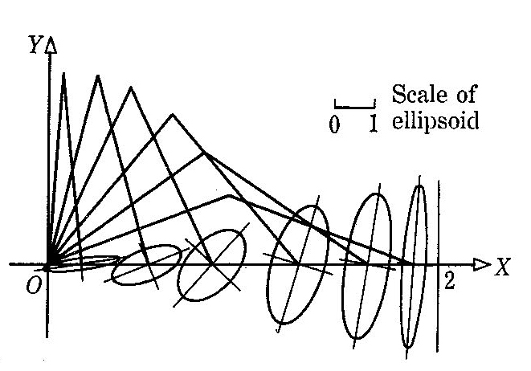
Performance Index – Manipulability
Kinematic Singularity – The robot end effector loses its ability to translate or rotate in one or more directions
Kinematic Singularity – Binary - A kinematic singularity presents a binary proposition – a particular configuration is either kinematically singular or it is not
Proximity to Singularity - it is reasonable to ask if a nonsingular configuration is “close” to being singular.
Manipulability Ellipsoid - The manipulability ellipsoid allows one to visualize geometrically the directions in which the end-effector moves with least effort or with greatest effort
Instructor: Jacob Rosen
Advanced Robotic - Department of Mechanical & Aerospace Engineering - UCLA

Slide 3
Jacobian – Singularity – Mathematical Introduction
Robotic
System
Non Singular
Conditions
Singular
Conditions
Instructor: Jacob Rosen
Advanced Robotic - Department of Mechanical & Aerospace Engineering - UCLA

Slide 4
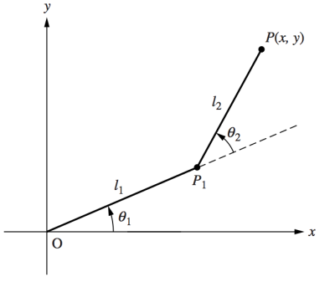




Jacobian – Singularity – Mathematical Introduction
$${\dot{θ}}_{2}^{ }$$
$${\dot{θ}}_{1}^{ }$$
$$v=J\left(θ\right)\dot{θ}$$
$$τ=J^{T}\left(θ\right)F$$
Instructor: Jacob Rosen
Advanced Robotic - Department of Mechanical & Aerospace Engineering - UCLA

Slide 5
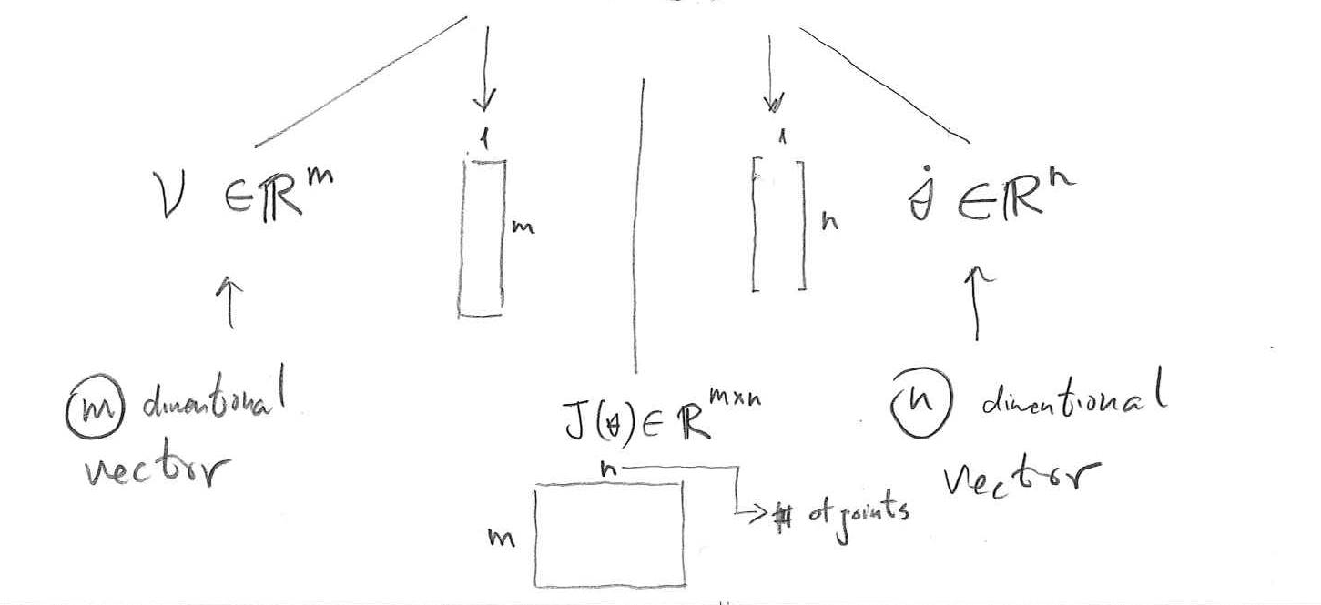

Jacobian – Singularity – Mathematical Introduction
General expression of the end effector velocity ellipsoid
$$v=J\left(θ\right)\dot{θ}$$
Instructor: Jacob Rosen
Advanced Robotic - Department of Mechanical & Aerospace Engineering - UCLA

Slide 6

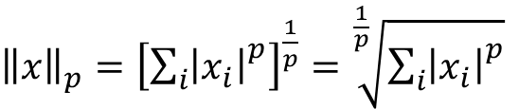
Jacobian – Singularity – Mathematical Introduction
Linear Algebra – Norm – Definition
  Norm P - $L_{p}$ norm of x
  $\left|x_{i}\right|$ Calculate the absolute value of the i-th element
  ${\left|x_{i}\right|}^{p}$ take its power p
  ${\sum_{i}{\left|x_{i}\right|}}^{p}$ sum all these power absolute values
  ${\left[{\sum_{i}{\left|x_{i}\right|}}^{p}\right]}^{\frac{1}{p}}$ take the power $\frac{1}{p}$ of the result
${\left\|x\right\|}_{p}={\left[{\sum_{i}{\left|x_{i}\right|}}^{p}\right]}^{\frac{1}{p}}=\sqrt[\frac{1}{p}]{{\sum_{i}{\left|x_{i}\right|}}^{p}}$
Instructor: Jacob Rosen
Advanced Robotic - Department of Mechanical & Aerospace Engineering - UCLA

Slide 7



Jacobian – Singularity – Mathematical Introduction
  Norm P=0 - $L_{0}$ norm of x
    Using the power of 0 with an absolute values will get you
      1 for every non-zero value
      0 for every zero value
    This norm corresponds to the number of non-zero elements in the vector
  Norm P=1 - $L_{1}$ norm of x
    The sum of the absolute values
${\left\|x\right\|}_{0}={\left[{\sum_{i}{\left|x_{i}\right|}}^{0}\right]}^{\frac{1}{0}}$
${\left\|x\right\|}_{1}={\left[{\sum_{i}{\left|x_{i}\right|}}^{1}\right]}^{\frac{1}{1}}=\sum_{i}{\left|x_{i}\right|}$
Instructor: Jacob Rosen
Advanced Robotic - Department of Mechanical & Aerospace Engineering - UCLA

Slide 8
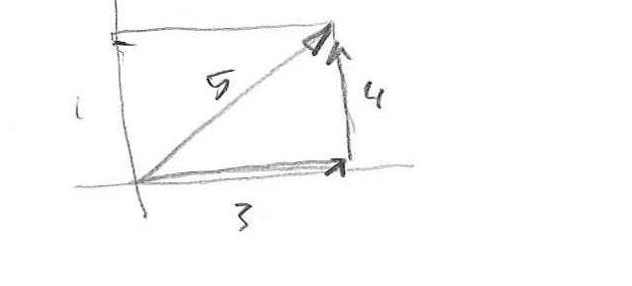



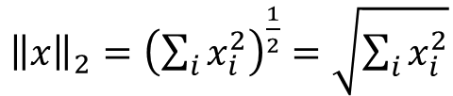
Jacobian – Singularity – Mathematical Introduction
  Norm P=2 - $L_{2}^{ }$ norm X (Euclidean Norm)
    The absolute value is not needed anymore since x is squared
    Provide the length of the vector in Pythagorean theorem
    Example
${\left\|x\right\|}_{2}={\left(\sum_{i}{x_{i}^{2}}\right)}^{\frac{1}{2}}=\sqrt{\sum_{i}{x_{i}^{2}}}$
$$u=\left\{\begin{matrix}3 \\ 4\end{matrix}\right\}$$
$${\left\|u\right\|}_{2}=\sqrt{{\left|3\right|}^{2}+{\left|4\right|}^{2}}=\sqrt{25}=5$$
Instructor: Jacob Rosen
Advanced Robotic - Department of Mechanical & Aerospace Engineering - UCLA

Slide 9


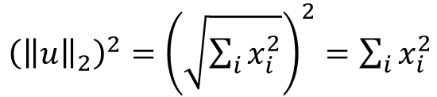
Jacobian – Singularity – Mathematical Introduction
  $L_{2}^{2}$ - Squared Euclidean norm (Squared $L_{2}^{2}$ norm)
    Alternative expressions for $L_{2}^{2}$
${\left({\left\|u\right\|}_{2}\right)}^{2}={\left(\sqrt{\sum_{i}{x_{i}^{2}}}\right)}^{2}=\sum_{i}{x_{i}^{2}}$
$${\left({\left\|u\right\|}_{2}\right)}^{2}=x∙x=x^{T}x$$
Instructor: Jacob Rosen
Advanced Robotic - Department of Mechanical & Aerospace Engineering - UCLA

Slide 10
Jacobian – Singularity – Mathematical Introduction
$${\dot{θ}}_{2}^{ }$$
$${\dot{θ}}_{1}^{ }$$
$$v=J\left(θ\right)\dot{θ}$$
$$τ=J^{T}\left(θ\right)F$$
Instructor: Jacob Rosen
Advanced Robotic - Department of Mechanical & Aerospace Engineering - UCLA

Slide 11
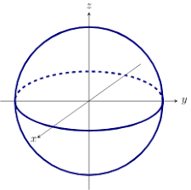










Jacobian – Singularity – Mathematical Introduction
A circle/sphere of joint velocities, like the circle shown here is defined by the equation
Using the definition of the Jacobian
Assume that the Jacobian is invertible (not strictly necessary) the previous equation can be rewritten as
$${\dot{θ}}_{2}^{ }$$
$${\dot{θ}}^{T}\dot{θ}=1$$
$${\dot{θ}}_{1}^{ }$$
$$v=J\left(θ\right)\dot{θ}$$
$${\dot{θ}}_{3}^{ }$$
$$\dot{θ}=J^{−1}v$$
$${\dot{θ}}^{T}={\left(J^{−1}v\right)}^{T}$$
$${\dot{θ}}_{2}^{ }$$
$${\dot{θ}}_{1}^{ }$$
$${\left(J^{−1}v\right)}^{T}\left(J^{−1}v\right)=1$$
Instructor: Jacob Rosen
Advanced Robotic - Department of Mechanical & Aerospace Engineering - UCLA

Slide 12







Jacobian – Singularity – Mathematical Introduction
Based on Linear Algebra property
The previous equations
Can be rewritten as
Based on linear Algebra properties
The previous equation can be rewritten as
$${\left(Ax\right)}^{T}=x^{T}A^{T}$$
$${\left(J^{−1}v\right)}^{T}\left(J^{−1}v\right)=1$$
$$v^{T}{\left(J^{−1}\right)}^{T}J^{−1}v=1$$
$${\left(A^{T}\right)}^{−1}={\left(A^{−1}\right)}^{T} (⋆)$$
$${\left(AB\right)}^{−1}=B^{−1}A^{−1} (⋆⋆)$$
$$from ⋆ →v^{T}{\left(J^{T}\right)}^{−1}J^{−1}v=0$$
$$from ⋆⋆ →v^{T}{\left(JJ^{T}\right)}^{−1}v=0$$
Instructor: Jacob Rosen
Advanced Robotic - Department of Mechanical & Aerospace Engineering - UCLA

Slide 13





Jacobian – Singularity – Mathematical Introduction
Rewriting
where
$$v^{T}{\left(JJ^{T}\right)}^{−1}v=0$$
$$v^{T}{\left(A\right)}^{−1}v=0$$
$$A=JJ^{T}$$
$$A∈ℝ^{m×m},J∈ℝ^{m×n},J^{T}∈ℝ^{n×m}$$
$A^{−1},A$ properties:
$A^{−1},A$ – is positive
$A^{−1},A$ – symmetric
Instructor: Jacob Rosen
Advanced Robotic - Department of Mechanical & Aerospace Engineering - UCLA

Slide 14
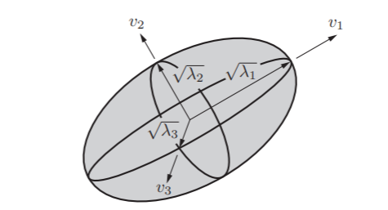

Performance Index – Manipulability
Performing eigenvector/eigenvalue analysis of $A=JJ^{T}$ defining
  Eigenvectors $ν_{i}$
  eigenvalues $λ_{i}$
The directions of the principal axes of the ellipsoid are $ν_{i}$ and the lengths of the principal semi-axes are $\sqrt{λ_{i}}$
Instructor: Jacob Rosen
Advanced Robotic - Department of Mechanical & Aerospace Engineering - UCLA

Slide 15

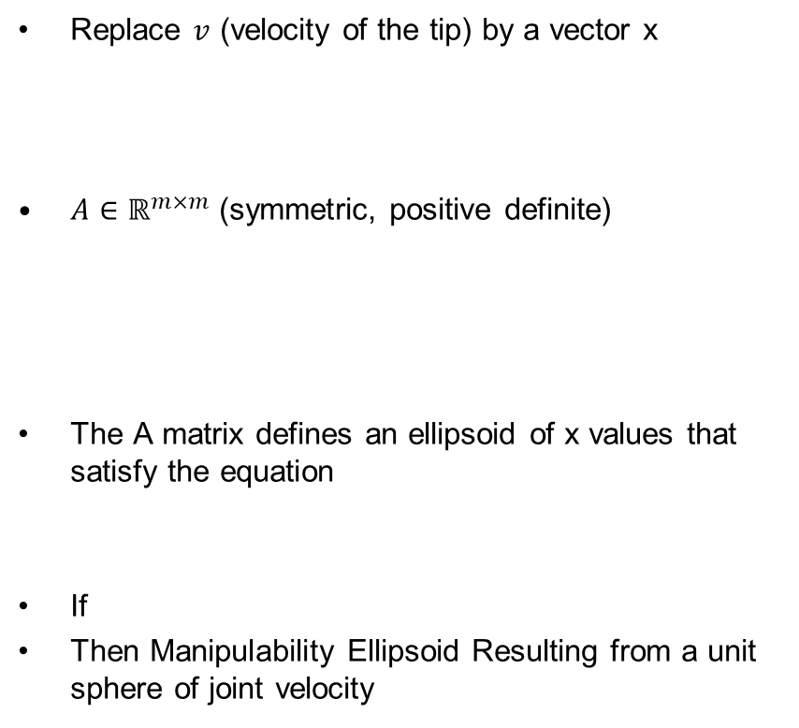



Jacobian – Singularity – Mathematical Introduction
Replace $v$ (velocity of the tip) by a vector x
$A∈ℝ^{m×m}$ (symmetric, positive definite)
The A matrix defines an ellipsoid of x values that satisfy the equation
If
Then Manipulability Ellipsoid Resulting from a unit sphere of joint velocity
$$x^{T}A^{−1}x=0$$
Eigenvalues of A$→λ_{1},λ_{2},…,λ_{m}$
Eigenvectors of A$→v_{1},v_{2},…,v_{m}$
$$A=JJ^{T}$$
$$x=v_{tip}$$
Instructor: Jacob Rosen
Advanced Robotic - Department of Mechanical & Aerospace Engineering - UCLA

Slide 16





Jacobian – Singularity – Mathematical Introduction
If
Then Manipulability Ellipsoid Resulting from a unit sphere of joint velocity
If
Then Force Ellipsoid Resulting from a unit sphere of joint forces or torques
$$x^{T}A^{−1}x=0$$
$$A=JJ^{T}$$
$$x=v_{tip}$$
$$A={\left(JJ^{T}\right)}^{−1}$$
$$x=F_{tip}$$
Instructor: Jacob Rosen
Advanced Robotic - Department of Mechanical & Aerospace Engineering - UCLA

Slide 17
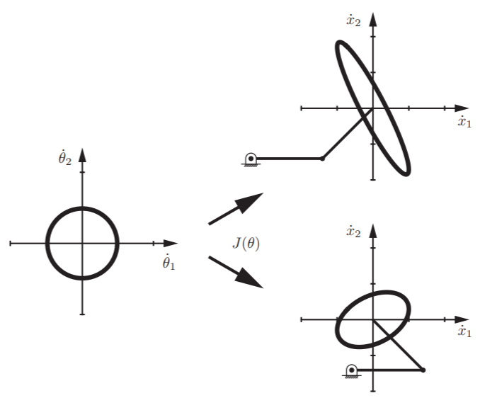
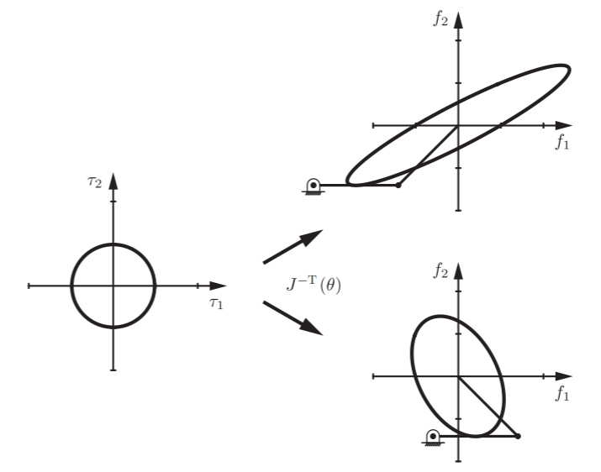


Performance Index – Manipulability
$$\dot{q}=\dot{X}=J\dot{Θ}$$
$$τ=J^{T}F \\ F=J^{−T}τ$$
Joint Space
Task Space
Joint Space
Task Space
Instructor: Jacob Rosen
Advanced Robotic - Department of Mechanical & Aerospace Engineering - UCLA

Slide 18
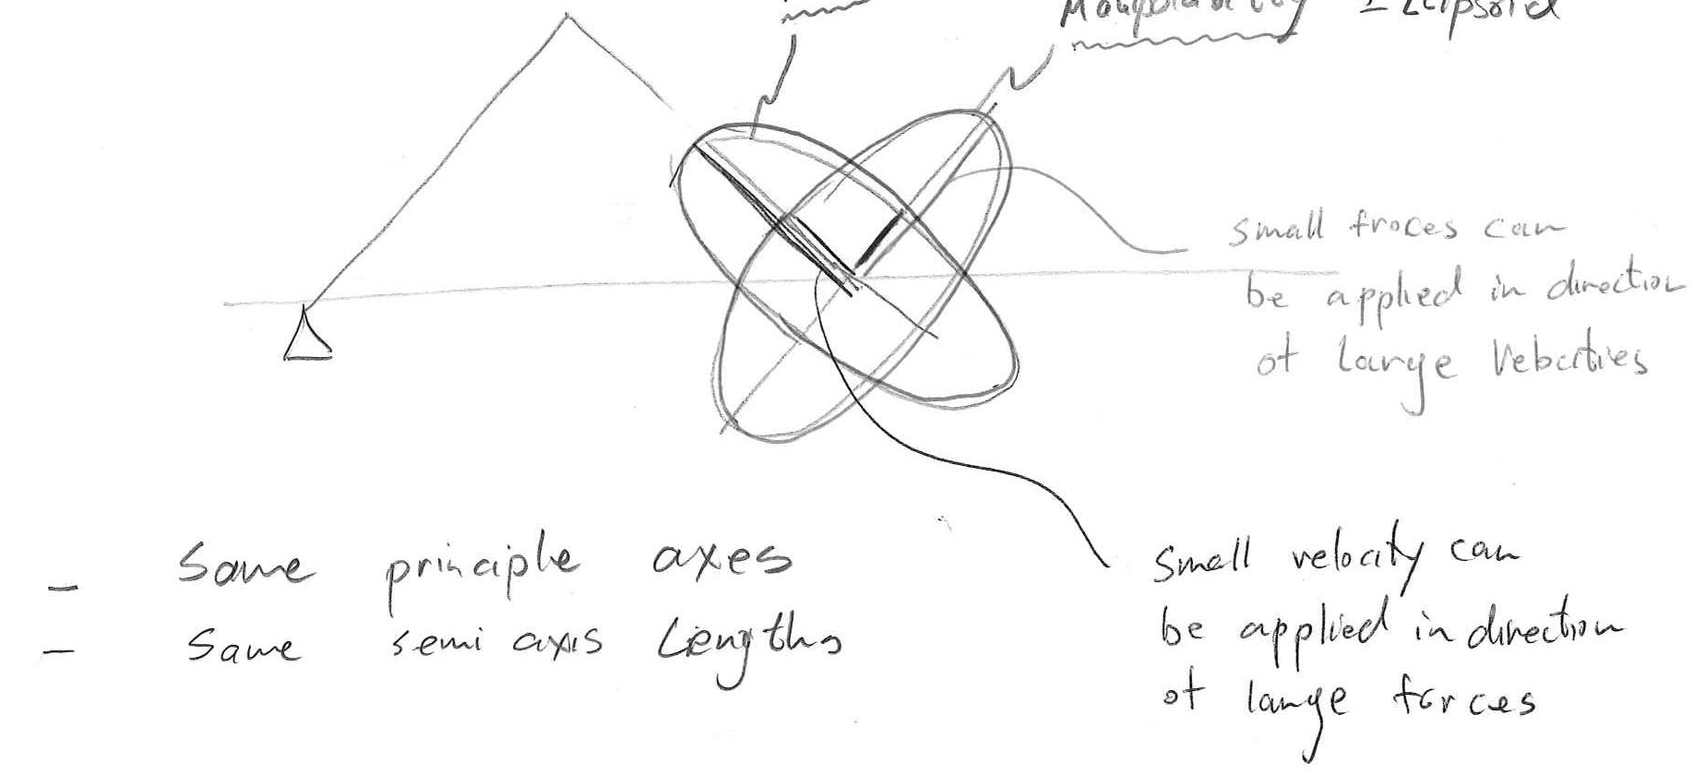
Jacobian – Singularity – Mathematical Introduction
Force ellipsoid
Manipulability ellipsoid
  Small forces can be applied in direction of large velocities
  Same principle axes
  Same semi axis lengths
  Small velocity can be applied in direction of large forces
Instructor: Jacob Rosen
Advanced Robotic - Department of Mechanical & Aerospace Engineering - UCLA

Slide 19
Jacobian – Singularity – Mathematical Introduction
  Assigning a single number representing how close the robot is to being a singular
  OR
  Reducing the representation of the ellipsoid into a single number
  Performance Index
Instructor: Jacob Rosen
Advanced Robotic - Department of Mechanical & Aerospace Engineering - UCLA

Slide 20
Performance Indices
Definition
Instructor: Jacob Rosen
Advanced Robotic - Department of Mechanical & Aerospace Engineering - UCLA

Slide 21
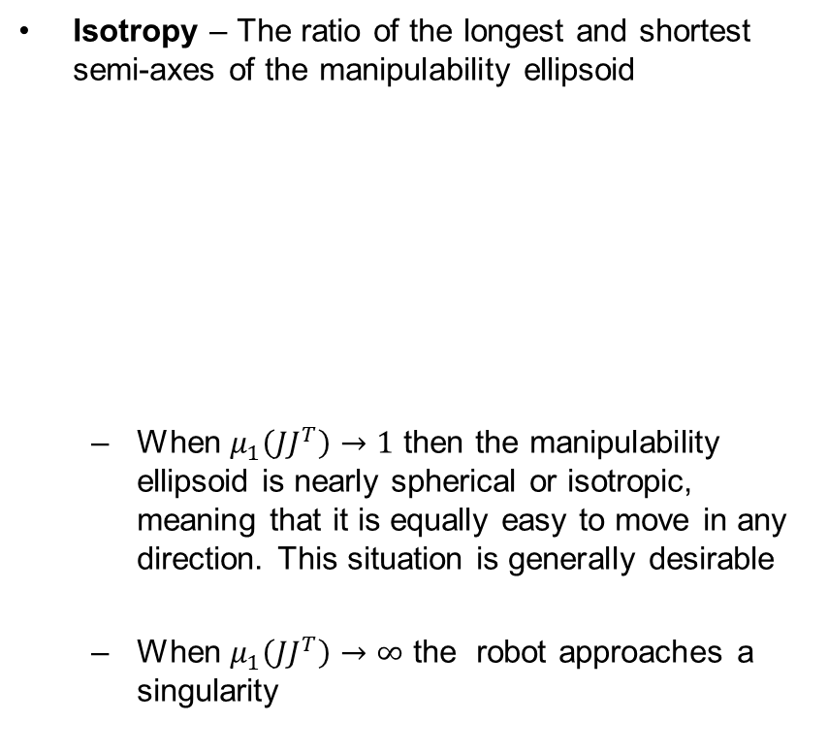

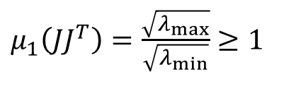
Performance Index Measure No.1 - Isotropy
Isotropy – The ratio of the longest and shortest semi-axes of the manipulability ellipsoid
  When $μ_{1}\left(JJ^{T}\right)→1$ then the manipulability ellipsoid is nearly spherical or isotropic, meaning that it is equally easy to move in any direction. This situation is generally desirable
  When $μ_{1}\left(JJ^{T}\right)→∞$ the robot approaches a singularity
$μ_{1}\left(JJ^{T}\right)=\frac{\sqrt{λ_{max}}}{\sqrt{λ_{min}}}$ $≥1$
$$1≤μ_{1}\left(JJ^{T}\right)≤∞$$
Instructor: Jacob Rosen
Advanced Robotic - Department of Mechanical & Aerospace Engineering - UCLA

Slide 22

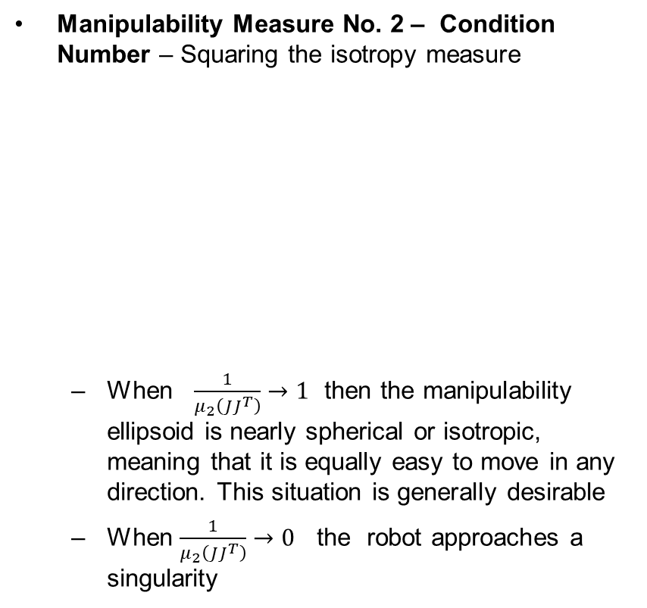

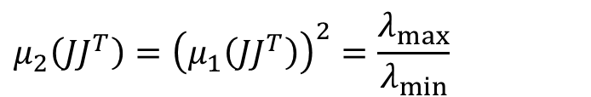
Performance Index Measure No.2 – Condition Number
Manipulability Measure No. 2 – Condition Number – Squaring the isotropy measure
  When $\frac{1}{μ_{2}\left(JJ^{T}\right)}→1$ then the manipulability ellipsoid is nearly spherical or isotropic, meaning that it is equally easy to move in any direction. This situation is generally desirable
  When $\frac{1}{μ_{2}\left(JJ^{T}\right)}→0$ the robot approaches a singularity
$$μ_{2}\left(JJ^{T}\right)={\left(μ_{1}\left(JJ^{T}\right)\right)}^{2}=\frac{λ_{max}}{λ_{min}}$$
$$1≤μ_{2}\left(JJ^{T}\right)≤∞$$
$$0≥ \frac{1}{μ_{2}\left(JJ^{T}\right)}=\frac{λ_{min}\left(A\right)}{λ_{max}\left(A\right)}≥1$$
Instructor: Jacob Rosen
Advanced Robotic - Department of Mechanical & Aerospace Engineering - UCLA

Slide 23

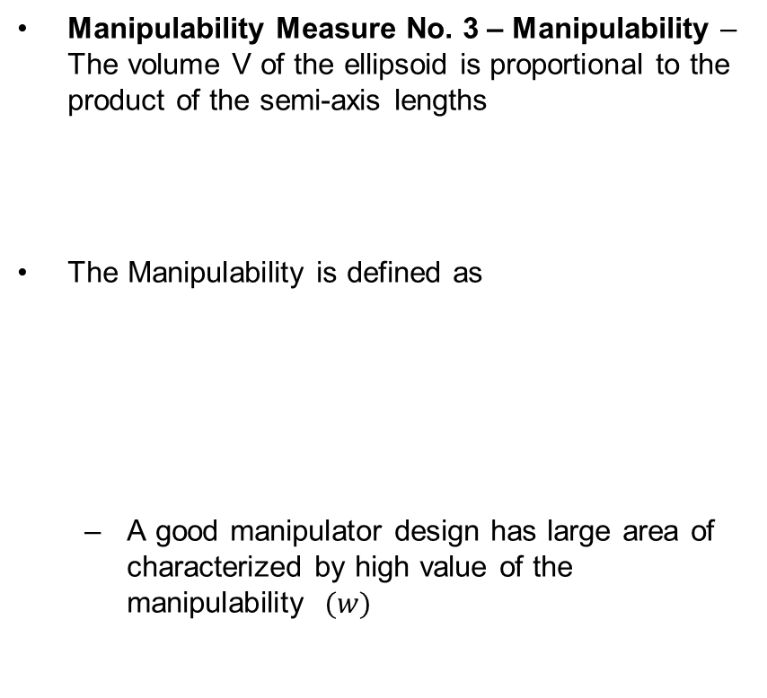
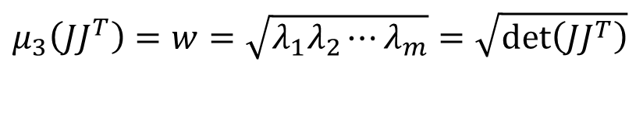

Performance Index – Manipulability
Manipulability Measure No. 3 – Manipulability – The volume V of the ellipsoid is proportional to the product of the semi-axis lengths
The Manipulability is defined as
  A good manipulator design has large area of characterized by high value of the manipulability $(w)$
$$V∝\sqrt{λ_{1}λ_{2}⋯λ_{m}}=\sqrt{\det\left(JJ^{T}\right)}$$
$$μ_{3}\left(JJ^{T}\right)=w=\sqrt{λ_{1}λ_{2}⋯λ_{m}}=\sqrt{\det\left(JJ^{T}\right)}$$
$$0≤w<∞$$
Instructor: Jacob Rosen
Advanced Robotic - Department of Mechanical & Aerospace Engineering - UCLA

Slide 24







Performance Index – Manipulability
Given the structure of the Jacobian matrix, it makes sense to separate it into the two sub matrixes because the units of
  are linear velocities (m/s) and the unites of
  are angular velocities (rad/s)
This leads to two three-dimensional manipulability ellipsoids, one for linear velocities and one for angular velocities.
$$J_{ν}$$
$$J_{ω}$$
$$J\left(θ\right)∈ℝ^{6×n}$$
$$J(θ)=\left[\begin{matrix} & J_{v} & \\ & J_{ω} & \end{matrix}\right]$$
$J_{v}∈ℝ^{3×n}→$ Linear velocity/force ellipsoids
$J_{w}∈ℝ^{3×n}→$ Angular velocity/moment ellipsoids
$$J_{ν}{J_{ν}}^{T}$$
$$J_{ω}{J_{ω}}^{T}$$
Instructor: Jacob Rosen
Advanced Robotic - Department of Mechanical & Aerospace Engineering - UCLA

Slide 25



Performance Index – Manipulability
When calculating the linear-velocity manipulability ellipsoid ( ),
it generally makes more sense to use the Jacobian expressed in the end effector space
instead of the Base Frame
since we are usually interested in the linear velocity of the end effector in its own coordinate system than a fixed frame at the base
$$J_{ν}{J_{ν}}^{T}$$
$${{}_{ }^{N}J}_{ν}{{{}_{ }^{N}J}_{ν}}^{T}$$
$${{}_{ }^{0}J}_{ν}{{{}_{ }^{0}J}_{ν}}^{T}$$
Instructor: Jacob Rosen
Advanced Robotic - Department of Mechanical & Aerospace Engineering - UCLA

Slide 26
Designing Well Conditioned Workspace – Rational
Challenge
  Difficulty in operating at
    Workspace Boundaries
    Neighborhood of singular point inside the workspace
Goal
  Singularity - The further the manipulator is away from singularities the better it moves uniformly and apply forces in all directions
Performance Criterion
  It is useful to assign a single scalar measure defining how easily the robot can move at a given posture.
Instructor: Jacob Rosen
Advanced Robotic - Department of Mechanical & Aerospace Engineering - UCLA

Slide 27
Recap
Instructor: Jacob Rosen
Advanced Robotic - Department of Mechanical & Aerospace Engineering - UCLA

Slide 28






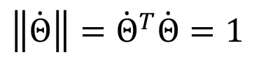


Performance Index – Manipulability
Manipulabity Ellipsoid - For a general n-joint serial (open chain) and a task space with coordinates the manipulability ellipsoid corresponds to the end-effector velocities for joint rates
satisfying the norm of $\dot{Θ}$ to be equal to 1
representing a unite sphere in the n-th dimensional joint velocity space
$$q$$
$$\dot{q}$$
$$q=X=\left\{\begin{matrix}x \\ y \\ Z \\ θ_{x} \\ θ_{y} \\ θ_{z}\end{matrix}\right\}$$
$$\dot{Θ}=\left\{\begin{matrix}{\dot{θ}}_{1} \\ {\dot{θ}}_{2} \\ \\ {\dot{d}}_{i} \\ \\ {\dot{θ}}_{n}\end{matrix}\right\}$$
$$\dot{q}=\dot{X}=\left\{\begin{matrix}\dot{x} \\ \dot{y} \\ \dot{Z} \\ {\dot{θ}}_{x} \\ {\dot{θ}}_{y} \\ {\dot{θ}}_{z}\end{matrix}\right\}$$
$$Θ=\left\{\begin{matrix}θ_{1} \\ θ_{2} \\ \\ d_{i} \\ \\ θ_{n}\end{matrix}\right\}$$
$$\dot{q}=J\dot{Θ} \\ \dot{Θ}=J^{−1}\dot{q}$$
$$\left\|\dot{Θ}\right\|={\dot{Θ}}^{T}\dot{Θ}=1$$
Instructor: Jacob Rosen
Advanced Robotic - Department of Mechanical & Aerospace Engineering - UCLA

Slide 29



Performance Index – Manipulability
Assuming J is invertible, the unit joint-velocity condition can be written
If J is full rank the matrix and are
  square,
  symmetric
  positive definite
$$1={\dot{Θ}}^{T}\dot{Θ} \\ 1={\left(J^{−1}\dot{q}\right)}^{T}\left(J^{−1}\dot{q}\right) \\ 1={\dot{q}}^{T}{\left(J^{−1}\right)}^{T}J^{−1}\dot{q}={\dot{q}}^{T}J^{−T}J^{−1}\dot{q} \\ 1={\dot{q}}^{T}{\left(JJ^{T}\right)}^{−1}\dot{q}$$
$$JJ^{T}$$
$${\left(JJ^{T}\right)}^{−1}$$
Instructor: Jacob Rosen
Advanced Robotic - Department of Mechanical & Aerospace Engineering - UCLA

Slide 30





Performance Index – Manipulability
For any symmetric positive-definite , the set of vectors satisfying
defines an ellipsoid in the m-dimensional space.
Recap
Represent an circle / sphere
Represent a ellipse / ellipsoid
$$JJ^{T}$$
$$\dot{q}$$
$${\dot{q}}^{T}{\left(JJ^{T}\right)}^{−1}\dot{q}=1$$
$${\dot{Θ}}^{T}\dot{Θ}=1$$
$${\dot{q}}^{T}{\left(JJ^{T}\right)}^{−1}\dot{q}=1$$
Instructor: Jacob Rosen
Advanced Robotic - Department of Mechanical & Aerospace Engineering - UCLA

Slide 31
Performance Indices - Design
Optimization Approach
Instructor: Jacob Rosen
Advanced Robotic - Department of Mechanical & Aerospace Engineering - UCLA

Slide 32
Jacobian – Design - Performance Index – Optimization
Instructor: Jacob Rosen
Advanced Robotic - Department of Mechanical & Aerospace Engineering - UCLA

Slide 33

Jacobian – Design - Performance Index – Optimization – Pseudo Code
FOR $L_{1}:0→500++∆L_{1}$
FOR $L_{2}:0→500++∆L_{2}$
Check if the link lengths allows the tip to reach all the points in
the workspace by solving the IK for every point in the workspace
IF NOT $→$ select a new pair of $L_{1},L_{2}$
FOR $x:x+d→x+d+w ++∆x$
FOR $y:y−\frac{h}{2}→y+\frac{h}{2} ++∆y$
[Calculate the angles $θ_{1},θ_{2}$ using IK]
[Calculate $J$ and $J^{T}$]
[Calculate the eigenvalues of $JJ^{T}$]
[Calculate $\sqrt{\frac{λ_{min}}{λ_{max}}}$]
[Populate $κ$]
END (FOR $y$)
END (FOR $x$)
[Calculate $\sum{κ_{i}}$]
[Calculate $κ_{min}$]
[Calculate $C=\frac{\sum{κ_{i}κ_{min}}}{L_{1}^{3}+L_{2}^{3}}$]
[Calculate optimal $L_{1},L_{2},\sum{κ_{i}},κ_{min},C$]
END (FOR $L_{2}$)
END (FOR $L_{1}$)
[Select max $C→L_{1},L_{2}$]
Instructor: Jacob Rosen
Advanced Robotic - Department of Mechanical & Aerospace Engineering - UCLA

Slide 34
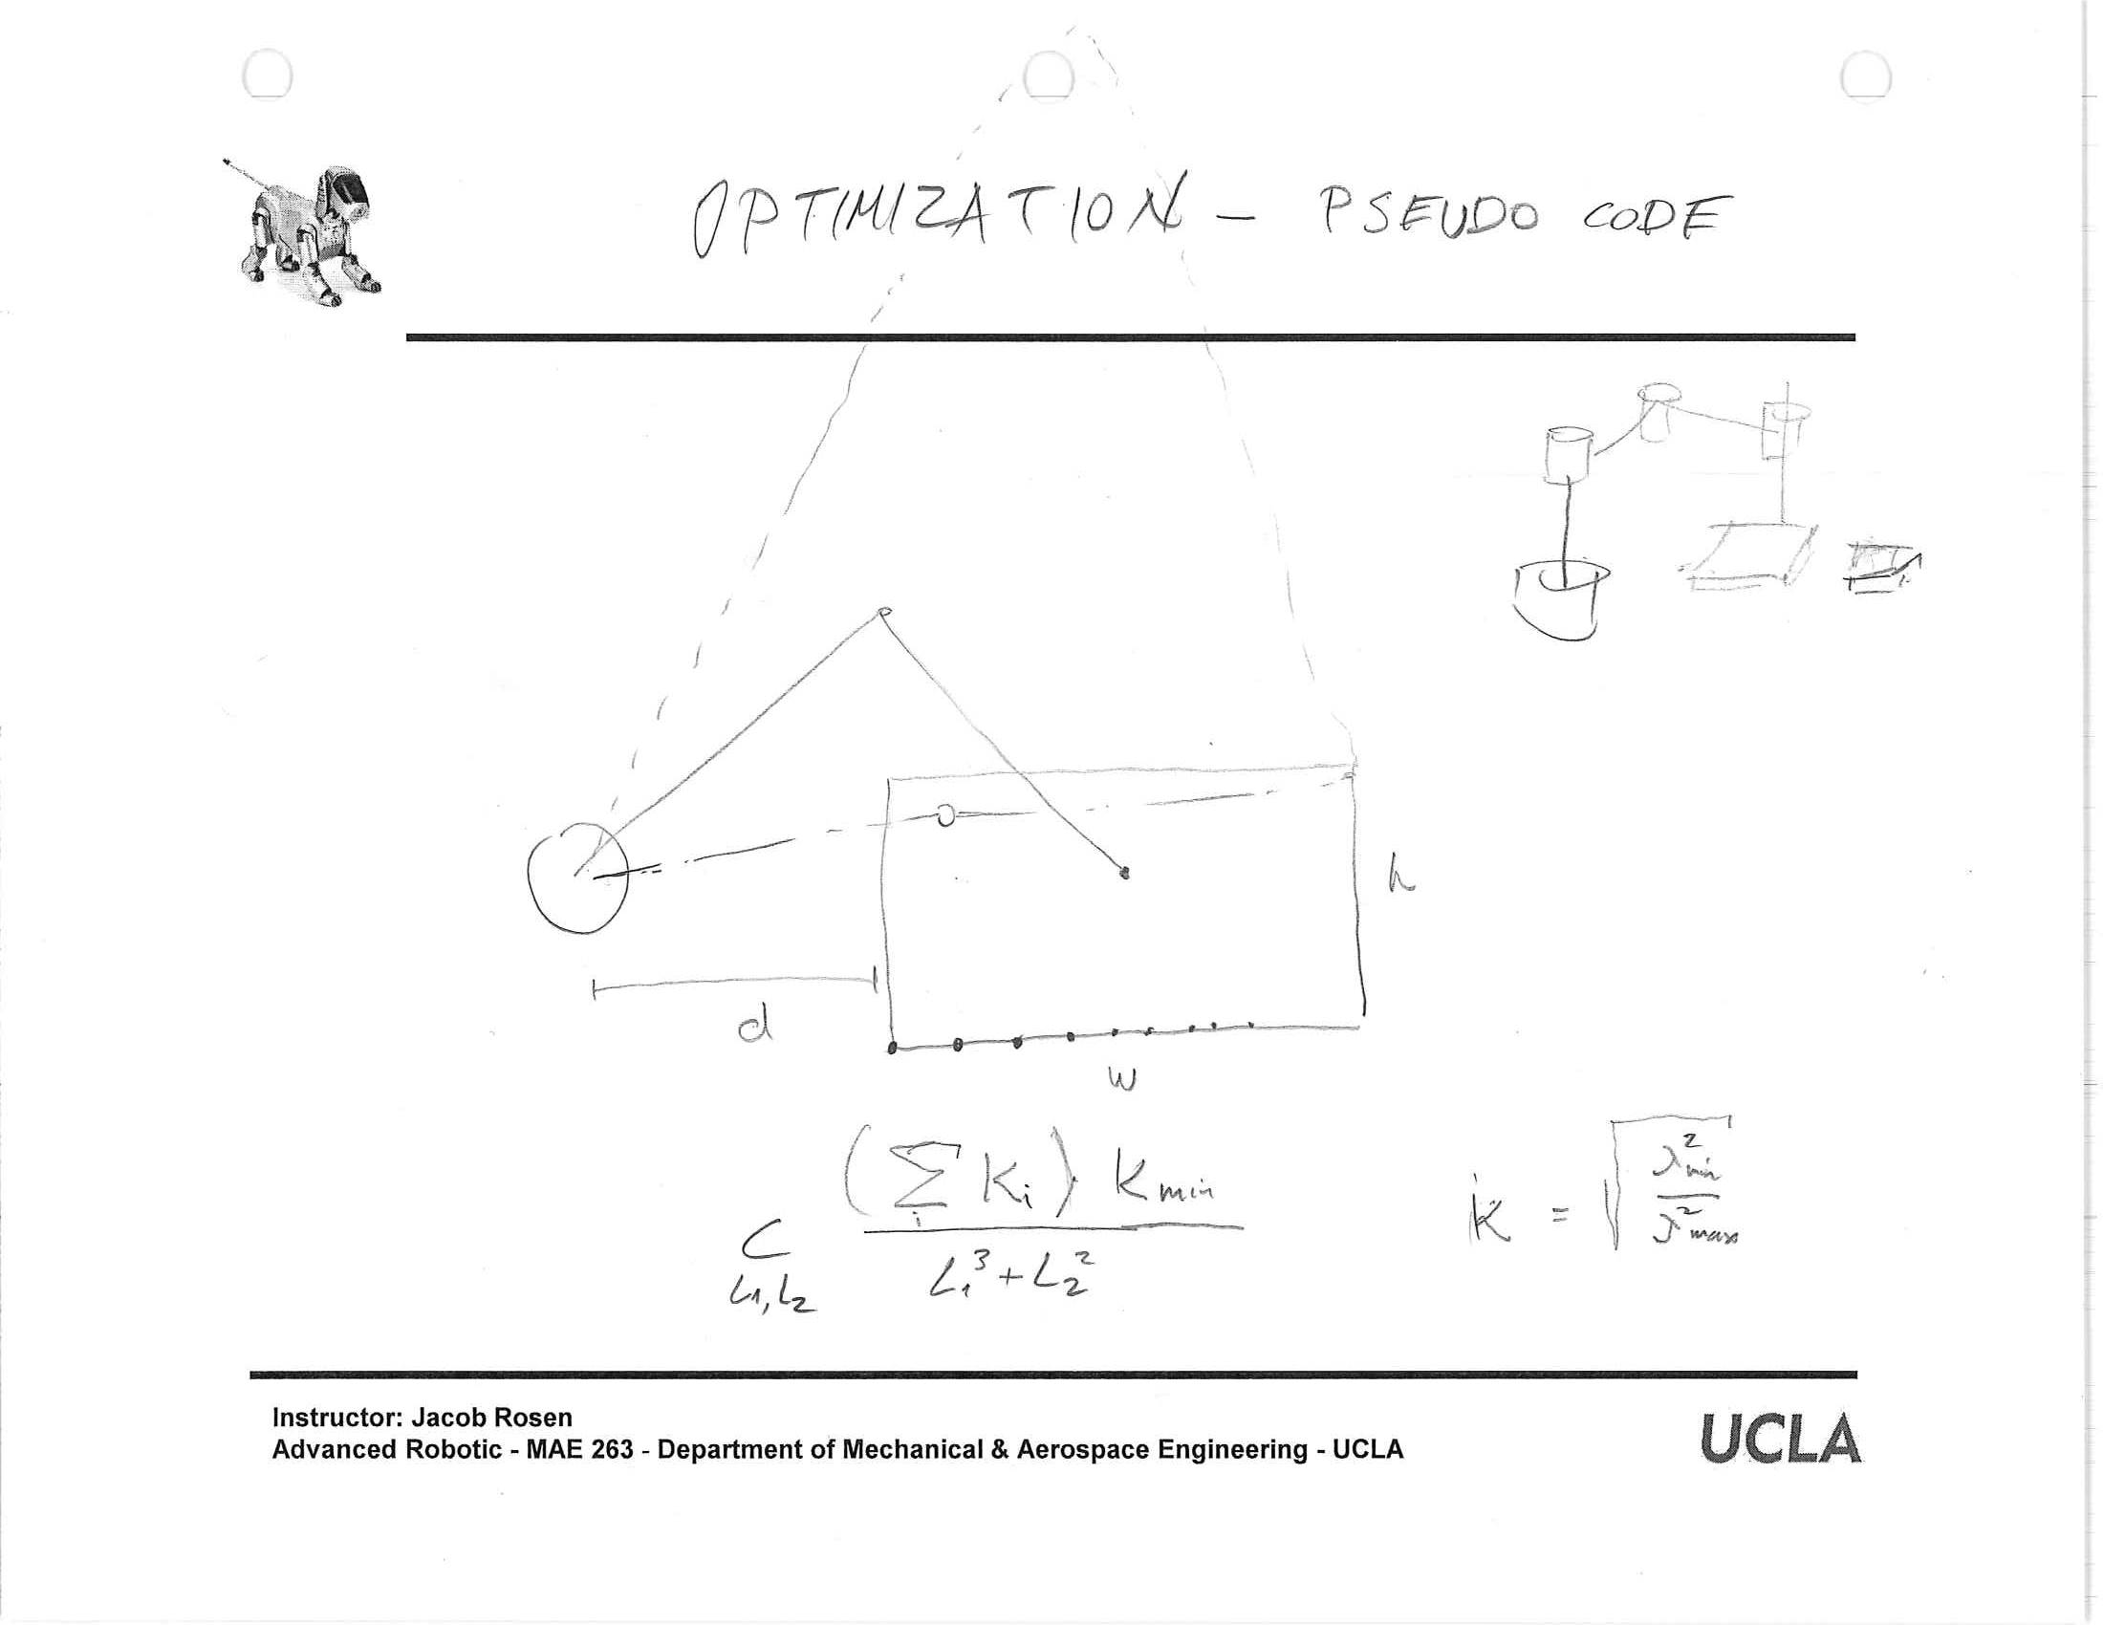
Jacobian – Design - Performance Index – Optimization
Instructor: Jacob Rosen
Advanced Robotic - Department of Mechanical & Aerospace Engineering - UCLA

Slide 35
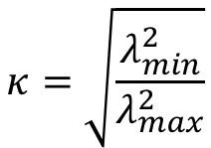
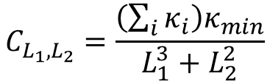
Jacobian – Design - Performance Index – Optimization
$$κ=\sqrt{\frac{λ_{min}^{2}}{λ_{max}^{2}}}$$
$$C_{L_{1},L_{2}}=\frac{\left(\sum_{i}{κ_{i}}\right)κ_{min}}{L_{1}^{3}+L_{2}^{2}}$$
Instructor: Jacob Rosen
Advanced Robotic - Department of Mechanical & Aerospace Engineering - UCLA

Slide 36
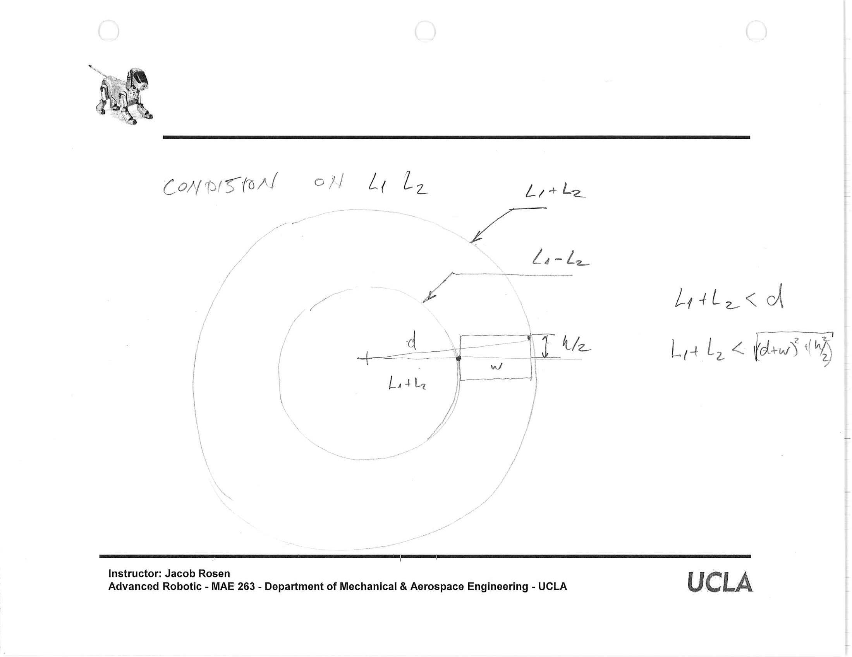
Jacobian – Design - Performance Index – Optimization
Instructor: Jacob Rosen
Advanced Robotic - Department of Mechanical & Aerospace Engineering - UCLA

Slide 37
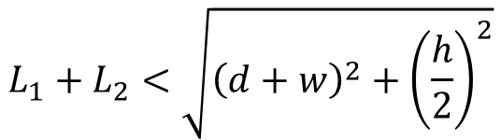

Jacobian – Design - Performance Index – Optimization
$$L_{1}+L_{2}<d$$
$$L_{1}+L_{2}<\sqrt{{\left(d+w\right)}^{2}+{\left(\frac{h}{2}\right)}^{2}}$$
Instructor: Jacob Rosen
Advanced Robotic - Department of Mechanical & Aerospace Engineering - UCLA

Slide 38
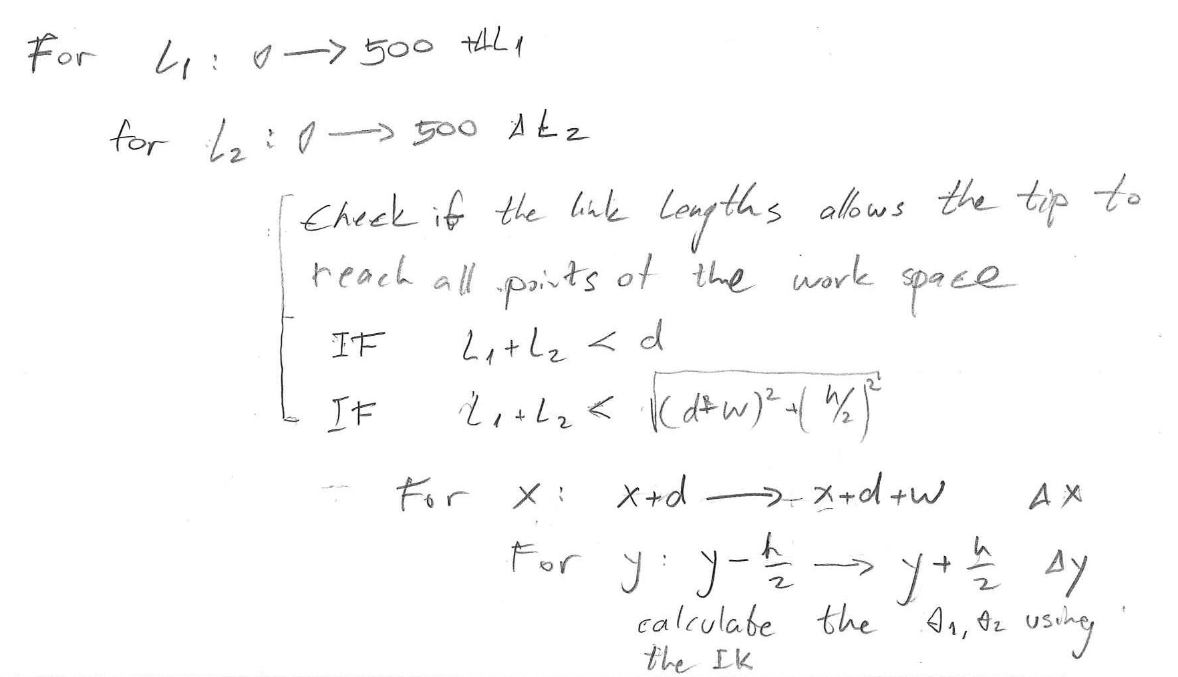
Jacobian – Design - Performance Index – Optimization
Instructor: Jacob Rosen
Advanced Robotic - Department of Mechanical & Aerospace Engineering - UCLA

Slide 39
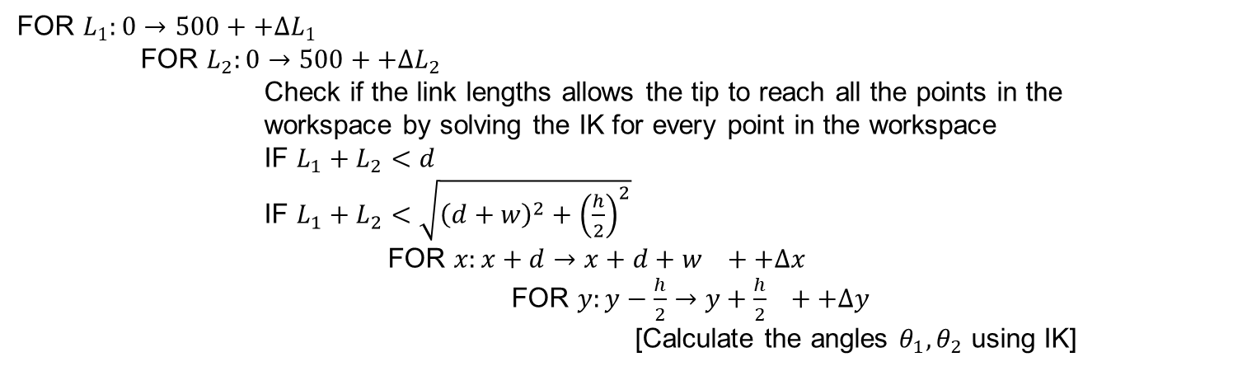
Jacobian – Design - Performance Index – Optimization
FOR $L_{1}:0→500++∆L_{1}$
FOR $L_{2}:0→500++∆L_{2}$
Check if the link lengths allows the tip to reach all the points in the workspace by solving the IK for every point in the workspace
IF $L_{1}+L_{2}<d$
IF $L_{1}+L_{2}<\sqrt{{\left(d+w\right)}^{2}+{\left(\frac{h}{2}\right)}^{2}}$
    FOR $x:x+d→x+d+w ++∆x$
    FOR $y:y−\frac{h}{2}→y+\frac{h}{2} ++∆y$
    [Calculate the angles $θ_{1},θ_{2}$ using IK]
Instructor: Jacob Rosen
Advanced Robotic - Department of Mechanical & Aerospace Engineering - UCLA

Slide 40
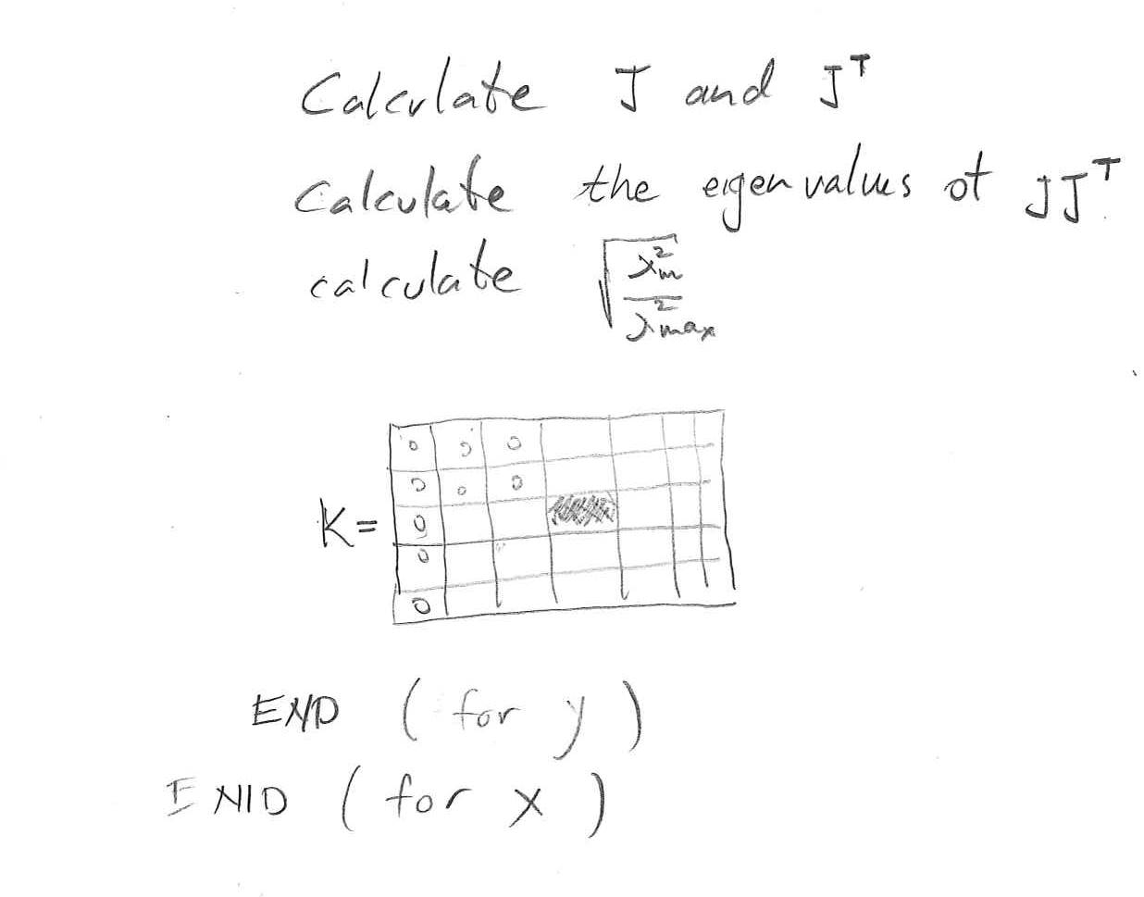
Jacobian – Design - Performance Index – Optimization
Instructor: Jacob Rosen
Advanced Robotic - Department of Mechanical & Aerospace Engineering - UCLA

Slide 41
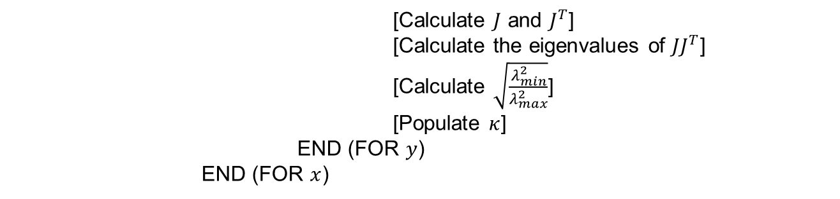
Jacobian – Design - Performance Index – Optimization
[Calculate $J$ and $J^{T}$]
[Calculate the eigenvalues of $JJ^{T}$]
[Calculate $\sqrt{\frac{λ_{min}^{2}}{λ_{max}^{2}}}$]
[Populate $κ$]
END (FOR $y$)
END (FOR $x$)
Instructor: Jacob Rosen
Advanced Robotic - Department of Mechanical & Aerospace Engineering - UCLA

Slide 42
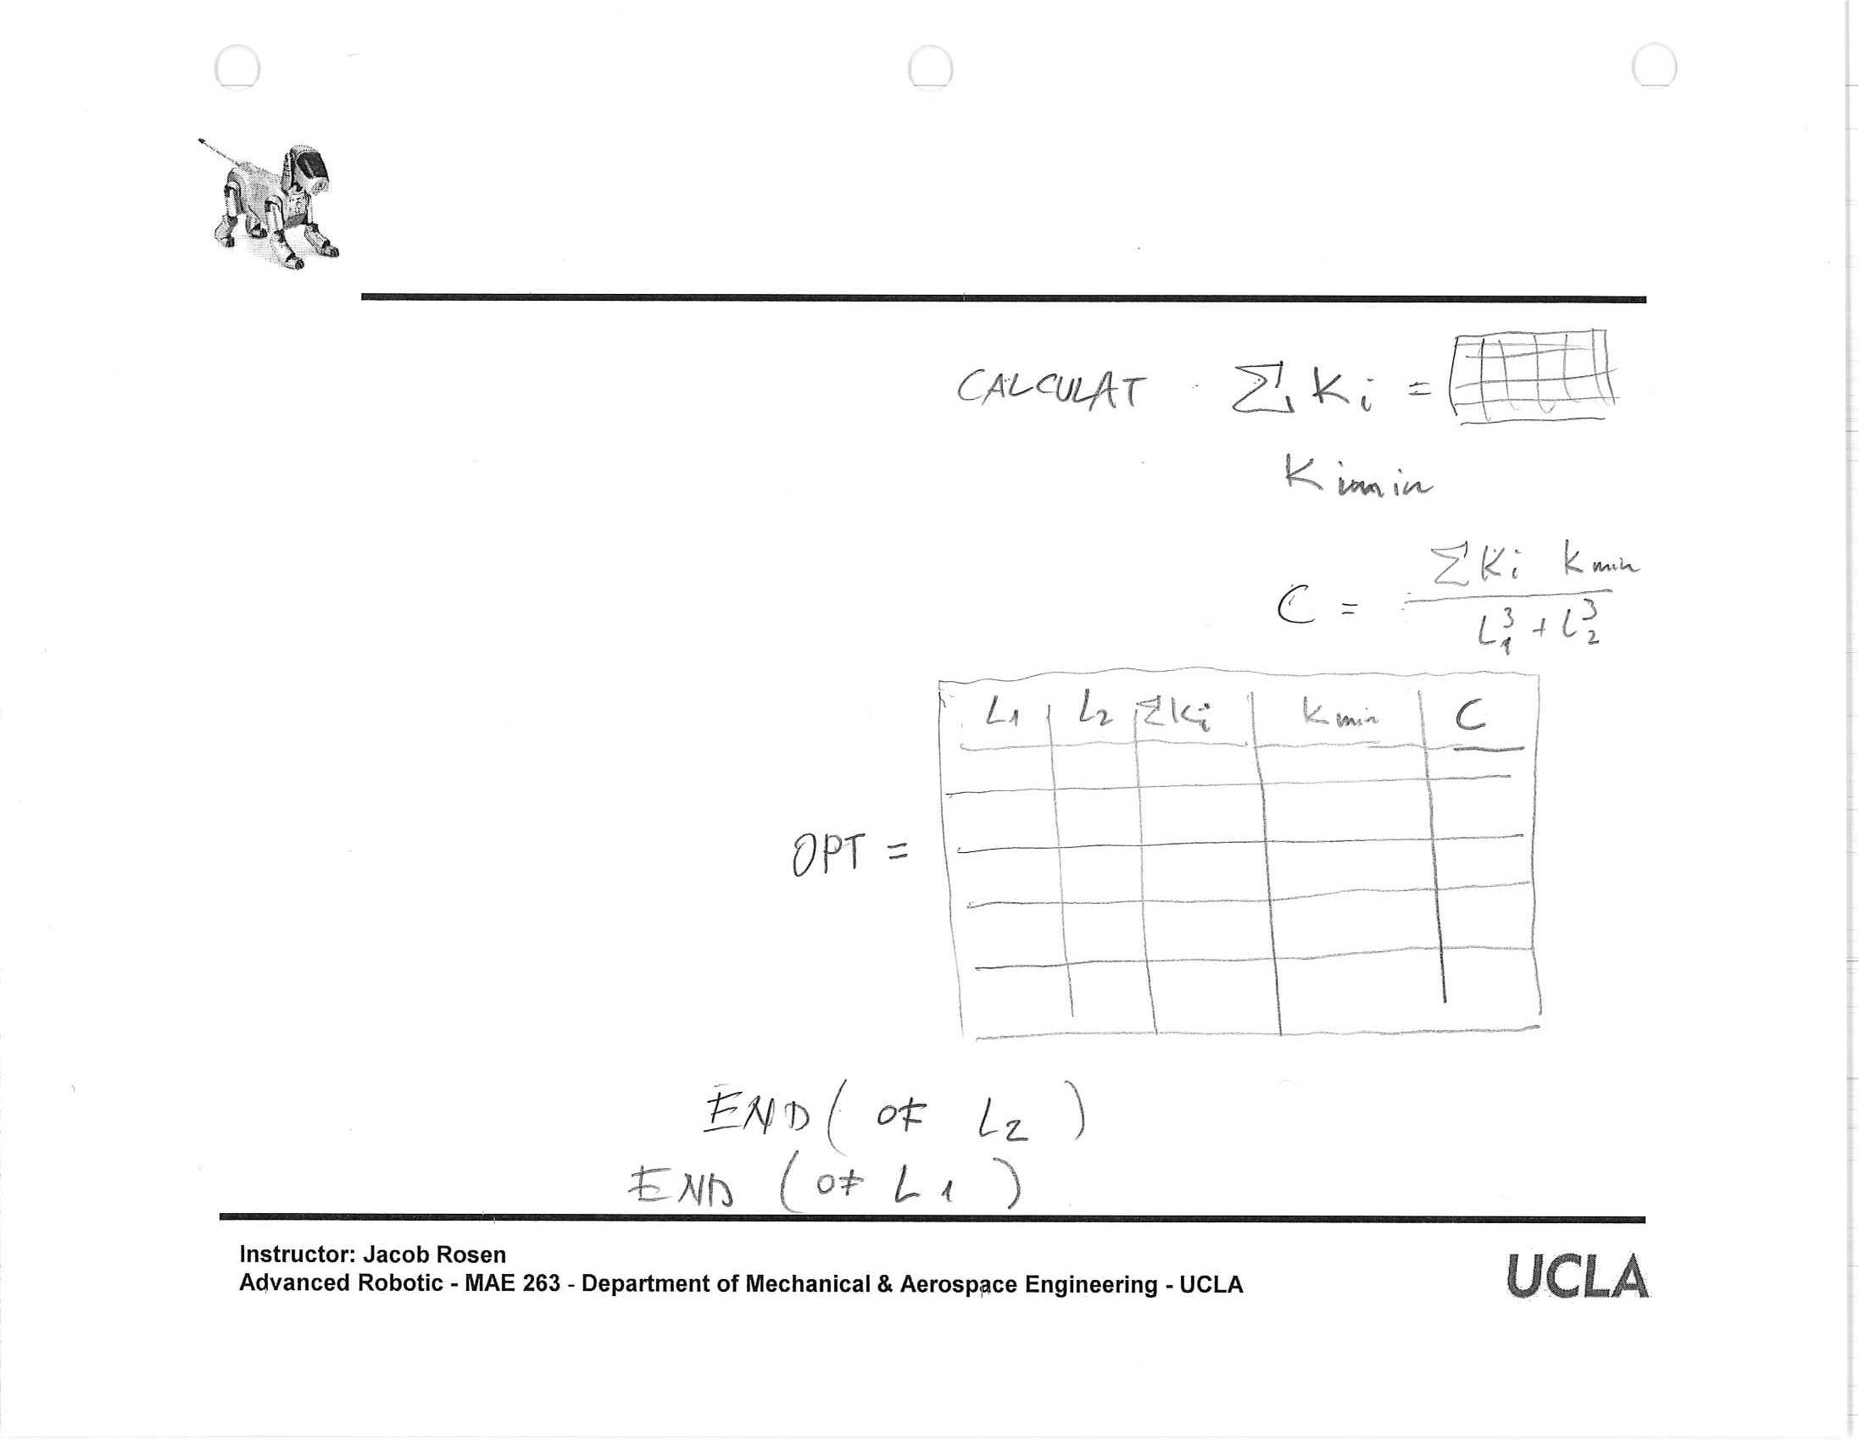
Jacobian – Design - Performance Index – Optimization
Instructor: Jacob Rosen
Advanced Robotic - Department of Mechanical & Aerospace Engineering - UCLA

Slide 43
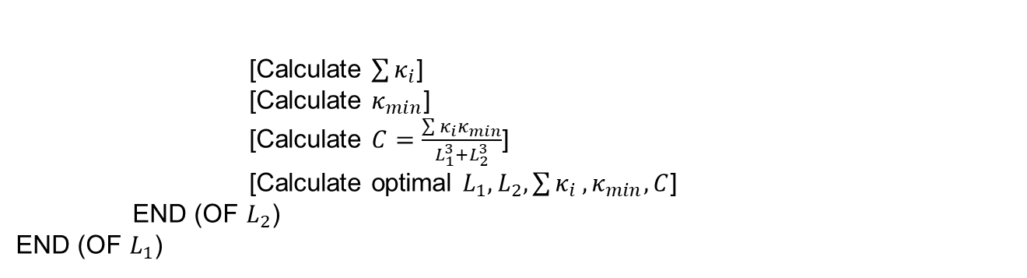
Jacobian – Design - Performance Index – Optimization
[Calculate $\sum{κ_{i}}$]
[Calculate $κ_{min}$]
[Calculate $C=\frac{\sum{κ_{i}κ_{min}}}{L_{1}^{3}+L_{2}^{3}}$]
[Calculate optimal $L_{1},L_{2},\sum{κ_{i}},κ_{min},C$]
END (OF $L_{2}$)
END (OF $L_{1}$)
Instructor: Jacob Rosen
Advanced Robotic - Department of Mechanical & Aerospace Engineering - UCLA

Slide 44
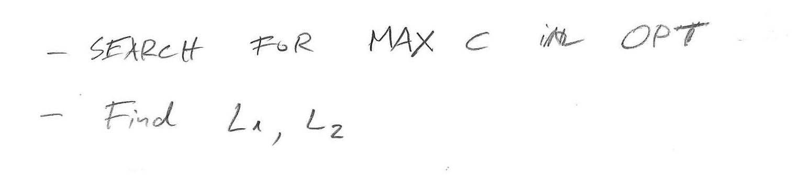
Jacobian – Design - Performance Index – Optimization
Instructor: Jacob Rosen
Advanced Robotic - Department of Mechanical & Aerospace Engineering - UCLA

Slide 45
Jacobian – Design - Performance Index – Optimization
- Search for MAX $C$ in OPT
- Find $L_{1},L_{2}$
Instructor: Jacob Rosen
Advanced Robotic - Department of Mechanical & Aerospace Engineering - UCLA

Slide 46
Design – Example
Instructor: Jacob Rosen
Advanced Robotic - Department of Mechanical & Aerospace Engineering - UCLA

Slide 47

RAVEN – A SURGICAL ROBTICS SYSTEM
DESIGN – Specifications
Notes:
47

Slide 48
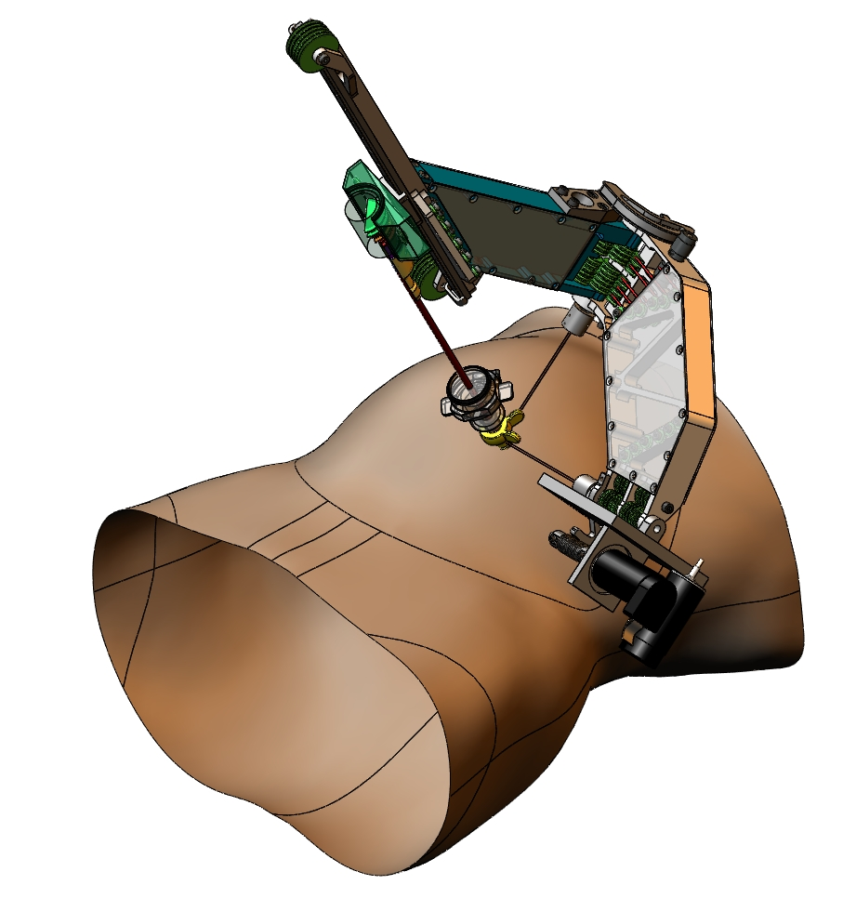
Notes:
48

Slide 49
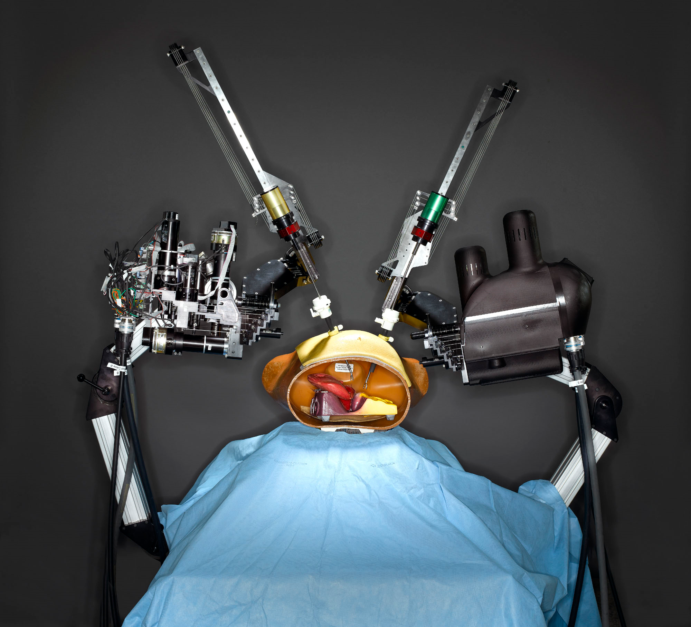

Slide 50


Slide 51

Blue DRAGON
Notes:
This video clip shows the synthesized haptic and visual interface while performing one of the tool tissue interaction called grasping-pushing-sweeping

Slide 52
Engineering Specifications - BlueDRAGON
Notes:
52

Slide 53

Kinematic Analysis –
Playback Simulation using Measured Data

Slide 54

Robot Optimization - Workspace
60º- 60º
Dexterous Workspace (DWS)
  High dexterity region defined by a right circular cone with a vertex angel of 60º
  Contains 95% of the tool motions based on in-vivo measurements.
Notes:
54

Slide 55

Notes:
55

Slide 56

Notes:
56

Slide 57


Spherical Mechanism - Robot Optimization
Notes:
57

Slide 58
Optimization of Raven IV –
Problem & Parameters (7) Definitions
Notes:
Link length
Port placement
Base orientation
Min Isotropy performance

Slide 59

Notes:
59

Slide 60
RAVEN – A SURGICAL ROBTICS SYSTEM
DESIGN – Kinematic Analysis & Optimization
Notes:
60

Slide 61

Direct Kinematics –
Coordinate Systems Assignment
Notes:
61

Slide 62
Direct Kinematics –
Coordinate Systems Assignment

Slide 63

Direct Kinematics:
DH Parameters - Left and Right Robot
Notes:
63

Slide 64






Direct Kinematics:
Transform Matrix for Left Robot
$${}_{3}^{2}T=\left[\begin{matrix}s_{3} & −c_{3} & 0 & 0 \\ c_{3} & s_{3} & 0 & 0 \\ 0 & 0 & 1 & 0 \\ 0 & 0 & 0 & 1\end{matrix}\right]$$
$${}_{4}^{3}T=\left[\begin{matrix}1 & 0 & 0 & 0 \\ 0 & 0 & 1 & 0 \\ 0 & −1 & 0 & d_{4} \\ 0 & 0 & 0 & 1\end{matrix}\right]$$
$${}_{5}^{4}T=\left[\begin{matrix}s_{5} & 0 & c_{5} & a_{5}s_{5} \\ c_{5} & 0 & −s_{5} & a_{5}c_{5} \\ 0 & 1 & 0 & 0 \\ 0 & 0 & 0 & 1\end{matrix}\right]$$
$${}_{1}^{0}T=\left[\begin{matrix}c_{1} & −s_{1}cα & s_{1}sα & 0 \\ s_{1} & c_{1}cα & −c_{1}sα & 0 \\ 0 & sα & cα & 0 \\ 0 & 0 & 0 & 1\end{matrix}\right]$$
$${}_{2}^{1}T=\left[\begin{matrix}c_{2} & −s_{2}cβ & s_{2}sβ & 0 \\ s_{2} & c_{2}cβ & −c_{2}sβ & 0 \\ 0 & sβ & cβ & 0 \\ 0 & 0 & 0 & 1\end{matrix}\right]$$
$${}_{6}^{5}T=\left[\begin{matrix}−s_{6} & 0 & −c_{6} & 0 \\ c_{6} & 0 & −s_{6} & 0 \\ 0 & −1 & 0 & 0 \\ 0 & 0 & 0 & 1\end{matrix}\right]$$
Notes:
64

Slide 65





Direct Kinematics:
Transform Matrix for Right Robot
$${}_{3}^{2}T=\left[\begin{matrix}s_{3} & c_{3} & 0 & 0 \\ −c_{3} & s_{3} & 0 & 0 \\ 0 & 0 & 1 & 0 \\ 0 & 0 & 0 & 1\end{matrix}\right]$$
$${}_{4}^{3}T=\left[\begin{matrix}1 & 0 & 0 & 0 \\ 0 & 0 & 1 & 0 \\ 0 & −1 & 0 & d_{4} \\ 0 & 0 & 0 & 1\end{matrix}\right]$$
$${}_{5}^{4}T=\left[\begin{matrix}−s_{5} & 0 & −c_{5} & −a_{5}s_{5} \\ c_{5} & 0 & −s_{5} & a_{5}c_{5} \\ 0 & −1 & 0 & 0 \\ 0 & 0 & 0 & 1\end{matrix}\right]$$
$${}_{1}^{0}T=\left[\begin{matrix}−c_{1} & s_{1}cα & s_{1}sα & 0 \\ s_{1} & c_{1}cα & c_{1}sα & 0 \\ 0 & sα & −cα & 0 \\ 0 & 0 & 0 & 1\end{matrix}\right]$$
$${}_{2}^{1}T=\left[\begin{matrix}c_{2} & −s_{2}cβ & −s_{2}sβ & 0 \\ s_{2} & c_{2}cβ & c_{2}sβ & 0 \\ 0 & −sβ & cβ & 0 \\ 0 & 0 & 0 & 1\end{matrix}\right]$$
$${}_{6}^{5}T=\left[\begin{matrix}s_{6} & 0 & −c_{6} & 0 \\ c_{6} & 0 & s_{6} & 0 \\ 0 & −1 & 0 & 0 \\ 0 & 0 & 0 & 1\end{matrix}\right]$$
Notes:
65

Slide 66






Direct Kinematics: Solution
$${}_{1}^{0}T=\left[\begin{matrix}−c_{1} & s_{1}cα & s_{1}sα & 0 \\ s_{1} & c_{1}cα & c_{1}sα & 0 \\ 0 & sα & −cα & 0 \\ 0 & 0 & 0 & 1\end{matrix}\right]$$
$${}_{2}^{1}T=\left[\begin{matrix}c_{2} & −s_{2}cβ & −s_{2}sβ & 0 \\ s_{2} & c_{2}cβ & c_{2}sβ & 0 \\ 0 & −sβ & cβ & 0 \\ 0 & 0 & 0 & 1\end{matrix}\right]$$
$${}_{3}^{2}T=\left[\begin{matrix}s_{3} & c_{3} & 0 & 0 \\ −c_{3} & s_{3} & 0 & 0 \\ 0 & 0 & 1 & 0 \\ 0 & 0 & 0 & 1\end{matrix}\right]$$
$${}_{4}^{3}T=\left[\begin{matrix}1 & 0 & 0 & 0 \\ 0 & 0 & 1 & 0 \\ 0 & −1 & 0 & d_{4} \\ 0 & 0 & 0 & 1\end{matrix}\right]$$
$${}_{5}^{4}T=\left[\begin{matrix}−s_{5} & 0 & −c_{5} & −a_{5}s_{5} \\ c_{5} & 0 & −s_{5} & a_{5}c_{5} \\ 0 & −1 & 0 & 0 \\ 0 & 0 & 0 & 1\end{matrix}\right]$$
$${}_{6}^{5}T=\left[\begin{matrix}s_{6} & 0 & −c_{6} & 0 \\ c_{6} & 0 & s_{6} & 0 \\ 0 & −1 & 0 & 0 \\ 0 & 0 & 0 & 1\end{matrix}\right]$$
$${}_{6}^{0}T={}_{1}^{0}T{}_{2}^{1}T{}_{3}^{2}T{}_{4}^{3}T{}_{5}^{4}T{}_{6}^{5}T=\left[\begin{matrix}r_{11} & r_{12} & r_{13} & P_{x} \\ r_{21} & r_{22} & r_{23} & P_{y} \\ r_{31} & r_{32} & r_{33} & P_{z} \\ 0 & 0 & 0 & 1\end{matrix}\right]$$
Notes:
66

Slide 67

Inverse Kinematics
6 DOFs for positioning and orienting → Inverse Kinematics
1 DOF for the opening and closing of the grasper → Redundancy
Joint Limit Range

Slide 68







Inverse Kinematics:
Homogeneous Transformation Matrix and Its Inverse
Homogenous Transform Matrix → Inverse
$${}_{6}^{0}T={}_{1}^{0}T{}_{2}^{1}T{}_{3}^{2}T{}_{4}^{3}T{}_{5}^{4}T{}_{6}^{5}T=\left[\begin{matrix}r_{11} & r_{12} & r_{13} & P_{x} \\ r_{21} & r_{22} & r_{23} & P_{y} \\ r_{31} & r_{32} & r_{33} & P_{z} \\ 0 & 0 & 0 & 1\end{matrix}\right]$$
$${}_{0}^{6}T=[{}_{1}^{0}T{}_{2}^{1}T{}_{3}^{2}T{}_{4}^{3}T{}_{5}^{4}T{}_{6}^{5}T]^{−1}=\left[\begin{matrix}r_{11}^{′} & r_{12}^{′} & r_{13}^{′} & P_{xinv} \\ r_{21}^{′} & r_{22}^{′} & r_{23}^{′} & P_{yinv} \\ r_{31}^{′} & r_{32}^{′} & r_{33}^{′} & P_{zinv} \\ 0 & 0 & 0 & 1\end{matrix}\right]$$
$$⇒$$
For the left robot,
For the right robot,
Define
Which gives
$$P_{xinv}=(−d_{4}c_{5}+a_{5})c_{6} \\ P_{yinv}=s_{5}d_{4} \\ P_{zinv}=(−d_{4}c_{5}+a_{5})s_{6}$$
$$P_{inv}^{2}=P_{xinv}^{2}+P_{yinv}^{2}+P_{zinv}^{2}=(a_{5}−d_{4}c_{5})^{2}c_{6}^{2}+(a_{5}−d_{4}c_{5})s_{6}^{2}+s_{5}^{2}d_{4}^{2} \\ ⇒ \\ P_{inv}^{2}=(a_{5}−d_{4}c_{5})^{2}+s_{5}^{2}d_{4}^{2}=a_{5}^{2}−2a_{5}d_{4}c_{5}+d_{4}^{2}c_{5}^{2}+d_{4}^{2}s_{5}^{2} \\ ⇒ \\ P_{inv}^{2}=a_{5}^{2}−2a_{5}d_{4}c_{5}+d_{4}^{2}$$
$$P_{xinv}=(d_{4}c_{5}−a_{5})c_{6} \\ P_{yinv}=s_{5}d_{4} \\ P_{zinv}=−(d_{4}c_{5}−a_{5})s_{6}$$
$$c_{5}^{2}=(\frac{a_{5}^{2}+d_{4}^{2}−P_{inv}^{2}}{2a_{5}d_{4}})^{2}$$

Slide 69










Inverse Kinematics
For the left robot,
For the right robot,
$$P_{xinv}=(−d_{4}c_{5}+a_{5})c_{6} \\ P_{yinv}=s_{5}d_{4} \\ P_{zinv}=(−d_{4}c_{5}+a_{5})s_{6}$$
$$\}$$
$$⇒$$
$$s_{5}=\frac{P_{yinv}}{d_{4}}$$
$$\}$$
$$P_{xinv}=(d_{4}c_{5}−a_{5})c_{6} \\ P_{yinv}=s_{5}d_{4} \\ P_{zinv}=−(d_{4}c_{5}−a_{5})s_{6}$$
$$d_{4}$$
$$c_{5}^{2}=(\frac{a_{5}^{2}+d_{4}^{2}−P_{inv}^{2}}{2a_{5}d_{4}})^{2}$$
$$⇒$$
$$c_{5}^{2}+s_{5}^{2}=1$$

Slide 70












Inverse Kinematics
Four Possible Solutions of
$$d_{4}$$
$$\left\{\begin{matrix}d_{4}=\sqrt{a_{5}^{2}+P_{inv}^{2}+2a_{5}+\sqrt{P_{inv}^{2}−P_{zinv}^{2}}} \\ d_{4}=−\sqrt{a_{5}^{2}+P_{inv}^{2}+2a_{5}+\sqrt{P_{inv}^{2}−P_{zinv}^{2}}} \\ d_{4}=\sqrt{a_{5}^{2}+P_{inv}^{2}+2a_{5}+\sqrt{P_{inv}^{2}−P_{zinv}^{2}}} \\ d_{4}=−\sqrt{a_{5}^{2}+P_{inv}^{2}−2a_{5}+\sqrt{P_{inv}^{2}−P_{zinv}^{2}}}\end{matrix}\right\}$$
$$⇒$$
$$d_{4}=−\sqrt{a_{5}^{2}+P_{inv}^{2}−2a_{5}+\sqrt{P_{inv}^{2}−P_{zinv}^{2}}}$$
$$c_{6}=\frac{P_{zinv}}{(−c_{5}d_{4}+a_{5})}$$
Resolve
$$θ_{6}$$
Resolve
$$θ_{5}$$
For the left robot,
$$s_{6}=\frac{P_{xinv}}{(−c_{5}d_{4}+a_{5})} \\ s_{6}=\frac{−P_{xinv}}{(−c_{5}d_{4}+a_{5})}$$
$$s_{6}=\frac{P_{yinv}}{d_{4}}$$
For the right robot,
$$c_{6}=\sqrt{1−s_{6}^{2}}$$
$$θ_{6}=A\tan{2}(s_{6},c_{6})$$
$$θ_{6}=A\tan{2}(s_{6},c_{6})$$

Slide 71











Inverse Kinematics
$$d_{4}$$
With resolved , and
$$θ_{5}$$
$$θ_{6}$$
$${}_{3}^{0}T={}_{1}^{0}T{}_{2}^{1}T{}_{3}^{2}T={}_{0}^{6}T[{}_{4}^{3}T{}_{5}^{4}T{}_{6}^{5}T]^{−1}=\left[\begin{matrix}a_{11} & a_{12} & a_{13} & a_{x} \\ a_{21} & a_{22} & a_{23} & a_{y} \\ a_{31} & a_{32} & a_{33} & a_{z} \\ 0 & 0 & 0 & 1\end{matrix}\right]$$
Where
Define
We have
According to [1]
$$a_{32}=s_{2}s_{α}c_{3}+(c_{2}s_{α}c_{β}+c_{α}s_{β})s_{3} \\ a_{33}=c_{2}s_{α}c_{β}−c_{α}s_{β}$$
$$a=_{2}s_{α} \\ b=c_{2}s_{α}c_{β}+c_{α}s_{β}$$
Resolve
$$θ_{2}$$
$$c_{2}=\frac{c_{α}s_{β}+a_{33}}{s_{α}c_{β}} \\ s_{2}=\sqrt{1−c_{2}^{2}}$$
$$a_{32}=ac_{3}+bs_{3}$$
$$θ_{3}=2A\tan{(}\frac{b+\sqrt{a^{2}+b^{2}−a_{32}}}{a+a_{32}})$$
$$θ_{2}=A\tan{2}(s_{2},c_{2})$$

Slide 72















Inverse Kinematics
$$θ_{3}$$
Check to select between the two solution of
$$a_{13}$$
For the left robot,
$$a_{13}=−s_{2}s_{α}s_{3}+c_{2}s_{α}c_{3}c_{β}+s_{α}c_{3}s_{β}$$
For the right robot,
$$a_{13}=s_{2}s_{α}s_{3}−c_{2}s_{α}c_{3}c_{β}−s_{α}c_{3}s_{β}$$
With resolved , , , and
$$θ_{5}$$
$$θ_{5}$$
$$d_{4}$$
$$θ_{3}=2A\tan{(}\frac{b+\sqrt{a^{2}+b^{2}−a_{32}}}{a+a_{32}})$$
$$θ_{6}$$
$${}_{1}^{0}T={}_{0}^{6}T[{}_{4}^{3}T{}_{5}^{4}T{}_{6}^{5}T]^{−1}[{}_{2}^{1}T{}_{3}^{2}T]^{−1}=\left[\begin{matrix}b_{11} & b_{12} & b_{13} & b_{x} \\ b_{21} & b_{22} & b_{23} & b_{y} \\ b_{31} & b_{32} & b_{33} & b_{z} \\ 0 & 0 & 0 & 1\end{matrix}\right]$$
Where
For the left robot,
$$\}$$
$$s_{1}=b_{11},c_{1}=b_{21}$$
$$⇒$$
$$θ_{1}=A\tan{2}(s_{1},c_{1})$$
For the right robot,
$$s_{1}=b_{11},c_{1}=−b_{21}$$

Slide 73





Jacobian & Isotropy
The mechanism isotropy is determined by the eigen-values of Jacobian matrix, which can be derived by velocity propagation
General equations for velocity propagation:
$$\overset{•}{X}=J\overset{•}{Θ}$$
For the angular velocity,
$${{}_{}^{i+1}ω}_{i+1}={{}_{i}^{i+1}R}^{i}ω_{i}+{\overset{•}{θ}}_{i+2}{\overset{∧}{Z}}_{i+1}$$
For the linear velocity,
$${{}_{}^{i+1}v}_{i+1}={}_{i}^{i+1}R(^{i}ω_{i}×P_{i+1}+{{}_{}^{i}v}_{i})+{\overset{•}{d}}_{i+2}{\overset{∧}{Z}}_{i+1}$$
For the revolute joint,
$${\overset{•}{θ}}_{i+2}=0$$
For the prismatic joint,
$${\overset{•}{d}}_{i+2}=0$$

Slide 74

















Jacobian & Isotropy
Initial Condition
Rotation Matrices , which leads to
$$\overset{•}{θ_{1}}$$
$$z_{0}$$
$${{}_{}^{0}ω}_{0}=[0,0,\overset{•}{θ_{1}}]^{T}$$
Link 1 is rotating at about :
$${{}_{}^{0}v}_{0}=[0,0,0]^{T}$$
$$\overset{•}{θ_{2}}$$
$$z_{1}$$
Link 2 is rotating at about
$$\overset{•}{θ_{3}}=0$$
Link 3 is frozen with
Translation in homogeneous transformation matrix:
$${{}_{}^{0}P}_{1}={{}_{}^{1}P}_{2}={{}_{}^{2}P}_{3}=[0,0,0]^{T}$$
$$\overset{•}{d_{4}}$$
$$z_{3}$$
Link 4 is translating at along
$${}_{i}^{i+1}R={{}_{i+1}^{i}R}^{T}$$
$${}_{0}^{1}R=\left[\begin{matrix}c_{1} & s_{1} & 0 \\ s_{1}cα & −c_{1}cα & sα \\ s_{1}sα & −c_{1}sα & −cα\end{matrix}\right]$$
$${}_{1}^{2}R=\left[\begin{matrix}c_{2} & −s_{2} & 0 \\ s_{2}cβ & c_{1}cβ & −sβ \\ s_{2}sβ & c_{1}sβ & cβ\end{matrix}\right]$$
$${}_{2}^{3}R=\left[\begin{matrix}0 & 1 & 0 \\ −1 & 0 & 0 \\ 0 & 0 & 1\end{matrix}\right]$$
For the left robot
$${}_{0}^{1}R=\left[\begin{matrix}−c_{1} & s_{1} & 0 \\ s_{1}cα & c_{1}cα & sα \\ s_{1}sα & c_{1}sα & −cα\end{matrix}\right]$$
$${}_{1}^{2}R=\left[\begin{matrix}c_{2} & s_{2} & 0 \\ −s_{2}cβ & c_{1}cβ & −sβ \\ −s_{2}sβ & c_{1}sβ & cβ\end{matrix}\right]$$
$${}_{2}^{3}R=\left[\begin{matrix}0 & −1 & 0 \\ 1 & 0 & 0 \\ 0 & 0 & 1\end{matrix}\right]$$
For the right robot

Slide 75






Jacobian & Isotropy
Angular velocity propagation
Linear velocity propagation
$${{}_{}^{1}ω}_{1}={{}_{0}^{1}R}^{0}ω_{0}+{\overset{•}{θ}}_{2}{\overset{∧}{Z}}_{1}$$
$${{}_{}^{2}ω}_{2}={{}_{1}^{2}R}^{1}ω_{1}$$
$${{}_{}^{3}ω}_{3}={{}_{2}^{3}R}^{2}ω_{2}$$
$${{}_{}^{1}v}_{1}={}_{0}^{1}R(^{0}ω_{0}×P_{1}+{{}_{}^{0}v}_{0})$$
$${{}_{}^{2}v}_{2}={}_{1}^{2}R(^{1}ω_{1}×P_{2}+{{}_{}^{1}v}_{1})$$
$${{}_{}^{3}v}_{3}={}_{2}^{3}R(^{2}ω_{2}×P_{3}+{{}_{}^{2}v}_{2})+{\overset{•}{d}}_{4}{\overset{∧}{Z}}_{3}$$

Slide 76



Jacobian & Isotropy
Hence, the velocity of the end-point of Link 3 is with reference to Frame 3 is
Angular Velocity
For the left robot
For the right robot
$${}_{3}^{3}ω=\left[\begin{matrix}c_{2}cβsα\overset{•}{θ_{1}}+sβcα\overset{•}{θ_{1}}−sβ\overset{•}{θ_{2}} \\ s_{2}sα\overset{•}{θ_{1}} \\ c_{2}sβsα\overset{•}{θ_{1}}−cβcα\overset{•}{θ_{1}}+cβ\overset{•}{θ_{2}}\end{matrix}\right]$$
$${}_{3}^{3}ω=\left[\begin{matrix}−c_{2}cβsα\overset{•}{θ_{1}}−sβcα\overset{•}{θ_{1}}+sβ\overset{•}{θ_{2}} \\ s_{2}sα\overset{•}{θ_{1}} \\ c_{2}sβsα\overset{•}{θ_{1}}−cβcα\overset{•}{θ_{1}}+cβ\overset{•}{θ_{2}}\end{matrix}\right]$$
Linear Velocity
For both the left robot and right robot
$${}_{3}^{3}v=\left[\begin{matrix}0 \\ 0 \\ \overset{•}{d_{4}}\end{matrix}\right]$$

Slide 77



Jacobian & Isotropy
Hence, the Jacobian Matrix is
The mechanism isotropy only depends on the 2X2 sub-matrix to the left corner
$$\left[\begin{matrix}{{}_{}^{3}ω}_{x} \\ {{}_{}^{3}ω}_{y} \\ \overset{•}{{{}_{}^{3}d}_{z}}\end{matrix}\right]={}_{}^{3}J\left[\begin{matrix}\overset{•}{θ_{1}} \\ \overset{•}{θ_{2}} \\ \overset{•}{d_{4}}\end{matrix}\right]=\left[\begin{matrix}c_{2}cβsα+sβcα & −sβ & 0 \\ s_{2}sα & 0 & 0 \\ c_{2}sβsα−cβcα & cβ & 1\end{matrix}\right]\left[\begin{matrix}\overset{•}{θ_{1}} \\ \overset{•}{θ_{2}} \\ \overset{•}{d_{4}}\end{matrix}\right]$$
For the left robot
For the right robot
$$\left[\begin{matrix}{{}_{}^{3}ω}_{x} \\ {{}_{}^{3}ω}_{y} \\ \overset{•}{{{}_{}^{3}d}_{z}}\end{matrix}\right]={}_{}^{3}J\left[\begin{matrix}\overset{•}{θ_{1}} \\ \overset{•}{θ_{2}} \\ \overset{•}{d_{4}}\end{matrix}\right]=\left[\begin{matrix}−(c_{2}cβsα+sβcα) & −sβ & 0 \\ s_{2}sα & 0 & 0 \\ c_{2}sβsα−cβcα & cβ & 1\end{matrix}\right]\left[\begin{matrix}\overset{•}{θ_{1}} \\ \overset{•}{θ_{2}} \\ \overset{•}{d_{4}}\end{matrix}\right]$$
$${{}_{}^{3}J}_{s}=\left[\begin{matrix}±(c_{2}cβsα+sβcα) & −sβ \\ s_{2}sα & 0\end{matrix}\right]$$

Slide 78


Mechanism Isotropy
Mechanism isotropy - the end-effector's ability of moving in all direction given a specific manipulator configuration.
Definition
Range
$$Iso=\frac{λ_{min}}{λ_{max}}$$
$$0≤Iso≤1$$

Slide 79



Jacobian & Isotropy
The eigen-values of the Jacobian matrix can be found by solving
Which gives
Define
$$det{({{}_{}^{3}J}}_{s}{{}_{}^{3}J}_{s}^{T}−λI_{2×2})=0$$
$$det{({{}_{}^{3}J}}_{s}{{}_{}^{3}J}_{s}^{T}−λI_{2×2})=λ^{2}−[(c_{2}cβsα+sβcα)^{2}+(sβ)^{2}]λ−(c_{2}cβsα+sβcα)^{2}(s_{2}sα)^{2}$$
$$B=(c_{2}cβsα+sβcα)^{2}+(sβ)^{2} \\ C=−(c_{2}cβsα+sβcα)^{2}(s_{2}sα)^{2}$$
$$Iso=\frac{λ_{min}}{λ_{max}=\frac{B−\sqrt{B^{2}−4C}}{B+\sqrt{B^{2}−4C}}=1−\frac{2\sqrt{B^{2}−4C}}{B+\sqrt{B^{2}−4C}}}$$

Slide 80
Notes:
80

Slide 81
Optimization of Raven IV –
Problem & Parameters (7) Definitions
Notes:
Link length
Port placement
Base orientation
Min Isotropy performance

Slide 82

Optimization of Raven IV – Cost Function
Cost Function
  Geometry - Largest circular common workspace (Area Circumference Ratio)
  Manipulations - Best Isotropy
    Across the common workspace
    Worst case value (min/max problem)
  Mechanics - Stiff mechanism (Smallest Mechanism)
Method
  Brute force search across all the free parameters
$$C=\max_{(α,β,φ_{x},φ_{y},φ_{z},b_{x},b_{y})}\left\{\frac{ς⋅\sum{Iso}⋅Iso_{min}}{α^{3}+β^{3}}\{\}\right\}$$
Notes:
The parameters are …
Maximize area-circumference ratio = optimal size and shape of the common workspace
Sum Iso = maximize the overall isotropy of the common workspace
Iso = maximize the min iso performance
Alpha & beta = minimize the mechanism structure

Slide 83
Common Workspace – Reference Plane

Slide 84


Area-Circumference Ratio
Definition
According to the Isoperimetric Inequality, a circle has the largest possible area among all the figures with the length of boundary
$$ς=\frac{Area}{Circumference}$$
$$ς_{c}=\frac{πr^{2}}{2πr}=\frac{r}{2}$$

Slide 85
Effect of Limiting Minimum Isotropy Performance

Slide 86

Optimization of Raven IV surgical System
Effect of Limiting Minimum Isotropy Performance
Workspace propagation – Minimum Mechanism Isotropy = 0.2

Slide 87
Optimization of Raven IV surgical System
Overall simulation result
Parameter ranges, resolutions and optimal values
Notes:
Range
Resolution
Optimal value

Slide 88


Optimization of Raven IV - Conclusion

