Slide 1
Jacobian – Implications & Applications
Singularity & Performance & Design
Instructor: Jacob Rosen
Advanced Robotic - Department of Mechanical & Aerospace Engineering - UCLA

Slide 2
Jacobian Methods – Reference Frame - Summary
Instructor: Jacob Rosen
Advanced Robotic - Department of Mechanical & Aerospace Engineering - UCLA

Slide 3
Jacobian Methods of Derivation & the Corresponding Reference Frame – Summary
Method | Jacobian Matrix Reference Frame | Transformation to Base Frame (Frame 0)
Explicit (Diff. the Forward Kinematic Eq.) |  | None
Iterative Velocity Eq. |  | Transform Method 1: Transform Method 2:
Iterative Force Eq. |  | Transpose Transform
$${{}_{}^{0}J}_{N}$$
$${{}_{}^{0}v}_{N}={}_{N}^{0}R{{}_{}^{N}v}_{N}$$
$${{}_{}^{0}ω}_{N}={}_{N}^{0}R{{}_{}^{N}ω}_{N}$$
$${{}_{}^{N}J}_{N}$$
$${{}_{}^{0}J}_{N}\left(θ\right)=\left[\begin{matrix}{}_{N}^{0}R & 0 \\ 0 & {}_{N}^{0}R\end{matrix}\right] {{}_{}^{N}J}_{N}\left(θ\right)$$
$${{}_{}^{N}J}_{N}= [{{}_{}^{N}J}_{N}^{T}]^{T}$$
$${{}_{}^{N}J}_{N}^{T}$$
$${{}_{}^{0}J}_{N}\left(θ\right)=\left[\begin{matrix}{}_{N}^{0}R & 0 \\ 0 & {}_{N}^{0}R\end{matrix}\right] {{}_{}^{N}J}_{N}\left(θ\right)$$
Instructor: Jacob Rosen
Advanced Robotic - Department of Mechanical & Aerospace Engineering - UCLA

Slide 4
Propagation to the Tip of the Tool
Problem Defenition
Instructor: Jacob Rosen
Advanced Robotic - Department of Mechanical & Aerospace Engineering - UCLA

Slide 5
Propagation to the Tip of the Tool – Problem Definition
Problem
Practical Configuration of a robotic arm - The robotic arm typically includes the following
F/T Sensor
Gripper / End Effector
Tool
Analysis – The generic analysis of the robotic arm mapping position, velocities and forces / torques between the base and the wrist (last frame of the manipulators)
Rational –
Generic Analysis versus task specific elements (F/T sensor, gripper tool) - The analysis is conducted by the robot arm manufacturer however the F/T sensor, the gripper and the tool are task specific and selected by the user.
Tool Change – The same arm performing different tasks may need different tools that are changed during the course of its operation
Need – The need is typically to
Trace the position and orientation and velocities (linear and angular) of the tool tip as it follows a trajectory
Express force and torques applied on the environment by the tool tip and vice versa by a force sensor measuring these parameters in a different location
Solution – Expressing position, velocity forces and torques from the last frame (Frame 6 at the wrist) to the tip of the tool
Instructor: Jacob Rosen
Advanced Robotic - Department of Mechanical & Aerospace Engineering - UCLA

Slide 6
Propagation to the Tip of the Tool
Position
Instructor: Jacob Rosen
Advanced Robotic - Department of Mechanical & Aerospace Engineering - UCLA

Slide 7
Jacobian Propagation to the Tip of the Tool – Position
In a case where the tool tips follows a trajectory, the path defines the goal position and orientation
Since the tool is attached to the end effector its position does not change as a function of time with respect to frame 6
Multiply both sides of the equations by
Solve the Inverse Kinematics
Known
$$T_{path}={}_{1}^{0}T{}_{2}^{1}T{}_{3}^{2}T{}_{4}^{3}T{}_{5}^{4}T{}_{6}^{5}T{}_{T}^{6}T$$
$${\left({}_{T}^{6}T\right)}^{−1}={}_{6}^{T}T$$
$$T_{path}{\left({}_{T}^{6}T\right)}^{−1}={}_{1}^{0}T{}_{2}^{1}T{}_{3}^{2}T{}_{4}^{3}T{}_{5}^{4}T{}_{6}^{5}T{}_{T}^{6}T{\left({}_{T}^{6}T\right)}^{−1}$$
$$T_{path}{}_{6}^{T}T={}_{1}^{0}T{}_{2}^{1}T{}_{3}^{2}T{}_{4}^{3}T{}_{5}^{4}T{}_{6}^{5}T$$
Instructor: Jacob Rosen
Advanced Robotic - Department of Mechanical & Aerospace Engineering - UCLA

Slide 8
Jacobian Propagation to the Tip of the Tool
Instructor: Jacob Rosen
Advanced Robotic - Department of Mechanical & Aerospace Engineering - UCLA

Slide 9
Jacobian Propagation to the Tip of the Tool
Forces/Torques
Velocities (Linear and Angular)
Instructor: Jacob Rosen
Advanced Robotic - Department of Mechanical & Aerospace Engineering - UCLA

Slide 10
Jacobian Propagation to the Tip of the Tool
Velocity
Instructor: Jacob Rosen
Advanced Robotic - Department of Mechanical & Aerospace Engineering - UCLA

Slide 11
Jacobian Propagation to the Tip of the Tool – Position
Position
Vector Form
Matrix Form
${{}_{ }^{A}P}_{Q}=\left[\begin{matrix} & & & \\ & {}_{B}^{A}R & & {{}_{ }^{A}P}_{BORG} \\ & & & \\ 0 & 0 & 0 & 1\end{matrix}\right]{{}_{ }^{B}P}_{Q}$
$${{}_{ }^{A}P}_{Q}={{}_{ }^{A}P}_{BORG}+{}_{B}^{A}R{{}_{ }^{B}P}_{Q}$$
$${{}_{ }^{i}P}_{Q}=\left[\begin{matrix} & & & \\ & {}_{i+1}^{i}R & & {{}_{ }^{i}P}_{i+1ORG} \\ & & & \\ 0 & 0 & 0 & 1\end{matrix}\right]{{}_{ }^{i+1}P}_{Q}$$
$${{}_{ }^{i}P}_{Q}={{}_{ }^{i}P}_{i+1ORG}+{}_{i+1}^{i}R{{}_{ }^{i+1}P}_{Q}$$
Instructor: Jacob Rosen
Advanced Robotic - Department of Mechanical & Aerospace Engineering - UCLA

Slide 12
Jacobian Propagation to the Tip of the Tool - Velocities
Velocity of two rigidly connected frames (rigid body)
Vector Form
Matrix Form
Note: The equations are formulated as a forward propagation i.e propagating from frame {i} to {i+1}. Challenge: We know the linear and angular velocities at the tip of the tool i.e. frame {T} and we wish to express the velocities by backwards propagation to the wrist i.e. frame {6} or frame {w}
Solution: Find the expressions for ${{}_{ }^{6}ω}_{6}$ ${{}_{ }^{6}v}_{6}$ as a function of ${{}_{ }^{T}ω}_{T}$ ${{}_{ }^{T}v}_{T}$
$$\left\{\begin{matrix}i→6,W(Wrist) \\ i+1→T(Tool)\end{matrix}\right.$$
0 (Rigid)
$${{}_{ }^{i+1}ω}_{i+1}={}_{i}^{i+1}R{{}_{ }^{i}ω}_{i}+{\dot{θ}}_{i+1}{{}_{ }^{i+1}Z}_{i+1}$$
$${{}_{ }^{i+1}v}_{i+1}={}_{i}^{i+1}R\left({{}_{ }^{i}v}_{i}+{{}_{ }^{i}ω}_{i}×{{}_{ }^{i}P}_{i+1}\right)$$
$$\left\{\begin{matrix}{{}_{ }^{i+1}v}_{i+1} \\ {{}_{ }^{i+1}ω}_{i+1}\end{matrix}\right\}=\left[\begin{matrix}{}_{i}^{i+1}R & {}_{i}^{i+1}R\left(□×{{}_{ }^{i}P}_{i+1}\right) \\ 0 & {}_{i}^{i+1}R\end{matrix}\right]\left\{\begin{matrix}{{}_{ }^{i}v}_{i} \\ {{}_{ }^{i}ω}_{i}\end{matrix}\right\}$$
Instructor: Jacob Rosen
Advanced Robotic - Department of Mechanical & Aerospace Engineering - UCLA

Slide 13
Jacobian Propagation to the Tip of the Tool - Velocities
Expressing the equations in a back propagation fashion given the linear and angular velocities in frame {i} or frame {w} as a function of the linear and angular velocities in frame {i+1} or frame {T}
Finding expressions for ${{}_{ }^{i}ω}_{i}$ and ${{}_{ }^{i}v}_{i}→$ Multiply both sides of the equation by ${}_{i+1}^{i}R$
Resulting in vector form
and a matrix form
$${}_{i+1}^{i}R {{}_{ }^{i+1}ω}_{i+1}={}_{i+1}^{i}R{}_{i}^{i+1}R{{}_{ }^{i}ω}_{i}$$
$${}_{i+1}^{i}R {{}_{ }^{i+1}v}_{i+1}={}_{i+1}^{i}R{}_{i}^{i+1}R\left({{}_{ }^{i}v}_{i}+{{}_{ }^{i}ω}_{i}×{{}_{ }^{i}P}_{i+1}\right)$$
$${{}_{ }^{i}ω}_{i}={}_{i+1}^{i}R {{}_{ }^{i+1}ω}_{i+1}$$
$${{}_{ }^{i}v}_{i}={}_{i+1}^{i}R {{}_{ }^{i+1}v}_{i+1}−{{}_{ }^{i}ω}_{i}×{{}_{ }^{i}P}_{i+1}$$
$$\left\{\begin{matrix}{{}_{ }^{i}v}_{i} \\ {{}_{ }^{i}ω}_{i}\end{matrix}\right\}=\left[\begin{matrix}{}_{i+1}^{i}R & −□×{{}_{ }^{i}P}_{i+1} \\ 0 & {}_{i+1}^{i}R\end{matrix}\right]\left\{\begin{matrix}{{}_{ }^{i+1}v}_{i+1} \\ {{}_{ }^{i+1}ω}_{i+1}\end{matrix}\right\}$$
Instructor: Jacob Rosen
Advanced Robotic - Department of Mechanical & Aerospace Engineering - UCLA

Slide 14
Jacobian Propagation to the Tip of the Tool – Velocities - Summary
$$\left\{\begin{matrix}i→6 or W(Wrist) \\ i+1→T(Tool)\end{matrix}\right.$$
Preform the following replacement of indexes
Resulting in vector form
and a matrix form
$${{}_{ }^{6}ω}_{6}={}_{T}^{6}R {{}_{ }^{T}ω}_{T}$$
$${{}_{ }^{6}v}_{6}={}_{T}^{6}R {{}_{ }^{T}v}_{T}−{{}_{ }^{6}ω}_{6}×{{}_{ }^{6}P}_{T}$$
$$\left\{\begin{matrix}{{}_{ }^{6}v}_{6} \\ {{}_{ }^{6}ω}_{6}\end{matrix}\right\}=\left[\begin{matrix}{}_{T}^{6}R & −□×{{}_{ }^{6}P}_{T} \\ 0 & {}_{T}^{6}R\end{matrix}\right]\left\{\begin{matrix}{{}_{ }^{T}v}_{T} \\ {{}_{ }^{T}ω}_{T}\end{matrix}\right\}$$
Instructor: Jacob Rosen
Advanced Robotic - Department of Mechanical & Aerospace Engineering - UCLA

Slide 15
Jacobian Propagation to the Tip of the Tool – Forces/Torques
Force and torque applied on a rigid body
Vector Form
Matrix Form
Note: The equations are formulated as a backward propagation i.e propagating from frame {i+1} to {i}. Challenge: The Force/Torque (F/T) sensor i.e. frame {S} is located between the tool tip i.e. frame {T} and the wrist i.e. frame {6} or frame {w}
Solution: Find an expression for the forces and torque applied on the tool tip but measured by the sensor
$$\left\{\begin{matrix}i→6,W(Wrist) \\ i+1→T(Tool)\end{matrix}\right.$$
$${{}_{ }^{i}f}_{i}={}_{i+1}^{i}R{{}_{ }^{i+1}f}_{i+1}$$
$${{}_{ }^{i}n}_{i}={}_{i+1}^{i}R{{}_{ }^{i+1}n}_{i+1}+{{}_{ }^{i}P}_{i+1}×{{}_{ }^{i}f}_{i+1}$$
$$\left\{\begin{matrix}{{}_{ }^{i}f}_{i} \\ {{}_{ }^{i}n}_{i}\end{matrix}\right\}=\left[\begin{matrix}{}_{i+1}^{i}R & 0 \\ {{}_{ }^{i}P}_{i+1}×{}_{i+1}^{i}R□ & {}_{i+1}^{i}R\end{matrix}\right]\left\{\begin{matrix}{{}_{ }^{i+1}f}_{i+1} \\ {{}_{ }^{i+1}n}_{i+1}\end{matrix}\right\}$$
Instructor: Jacob Rosen
Advanced Robotic - Department of Mechanical & Aerospace Engineering - UCLA

Slide 16
Jacobian Propagation to the Tip of the Tool
The end effector holds a tool on which forces and torques are applied
A force/torque sensor is attached close to the wrist that is expected to measure the forces and torque applied on the tool
$\left\{\begin{matrix}{{}_{ }^{T}f}_{T} \\ {{}_{ }^{T}n}_{T}\end{matrix}\right\}=\left[\begin{matrix}{}_{S}^{T}R & 0 \\ {{}_{ }^{T}P}_{SORG}×{}_{S}^{T}{R □} & {}_{S}^{T}R\end{matrix}\right]$ $\left\{\begin{matrix}{{}_{ }^{S}f}_{S} \\ {{}_{ }^{S}n}_{S}\end{matrix}\right\}$
Instructor: Jacob Rosen
Advanced Robotic - Department of Mechanical & Aerospace Engineering - UCLA

Slide 17
Jacobian – Singularity Problem Definition
Instructor: Jacob Rosen
Advanced Robotic - Department of Mechanical & Aerospace Engineering - UCLA

Slide 18
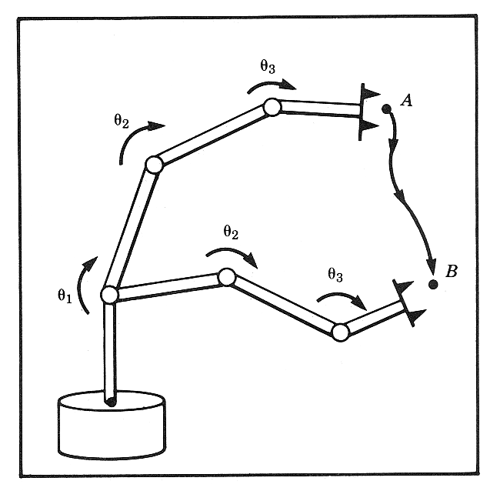
Inverse Jacobian
Given
Tool tip path (defined mathematically)
Tool tip position/orientation
Tool tip velocity
Jacobian Matrix
Problem: Calculate the joint velocities
Solution:
Compute the inverse Jacobian matrix
Use the following equation to compute the joint velocity
$$\underline{\dot{x}}=J{\left(θ\right)}^{ }\underline{\dot{θ}}$$
$$\underline{\dot{θ}}=J{\left(θ\right)}^{−1}\underline{\dot{x}}$$
Instructor: Jacob Rosen
Advanced Robotic - Department of Mechanical & Aerospace Engineering - UCLA

Slide 19
Singularity - The Concept
Motivation: We would like the hand of a robot (end effecror) to move with a certain velocity vector in Cartesian space. Using linear transformation relating the joint velocity to the Cartesian velocity we could calculate the necessary joint rates at each instance along the path.
Given: a linear transformation relating the joint velocity to the Cartesian velocity (usually the end effector)
Questions:
Is the Jacobian matrix invertible? (Or) Is it nonsingular?
Is the Jacobian invertible for all values of $θ$?
If not, where is it not invertible?
$$\underline{\dot{θ}}=J{\left(\underline{θ}\right)}^{−1}\underline{\dot{x}}$$
Instructor: Jacob Rosen
Advanced Robotic - Department of Mechanical & Aerospace Engineering - UCLA

Slide 20
Inverse Jacobian
$$J{\left(θ\right)}^{ }$$
Cases in which the Jacobian matrix is not inevitable ($J{\left(θ\right)}^{−1}$ does not exists).
Non invertible matrix is called singular matrix
Case 1 - The Jacobian matrix is not squared
In general the 6xN Jacobian matrix may be non-square in which case the inverse is not defined
Case 2 - The determinant $\det\left(J\left(θ\right)\right)$ is equal to zero
Instructor: Jacob Rosen
Advanced Robotic - Department of Mechanical & Aerospace Engineering - UCLA

Slide 21
Singularity - The Concept
Answer (Conceptual): Most manipulator have values of where the Jacobian becomes singular . Such locations are called singularities of the mechanism or singularities for short
$$θ$$
Singularities of the mechanism
Workspace boundary singularities
Workspace interior Singularities
- Stretched out
- Folded back
End
Effector
Workspace
Boundary
- Two or more joints are lining up
Instructor: Jacob Rosen
Advanced Robotic - Department of Mechanical & Aerospace Engineering - UCLA

Slide 22
Singularity - The Concept
Manipulator
Singular
Configuration
General
Configuration
Losing
One or More DOF
Problematic
Load Balance
Problematic
Joint Velocity
All DOF
Are Available
Lost of DOF - Losing one or more DOF means that there is a some direction (or subspace) in Cartesian space along which it is impossible to move the hand of the robot (end effector) no matter which joint rate are selected
Load Balance – A finite force can be applied to the end effector that produces no torque at the robot’s joints
Joint Velocity – A zero end effector velocity will cause high joint velocity
Instructor: Jacob Rosen
Advanced Robotic - Department of Mechanical & Aerospace Engineering - UCLA

Slide 23
Singularity – Physical Interpretation - Examples
Type of Singularities
Wrist
Elbow
Shoulder
Instructor: Jacob Rosen
Advanced Robotic - Department of Mechanical & Aerospace Engineering - UCLA

Slide 24
Singularity – Physical Interpretation - Examples
Instructor: Jacob Rosen
Advanced Robotic - Department of Mechanical & Aerospace Engineering - UCLA

Slide 25
Singularities

Slide 26
Singularities

Slide 27
Singularities

Slide 28
Jacobian – Singularity Example 1 – 2R Elbow Singularity Singularity at the Edge of the Workspace
Instructor: Jacob Rosen
Advanced Robotic - Department of Mechanical & Aerospace Engineering - UCLA

Slide 29
Jacobian Matrix by Differanciation - 3R - 1/4
Consider the following 3 DOF Planar manipulator
Instructor: Jacob Rosen
Advanced Robotic - Department of Mechanical & Aerospace Engineering - UCLA

Slide 30
Jacobian Matrix by Differanciation - 3R - 4/4
Using a matrix form we get
The Jacobian provides a linear transformation, giving a velocity map and a force map for a robot manipulator. For the simple example above, the equations are trivial, but can easily become more complicated with robots that have additional degrees a freedom. Before tackling these problems, consider this brief review of linear algebra.
$$\underline{\dot{x}}={}_{ }^{0}J\left(\underline{θ}\right)\underline{\dot{θ}}$$
$$\left\{\begin{matrix}v_{x} \\ v_{y}\end{matrix}\right\}=\left[\begin{matrix}−L_{1}s_{1}−L_{2}s_{12} & −L_{2}s_{12} \\ L_{1}c_{1}+L_{2}c_{12} & L_{2}c_{12}\end{matrix}\right]\left\{\begin{matrix}{\dot{θ}}_{1} \\ {\dot{θ}}_{2}\end{matrix}\right\}$$
Instructor: Jacob Rosen
Advanced Robotic - Department of Mechanical & Aerospace Engineering - UCLA

Slide 31
Properties of the Jacobian - Velocity Mapping and Singularities
Example: Planar 3R
Note that $\det{(}J(θ))$ is not a function of $θ_{1}$
$$\det{(}J(θ))=\left[\begin{matrix}−L_{1}s_{1}−L_{2}s_{12} & −L_{2}s_{12} \\ L_{1}c_{1}+L_{2}c_{12} & L_{2}c_{12}\end{matrix}\right]=L_{1}L_{2}s_{2}$$
$$\det{(}J(θ))=L_{1}L_{2}s_{2}=0$$
Instructor: Jacob Rosen
Advanced Robotic - Department of Mechanical & Aerospace Engineering - UCLA

Slide 32
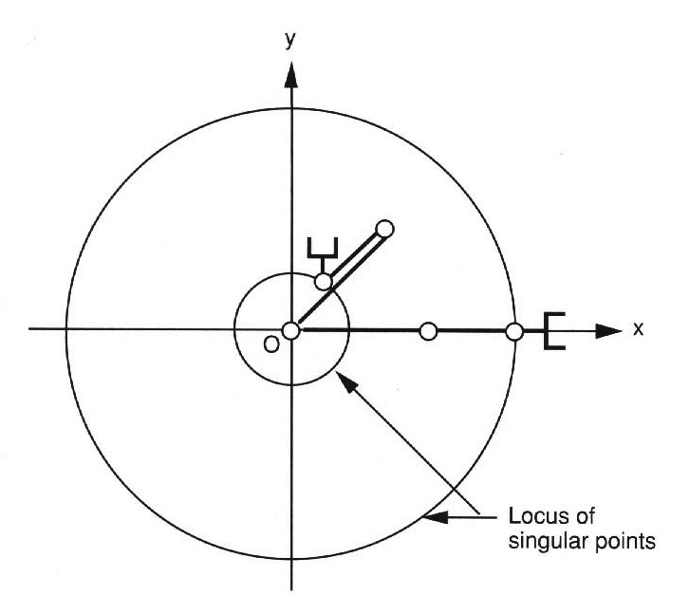
Properties of the Jacobian - Velocity Mapping and Singularities
The manipulator loses 1 DOF. The end effector can only move along the tangent direction of the arm. Motion along the radial direction is not possible.
$$\text{singular} \text{configuration} \left\{\begin{matrix}θ_{2}=0 \text{Stretched} \text{Out} \\ θ_{2}=π \text{Fold} \text{Back}\end{matrix}\right.$$
Instructor: Jacob Rosen
Advanced Robotic - Department of Mechanical & Aerospace Engineering - UCLA

Slide 33
Properties of the Jacobian - Force Mapping and Singularities
The relationship between joint torque and end effector force and moments is given by:
The rank of $J{\left(θ\right)}^{T}$ is equals the rank of $J\left(θ\right)$
At a singular configuration there exists a non trivial force $\underline{F}$ such that
In other words, a finite force can be applied to the end effector that produces no torque at the robot’s joints. In the singular configuration, the manipulator can “lock up.”
$$\underline{τ}=J{\left(\underline{θ}\right)}^{T}\underline{F}$$
$$J{\left(\underline{θ}\right)}^{T}\underline{F}=0$$
Instructor: Jacob Rosen
Advanced Robotic - Department of Mechanical & Aerospace Engineering - UCLA

Slide 34
Properties of the Jacobian - Force Mapping and Singularities
$$θ_{1}=θ; θ_{2}=0$$
Example: Planar 3R
In this case the force acting on the end effector (relative to the {0} frame) is given by
$$F$$
$$θ_{1}$$
$${}_{ }^{0}F=\left[\begin{matrix}Fc_{1} \\ Fs_{1}\end{matrix}\right]$$
Instructor: Jacob Rosen
Advanced Robotic - Department of Mechanical & Aerospace Engineering - UCLA

Slide 35
Properties of the Jacobian - Force Mapping and Singularities
For we get
$$\underline{{}_{ }^{0}τ}={}_{ }^{0}J{\left(\underline{θ}\right)}^{T}\underline{{}_{ }^{0}F}=\left[\begin{matrix}−L_{1}s_{1}−L_{2}s_{12} & L_{1}c_{1}+L_{2}c_{12} \\ −L_{2}s_{12} & L_{2}c_{12}\end{matrix}\right]$$
$$θ_{1}=θ; θ_{2}=0$$
$$\underline{{}_{ }^{0}τ}={}_{ }^{0}J{\left(\underline{θ}\right)}^{T}\underline{{}_{ }^{0}F}=\left[\begin{matrix}−L_{1}s_{1}−L_{2}s_{12} & L_{1}c_{1}+L_{2}c_{12} \\ −L_{2}s_{12} & L_{2}c_{12}\end{matrix}\right]\left[\begin{matrix}Fc_{1} \\ Fs_{1}\end{matrix}\right]=$$
$\left[\begin{matrix}−Fs_{1}c_{1}(L_{1}+L_{2})+Fs_{1}c_{1}(L_{1}+L_{2}) \\ −Fs_{1}c_{1}(L_{2})+Fs_{1}c_{1}(L_{2})\end{matrix}\right]=$ $\left[\begin{matrix}0 \\ 0\end{matrix}\right]$
Instructor: Jacob Rosen
Advanced Robotic - Department of Mechanical & Aerospace Engineering - UCLA

Slide 36
Jacobian – Singularity Example 2 – 3R Shoulder Singulaity Singularity Inside the Workspace
Instructor: Jacob Rosen
Advanced Robotic - Department of Mechanical & Aerospace Engineering - UCLA

Slide 37
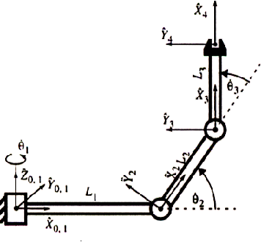

Slide 38
Jacobian: Singular Configuration - 3R Example
If we want to use the inverse Jacobian to compute the joint angular velocities we need to first find out at what points the inverse exists.
Considering the 3R robot
The determinate of the Jacobian is defined as follows
$$\underline{\dot{x}}={}_{ }^{4}J\left(\underline{θ}\right)\underline{\dot{θ}}$$
$${{}_{ }^{4}J}_{ }\left(θ\right)=\left[\begin{matrix}0 & L2s3 & 0 \\ 0 & L2c3+L3 & L3 \\ −L1−L2c2−L3c23 & 0 & 0\end{matrix}\right]$$
$$\left|{{}_{ }^{4}J}_{ }\left(θ\right)\right|=−(L1+L2c2+L3c23)(L2s3)L3$$
Instructor: Jacob Rosen
Advanced Robotic - Department of Mechanical & Aerospace Engineering - UCLA

Slide 39
Jacobian: Singular Configuration - 3R Example
The reduced Jacbian matrix is singular when it determinate is equal to zero
The singular condition occur when either of the following are true
$$\left|{{}_{ }^{4}J}_{ }\left(θ\right)\right|=−(L1+L2c2+L3c23)(L2s3)L3$$
$$−(L1+L2c2+L3c23)(L2s3)L3=0$$
$$s3=0$$
$$−L1−L2c2−L3c23=0$$
Instructor: Jacob Rosen
Advanced Robotic - Department of Mechanical & Aerospace Engineering - UCLA

Slide 40
Jacobian: Singular Configuration - 3R Example
Case 1:
The first row of the Jacobian is zero
The 3R robot is loosing one DOF.
The robot can no longer move along the X-axis of frame {4}
$$s3=0$$
$$s3=0⇒\left\{\begin{matrix}θ_{3}=0^{o} \\ θ_{3}=180^{o}\end{matrix}\right.$$
$${{}_{ }^{4}J}_{ }\left(θ\right)=\left[\begin{matrix}0 & L2s3 & 0 \\ 0 & L2c3+L3 & L3 \\ −L1−L2c2−L3c23 & 0 & 0\end{matrix}\right]$$
Instructor: Jacob Rosen
Advanced Robotic - Department of Mechanical & Aerospace Engineering - UCLA

Slide 41
Jacobian: Singular Configuration - 3R Example
$$−L1−L2c2−L3c23=0$$
Case 2:
Occur only if
The third row of the Jacobian is zero
The origin of frame {4} intersects the Z-axis of frame {1}
The 3R robot is loosing one DOF.
The robot can no longer move along the Z-axis of frame {4}
$$L1=−L2c2−L3c23$$
$$L2+L3≥L1$$
$${{}_{ }^{4}J}_{ }\left(θ\right)=\left[\begin{matrix}0 & L2s3 & 0 \\ 0 & L2c3+L3 & L3 \\ −L1−L2c2−L3c23 & 0 & 0\end{matrix}\right]$$
Instructor: Jacob Rosen
Advanced Robotic - Department of Mechanical & Aerospace Engineering - UCLA

Slide 42
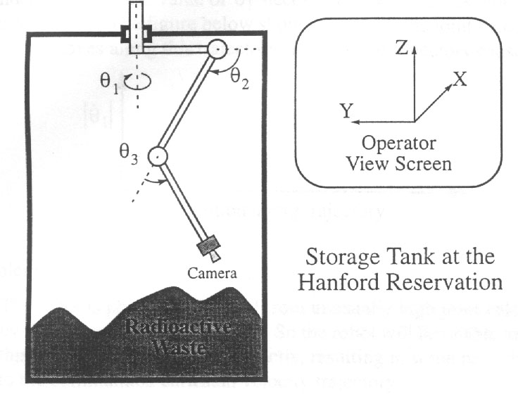
Joint Velocity Near Singular Position - 3R Example
Robot : 3R robot
Task: Visual inspection
Control
Operator
Control
Robot
$$\underline{\dot{θ}}=J{\left(θ\right)}^{−1}\underline{\dot{x}}$$
Instructor: Jacob Rosen
Advanced Robotic - Department of Mechanical & Aerospace Engineering - UCLA

Slide 43
Joint Velocity Near Singular Position - 3R Example
Singularity (Case 2)- The origin of frame {4} intersects the Z-axis of frame {1}
Solve for ${\dot{θ}}_{1}$ in terms of $\dot{z}$ we find
$$\left[\begin{matrix}\dot{x} \\ \dot{y} \\ \dot{z}\end{matrix}\right]=\left[\begin{matrix}0 & L2s3 & 0 \\ 0 & L2c3+L3 & L3 \\ −L1−L2c2−L3c23 & 0 & 0\end{matrix}\right]\left[\begin{matrix}{\dot{θ}}_{1} \\ {\dot{θ}}_{2} \\ {\dot{θ}}_{3}\end{matrix}\right]$$
$${\dot{θ}}_{1}=\frac{\dot{z}}{−L1−L2c2−L3c23}$$
$$−L1−L2c2−L3c23=0$$
$${\dot{θ}}_{1}→∞$$
Instructor: Jacob Rosen
Advanced Robotic - Department of Mechanical & Aerospace Engineering - UCLA

Slide 44
Joint Velocity Near Singular Position - 3R Example
Singularity -
Problems:
Motor Constrains - The robot is physically limited from moving in unusual high joint velocities by motor power constrains. Therefore, the robot will be unable to track the required joint velocity trajectory exactly resulting in some perturbation to the commanded Cartesian velocity trajectory.
Gears and Shafts - The derivative of the angular velocity is the angular acceleration. The high acceleration of the joint resulting form approaching too close to a singularity may cause damage to the gear/shafts.
DOF - At a singular configuration (specific point in space) the manipulator loses one or more DOF.
Consequences – Certain tasks can not be performed at a singular configuration
$$\det\left(J\left(θ\right)\right)=0$$
Instructor: Jacob Rosen
Advanced Robotic - Department of Mechanical & Aerospace Engineering - UCLA

Slide 45
Jacobian – Singularity Example 3 – 3R Wrist Singularity Singularity Inside the Workspace
Instructor: Jacob Rosen
Advanced Robotic - MAE 263B - Department of Mechanical & Aerospace Engineering - UCLA

Slide 46
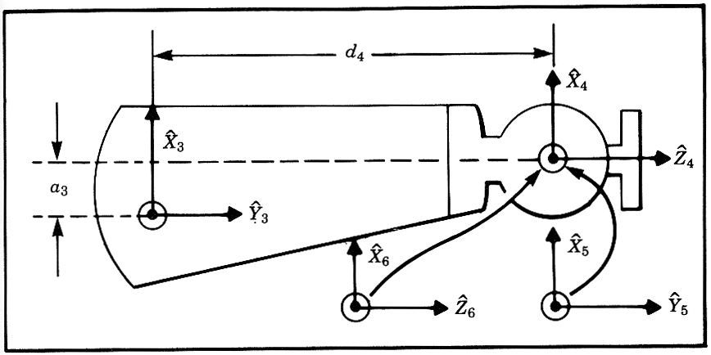
Mapping - Rotated Frames - Z-Y-Z Euler Angles
Start with frame {4}.
Rotate frame {4} about by an angle $α$
Rotate frame {4} about by an angle $β$
Rotate frame {4} about by an angle $γ$
Note - Each rotation is preformed about an axis of the moving reference frame, rather then a fixed reference.
$${\hat{Z}}_{4}$$
$${\hat{Y}}_{B}$$
Euler Angles
$${\hat{Z}}_{4}$$
Instructor: Jacob Rosen
Advanced Robotic - Department of Mechanical & Aerospace Engineering - UCLA

Slide 47
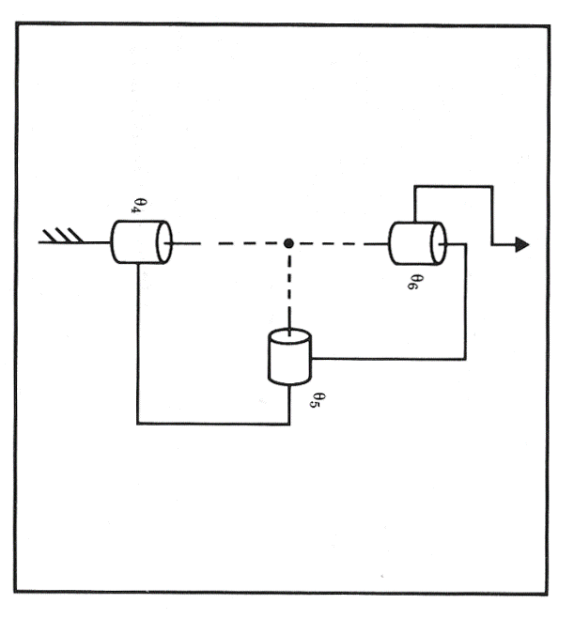
Mapping - Rotated Frames - Z-Y-Z Euler Angles
Instructor: Jacob Rosen
Advanced Robotic - Department of Mechanical & Aerospace Engineering - UCLA

Slide 48
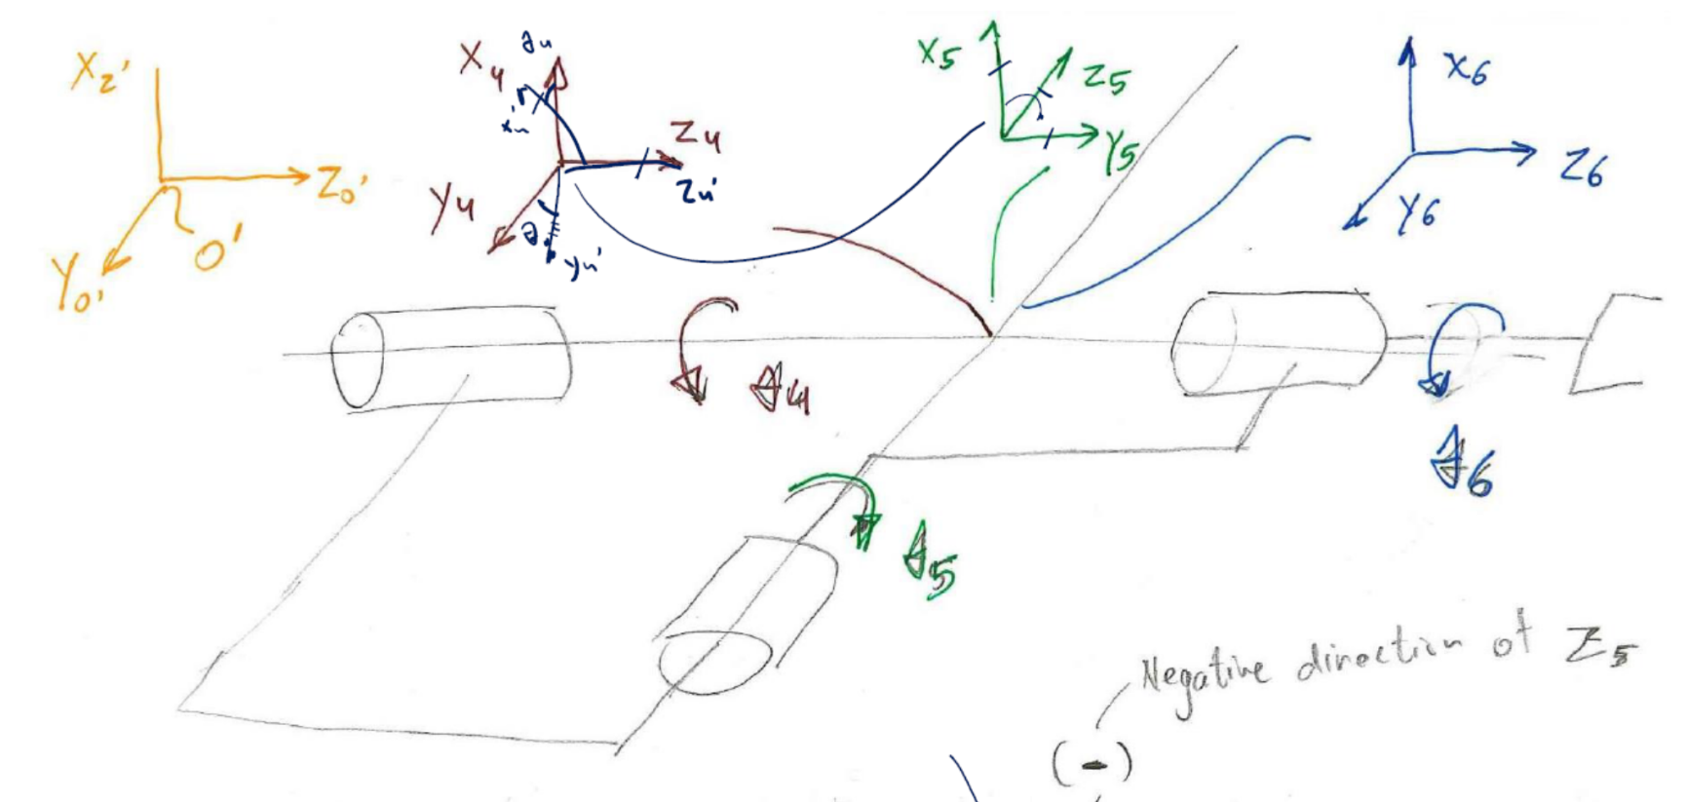
Mapping - Rotated Frames - Z-Y-Z Euler Angles
$$R_{Euler}=R_{z4}\left(θ_{4}\right)R_{y4}\left({−θ}_{5}\right)R_{z4}\left(θ_{6}\right)$$
Instructor: Jacob Rosen
Advanced Robotic - Department of Mechanical & Aerospace Engineering - UCLA

Slide 49
Mapping - Rotated Frames - Z-Y-Z Euler Angles
$$R_{Z′Y′Z′}(α,β,γ)=R_{Z}(α)R_{Y}(β)R_{Z}(γ)=\left[\begin{matrix}cα & −sα & 0 \\ sα & cα & 0 \\ 0 & 0 & 1\end{matrix}\right]\left[\begin{matrix}cβ & 0 & sβ \\ 0 & 1 & 0 \\ −sβ & 0 & cβ\end{matrix}\right]\left[\begin{matrix}cγ & −sγ & 0 \\ sγ & cγ & 0 \\ 0 & 0 & 1\end{matrix}\right]$$
$$R_{Z′Y′Z′}(α,β,γ)=\left[\begin{matrix}cαcβcγ−sαsγ & −cαcβsγ−sαcγ & cαsβ \\ sαcβcγ+cαsγ & −sαcβsγ+cαcγ & sαsβ \\ −sβcγ & sβsγ & cβ\end{matrix}\right]$$
$${{}_{B}^{A}R}_{X′Y′Z′}(α,β,γ)={{}_{6}^{4}R}_{θ_{4}=0}$$
Instructor: Jacob Rosen
Advanced Robotic - Department of Mechanical & Aerospace Engineering - UCLA

Slide 50
Three consecutive Axes Intersect - wrist
$$\left[\begin{matrix}r_{11} & r_{12} & r_{13} \\ r_{21} & r_{22} & r_{23} \\ r_{31} & r_{32} & r_{33}\end{matrix}\right]=\left[\begin{matrix}cαcβcγ−sαsγ & −cαcβsγ−sαcγ & cαsβ \\ sαcβcγ+cαsγ & −sαcβsγ+cαcγ & sαsβ \\ −sβcγ & sβsγ & cβ\end{matrix}\right]$$
Goal
Direct Kinematics
Instructor: Jacob Rosen
Advanced Robotic - Department of Mechanical & Aerospace Engineering - UCLA

Slide 51
Three consecutive Axes Intersect - wrist
Solve for $β$
using element $r_{31},r_{32},r_{33}$
Using the Atan2 function, we find
$$r_{31}=−sβcα \\ r_{32}=sβsα \\ r_{33}=cβ$$
$$\left[\begin{matrix}r_{11} & r_{12} & r_{13} \\ r_{21} & r_{22} & r_{23} \\ r_{31} & r_{32} & r_{33}\end{matrix}\right]=\left[\begin{matrix}cαcβcγ−sαsγ & −cαcβsγ−sαcγ & cαsβ \\ sαcβcγ+cαsγ & −sαcβsγ+cαcγ & sαsβ \\ −sβcγ & sβsγ & cβ\end{matrix}\right]$$
$$r_{31}^{2}+r_{32}^{2}=sβ^{2}\left(cα^{2}+sα^{2}\right)$$
$$r_{33}=cβ$$
$$sβ=±\sqrt{r_{31}^{2}+r_{32}^{2}}$$
$$β=\text{Atan}\text{2}\left(±\sqrt{r_{31}^{2}+r_{32}^{2}},r_{33}\right)$$
Instructor: Jacob Rosen
Advanced Robotic - Department of Mechanical & Aerospace Engineering - UCLA

Slide 52
Three consecutive Axes Intersect - wrist
Solve for $α$ using elements $r_{23},r_{13}$
$$r_{13}=cαsβ$$
$$r_{23}=sαsβ$$
$$\left[\begin{matrix}r_{11} & r_{12} & r_{13} \\ r_{21} & r_{22} & r_{23} \\ r_{31} & r_{32} & r_{33}\end{matrix}\right]=\left[\begin{matrix}cαcβcγ−sαsγ & −cαcβsγ−sαcγ & cαsβ \\ sαcβcγ+cαsγ & −sαcβsγ+cαcγ & sαsβ \\ −sβcγ & sβsγ & cβ\end{matrix}\right]$$
$$α=\text{Atan}\text{2}\left(r_{23}/sβ,r_{13}/sβ\right)$$

Slide 53
Three consecutive Axes Intersect - wrist
Solve for $γ$ using elements $r_{32},r_{31}$
$$r_{32}=sβsγ$$
$$r_{31}=−sβcγ$$
$$\left[\begin{matrix}r_{11} & r_{12} & r_{13} \\ r_{21} & r_{22} & r_{23} \\ r_{31} & r_{32} & r_{33}\end{matrix}\right]=\left[\begin{matrix}cαcβcγ−sαsγ & −cαcβsγ−sαcγ & cαsβ \\ sαcβcγ+cαsγ & −sαcβsγ+cαcγ & sαsβ \\ −sβcγ & sβsγ & cβ\end{matrix}\right]$$
$$γ=\text{Atan}\text{2}\left(r_{32}/sβ,−r_{31}/sβ\right)$$
Instructor: Jacob Rosen
Advanced Robotic - Department of Mechanical & Aerospace Engineering - UCLA

Slide 54
Three consecutive Axes Intersect - wrist
Note: Two answers exist for angle $β$ which will result in two answers each for angles $α$ and $γ$
If the solution degenerates
$$β=\text{Atan}\text{2}\left(±\sqrt{r_{31}^{2}+r_{32}^{2}},r_{33}\right)$$
$$α=\text{Atan}\text{2}\left(r_{23}/sβ,r_{13}/sβ\right)$$
$$γ=\text{Atan}\text{2}\left(r_{32}/sβ,−r_{31}/sβ\right)$$
$$β=0^{o},β=180^{o}⇒sβ=0$$
Instructor: Jacob Rosen
Advanced Robotic - Department of Mechanical & Aerospace Engineering - UCLA

Slide 55
Three consecutive Axes Intersect - wrist
We are left with for every case. This means we can’t solve for either, just their sum.
$$\left[\begin{matrix}r_{11} & r_{12} & r_{13} \\ r_{21} & r_{22} & r_{23} \\ r_{31} & r_{32} & r_{33}\end{matrix}\right]=\left[\begin{matrix}cαcβcγ−sαsγ & −cαcβsγ−sαcγ & cαsβ \\ sαcβcγ+cαsγ & −sαcβsγ+cαcγ & sαsβ \\ −sβcγ & sβsγ & cβ\end{matrix}\right]$$
$$β=0^{o}$$
$$\left[\begin{matrix}r_{11} & r_{12} & r_{13} \\ r_{21} & r_{22} & r_{23} \\ r_{31} & r_{32} & r_{33}\end{matrix}\right]=\left[\begin{matrix}cαcγ−sαsγ & −cαsγ−sαcγ & 0 \\ sαcγ+cαsγ & −sαsγ+cαcγ & 0 \\ 0 & 0 & 1\end{matrix}\right]=\left[\begin{matrix}c(α+γ) & −s(α+γ) & 0 \\ s(α+γ) & c(α+γ) & 0 \\ 0 & 0 & 1\end{matrix}\right]$$
$$\left(γ+α\right)$$
Instructor: Jacob Rosen
Advanced Robotic - Department of Mechanical & Aerospace Engineering - UCLA

Slide 56
Three consecutive Axes Intersect - wrist
One possible convention is to choose $α=0^{o}$
The solution can be calculated to be
$$β=0$$
$$β=180$$
$$α=0$$
$$α=0$$
$$γ=\text{Atan}\text{2}\left(−r_{12},r_{11}\right)=\text{Atan}\text{2}\left(sγ,cγ\right)$$
$$γ=\text{Atan}\text{2}\left(r_{12},−r_{11}\right)=\text{Atan}\text{2}\left(sγ,cγ\right)$$
Instructor: Jacob Rosen
Advanced Robotic - Department of Mechanical & Aerospace Engineering - UCLA

Slide 57
Three consecutive Axes Intersect - wrist
For this example, the singular case results in the capability for self-rotation. That is, the middle link can rotate while the end effector’s orientation never changes.
Instructor: Jacob Rosen
Advanced Robotic - Department of Mechanical & Aerospace Engineering - UCLA

Slide 58
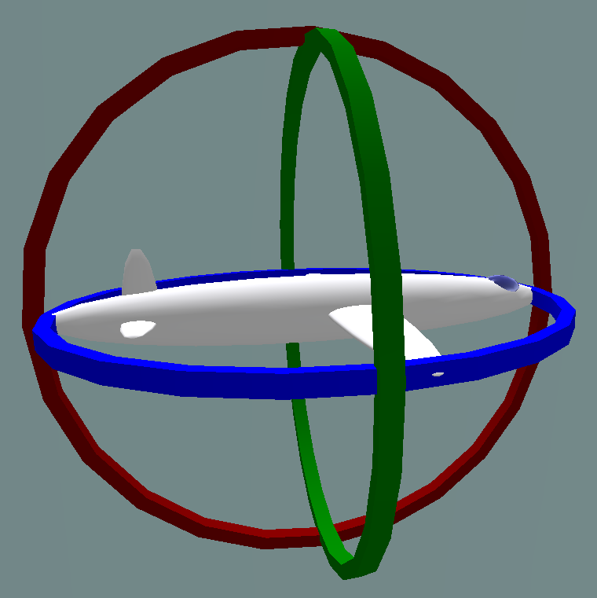
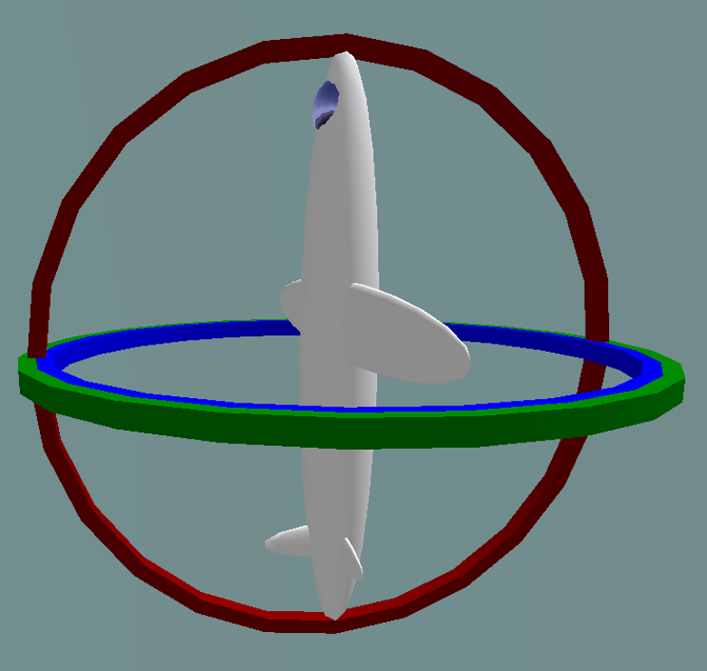
Gimbal Lock
http://youtu.be/zc8b2Jo7mno
Normal situation
The three gimbals are independent
Gimbal lock:
Two out of the three gimbals are in the
same plane, one degree of freedom is lost
Instructor: Jacob Rosen
Advanced Robotic - Department of Mechanical & Aerospace Engineering - UCLA

Slide 59
Gimbal Lock – Robotics
In robotics, gimbal lock is commonly referred to as "wrist flip", due to the use of a "triple-roll wrist" in robotic arms, where three axes of the wrist, controlling yaw, pitch, and roll, all pass through a common point.
An example of a wrist flip, also called a wrist singularity, is when the path through which the robot is traveling causes the first and third axes of the robot's wrist to line up. The second wrist axis then attempts to spin 180° in zero time to maintain the orientation of the end effector. The result of a singularity can be quite dramatic and can have adverse effects on the robot arm, the end effector, and the process.
The importance of non-singularities in robotics has led the American National Standard for Industrial Robots and Robot Systems — Safety Requirements to define it as "a condition caused by the collinear alignment of two or more robot axes resulting in unpredictable robot motion and velocities".
Instructor: Jacob Rosen
Advanced Robotic - Department of Mechanical & Aerospace Engineering - UCLA

Slide 60
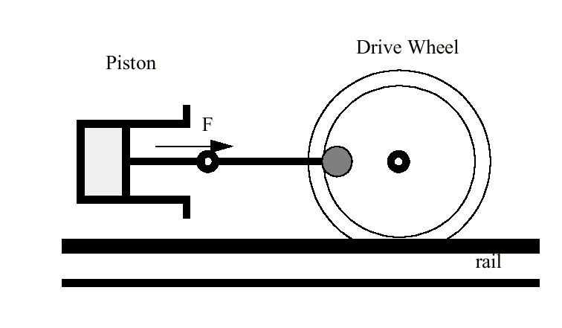
Properties of the Jacobian - Force Mapping and Singularities
This situation is an old and famous one in mechanical engineering.
For example, in the steam locomotive, “top dead center” refers to the following condition
The piston force, F, cannot generate any torque around the drive wheel axis because the linkage is singular in the position shown.
Instructor: Jacob Rosen
Advanced Robotic - Department of Mechanical & Aerospace Engineering - UCLA

Slide 61
Properties of the Jacobian - Velocity Mapping and Singularities
We have shown the relationship between joint space velocity and end effector velocity, given by
It is interesting to determine the inverse of this relationship, namely
$$\underline{\dot{x}}=J\left(\underline{θ}\right)\underline{\dot{θ}}$$
$$\underline{\dot{θ}}=J{\left(\underline{θ}\right)}^{−1}\underline{\dot{x}}$$
Instructor: Jacob Rosen
Advanced Robotic - Department of Mechanical & Aerospace Engineering - UCLA

Slide 62
Properties of the Jacobian - Velocity Mapping and Singularities
Consider the square 6x6 case for .
If rank < 6 ( ) , then there is no solution to the inverse equation (see Brief Linear Algebra Review - 1,7).
However, if the rank = 5, then there is at least one non-trivial solution to the forward equation (see Brief Linear Algebra Review - 7). That is, for
$$J\left(\underline{θ}\right)$$
$$Det\left(J\left(\underline{θ}\right)\right)=0$$
$$Rank\left(J\left(\underline{θ}\right)\right)<6$$
$$\underline{\dot{θ}}=J{\left(\underline{θ}\right)}^{−1}\underline{\dot{x}}$$
$$\underline{\dot{x}}=J\left(\underline{θ}\right)\underline{\dot{θ}}=0$$
Instructor: Jacob Rosen
Advanced Robotic - Department of Mechanical & Aerospace Engineering - UCLA

Slide 63
Properties of the Jacobian - Velocity Mapping and Singularities
The solution is a direction in the in joint velocity space for which joint motion produces no end effector motion.
We call any joint configuration for which
a singular configuration.
$$\left(\underline{θ}\right)$$
$$\underline{θ}=Q$$
$$Rank\left(J\left(\underline{θ}\right)\right)<6$$
Instructor: Jacob Rosen
Advanced Robotic - Department of Mechanical & Aerospace Engineering - UCLA

Slide 64
Properties of the Jacobian - Velocity Mapping and Singularities
For certain directions of end effector motion ,
where:
are the eigenvalues of
are the eigenvectors of
If is fully ranked (see Brief Linear Algebra Review - 6/ ), we have
$$\underline{\dot{x}}i$$
$$1≤i≤6$$
$$\underline{\dot{x}}=J\left(θ\right)\underline{\dot{θ}}=λ_{i}\left(\underline{θ}\right){\underline{ω}}_{i}$$
$$λ_{i}$$
$$J\left(θ\right)$$
$${\underline{ω}}_{i}$$
$$J\left(θ\right)$$
$$J\left(θ\right)$$
$$\underline{ω}i=J{\left(θ\right)}^{−1}\underline{\dot{x}}=λ_{i}{\left(\underline{θ}\right)}^{−1}\underline{\dot{x}}$$
Instructor: Jacob Rosen
Advanced Robotic - Department of Mechanical & Aerospace Engineering - UCLA

Slide 65
Properties of the Jacobian - Velocity Mapping and Singularities
As the joint approach a singular configuration there is at least one eigenvalue for which . This results in
In other word, as the joints approach the singular configuration, the end effector motion in a particular task direction causes the joint velocities to approach infinity. However, there are task velocities that can have solutions.
If loses rank by only one, then there are n-1 eigenvectors in the task velocity space ( ) for which solutions do exist. However, there can be multiple solutions.
$$\underline{θ}=Q$$
$$λ_{i}→0$$
$$\underline{ω}i=\frac{\underline{\dot{x}}}{λ_{i}\left(\underline{θ}\right)}→\frac{\underline{\dot{x}}}{0}→ ∞$$
$$\underline{\dot{x}}j$$
$$J\left(\underline{θ}\right)$$
$$\underline{\dot{x}}j$$
Instructor: Jacob Rosen
Advanced Robotic - Department of Mechanical & Aerospace Engineering - UCLA

Slide 66
Physical Expressions of Singularity – Summary
Instructor: Jacob Rosen
Advanced Robotic - Department of Mechanical & Aerospace Engineering - UCLA

Slide 67
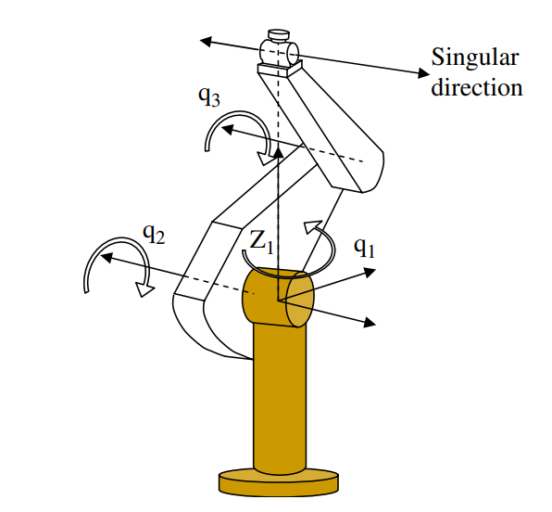
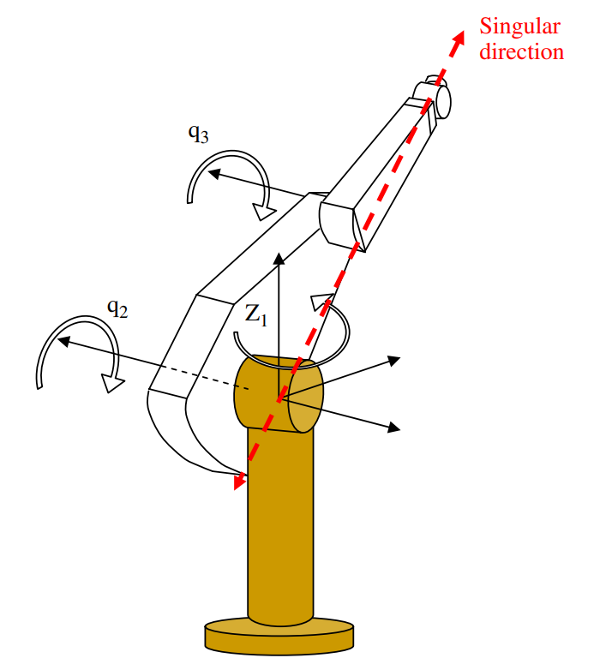
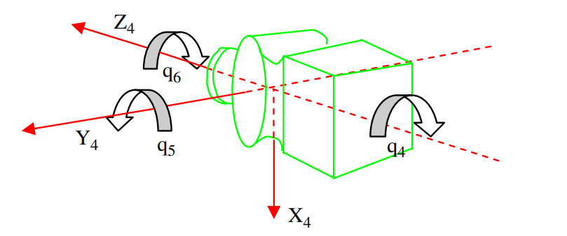
Physical Expressions of Singularity
DOF
Phenomena -
Kinematic Deficiency –
Mechanical Risk -
Shoulder
Elbow
Wrist
Instructor: Jacob Rosen
Advanced Robotic - Department of Mechanical & Aerospace Engineering - UCLA

Slide 68
Physical Expressions of Singularity
DOF
Phenomena - Losing one or more DOF
Kinematic Deficiency – Inability to move in a specific direction
Mechanical Risk - None
Shoulder
Elbow
Wrist
Instructor: Jacob Rosen
Advanced Robotic - Department of Mechanical & Aerospace Engineering - UCLA

Slide 69
Physical Expressions of Singularity
Velocity
Phenomena -
Kinematic Deficiency –
Mechanical Risk -
Shoulder
Elbow
Wrist
Instructor: Jacob Rosen
Advanced Robotic - Department of Mechanical & Aerospace Engineering - UCLA

Slide 70
Physical Expressions of Singularity
Velocity
Phenomena - High velocities (theoretically infinity) of some joints, and zero velocities in other directions
Kinematic Deficiency – Inability to provide the required joint velocity to support the end effector velocity
Mechanical Risk - High demand of joint velocities may damage the actuator/gear/joint
Shoulder
Elbow
Wrist
Instructor: Jacob Rosen
Advanced Robotic - Department of Mechanical & Aerospace Engineering - UCLA

Slide 71
Physical Expressions of Singularity
Forces / Torques
Phenomena -
Kinematic Deficiency –
Mechanical Risk -
Shoulder
Elbow
Wrist
Instructor: Jacob Rosen
Advanced Robotic - Department of Mechanical & Aerospace Engineering - UCLA

Slide 72
Physical Expressions of Singularity
Forces / Torques
Phenomena - High external loads applied on the end effector resulted with zero joint torques generated at the joint.
Kinematic Deficiency - None
Mechanical Risk - The high loads deform the links and can potential damage them
Shoulder
Elbow
Wrist
Instructor: Jacob Rosen
Advanced Robotic - Department of Mechanical & Aerospace Engineering - UCLA

Slide 73
Jacobian – Duality
Instructor: Jacob Rosen
Advanced Robotic - Department of Mechanical & Aerospace Engineering - UCLA

Slide 74
Jacobian – Duality
Joint Space
$$J\dot{θ}$$
End-Effector Space
$$\dot{θ}$$
$$S_{1}$$
$$S_{2}$$
$$\dot{X}$$
$$\dot{θ}∈ℜ^{n}$$
$$R(J)$$
$$\dot{X}∈ℜ^{m}$$
is a linear mapping of the joint space velocities which is a n - dimensional vector space to the end effector velocities which is a m – dimensional vector space
$$\dot{X}=J\dot{θ}$$
$$\dot{θ}$$
$$\dot{θ}∈ℜ^{n}$$
$$\dot{X}$$
$$\dot{X}∈ℜ^{m}$$
Instructor: Jacob Rosen
Advanced Robotic - Department of Mechanical & Aerospace Engineering - UCLA

Slide 75
Jacobian – Duality
Joint Space
$$J\dot{θ}$$
End-Effector Space
$$\dot{θ}$$
$$S_{1}$$
$$S_{2}$$
$$\dot{X}$$
$$\dot{θ}∈ℜ^{n}$$
$$R(J)$$
$$\dot{X}∈ℜ^{m}$$
Accessible
None Accessible
The subset of all the end effector velocities resulting from the mapping represents all the possible end effector velocities that can be generated by the n joints given the arm configuration
$$\dot{X}$$
$$\dot{X}=J\dot{θ}$$
Instructor: Jacob Rosen
Advanced Robotic - Department of Mechanical & Aerospace Engineering - UCLA

Slide 76
Jacobian – Duality
Joint Space
$$J\dot{θ}$$
End-Effector Space
$$\dot{θ}$$
$$S_{1}$$
$$S_{2}$$
$$\dot{X}$$
$$\dot{θ}∈ℜ^{n}$$
$$R(J)$$
$$\dot{X}∈ℜ^{m}$$
In at least on direction
$$\dot{X}=J\dot{θ}=0$$
Accessible
None Accessible
If the rank of the Jacobian matrix is at full of row rank (square matrix) the joint space
covers the entire end effector vector otherwise there is at least one direction in which the end effector can not be moved
$$J$$
$$\dot{θ}$$
$$\dot{X}$$
Instructor: Jacob Rosen
Advanced Robotic - Department of Mechanical & Aerospace Engineering - UCLA

Slide 77
Jacobian – Duality
Joint Space
$$J\dot{θ}$$
End-Effector Space
$$\dot{θ}$$
$$S_{1}$$
$$S_{2}$$
$$\dot{X}$$
$$\dot{θ}∈ℜ^{n}$$
$$R(J)$$
$$\dot{X}∈ℜ^{m}$$
$$N(J)$$
In at least on direction
$$\dot{X}=J\dot{θ}=0$$
Accessible
None Accessible
The subset is the null space of the linear mapping. Any element in this subspace is mapped into a zero vector in such that therefore any joint velocity vector that belongs to the null space does not produce any velocity at the end effector
$$N(J)$$
$$ℜ^{m}$$
$$\dot{X}=J\dot{θ}=0$$
$$\dot{θ}$$
Instructor: Jacob Rosen
Advanced Robotic - Department of Mechanical & Aerospace Engineering - UCLA

Slide 78
Jacobian – Duality
Joint Space
$$J\dot{θ}$$
End-Effector Space
$$\dot{θ}$$
$$S_{1}$$
$$S_{2}$$
$$\dot{X}$$
$$\dot{θ}∈ℜ^{n}$$
$$R(J)$$
$$\dot{X}∈ℜ^{m}$$
$$N(J)$$
In at least on direction
$$\dot{X}=J\dot{θ}=0$$
Accessible
None Accessible
$$\left[\begin{matrix}\dot{x} \\ \dot{y} \\ \dot{z} \\ ω_{x} \\ ω_{y} \\ ω_{z}\end{matrix}\right]=\left[\begin{matrix} & & & & & & \\ & & & 6X7 & & & \\ & & & J(θ) & & & \\ & & & & & & \\ & & & & & & \\ & & & & & & \end{matrix}\right]\left[\begin{matrix}{\dot{θ}}_{1} \\ {\dot{θ}}_{2} \\ {\dot{θ}}_{3} \\ {\dot{θ}}_{4} \\ {\dot{θ}}_{5} \\ {\dot{θ}}_{6} \\ {\dot{θ}}_{7}\end{matrix}\right]$$
If the Jacobian of a manipulator is full rank the dimension of the null space is the same as the redundant degrees of freedom (n-m). For example the human arm has 7 DOF whereas the hand may have 6 linear and angular velocities therefore the null dimension is one (n-m=7-1=1)
$$\dim{(}N(J))$$
Instructor: Jacob Rosen
Advanced Robotic - Department of Mechanical & Aerospace Engineering - UCLA

Slide 79
Jacobian – Duality
Joint Space
$$J\dot{θ}$$
End-Effector Space
$$\dot{θ}$$
$$S_{1}$$
$$S_{2}$$
$$\dot{X}$$
$$\dot{θ}∈ℜ^{n}$$
$$R(J)$$
$$\dot{X}∈ℜ^{m}$$
$$N(J)$$
In at least on direction
$$\dot{X}=J\dot{θ}=0$$
Accessible
None Accessible
$$\left[\begin{matrix}\dot{x} \\ \dot{y} \\ \dot{z} \\ ω_{x} \\ ω_{y} \\ ω_{z}\end{matrix}\right]=\left[\begin{matrix} & & & & & & \\ & & & 6X7 & & & \\ & & & J(θ) & & & \\ & & & & & & \\ & & & & & & \\ & & & & & & \end{matrix}\right]\left[\begin{matrix}{\dot{θ}}_{1} \\ {\dot{θ}}_{2} \\ {\dot{θ}}_{3} \\ {\dot{θ}}_{4} \\ {\dot{θ}}_{5} \\ {\dot{θ}}_{6} \\ {\dot{θ}}_{7}\end{matrix}\right]$$
If the Jacobian of a manipulator is full rank (i.e. n>m full row rank where the rows are linearly independent) the dimension of the null space is the same as the redundant degrees of freedom (n-m). For example the human arm has 7 DOF whereas the hand may have 6 linear and angular velocities therefore the null dimension is one (n-m=7-1=1)
$$\dim{(}N(J))$$
Instructor: Jacob Rosen
Advanced Robotic - Department of Mechanical & Aerospace Engineering - UCLA

Slide 80
Jacobian – Duality
Joint Space
$$J\dot{θ}$$
End-Effector Space
$$\dot{θ}$$
$$S_{1}$$
$$S_{2}$$
$$\dot{X}$$
$$\dot{θ}∈ℜ^{n}$$
$$R(J)$$
$$\dot{X}∈ℜ^{m}$$
$$N(J)$$
In at least on direction
$$\dot{X}=J\dot{θ}=0$$
Accessible
None Accessible
$$\left[\begin{matrix}\dot{x} \\ \dot{y} \\ \dot{z} \\ ω_{x} \\ ω_{y} \\ ω_{z}\end{matrix}\right]=\left[\begin{matrix} & & & & & & \\ & & & 6X7 & & & \\ & & & J(θ) & & & \\ & & & & & & \\ & & & & & & \\ & & & & & & \end{matrix}\right]\left[\begin{matrix}{\dot{θ}}_{1} \\ {\dot{θ}}_{2} \\ {\dot{θ}}_{3} \\ {\dot{θ}}_{4} \\ {\dot{θ}}_{5} \\ {\dot{θ}}_{6} \\ {\dot{θ}}_{7}\end{matrix}\right]$$
If the Jacobian of a manipulator is full rank (i.e. for redundant manipulator n>m full row rank where the rows are linearly independent) the dimension of the null space is the same as the redundant degrees of freedom (n-m). For example the human arm has 7 DOF whereas the end effector (hand) may have 6 linear and angular velocities therefore the null dimension is one (n-m=7-1=1)
$$\dim{(}N(J))$$
Instructor: Jacob Rosen
Advanced Robotic - Department of Mechanical & Aerospace Engineering - UCLA

Slide 81
Jacobian – Duality
Joint Space
$$J\dot{θ}$$
End-Effector Space
$$\dot{θ}$$
$$S_{1}$$
$$S_{2}$$
$$\dot{X}$$
$$\dot{θ}∈ℜ^{n}$$
$$R(J)$$
$$\dot{X}∈ℜ^{m}$$
$$N(J)$$
In at least on direction
$$\dot{X}=J\dot{θ}=0$$
Accessible
None Accessible
When the Jacobian matrix degenerates (i.e. not full rank e.g. due to singularity) the dimension of the range space decreases at the same time as the dimension of the
null space increases by the same amount. The sum of the two is always equal to n
$$\dim{(}R(J))$$
$$\dim{(}N(J))$$
$$\dim{(}R(J))+\dim{(}N(J))=n$$
Instructor: Jacob Rosen
Advanced Robotic - Department of Mechanical & Aerospace Engineering - UCLA

Slide 82
Jacobian – Duality
Joint Space
$$J\dot{θ}$$
End-Effector Space
$$\dot{θ}$$
$$S_{1}$$
$$S_{2}$$
$$\dot{X}$$
$$\dot{θ}∈ℜ^{n}$$
$$R(J)$$
$$\dot{X}∈ℜ^{m}$$
$$N(J)$$
In at least on direction
$$\dot{X}=J\dot{θ}=0$$
Accessible
None Accessible
If the null space is not empty set, the instantaneous kinematic equation has an infinite number of solutions that cause the same end effector velocities (recall the 3 axis end effector)
Instructor: Jacob Rosen
Advanced Robotic - Department of Mechanical & Aerospace Engineering - UCLA

Slide 83
Jacobian – Duality
Joint Space
$$J\dot{θ}$$
End-Effector Space
$$\dot{θ}$$
$$S_{1}$$
$$S_{2}$$
$$\dot{X}$$
$$\dot{θ}∈ℜ^{n}$$
$$R(J)$$
$$\dot{X}∈ℜ^{m}$$
$$N(J)$$
In at least on direction
$$\dot{X}=J\dot{θ}=0$$
Accessible
$$J^{T}f_{external}$$
None Accessible
$$τ$$
$$f_{ext}$$
$$τ∈ℜ^{n}$$
$$f_{ext}∈ℜ^{m}$$
$$R(J^{T})$$
$$τ=0$$
Accessible
$$S_{3}$$
$$S_{4}$$
None Accessible
Unlike the mapping of the instantaneous kinematics the mapping of the static external forces is from the m-th vector space associated with the end effector coordinates to the n-th dimensional vector space associated with the torques at the joint space. Therefore the joint torque are always determined uniquely from any end effector point force
$$f_{ext}∈ℜ^{m}$$
$$τ∈ℜ^{n}$$
Instructor: Jacob Rosen
Advanced Robotic - Department of Mechanical & Aerospace Engineering - UCLA

Slide 84
Jacobian – Duality
Joint Space
$$J\dot{θ}$$
End-Effector Space
$$\dot{θ}$$
$$S_{1}$$
$$S_{2}$$
$$\dot{X}$$
$$\dot{θ}∈ℜ^{n}$$
$$R(J)$$
$$\dot{X}∈ℜ^{m}$$
$$N(J)$$
In at least on direction
$$\dot{X}=J\dot{θ}=0$$
Accessible
$$J^{T}f_{external}$$
None Accessible
$$τ$$
$$f_{ext}$$
$$τ∈ℜ^{n}$$
$$f_{ext}∈ℜ^{m}$$
$$R(J^{T})$$
$$N(J^{T})$$
$$τ=0$$
Accessible
$$S_{3}$$
$$S_{4}$$
None Accessible
The null space represents the set of all end point forces that do not require any torques at the joints to bear the corresponding load (e.g. 2R fully stretched or collapsed elbow).
$$N(J^{T})$$
Instructor: Jacob Rosen
Advanced Robotic - Department of Mechanical & Aerospace Engineering - UCLA

Slide 85
Jacobian – Duality
Joint Space
$$J\dot{θ}$$
End-Effector Space
$$\dot{θ}$$
$$S_{1}$$
$$S_{2}$$
$$\dot{X}$$
$$\dot{θ}∈ℜ^{n}$$
$$R(J)$$
$$\dot{X}∈ℜ^{m}$$
$$N(J)$$
In at least on direction
$$\dot{X}=J\dot{θ}=0$$
Accessible
$$J^{T}f_{external}$$
None Accessible
$$τ$$
$$f_{ext}$$
$$τ∈ℜ^{n}$$
$$f_{ext}∈ℜ^{m}$$
$$R(J^{T})$$
$$N(J^{T})$$
$$τ=0$$
Accessible
$$S_{3}$$
$$S_{4}$$
None Accessible
When the Jacobian matrix is degenerated or the arm is in a singular configuration external endpoint force is borne entirely by the structure and not by the joint torque.
Instructor: Jacob Rosen
Advanced Robotic - Department of Mechanical & Aerospace Engineering - UCLA

