Slide 1
Jacobian Iterative Method - Force/Torque Propagation (Method No. 3)
Instructor: Jacob Rosen
Advanced Robotic - Department of Mechanical & Aerospace Engineering - UCLA

Slide 2
Jacobian Matrix - Derivation Methods
Explicit Method
Iterative Methods
Recursive Equations
Differentiation the
Forward Kinematics Eqs.
(Method 1)
Velocity
Propagation –
Base to EE
(Method 2)
Force/Torque
Propagation –
EE to Base
(Method 3)
Jacobian Matrix
Instructor: Jacob Rosen
Advanced Robotic - Department of Mechanical & Aerospace Engineering - UCLA

Slide 3
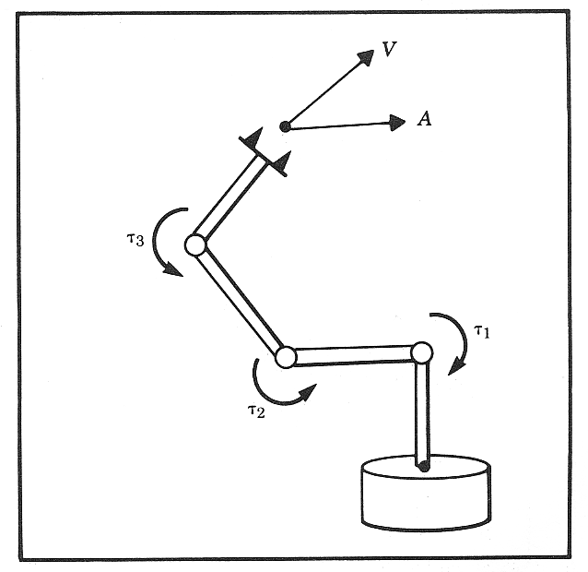
Statics - Forces & Torques
Problem
Given: Typically the robot’s end effector is applying forces and torques on an object in the environment or carrying an object (gravitational load).
Compute: The joint torques which must be acting to keep the system in static equilibrium.
Solution
Jacobian - Mapping from the joint force/torques - to forces/torque in the Cartesian space applied on the end effector) - .
Free Body Diagram - The chain like nature of a manipulator leads to decompose the chain into individual links and calculate how forces and moments propagate from one link to the next.
Instructor: Jacob Rosen
Advanced Robotic - Department of Mechanical & Aerospace Engineering - UCLA

Slide 4
Static Analysis Protocol - Free Body Diagram 1/
Step 1
Lock all the joints - Converting the manipulator (mechanism) to a structure
Step 2
Consider each link in the structure as a free body and write the force / moment equilibrium equations
(3 Eqs.)
(3 Eqs.)
Step 3
Solve the equations - 6 Eq. for each link.
Apply backward solution starting from the last link (end effector) and end up at the first link (base)
Instructor: Jacob Rosen
Advanced Robotic - Department of Mechanical & Aerospace Engineering - UCLA

Slide 5
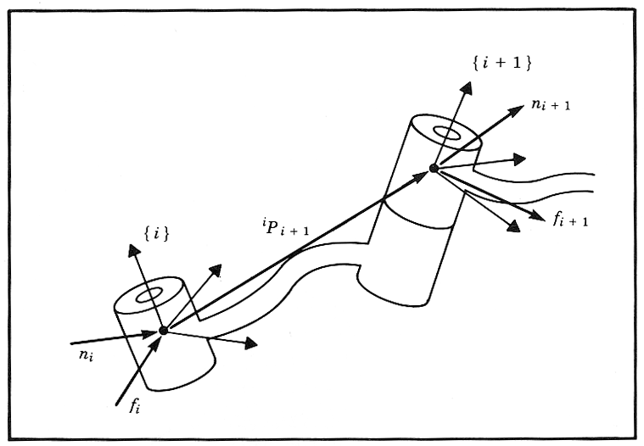
Static Analysis Protocol - Free Body Diagram 2/
Special Symbols are defined for the force and torque exerted by the neighbor link
- Force exerted on link i by link i-1
- Torque exerted on link i by link i-1
For easy solution superscript index (A) should the same as the subscript (B)
Force f or torque n
Reference coordinate system {B}
Exerted on link A by link A-1
Instructor: Jacob Rosen
Advanced Robotic - Department of Mechanical & Aerospace Engineering - UCLA

Slide 6
Static Analysis Protocol - Free Body Diagram 3/
For serial manipulator in static equilibrium (joints locked), the sum the forces and torques acting on link i in the link frame {i} are equal to zero.
Instructor: Jacob Rosen
Advanced Robotic - Department of Mechanical & Aerospace Engineering - UCLA

Slide 7
Static Analysis Protocol - Free Body Diagram 3/
For serial manipulator in static equilibrium (joints locked), the sum the forces and torques acting on link i in the link frame {i} are equal to zero.
Instructor: Jacob Rosen
Advanced Robotic - Department of Mechanical & Aerospace Engineering - UCLA

Slide 8
Static Analysis Protocol - Free Body Diagram 4/
Procedural Note: The solution starts at the end effector and ends at the base
Re-writing these equations in order such that the known forces (or torques) are on the right-hand side and the unknown forces (or torques) are on the left, we find
Instructor: Jacob Rosen
Advanced Robotic - Department of Mechanical & Aerospace Engineering - UCLA

Slide 9
Static Analysis Protocol - Free Body Diagram 5/
Changing the reference frame such that each force (and torque) is expressed upon their link’s frame, we find the static force (and torque) propagation from link i+1 to link i
These equations provide the static force (and torque) propagation from link to link. They allow us to start with the force and torque applied at the end effector, and calculate the force and torque at each joint all the way back to the robot base frame.
Instructor: Jacob Rosen
Advanced Robotic - Department of Mechanical & Aerospace Engineering - UCLA

Slide 10
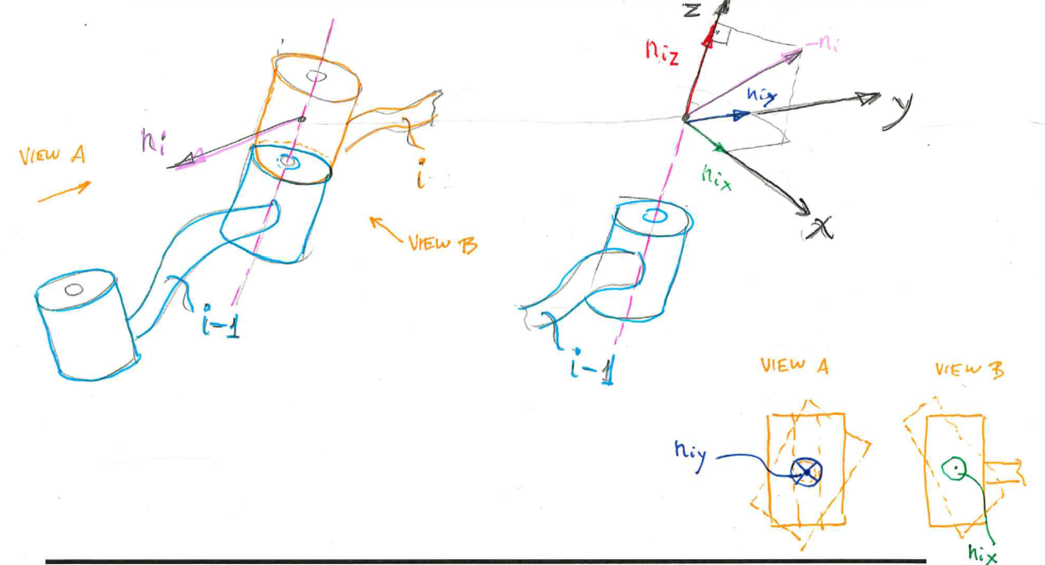
Static Analysis Protocol - Free Body Diagram 6/
Question: What torques are needed at the joints in order to balance the reaction moments acting on the link (Revolute Joint).
Instructor: Jacob Rosen
Advanced Robotic - Department of Mechanical & Aerospace Engineering - UCLA

Slide 11
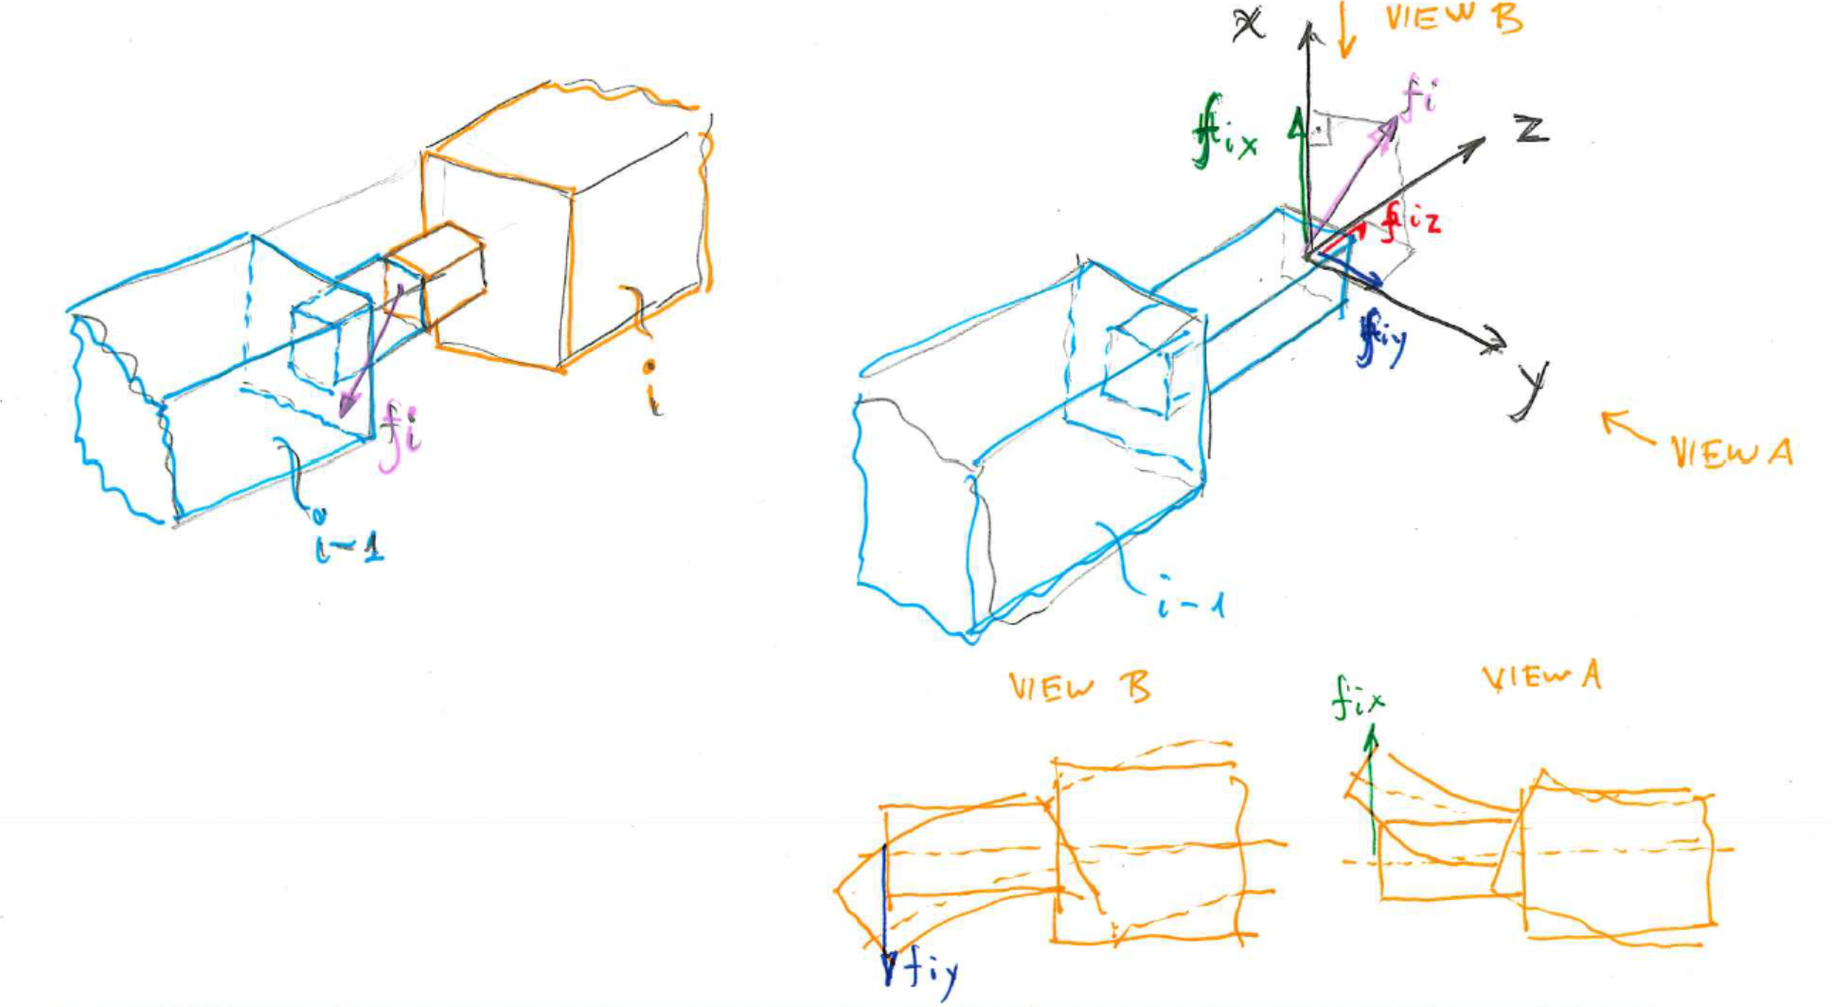
Static Analysis Protocol - Free Body Diagram 7/
Question: What forces are needed at the joints in order to balance the reaction forces acting on the link (Prismatic Joint).
Instructor: Jacob Rosen
Advanced Robotic - Department of Mechanical & Aerospace Engineering - UCLA

Slide 12
Static Analysis Protocol - Free Body Diagram 8/
Answer: All the components of the force and moment vectors are resisted by the structure of mechanism itself, except for the torque about the joint axis (revolute joint) or the force along the joint (prismatic joint).
Therefore, to find the joint the torque or force required to maintain the static equilibrium, the dot product of the joint axis vector with the moment vector or force vector acting on the link is computed
Revolute Joint
Prismatic Joint
Instructor: Jacob Rosen
Advanced Robotic - Department of Mechanical & Aerospace Engineering - UCLA

Slide 13
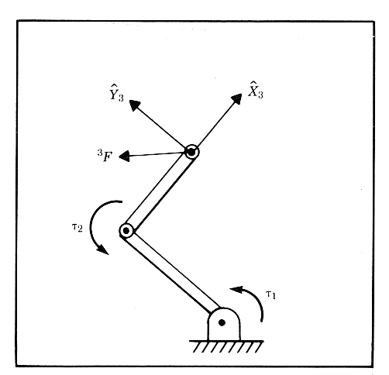
Example - 2R Robot - Static Analysis
Problem
Given:
- 2R Robot
- A Force vector is applied by the
end effector
- A torque vector
Compute:
The required joint torque as a function of
the robot configuration and the applied
force
Instructor: Jacob Rosen
Advanced Robotic - Department of Mechanical & Aerospace Engineering - UCLA

Slide 14
Example - 2R Robot - Static Analysis
Instructor: Jacob Rosen
Advanced Robotic - Department of Mechanical & Aerospace Engineering - UCLA

Slide 15
Example - 2R Robot - Static Analysis
Solution
Lock the revolute joints
Apply the static equilibrium equations starting from the end effector and going toward the base
Instructor: Jacob Rosen
Advanced Robotic - Department of Mechanical & Aerospace Engineering - UCLA

Slide 16
Example - 2R Robot - Static Analysis
For i=2
Instructor: Jacob Rosen
Advanced Robotic - Department of Mechanical & Aerospace Engineering - UCLA

Slide 17
Example - 2R Robot - Static Analysis
For i=1
Instructor: Jacob Rosen
Advanced Robotic - Department of Mechanical & Aerospace Engineering - UCLA

Slide 18
Example - 2R Robot - Static Analysis
Instructor: Jacob Rosen
Advanced Robotic - Department of Mechanical & Aerospace Engineering - UCLA

Slide 19
Example - 2R Robot - Static Analysis
Re-writing the equations in a matrix form
Instructor: Jacob Rosen
Advanced Robotic - Department of Mechanical & Aerospace Engineering - UCLA

Slide 20
Jacobian Methods of Derivation & the Corresponding Reference Frame – Summary
Method | Jacobian Matrix Reference Frame | Transformation to Base Frame (Frame 0)
Explicit (Diff. the Forward Kinematic Eq.) |  | None
Iterative Velocity Eq. |  | Transform Method 1: Transform Method 2:
Iterative Force Eq. |  | Transpose Transform
Instructor: Jacob Rosen
Advanced Robotic - Department of Mechanical & Aerospace Engineering - UCLA

