Slide 1
Jacobian Iterative Method - Velocity Propagation (Method No. 2) Part 1 – Method Derivation
Instructor: Jacob Rosen
Advanced Robotic - Department of Mechanical & Aerospace Engineering - UCLA

Slide 2
Jacobian Matrix - Derivation Methods
Explicit Method
Iterative Methods
Recursive Equations
Differentiation the
Forward Kinematics Eqs.
(Method 1)
Velocity
Propagation –
Base to EE
(Method 2)
Force/Torque
Propagation –
EE to Base
(Method 3)
Jacobian Matrix
Instructor: Jacob Rosen
Advanced Robotic - Department of Mechanical & Aerospace Engineering - UCLA

Slide 3
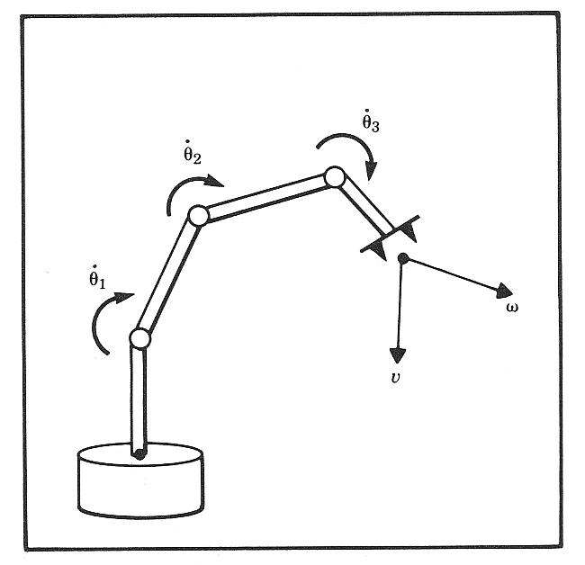
Jacobian Matrix - Introduction
In the field of robotics the Jacobian matrix describe the relationship between the joint angle rates (${\underline{\dot{θ}}}_{N}$) and the translation and rotation velocities of the end effector ($\underline{\dot{x}}$). This relationship is given by:
$$ν=J^{ }(Θ)\dot{Θ}$$
$$ν=\frac{d}{dt}[X]=\left[\begin{matrix}\left[{{}_{ }^{ }v}_{N}\right] \\ \left[{{}_{ }^{ }ω}_{N}\right]\end{matrix}\right]=\left[\begin{matrix}v_{x} \\ v_{y} \\ v_{z} \\ ω_{x} \\ ω_{y} \\ ω_{z}\end{matrix}\right]$$
$$\dot{θ}=\left[\begin{matrix}{\dot{θ}}_{1} \\ {\dot{θ}}_{2} \\ \begin{aligned}{\dot{d}}_{3} \\ {\dot{θ}}_{4} \\ {\dot{θ}}_{5}\end{aligned} \\ {\dot{θ}}_{6}\end{matrix}\right]$$
$$\dot{Θ}=J{\left(\underline{θ}\right)}^{−1}ν$$
Instructor: Jacob Rosen
Advanced Robotic - MAE 263D - Department of Mechanical & Aerospace Engineering - UCLA

Slide 4
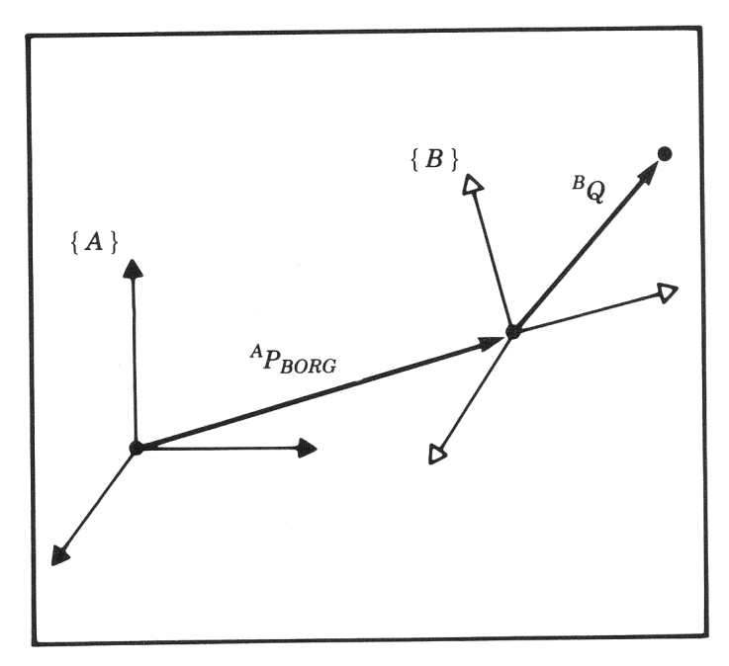
Summary – Changing Frame of Representation
Linear and Rotational Velocity
Vector Form
Matrix Form
Angular Velocity
Vector Form
Matrix Form
$${{}_{ }^{A}V}_{Q}={{}_{ }^{A}V}_{BORG}+{}_{B}^{A}R{{}_{ }^{B}V}_{Q}+{{}_{ }^{A}Ω}_{B}×{}_{B}^{A}R{{}_{ }^{B}P}_{Q}$$
$${{}_{ }^{A}Ω}_{B}$$
$${{}_{ }^{A}V}_{Q}={{}_{ }^{A}V}_{BORG}+{}_{B}^{A}R{{}_{ }^{B}V}_{Q}+{\dot{{}_{B}^{A}R}}_{Ω}\left({}_{B}^{A}R{{}_{ }^{B}P}_{Q}\right)$$
$${{}_{ }^{B}P}_{Q}$$
$${{}_{ }^{A}Ω}_{C}={{}_{ }^{A}Ω}_{B}+{}_{B}^{A}R{{}_{ }^{B}Ω}_{C}$$
$${\dot{{}_{C}^{A}R}}_{Ω}={\dot{{}_{B}^{A}R}}_{Ω}+{}_{B}^{A}R{\dot{{}_{C}^{B}R}}_{Ω}{{}_{B}^{A}R}^{T}$$
Instructor: Jacob Rosen
Advanced Robotic - Department of Mechanical & Aerospace Engineering - UCLA

Slide 5
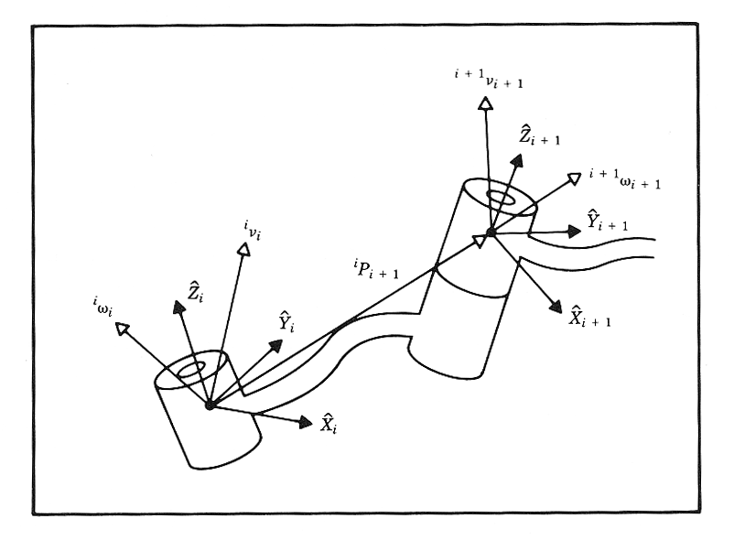
Velocity of Adjacent Links - Summary
Angular Velocity
Linear Velocity
0 - Prismatic Joint
$${{}_{ }^{i+1}ω}_{i+1}={}_{i}^{i+1}R{{}_{ }^{i}ω}_{i}+\left[\begin{matrix}0 \\ 0 \\ {\dot{θ}}_{i+1}\end{matrix}\right]$$
0 - Revolute Joint
$${{}_{ }^{i+1}v}_{i+1}={}_{i}^{i+1}R\left({}_{ }^{i}ω×{{}_{ }^{i}P}_{i+1}+{{}_{ }^{i}v}_{i}\right)+\left[\begin{matrix}0 \\ 0 \\ {\dot{d}}_{i+1}\end{matrix}\right]$$
Instructor: Jacob Rosen
Advanced Robotic - Department of Mechanical & Aerospace Engineering - UCLA

Slide 6
Representation / Reference Frame Computed / Measured Frame
Frame Notation
Instructor: Jacob Rosen
Advanced Robotic - Department of Mechanical & Aerospace Engineering - UCLA

Slide 7
Frame - Velocity
As with any vector, a velocity vector may be described in terms of any frame, and this frame of reference is noted with a leading superscript.
A velocity vector computed in frame {B} and represented in frame {A} would be written
Represented
(Reference Frame)
$${}_{ }^{A}{({{}_{ }^{B}V}_{Q})}=\frac{{}_{ }^{A}d}{dt}{{}_{ }^{B}P}_{Q}$$
Computed
(Measured)
Instructor: Jacob Rosen
Advanced Robotic - Department of Mechanical & Aerospace Engineering - UCLA

Slide 8
Position Propagation
The homogeneous transform matrix provides a complete description of the linear and angular position relationship between adjacent links.
These descriptions may be combined together to describe the position of a link relative to the robot base frame {0}.
A similar description of the linear and angular velocities between adjacent links as well as the base frame would also be useful.
$${}_{i}^{o}T={}_{1}^{o}T{}_{2}^{1}T⋯{}_{i}^{i−1}T$$
Instructor: Jacob Rosen
Advanced Robotic - Department of Mechanical & Aerospace Engineering - UCLA

Slide 9
Position Propagation
$${}_{T}^{0}T = {}_{1}^{0}T {}_{2}^{1}T {}_{3}^{2}T {}_{4}^{3}T {}_{5}^{4}T {}_{6}^{5}T {}_{T}^{6}T$$
Instructor: Jacob Rosen
Advanced Robotic - Department of Mechanical & Aerospace Engineering - UCLA

Slide 10
Motion of the Link of a Robot
In considering the motion of a robot link we will always use link frame {0} as the reference frame (Computed AND Represented). However any frame can be used as the reference (represented) frame including the link’s own frame (i)
Where: - is the linear velocity of the origin of link frame (i) with respect to
frame {0} (Computed AND Represented)
- is the angular velocity of the origin of link frame (i) with respect to
frame {0} (Computed AND Represented)
Expressing the velocity of a frame {i} (associated with link i ) relative to the robot base (frame {0}) using our previous notation is defined as follows:
$$v_{i}$$
$$ω_{i}$$
Instructor: Jacob Rosen
Advanced Robotic - Department of Mechanical & Aerospace Engineering - UCLA

Slide 11
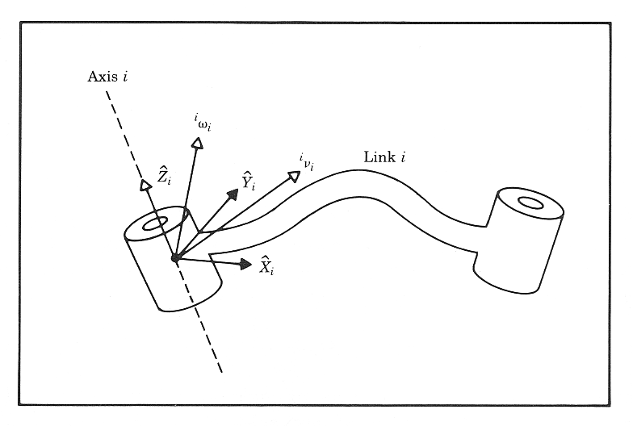
Velocities - Frame & Notation
The velocities differentiate (computed) relative to the base frame {0} are often represented relative to other frames {k}. The following notation is used for this conditions
Instructor: Jacob Rosen
Advanced Robotic - Department of Mechanical & Aerospace Engineering - UCLA

Slide 12
Velocity Propagation
Given: A manipulator - A chain of rigid bodies each one capable of moving relative to its neighbor
Problem: Calculate the linear and angular velocities of the link of a robot
Solution (Concept): Due to the robot structure (serial mechanism) we can compute the velocities of each link in order starting from the base.
The velocity of link i+1 will be that of link i , plus whatever new velocity components were added by joint i+1
Instructor: Jacob Rosen
Advanced Robotic - Department of Mechanical & Aerospace Engineering - UCLA

Slide 13
Angular Velocity Propagation
Instructor: Jacob Rosen
Advanced Robotic - Department of Mechanical & Aerospace Engineering - UCLA

Slide 14
Velocity of Adjacent Links - Angular Velocity 0/5
Instructor: Jacob Rosen
Advanced Robotic - Department of Mechanical & Aerospace Engineering - UCLA

Slide 15
Velocity of Adjacent Links - Angular Velocity 1/5
From the relationship developed previously
we can reassign link names to calculate the velocity of any link i relative to the base frame {0}
We can convert the frame of reference from the base {0} to frame {i+1} by pre-multiplying both sides of the equation by ,we can convert the frame of reference for the base {0} to frame {i+1}
$${{}_{ }^{A}Ω}_{C}={{}_{ }^{A}Ω}_{B}+{}_{B}^{A}R{{}_{ }^{B}Ω}_{C}$$
$$\left\{\begin{matrix}A→0 \\ B→i \\ C→i+1\end{matrix}\right.$$
$${{}_{ }^{0}Ω}_{i+1}={{}_{ }^{0}Ω}_{i}+{}_{i}^{0}R{{}_{ }^{i}Ω}_{i+1}$$
$${}_{0}^{i+1}R$$
Instructor: Jacob Rosen
Advanced Robotic - Department of Mechanical & Aerospace Engineering - UCLA

Slide 16
Velocity of Adjacent Links - Angular Velocity 2/5
Using the recently defined notation, we have
${{}_{ }^{i+1}ω}_{i+1}$ - Angular velocity of frame {i+1} measured relative to the robot base, and expressed in frame {i+1} Recall the car example
${{}_{ }^{i+1}ω}_{i}$ - Angular velocity of frame {i} measured relative to the robot base, and expressed in frame {i+1}
${}_{i}^{i+1}R{{}_{ }^{i}Ω}_{i+1}$- Angular velocity of frame {i+1} measured relative to frame {i} and expressed in frame {i+1}
$${}_{0}^{i+1}R{{}_{ }^{0}Ω}_{i+1}={}_{0}^{i+1}R{{}_{ }^{0}Ω}_{i}+{}_{0}^{i+1}R{}_{i}^{0}R{{}_{ }^{i}Ω}_{i+1}$$
$${{}_{ }^{i+1}ω}_{i+1}={{}_{ }^{i+1}ω}_{i}+{}_{i}^{i+1}R{{}_{ }^{i}Ω}_{i+1}$$
Instructor: Jacob Rosen
Advanced Robotic - Department of Mechanical & Aerospace Engineering - UCLA

Slide 17
Velocity of Adjacent Links - Angular Velocity 3/5
Angular velocity of frame {i} measured relative to the robot base, expressed in frame {i+1}
$${{}_{ }^{i+1}ω}_{i+1}={{}_{ }^{i+1}ω}_{i}+{}_{i}^{i+1}R{{}_{ }^{i}Ω}_{i+1}$$
$${{}_{ }^{i+1}ω}_{i}={}_{i}^{i+1}R{{}_{ }^{i}ω}_{i}$$
Instructor: Jacob Rosen
Advanced Robotic - Department of Mechanical & Aerospace Engineering - UCLA

Slide 18
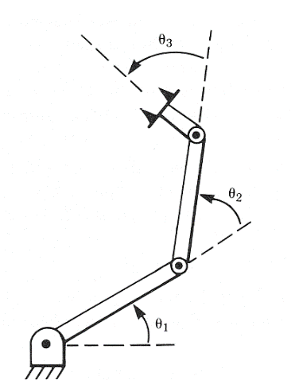
Velocity of Adjacent Links - Angular Velocity 4/5
Angular velocity of frame {i+1} measured (differentiate) in frame {i} and represented (expressed) in frame {i+1}
Assuming that a joint has only 1 DOF. The joint configuration can be either revolute joint (angular velocity) or prismatic joint (Linear velocity).
Based on the frame attachment convention in which we assign the Z axis pointing along the i+1 joint axis such that the two are coincide (rotations of a link is preformed only along its Z- axis) we can rewrite this term as follows:
$${{}_{ }^{i+1}ω}_{i+1}={{}_{ }^{i+1}ω}_{i}+{}_{i}^{i+1}R{{}_{ }^{i}Ω}_{i+1}$$
$${\dot{θ}}_{3}$$
$${}_{i}^{i+1}R{{}_{ }^{i}Ω}_{i+1}=\left[\begin{matrix}0 \\ 0 \\ {\dot{θ}}_{i+1}\end{matrix}\right]$$
i+1
$${\dot{θ}}_{2}$$
i
$${\dot{θ}}_{1}$$
Instructor: Jacob Rosen
Advanced Robotic - Department of Mechanical & Aerospace Engineering - UCLA

Slide 19
Velocity of Adjacent Links - Angular Velocity 5/5
The result is a recursive equation that shows the angular velocity of one link in terms of the angular velocity of the previous link plus the relative motion of the two links.
Since the term ${{}_{ }^{i+1}ω}_{i+1}$ depends on all previous links through this recursion, the angular velocity is said to propagate from the base to subsequent links.
$${{}_{ }^{i+1}ω}_{i+1}={}_{i}^{i+1}R{{}_{ }^{i}ω}_{i}+\left[\begin{matrix}0 \\ 0 \\ {\dot{θ}}_{i+1}\end{matrix}\right]$$
Instructor: Jacob Rosen
Advanced Robotic - Department of Mechanical & Aerospace Engineering - UCLA

Slide 20
Linear Velocity Propagation
Instructor: Jacob Rosen
Advanced Robotic - Department of Mechanical & Aerospace Engineering - UCLA

Slide 21
Velocity of Adjacent Links - Linear Velocity 0/6
Instructor: Jacob Rosen
Advanced Robotic - Department of Mechanical & Aerospace Engineering - UCLA

Slide 22
Velocity of Adjacent Links - Linear Velocity 1/6
Simultaneous Linear and Rotational Velocity
The derivative of a vector in a moving frame (linear and rotation velocities) as seen from a stationary frame
Vector Form
Matrix Form
$${{}_{ }^{A}Ω}_{B}$$
$${{}_{ }^{B}P}_{Q}$$
$${{}_{ }^{A}V}_{Q}={{}_{ }^{A}V}_{BORG}+{}_{B}^{A}R{{}_{ }^{B}V}_{Q}+{{}_{ }^{A}Ω}_{B}×{}_{B}^{A}R{{}_{ }^{B}P}_{Q}$$
$${{}_{ }^{A}V}_{Q}={{}_{ }^{A}V}_{BORG}+{}_{B}^{A}R{{}_{ }^{B}V}_{Q}+{\dot{{}_{B}^{A}R}}_{Ω}\left({}_{B}^{A}R{{}_{ }^{B}P}_{Q}\right)$$
Instructor: Jacob Rosen
Advanced Robotic - Department of Mechanical & Aerospace Engineering - UCLA

Slide 23
Velocity of Adjacent Links - Linear Velocity 2/6
From the relationship developed previously (matrix form)
we re-assign link frames for adjacent links (i and i +1) with the velocity computed relative to the robot base frame {0}
We can convert the frame of reference from frame {0} to frame {i+1} by pre-multiplying both sides of the equation by ${}_{0}^{i+1}R$
$${{}_{ }^{A}V}_{Q}={{}_{ }^{A}V}_{BORG}+{}_{B}^{A}R{{}_{ }^{B}V}_{Q}+{\dot{{}_{B}^{A}R}}_{Ω}\left({}_{B}^{A}R{{}_{ }^{B}P}_{Q}\right)$$
$$\left\{\begin{matrix}A→0 \\ B→i \\ C→i+1\end{matrix}\right.$$
$${{}_{ }^{0}V}_{i+1}={\dot{{}_{i}^{0}R}}_{Ω}\left({}_{i}^{0}R{{}_{ }^{i}P}_{i+1}\right)+{{}_{ }^{0}V}_{i}+{}_{i}^{0}R{{}_{ }^{i}V}_{i+1}$$
Instructor: Jacob Rosen
Advanced Robotic - Department of Mechanical & Aerospace Engineering - UCLA

Slide 24
Velocity of Adjacent Links - Linear Velocity 3/6
Which simplifies to
Factoring out from the blue term
$${}_{0}^{i+1}R{{}_{ }^{0}V}_{i+1}={}_{0}^{i+1}R{\dot{{}_{i}^{0}R}}_{Ω}\left({}_{i}^{0}R{{}_{ }^{i}P}_{i+1}\right)+{}_{0}^{i+1}R{{}_{ }^{0}V}_{i}+{}_{0}^{i+1}R{}_{i}^{0}R{{}_{ }^{i}V}_{i+1}$$
$${}_{0}^{i+1}R{{}_{ }^{0}V}_{i+1}={}_{0}^{i+1}R{\dot{{}_{i}^{0}R}}_{Ω}\left({}_{i}^{0}R{{}_{ }^{i}P}_{i+1}\right)+{}_{0}^{i+1}R{{}_{ }^{0}V}_{i}+{}_{i}^{i+1}R{{}_{ }^{i}V}_{i+1}$$
$${}_{i}^{i+1}R$$
$${}_{0}^{i+1}R{{}_{ }^{0}V}_{i+1}={}_{i}^{i+1}R\left({}_{0}^{i}R{\dot{{}_{i}^{0}R}}_{Ω}{}_{i}^{0}R{{}_{ }^{i}P}_{i+1}+{}_{0}^{i}R{{}_{ }^{0}V}_{i}\right)+{}_{i}^{i+1}R{{}_{ }^{i}V}_{i+1}$$
Instructor: Jacob Rosen
Advanced Robotic - Department of Mechanical & Aerospace Engineering - UCLA

Slide 25
Velocity of Adjacent Links - Linear Velocity 4/6
${}_{i}^{i+1}R{{}_{ }^{i}V}_{i+1}$ - Linear velocity of frame {i+1} measured relative to frame {i} and expressed in frame {i+1}
Assuming that a joint has only 1 DOF. The joint configuration can be either revolute joint (angular velocity) or prismatic joint (Linear velocity).
Based on the frame attachment convention in which we assign the Z axis pointing along the i+1 joint axis such that the two are coincide (translation of a link is preformed only along its Z- axis) we can rewrite this term as follows:
$${}_{0}^{i+1}R{{}_{ }^{0}V}_{i+1}={}_{i}^{i+1}R\left({}_{0}^{i}R{\dot{{}_{i}^{0}R}}_{Ω}{}_{i}^{0}R{{}_{ }^{i}P}_{i+1}+{}_{0}^{i}R{{}_{ }^{0}V}_{i}\right)+{}_{i}^{i+1}R{{}_{ }^{i}V}_{i+1}$$
$${}_{i}^{i+1}R{{}_{ }^{i}V}_{i+1}=\left[\begin{matrix}0 \\ 0 \\ {\dot{d}}_{i+1}\end{matrix}\right]$$
Instructor: Jacob Rosen
Advanced Robotic - Department of Mechanical & Aerospace Engineering - UCLA

Slide 26
Angular Velocity - Matrix & Vector Forms
$${{}_{}^{A}V}_{Q}={{}_{}^{A}V}_{BORG}+{}_{B}^{A}R{{}_{}^{B}V}_{Q}+{{}_{}^{A}Ω}_{B}×{}_{B}^{A}R{{}_{}^{B}P}_{Q}$$
$${{}_{}^{A}V}_{Q}={{}_{}^{A}V}_{BORG}+{}_{B}^{A}R{{}_{}^{B}V}_{Q}+{\dot{{}_{B}^{A}R}}_{Ω}\left({}_{B}^{A}R{{}_{}^{B}P}_{Q}\right)$$
Matrix Form Vector Form
Definition
Multiply by Constant
Multiply by Vector
Multiply by Matrix
$${\dot{{}_{B}^{A}R}}_{Ω}≡\left[\begin{matrix}0 & −Ω_{z} & Ω_{y} \\ Ω_{z} & 0 & −Ω_{x} \\ −Ω_{y} & Ω_{x} & 0\end{matrix}\right]$$
$${{}_{ }^{A}Ω}_{B}≡\left[\begin{matrix}Ω_{x} \\ Ω_{y} \\ Ω_{z}\end{matrix}\right]$$
$$k \left[{\dot{{}_{B}^{A}R}}_{Ω}\right]$$
$$k \left[{{}_{ }^{A}Ω}_{B}\right]$$
$$\left[{\dot{{}_{B}^{A}R}}_{Ω}\right] \left[\begin{matrix}x \\ y \\ z\end{matrix}\right]$$
$${{}_{ }^{A}Ω}_{B}×\left[\begin{matrix}x \\ y \\ z\end{matrix}\right]=ω × r$$
$$\left[ {}_{t}^{s}R \right] \left[ {\dot{{}_{B}^{A}R}}_{Ω} \right] {\left[ {}_{t}^{s}R \right]}^{ T}$$
$$\left[ {}_{t}^{s}R \right] \left[ {{}_{ }^{A}Ω}_{B} \right]$$
Instructor: Jacob Rosen
Advanced Robotic - MAE 263 - Department of Mechanical & Aerospace Engineering - UCLA

Slide 27
Velocity of Adjacent Links - Linear Velocity 5/6
$${}_{0}^{i+1}R{{}_{ }^{0}V}_{i+1}={}_{i}^{i+1}R\left({}_{0}^{i}R{\dot{{}_{i}^{0}R}}_{Ω}{}_{i}^{0}R{{}_{ }^{i}P}_{i+1}+{}_{0}^{i}R{{}_{ }^{0}V}_{i}\right)+\left[\begin{matrix}0 \\ 0 \\ {\dot{d}}_{i+1}\end{matrix}\right]$$
$${}_{0}^{i}R{\dot{{}_{i}^{0}R}}_{Ω}{}_{i}^{0}R={}_{0}^{i}R{\dot{{}_{i}^{0}R}}_{Ω}{{}_{0}^{i}R}^{T}={}_{0}^{i}R{{}_{ }^{0}Ω}_{i}={}_{0}^{i}Rω_{i}={{}_{ }^{i}ω}_{i}$$
Multiply by Matrix
Definition
$${}_{0}^{i+1}R{{}_{ }^{0}V}_{i+1}={{}_{ }^{i+1}v}_{i+1}$$
$${}_{0}^{i}R{{}_{ }^{0}V}_{i}={{}_{ }^{i}v}_{i}$$
Definition
Definition
Instructor: Jacob Rosen
Advanced Robotic - Department of Mechanical & Aerospace Engineering - UCLA

Slide 28
Velocity of Adjacent Links - Linear Velocity 6/6
The result is a recursive equation that shows the linear velocity of one link in terms of the previous link plus the relative motion of the two links.
Since the term ${{}_{ }^{i+1}v}_{i+1}$ depends on all previous links through this recursion, the angular velocity is said to propagate from the base to subsequent links.
$${{}_{ }^{i+1}v}_{i+1}={}_{i}^{i+1}R\left({{}_{ }^{i}ω}_{i}×{{}_{ }^{i}P}_{i+1}+{{}_{ }^{i}v}_{i}\right)+\left[\begin{matrix}0 \\ 0 \\ {\dot{d}}_{i+1}\end{matrix}\right]$$
Instructor: Jacob Rosen
Advanced Robotic - Department of Mechanical & Aerospace Engineering - UCLA

Slide 29
Velocity of Adjacent Links - Summary
Angular Velocity
Linear Velocity
0 - Prismatic Joint
$${{}_{ }^{i+1}ω}_{i+1}={}_{i}^{i+1}R{{}_{ }^{i}ω}_{i}+\left[\begin{matrix}0 \\ 0 \\ {\dot{θ}}_{i+1}\end{matrix}\right]$$
0 - Revolute Joint
$${{}_{ }^{i+1}v}_{i+1}={}_{i}^{i+1}R\left({}_{ }^{i}ω×{{}_{ }^{i}P}_{i+1}+{{}_{ }^{i}v}_{i}\right)+\left[\begin{matrix}0 \\ 0 \\ {\dot{d}}_{i+1}\end{matrix}\right]$$
Instructor: Jacob Rosen
Advanced Robotic - Department of Mechanical & Aerospace Engineering - UCLA

Slide 30
3R – Example
Analytical Approach
Instructor: Jacob Rosen
Advanced Robotic - Department of Mechanical & Aerospace Engineering - UCLA

Slide 31
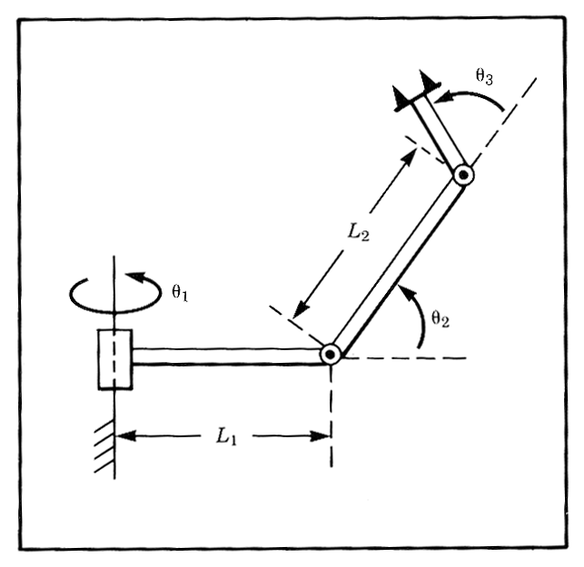
Angular and Linear Velocities - 3R Robot - Example
For the manipulator shown in the figure, compute the angular and linear velocity of the “tool” frame relative to the base frame expressed in the “tool” frame (that is, calculate and ).
$${{}_{}^{4}ω}_{4}$$
$${{}_{}^{4}v}_{4}$$
Instructor: Jacob Rosen
Advanced Robotic - Department of Mechanical & Aerospace Engineering - UCLA

Slide 32
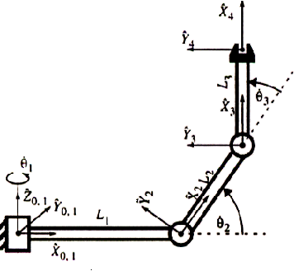
Angular and Linear Velocities - 3R Robot - Example
Frame attachment
Instructor: Jacob Rosen
Advanced Robotic - Department of Mechanical & Aerospace Engineering - UCLA

Slide 33
Angular and Linear Velocities - 3R Robot - Example
DH Parameters
Instructor: Jacob Rosen
Advanced Robotic - Department of Mechanical & Aerospace Engineering - UCLA

Slide 34
Angular and Linear Velocities - 3R Robot - Example
From the DH parameter table, we can specify the homogeneous transform matrix for each adjacent link pair:
$${}_{1}^{0}T=\left[\begin{matrix}c1 & −s1 & 0 & 0 \\ s1 & c1 & 0 & 0 \\ 0 & 0 & 1 & 0 \\ 0 & 0 & 0 & 1\end{matrix}\right]$$
$${}_{i}^{i−1}T=\left[\begin{matrix}cθ_{i} & −sθ_{i} & 0 & a_{i−1} \\ sθ_{i}cα_{i−1} & cθ_{i}cα_{i−1} & −sα_{i−1} & −sα_{i−1}d_{i} \\ sθ_{i}sα_{i−1} & cθ_{i}sα_{i−1} & cα_{i−1} & cα_{i−1}d \\ 0 & 0 & 0 & 1\end{matrix}\right]$$
$${}_{2}^{1}T=\left[\begin{matrix}c2 & −s2 & 0 & L1 \\ 0 & 0 & −1 & 0 \\ s2 & c2 & 0 & 0 \\ 0 & 0 & 0 & 1\end{matrix}\right]$$
$${}_{3}^{2}T=\left[\begin{matrix}c3 & −s3 & 0 & L2 \\ s3 & c3 & 0 & 0 \\ 0 & 0 & 1 & 0 \\ 0 & 0 & 0 & 1\end{matrix}\right]$$
$${}_{4}^{3}T=\left[\begin{matrix}1 & 0 & 0 & L3 \\ 0 & 1 & 0 & 0 \\ 0 & 0 & 1 & 0 \\ 0 & 0 & 0 & 1\end{matrix}\right]$$

Slide 35
Angular and Linear Velocities - 3R Robot - Example
The homogeneous transform matrix from frame 0 to each one of the joints (1,2,3,4)
$${}_{1}^{0}T=\left[\begin{matrix}c1 & −s1 & 0 & 0 \\ s1 & c1 & 0 & 0 \\ 0 & 0 & 1 & 0 \\ 0 & 0 & 0 & 1\end{matrix}\right]$$
${}_{2}^{0}T={}_{1}^{0}T{}_{2}^{1}T=\left[\begin{matrix}c1 & −s1 & 0 & 0 \\ s1 & c1 & 0 & 0 \\ 0 & 0 & 1 & 0 \\ 0 & 0 & 0 & 1\end{matrix}\right]$ $\left[\begin{matrix}c2 & −s2 & 0 & L1 \\ 0 & 0 & −1 & 0 \\ s2 & c2 & 0 & 0 \\ 0 & 0 & 0 & 1\end{matrix}\right]$ = $\left[\begin{matrix}c1c2 & −c1s1 & s1 & L1c1 \\ s1c2 & −s1s2 & −c1 & L1s1 \\ s2 & c2 & 0 & 0 \\ 0 & 0 & 0 & 1\end{matrix}\right]$
${}_{3}^{0}T={}_{1}^{0}T{}_{2}^{1}T{}_{3}^{2}T=\left[\begin{matrix}c1 & −s1 & 0 & 0 \\ s1 & c1 & 0 & 0 \\ 0 & 0 & 1 & 0 \\ 0 & 0 & 0 & 1\end{matrix}\right]$ $\left[\begin{matrix}c2 & −s2 & 0 & L1 \\ 0 & 0 & −1 & 0 \\ s2 & c2 & 0 & 0 \\ 0 & 0 & 0 & 1\end{matrix}\right]$ $\left[\begin{matrix}c3 & −s3 & 0 & L2 \\ s3 & c3 & 0 & 0 \\ 0 & 0 & 1 & 0 \\ 0 & 0 & 0 & 1\end{matrix}\right]$ = $\left[\begin{matrix}c1c23 & −c1s23 & s1 & c1(L1+L2c2) \\ s1c23 & −s1s23 & −c1 & s1(L1+L2c2) \\ s23 & c23 & 0 & L2s2 \\ 0 & 0 & 0 & 1\end{matrix}\right]$
${}_{4}^{0}T={}_{1}^{0}T{}_{2}^{1}T{}_{3}^{2}T{}_{4}^{3}T=\left[\begin{matrix}c1 & −s1 & 0 & 0 \\ s1 & c1 & 0 & 0 \\ 0 & 0 & 1 & 0 \\ 0 & 0 & 0 & 1\end{matrix}\right]$ $\left[\begin{matrix}c2 & −s2 & 0 & L1 \\ 0 & 0 & −1 & 0 \\ s2 & c2 & 0 & 0 \\ 0 & 0 & 0 & 1\end{matrix}\right]$ $\left[\begin{matrix}c3 & −s3 & 0 & L2 \\ s3 & c3 & 0 & 0 \\ 0 & 0 & 1 & 0 \\ 0 & 0 & 0 & 1\end{matrix}\right]$ $\left[\begin{matrix}1 & 0 & 0 & L3 \\ 0 & 1 & 0 & 0 \\ 0 & 0 & 1 & 0 \\ 0 & 0 & 0 & 1\end{matrix}\right]$ =$\left[\begin{matrix}c1c23 & −c1s23 & s1 & c1(L1+L3c23+L2c2) \\ s1c23 & −s1s23 & −c1 & s1(L1+L3c23+L2c2) \\ s23 & c23 & 0 & L3s23+L2s2 \\ 0 & 0 & 0 & 1\end{matrix}\right]$

Slide 36
Angular and Linear Velocities - 3R Robot - Example
Compute the angular velocity of the end effector frame relative to the base frame expressed at the end effector frame.
For i=0
$${{}_{ }^{i+1}ω}_{i+1}={}_{i}^{i+1}R{{}_{ }^{i}ω}_{i}+\left[\begin{matrix}0 \\ 0 \\ {\dot{θ}}_{i+1}\end{matrix}\right]$$
$${{}_{ }^{1}ω}_{1}={}_{0}^{1}R{{}_{ }^{0}ω}_{0}+\left[\begin{matrix}0 \\ 0 \\ {\dot{θ}}_{1}\end{matrix}\right]=\left[\begin{matrix}c1 & s1 & 0 \\ −s1 & c1 & 0 \\ 0 & 0 & 1\end{matrix}\right]\left[\begin{matrix}0 \\ 0 \\ 0\end{matrix}\right]+\left[\begin{matrix}0 \\ 0 \\ {\dot{θ}}_{1}\end{matrix}\right]=\left[\begin{matrix}0 \\ 0 \\ {\dot{θ}}_{1}\end{matrix}\right]$$
Instructor: Jacob Rosen
Advanced Robotic - Department of Mechanical & Aerospace Engineering - UCLA

Slide 37
Angular and Linear Velocities - 3R Robot - Example
For i=1
For i=2
For i=3
Note
$${{}_{ }^{2}ω}_{2}={}_{1}^{2}R{{}_{ }^{1}ω}_{1}+\left[\begin{matrix}0 \\ 0 \\ {\dot{θ}}_{2}\end{matrix}\right]=\left[\begin{matrix}c2 & 0 & s2 \\ −s2 & 0 & c2 \\ 0 & −1 & 0\end{matrix}\right]\left[\begin{matrix}0 \\ 0 \\ {\dot{θ}}_{1}\end{matrix}\right]+\left[\begin{matrix}0 \\ 0 \\ {\dot{θ}}_{2}\end{matrix}\right]=\left[\begin{matrix}s2{\dot{θ}}_{1} \\ c2{\dot{θ}}_{1} \\ {\dot{θ}}_{2}\end{matrix}\right]$$
$${{}_{ }^{3}ω}_{3}={}_{2}^{3}R{{}_{ }^{2}ω}_{2}+\left[\begin{matrix}0 \\ 0 \\ {\dot{θ}}_{3}\end{matrix}\right]=\left[\begin{matrix}c3 & s3 & 0 \\ −s3 & c3 & 0 \\ 0 & 0 & 1\end{matrix}\right]\left[\begin{matrix}s2{\dot{θ}}_{1} \\ c2{\dot{θ}}_{1} \\ {\dot{θ}}_{2}\end{matrix}\right]+\left[\begin{matrix}0 \\ 0 \\ {\dot{θ}}_{3}\end{matrix}\right]=\left[\begin{matrix}s23{\dot{θ}}_{1} \\ c23{\dot{θ}}_{1} \\ {\dot{θ}}_{2}+{\dot{θ}}_{3}\end{matrix}\right]$$
$${{}_{ }^{4}ω}_{4}={}_{3}^{4}R{{}_{ }^{3}ω}_{3}+\left[\begin{matrix}0 \\ 0 \\ 0\end{matrix}\right]=\left[\begin{matrix}1 & 0 & 0 \\ 0 & 1 & 0 \\ 0 & 0 & 1\end{matrix}\right]\left[\begin{matrix}s23{\dot{θ}}_{1} \\ c23{\dot{θ}}_{1} \\ {\dot{θ}}_{2}+{\dot{θ}}_{3}\end{matrix}\right]+\left[\begin{matrix}0 \\ 0 \\ 0\end{matrix}\right]=\left[\begin{matrix}s23{\dot{θ}}_{1} \\ c23{\dot{θ}}_{1} \\ {\dot{θ}}_{2}+{\dot{θ}}_{3}\end{matrix}\right]$$
$${{}_{ }^{3}ω}_{3}={{}_{ }^{4}ω}_{4}$$

Slide 38
Angular and Linear Velocities - 3R Robot - Example
Compute the linear velocity of the end effector frame relative to the base frame expressed at the end effector frame.
Note that the term involving the prismatic joint has been dropped from the equation (it is equal to zero).
0
$${{}_{ }^{i+1}v}_{i+1}={}_{i}^{i+1}R\left({}_{ }^{i}ω×{{}_{ }^{i}P}_{i+1}+{{}_{ }^{i}v}_{i}\right)+\left[\begin{matrix}0 \\ 0 \\ {\dot{d}}_{i+1}\end{matrix}\right]$$
Instructor: Jacob Rosen
Advanced Robotic - MAE 263B - Department of Mechanical & Aerospace Engineering - UCLA

Slide 39
Angular and Linear Velocities - 3R Robot - Example
For i=0
For i=1
$${{}_{ }^{1}v}_{1}={}_{0}^{1}R\left\{{{}_{ }^{0}ω}_{0}×{{}_{ }^{0}P}_{1}+{{}_{ }^{0}v}_{0}\right\}=\left[\begin{matrix}c1 & s1 & 0 \\ −s1 & c1 & 0 \\ 0 & 0 & 1\end{matrix}\right]\left\{\left[\begin{matrix}0 \\ 0 \\ 0\end{matrix}\right]×\left[\begin{matrix}0 \\ 0 \\ 0\end{matrix}\right]+\left[\begin{matrix}0 \\ 0 \\ 0\end{matrix}\right]\right\}=\left[\begin{matrix}0 \\ 0 \\ 0\end{matrix}\right]$$
$${{}_{ }^{2}v}_{2}={}_{1}^{2}R\left\{{{}_{ }^{1}ω}_{1}×{{}_{ }^{1}P}_{2}+{{}_{ }^{1}v}_{1}\right\}=\left[\begin{matrix}c2 & 0 & s2 \\ −s2 & 0 & c2 \\ 0 & −1 & 0\end{matrix}\right]\left\{\left[\begin{matrix}0 \\ 0 \\ {\dot{θ}}_{1}\end{matrix}\right]×\left[\begin{matrix}L1 \\ 0 \\ 0\end{matrix}\right]+\left[\begin{matrix}0 \\ 0 \\ 0\end{matrix}\right]\right\}=\left[\begin{matrix}0 \\ 0 \\ −L_{1}{\dot{θ}}_{1}\end{matrix}\right]$$
Instructor: Jacob Rosen
Advanced Robotic - MAE 263B - Department of Mechanical & Aerospace Engineering - UCLA

Slide 40
Angular and Linear Velocities - 3R Robot - Example
For i=3
$${{}_{ }^{3}v}_{3}={}_{2}^{3}R\left\{{{}_{ }^{2}ω}_{2}×{{}_{ }^{2}P}_{3}+{{}_{ }^{2}v}_{2}\right\}=\left[\begin{matrix}c3 & s3 & 0 \\ −s3 & c30 & 0 \\ 0 & 0 & 1\end{matrix}\right]\left\{\left[\begin{matrix}s2{\dot{θ}}_{1} \\ c2{\dot{θ}}_{1} \\ {\dot{θ}}_{2}\end{matrix}\right]×\left[\begin{matrix}L2 \\ 0 \\ 0\end{matrix}\right]+\left[\begin{matrix}0 \\ 0 \\ −L1{\dot{θ}}_{1}\end{matrix}\right]\right\} \\ =\left[\begin{matrix}c3 & s3 & 0 \\ −s3 & c3 & 0 \\ 0 & 0 & 1\end{matrix}\right]\left\{\left[\begin{matrix}0 \\ L2{\dot{θ}}_{1} \\ −L2c2{\dot{θ}}_{1}−L1{\dot{θ}}_{1}\end{matrix}\right]\right\}=\left[\begin{matrix}L2s3{\dot{θ}}_{2} \\ L2c3{\dot{θ}}_{2} \\ (−L1−L2c2){\dot{θ}}_{1}\end{matrix}\right]$$
Instructor: Jacob Rosen
Advanced Robotic - MAE 263B - Department of Mechanical & Aerospace Engineering - UCLA

Slide 41
Angular and Linear Velocities - 3R Robot - Example
For i=4
$${{}_{ }^{4}v}_{4}={}_{3}^{4}R\left\{{{}_{ }^{3}ω}_{3}×{{}_{ }^{3}P}_{4}+{{}_{ }^{3}v}_{3}\right\}=\left[\begin{matrix}1 & 0 & 0 \\ 0 & 1 & 0 \\ 0 & 0 & 1\end{matrix}\right]\left\{\left[\begin{matrix}s23{\dot{θ}}_{1} \\ c23{\dot{θ}}_{1} \\ {\dot{θ}}_{2}+{\dot{θ}}_{3}\end{matrix}\right]×\left[\begin{matrix}L3 \\ 0 \\ 0\end{matrix}\right]+\left[\begin{matrix}L2s3{\dot{θ}}_{2} \\ L2c3{\dot{θ}}_{2} \\ (−L1−L2c2){\dot{θ}}_{1}\end{matrix}\right]\right\} \\ =\left[\begin{matrix}L2s3{\dot{θ}}_{2} \\ (L2c3+L3){\dot{θ}}_{2}+L3{\dot{θ}}_{3} \\ (−L1−L2c2−L3c23){\dot{θ}}_{1}\end{matrix}\right]$$
Instructor: Jacob Rosen
Advanced Robotic - MAE 263B - Department of Mechanical & Aerospace Engineering - UCLA

Slide 42
Angular and Linear Velocities - 3R Robot - Example
Note that the linear and angular velocities (${{}_{ }^{4}ω}_{4},{{}_{ }^{4}v}_{4}$ ) of the end effector where differentiate (measured) in frame {0} however represented (expressed) in frame {4}
In the car example: Observer sitting in the “Car”
Observer sitting in the “World”
Solve for and by multiply both side of the questions from the left by
$$v_{4}$$
$$ω_{4}$$
$${{}_{0}^{4}R}^{−1}$$
$${{}_{ }^{4}v}_{4}= {}_{0}^{4}R⋅v_{4}$$
$${{}_{ }^{4}ω}_{4}= {}_{0}^{4}R⋅ω_{4}$$
Instructor: Jacob Rosen
Advanced Robotic - MAE 263B - Department of Mechanical & Aerospace Engineering - UCLA

Slide 43
Angular and Linear Velocities - 3R Robot - Example
Multiply both sides of the equation by the inverse transformation matrix, we finally get the linear and angular velocities expressed and measured in the stationary frame {0}
$$v_{4}= {{}_{0}^{4}R}^{−1}⋅{{}_{ }^{4}v}_{4}= {{}_{0}^{4}R}^{T}⋅{{}_{ }^{4}v}_{4}= {{}_{4}^{0}R}^{ }⋅{{}_{ }^{4}v}_{4}$$
$$ω_{4}= {{}_{0}^{4}R}^{−1}⋅{{}_{ }^{4}ω}_{4}= {{}_{0}^{4}R}^{T}⋅{{}_{ }^{4}ω}_{4}= {{}_{4}^{0}R}^{ }⋅{{}_{ }^{4}ω}_{4}$$
$${}_{4}^{0}T={}_{1}^{0}T{}_{2}^{1}T{}_{3}^{2}T{}_{4}^{3}T$$
Instructor: Jacob Rosen
Advanced Robotic - Department of Mechanical & Aerospace Engineering - UCLA

Slide 44
3R – Example
Analytical Approach – Graphical Interpretation
Instructor: Jacob Rosen
Advanced Robotic - Department of Mechanical & Aerospace Engineering - UCLA

Slide 45
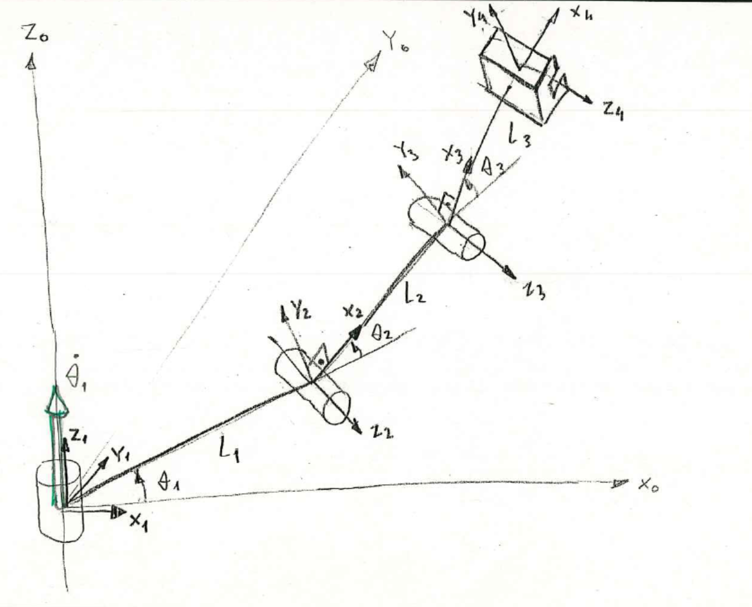
Angular and Linear Velocities - 3R Robot - Example
$${{}_{ }^{1}ω}_{1}=\left[\begin{matrix}0 \\ 0 \\ {\dot{θ}}_{1}\end{matrix}\right]$$
Instructor: Jacob Rosen
Advanced Robotic - Department of Mechanical & Aerospace Engineering - UCLA

Slide 46
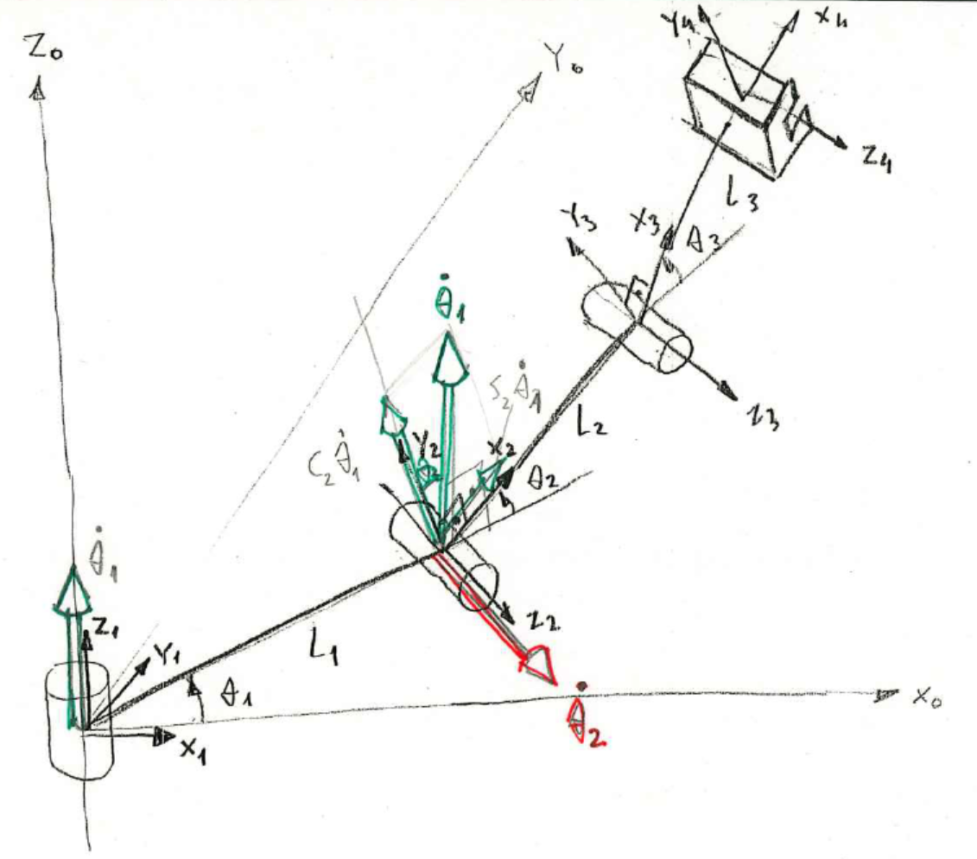
Angular and Linear Velocities - 3R Robot - Example
$${{}_{ }^{2}ω}_{2}=\left[\begin{matrix}s2{\dot{θ}}_{1} \\ c2{\dot{θ}}_{1} \\ {\dot{θ}}_{2}\end{matrix}\right]$$
Instructor: Jacob Rosen
Advanced Robotic - Department of Mechanical & Aerospace Engineering - UCLA

Slide 47
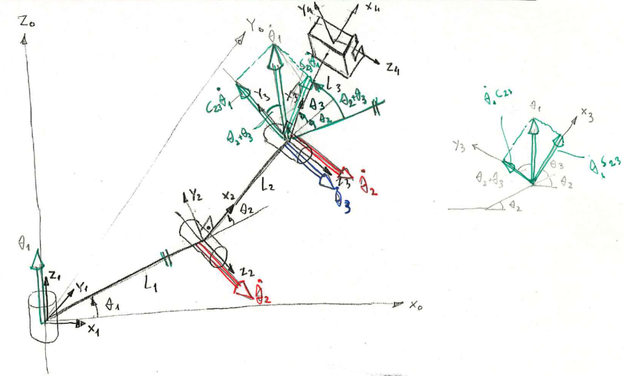
Angular and Linear Velocities - 3R Robot - Example
$${{}_{ }^{3}ω}_{3}=\left[\begin{matrix}s23{\dot{θ}}_{1} \\ c23{\dot{θ}}_{1} \\ {\dot{θ}}_{2}+{\dot{θ}}_{3}\end{matrix}\right]$$
Instructor: Jacob Rosen
Advanced Robotic - Department of Mechanical & Aerospace Engineering - UCLA

Slide 48
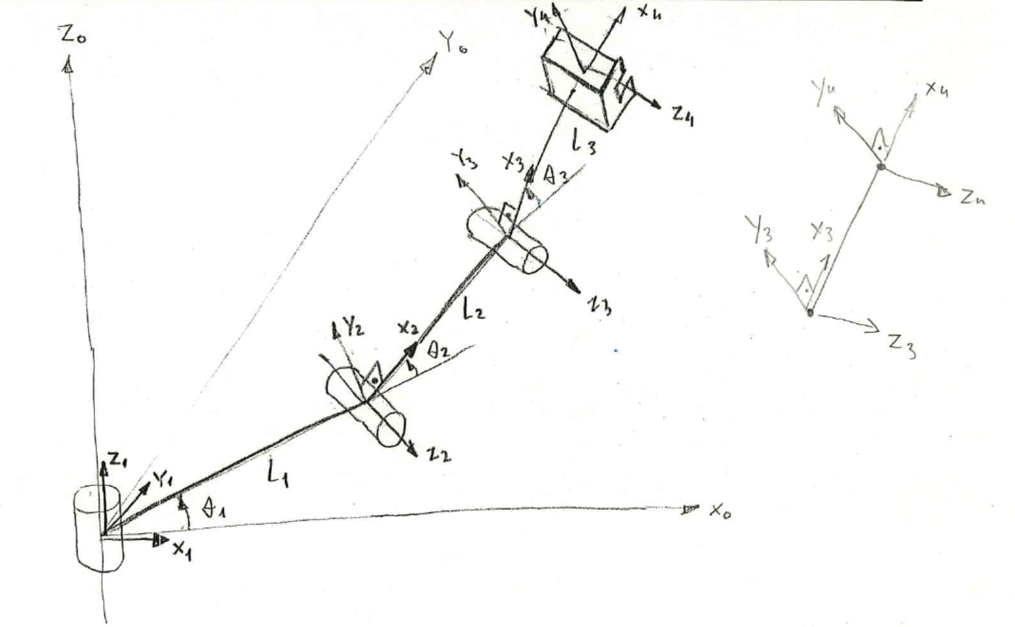
Angular and Linear Velocities - 3R Robot - Example
$${{}_{ }^{3}ω}_{3}={{}_{ }^{4}ω}_{4}$$
Instructor: Jacob Rosen
Advanced Robotic - Department of Mechanical & Aerospace Engineering - UCLA

Slide 49
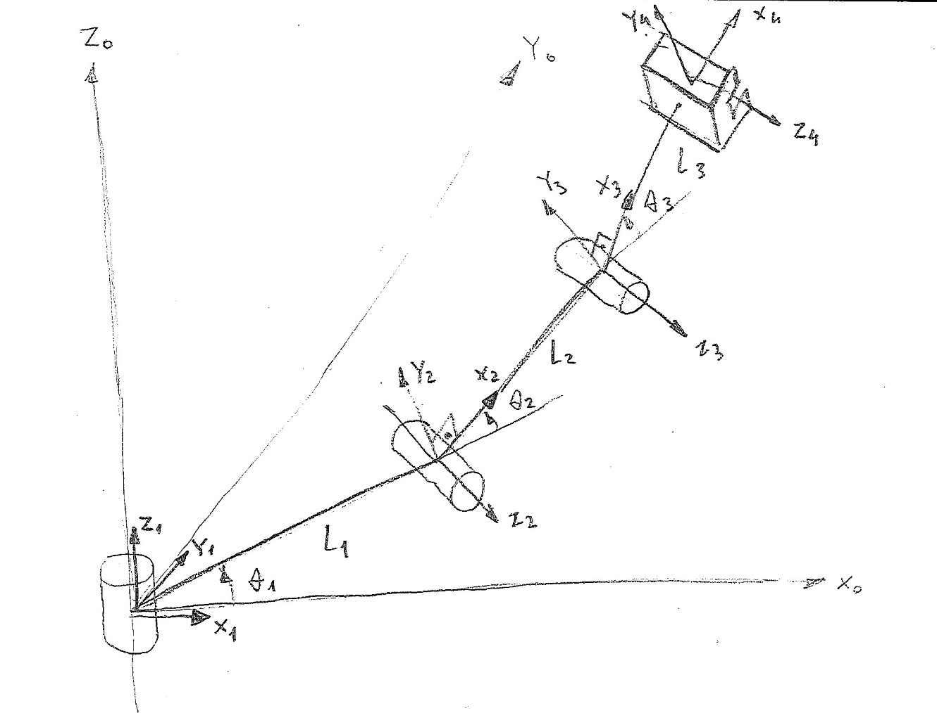
Angular and Linear Velocities - 3R Robot - Example
$${{}_{ }^{1}v}_{1}=\left[\begin{matrix}0 \\ 0 \\ 0\end{matrix}\right]$$
Instructor: Jacob Rosen
Advanced Robotic - Department of Mechanical & Aerospace Engineering - UCLA

Slide 50
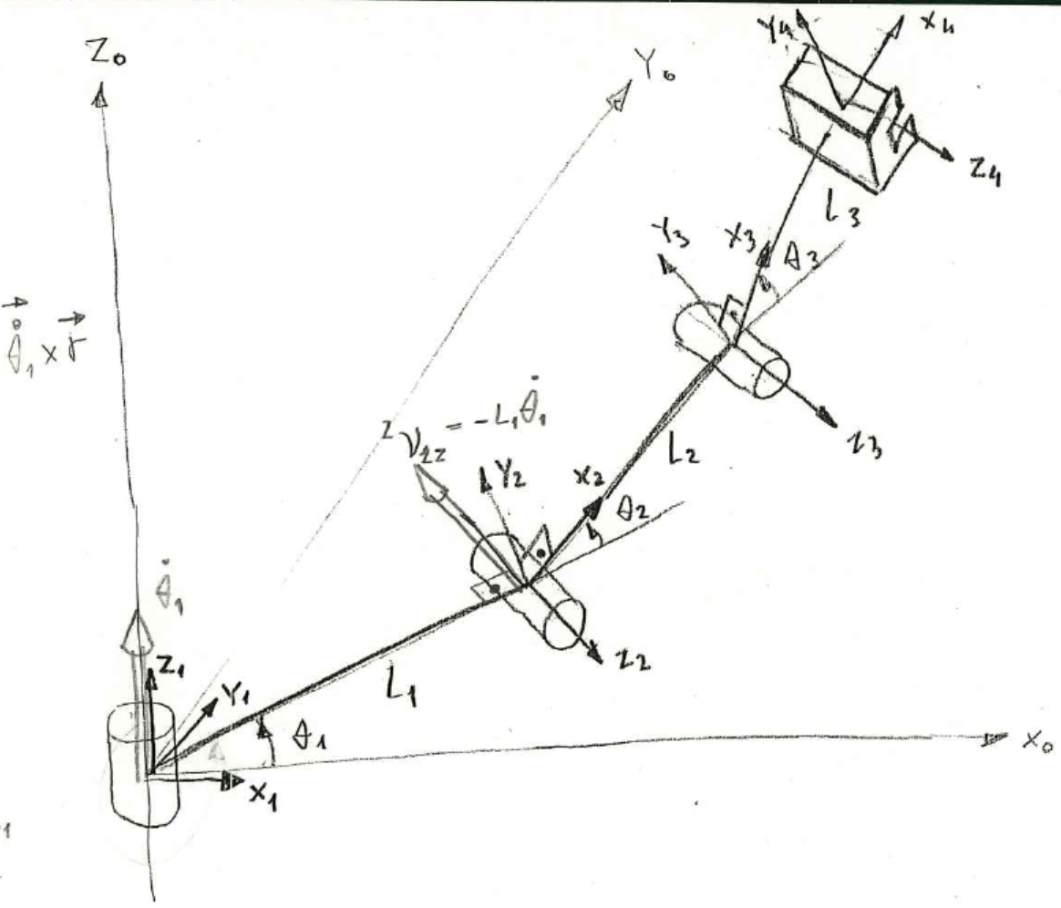
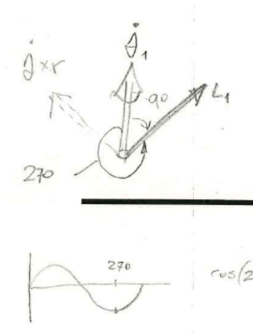
Angular and Linear Velocities - 3R Robot - Example
$${{}_{ }^{2}v}_{2}=\left[\begin{matrix}0 \\ 0 \\ −L_{1}{\dot{θ}}_{1}\end{matrix}\right]$$
Instructor: Jacob Rosen
Advanced Robotic - Department of Mechanical & Aerospace Engineering - UCLA

Slide 51
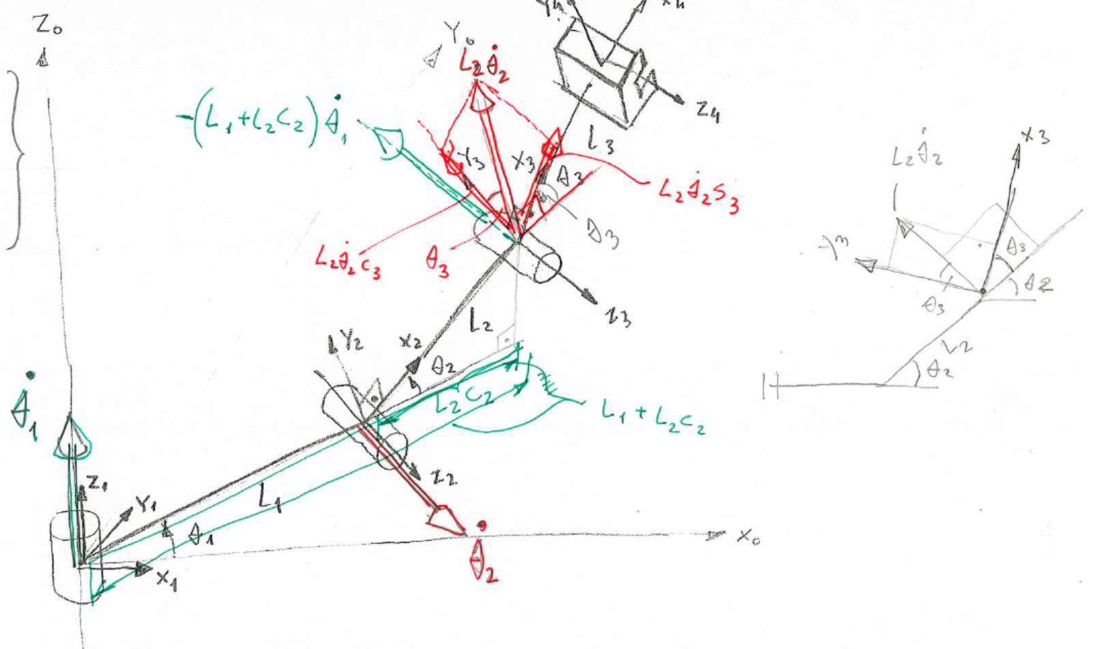
Angular and Linear Velocities - 3R Robot - Example
$${{}_{ }^{3}v}_{3}=\left[\begin{matrix}L2s3{\dot{θ}}_{2} \\ L2c3{\dot{θ}}_{2} \\ (−L1−L2c2){\dot{θ}}_{1}\end{matrix}\right]$$
Instructor: Jacob Rosen
Advanced Robotic - Department of Mechanical & Aerospace Engineering - UCLA

Slide 52
Angular and Linear Velocities - 3R Robot - Example
$${{}_{ }^{4}v}_{4}=\left[\begin{matrix}L2s3{\dot{θ}}_{2} \\ (L2c3+L3){\dot{θ}}_{2}+L3{\dot{θ}}_{3} \\ −(L1+L2c2+L3c23){\dot{θ}}_{1}\end{matrix}\right]$$
Instructor: Jacob Rosen
Advanced Robotic - Department of Mechanical & Aerospace Engineering - UCLA

Slide 53
Angular and Linear Velocities - 3R Robot - Example
Instructor: Jacob Rosen
Advanced Robotic - Department of Mechanical & Aerospace Engineering - UCLA

