Slide 1

Jacobian Explicit Method -
Differentiation the Forward Kinematics Eqs. (Method No. 1)
Instructor: Jacob Rosen
Advanced Robotic - Department of Mechanical & Aerospace Engineering - UCLA

Slide 2
Jacobian Matrix - Derivation Methods
Explicit Method
Iterative Methods
Recursive Equations
Differentiation the
Forward Kinematics Eqs.
(Method 1)
Velocity
Propagation –
Base to EE
(Method 2)
Force/Torque
Propagation –
EE to Base
(Method 3)
Jacobian Matrix
Instructor: Jacob Rosen
Advanced Robotic - Department of Mechanical & Aerospace Engineering - UCLA

Slide 3
Jacobian – Explicit Form – Overview
Instructor: Jacob Rosen
Advanced Robotic - Department of Mechanical & Aerospace Engineering - UCLA

Slide 4
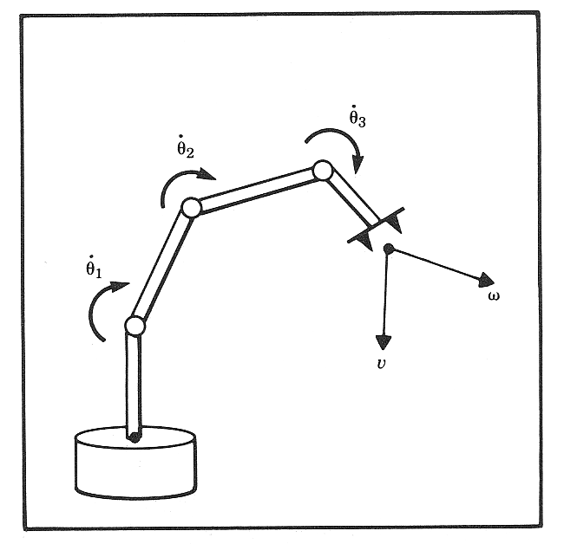
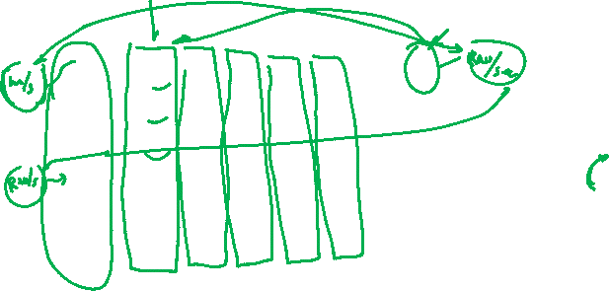
Jacobian Matrix
The meaning of each column (e.g. the first column) of the Jacobian matrix:
The first column maps the contribution of the angular velocity of the first joint to the linear and angular velocities of the end effector along all the axis (x,y,z)
Instructor: Jacob Rosen
Advanced Robotic - Department of Mechanical & Aerospace Engineering - UCLA

Slide 5
Jacobian Explicit Method
Technique
Instructor: Jacob Rosen
Advanced Robotic - Department of Mechanical & Aerospace Engineering - UCLA

Slide 6
Jacobian – Explicit Form
Revolute Joint
Prismatic Joint
OR
OR
Instructor: Jacob Rosen
Advanced Robotic - Department of Mechanical & Aerospace Engineering - UCLA

Slide 7
Jacobian Explicit Method – Rational
Intuitive Explanation
Instructor: Jacob Rosen
Advanced Robotic - Department of Mechanical & Aerospace Engineering - UCLA

Slide 8
Jacobian Matrix
The meaning of each column of the Jacobian matrix:
The i’th column maps the contribution of the angular velocity of the i’th joint to the linear and angular velocities of the end effector along all the axis (x,y,z)
Instructor: Jacob Rosen
Advanced Robotic - Department of Mechanical & Aerospace Engineering - UCLA

Slide 9
Jacobian – Explicit Form
Revolute Joint
Prismatic Joint
OR
OR
Instructor: Jacob Rosen
Advanced Robotic - Department of Mechanical & Aerospace Engineering - UCLA

Slide 10









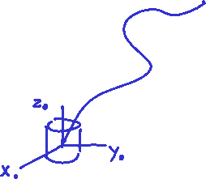




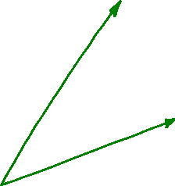
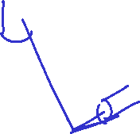
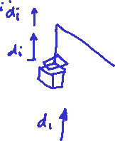

Jacobian – Explicit Form – Linear Velocity
Two Cases
Instructor: Jacob Rosen
Advanced Robotic - Department of Mechanical & Aerospace Engineering - UCLA
The i’th column of the Jacobian can be generated by holding all the joints fixed but the i’th and actuating the i’th at a unite velocity

Slide 11
Jacobian – Explicit Form
Revolute Joint
Prismatic Joint
OR
OR
Instructor: Jacob Rosen
Advanced Robotic - Department of Mechanical & Aerospace Engineering - UCLA

Slide 12
Jacobian – Explicit Form – Angular Velocity
Instructor: Jacob Rosen
Advanced Robotic - Department of Mechanical & Aerospace Engineering - UCLA

Slide 13
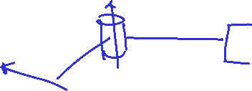

Jacobian – Explicit Form – Angular Velocity
Instructor: Jacob Rosen
Advanced Robotic - Department of Mechanical & Aerospace Engineering - UCLA

Slide 14
Jacobian Explicit Method – Rational
Geometrical / Analytical Explanation Based on Velocity Propagation Method
Instructor: Jacob Rosen
Advanced Robotic - Department of Mechanical & Aerospace Engineering - UCLA

Slide 15
Jacobian – Explicit Form
Revolute Joint
Prismatic Joint
OR
OR
Instructor: Jacob Rosen
Advanced Robotic - Department of Mechanical & Aerospace Engineering - UCLA

Slide 16
Jacobian – Explicit Form – Linear Velocity
Instructor: Jacob Rosen
Advanced Robotic - Department of Mechanical & Aerospace Engineering - UCLA

Slide 17
Jacobian – Explicit Form – Linear Velocity
Instructor: Jacob Rosen
Advanced Robotic - Department of Mechanical & Aerospace Engineering - UCLA

Slide 18
Jacobian – Explicit Form – Linear Velocity
Derivative
Instructor: Jacob Rosen
Advanced Robotic - Department of Mechanical & Aerospace Engineering - UCLA
The linear velocity of the end effector is . By the chain rule for differentiation
Where is the generalized notation for both the angle (revolute joint) and displacement (prismatic joint)
Thus the i’th column of which denoted as is given by
This expression is just the linear velocity of the end effector that would result if and all the others

Slide 19
Jacobian – Explicit Form
Revolute Joint
Prismatic Joint
OR
OR
Instructor: Jacob Rosen
Advanced Robotic - Department of Mechanical & Aerospace Engineering - UCLA

Slide 20
Jacobian Matrix
The meaning of each column of the Jacobian matrix:
The i’th column maps the contribution of the angular velocity of the i’th joint to the linear and angular velocities of the end effector along all the axis (x,y,z)
Instructor: Jacob Rosen
Advanced Robotic - Department of Mechanical & Aerospace Engineering - UCLA

Slide 21
Jacobian – Explicit Form – Linear Velocity
Two Cases
Instructor: Jacob Rosen
Advanced Robotic - Department of Mechanical & Aerospace Engineering - UCLA
The i’th column of the Jacobian can be generated by holding all the joints fixed but the i’th and actuating the i’th at a unite velocity

Slide 22
Jacobian – Explicit Form
Revolute Joint
Prismatic Joint
OR
OR
Instructor: Jacob Rosen
Advanced Robotic - Department of Mechanical & Aerospace Engineering - UCLA

Slide 23





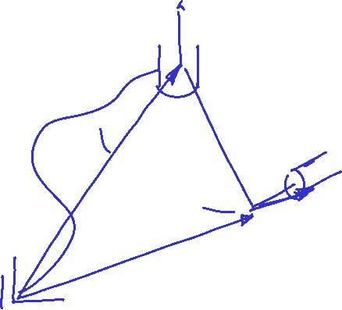


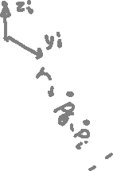

Jacobian – Explicit Form – Linear Velocity
Case 1 – Revolute Joint
Instructor: Jacob Rosen
Advanced Robotic - Department of Mechanical & Aerospace Engineering - UCLA
Freeze all DOF Except the i’th DOF (Revolute )

Slide 24
Jacobian – Explicit Form
Revolute Joint
Prismatic Joint
OR
OR
Instructor: Jacob Rosen
Advanced Robotic - Department of Mechanical & Aerospace Engineering - UCLA

Slide 25


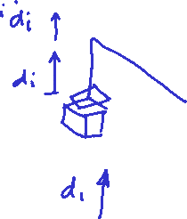

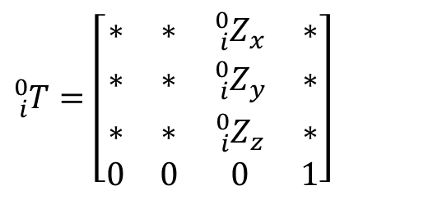
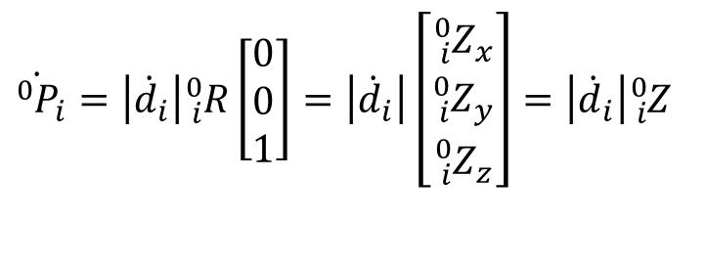



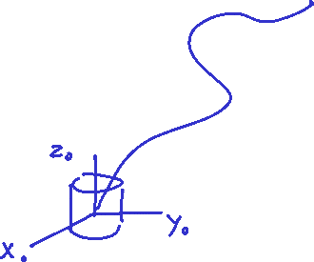
Jacobian – Explicit Form – Linear Velocity
Case 2- Prismatic Joint
$${\dot{{}_{ }^{0}P}}_{i}=\left|{\dot{d}}_{i}\right|{}_{i}^{0}R\left[\begin{matrix}0 \\ 0 \\ 1\end{matrix}\right]=\left|{\dot{d}}_{i}\right|\left[\begin{matrix}{{}_{i}^{0}Z}_{x} \\ {{}_{i}^{0}Z}_{y} \\ {{}_{i}^{0}Z}_{z}\end{matrix}\right]=\left|{\dot{d}}_{i}\right|{}_{i}^{0}Z$$
$${}_{i}^{0}T=\left[\begin{matrix}∗ & ∗ & {{}_{i}^{0}Z}_{x} & ∗ \\ ∗ & ∗ & {{}_{i}^{0}Z}_{y} & ∗ \\ ∗ & ∗ & {{}_{i}^{0}Z}_{z} & ∗ \\ 0 & 0 & 0 & 1\end{matrix}\right]$$
Instructor: Jacob Rosen
Advanced Robotic - Department of Mechanical & Aerospace Engineering - UCLA
All the joints are fixed except a single prismatic joint.
The i’th prismatic joint generates pure translation of the end effector
The direction of the translation is parallel to the axis

Slide 26
Jacobian – Explicit Form
Revolute Joint
Prismatic Joint
OR
OR
Instructor: Jacob Rosen
Advanced Robotic - Department of Mechanical & Aerospace Engineering - UCLA

Slide 27
Jacobian – Explicit Form – Angular Velocity
0
For i=0
For i=1
For i=2
Instructor: Jacob Rosen
Advanced Robotic - Department of Mechanical & Aerospace Engineering - UCLA

Slide 28
Jacobian – Explicit Form – Angular Velocity
I
Multiply both side of the equations by
For i=n-1
Instructor: Jacob Rosen
Advanced Robotic - Department of Mechanical & Aerospace Engineering - UCLA

Slide 29
Jacobian – Explicit Form – Angular Velocity
Instructor: Jacob Rosen
Advanced Robotic - Department of Mechanical & Aerospace Engineering - UCLA

Slide 30
Jacobian – Explicit Form – Angular Velocity
Instructor: Jacob Rosen
Advanced Robotic - Department of Mechanical & Aerospace Engineering - UCLA

Slide 31
Jacobian – Explicit Form – Angular Velocity
Instructor: Jacob Rosen
Advanced Robotic - Department of Mechanical & Aerospace Engineering - UCLA

Slide 32
3R – Example
Explicit Methods
Instructor: Jacob Rosen
Advanced Robotic - Department of Mechanical & Aerospace Engineering - UCLA

Slide 33
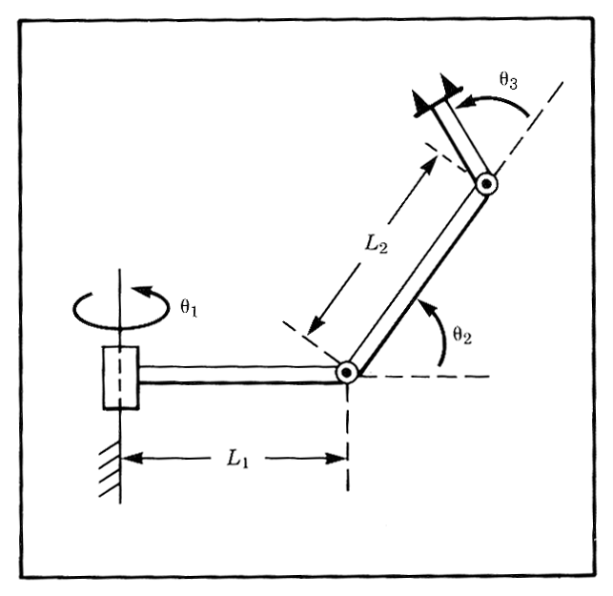
Angular and Linear Velocities - 3R Robot - Example
For the manipulator shown in the figure, compute the angular and linear velocity of the “tool” frame relative to the base frame expressed in the “tool” frame (that is, calculate and ).
Instructor: Jacob Rosen
Advanced Robotic - Department of Mechanical & Aerospace Engineering - UCLA

Slide 34
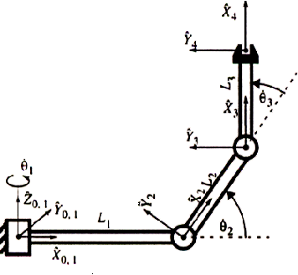
Angular and Linear Velocities - 3R Robot - Example
Frame attachment
Instructor: Jacob Rosen
Advanced Robotic - Department of Mechanical & Aerospace Engineering - UCLA

Slide 35
Angular and Linear Velocities - 3R Robot - Example
DH Parameters
Instructor: Jacob Rosen
Advanced Robotic - Department of Mechanical & Aerospace Engineering - UCLA

Slide 36
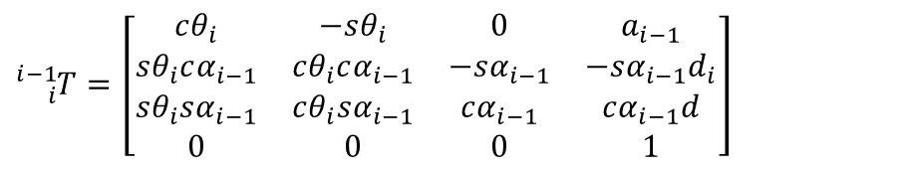




Angular and Linear Velocities - 3R Robot - Example
From the DH parameter table, we can specify the homogeneous transform matrix for each adjacent link pair:
$${}_{1}^{0}T=\left[\begin{matrix}c1 & −s1 & 0 & 0 \\ s1 & c1 & 0 & 0 \\ 0 & 0 & 1 & 0 \\ 0 & 0 & 0 & 1\end{matrix}\right]$$
$${}_{i}^{i−1}T=\left[\begin{matrix}cθ_{i} & −sθ_{i} & 0 & a_{i−1} \\ sθ_{i}cα_{i−1} & cθ_{i}cα_{i−1} & −sα_{i−1} & −sα_{i−1}d_{i} \\ sθ_{i}sα_{i−1} & cθ_{i}sα_{i−1} & cα_{i−1} & cα_{i−1}d \\ 0 & 0 & 0 & 1\end{matrix}\right]$$
$${}_{2}^{1}T=\left[\begin{matrix}c2 & −s2 & 0 & L1 \\ 0 & 0 & −1 & 0 \\ s2 & c2 & 0 & 0 \\ 0 & 0 & 0 & 1\end{matrix}\right]$$
$${}_{3}^{2}T=\left[\begin{matrix}c3 & −s3 & 0 & L2 \\ s3 & c3 & 0 & 0 \\ 0 & 0 & 1 & 0 \\ 0 & 0 & 0 & 1\end{matrix}\right]$$
$${}_{4}^{3}T=\left[\begin{matrix}1 & 0 & 0 & L3 \\ 0 & 1 & 0 & 0 \\ 0 & 0 & 1 & 0 \\ 0 & 0 & 0 & 1\end{matrix}\right]$$

Slide 37
Jacobian – Explicit Form
Revolute Joint
Prismatic Joint
OR
OR
Instructor: Jacob Rosen
Advanced Robotic - Department of Mechanical & Aerospace Engineering - UCLA

Slide 38
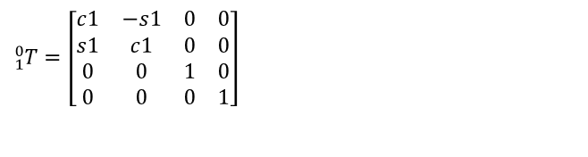
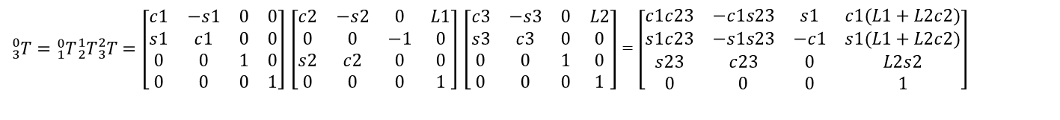
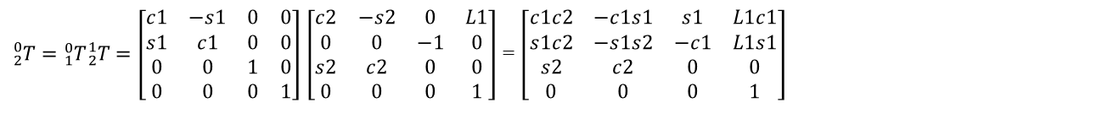
Angular and Linear Velocities - 3R Robot - Example
The homogeneous transform matrix from frame 0 to each one of the joints (1,2,3,4)
$${}_{1}^{0}T=\left[\begin{matrix}c1 & −s1 & 0 & 0 \\ s1 & c1 & 0 & 0 \\ 0 & 0 & 1 & 0 \\ 0 & 0 & 0 & 1\end{matrix}\right]$$
${}_{2}^{0}T={}_{1}^{0}T{}_{2}^{1}T=\left[\begin{matrix}c1 & −s1 & 0 & 0 \\ s1 & c1 & 0 & 0 \\ 0 & 0 & 1 & 0 \\ 0 & 0 & 0 & 1\end{matrix}\right]$ $\left[\begin{matrix}c2 & −s2 & 0 & L1 \\ 0 & 0 & −1 & 0 \\ s2 & c2 & 0 & 0 \\ 0 & 0 & 0 & 1\end{matrix}\right]$ = $\left[\begin{matrix}c1c2 & −c1s1 & s1 & L1c1 \\ s1c2 & −s1s2 & −c1 & L1s1 \\ s2 & c2 & 0 & 0 \\ 0 & 0 & 0 & 1\end{matrix}\right]$
${}_{3}^{0}T={}_{1}^{0}T{}_{2}^{1}T{}_{3}^{2}T=\left[\begin{matrix}c1 & −s1 & 0 & 0 \\ s1 & c1 & 0 & 0 \\ 0 & 0 & 1 & 0 \\ 0 & 0 & 0 & 1\end{matrix}\right]$ $\left[\begin{matrix}c2 & −s2 & 0 & L1 \\ 0 & 0 & −1 & 0 \\ s2 & c2 & 0 & 0 \\ 0 & 0 & 0 & 1\end{matrix}\right]$ $\left[\begin{matrix}c3 & −s3 & 0 & L2 \\ s3 & c3 & 0 & 0 \\ 0 & 0 & 1 & 0 \\ 0 & 0 & 0 & 1\end{matrix}\right]$ = $\left[\begin{matrix}c1c23 & −c1s23 & s1 & c1(L1+L2c2) \\ s1c23 & −s1s23 & −c1 & s1(L1+L2c2) \\ s23 & c23 & 0 & L2s2 \\ 0 & 0 & 0 & 1\end{matrix}\right]$
${}_{4}^{0}T={}_{1}^{0}T{}_{2}^{1}T{}_{3}^{2}T{}_{4}^{3}T=\left[\begin{matrix}c1 & −s1 & 0 & 0 \\ s1 & c1 & 0 & 0 \\ 0 & 0 & 1 & 0 \\ 0 & 0 & 0 & 1\end{matrix}\right]$ $\left[\begin{matrix}c2 & −s2 & 0 & L1 \\ 0 & 0 & −1 & 0 \\ s2 & c2 & 0 & 0 \\ 0 & 0 & 0 & 1\end{matrix}\right]$ $\left[\begin{matrix}c3 & −s3 & 0 & L2 \\ s3 & c3 & 0 & 0 \\ 0 & 0 & 1 & 0 \\ 0 & 0 & 0 & 1\end{matrix}\right]$ $\left[\begin{matrix}1 & 0 & 0 & L3 \\ 0 & 1 & 0 & 0 \\ 0 & 0 & 1 & 0 \\ 0 & 0 & 0 & 1\end{matrix}\right]$ =$\left[\begin{matrix}c1c23 & −c1s23 & s1 & c1(L1+L3c23+L2c2) \\ s1c23 & −s1s23 & −c1 & s1(L1+L3c23+L2c2) \\ s23 & c23 & 0 & L3s23+L2s2 \\ 0 & 0 & 0 & 1\end{matrix}\right]$

Slide 39



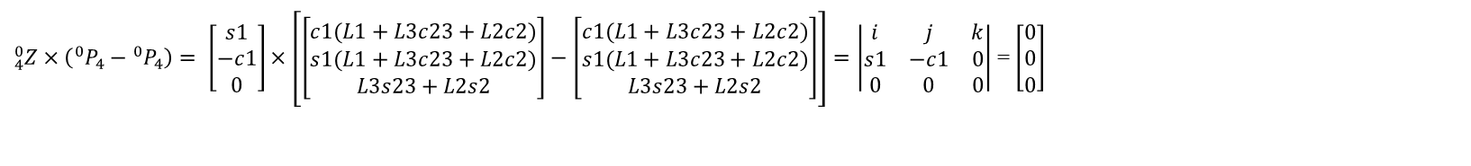



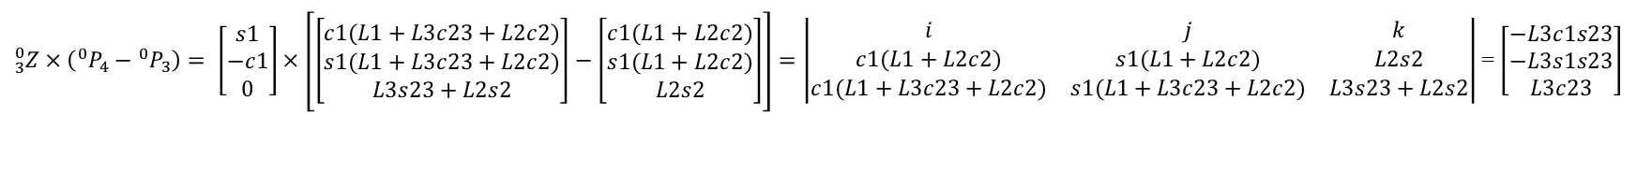
Angular and Linear Velocities - 3R Robot - Example
$$J_{υ}\left(Θ\right)$$
Expressing the columns of $J_{υ}\left(Θ\right)$. Since all the joints are revolute joints i.e. $ρ=1$ and the last frame is frame 4 the generic expression for the columns of $J_{υ}\left(Θ\right)$ is ${}_{i}^{0}Z×({{}_{ }^{0}P}_{4}−{{}_{ }^{0}P}_{i})$ for $i=1,2,3,4$
$$For i=1$$
${}_{1}^{0}Z×\left({{}_{ }^{0}P}_{4}−{{}_{ }^{0}P}_{1}\right)= \left[\begin{matrix}0 \\ 0 \\ 1\end{matrix}\right]×\left[\left[\begin{matrix}c1(L1+L3c23+L2c2) \\ s1(L1+L3c23+L2c2) \\ L3s23+L2s2\end{matrix}\right]−\left[\begin{matrix}0 \\ 0 \\ 0\end{matrix}\right]\right]=\left|\begin{matrix}i & j & k \\ 0 & 0 & 1 \\ c1(L1+L3c23+L2c2) & s1(L1+L3c23+L2c2) & L3s23+L2s2\end{matrix}\right|$=$\left[\begin{matrix}−s1(L1+L3c23+L2c2 \\ c1(L1+L3c23+L2c2 \\ 0\end{matrix}\right]$
$$For i=2$$
${}_{2}^{0}Z×\left({{}_{ }^{0}P}_{4}−{{}_{ }^{0}P}_{2}\right)= \left[\begin{matrix}s1 \\ −c1 \\ 0\end{matrix}\right]×\left[\left[\begin{matrix}c1(L1+L3c23+L2c2) \\ s1(L1+L3c23+L2c2) \\ L3s23+L2s2\end{matrix}\right]−\left[\begin{matrix}L1c1 \\ L1s1 \\ 0\end{matrix}\right]\right]=\left|\begin{matrix}i & j & k \\ s1 & −c1 & 0 \\ c1(L1+L3c23+L2c2) & s1(L1+L3c23+L2c2) & L3s23+L2s2\end{matrix}\right|$= $\left[\begin{matrix}−c1∗(L3s23+L2s2) \\ −s1(L3s23+L2s2) \\ L3c23+L2c2\end{matrix}\right]$
$$For i=3$$
${}_{3}^{0}Z×\left({{}_{ }^{0}P}_{4}−{{}_{ }^{0}P}_{3}\right)= \left[\begin{matrix}s1 \\ −c1 \\ 0\end{matrix}\right]×\left[\left[\begin{matrix}c1(L1+L3c23+L2c2) \\ s1(L1+L3c23+L2c2) \\ L3s23+L2s2\end{matrix}\right]−\left[\begin{matrix}c1(L1+L2c2) \\ s1(L1+L2c2) \\ L2s2\end{matrix}\right]\right]=\left|\begin{matrix}i & j & k \\ c1(L1+L2c2) & s1(L1+L2c2) & L2s2 \\ c1(L1+L3c23+L2c2) & s1(L1+L3c23+L2c2) & L3s23+L2s2\end{matrix}\right|$= $\left[\begin{matrix}−L3c1s23 \\ −L3s1s23 \\ L3c23\end{matrix}\right]$
$$For i=4$$
${}_{4}^{0}Z×\left({{}_{ }^{0}P}_{4}−{{}_{ }^{0}P}_{4}\right)= \left[\begin{matrix}s1 \\ −c1 \\ 0\end{matrix}\right]×\left[\left[\begin{matrix}c1(L1+L3c23+L2c2) \\ s1(L1+L3c23+L2c2) \\ L3s23+L2s2\end{matrix}\right]−\left[\begin{matrix}c1(L1+L3c23+L2c2) \\ s1(L1+L3c23+L2c2) \\ L3s23+L2s2\end{matrix}\right]\right]=\left|\begin{matrix}i & j & k \\ s1 & −c1 & 0 \\ 0 & 0 & 0\end{matrix}\right|$= $\left[\begin{matrix}0 \\ 0 \\ 0\end{matrix}\right]$

Slide 40

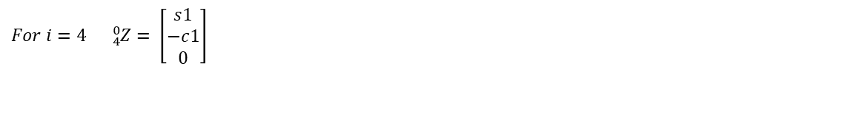
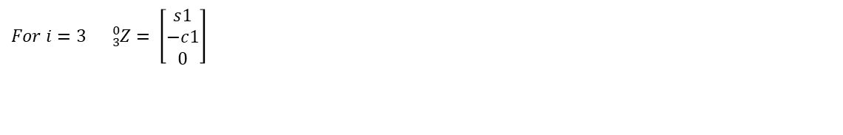

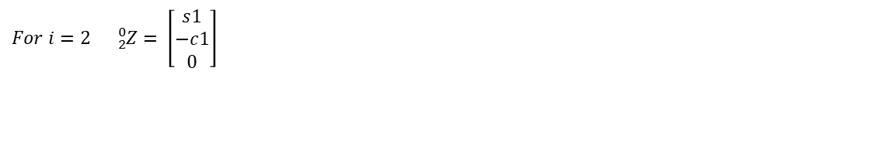
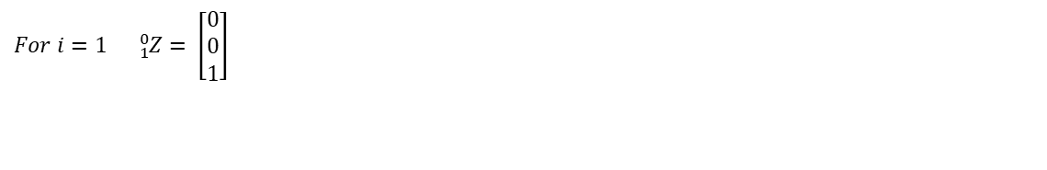
Angular and Linear Velocities - 3R Robot - Example
$$J_{ω}\left(Θ\right)$$
Expressing the columns of $J_{ω}\left(Θ\right)$. Since all the joints are revolute joints i.e. $ρ=1$ and the last frame is frame 4 the generic expression for the columns of $J_{ω}\left(Θ\right)$is ${}_{i}^{0}Z$ for $i=1,2,3,4$
$$For i=1 {}_{1}^{0}Z= \left[\begin{matrix}0 \\ 0 \\ 1\end{matrix}\right]$$
$$For i=2 {}_{2}^{0}Z= \left[\begin{matrix}s1 \\ −c1 \\ 0\end{matrix}\right]$$
$$For i=3 {}_{3}^{0}Z= \left[\begin{matrix}s1 \\ −c1 \\ 0\end{matrix}\right]$$
$$For i=4 {}_{4}^{0}Z= \left[\begin{matrix}s1 \\ −c1 \\ 0\end{matrix}\right]$$

Slide 41
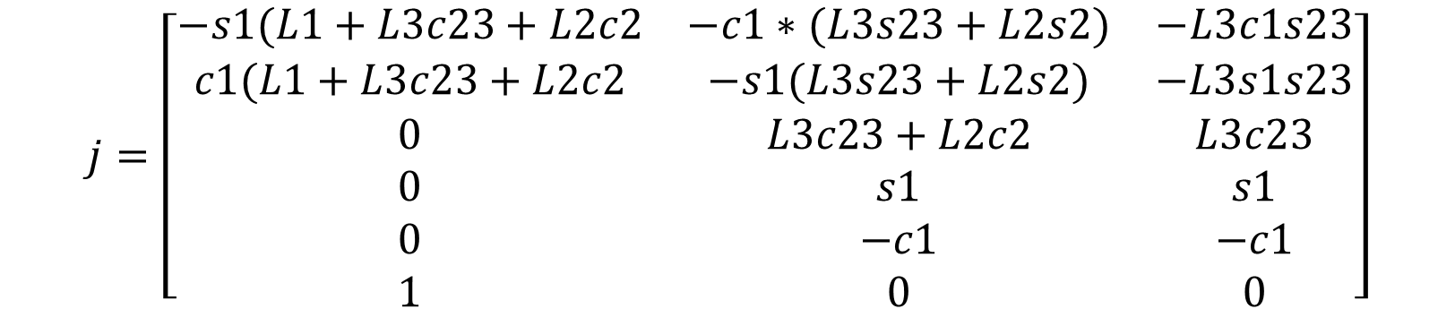
Angular and Linear Velocities - 3R Robot - Example
Compiling the results into a single matrix
$$j=\left[\begin{matrix}−s1(L1+L3c23+L2c2 & −c1∗(L3s23+L2s2) & −L3c1s23 \\ c1(L1+L3c23+L2c2 & −s1(L3s23+L2s2) & −L3s1s23 \\ 0 & L3c23+L2c2 & L3c23 \\ 0 & s1 & s1 \\ 0 & −c1 & −c1 \\ 1 & 0 & 0\end{matrix}\right]$$

Slide 42
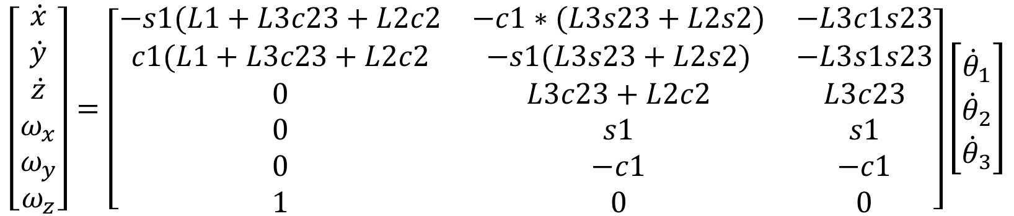
Angular and Linear Velocities - 3R Robot - Example
With the end results mapping the joint space velocities to task space velocities
Note 1- Size – The size of the matrix is 6x3. Can we control all six velocities of the end effector with only three DOF (Hint: The dimension of the Jacobian matrix will have to be reduced)
Note 2 – Frame of Reference – The explicit method produce an expression of the Jacobian matrix in frame zero
$$\left[\begin{matrix}\dot{x} \\ \dot{y} \\ \dot{z} \\ ω_{x} \\ ω_{y} \\ ω_{z}\end{matrix}\right]=\left[\begin{matrix}−s1(L1+L3c23+L2c2 & −c1∗(L3s23+L2s2) & −L3c1s23 \\ c1(L1+L3c23+L2c2 & −s1(L3s23+L2s2) & −L3s1s23 \\ 0 & L3c23+L2c2 & L3c23 \\ 0 & s1 & s1 \\ 0 & −c1 & −c1 \\ 1 & 0 & 0\end{matrix}\right]\left[\begin{matrix}{\dot{θ}}_{1} \\ {\dot{θ}}_{2} \\ {\dot{θ}}_{3}\end{matrix}\right]$$

Slide 43
Jacobian Methods of Derivation & the
Corresponding Reference Frame – Summary
Method | Jacobian Matrix Reference Frame | Transformation to Base Frame (Frame 0)
Explicit (Diff. the Forward Kinematic Eq.) |  | None
Iterative Velocity Eq. |  | Transform Method 1: Transform Method 2:
Iterative Force Eq. |  | Transpose Transform
Instructor: Jacob Rosen
Advanced Robotic - Department of Mechanical & Aerospace Engineering - UCLA

