Slide 1

Jacobian
Introduction
Instructor: Jacob Rosen
Advanced Robotic - MAE 263D - Department of Mechanical & Aerospace Engineering - UCLA

Slide 2
Jacobian – Mapping Operator
Joint & Cartesian/Task Spaces
Instructor: Jacob Rosen
Advanced Robotic - MAE 263D - Department of Mechanical & Aerospace Engineering - UCLA

Slide 3
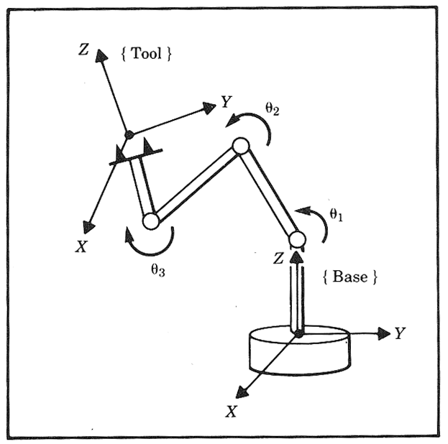



Kinematics Relations - Joint & Cartesian/Task Spaces
A robot is often used to manipulate object attached to its tip (end effector).
The location of the robot tip may be specified using one of the following descriptions:
Joint Space
Task Space (Cartesian Space)
{N}
$$θ=\left[\begin{matrix}θ_{1} \\ θ_{2} \\ \begin{aligned}⋮ \\ d_{i} \\ ⋮\end{aligned} \\ θ_{N}\end{matrix}\right]$$
$${}_{N}^{0}T=\left[\begin{matrix}{}_{N}^{0}R & {{}_{ }^{0}P}_{N} \\ 0 & 1\end{matrix}\right]$$
$$X=\left[\begin{matrix}\left[{{}_{ }^{0}P}_{N}\right] \\ \left[{{}_{ }^{0}K}_{N}\right]\end{matrix}\right]$$
Equivalent Axis
Instructor: Jacob Rosen
Advanced Robotic - MAE 263D - Department of Mechanical & Aerospace Engineering - UCLA

Slide 4




Kinematics Relations - Forward & Inverse
The robot kinematic equations relate the two description of the robot tip location
$$X=FK(θ)$$
$$θ=\left[\begin{matrix}θ_{1} \\ θ_{2} \\ \begin{aligned}⋮ \\ d_{i} \\ ⋮\end{aligned} \\ θ_{N}\end{matrix}\right]$$
$$X=\left[\begin{matrix}\left[{{}_{ }^{0}P}_{N}\right] \\ \left[{{}_{ }^{0}K}_{N}\right]\end{matrix}\right]$$
$$θ=IK(X)$$
Tip Location in
Joint Space
Tip Location in
Task/Cartesian/EE Space
Instructor: Jacob Rosen
Advanced Robotic - MAE 263D - Department of Mechanical & Aerospace Engineering - UCLA

Slide 5




Kinematics Relations - Forward & Inverse
$$\underline{\dot{x}}=J\left(\underline{θ}\right)\underline{\dot{θ}}$$
$$\dot{θ}=\frac{d}{dt}[θ]=\left[\begin{matrix}{\dot{θ}}_{1} \\ {\dot{θ}}_{2} \\ \begin{aligned}⋮ \\ {\dot{d}}_{i} \\ ⋮\end{aligned} \\ {\dot{θ}}_{N}\end{matrix}\right]$$
$$\dot{X}=\frac{d}{dt}[X]=\left[\begin{matrix}\left[{{}_{ }^{ }v}_{N}\right] \\ \left[{{}_{ }^{ }ω}_{N}\right]\end{matrix}\right]=\left[\begin{matrix}v_{x} \\ v_{y} \\ v_{z} \\ ω_{x} \\ ω_{y} \\ ω_{z}\end{matrix}\right]$$
$$\underline{\dot{θ}}=J^{−1}\left(\underline{θ}\right)\underline{\dot{x}}$$
Tip Velocity in
Joint Space
Tip velocity in
Task/Cartesian/EE Space
Instructor: Jacob Rosen
Advanced Robotic - MAE 263D - Department of Mechanical & Aerospace Engineering - UCLA

Slide 6
Jacobian – Derivation from First Principals
Velocity Maping
Instructor: Jacob Rosen
Advanced Robotic - MAE 263D - Department of Mechanical & Aerospace Engineering - UCLA

Slide 7


Jacobian Matrix - Introduction
The Jacobian is a multi dimensional form of the derivative.
Suppose that for example we have 6 functions, each of which is a function of 6 independent variables
We may also use a vector notation to write these equations as
$$y_{1}=f_{1}(x_{1},x_{2},x_{3},x_{4},x_{5},x_{6}) \\ y_{2}=f_{2}(x_{1},x_{2},x_{3},x_{4},x_{5},x_{6}) \\ ⋮ \\ y_{6}=f_{6}(x_{1},x_{2},x_{3},x_{4},x_{5},x_{6})$$
$$Y=F(X)$$
Instructor: Jacob Rosen
Advanced Robotic - MAE 263D - Department of Mechanical & Aerospace Engineering - UCLA

Slide 8







Jacobian Matrix - Introduction
If we wish to calculate the differential of $y_{i}$ as a function of the differential $x_{i}$ we use the chain rule to get
Which again might be written more simply using a vector notation as
$$δy_{1}=\frac{∂f_{1}}{∂x_{1}}δx_{1}+\frac{∂f_{1}}{∂x_{2}}δx_{2}+…+\frac{∂f_{1}}{∂x_{6}}δx_{6} \\ δy_{2}=\frac{∂f_{2}}{∂x_{1}}δx_{1}+\frac{∂f_{2}}{∂x_{2}}δx_{2}+…+\frac{∂f_{2}}{∂x_{6}}δx_{6} \\ ⋮ \\ δy_{6}=\frac{∂f_{6}}{∂x_{1}}δx_{1}+\frac{∂f_{6}}{∂x_{2}}δx_{2}+…+\frac{∂f_{6}}{∂x_{6}}δx_{6}$$
$$δY=\frac{∂F}{∂X}δX$$
Instructor: Jacob Rosen
Advanced Robotic - MAE 263D - Department of Mechanical & Aerospace Engineering - UCLA

Slide 9
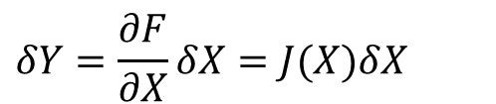

Jacobian Matrix - Introduction
The 6x6 matrix of partial derivative is defined as the Jacobian matrix
By dividing both sides by the differential time element, we can think of the Jacobian as mapping velocities in X to those in Y
Note that the Jacobian is time varying linear transformation
$$δY=\frac{∂F}{∂X}δX=J(X)δX$$
$$\dot{Y}=J(X)\dot{X}$$
Instructor: Jacob Rosen
Advanced Robotic - MAE 263D - Department of Mechanical & Aerospace Engineering - UCLA

Slide 10
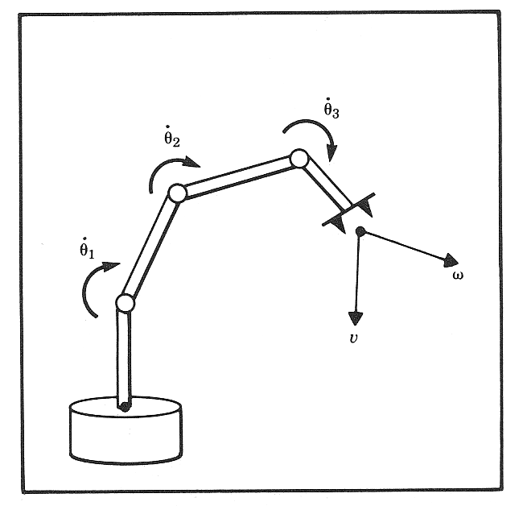





Jacobian Matrix - Introduction
In the field of robotics the Jacobian matrix describe the relationship between the joint angle rates (${\underline{\dot{θ}}}_{N}$) and the translation and rotation velocities of the end effector ($\underline{\dot{x}}$). This relationship is given by:
$$\underline{\dot{x}}=J\left(\underline{θ}\right)\underline{\dot{θ}}$$
$$\dot{X}=\frac{d}{dt}[X]=\left[\begin{matrix}\left[{{}_{ }^{ }v}_{N}\right] \\ \left[{{}_{ }^{ }ω}_{N}\right]\end{matrix}\right]=\left[\begin{matrix}v_{x} \\ v_{y} \\ v_{z} \\ ω_{x} \\ ω_{y} \\ ω_{z}\end{matrix}\right]$$
$$\dot{θ}=\left[\begin{matrix}{\dot{θ}}_{1} \\ {\dot{θ}}_{2} \\ \begin{aligned}{\dot{d}}_{3} \\ {\dot{θ}}_{4} \\ {\dot{θ}}_{5}\end{aligned} \\ {\dot{θ}}_{6}\end{matrix}\right]$$
$$\underline{\dot{θ}}=J{\left(\underline{θ}\right)}^{−1}\underline{\dot{x}}$$
Instructor: Jacob Rosen
Advanced Robotic - MAE 263D - Department of Mechanical & Aerospace Engineering - UCLA

Slide 11
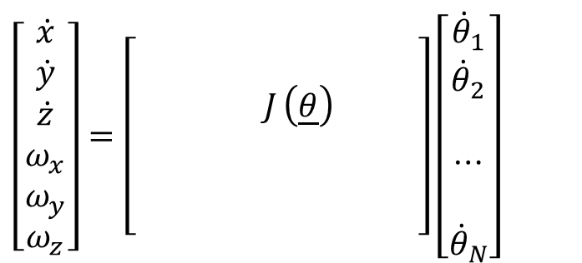



Jacobian Matrix - Introduction
In the field of robotics the Jacobian matrix describe the relationship between the joint angle rates (${\underline{\dot{θ}}}_{N}$) and the translation and rotation velocities of the end effector ($\underline{\dot{x}}$). This relationship is given by:
Note: The Jacobian is a function of joint angle $θ$ meaning that the Jacobian varies as the configuration of the arm changes
$$\underline{\dot{x}}=J\left(\underline{θ}\right)\underline{\dot{θ}}$$
$$\left[\begin{matrix}\dot{x} \\ \dot{y} \\ \dot{z} \\ ω_{x} \\ ω_{y} \\ ω_{z}\end{matrix}\right]=\left[\begin{matrix} & & & & & \\ & & & & & \\ & & & J_{ }\left(\underline{θ}\right) & & \\ & & & & & \\ & & & & & \\ & & & & & \end{matrix}\right]\left[\begin{matrix}{\dot{θ}}_{1} \\ {\dot{θ}}_{2} \\ \\ ⋯ \\ \\ {\dot{θ}}_{N}\end{matrix}\right]$$
$$\underline{\dot{θ}}=J{\left(\underline{θ}\right)}^{−1}\underline{\dot{x}}$$
Instructor: Jacob Rosen
Advanced Robotic - MAE 263D - Department of Mechanical & Aerospace Engineering - UCLA

Slide 12


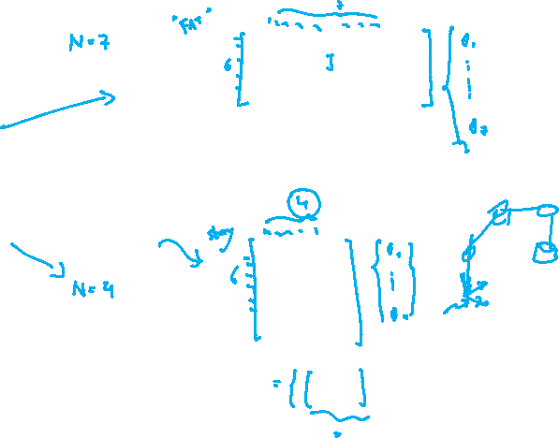



Jacobian Matrix - Introduction
This expression can be expanded to:
Where:
  is a 6x1 vector of the end effector linear and angular velocities
  is a 6xN Jacobian matrix
  is a Nx1 vector of the manipulator joint velocities
  is the number of joints
$$\left[\begin{matrix}\dot{x} \\ \dot{y} \\ \dot{z} \\ ω_{x} \\ ω_{y} \\ ω_{z}\end{matrix}\right]=\left[\begin{matrix} & & & & & \\ & & & J_{υ}\left(\underline{θ}\right) & & \\ & & & & & \\ & & & & & \\ & & & J_{ω}\left(\underline{θ}\right) & & \\ & & & & & \end{matrix}\right]\left[\begin{matrix}{\dot{θ}}_{1} \\ {\dot{θ}}_{2} \\ \\ ⋯ \\ \\ {\dot{θ}}_{N}\end{matrix}\right]$$
6x1
6xN
Nx1
$$\underline{\dot{x}}$$
$$J\left(\underline{θ}\right)$$
$${\underline{\dot{θ}}}_{N}$$
$$N$$
Instructor: Jacob Rosen
Advanced Robotic - MAE 263D - Department of Mechanical & Aerospace Engineering - UCLA

Slide 13

Jacobian Matrix - Introduction
The meaning of each line (e.g. the first line) of the Jacobian matrix:
The first line maps the contribution of the angular velocity of each joint to the linear velocity of the end effector along the x-axis
$$\left[\begin{matrix}\dot{x} \\ \dot{y} \\ \dot{z} \\ ω_{x} \\ ω_{y} \\ ω_{z}\end{matrix}\right]=\left[\begin{matrix}J_{11} & J_{12} & J_{13} & J_{14} & J_{15} & J_{16} \\ & & & J_{υ}\left(\underline{θ}\right) & & \\ & & & & & \\ & & & & & \\ & & & J_{ω}\left(\underline{θ}\right) & & \\ & & & & & \end{matrix}\right]\left[\begin{matrix}{\dot{θ}}_{1} \\ {\dot{θ}}_{2} \\ \\ ⋯ \\ \\ {\dot{θ}}_{N}\end{matrix}\right]$$
Instructor: Jacob Rosen
Advanced Robotic - MAE 263D - Department of Mechanical & Aerospace Engineering - UCLA

Slide 14

Jacobian Matrix - Introduction
The meaning of each column (e.g. the first column) of the Jacobian matrix:
The first column maps the contribution of the angular velocity of the first joint to the linear and angular velocities of the end effector along all the axis (x,y,z)
$$\left[\begin{matrix}\dot{x} \\ \dot{y} \\ \dot{z} \\ ω_{x} \\ ω_{y} \\ ω_{z}\end{matrix}\right]=\left[\begin{matrix}J_{11} & & & & & \\ J_{21} & & & J_{υ}\left(\underline{θ}\right) & & \\ J_{31} & & & & & \\ J_{41} & & & & & \\ J_{51} & & & J_{ω}\left(\underline{θ}\right) & & \\ J_{61} & & & & & \end{matrix}\right]\left[\begin{matrix}{\dot{θ}}_{1} \\ {\dot{θ}}_{2} \\ \\ ⋯ \\ \\ {\dot{θ}}_{N}\end{matrix}\right]$$
Instructor: Jacob Rosen
Advanced Robotic - MAE 263D - Department of Mechanical & Aerospace Engineering - UCLA

Slide 15
Jacobian – Derivation from First Principles (Virtual Work)
Forces & Torque
Instructor: Jacob Rosen
Advanced Robotic - MAE 263D - Department of Mechanical & Aerospace Engineering - UCLA

Slide 16
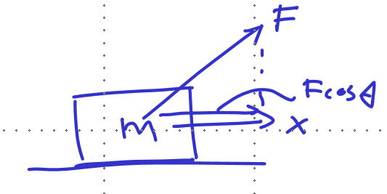
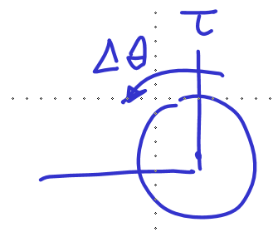
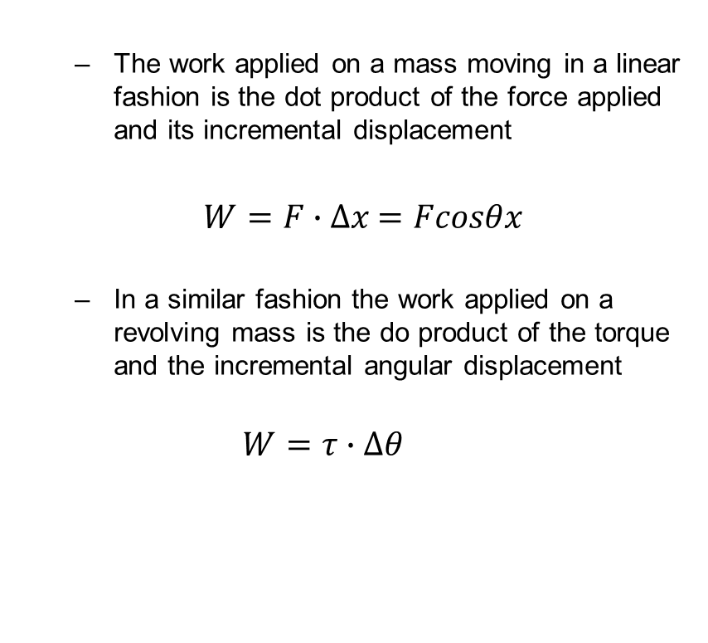
Jacobian Matrix – Derivation Using Virtual Work Principles
  The work applied on a mass moving in a linear fashion is the dot product of the force applied and its incremental displacement
  $W=F∙Δx$ $=Fcosθx$
  In a similar fashion the work applied on a revolving mass is the do product of the torque and the incremental angular displacement
  $$W=τ∙Δθ$$

Slide 17
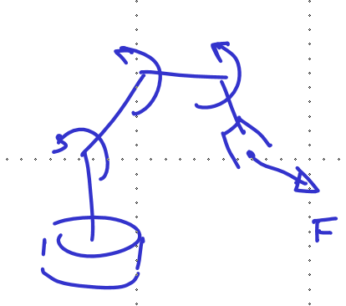
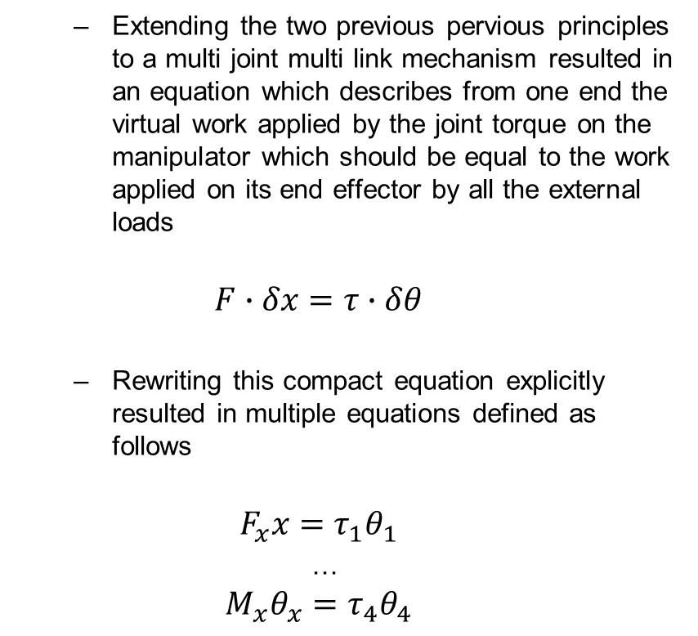
Jacobian Matrix – Derivation Using Virtual Work Principles
  Extending the two previous pervious principles to a multi joint multi link mechanism resulted in an equation which describes from one end the virtual work applied by the joint torque on the manipulator which should be equal to the work applied on its end effector by all the external loads
  $$F∙δx=τ∙δθ$$
  Rewriting this compact equation explicitly resulted in multiple equations defined as follows
  $$F_{x}x=τ_{1}θ_{1}$$
  …
  $$M_{x}θ_{x}=τ_{4}θ_{4}$$

Slide 18

Jacobian Matrix – Derivation Using Virtual Work Principles
  Transposing the following compact equation
  $$F∙δx=τ∙δθ$$
  $${\left(F∙δx=τ∙δθ\right)}^{T}$$
  Resulted in
  $$F^{T}δx=τ^{T}δθ$$
  Utilizing the relationship between task space displacement and joint space displacement
  $$δx=Jδθ$$
  And plugging it into the transpose equation, resulted in
  $$F^{T}Jδθ=τ^{T}δθ$$

Slide 19

Jacobian Matrix – Derivation Using Virtual Work Principles
  Canceling delta theta $δθ$ and transposing the following compact equation
  $$F^{T}Jδθ=τ^{T}δθ$$
  $${\left[τ^{T}=F^{T}J\right]}^{T}$$
  Base on the notation where
  ${\left[AB\right]}^{T}=B^{T}A^{T}$
  $${\left[F^{T}J\right]}^{T}=J^{T}F$$
  Resulting in the equation defining the mapping between external loads and the joint torque
  $$τ=J^{T}F$$

Slide 20










Jacobian Matrix - Introduction
$$F_{x}x=τ_{1}θ_{1}$$
$$W=F∙Δx$$
$$=Fcosθx$$
$$M_{x}θ_{x}=τ_{4}θ_{4}$$
$$W=τ∙Δθ$$
$$F^{T}δx=τ^{T}δθ$$
$${\left(F∙δx=τ∙δθ\right)}^{T}$$
$$δx=Jδθ$$
$$F^{T}Jδθ=τ^{T}δθ$$
Deriving the Jacobian matrix using virtual work principle

Slide 21
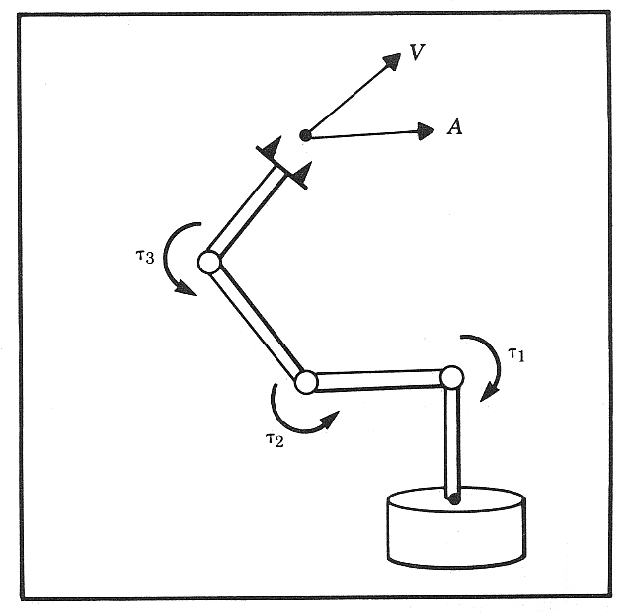



Jacobian Matrix - Introduction
In addition to the velocity relationship, we are also interested in developing a relationship between the robot joint torques ($\underline{τ}$ ) and the forces and moments ($\underline{F}$) at the robot end effector (Static Conditions). This relationship is given by:
$$\underline{F}$$
$$\underline{τ}=J{\left(\underline{θ}\right)}^{T}\underline{F}$$
Instructor: Jacob Rosen
Advanced Robotic - MAE 263D - Department of Mechanical & Aerospace Engineering - UCLA

Slide 22





Jacobian Matrix - Introduction
This expression can be expanded to:
Where:
  is a 6x1 vector of the robot joint torques
  is a 6xN Transposed Jacobian matrix
  is a Nx1 vector of the forces and moments at the robot end effector
  is the number of joints
$$\left[\begin{matrix}τ_{1} \\ τ_{2} \\ \\ ⋯ \\ \\ τ_{N}\end{matrix}\right]={\left[\begin{matrix} & & & & & \\ & & & & & \\ & J_{f}\left(\underline{θ}\right) & & & J_{τ}\left(\underline{θ}\right) & \\ & & & & & \\ & & & & & \\ & & & & & \end{matrix}\right]}^{T}\left[\begin{matrix}F_{x} \\ F_{y} \\ F_{z} \\ M_{x} \\ M_{y} \\ M_{z}\end{matrix}\right]$$
Nx1
6xN
6x1
$$\underline{τ}$$
$$J{\left(\underline{θ}\right)}^{T}$$
$$\underline{F}$$
$$N$$
Instructor: Jacob Rosen
Advanced Robotic - MAE 263D - Department of Mechanical & Aerospace Engineering - UCLA

Slide 23

Jacobian Matrix - Introduction
The meaning of each line (e.g. the first line) of the Jacobian matrix:
Action: The first line represent how the torque applied at the first joint contributes to the forces and torques applied by the end effector
Reaction: The first line maps the contribution of the partial external loads applied on the end effector to the join torque that needs to be applied to maintain static equilibriums
$$\left[\begin{matrix}τ_{1} \\ τ_{2} \\ \\ ⋯ \\ \\ τ_{N}\end{matrix}\right]={\left[\begin{matrix}J_{11} & J_{21} & J_{31} & J_{41} & J_{51} & J_{61} \\ & & & & & \\ & J_{f}\left(\underline{θ}\right) & & & J_{τ}\left(\underline{θ}\right) & \\ & & & & & \\ & & & & & \\ & & & & & \end{matrix}\right]}^{T}\left[\begin{matrix}F_{x} \\ F_{y} \\ F_{z} \\ M_{x} \\ M_{y} \\ M_{z}\end{matrix}\right]$$
Nx1
6xN
6x1
Instructor: Jacob Rosen
Advanced Robotic - MAE 263D - Department of Mechanical & Aerospace Engineering - UCLA

Slide 24

Jacobian Matrix - Introduction
The meaning of each column (e.g. the first column) of the Jacobian matrix:
Action: The first column represent what partial torque applied by each joint is required to create an equilibrium of the force alon the X- Axis
Reaction: The first column maps the contribution of the partial external loads of the force along the X-axis applied on the end effector to the join torques that are needed to be applied to maintain static equilibriums
$$\left[\begin{matrix}τ_{1} \\ τ_{2} \\ \\ ⋯ \\ \\ τ_{N}\end{matrix}\right]={\left[\begin{matrix}J_{11} & & & & & \\ J_{12} & & & & & \\ J_{13} & J_{f}\left(\underline{θ}\right) & & & J_{τ}\left(\underline{θ}\right) & \\ J_{14} & & & & & \\ J_{15} & & & & & \\ J_{16} & & & & & \end{matrix}\right]}^{T}\left[\begin{matrix}F_{x} \\ F_{y} \\ F_{z} \\ M_{x} \\ M_{y} \\ M_{z}\end{matrix}\right]$$
Nx1
6xN
6x1
Instructor: Jacob Rosen
Advanced Robotic - MAE 263D - Department of Mechanical & Aerospace Engineering - UCLA

Slide 25
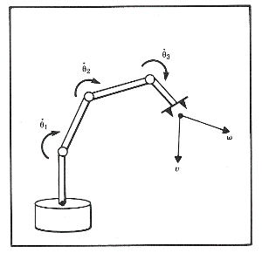

Jacobian Matrix - Derivation Methods
$$\underline{F}$$
Explicit Method
Iterative Methods
Recursive Equations
Differentiation the
Forward Kinematics Eqs.
(Method 1)
Velocity
Propagation –
Base to EE
(Method 2)
Force/Torque
Propagation –
EE to Base
(Method 3)
Jacobian Matrix
Instructor: Jacob Rosen
Advanced Robotic - MAE 263D - Department of Mechanical & Aerospace Engineering - UCLA

Slide 26
Jacobian – R Robot (1 DOF) - Example
Instructor: Jacob Rosen
Advanced Robotic - MAE 263D - Department of Mechanical & Aerospace Engineering - UCLA

Slide 27







Jacobian Matrix by Differentiation - 1R - 1/4
Consider a simple planar 1R robot
The end effector position is given by
$$y$$
$$P_{y}$$
$$V_{ee}$$
$$r$$
$$θ,\dot{θ}$$
$$x$$
$$P_{x}$$
$${{}_{ }^{0}P}_{x}=x=r\cos{θ} \\ {{}_{ }^{0}P}_{y}=y=r\sin{θ}$$
Instructor: Jacob Rosen
Advanced Robotic - MAE 263D - Department of Mechanical & Aerospace Engineering - UCLA

Slide 28
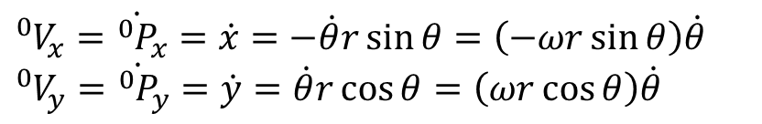

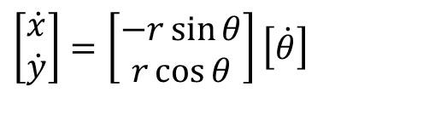
Jacobian Matrix by Differentiation - 1R - 2/4
The velocity of the end effector is defined by
Expressed in matrix form we have
$${{}_{ }^{0}V}_{x}={\dot{{}_{ }^{0}P}}_{x}=\dot{x}=−\dot{θ}r\sin{θ}=\left(−ωr\sin{θ}\right)\dot{θ} \\ {{}_{ }^{0}V}_{y}={\dot{{}_{ }^{0}P}}_{y}=\dot{y}=\dot{θ}r\cos{θ}=\left(ωr\cos{θ}\right)\dot{θ}$$
$$\underline{\dot{x}}=J\left(\underline{θ}\right)\underline{\dot{θ}}$$
$$\left[\begin{matrix}\dot{x} \\ \dot{y}\end{matrix}\right]=\left[\begin{matrix}−r\sin{θ} \\ r\cos{θ}\end{matrix}\right]\left[\dot{θ}\right]$$
2x1
2x1
1x1
Instructor: Jacob Rosen
Advanced Robotic - MAE 263D - Department of Mechanical & Aerospace Engineering - UCLA

Slide 29







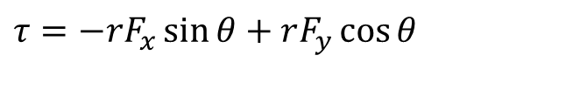



Jacobian Matrix by Differentiation - 1R - 3/4
$$y$$
The moment about the joint generated by the force acting on the end effector is given by
$$F_{y}$$
$$F_{ee}$$
$$P_{y}$$
$$F_{x}$$
$$r$$
$$θ,\dot{θ}$$
$$τ$$
$$x$$
$$P_{x}$$
$$τ=−rF_{x}\sin{θ}+rF_{y}\cos{θ}$$
Instructor: Jacob Rosen
Advanced Robotic - MAE 263D - Department of Mechanical & Aerospace Engineering - UCLA

Slide 30
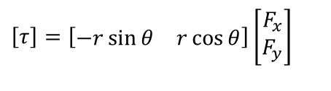



Jacobian Matrix by Differentiation - 1R - 4/4
Expressed in matrix form we have
$$\underline{τ}=J{\left(\underline{θ}\right)}^{T}\underline{F}$$
$$\left[τ\right]=\left[\begin{matrix}−r\sin{θ} & r\cos{θ}\end{matrix}\right]\left[\begin{matrix}F_{x} \\ F_{y}\end{matrix}\right]$$
1x1
1x2
2x1
$$\underline{\dot{x}}=J\left(\underline{θ}\right)\underline{\dot{θ}}$$
$$\left[\begin{matrix}\dot{x} \\ \dot{y}\end{matrix}\right]=\left[\begin{matrix}−r\sin{θ} \\ r\cos{θ}\end{matrix}\right]\left[\dot{θ}\right]$$
Instructor: Jacob Rosen
Advanced Robotic - MAE 263D - Department of Mechanical & Aerospace Engineering - UCLA

Slide 31
Jacobian – 2R Robot (2 DOF) - Example
Jacobian – Manipulability Ellipsoid
Instructor: Jacob Rosen
Advanced Robotic - Department of Mechanical & Aerospace Engineering - UCLA

Slide 32
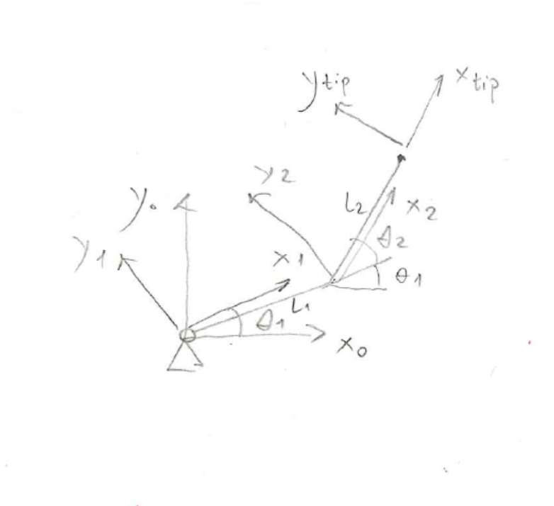



Jacobian Matrix by Differentiation - 2R
Given: Consider the following 2 DOF Planar manipulator
Problem: Compute the Jacobian matrix that describes the relationship
Solution: Differentiating the forward kinematics equations
Result: The end effector position and orientation is defined in the base frame by
$$\underline{\dot{x}}=J\left(\underline{θ}\right)\underline{\dot{θ}}$$
$$\underline{τ}=J{\left(\underline{θ}\right)}^{T}\underline{F}$$
$$\underline{x}=\left[\begin{matrix}x \\ y\end{matrix}\right]$$
Instructor: Jacob Rosen
Advanced Robotic - MAE 263D - Department of Mechanical & Aerospace Engineering - UCLA

Slide 33
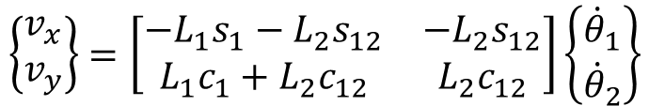




Jacobian Matrix by Differentiation - 2R
$$x_{tip}=L_{1}c_{1}+L_{2}c_{12}$$
$$y_{tip}=L_{1}s_{1}+L_{2}s_{12}$$
$$v_{xtip}=\frac{dx_{tip}}{dt}=−L_{1}{\dot{θ}}_{1}s_{1}−L_{2}\left({\dot{θ}}_{1}+{\dot{θ}}_{2}\right)s_{12}$$
$$v_{ytip}=\frac{dy_{tip}}{dt}=L_{1}{\dot{θ}}_{1}c_{1}+L_{2}\left({\dot{θ}}_{1}+{\dot{θ}}_{2}\right)c_{12}$$
$$\left\{\begin{matrix}v_{x} \\ v_{y}\end{matrix}\right\}=\left[\begin{matrix}−L_{1}s_{1}−L_{2}s_{12} & −L_{2}s_{12} \\ L_{1}c_{1}+L_{2}c_{12} & L_{2}c_{12}\end{matrix}\right]\left\{\begin{matrix}{\dot{θ}}_{1} \\ {\dot{θ}}_{2}\end{matrix}\right\}$$
Instructor: Jacob Rosen
Advanced Robotic - Department of Mechanical & Aerospace Engineering - UCLA

Slide 34
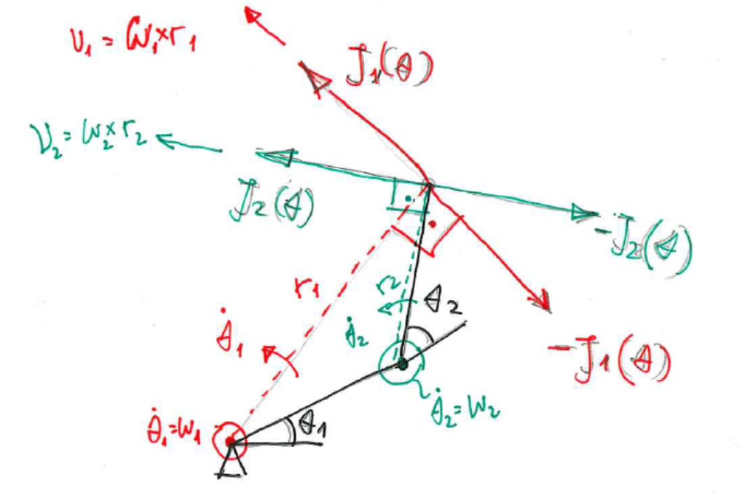
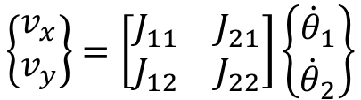
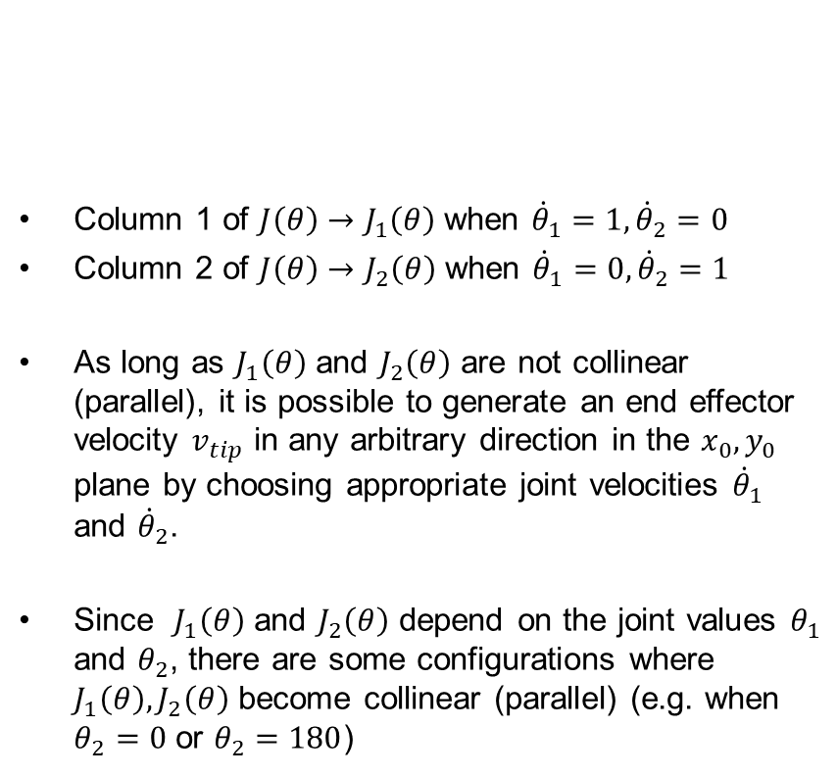
Jacobian Matrix by Differentiation - 2R
Column 1 of $J\left(θ\right)→J_{1}\left(θ\right)$ when ${\dot{θ}}_{1}=1,{\dot{θ}}_{2}=0$
Column 2 of $J\left(θ\right)→J_{2}\left(θ\right)$ when ${\dot{θ}}_{1}=0,{\dot{θ}}_{2}=1$
As long as $J_{1}\left(θ\right)$ and $J_{2}\left(θ\right)$ are not collinear (parallel), it is possible to generate an end effector velocity $v_{tip}$ in any arbitrary direction in the $x_{0},y_{0}$ plane by choosing appropriate joint velocities ${\dot{θ}}_{1}$ and ${\dot{θ}}_{2}$.
Since $J_{1}\left(θ\right)$ and $J_{2}\left(θ\right)$ depend on the joint values $θ_{1}$ and $θ_{2}$, there are some configurations where $J_{1}\left(θ\right),J_{2}\left(θ\right)$ become collinear (parallel) (e.g. when $θ_{2}=0$ or $θ_{2}=180$)
$$\left\{\begin{matrix}v_{x} \\ v_{y}\end{matrix}\right\}=\left[\begin{matrix}J_{11} & J_{21} \\ J_{12} & J_{22}\end{matrix}\right]\left\{\begin{matrix}{\dot{θ}}_{1} \\ {\dot{θ}}_{2}\end{matrix}\right\}$$
Instructor: Jacob Rosen
Advanced Robotic - Department of Mechanical & Aerospace Engineering - UCLA

Slide 35
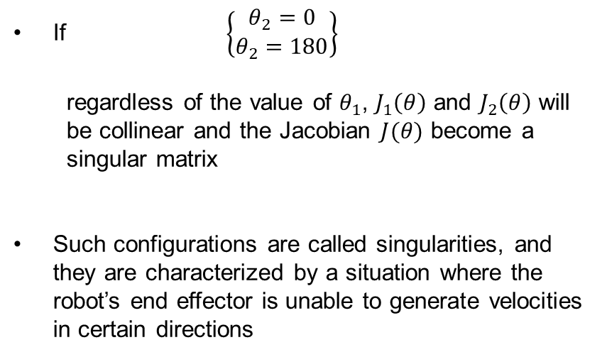
Jacobian Matrix by Differentiation - 2R
If $\left\{\begin{matrix}θ_{2}=0 \\ θ_{2}=180\end{matrix}\right\}$
  regardless of the value of $θ_{1}$, $J_{1}\left(θ\right)$ and $J_{2}\left(θ\right)$ will be collinear and the Jacobian $J(θ)$ become a singular matrix
Such configurations are called singularities, and they are characterized by a situation where the robot’s end effector is unable to generate velocities in certain directions
Instructor: Jacob Rosen
Advanced Robotic - Department of Mechanical & Aerospace Engineering - UCLA

Slide 36
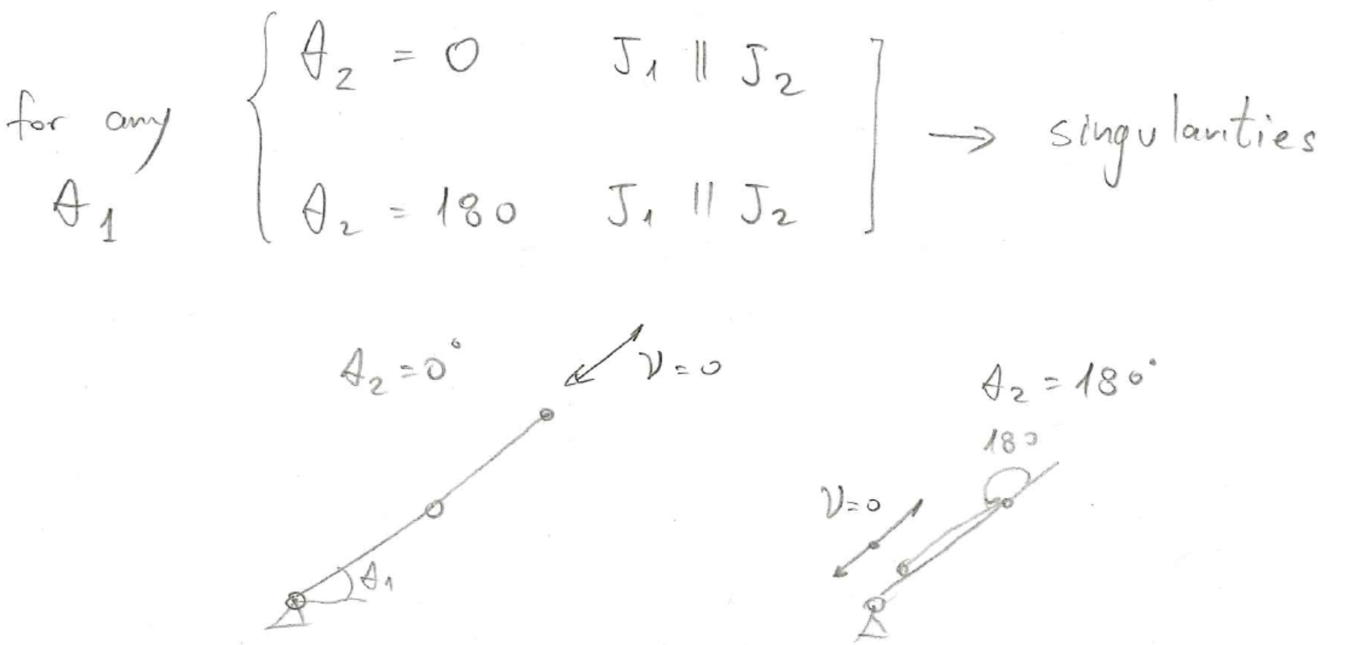

Jacobian Matrix by Differentiation - 2R
For any $θ_{1}$ $\left\{\begin{matrix}θ_{2}=0 \\ θ_{2}=180\end{matrix}\right\} \left[\begin{matrix}J_{1}∥J_{2} \\ J_{1}∥J_{2}\end{matrix}\right]→singularities$
Instructor: Jacob Rosen
Advanced Robotic - Department of Mechanical & Aerospace Engineering - UCLA

Slide 37






Jacobian Matrix by Differentiation - 2R
Substitute $L_{1}=1$; $L_{2}=1$
Consider the robot at two different non-singular postures
The Jacobian can be used to map bounds on rotational speed of the joints $\left(\dot{θ}\right)$ to bounds on the end effector velocity $\left(v_{tip}\right)$
$$θ=\left[\begin{matrix}0 \\ π/4\end{matrix}\right]$$
$$J\left(\left[\begin{matrix}0 \\ π/4\end{matrix}\right]\right)=\left[\begin{matrix}−0.71 & −0.71 \\ 1.71 & 0.71\end{matrix}\right]$$
$$\dot{θ}=\left[\begin{matrix}{\dot{θ}}_{1} \\ {\dot{θ}}_{2}\end{matrix}\right]$$
$$\dot{X}=\left[\begin{matrix}v_{x} \\ v_{y}\end{matrix}\right]$$
$\dot{X}=J\left(θ\right)\dot{θ}$
$\left[\begin{matrix}v_{x} \\ v_{y}\end{matrix}\right]=\left[\begin{matrix}−0.71 & −0.71 \\ 1.71 & 0.71\end{matrix}\right]$ $\left[\begin{matrix}{\dot{θ}}_{1} \\ {\dot{θ}}_{2}\end{matrix}\right]$
Tip Velocity in
Joint Space
Tip velocity in
Task Space
Instructor: Jacob Rosen
Advanced Robotic - Department of Mechanical & Aerospace Engineering - UCLA

Slide 38








Jacobian Matrix by Differentiation - 2R
$$\dot{θ}=\left[\begin{matrix}{\dot{θ}}_{1} \\ {\dot{θ}}_{2}\end{matrix}\right]$$
$$\dot{X}=\left[\begin{matrix}v_{x} \\ v_{y}\end{matrix}\right]$$
$\dot{X}=J\left(θ\right)\dot{θ}$
$\left[\begin{matrix}v_{x} \\ v_{y}\end{matrix}\right]=\left[\begin{matrix}−0.71 & −0.71 \\ 1.71 & 0.71\end{matrix}\right]$ $\left[\begin{matrix}{\dot{θ}}_{1} \\ {\dot{θ}}_{2}\end{matrix}\right]$
Tip Velocity in
Joint Space
Tip velocity in
Task Space
$$v_{tip}=\left[\begin{matrix}−0.71 & −0.71 \\ 1.71 & 0.71\end{matrix}\right]\left[\begin{matrix}1 \\ 1\end{matrix}\right]=\left[\begin{matrix}−1.42 \\ 2.42\end{matrix}\right]$$
A
B
$$v_{tip}=\left[\begin{matrix}−0.71 & −0.71 \\ 1.71 & 0.71\end{matrix}\right]\left[\begin{matrix}−1 \\ 1\end{matrix}\right]=\left[\begin{matrix}0 \\ −1\end{matrix}\right]$$
C
$$v_{tip}=\left[\begin{matrix}−0.71 & −0.71 \\ 1.71 & 0.71\end{matrix}\right]\left[\begin{matrix}−1 \\ −1\end{matrix}\right]=\left[\begin{matrix}1.42 \\ −2.42\end{matrix}\right]$$
D
$$v_{tip}=\left[\begin{matrix}−0.71 & −0.71 \\ 1.71 & 0.71\end{matrix}\right]\left[\begin{matrix}1 \\ −1\end{matrix}\right]=\left[\begin{matrix}0 \\ 1\end{matrix}\right]$$
Instructor: Jacob Rosen
Advanced Robotic - Department of Mechanical & Aerospace Engineering - UCLA

Slide 39



Jacobian Matrix by Differentiation - 2R
Rather than mapping a polygon of joint velocities through the Jacobian, we could instead map a unit circle of joint velocities into the end effector velocities in the $x_{0},y_{0}$ plane
The circle represents an iso-effort contour in the joint velocity space, where total actuator effort is considered to be the sum of squares of the joint velocities
Tip Velocity in
Joint Space
Tip velocity in
Task Space
$$1=\sqrt{{\dot{θ}}_{1}^{2}+{\dot{θ}}_{2}^{2}}$$
Instructor: Jacob Rosen
Advanced Robotic - Department of Mechanical & Aerospace Engineering - UCLA

Slide 40


Properties of the Jacobian -
Velocity Mapping and Singularities
Instructor: Jacob Rosen
Advanced Robotic - Department of Mechanical & Aerospace Engineering - UCLA
Note: See Mathematica Simulations
  Two Link: https://demonstrations.wolfram.com/ForwardAndInverseKinematicsForTwoLinkArm/
  Three links : https://demonstrations.wolfram.com/ManipulabilityEllipsoidOfARobotArm/

Slide 41


Manipulability Ellipsoid – Definition
Tip Velocity in
Joint Space
Tip velocity in
Task Space
$$\dot{x}=J\left(θ\right)\dot{q}$$
Instructor: Jacob Rosen
Advanced Robotic - Department of Mechanical & Aerospace Engineering - UCLA

Slide 42
Manipulability Ellipsoid & Manipulability Measures – Design
Robotic Arm Design – Mechanism Size
Robotic Arm - Base Position – Position of the mechanism with respect to the workspace to maximize the manipulability
Instructor: Jacob Rosen
Advanced Robotic - Department of Mechanical & Aerospace Engineering - UCLA

Slide 43
Jacobian – RR Robot (3 DOF) - Example
Instructor: Jacob Rosen
Advanced Robotic - MAE 263D - Department of Mechanical & Aerospace Engineering - UCLA

Slide 44














Jacobian Matrix by Differanciation - 3R - 1/4
Given: Consider the following 3 DOF Planar manipulator
Problem: Compute the Jacobian matrix that describes the relationship
Solution: Differentiating the forward kinematics equations
Result: The end effector position and orientation is defined in the base frame by
$$y_{0}$$
$$α$$
$$\underline{\dot{x}}=J\left(\underline{θ}\right)\underline{\dot{θ}}$$
$$\underline{τ}=J{\left(\underline{θ}\right)}^{T}\underline{F}$$
$$x_{3}$$
$$y$$
$$x_{2}$$
$$y_{3}$$
$$\underline{x}=\left[\begin{matrix}x \\ y \\ α\end{matrix}\right]$$
$$y_{2}$$
$$y_{1}$$
$$x_{1}$$
$$x_{}$$
$$x_{0}$$
Instructor: Jacob Rosen
Advanced Robotic - MAE 263D - Department of Mechanical & Aerospace Engineering - UCLA

Slide 45



Jacobian Matrix by Differanciation - 3R - 2/4
Problem: Compute the Jacobian matrix that describes the relationship
Solution: The end effector position and orientation is defined in the base frame by
$$\underline{\dot{x}}=J\left(\underline{θ}\right)\underline{\dot{θ}}$$
$$\underline{τ}=J{\left(\underline{θ}\right)}^{T}\underline{F}$$
$$\underline{x}=\left[\begin{matrix}x \\ y \\ α\end{matrix}\right]$$
Instructor: Jacob Rosen
Advanced Robotic - MAE 263D - Department of Mechanical & Aerospace Engineering - UCLA

Slide 46













Jacobian Matrix by Differanciation - 3R - 3/4
The forward kinematics gives us relationship of the end effector to the joint angles:
Differentiating the three expressions gives
$$y_{0}$$
$${{}_{ }^{0}P}_{3 org, x}=x=L_{1}c_{1}+L_{2}c_{12}+L_{3}c_{123}$$
$$α$$
$${{}_{ }^{0}P}_{3 org, y}=y=L_{1}s_{1}+L_{2}s_{12}+L_{3}s_{123}$$
$$y$$
$$x_{3}$$
$${{}_{ }^{0}P}_{3 org, α}=α=θ_{1}+θ_{2}+θ_{3}$$
$$y_{3}$$
$$x_{2}$$
$$y_{2}$$
$$y_{1}$$
$$x_{1}$$
$$\dot{x}=−L_{1}s_{1}{\dot{θ}}_{1}−L_{2}s_{12}\left({\dot{θ}}_{1}+{\dot{θ}}_{2}\right)−L_{3}s_{123}\left({\dot{θ}}_{1}+{\dot{θ}}_{2}+{\dot{θ}}_{3}\right) \\ =−\left(L_{1}s_{1}+L_{2}s_{12}+L_{3}s_{123}\right){\dot{θ}}_{1}−\left(L_{2}s_{12}+L_{3}s_{123}\right){\dot{θ}}_{2}−\left(L_{3}s_{123}\right){\dot{θ}}_{3}$$
$$x_{}$$
$$x_{0}$$
$$\dot{y}=L_{1}c_{1}{\dot{θ}}_{1}+L_{2}c_{12}\left({\dot{θ}}_{1}+{\dot{θ}}_{2}\right)+L_{3}c_{123}\left({\dot{θ}}_{1}+{\dot{θ}}_{2}+{\dot{θ}}_{3}\right) \\ =\left(L_{1}c_{1}+L_{2}c_{12}+L_{3}c_{123}\right){\dot{θ}}_{1}+\left(L_{2}c_{12}+L_{3}c_{123}\right){\dot{θ}}_{2}+\left(L_{3}c_{123}\right){\dot{θ}}_{3}$$
$$\dot{α}={\dot{θ}}_{1}+{\dot{θ}}_{2}+{\dot{θ}}_{3}$$
Instructor: Jacob Rosen
Advanced Robotic - MAE 263D - Department of Mechanical & Aerospace Engineering - UCLA

Slide 47


Jacobian Matrix by Differanciation - 3R - 4/4
Using a matrix form we get
The Jacobian provides a linear transformation, giving a velocity map and a force map for a robot manipulator. For the simple example above, the equations are trivial, but can easily become more complicated with robots that have additional degrees a freedom. Before tackling these problems, consider this brief review of linear algebra.
$$\underline{\dot{x}}={}_{ }^{0}J\left(\underline{θ}\right)\underline{\dot{θ}}$$
$$\left[\begin{matrix}\dot{x} \\ \dot{y} \\ \dot{α}\end{matrix}\right]=\left[\begin{matrix}−L_{1}s_{1}−L_{2}s_{12}−L_{3}s_{123} & −L_{2}s_{12}−L_{3}s_{123} & −L_{3}s_{123} \\ L_{1}c_{1}+L_{2}c_{12}+L_{3}c_{123} & L_{2}c_{12}+L_{3}c_{123} & L_{3}c_{123} \\ 1 & 1 & 1\end{matrix}\right]\left[\begin{matrix}{\dot{θ}}_{1} \\ {\dot{θ}}_{2} \\ {\dot{θ}}_{3}\end{matrix}\right]$$
Instructor: Jacob Rosen
Advanced Robotic - MAE 263D - Department of Mechanical & Aerospace Engineering - UCLA

