Slide 1

Advanced Kinematics
Linear and Angular Velocities
Instructor: Jacob Rosen
Advanced Robotic - MAE 263 - Department of Mechanical & Aerospace Engineering - UCLA

Slide 2
Jacobian Matrix - Derivation Methods
Explicit Method
Iterative Methods
Recursive Equations
Differentiation the
Forward Kinematics Eqs.
(Method 1)
Velocity
Propagation –
Base to EE
(Method 2)
Force/Torque
Propagation –
EE to Base
(Method 3)
Jacobian Matrix
Instructor: Jacob Rosen
Advanced Robotic - Department of Mechanical & Aerospace Engineering - UCLA

Slide 3
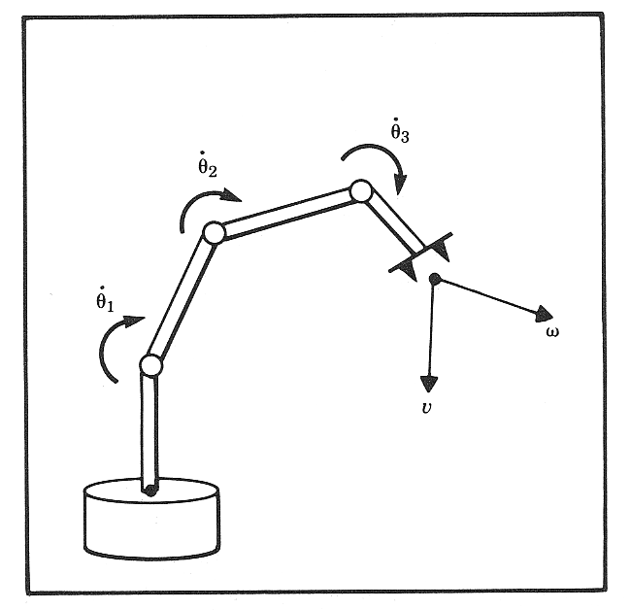
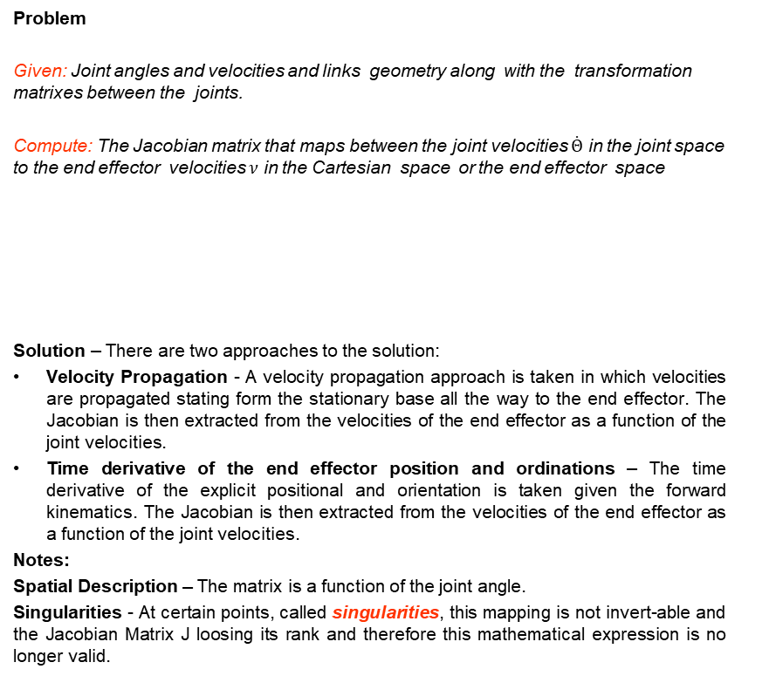
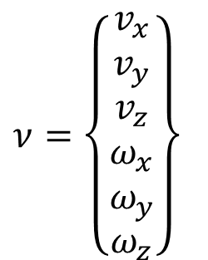
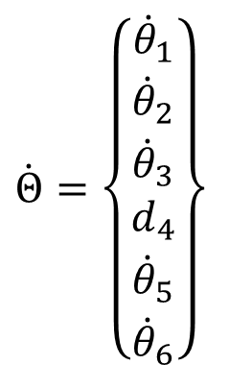


Jacobian Matrix – Introduction - Velocity Transformation
Problem
Given: Joint angles and velocities and links geometry along with the transformation matrixes between the joints.
Compute: The Jacobian matrix that maps between the joint velocities $\dot{Θ}$ in the joint space to the end effector velocities $ν$ in the Cartesian space or the end effector space
Solution – There are two approaches to the solution:
Velocity Propagation - A velocity propagation approach is taken in which velocities are propagated stating form the stationary base all the way to the end effector. The Jacobian is then extracted from the velocities of the end effector as a function of the joint velocities.
Time derivative of the end effector position and ordinations – The time derivative of the explicit positional and orientation is taken given the forward kinematics. The Jacobian is then extracted from the velocities of the end effector as a function of the joint velocities.
Notes:
Spatial Description – The matrix is a function of the joint angle.
Singularities - At certain points, called singularities, this mapping is not invert-able and the Jacobian Matrix J loosing its rank and therefore this mathematical expression is no longer valid.
$$\dot{Θ}=\left\{\begin{matrix}{\dot{θ}}_{1} \\ {\dot{θ}}_{2} \\ {\dot{θ}}_{3} \\ d_{4} \\ {\dot{θ}}_{5} \\ {\dot{θ}}_{6}\end{matrix}\right\}$$
$$ν=J^{ }(Θ)\dot{Θ}$$
$$\dot{Θ}=J^{−1}(Θ)ν$$
$$ν=\left\{\begin{matrix}v_{x} \\ v_{y} \\ v_{z} \\ ω_{x} \\ ω_{y} \\ ω_{z}\end{matrix}\right\}$$
Instructor: Jacob Rosen
Advanced Robotic - MAE 263 - Department of Mechanical & Aerospace Engineering - UCLA

Slide 4
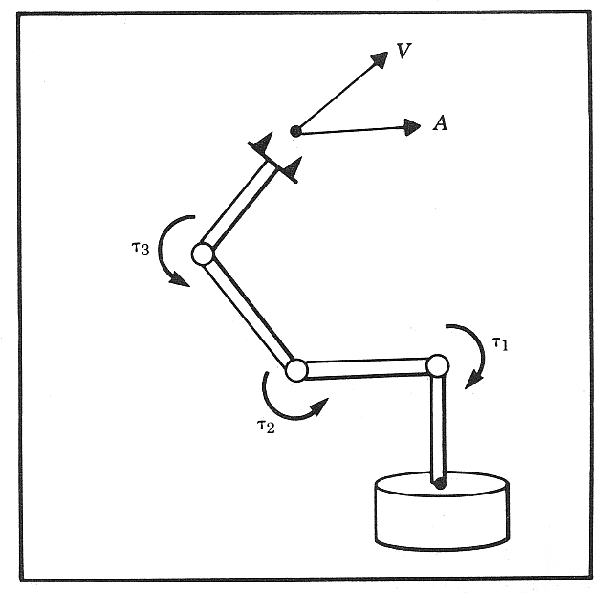

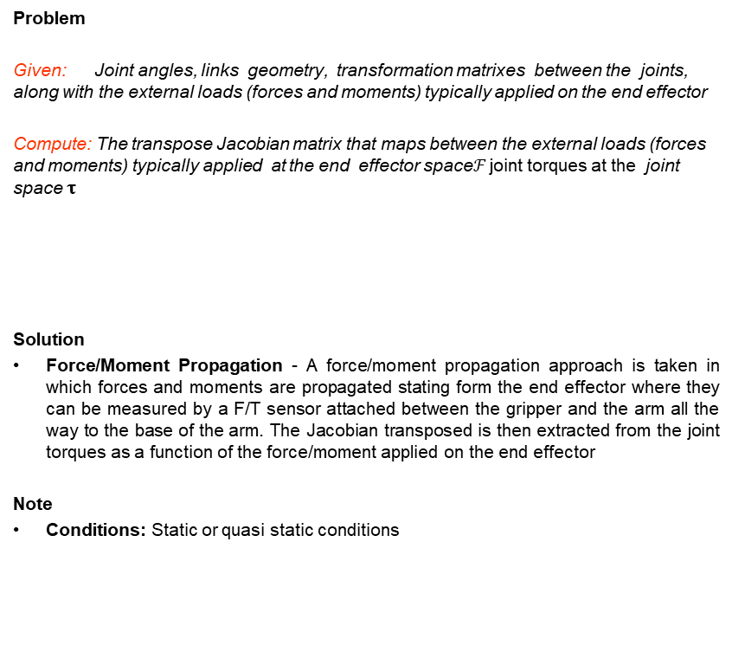
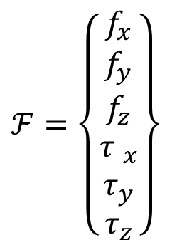
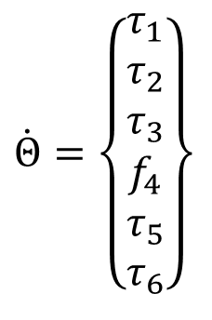


Jacobian Matrix – Introduction - Force Transformation
Problem
Given: Joint angles, links geometry, transformation matrixes between the joints, along with the external loads (forces and moments) typically applied on the end effector
Compute: The transpose Jacobian matrix that maps between the external loads (forces and moments) typically applied at the end effector space$ℱ$ joint torques at the joint space $τ$
Solution
Force/Moment Propagation - A force/moment propagation approach is taken in which forces and moments are propagated stating form the end effector where they can be measured by a F/T sensor attached between the gripper and the arm all the way to the base of the arm. The Jacobian transposed is then extracted from the joint torques as a function of the force/moment applied on the end effector
Note
Conditions: Static or quasi static conditions
$$\dot{Θ}=\left\{\begin{matrix}τ_{1} \\ τ_{2} \\ τ_{3} \\ f_{4} \\ τ_{5} \\ τ_{6}\end{matrix}\right\}$$
$$f$$
$$τ$$
$$τ=J^{T}ℱ$$
$$ℱ=\left\{\begin{matrix}f_{x} \\ f_{y} \\ f_{z} \\ {τ }_{x} \\ τ_{y} \\ τ_{z}\end{matrix}\right\}$$
Instructor: Jacob Rosen
Advanced Robotic - MAE 263 - Department of Mechanical & Aerospace Engineering - UCLA

Slide 5
Sensation 1 – Simultaneous Linear and Rotational Velocities
Given - Two frames i.e frame {A} and frame {B} as well as point Q.
Three actions take place simultaneously
  The origin of frame B moves as a function of time with respect to the origin of frame A
  Point Q moves with respect to frame B
  Frame B rotates with respect to frame A along an axis defined by
Challenge – Express the velocity of point Q
Instructor: Jacob Rosen
Advanced Robotic - MAE 263 - Department of Mechanical & Aerospace Engineering - UCLA

Slide 6
Scenarios 1 – Implications for Serial Manipulators
Instructor: Jacob Rosen
Advanced Robotic - MAE 263 - Department of Mechanical & Aerospace Engineering - UCLA

Slide 7
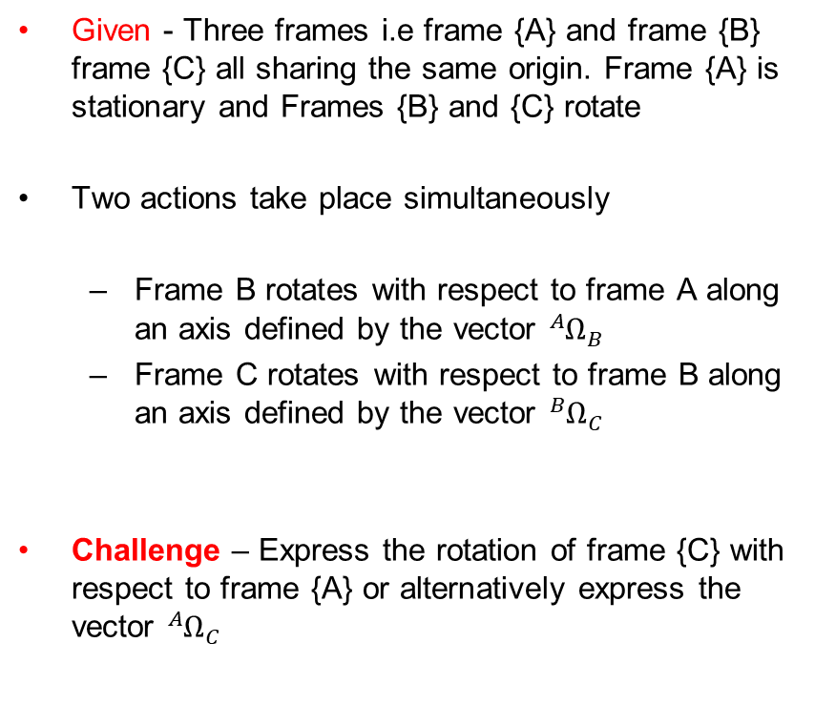
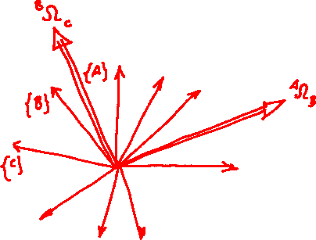
Sensation 2 – Two Consecutive Rotation
Given - Three frames i.e frame {A} and frame {B} frame {C} all sharing the same origin. Frame {A} is stationary and Frames {B} and {C} rotate
Two actions take place simultaneously
  Frame B rotates with respect to frame A along an axis defined by the vector ${{}_{ }^{A}Ω}_{B}$
  Frame C rotates with respect to frame B along an axis defined by the vector ${{}_{ }^{B}Ω}_{C}$
Challenge – Express the rotation of frame {C} with respect to frame {A} or alternatively express the vector ${{}_{ }^{A}Ω}_{C}$
Instructor: Jacob Rosen
Advanced Robotic - MAE 263 - Department of Mechanical & Aerospace Engineering - UCLA

Slide 8
Scenarios 2 – Implications for Serial Manipulators
Instructor: Jacob Rosen
Advanced Robotic - MAE 263 - Department of Mechanical & Aerospace Engineering - UCLA

Slide 9
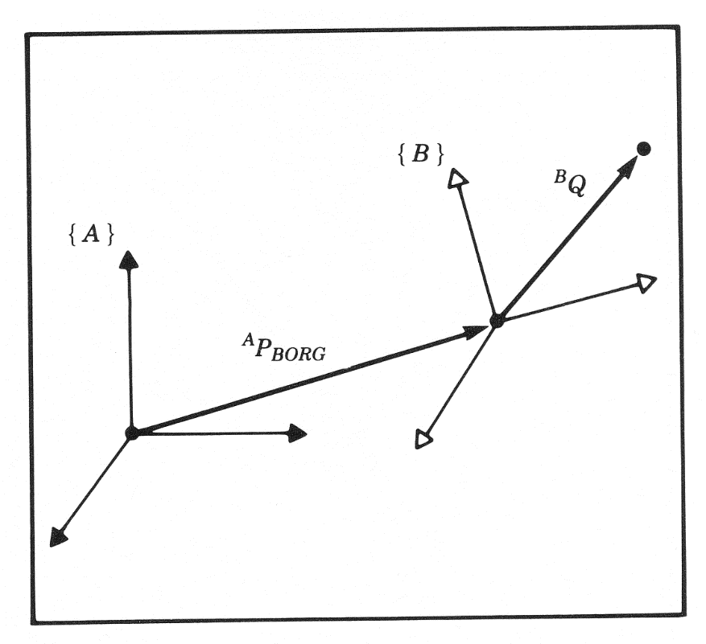
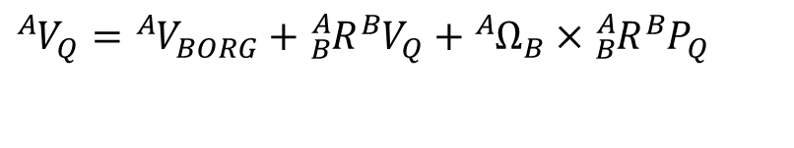
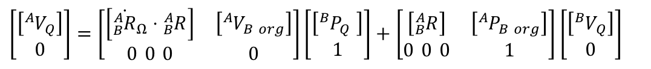




Simultaneous Linear and Rotational Velocity - Scenario No.1
Vector Form (Method No. 1)
Matrix Form (Method No. 2)
Matrix Formulation – Homogeneous Transformation Form – Method No. 3
$${{}_{ }^{A}V}_{Q}=f({{}_{ }^{B}P}_{Q}, {{}_{ }^{B}V}_{Q}, {{}_{ }^{A}V}_{BORG}, {{}_{ }^{A}Ω}_{B}, {}_{B}^{A}R)$$
$${{}_{ }^{A}Ω}_{B}$$
$${{}_{ }^{B}P}_{Q}$$
$${{}_{ }^{A}V}_{Q}={{}_{ }^{A}V}_{BORG}+{}_{B}^{A}R{{}_{ }^{B}V}_{Q}+{{}_{ }^{A}Ω}_{B}×{}_{B}^{A}R{{}_{ }^{B}P}_{Q}$$
$${{}_{ }^{A}V}_{Q}={{}_{ }^{A}V}_{BORG}+{}_{B}^{A}R{{}_{ }^{B}V}_{Q}+{\dot{{}_{B}^{A}R}}_{Ω}\left({}_{B}^{A}R{{}_{ }^{B}P}_{Q}\right)$$
$$\left[\begin{matrix}\left[{{}_{ }^{A}V}_{Q}\right] \\ 0\end{matrix}\right]=\left[\begin{matrix}\left[{\dot{{}_{B}^{A}R}}_{Ω}⋅{}_{B}^{A}R\right] & \left[{{}_{ }^{A}V}_{B org}\right] \\ 0 0 0 & 0\end{matrix}\right]\left[\begin{matrix}\left[{{}_{ }^{B}P}_{Q }\right] \\ 1\end{matrix}\right]+\left[\begin{matrix}\left[{}_{B}^{A}R\right] & \left[{{}_{ }^{A}P}_{B org}\right] \\ 0 0 0 & 1\end{matrix}\right]\left[\begin{matrix}\left[{{}_{ }^{B}V}_{Q}\right] \\ 0\end{matrix}\right]$$
Instructor: Jacob Rosen
Advanced Robotic - MAE 263 - Department of Mechanical & Aerospace Engineering - UCLA

Slide 10
Angular Velocity – Changing the Frame of Representation – Scenario No.2
Angular Velocity Representation in Various Frames
  Vector Form
  Matrix Form
Instructor: Jacob Rosen
Advanced Robotic - MAE 263 - Department of Mechanical & Aerospace Engineering - UCLA

Slide 11
Scenarios 1
Simultaneous Linear and Rotational Velocity
Instructor: Jacob Rosen
Advanced Robotic - MAE 263 - Department of Mechanical & Aerospace Engineering - UCLA

Slide 12
Linear & Angular Velocity – Derivation Method No. 1 & 2
Vector Form
Matrix Form
Instructor: Jacob Rosen
Advanced Robotic - MAE 263 - Department of Mechanical & Aerospace Engineering - UCLA

Slide 13
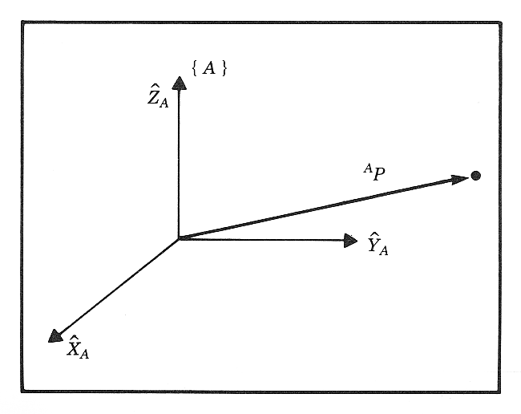
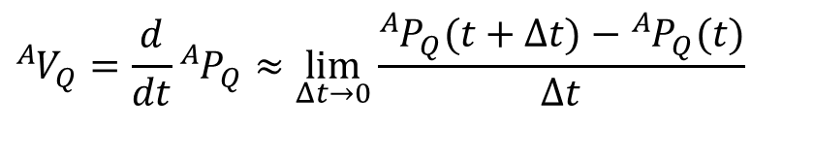

Definitions - Linear Velocity
Linear velocity - The instantaneous rate of change in linear position of a point relative to some frame.
$${{}_{ }^{A}P}_{Q}\left(t+Δt\right)={{}_{ }^{A}P}_{Q}(t)+{{}_{ }^{A}V}_{Q}Δt$$
$${{}_{ }^{A}V}_{Q}=\frac{d}{dt}{{}_{ }^{A}P}_{Q}≈\lim_{Δt→0}{\frac{{{}_{ }^{A}P}_{Q}(t+Δt)−{{}_{ }^{A}P}_{Q}(t)}{Δt}}$$
Instructor: Jacob Rosen
Advanced Robotic - MAE 263 - Department of Mechanical & Aerospace Engineering - UCLA

Slide 14


Definitions - Linear Velocity
The position of point Q in frame {A} is represented by the linear position vector
The velocity of a point Q relative to frame {A} is represented by the linear velocity vector
$${{}_{ }^{A}P}_{Q}=\left[\begin{matrix}{{}_{ }^{A}P}_{Qx} \\ {{}_{ }^{A}P}_{Qy} \\ {{}_{ }^{A}P}_{Qz}\end{matrix}\right]$$
$${{}_{ }^{A}V}_{Q}=\frac{{}_{ }^{A}d}{dt}\left[\begin{matrix}{{}_{ }^{A}P}_{Qx} \\ {{}_{ }^{A}P}_{Qy} \\ {{}_{ }^{A}P}_{Qz}\end{matrix}\right]=\left[\begin{matrix}{\dot{{}_{ }^{A}P}}_{Qx} \\ {\dot{{}_{ }^{A}P}}_{Qy} \\ {\dot{{}_{ }^{A}P}}_{Qz}\end{matrix}\right]$$
Instructor: Jacob Rosen
Advanced Robotic - MAE 263 - Department of Mechanical & Aerospace Engineering - UCLA

Slide 15


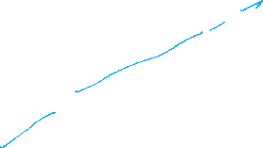









Linear Velocity – Translation (No Rotation)- Problem 1 Derivation
Problem No. 1 – Change in a position of Point Q
Conditions
  Point Q is fixed in frame {B}
  Frame {B} translates with respect to Frame {A}
Instructor: Jacob Rosen
Advanced Robotic - MAE 263 - Department of Mechanical & Aerospace Engineering - UCLA

Slide 16



Linear Velocity – Translation (No Rotation) – Problem 2 Derivation
Problem No. 2 – Translation of frame {B}
Conditions
  Point Q is fixed in frame {B}
  Frame {B} translates with respect to Frame {A}
Instructor: Jacob Rosen
Advanced Robotic - MAE 263 - Department of Mechanical & Aerospace Engineering - UCLA

Slide 17
Linear Velocity – Translation (No Rotation) – Problem 1&2 - Summary
Problem No. 1 – Change in a position of Point Q
Problem No. 2 – Translation of frame {B}
Instructor: Jacob Rosen
Advanced Robotic - MAE 263 - Department of Mechanical & Aerospace Engineering - UCLA

Slide 18
Linear Velocity – Translation – Simultaneous Derivation
Differentiate with respect to coordinate system {A}
Instructor: Jacob Rosen
Advanced Robotic - MAE 263 - Department of Mechanical & Aerospace Engineering - UCLA

Slide 19



Linear Velocities - Frames
When describing the velocity (linear or angular) of an object, there are two important frames that are being used:
  Represented Frame (Reference Frame) : e.g. {A}
  This is the frame used to represent (express) the object’s velocity.
  Computed Frame: e.g. {B}
  This is the frame in which the velocity is measured (differentiate the position).
Instructor: Jacob Rosen
Advanced Robotic - MAE 263 - Department of Mechanical & Aerospace Engineering - UCLA

Slide 20

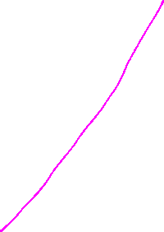




Linear Velocities - Frames
As with any vector, a velocity vector may be described in terms of any frame, and this frame of reference is noted with a leading superscript.
A velocity vector computed in frame {B} and represented in frame {A} would be written
Represented
(Reference Frame) -– Projected on
Computed
(Measured) - Differentiate with respect to
Instructor: Jacob Rosen
Advanced Robotic - MAE 263 - Department of Mechanical & Aerospace Engineering - UCLA

Slide 21
Frame - Linear Velocity
We can always remove the outer, leading superscript by explicitly including the rotation matrix which accomplishes the change in the reference frame
Note that in the general case because may be time-verging
If the calculated velocity is written in terms of of the frame of differentiation the result could be indicated by a single leading superscript.
In a similar fashion when the angular velocity is expresses and measured as a vector
Instructor: Jacob Rosen
Advanced Robotic - MAE 263 - Department of Mechanical & Aerospace Engineering - UCLA

Slide 22
Frames - Linear Velocity - Example
Given: The driver of the car maintains a speed of 100 km/h (as shown to the driver by the car’s speedometer).
Problem: Express the velocities in each section of the road A, B, C, D, E, F where {C} - Car frame, and {W} - World frame
Represented
(Reference Frame)
C
y
Computed
(Measured)
x
B
D
A
{C}
y
{W}
x
E
Object Frame
F
Instructor: Jacob Rosen
Advanced Robotic - MAE 263 - Department of Mechanical & Aerospace Engineering - UCLA

Slide 23
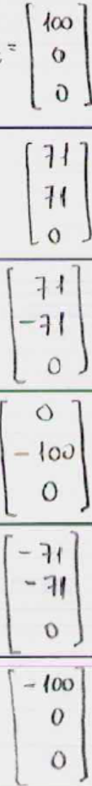





Frames - Linear Velocity - Example
C
B
D
A
E
F
Instructor: Jacob Rosen
Advanced Robotic - MAE 263 - Department of Mechanical & Aerospace Engineering - UCLA

Slide 24



Frames - Linear Velocity - Example
Instructor: Jacob Rosen
Advanced Robotic - MAE 263 - Department of Mechanical & Aerospace Engineering - UCLA

Slide 25
Frames - Linear Velocity - Example
is not time-varying (in this example)
Instructor: Jacob Rosen
Advanced Robotic - MAE 263 - Department of Mechanical & Aerospace Engineering - UCLA

Slide 26
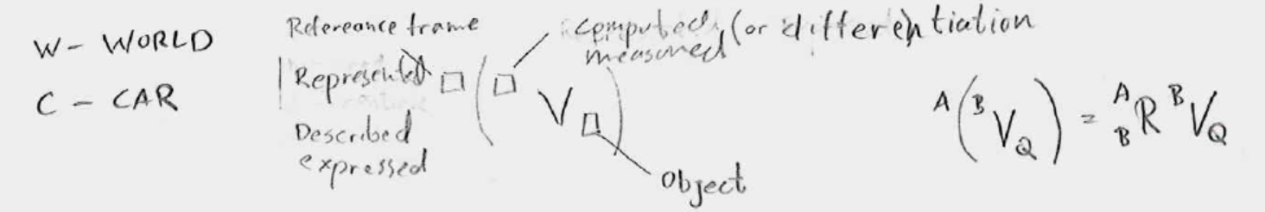
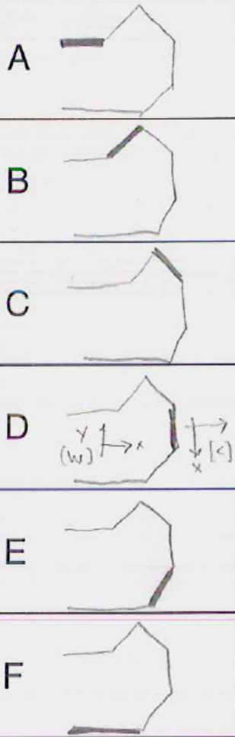







Frames - Linear Velocity - Example
$${{}_{}^{A}{({}_{}^{B}V}}_{Q})={}_{B}^{A}R{{}_{}^{B}V}_{Q}$$
C
$${}_{C}^{C}R{{}_{}^{C}V}_{C}=I{{}_{}^{C}V}_{C}=\left[\begin{matrix}0 \\ 0 \\ 0\end{matrix}\right]$$
A
B
D
E
C
$${}_{C}^{C}R{{}_{}^{C}V}_{C}=I{{}_{}^{C}V}_{C}=\left[\begin{matrix}0 \\ 0 \\ 0\end{matrix}\right]$$
A
B
D
E
C
$${}_{C}^{C}R{{}_{}^{C}V}_{C}=I{{}_{}^{C}V}_{C}=\left[\begin{matrix}0 \\ 0 \\ 0\end{matrix}\right]$$
A
B
D
E
C
$${}_{C}^{C}R{{}_{}^{C}V}_{C}=I{{}_{}^{C}V}_{C}=\left[\begin{matrix}0 \\ 0 \\ 0\end{matrix}\right]$$
A
B
D
E
C
$${}_{C}^{C}R{{}_{}^{C}V}_{C}=I{{}_{}^{C}V}_{C}=\left[\begin{matrix}0 \\ 0 \\ 0\end{matrix}\right]$$
A
B
D
E
C
$${}_{C}^{C}R{{}_{}^{C}V}_{C}=I{{}_{}^{C}V}_{C}=\left[\begin{matrix}0 \\ 0 \\ 0\end{matrix}\right]$$
A
B
D
E
Instructor: Jacob Rosen
Advanced Robotic - MAE 263 - Department of Mechanical & Aerospace Engineering - UCLA

Slide 27







Frames - Linear Velocity - Example
$${{}_{ }^{A}{({}_{ }^{B}V}}_{Q})={}_{B}^{A}R{{}_{ }^{B}V}_{Q}$$
C
$${}_{C}^{C}R{{}_{}^{C}V}_{C}=I{{}_{}^{C}V}_{C}=\left[\begin{matrix}0 \\ 0 \\ 0\end{matrix}\right]$$
$${}_{W}^{W}R{{}_{}^{W}V}_{C}=I{{}_{}^{W}V}_{C}=\left[\begin{matrix}100 \\ 0 \\ 0\end{matrix}\right]$$
A
B
D
E
C
$${}_{C}^{C}R{{}_{}^{C}V}_{C}=I{{}_{}^{C}V}_{C}=\left[\begin{matrix}0 \\ 0 \\ 0\end{matrix}\right]$$
$${}_{W}^{W}R{{}_{}^{W}V}_{C}=I{{}_{}^{W}V}_{C}=\left[\begin{matrix}71 \\ 71 \\ 0\end{matrix}\right]$$
A
B
D
E
C
$${}_{C}^{C}R{{}_{}^{C}V}_{C}=I{{}_{}^{C}V}_{C}=\left[\begin{matrix}0 \\ 0 \\ 0\end{matrix}\right]$$
$${}_{W}^{W}R{{}_{}^{W}V}_{C}=I{{}_{}^{W}V}_{C}=\left[\begin{matrix}71 \\ −71 \\ 0\end{matrix}\right]$$
A
B
D
E
C
$${}_{C}^{C}R{{}_{}^{C}V}_{C}=I{{}_{}^{C}V}_{C}=\left[\begin{matrix}0 \\ 0 \\ 0\end{matrix}\right]$$
$${}_{W}^{W}R{{}_{}^{W}V}_{C}=I{{}_{}^{W}V}_{C}=\left[\begin{matrix}0 \\ −100 \\ 0\end{matrix}\right]$$
A
B
D
E
C
$${}_{C}^{C}R{{}_{}^{C}V}_{C}=I{{}_{}^{C}V}_{C}=\left[\begin{matrix}0 \\ 0 \\ 0\end{matrix}\right]$$
$${}_{W}^{W}R{{}_{}^{W}V}_{C}=I{{}_{}^{W}V}_{C}=\left[\begin{matrix}−71 \\ −71 \\ 0\end{matrix}\right]$$
A
B
D
E
C
$${}_{C}^{C}R{{}_{}^{C}V}_{C}=I{{}_{}^{C}V}_{C}=\left[\begin{matrix}0 \\ 0 \\ 0\end{matrix}\right]$$
$${}_{W}^{W}R{{}_{}^{W}V}_{C}=I{{}_{}^{W}V}_{C}=\left[\begin{matrix}−100 \\ 0 \\ 0\end{matrix}\right]$$
A
B
D
E
Instructor: Jacob Rosen
Advanced Robotic - MAE 263 - Department of Mechanical & Aerospace Engineering - UCLA

Slide 28






Frames - Linear Velocity - Example
$${{}_{}^{A}{({}_{}^{B}V}}_{Q})={}_{B}^{A}R{{}_{}^{B}V}_{Q}$$
C
$${}_{C}^{C}R{{}_{}^{C}V}_{C}=I{{}_{}^{C}V}_{C}=\left[\begin{matrix}0 \\ 0 \\ 0\end{matrix}\right]$$
$${}_{W}^{W}R{{}_{}^{W}V}_{C}=I{{}_{}^{W}V}_{C}=\left[\begin{matrix}100 \\ 0 \\ 0\end{matrix}\right]$$
$${}_{C}^{W}R{{}_{}^{C}V}_{C}=\left[\begin{matrix}0 \\ 0 \\ 0\end{matrix}\right]$$
A
B
D
E
C
$${}_{C}^{C}R{{}_{}^{C}V}_{C}=I{{}_{}^{C}V}_{C}=\left[\begin{matrix}0 \\ 0 \\ 0\end{matrix}\right]$$
$${}_{W}^{W}R{{}_{}^{W}V}_{C}=I{{}_{}^{W}V}_{C}=\left[\begin{matrix}71 \\ 71 \\ 0\end{matrix}\right]$$
$${}_{C}^{W}R{{}_{}^{C}V}_{C}=\left[\begin{matrix}0 \\ 0 \\ 0\end{matrix}\right]$$
A
B
D
E
C
$${}_{C}^{C}R{{}_{}^{C}V}_{C}=I{{}_{}^{C}V}_{C}=\left[\begin{matrix}0 \\ 0 \\ 0\end{matrix}\right]$$
$${}_{W}^{W}R{{}_{}^{W}V}_{C}=I{{}_{}^{W}V}_{C}=\left[\begin{matrix}71 \\ −71 \\ 0\end{matrix}\right]$$
$${}_{C}^{W}R{{}_{}^{C}V}_{C}=\left[\begin{matrix}0 \\ 0 \\ 0\end{matrix}\right]$$
A
B
D
E
C
$${}_{C}^{C}R{{}_{}^{C}V}_{C}=I{{}_{}^{C}V}_{C}=\left[\begin{matrix}0 \\ 0 \\ 0\end{matrix}\right]$$
$${}_{W}^{W}R{{}_{}^{W}V}_{C}=I{{}_{}^{W}V}_{C}=\left[\begin{matrix}0 \\ −100 \\ 0\end{matrix}\right]$$
$${}_{C}^{W}R{{}_{}^{C}V}_{C}=\left[\begin{matrix}0 \\ 0 \\ 0\end{matrix}\right]$$
A
B
D
E
C
$${}_{C}^{C}R{{}_{}^{C}V}_{C}=I{{}_{}^{C}V}_{C}=\left[\begin{matrix}0 \\ 0 \\ 0\end{matrix}\right]$$
$${}_{W}^{W}R{{}_{}^{W}V}_{C}=I{{}_{}^{W}V}_{C}=\left[\begin{matrix}−71 \\ −71 \\ 0\end{matrix}\right]$$
$${}_{C}^{W}R{{}_{}^{C}V}_{C}=\left[\begin{matrix}0 \\ 0 \\ 0\end{matrix}\right]$$
A
B
D
E
C
$${}_{C}^{C}R{{}_{}^{C}V}_{C}=I{{}_{}^{C}V}_{C}=\left[\begin{matrix}0 \\ 0 \\ 0\end{matrix}\right]$$
$${}_{W}^{W}R{{}_{}^{W}V}_{C}=I{{}_{}^{W}V}_{C}=\left[\begin{matrix}−100 \\ 0 \\ 0\end{matrix}\right]$$
$${}_{C}^{W}R{{}_{}^{C}V}_{C}=\left[\begin{matrix}0 \\ 0 \\ 0\end{matrix}\right]$$
A
B
D
E
Instructor: Jacob Rosen
Advanced Robotic - MAE 263 - Department of Mechanical & Aerospace Engineering - UCLA

Slide 29




Frames - Linear Velocity - Example
$${{}_{}^{A}{({}_{}^{B}V}}_{Q})={}_{B}^{A}R{{}_{}^{B}V}_{Q}$$
C
$${}_{C}^{C}R{{}_{}^{C}V}_{C}=I{{}_{}^{C}V}_{C}=\left[\begin{matrix}0 \\ 0 \\ 0\end{matrix}\right]$$
$${}_{W}^{W}R{{}_{}^{W}V}_{C}=I{{}_{}^{W}V}_{C}=\left[\begin{matrix}100 \\ 0 \\ 0\end{matrix}\right]$$
$${}_{C}^{W}R{{}_{}^{C}V}_{C}=\left[\begin{matrix}0 \\ 0 \\ 0\end{matrix}\right]$$
$$R\left(\hat{z},0\right)=I\left[\begin{matrix}100 \\ 0 \\ 0\end{matrix}\right]=\left[\begin{matrix}100 \\ 0 \\ 0\end{matrix}\right]$$
A
B
D
E
C
$${}_{C}^{C}R{{}_{}^{C}V}_{C}=I{{}_{}^{C}V}_{C}=\left[\begin{matrix}0 \\ 0 \\ 0\end{matrix}\right]$$
$${}_{W}^{W}R{{}_{}^{W}V}_{C}=I{{}_{}^{W}V}_{C}=\left[\begin{matrix}71 \\ 71 \\ 0\end{matrix}\right]$$
$${}_{C}^{W}R{{}_{}^{C}V}_{C}=\left[\begin{matrix}0 \\ 0 \\ 0\end{matrix}\right]$$
$$R\left(\hat{z},45\right)\left[\begin{matrix}71 \\ 71 \\ 0\end{matrix}\right]=\left[\begin{matrix}.707 & −.707 & 0 \\ .707 & .707 & 0 \\ 0 & 0 & 1\end{matrix}\right]\left[\begin{matrix}71 \\ 71 \\ 0\end{matrix}\right]=\left[\begin{matrix}100 \\ 0 \\ 0\end{matrix}\right]$$
A
B
D
E
C
$${}_{C}^{C}R{{}_{}^{C}V}_{C}=I{{}_{}^{C}V}_{C}=\left[\begin{matrix}0 \\ 0 \\ 0\end{matrix}\right]$$
$${}_{W}^{W}R{{}_{}^{W}V}_{C}=I{{}_{}^{W}V}_{C}=\left[\begin{matrix}71 \\ −71 \\ 0\end{matrix}\right]$$
$${}_{C}^{W}R{{}_{}^{C}V}_{C}=\left[\begin{matrix}0 \\ 0 \\ 0\end{matrix}\right]$$
$$R\left(\hat{z},−45\right)\left[\begin{matrix}71 \\ 71 \\ 0\end{matrix}\right]=\left[\begin{matrix}.707 & .707 & 0 \\ −.707 & .707 & 0 \\ 0 & 0 & 1\end{matrix}\right]\left[\begin{matrix}71 \\ 71 \\ 0\end{matrix}\right]=\left[\begin{matrix}100 \\ 0 \\ 0\end{matrix}\right]$$
A
B
D
E
C
$${}_{C}^{C}R{{}_{}^{C}V}_{C}=I{{}_{}^{C}V}_{C}=\left[\begin{matrix}0 \\ 0 \\ 0\end{matrix}\right]$$
$${}_{W}^{W}R{{}_{}^{W}V}_{C}=I{{}_{}^{W}V}_{C}=\left[\begin{matrix}0 \\ −100 \\ 0\end{matrix}\right]$$
$${}_{C}^{W}R{{}_{}^{C}V}_{C}=\left[\begin{matrix}0 \\ 0 \\ 0\end{matrix}\right]$$
$$R\left(\hat{z},90\right)\left[\begin{matrix}0 \\ −100 \\ 0\end{matrix}\right]=\left[\begin{matrix}0 & −1 & 0 \\ 1 & 0 & 0 \\ 0 & 0 & 1\end{matrix}\right]\left[\begin{matrix}0 \\ −100 \\ 0\end{matrix}\right]=\left[\begin{matrix}100 \\ 0 \\ 0\end{matrix}\right]$$
A
B
D
E
C
$${}_{C}^{C}R{{}_{}^{C}V}_{C}=I{{}_{}^{C}V}_{C}=\left[\begin{matrix}0 \\ 0 \\ 0\end{matrix}\right]$$
$${}_{W}^{W}R{{}_{}^{W}V}_{C}=I{{}_{}^{W}V}_{C}=\left[\begin{matrix}−71 \\ −71 \\ 0\end{matrix}\right]$$
$${}_{C}^{W}R{{}_{}^{C}V}_{C}=\left[\begin{matrix}0 \\ 0 \\ 0\end{matrix}\right]$$
A
B
D
E
C
$${}_{C}^{C}R{{}_{}^{C}V}_{C}=I{{}_{}^{C}V}_{C}=\left[\begin{matrix}0 \\ 0 \\ 0\end{matrix}\right]$$
$${}_{W}^{W}R{{}_{}^{W}V}_{C}=I{{}_{}^{W}V}_{C}=\left[\begin{matrix}−100 \\ 0 \\ 0\end{matrix}\right]$$
$${}_{C}^{W}R{{}_{}^{C}V}_{C}=\left[\begin{matrix}0 \\ 0 \\ 0\end{matrix}\right]$$
A
B
D
E
Instructor: Jacob Rosen
Advanced Robotic - MAE 263 - Department of Mechanical & Aerospace Engineering - UCLA

Slide 30
Linear Velocity - Free Vector
Linear velocity vectors are insensitive to shifts in origin.
Consider the following example:
The velocity of the object in {C} relative to both {A} and {B} is the same, that is
As long as {A} and {B} remain fixed relative to each other (translational but not rotational), then the velocity vector remains unchanged (that is, a free vector).
{A}
{B}
{C}
Instructor: Jacob Rosen
Advanced Robotic - MAE 263 - Department of Mechanical & Aerospace Engineering - UCLA

Slide 31
Angular Velocity - Rigid Body - Intuitive Approach
Instructor: Jacob Rosen
Advanced Robotic - MAE 263 - Department of Mechanical & Aerospace Engineering - UCLA

Slide 32
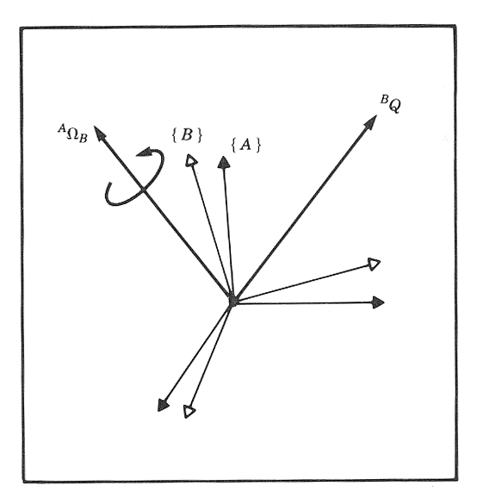
Angular Velocity - Rigid Body
Given: Consider a frame {B} attached to a rigid body whereas frame {A} is fixed. The vector is constant as view from frame {B}
Problem: describe the velocity of the vector representing the the point Q relative to frame {A}
Solution: Even though the vector is constant as view from frame {B} it is clear that point Q will have a velocity as seen from frame {A} due to the rotational velocity
Q
Instructor: Jacob Rosen
Advanced Robotic - MAE 263 - Department of Mechanical & Aerospace Engineering - UCLA

Slide 33
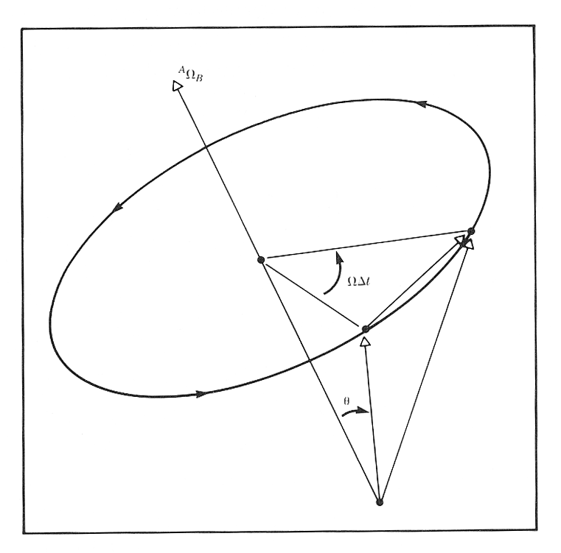












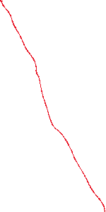












Angular Velocity - Rigid Body - Intuitive Approach
Pure 3D Rotation - The length of the vector Q does not change its length in frame B
In general the vector ${{}_{ }^{A}P}_{Q}$ can change with respect to frame {B}
$${{}_{ }^{A}P}_{Q}=CONST$$
$${{}_{ }^{B}V}_{Q}=0$$
$$Δ{{}_{ }^{A}P}_{Q}=\left(\left|{{}_{ }^{A}P}_{Q}\right|sinθ\right)\left({{}_{ }^{A}Ω}_{Q}Δt\right)$$
$${{}_{ }^{A}V}_{Q}={{}_{ }^{A}Ω}_{Q}×{{}_{ }^{A}P}_{Q}$$
$${{}_{ }^{A}V}_{Q}={}_{ }^{A}{\left({{}_{ }^{B}V}_{Q}\right)}+{{}_{ }^{A}Ω}_{B}×{{}_{ }^{A}P}_{Q}$$
$${{}_{ }^{A}V}_{Q}={}_{B}^{A}R{{}_{ }^{B}V}_{Q}+{{}_{ }^{A}Ω}_{B}×{}_{B}^{A}R{{}_{ }^{B}P}_{Q}$$
Instructor: Jacob Rosen
Advanced Robotic - MAE 263 - Department of Mechanical & Aerospace Engineering - UCLA

Slide 34
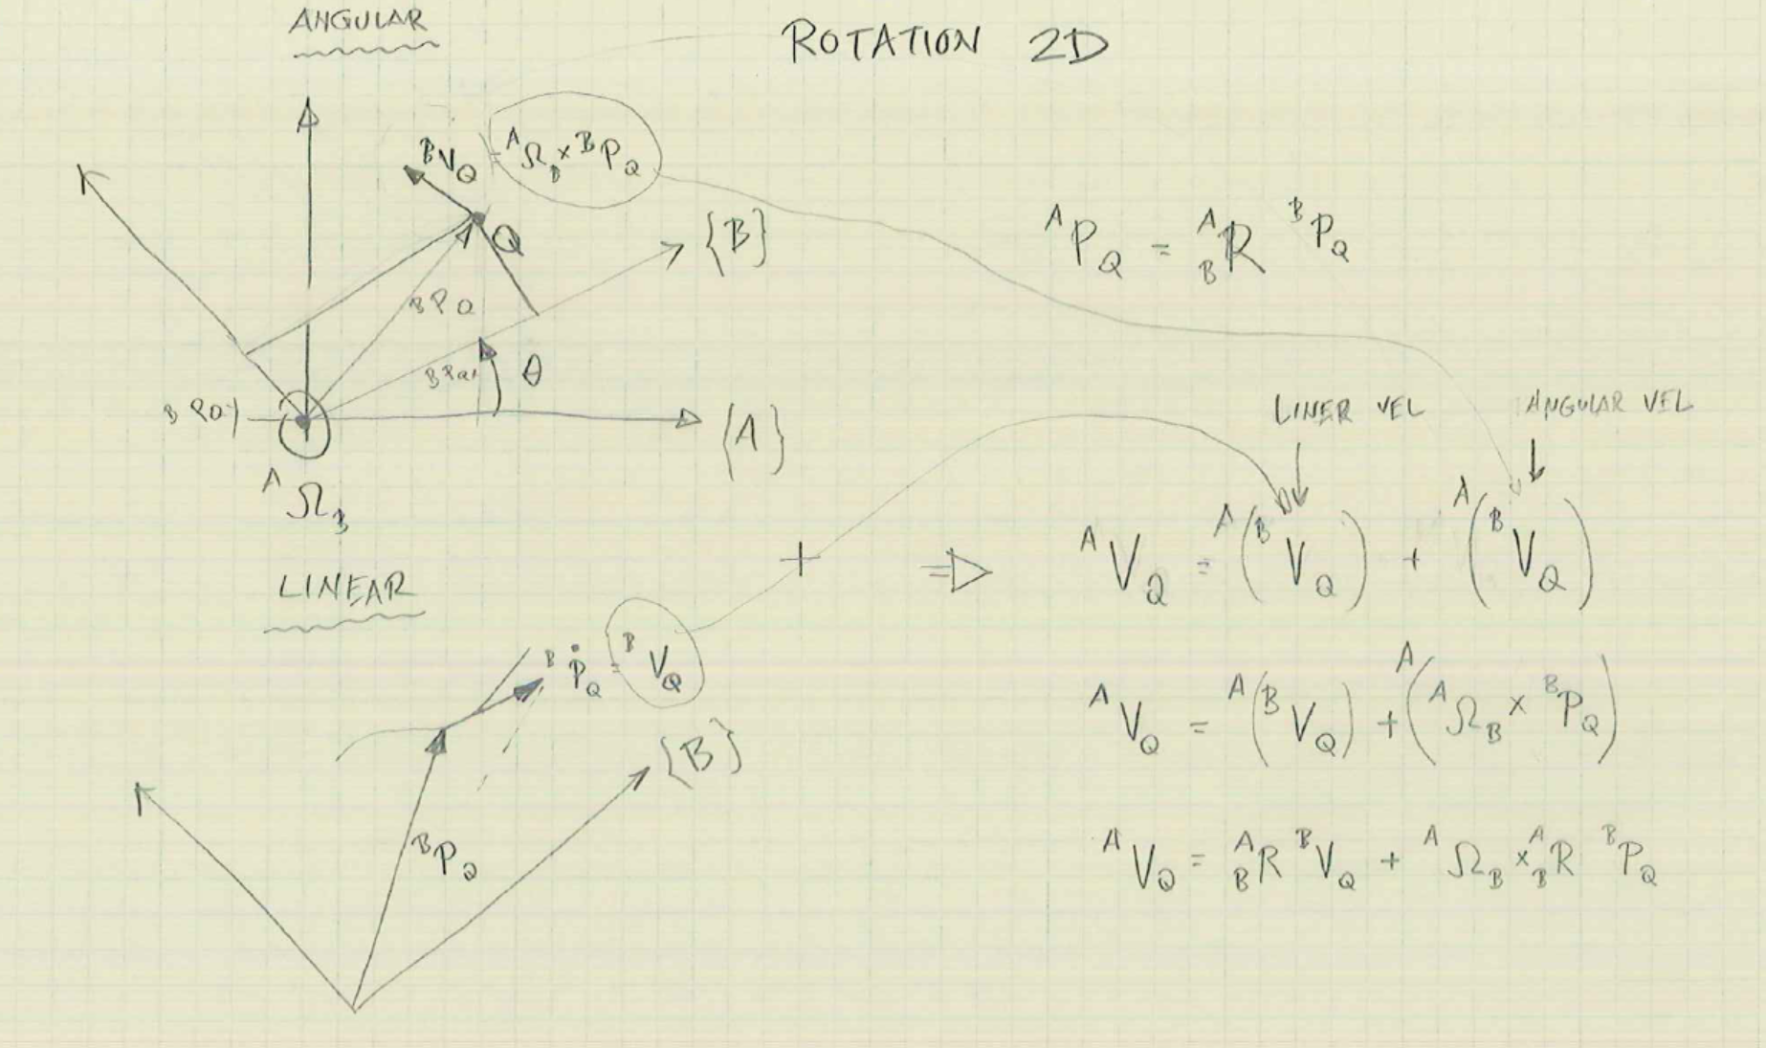




Angular Velocity - Rigid Body - Intuitive Approach
Rotation in 2D
${{}_{ }^{A}P}_{Q}={}_{B}^{A}R$ ${{}_{ }^{B}P}_{Q}$
$${{}_{ }^{A}V}_{Q}={}_{ }^{A}{\left({{}_{ }^{B}V}_{Q}\right)}+{}_{ }^{A}{\left({{}_{ }^{B}V}_{Q}\right)}$$
$${{}_{ }^{A}V}_{Q}={}_{ }^{A}{\left({{}_{ }^{B}V}_{Q}\right)}+{}_{ }^{A}{\left({{}_{ }^{B}Ω}_{Q}×{{}_{ }^{B}P}_{Q}\right)}$$
$${{}_{ }^{A}V}_{Q}={}_{B}^{A}R{{}_{ }^{B}V}_{Q}+{{}_{ }^{A}Ω}_{B}×{}_{B}^{A}R{{}_{ }^{B}P}_{Q}$$
Instructor: Jacob Rosen
Advanced Robotic - MAE 263 - Department of Mechanical & Aerospace Engineering - UCLA

Slide 35
Angular Velocity - Rigid Body - Intuitive Approach
In the general case, the vector Q may also be changing with respect to the frame {B}. Adding this component we get.
Using the rotation matrix to remove the dual-superscript,
Instructor: Jacob Rosen
Advanced Robotic - MAE 263 - Department of Mechanical & Aerospace Engineering - UCLA

Slide 36
Definitions - Angular Velocity
Just as there are many ways to represent orientation (Euler Angles, Roll-Pitch-Yaw Angles, Rotation Matrices, etc.), there are also many ways to represent the rate of change in orientation.
The angular velocity vector is convenient to use because it has an easy to grasp physical meaning. However, the matrix form is useful when performing algebraic manipulations.
Angular Velocity
Representation
Angular Velocity
Vector
Angular Velocity
Matrix
Instructor: Jacob Rosen
Advanced Robotic - MAE 263 - Department of Mechanical & Aerospace Engineering - UCLA

Slide 37
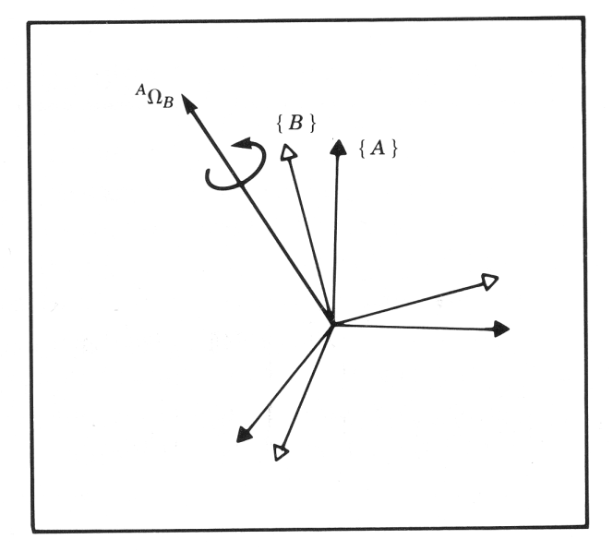


Definitions - Angular Velocity - Vector
Angular Velocity Vector: A vector whose direction is the instantaneous axis of rotation of one frame relative to another and whose magnitude is the rate of rotation about that axis.
The angular velocity vector describes the instantaneous change of rotation of frame {B} relative to frame {A}
$${{}_{ }^{A}Ω}_{B}≡\left[\begin{matrix}Ω_{x} \\ Ω_{y} \\ Ω_{z}\end{matrix}\right]$$
$${{}_{ }^{A}Ω}_{B}$$
Instructor: Jacob Rosen
Advanced Robotic - MAE 263 - Department of Mechanical & Aerospace Engineering - UCLA

Slide 38
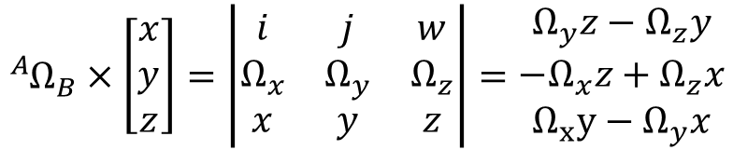
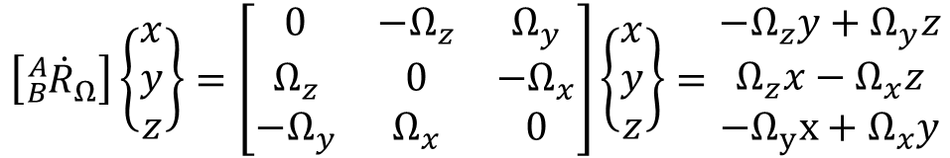
Definitions - Angular Velocity - Matrix
Angular Velocity Matrix:
$$\left[{}_{B}^{A}{{\dot{R}}_{Ω}}\right]\left\{\begin{matrix}x \\ y \\ z\end{matrix}\right\}=\left[\begin{matrix}0 & −Ω_{z} & Ω_{y} \\ Ω_{z} & 0 & −Ω_{x} \\ −Ω_{y} & Ω_{x} & 0\end{matrix}\right]\left\{\begin{matrix}x \\ y \\ z\end{matrix}\right\}=\begin{matrix}−Ω_{z}y+Ω_{y}z \\ Ω_{z}x−Ω_{x}z \\ −Ω_{y}x+Ω_{x}y\end{matrix}$$
$${{}_{ }^{A}Ω}_{B}×\left[\begin{matrix}x \\ y \\ z\end{matrix}\right]=\left|\begin{matrix}i & j & w \\ Ω_{x} & Ω_{y} & Ω_{z} \\ x & y & z\end{matrix}\right|=\begin{matrix}Ω_{y}z−Ω_{z}y \\ −Ω_{x}z+Ω_{z}x \\ Ω_{x}y−Ω_{y}x\end{matrix}$$
Instructor: Jacob Rosen
Advanced Robotic - MAE 263 - Department of Mechanical & Aerospace Engineering - UCLA

Slide 39
Definitions - Angular Velocity - Matrix
The rotation matrix ( ) defines the orientation of frame {B} relative to frame {A}. Specifically, the columns of are the unit vectors of {B} represented in {A}.
If we look at the derivative of the rotation matrix, the columns will be the velocity of each unit vector of {B} relative to {A}:
Instructor: Jacob Rosen
Advanced Robotic - MAE 263 - Department of Mechanical & Aerospace Engineering - UCLA

Slide 40
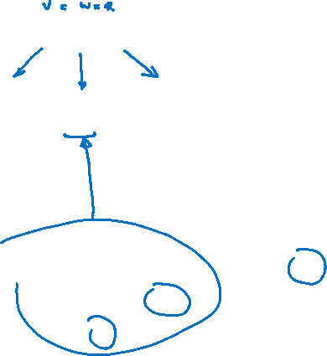
Definitions - Angular Velocity - Matrix
The relationship between the rotation matrix and the derivative of the rotation matrix can be expressed as follows:
where is defined as the angular velocity matrix
Instructor: Jacob Rosen
Advanced Robotic - MAE 263 - Department of Mechanical & Aerospace Engineering - UCLA

Slide 41








Angular Velocity - Matrix & Vector Forms
Matrix Form Vector Form
Definition
Multiply by Constant
Multiply by Vector
Multiply by Matrix
$${\dot{{}_{B}^{A}R}}_{Ω}≡\left[\begin{matrix}0 & −Ω_{z} & Ω_{y} \\ Ω_{z} & 0 & −Ω_{x} \\ −Ω_{y} & Ω_{x} & 0\end{matrix}\right]$$
$${{}_{ }^{A}Ω}_{B}≡\left[\begin{matrix}Ω_{x} \\ Ω_{y} \\ Ω_{z}\end{matrix}\right]$$
$$k \left[{\dot{{}_{B}^{A}R}}_{Ω}\right]$$
$$k \left[{{}_{ }^{A}Ω}_{B}\right]$$
$$\left[{\dot{{}_{B}^{A}R}}_{Ω}\right] \left[\begin{matrix}x \\ y \\ z\end{matrix}\right]$$
$${{}_{ }^{A}Ω}_{B}×\left[\begin{matrix}x \\ y \\ z\end{matrix}\right]=ω × r$$
$$\left[ {}_{t}^{s}R \right] \left[ {\dot{{}_{B}^{A}R}}_{Ω} \right] {\left[ {}_{t}^{s}R \right]}^{ T}$$
$$\left[ {}_{t}^{s}R \right] \left[ {{}_{ }^{A}Ω}_{B} \right]$$
Instructor: Jacob Rosen
Advanced Robotic - MAE 263 - Department of Mechanical & Aerospace Engineering - UCLA

Slide 42


Simultaneous Linear and Rotational Velocity
The final results for the derivative of a vector in a moving frame (linear and rotation velocities) as seen from a stationary frame
Vector Form
Matrix Form
$${{}_{ }^{A}Ω}_{B}$$
$${{}_{ }^{B}P}_{Q}$$
Instructor: Jacob Rosen
Advanced Robotic - MAE 263 - Department of Mechanical & Aerospace Engineering - UCLA

Slide 43
Velocity – Derivation Method No. 3
Homogeneous Transformation Form
Instructor: Jacob Rosen
Advanced Robotic - MAE 263 - Department of Mechanical & Aerospace Engineering - UCLA

Slide 44


Changing Frame of Representation - Linear Velocity
We have already used the homogeneous transform matrix to compute the location of position vectors in other frames:
To compute the relationship between velocity vectors in different frames, we will take the derivative:
$${{}_{ }^{A}Ω}_{B}$$
$${{}_{ }^{B}P}_{Q}$$
Instructor: Jacob Rosen
Advanced Robotic - MAE 263 - Department of Mechanical & Aerospace Engineering - UCLA

Slide 45
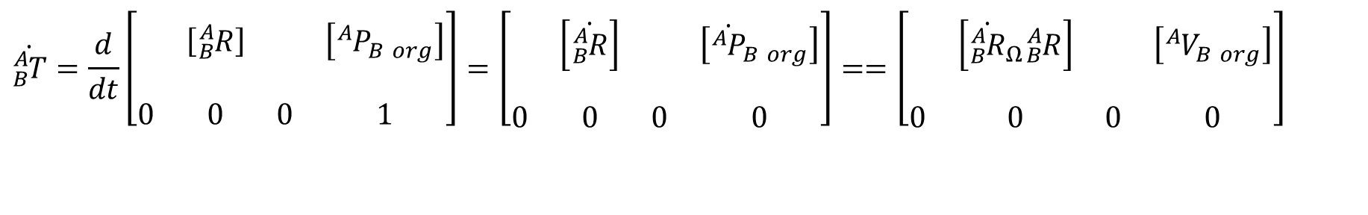

Changing Frame of Representation - Linear Velocity
Recall that
so that the derivative is
$${}_{B}^{A}T=\left[\begin{matrix} & & & \\ & \left[{}_{B}^{A}R\right] & & \left[{{}_{ }^{A}P}_{B org}\right] \\ & & & \\ 0 & 0 & 0 & 1\end{matrix}\right]$$
$$\dot{{}_{B}^{A}T}=\frac{d}{dt}\left[\begin{matrix} & & & \\ & \left[{}_{B}^{A}R\right] & & \left[{{}_{ }^{A}P}_{B org}\right] \\ & & & \\ 0 & 0 & 0 & 1\end{matrix}\right]=\left[\begin{matrix} & & & \\ & \left[\dot{{}_{B}^{A}R}\right] & & \left[{\dot{{}_{ }^{A}P}}_{B org}\right] \\ & & & \\ 0 & 0 & 0 & 0\end{matrix}\right]==\left[\begin{matrix} & & & \\ & \left[{\dot{{}_{B}^{A}R}}_{Ω}{}_{B}^{A}R\right] & & \left[{{}_{ }^{A}V}_{B org}\right] \\ & & & \\ 0 & 0 & 0 & 0\end{matrix}\right]$$
Instructor: Jacob Rosen
Advanced Robotic - MAE 263 - Department of Mechanical & Aerospace Engineering - UCLA

Slide 46
Changing Frame of Representation - Linear Velocity
Substitute the previous results into the original equation we get
This expression is equivalent to the following three-part expression:
Instructor: Jacob Rosen
Advanced Robotic - MAE 263 - Department of Mechanical & Aerospace Engineering - UCLA

Slide 47
Changing Frame of Representation - Linear Velocity
Converting from matrix to vector form yields
Instructor: Jacob Rosen
Advanced Robotic - MAE 263 - Department of Mechanical & Aerospace Engineering - UCLA

Slide 48
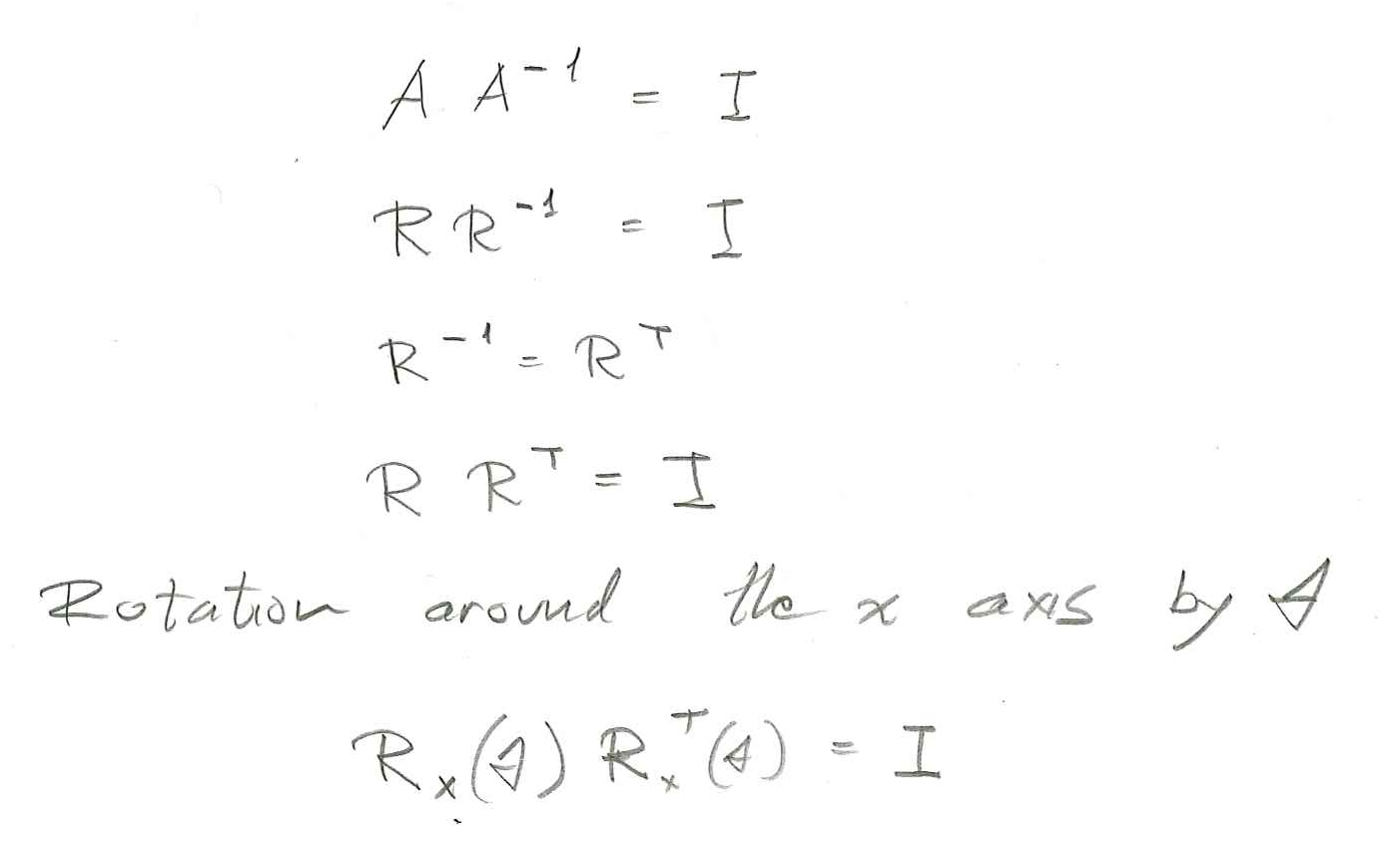
Time Derivative of the Rotation Matrix
Instructor: Jacob Rosen
Advanced Robotic - MAE 263 - Department of Mechanical & Aerospace Engineering - UCLA

Slide 49
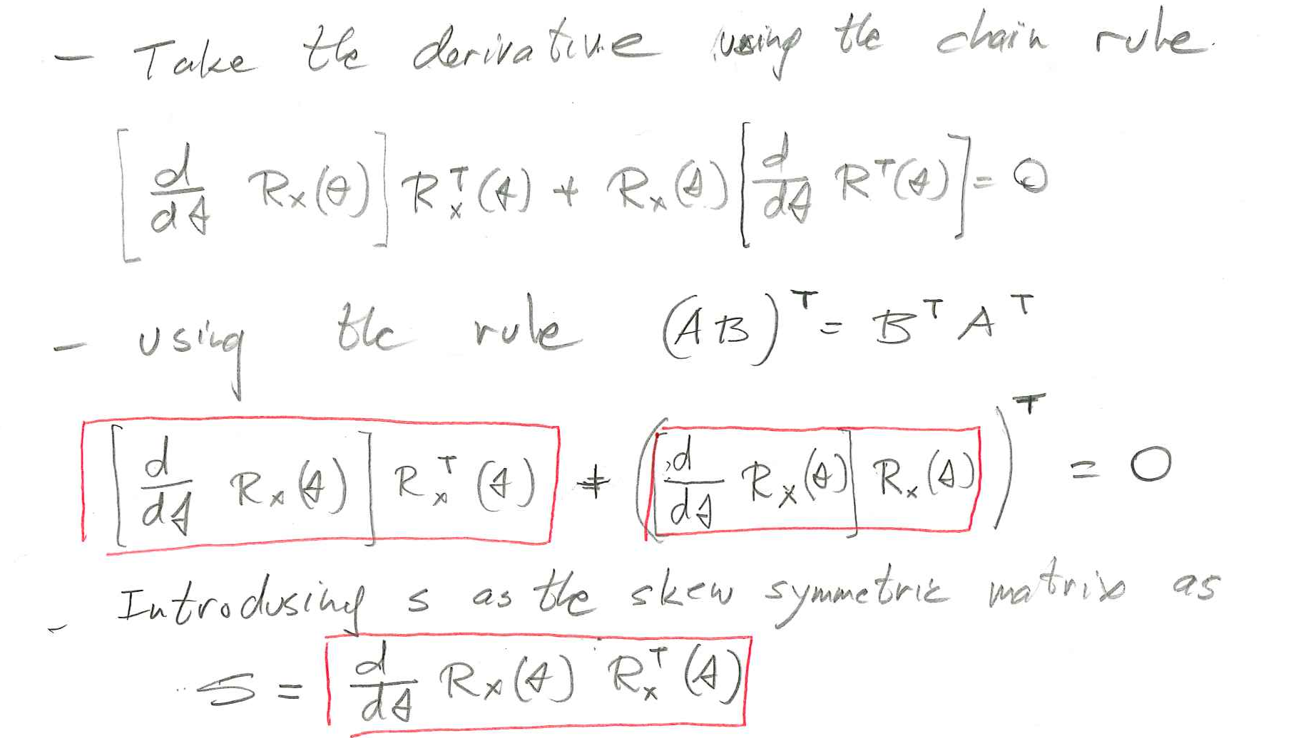
Time Derivative of the Rotation Matrix
Instructor: Jacob Rosen
Advanced Robotic - MAE 263 - Department of Mechanical & Aerospace Engineering - UCLA

Slide 50
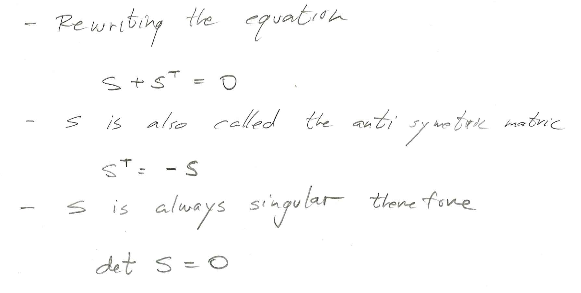
Time Derivative of the Rotation Matrix
Instructor: Jacob Rosen
Advanced Robotic - MAE 263 - Department of Mechanical & Aerospace Engineering - UCLA

Slide 51
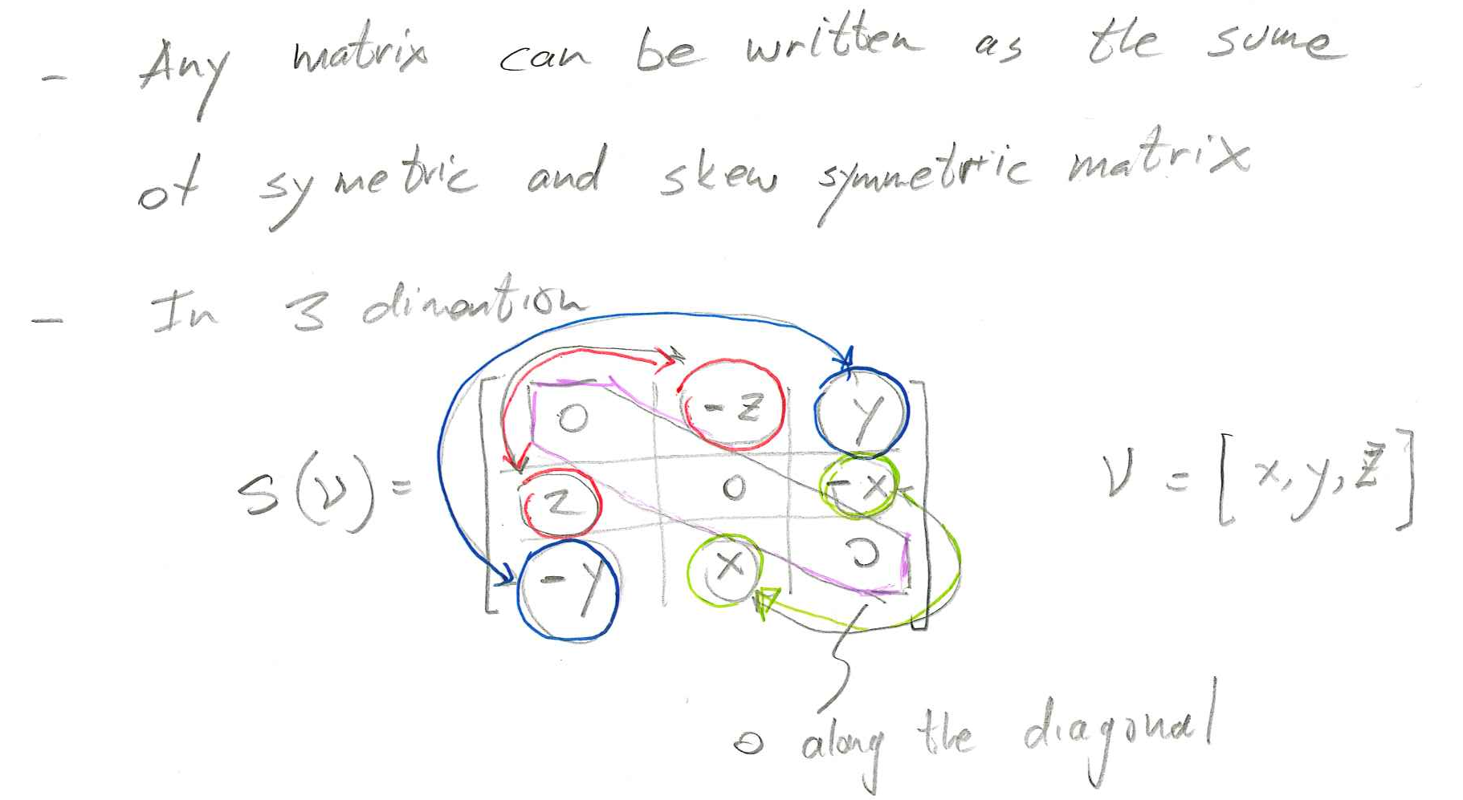
Time Derivative of the Rotation Matrix
Instructor: Jacob Rosen
Advanced Robotic - MAE 263 - Department of Mechanical & Aerospace Engineering - UCLA

Slide 52
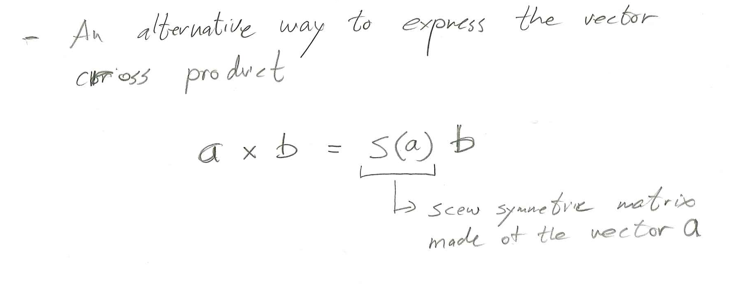
Time Derivative of the Rotation Matrix
Instructor: Jacob Rosen
Advanced Robotic - MAE 263 - Department of Mechanical & Aerospace Engineering - UCLA

Slide 53
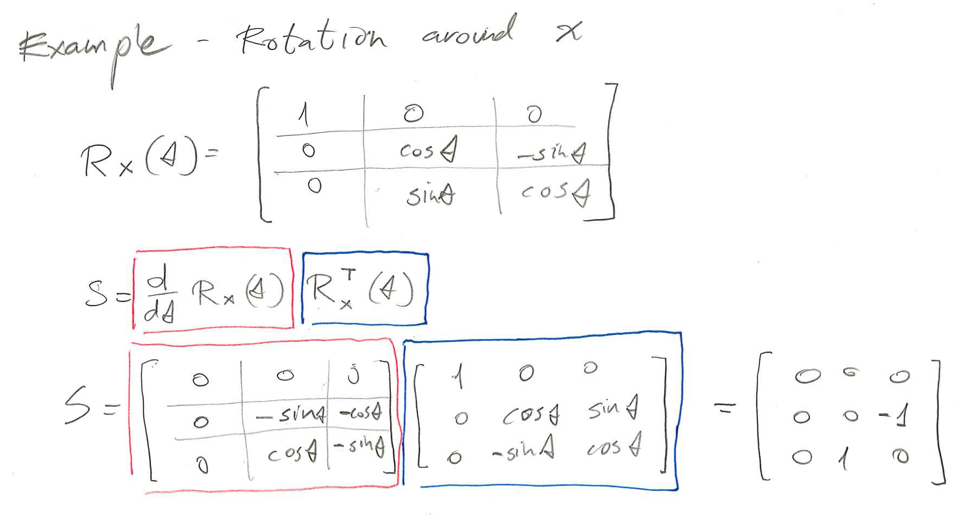
Time Derivative of the Rotation Matrix
Instructor: Jacob Rosen
Advanced Robotic - MAE 263 - Department of Mechanical & Aerospace Engineering - UCLA

Slide 54
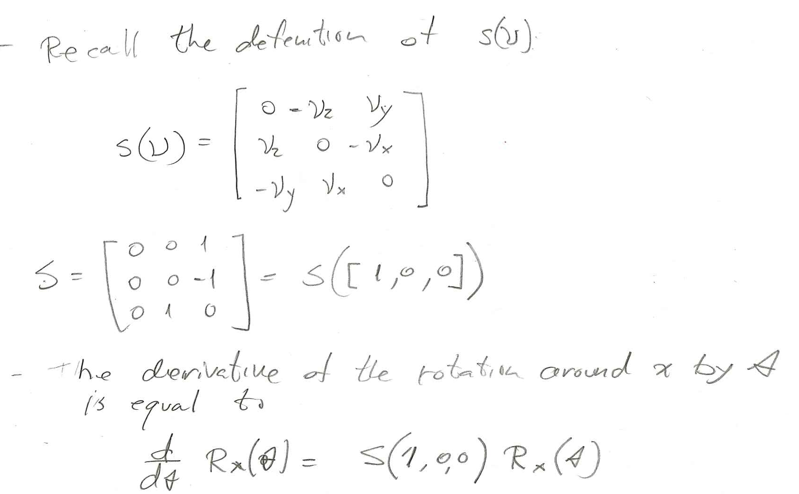
Time Derivative of the Rotation Matrix
Instructor: Jacob Rosen
Advanced Robotic - MAE 263 - Department of Mechanical & Aerospace Engineering - UCLA

Slide 55
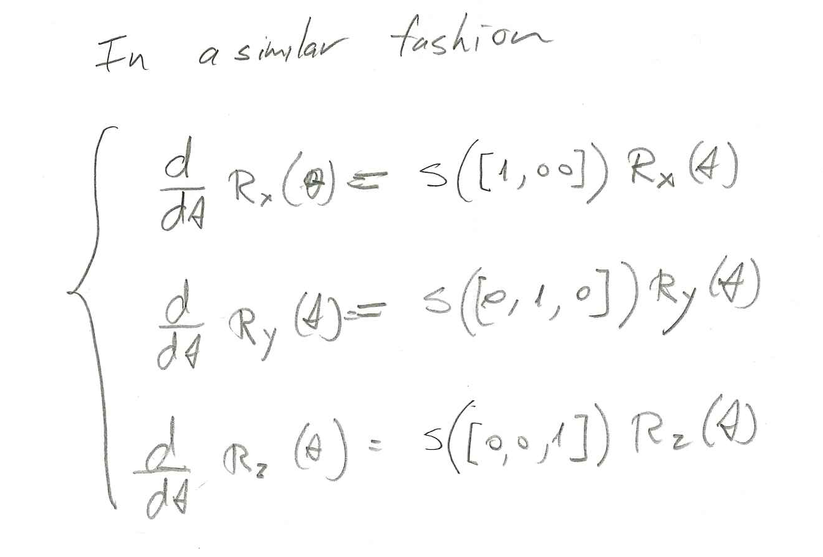
Time Derivative of the Rotation Matrix
Instructor: Jacob Rosen
Advanced Robotic - MAE 263 - Department of Mechanical & Aerospace Engineering - UCLA

Slide 56
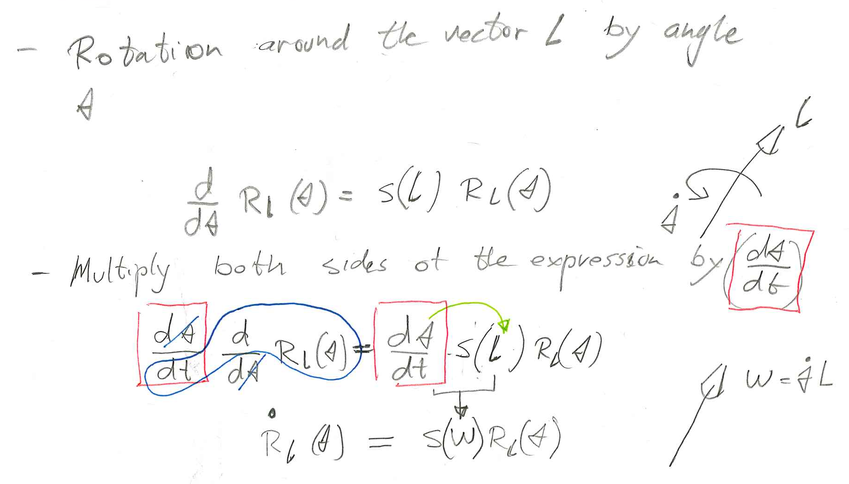
Time Derivative of the Rotation Matrix
Instructor: Jacob Rosen
Advanced Robotic - MAE 263 - Department of Mechanical & Aerospace Engineering - UCLA

Slide 57
Scenarios 2
Angular Velocity
Changing the Frame of Representation
Instructor: Jacob Rosen
Advanced Robotic - MAE 263 - Department of Mechanical & Aerospace Engineering - UCLA

Slide 58
Sensation 2 – Two Consecutive Rotation
Given - Three frames i.e frame {A} and frame {B} frame {C} all sharing the same origin. Frame {A} is stationary and Frames {B} and {C} rotate
Two actions take place simultaneously
  Frame B rotates with respect to frame A along an axis defined by the vector ${{}_{ }^{A}Ω}_{B}$
  Frame C rotates with respect to frame B along an axis defined by the vector ${{}_{ }^{B}Ω}_{C}$
Challenge – Express the rotation of frame {C} with respect to frame {A} or alternatively express the vector ${{}_{ }^{A}Ω}_{C}$
Instructor: Jacob Rosen
Advanced Robotic - MAE 263 - Department of Mechanical & Aerospace Engineering - UCLA

Slide 59
Angular Velocity – Changing the Frame of Representation – Scenario No.2
Angular Velocity Representation in Various Frames
  Vector Form
  Matrix Form
Instructor: Jacob Rosen
Advanced Robotic - MAE 263 - Department of Mechanical & Aerospace Engineering - UCLA

Slide 60
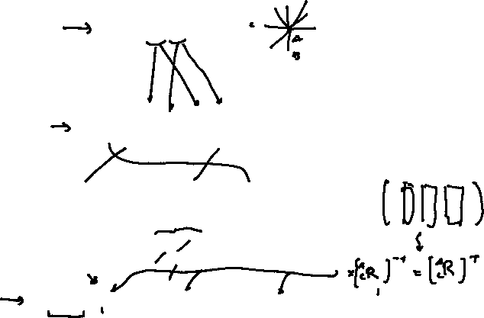
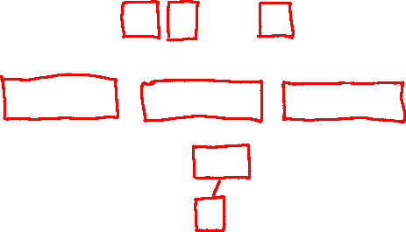
Changing Frame of Representation - Angular Velocity
We use rotation matrices to represent angular position so that we can compute the angular position of {C} in {A} if we know the angular position of {C} in {B} and {B} in {A} by
To derive the relationship describing how angular velocity propagates between frames, we will take the derivative
Substituting the angular velocity matrixes
we find
Instructor: Jacob Rosen
Advanced Robotic - MAE 263 - Department of Mechanical & Aerospace Engineering - UCLA

Slide 61

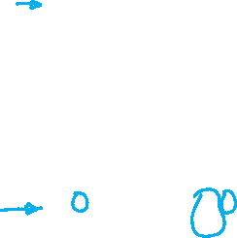

Changing Frame of Representation - Angular Velocity
Post-multiplying both sides by ,which for rotation matrices, is equivalent to
The above equation provides the relationship for changing the frame of representation of angular velocity matrices.
The vector form is given by
To summarize, the angular velocities of frames may be added as long as they are expressed in the same frame.
Instructor: Jacob Rosen
Advanced Robotic - MAE 263 - Department of Mechanical & Aerospace Engineering - UCLA

Slide 62
Summary
Instructor: Jacob Rosen
Advanced Robotic - MAE 263 - Department of Mechanical & Aerospace Engineering - UCLA

Slide 63
Simultaneous Linear and Rotational Velocity - Scenario No.1
Vector Form (Method No. 1)
Matrix Form (Method No. 2)
Matrix Formulation – Homogeneous Transformation Form – Method No. 3
$${{}_{ }^{A}V}_{Q}=f({{}_{ }^{B}P}_{Q}, {{}_{ }^{B}V}_{Q}, {{}_{ }^{A}V}_{BORG}, {{}_{ }^{A}Ω}_{B}, {}_{B}^{A}R)$$
$${{}_{ }^{A}Ω}_{B}$$
$${{}_{ }^{B}P}_{Q}$$
$${{}_{ }^{A}V}_{Q}={{}_{ }^{A}V}_{BORG}+{}_{B}^{A}R{{}_{ }^{B}V}_{Q}+{{}_{ }^{A}Ω}_{B}×{}_{B}^{A}R{{}_{ }^{B}P}_{Q}$$
$${{}_{ }^{A}V}_{Q}={{}_{ }^{A}V}_{BORG}+{}_{B}^{A}R{{}_{ }^{B}V}_{Q}+{\dot{{}_{B}^{A}R}}_{Ω}\left({}_{B}^{A}R{{}_{ }^{B}P}_{Q}\right)$$
$$\left[\begin{matrix}\left[{{}_{ }^{A}V}_{Q}\right] \\ 0\end{matrix}\right]=\left[\begin{matrix}\left[{\dot{{}_{B}^{A}R}}_{Ω}⋅{}_{B}^{A}R\right] & \left[{{}_{ }^{A}V}_{B org}\right] \\ 0 0 0 & 0\end{matrix}\right]\left[\begin{matrix}\left[{{}_{ }^{B}P}_{Q }\right] \\ 1\end{matrix}\right]+\left[\begin{matrix}\left[{}_{B}^{A}R\right] & \left[{{}_{ }^{A}P}_{B org}\right] \\ 0 0 0 & 1\end{matrix}\right]\left[\begin{matrix}\left[{{}_{ }^{B}V}_{Q}\right] \\ 0\end{matrix}\right]$$
Instructor: Jacob Rosen
Advanced Robotic - MAE 263 - Department of Mechanical & Aerospace Engineering - UCLA

Slide 64
Angular Velocity – Changing the Frame of Representation – Scenario No.2
Angular Velocity Representation in Various Frames
  Vector Form
  Matrix Form
Instructor: Jacob Rosen
Advanced Robotic - MAE 263 - Department of Mechanical & Aerospace Engineering - UCLA

Slide 65
Linear Algebra - Review
Instructor: Jacob Rosen
Advanced Robotic - MAE 263 - Department of Mechanical & Aerospace Engineering - UCLA

Slide 66

Brief Linear Algebra Review - 1/
Inverse of Matrix A exists if and only if the determinant of A is non-zero.
Exists if and only if
If the determinant of A is equal to zero, then the matrix A is a singular matrix
Singular
Instructor: Jacob Rosen
Advanced Robotic - MAE 263 - Department of Mechanical & Aerospace Engineering - UCLA

Slide 67

Brief Linear Algebra Review - 2/
The rank of the matrix A is the size of the largest squared Matrix S for which
Example 1 -
Example 2 -
Instructor: Jacob Rosen
Advanced Robotic - MAE 263 - Department of Mechanical & Aerospace Engineering - UCLA

Slide 68
Brief Linear Algebra Review - 3/
If two rows or columns of matrix A are equal or related by a constant, then
Example
Instructor: Jacob Rosen
Advanced Robotic - MAE 263 - Department of Mechanical & Aerospace Engineering - UCLA

Slide 69
Brief Linear Algebra Review - 4/
Eigenvalues
Eigenvalues are the roots of the polynomial
If each solution to the characteristic equation (Eigenvalue) has a corresponding Eigenvector
Instructor: Jacob Rosen
Advanced Robotic - MAE 263 - Department of Mechanical & Aerospace Engineering - UCLA

Slide 70



Brief Linear Algebra Review - 4/
Wikipedai - https://en.wikipedia.org/wiki/Eigenvalues_and_eigenvectors
Instructor: Jacob Rosen
Advanced Robotic - MAE 263 - Department of Mechanical & Aerospace Engineering - UCLA

Slide 71
Brief Linear Algebra Review - 4/
Instructor: Jacob Rosen
Advanced Robotic - MAE 263 - Department of Mechanical & Aerospace Engineering - UCLA

Slide 72

Brief Linear Algebra Review - 4/
Instructor: Jacob Rosen
Advanced Robotic - MAE 263 - Department of Mechanical & Aerospace Engineering - UCLA

Slide 73
Brief Linear Algebra Review - 5/
Any singular matrix ( ) has at least one Eigenvalue equal to zero
Instructor: Jacob Rosen
Advanced Robotic - MAE 263 - Department of Mechanical & Aerospace Engineering - UCLA

Slide 74
Brief Linear Algebra Review - 6/
If A is non-singular ( ), and is an eigenvalue of A with corresponding to eigenvector X, then
Instructor: Jacob Rosen
Advanced Robotic - MAE 263 - Department of Mechanical & Aerospace Engineering - UCLA

Slide 75
Brief Linear Algebra Review - 7/
If the n x n matrix A is of full rank (that is, Rank (A) = n), then the only solution to
is the trivial one
If A is of less than full rank (that is Rank (A) < n), then there are n-r linearly independent (orthogonal) solutions
for which
Instructor: Jacob Rosen
Advanced Robotic - MAE 263 - Department of Mechanical & Aerospace Engineering - UCLA

Slide 76
Brief Linear Algebra Review - 8/
If A is square, then A and A^{T} have the same eigenvalues
Instructor: Jacob Rosen
Advanced Robotic - MAE 263 - Department of Mechanical & Aerospace Engineering - UCLA

