Slide 1
Robotic System Architecture
High Level Introduction

Slide 2
Robotic System – Definitions

Slide 3
Robotic System – Definition – Merrian Webster
Robot (noun)
ro·​bot | \ ˈrō-ˌbät , -bət \
plural robots
Definition of robot
1: a machine that resembles a living creature in being capable of moving independently (as by walking or rolling on wheels) and performing complex actions (such as grasping and moving objects)
Often : such a machine built to resemble a human being or animal in appearance and behavior.
2a: a device that automatically performs complicated, often repetitive tasks (as in an industrial assembly line)
b: a mechanism guided by automatic controls
Did you Know?
In 1920, Czech writer Karel Čapek published a play titled R.U.R. Those initials stood for "Rossum's Universal Robots," which was the name of a fictional company that manufactured human-like machines designed to perform hard, dull, dangerous work for people. The machines in the play eventually grew to resent their jobs and rebelled—with disastrous results for humans. During the writing of his play, Čapek consulted with his brother, the painter and writer Josef Čapek, who suggested the name robot for these machines, from the Czech word robota, which means "forced labor." Robot made its way into our language in 1922 when R.U.R. was translated into English.

Slide 4
Robotic System – Definition – Britanica
Robot (noun)
ro·​bot | \ ˈrō-ˌbät , -bət \
plural robots
Definition of robot
1: a machine that resembles a living creature in being capable of moving independently (as by walking or rolling on wheels) and performing complex actions (such as grasping and moving objects)
Often : such a machine built to resemble a human being or animal in appearance and behavior.
2a: a device that automatically performs complicated, often repetitive tasks (as in an industrial assembly line)
b: a mechanism guided by automatic controls

Slide 5

Robotic System – Definition – IEEE
https://robots.ieee.org/learn/what-is-a-robot/
Rodney Brooks
Professor of Robotics Emeritus at MIT, Co-founder and CTO of Robust AI
Three characteristics of a robotic system
1. Sense
2. Compute
3. Act

Slide 6
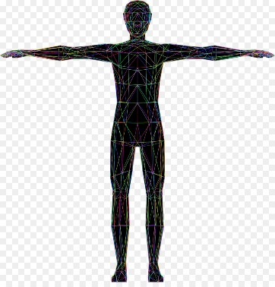
Robotic System – Definition
Environment
Manipulation
Air
Space
Robot
Sense
Compute
Think (Intelligence)
Act
Asses
4
Ground
Water
Mobility

Slide 7
Fundamental Problems in
Robotics Manipulation

Slide 8
Task Description

Slide 9
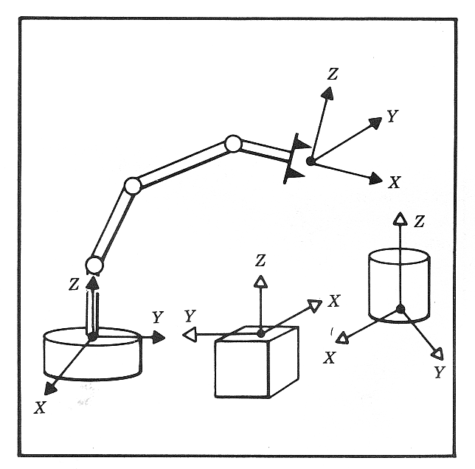
Description of Positioning Task
Problem
Given: The manipulator geometrical parameters
Specify: The position and orientation of manipulator
Solution
Coordinate system or “Frames” are attached to the manipulator (using the DH convention) and objects in the environment

Slide 10
Kinematics
Forward, Inverse, Jacobian (Velocity, Force)

Slide 11
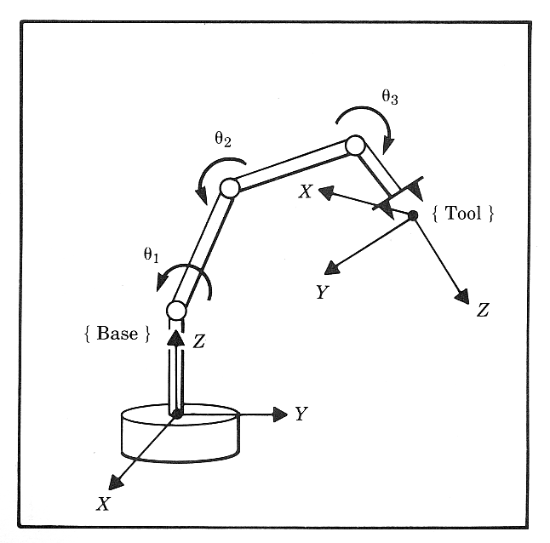
Forward (Direct) Kinematics (FK)
Problem
Given: Joint angles and links geometry
Compute: Position and orientation of the end effector relative to the base frame
Solution
Kinematic Equations - Linear Transformation (4x4 matrix) which is a function of the joint positions (angles & displacements) and specifies the EE configuration in the base frame.
Note
Mapping First to Last Joint - The FK address the pose of every joint with respect the base frame (Frame 0) and in particular the pose of the last frame of the manipulator (e.g. frame 6 for a 6 DOF manipulator)
Mapping Last Joint to Tool Tip - The mapping between the tool tip and the last frame is known by definition. This mapping may change based on the tool being used therefore it is not included in the FK analysis that focused on the core of the robotic arm (e.g. the first 6 joint of the robotic arm)
Where is the Tool -The FK kinematics in general including the mapping of the tool tip with respect to the last joint answers the question of where is the tool

Slide 12
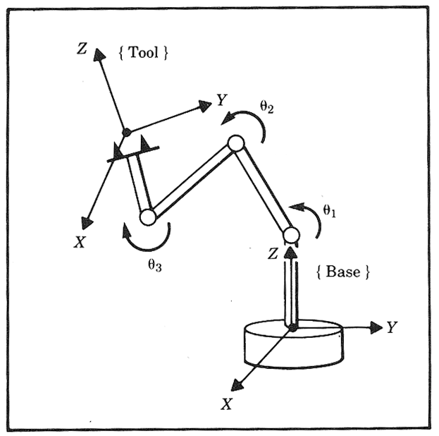
Inverse Kinematics
Problem
Given: Position and orientation of the end effector relative to the base frame
Compute: All possible sets of joint angles and links geometry which could be used to attain the given position and orientation of the end effetor.
Solution
Does a close form solution exist?
Close Form Solutions - There are three approaches for the solution:
Analytical Approach - Kinematic Equations - Linear Transformation (4x4 matrix) which is a function of the joint positions (angles & displacements) and specifies the EE configuration in the base frame. This linear transformation defines 12 non linear equations A subset of these equations are used for obtaining the invers kinematics
Geometric Approach – Projecting the arm configurations on specific planes and using geometrical consideration to obtain the invers kinematics
Hybrid Approach - Synthesizing the analytical and the geometrical approaches
Non Close Form Solution
Numerical Solution

Slide 13
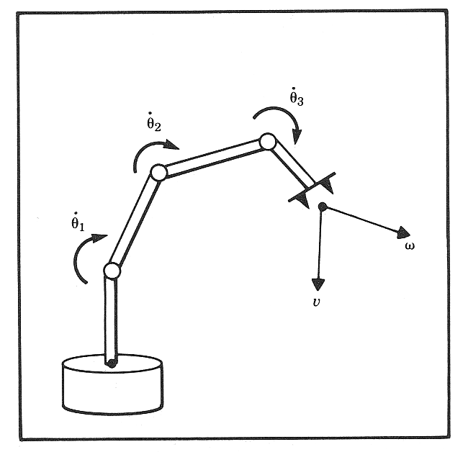
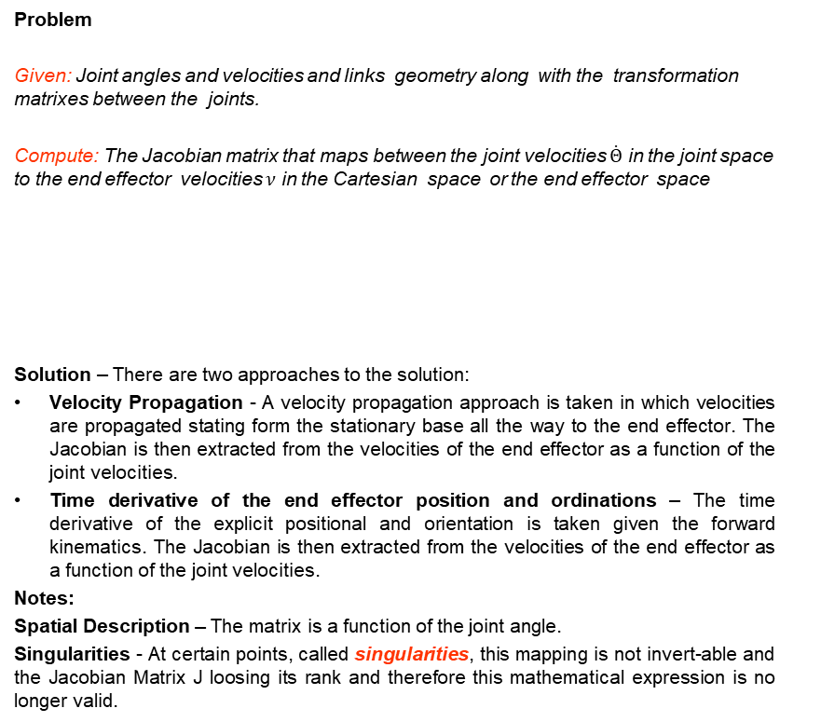
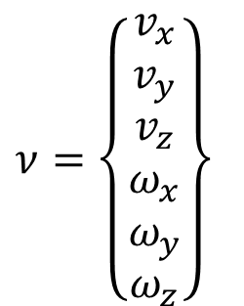
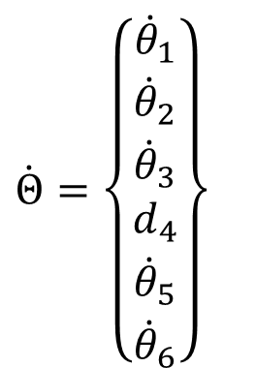


Velocity Transformation
Problem
Given: Joint angles and velocities and links geometry along with the transformation matrixes between the joints.
Compute: The Jacobian matrix that maps between the joint velocities $\dot{Θ}$ in the joint space to the end effector velocities $ν$ in the Cartesian space or the end effector space
Solution – There are two approaches to the solution:
Velocity Propagation - A velocity propagation approach is taken in which velocities are propagated stating form the stationary base all the way to the end effector. The Jacobian is then extracted from the velocities of the end effector as a function of the joint velocities.
Time derivative of the end effector position and ordinations – The time derivative of the explicit positional and orientation is taken given the forward kinematics. The Jacobian is then extracted from the velocities of the end effector as a function of the joint velocities.
Notes:
Spatial Description – The matrix is a function of the joint angle.
Singularities - At certain points, called singularities, this mapping is not invert-able and the Jacobian Matrix J loosing its rank and therefore this mathematical expression is no longer valid.
$$\dot{Θ}=\left\{\begin{matrix}{\dot{θ}}_{1} \\ {\dot{θ}}_{2} \\ {\dot{θ}}_{3} \\ d_{4} \\ {\dot{θ}}_{5} \\ {\dot{θ}}_{6}\end{matrix}\right\}$$
$$ν=J^{ }(Θ)\dot{Θ}$$
$$\dot{Θ}=J^{−1}(Θ)ν$$
$$ν=\left\{\begin{matrix}v_{x} \\ v_{y} \\ v_{z} \\ ω_{x} \\ ω_{y} \\ ω_{z}\end{matrix}\right\}$$

Slide 14
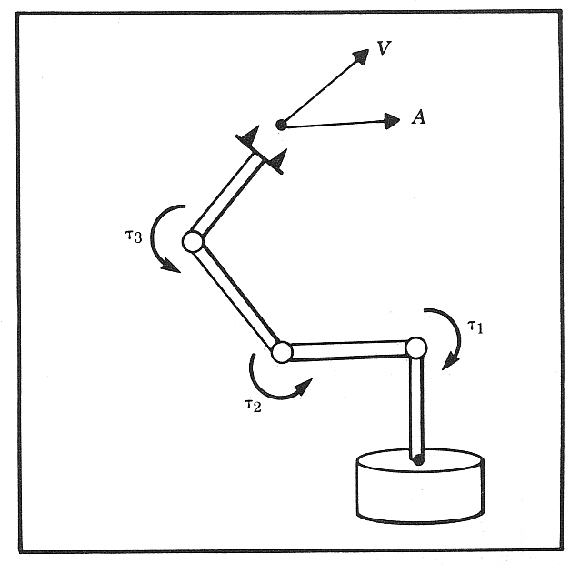

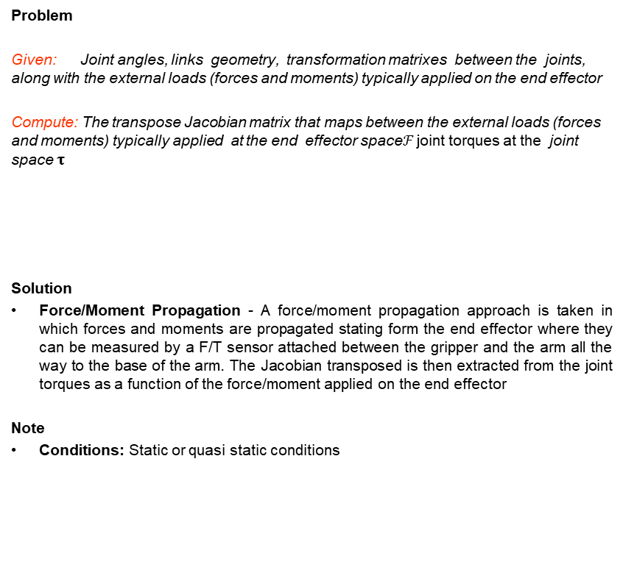
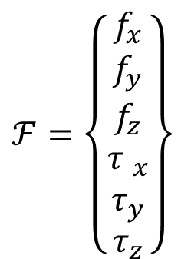
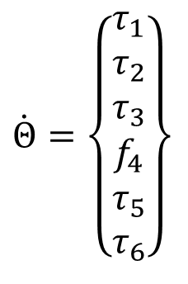


Force Transformation
Problem
Given: Joint angles, links geometry, transformation matrixes between the joints, along with the external loads (forces and moments) typically applied on the end effector
Compute: The transpose Jacobian matrix that maps between the external loads (forces and moments) typically applied at the end effector space$ℱ$ joint torques at the joint space $τ$
Solution
Force/Moment Propagation - A force/moment propagation approach is taken in which forces and moments are propagated stating form the end effector where they can be measured by a F/T sensor attached between the gripper and the arm all the way to the base of the arm. The Jacobian transposed is then extracted from the joint torques as a function of the force/moment applied on the end effector
Note
Conditions: Static or quasi static conditions
$$\dot{Θ}=\left\{\begin{matrix}τ_{1} \\ τ_{2} \\ τ_{3} \\ f_{4} \\ τ_{5} \\ τ_{6}\end{matrix}\right\}$$
$$f$$
$$τ$$
$$τ=J^{T}ℱ$$
$$ℱ=\left\{\begin{matrix}f_{x} \\ f_{y} \\ f_{z} \\ {τ }_{x} \\ τ_{y} \\ τ_{z}\end{matrix}\right\}$$

Slide 15
Dynamics

Slide 16



Forward Dynamics
Problem
Given: Joint torques and links geometry, mass, inertia, friction
Compute: Angular acceleration of the links (i.e. Solve Differential Equations)
Solution
Dynamic Equations - Newton-Euler method or Lagrangian Dynamics
$$f$$
$$τ$$
$$τ=M(Θ)\ddot{Θ}+V(Θ,\dot{Θ})+G(Θ)+𝓕(Θ,\dot{Θ})$$

Slide 17


Inverse Dynamics
Problem
Given: Angular acceleration, velocity and angels of the links in addition to the links geometry, mass, inertia, friction
Compute: Joint torques (i.e. Solve Algebraic Equation)
Solution
Dynamic Equations - Newton-Euler method or Lagrangian Dynamics
$$f$$
$$τ$$
$$τ=M(Θ)\ddot{Θ}+V(Θ,\dot{Θ})+G(Θ)+𝓕(Θ,\dot{Θ})$$

Slide 18
Trajectory
Join Space, Task (End Effector) Space

Slide 19
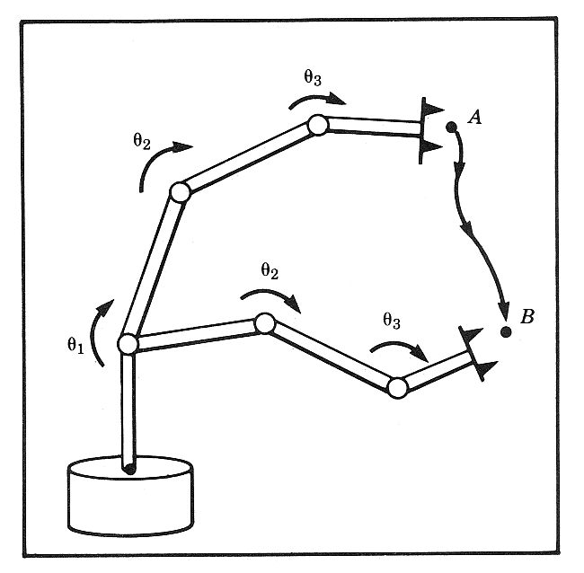
Trajectory Generation
Problem
Given: Manipulator geometry
Compute: The trajectory of each joint such that the end efferctor move in space from point A to Point B
Solution
Third order (or higher) polynomial, spline.
Interpolation in either:
Task / End Effector Space
Joint Space

Slide 20
Control
Position, Force, Hybrid, Impedance, Teleoperation

Slide 21
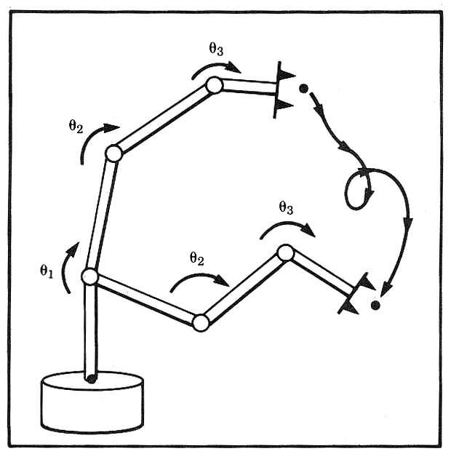
Position Control
Problem
Given: Joint angles (sensor readings) links geometry, mass, inertia, friction
Compute: Joint torques to achieve an end effector trajectory
Solution
Control Algorithm (PID - Feedback loop, Feed forward dynamic control)

Slide 22
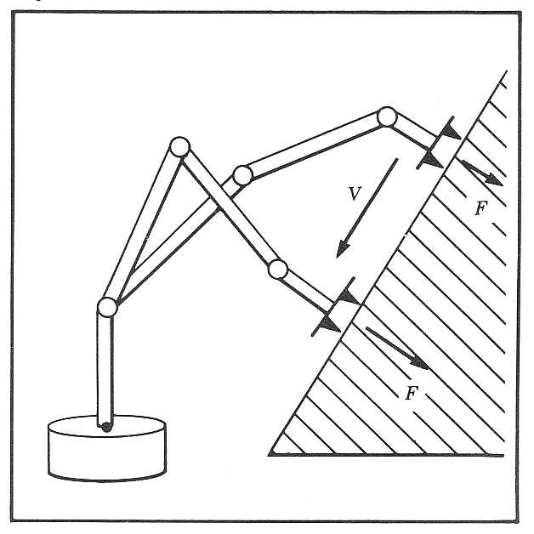
Force Control
Problem
Given: Joint torque or end effector Force/torque interaction (sensor readings) links geometry, mass, inertia, friction
Compute: Joint torques to achieve an end effector forces an torques
Solution
Control Algorithm (force control)

Slide 23
Hybrid Control
Problem
Scraping paint from a surface
Solution
Control type: Hybrid Control
Note: It is possible to control position (velocity) OR force (torque), but not both of them simultaneously along a given DOF. The environment impedance enforces a relationship between the two
Assumption:
The tool is stiff
The position and orientation of the window is NOT known with accurately respect to the robot base.
A contact force normal to the surface transmitted between the end effector and the surface is defined
Position control - tangent to the surface
Force control – normal to the surface

Slide 24
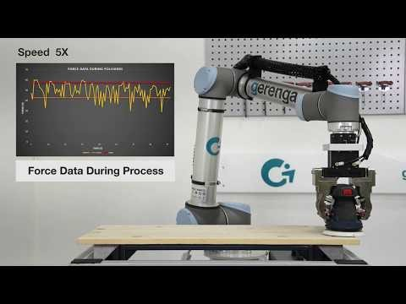
Universal Robots "Force Control Surface Grinding"

Slide 25
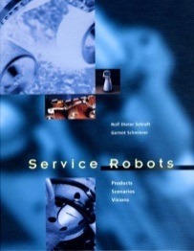
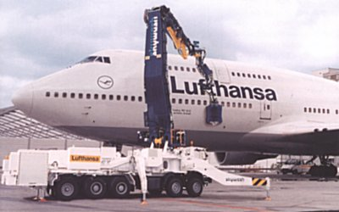
Hybrid Control - Robotic Systems - Cleaning
SKYWASH
AEG, Dornier, Fraunhofer Institute, Putzmeister - Germany
Using 2 Skywash robots for cleaning a Boeing 747-400 jumbo jet, its grounding time is reduced from 9 to 3.5 hours. The world´s largest cleaning brush travels a distance of approximately 3.8 kilometers and covers a surface of around 2,400 m² which is about 85% of the entire plane´s surface area.
The kinematics consist of 5 main joints for the robot´s arm, and an additional one for the turning circle of the rotating washing brush.The Skywash includes database that contains the aircraft-specific geometrical data.
A 3-D distance camera accurately positions the mobile robot next to the aircraft. The 3-D camera and the computer determine the aircraft´s ideal positioning, and thus the cleaning process begins.

Slide 26
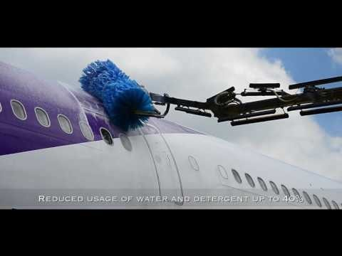
NORDIC DINO - Superior Aircraft washing machine

Slide 27

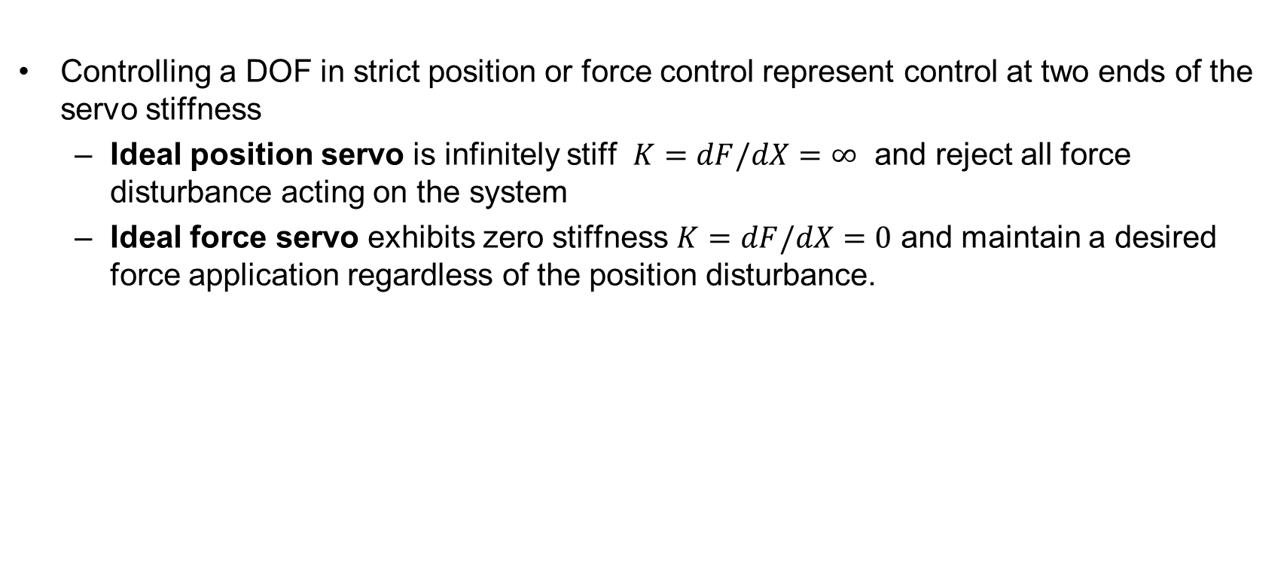



Impedance Control
Controlling a DOF in strict position or force control represent control at two ends of the servo stiffness
  Ideal position servo is infinitely stiff $K=dF/dX=∞$ and reject all force disturbance acting on the system
  Ideal force servo exhibits zero stiffness $K=dF/dX=0$ and maintain a desired force application regardless of the position disturbance.
Controlling variable |  | Stiffness
Position (P)
Force (F)
$$P_{d}−P=0$$
$$K=dF/dX=∞$$
$$F_{d}−F=0$$
$$K=dF/dX=0$$

Slide 28
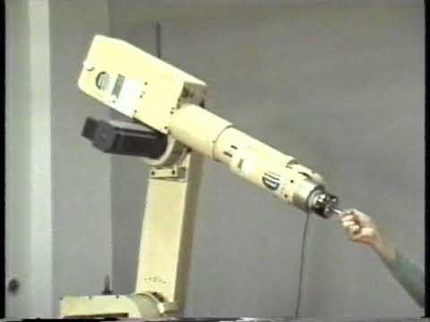
Robot Control

Slide 29
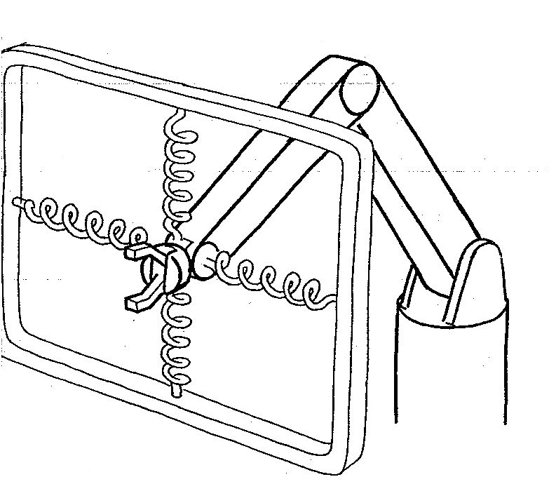
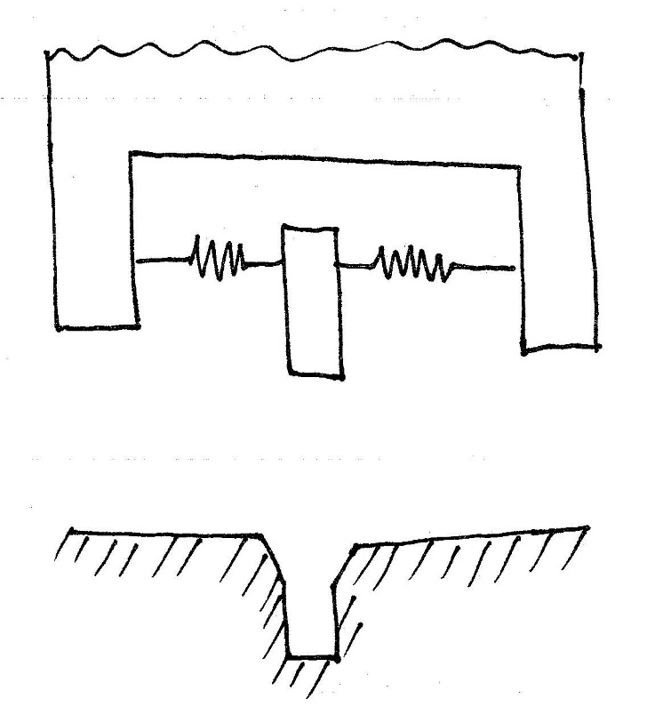
Impedance Control
Virtual Springs

Slide 30
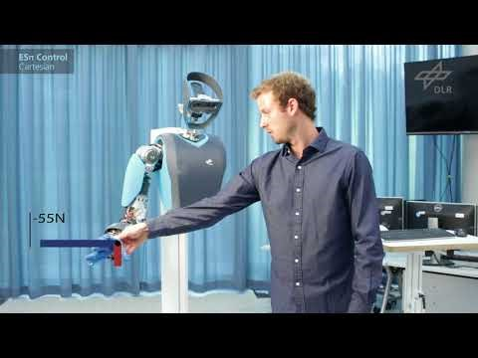
Impedance Control for Soft Robots

Slide 31
The Operational Environment
Structured versus Unstructured Environment
Static versus Dynamic Environment

Slide 32
Robotic System – Definition
Environment
Manipulation
Air
Space
Robot
Sense
Compute
Think (Intelligence)
Act
Asses
4
Ground
Water
Mobility

Slide 33
Structured versus Unstructured Environment – Definition
Structured Environment
In the context of robotics, a structured environment refers to:
Clearly defined boundaries
Known object placement
Consistent lighting and conditions
Regular and structured features
Reduced uncertainty
A controlled and predefined setting designed to facilitate the operation and movement of robots. It typically involves an environment that is organized, predictable, and well-defined, providing clear constraints and guidelines for robotic systems to navigate and interact with their surroundings.
Unstructured Environment
In the context of robotics, an unstructured environment refers to:
Lack of defined boundaries
Variability in object placement
Changing conditions
Complex features and clutter
Uncertain or unknown elements
A setting that lacks clearly defined boundaries, predictable conditions, and consistent features. It is characterized by the presence of uncertainties, variations, and complex interactions with the surroundings. In an unstructured environment, robots encounter diverse and changing situations that require adaptability, robustness, and the ability to handle ambiguity.

Slide 34
Static versus Dynamic Environment – Definition
Static Environment
A static environment refers to a setting where the surrounding conditions and objects remain relatively fixed and unchanging during the robot's operation. It implies that the environment does not undergo significant variations or movements that could affect the robot's perception, planning, or execution of tasks. Key characteristics of a static environment in robotics include:
Stationary objects
Predictable conditions
Known obstacles and boundaries
Absence of time dependent events
Operating in a static environment can simplify the robot's perception, planning, and control processes, as it allows for more deterministic and pre-determined behaviors.
Dynamic Environment
In the context of robotics, an unstructured environment refers to:
Lack of defined boundaries
Variability in object placement
Changing conditions
Complex features and clutter
Uncertain or unknown elements
A setting that lacks clearly defined boundaries, predictable conditions, and consistent features. It is characterized by the presence of uncertainties, variations, and complex interactions with the surroundings. In an unstructured environment, robots encounter diverse and changing situations that require adaptability, robustness, and the ability to handle ambiguity.

Slide 35
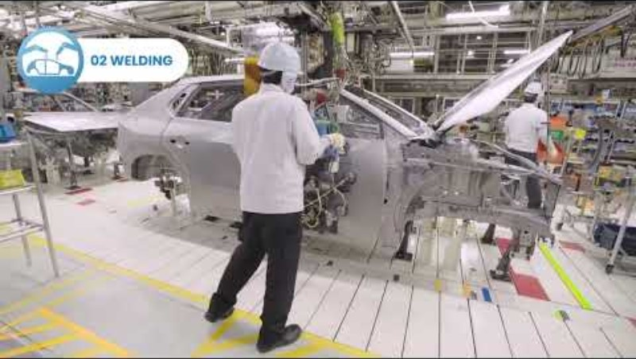
Automated Car Assembly Line

Slide 36
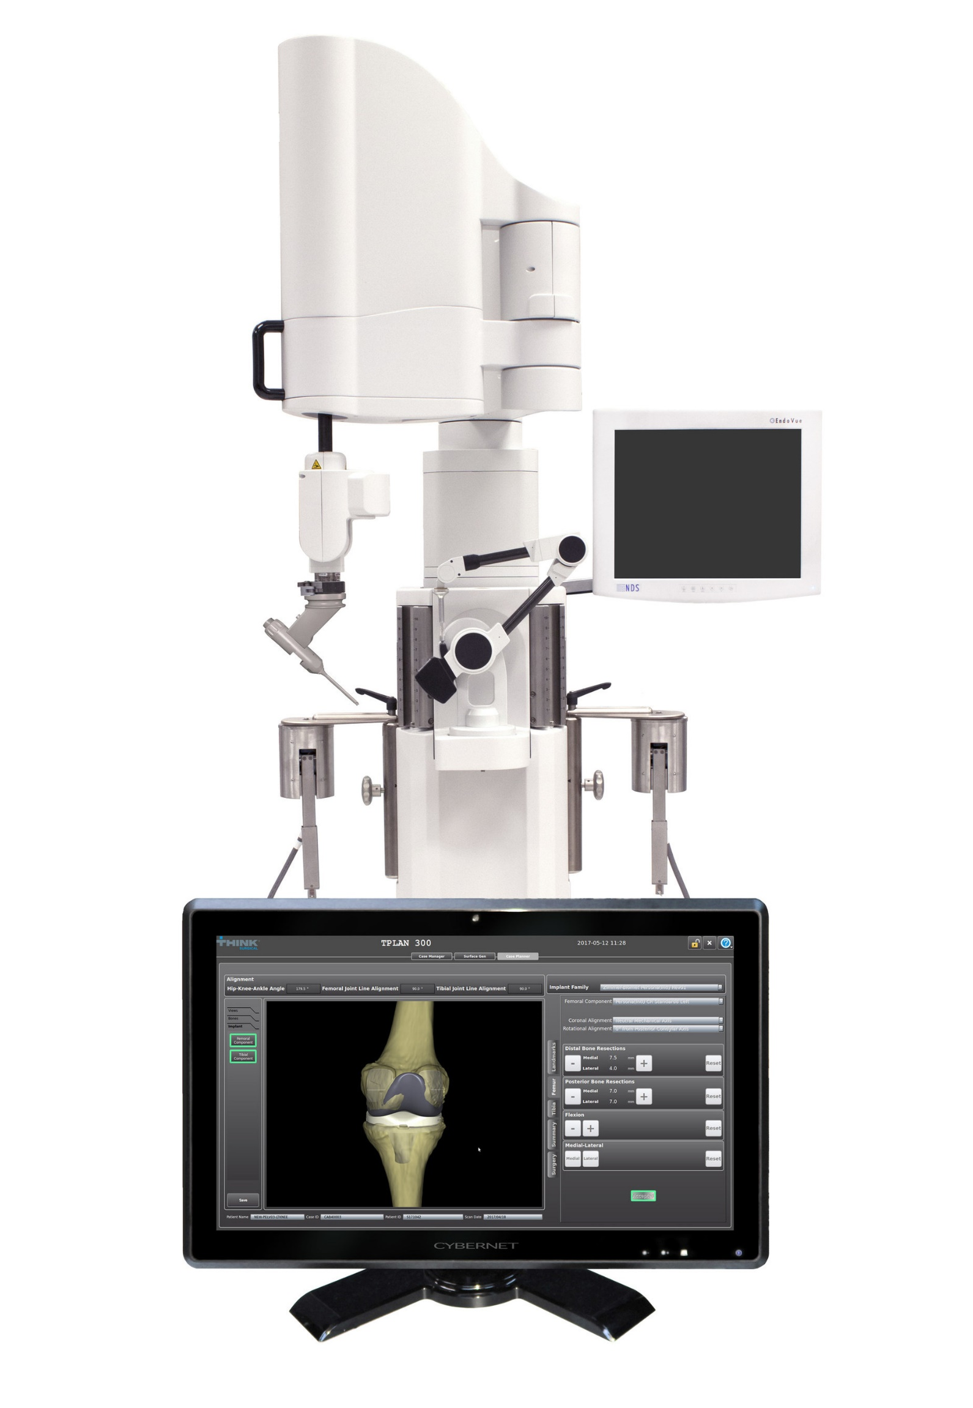
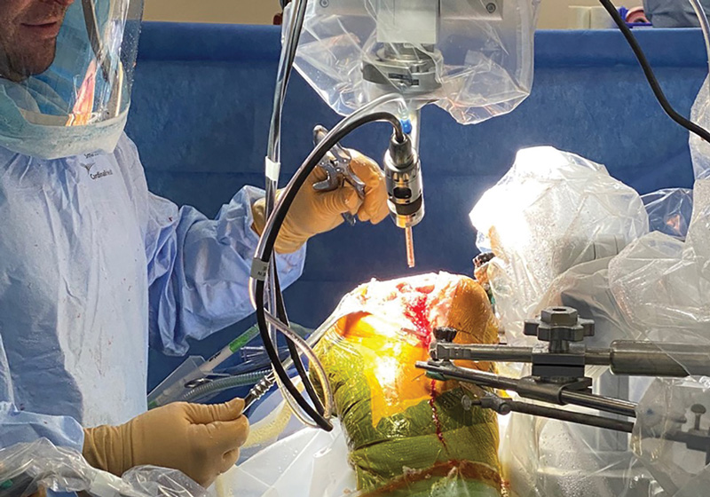
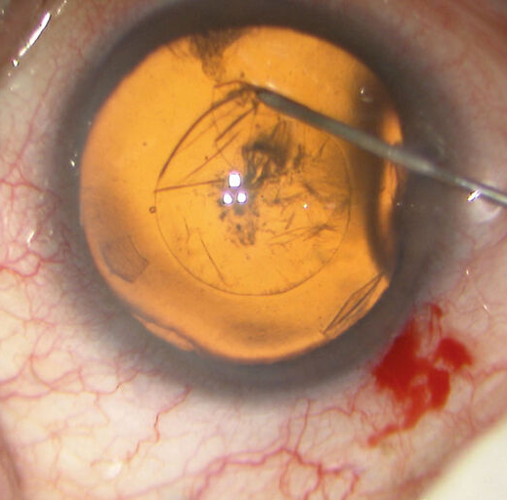
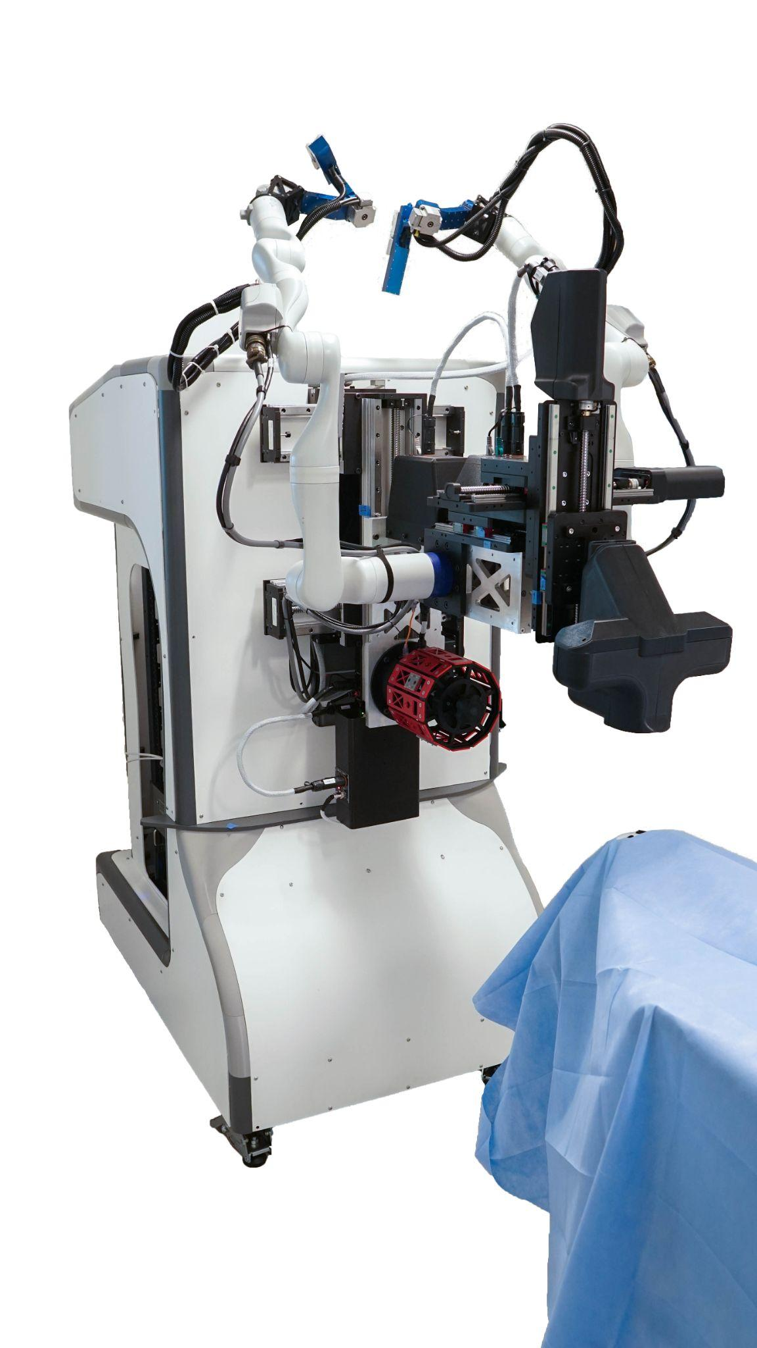
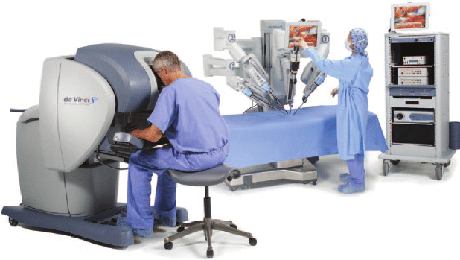
Surgical Robotics Environment
Structured
Unstructured
Hard Tissue
Orthopedics Surgery
Static
Dynamics
Soft Tissue
Ophthalmic Surgery
Soft Tissue
Adnominal Surgery

Slide 37
The Modes of Operation

Slide 38
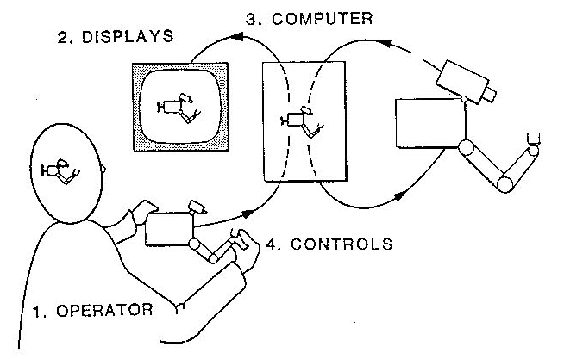
Teleoperation

Slide 39
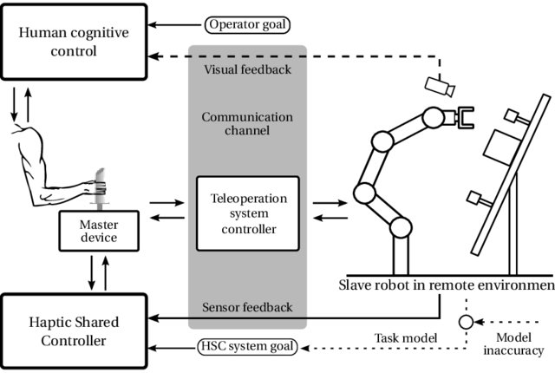
Teleoperation

Slide 40
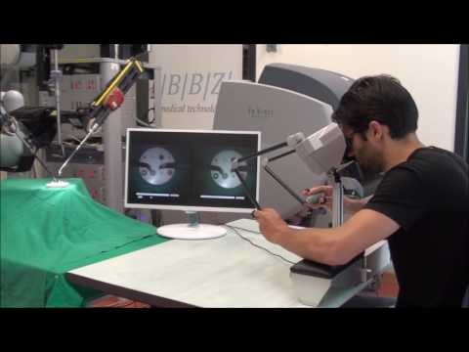
Surgical robot teleoperation with BBZ console

Slide 41
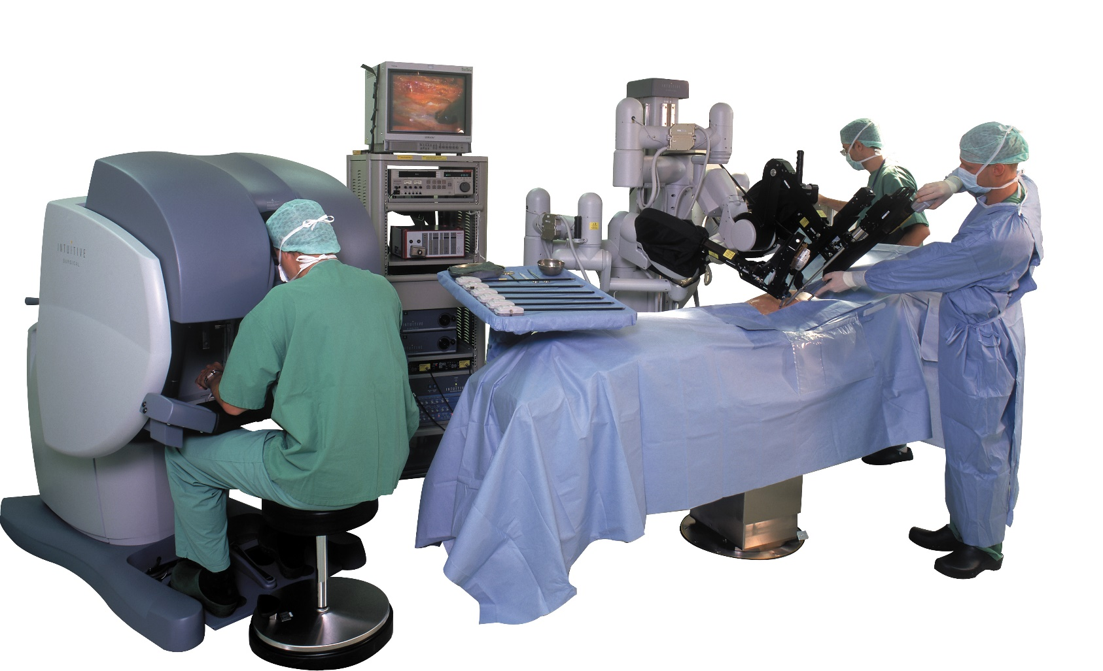
Teleoperation
Video Hyperlink

Slide 42
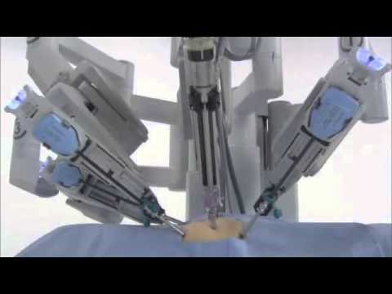
da Vinci® Surgery - How It Works

Slide 43
Accuracy Precision

Slide 44
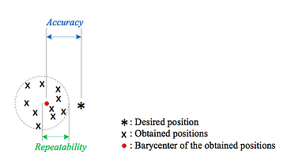
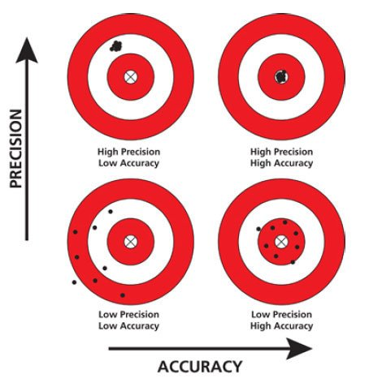
Accuracy / Precision
Accuracy (Definition)
Geometrically, the position accuracy of the robot for a given position can be defined as being the distance between the desired position and the centroid position (centroid is the mean position of all the points in all of the coordinate directions) which is actually achieved after repetitive movements of the end-effector toward the original desired position (see the Figure below). Mathematically, absolute accuracy is the compilation of the composed errors for each of the x, y, z cartesian positional errors. Finally, the robot position accuracy for a specific workspace can be described as the maximum composed error available for several positions uniformly distributed inside the predetermined workspace or reference frame.
Precision / Repeatability (Definition)
Repeatability can be defined as the closeness of agreement between several positions reached by the robot’s end-effector for the same controlled position, repeated several times under the same conditions. Geometrically, the position repeatability can be defined as the radius of the smallest sphere that encompasses all the positions reached for the same requested position. For more details about the calculation of accuracy and repeatability, interested readers are referred to the ISO: International Organization for Standardization. 1998. Manipulating industrial robots – Performance criteria and related test methods, NF EN ISO9283.

Slide 45
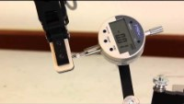
https://www.youtube.com/watch?v=3fbmguBgVPA
https://youtu.be/9orN_aUDY7w
Robot Reputability

Slide 46
Calibration Registration

Slide 47
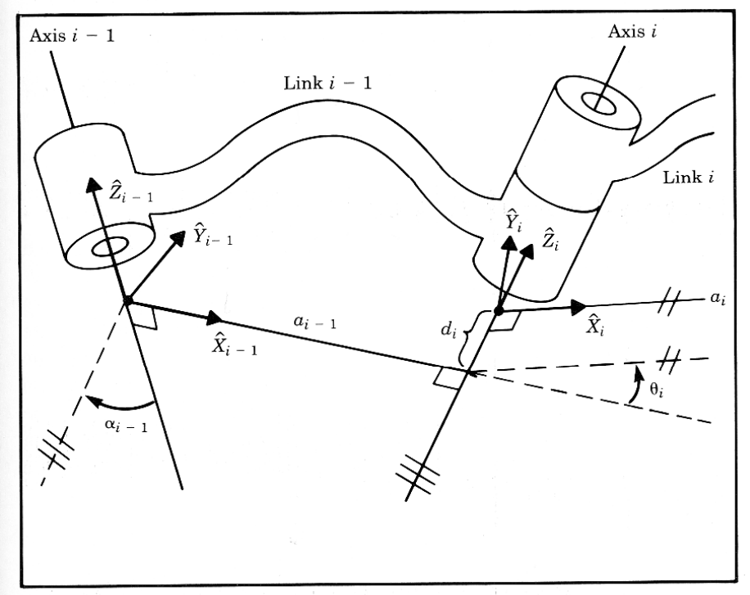
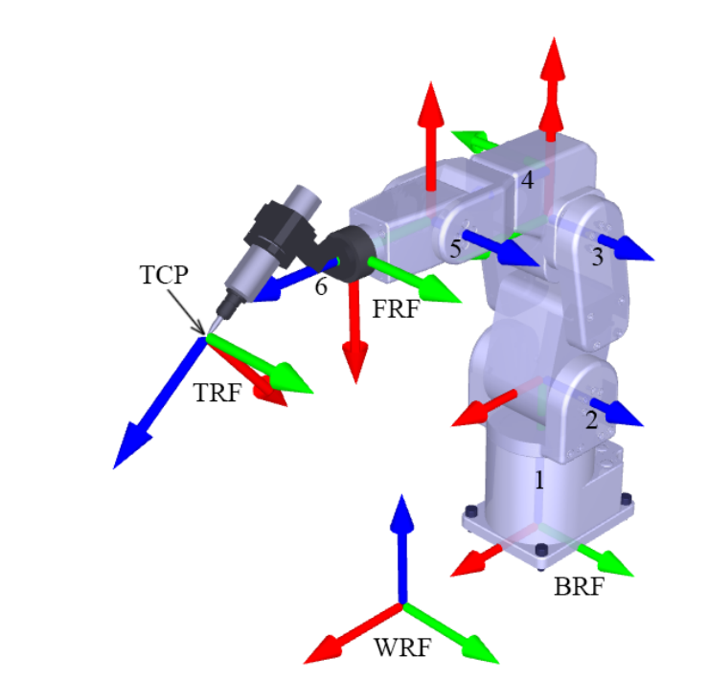
Calibration
Calibration – The process used for improve the accuracy of robots. Depending on the type of errors modeled, the calibration can be classified in three different ways.
  Level-1 calibration - Models differences between actual and reported joint displacement values, (also known as mastering).
  Level-2 calibration (kinematic calibration) Models the entire geometry of the robot including: angle offsets, axis offset, axis twist, joint lengths.
  Level-3 calibration (non-kinematic calibration), models errors other than geometric defaults such as stiffness, joint compliance, and friction.
  Note - Often Level-1 and Level-2 calibrations are sufficient for most practical needs.

Slide 48
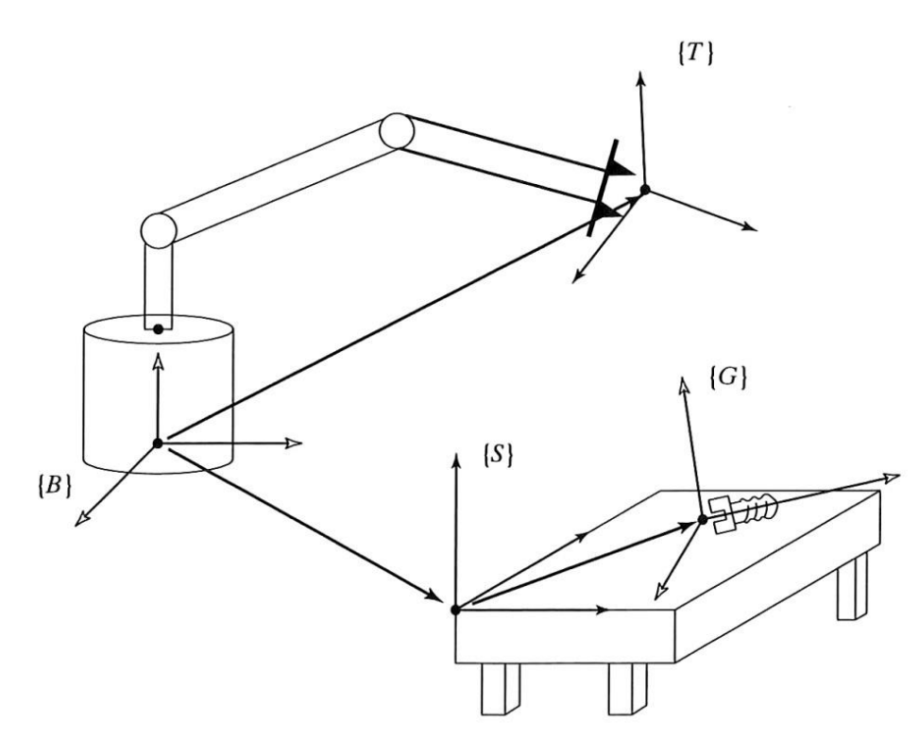
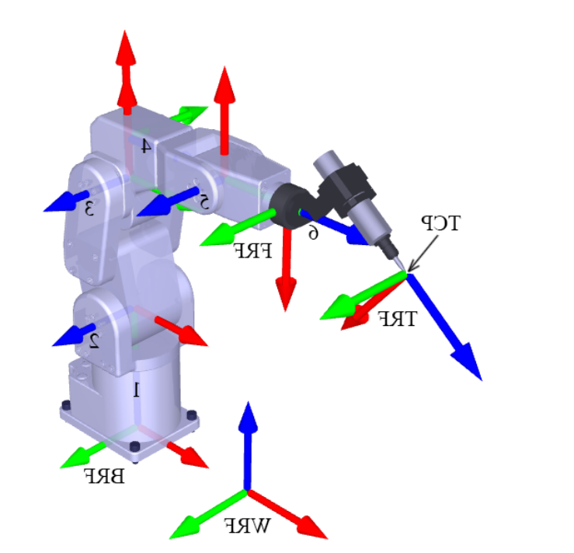
Registration
Registration - The process of robot registration involves finding the location of a robot with respect to another reference frame.
  Robot / Parts - Example 1 - if parts are in known locations on a table and a robot can locate itself with respect to the table (an external reference frame), then the robot will also know the location of the parts.
  Two Robotic Arms - Example 2 - if two or more robots can locate themselves with respect to the table, then each robot will not only know the location of the parts, but also the location of every other robot. This knowledge facilitates the coordination of robot motions and robot collaboration and eases the integration of additional robots into the work cell.

Slide 49
Robotic Arm Architecture
Serial Architecture
Parallel Architecture

Slide 50
Anatomy – Mechanism Topology

Slide 51

https://www.youtube.com/watch?v=3fbmguBgVPA
https://www.youtube.com/watch?v=3fbmguBgVPA
Serial robot vs. Parallel robot

Slide 52
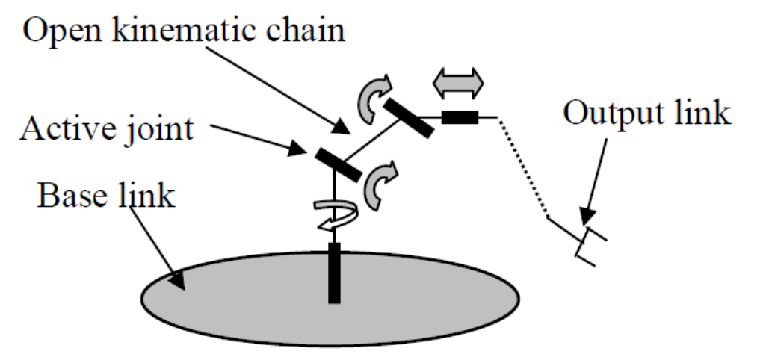
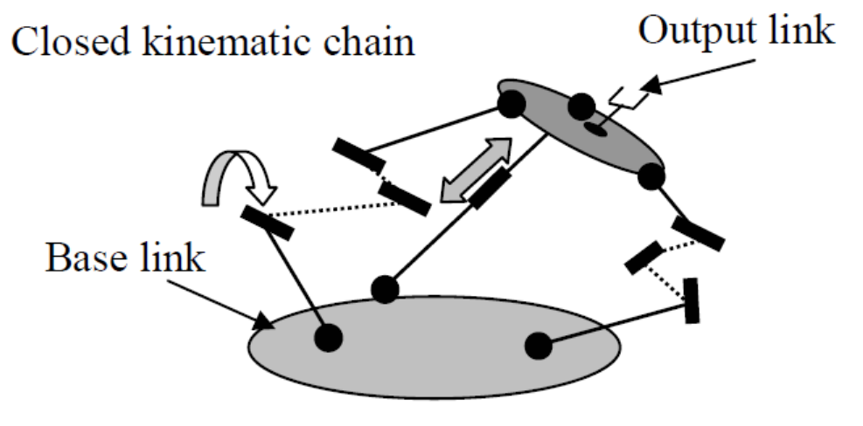
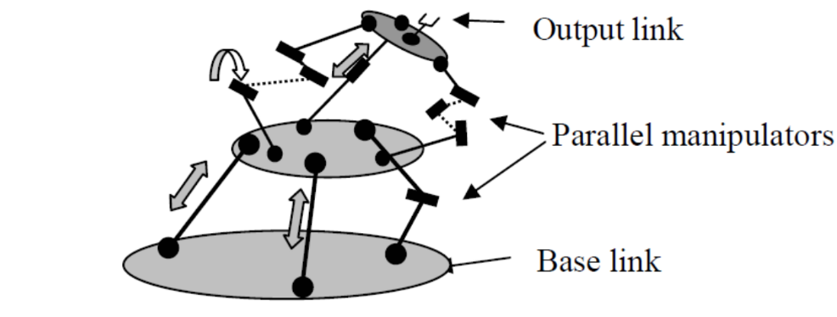
Robot Arm Anatomy
Serial Manipulator
Parallel Manipulator
Hybrid Manipulator

Slide 53
Comparison Table
Category | Property | Serial | Parallel
Mechanics | Type of Joints | Active (R, P) | Active & Passive (R,P,U,S)
Kinematics | Chain Type | Open | Close
 | Role of Active Joint | Twist | Wrench
 | Direct / Forward Kinematics | Simple | Complicated
 | Inverse Kinematics | Complicated | Simple
 | Multiple Solutions | Low (small number ) | High (large number)
 | Singularity | Loss of freedom | Gain of Freedom
 | Singularity Location | Arm – Edge - Workspace Wrist - Inside & Edge - Workspace | Inside & Edge - Workspace
Dynamics | Inertia of Moving Parts | High | Low
 | End Effector Speed | Low | High
Performance | Position Accuracy | Low | High
 | Payload to Weight Ratio | Low | Very High
 | Workspace (Volume) | High | Low
 | Computational Power (needed) | Low | High

Slide 54
Robotic Arm Architecture
Joints

Slide 55
Comparison Table
Category | Property | Serial | Parallel
Mechanics | Type of Joints | Active (R, P) | Active & Passive (R,P,U,S)
Kinematics | Chain Type | Open | Close
 | Role of Active Joint | Twist | Wrench
 | Direct / Forward Kinematics | Simple | Complicated
 | Inverse Kinematics | Complicated | Simple
 | Multiple Solutions | Low (small number ) | High (large number)
 | Singularity | Loss of freedom | Gain of Freedom
 | Singularity Location | Arm – Edge - Workspace Wrist - Inside & Edge - Workspace | Inside & Edge - Workspace
Dynamics | Inertia of Moving Parts | High | Low
 | End Effector Speed | Low | High
Performance | Position Accuracy | Low | High
 | Payload to Weight Ratio | Low | Very High
 | Workspace (Volume) | High | Low
 | Computational Power (needed) | Low | High

Slide 56
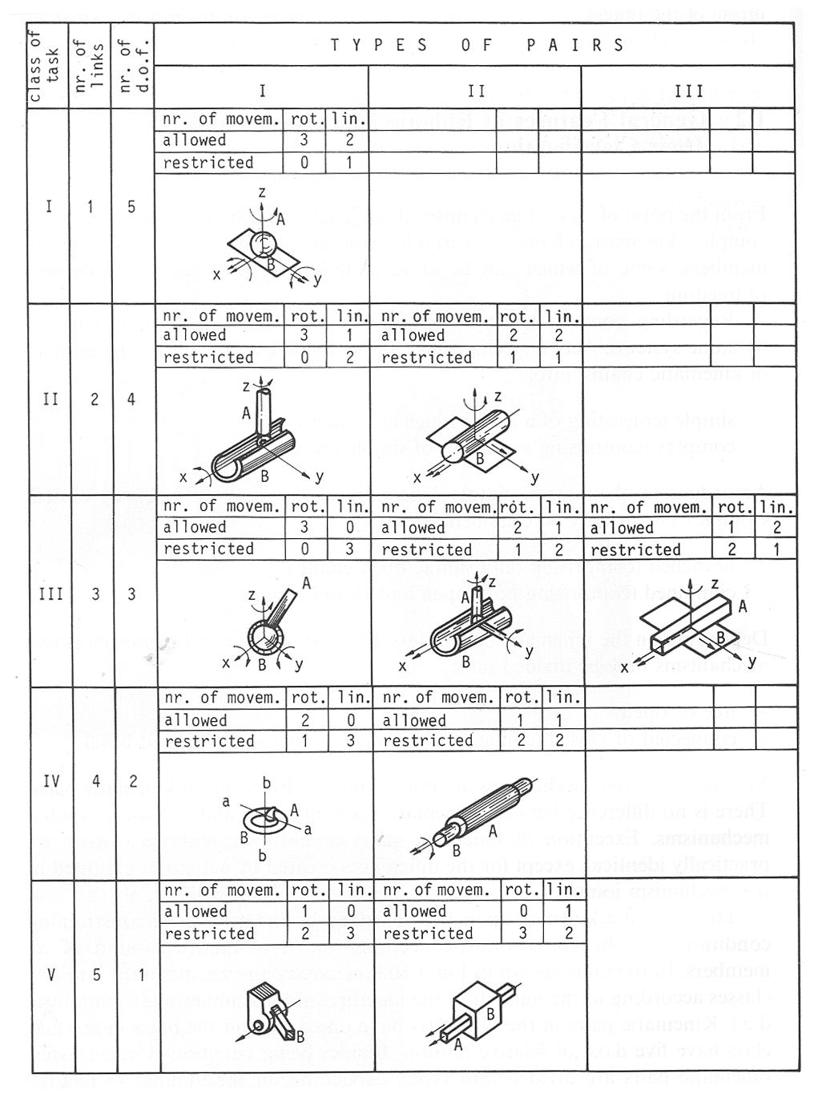
Joint Classification

Slide 57
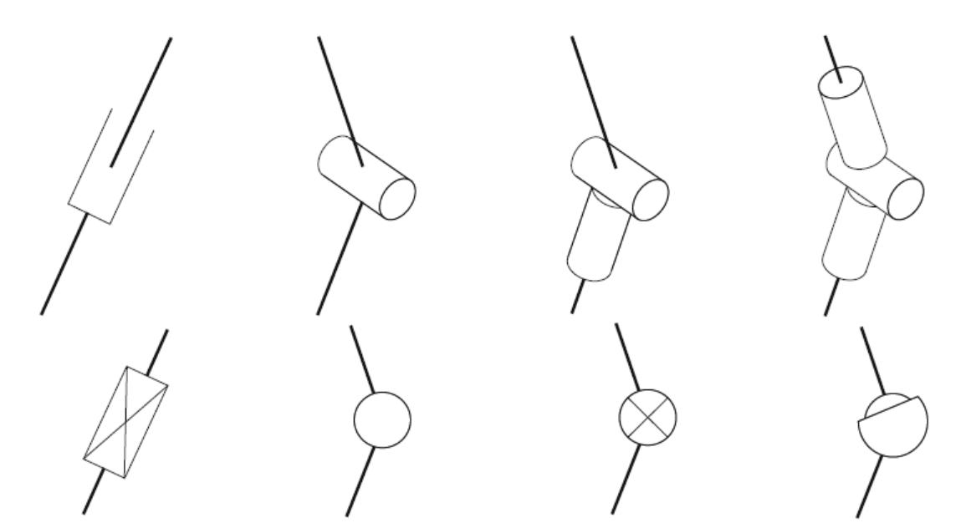
Joint Classification
Parallel Manipulator
Serial Manipulator
Prismatic (P)
Translational (T)
Linear
Revolute (R)
Rotational
Universal (U)
Spherical (S)

Slide 58
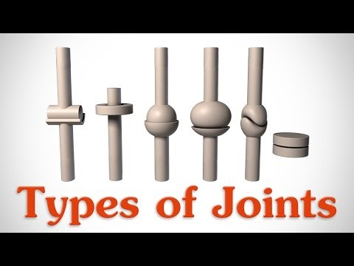
The 6 Types of Joints - Human Anatomy

Slide 59
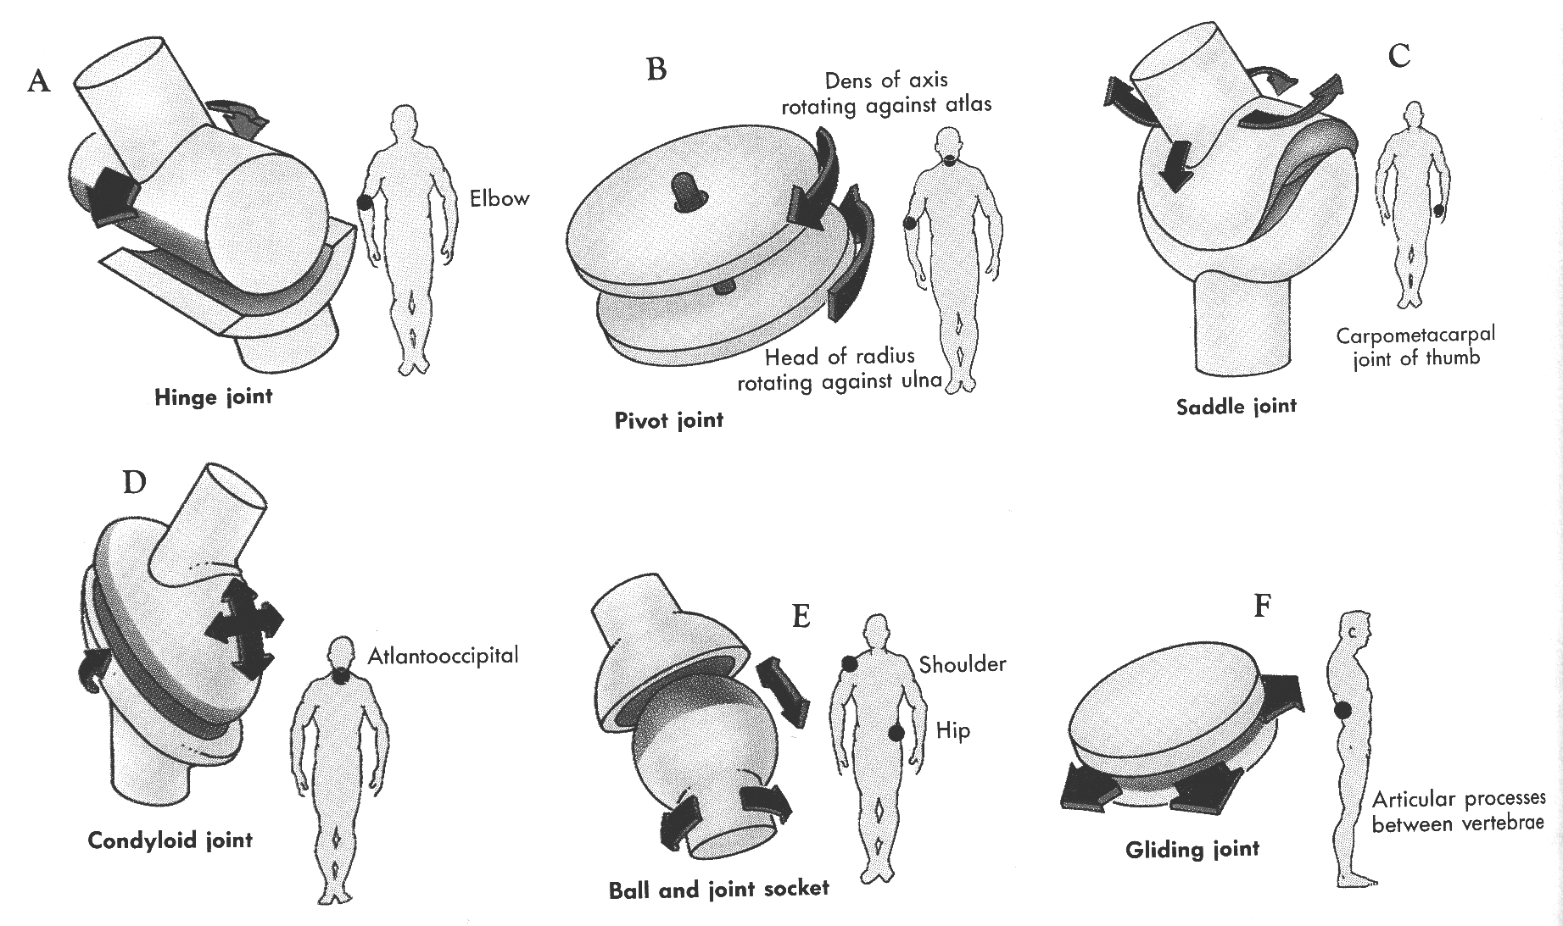
Synovial (Anatomical) Joints

Slide 60
Robotic Arm Architecture
Kinematic Chain
Connection between Links and Joints

Slide 61
Comparison Table
Category | Property | Serial | Parallel
Mechanics | Type of Joints | Active (R, P) | Active & Passive (R,P,U,S)
Kinematics | Chain Type | Open | Close
 | Role of Active Joint | Twist | Wrench
 | Direct / Forward Kinematics | Simple | Complicated
 | Inverse Kinematics | Complicated | Simple
 | Multiple Solutions | Low (small number ) | High (large number)
 | Singularity | Loss of freedom | Gain of Freedom
 | Singularity Location | Arm – Edge - Workspace Wrist - Inside & Edge - Workspace | Inside & Edge - Workspace
Dynamics | Inertia of Moving Parts | High | Low
 | End Effector Speed | Low | High
Performance | Position Accuracy | Low | High
 | Payload to Weight Ratio | Low | Very High
 | Workspace (Volume) | High | Low
 | Computational Power (needed) | Low | High

Slide 62
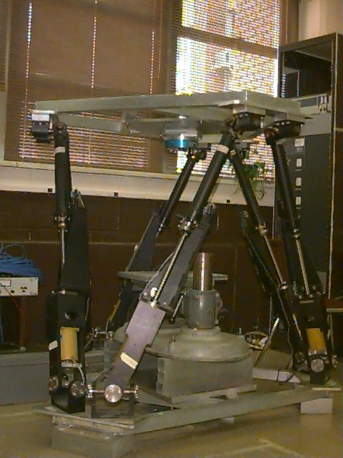

Kinematic Chain - Joint / Link - Definition
Kinematic Chain consists of nearly rigid links (members) which are connected with joints (kinematics pair) allowing relative motion of the neighboring links.
Closed Loop Chain - Every link in the kinematic chain is connected to any other link by at least two distinct paths
Open Loop Chain - Every link in the kinematic chain is connected to any other link by one and only one distinct path
Parallel (Close Loop) Robot
Serial (Open Loop) Robot
Video Hyperlink

Slide 63
Robotic Arm Architecture
Naming Convention

Slide 64




Manipulator Naming Convention
UTR-SS-RRTS
6 UTS (Gough–Stewart platform)
6R – RRRRRR (Puma 560)
3RPR – RRRPR (SCARA)

Slide 65
Robotic Arm Architecture
Degrees of Freedom (DOF)

Slide 66
Degrees of Freedom (DOF)
The number of Degree of Freedom that a manipulator possesses is the number independent position variable which would have to be specified in order to locate all parts of the mechanism.
Ideally, a manipulator should posses 6 DOF in order to manipulate an object in a 3D space
General Purpose Robot - # DOF = 6
Redundant Robot - # DOF >7
Deficient Robot - # DOF < 6

Slide 67


Human Arm - DOF

Slide 68
Robotic Arm Architecture
Workspace

Slide 69
Workspace - Definition
Workspace - The volume of space that the end-effector can reach
Dexterous Workspace - The volume of the space which every point can be reach by the end effector in all possible orientations.
Reachable Workspace - The volume of the space which every point can be reach by the end effector in at least one orientation.

Slide 70
Comparison Table
Category | Property | Serial | Parallel
Mechanics | Type of Joints | Active (R, P) | Active & Passive (R,P,U,S)
Kinematics | Chain Type | Open | Close
 | Role of Active Joint | Twist | Wrench
 | Direct / Forward Kinematics | Simple | Complicated
 | Inverse Kinematics | Complicated | Simple
 | Multiple Solutions | Low (small number ) | High (large number)
 | Singularity | Loss of freedom | Gain of Freedom
 | Singularity Location | Arm – Edge - Workspace Wrist - Inside & Edge - Workspace | Inside & Edge - Workspace
Dynamics | Inertia of Moving Parts | High | Low
 | End Effector Speed | Low | High
Performance | Position Accuracy | Low | High
 | Payload to Weight Ratio | Low | Very High
 | Workspace (Volume) | High | Low
 | Computational Power (needed) | Low | High

Slide 71






Workspace – Serial versus Parallel Archtecture

Slide 72
Serial Architecture

Slide 73

Serial Architecture – Summary
PPP
RPP
RRP
RRP
RRR

Slide 74

Robotic Arm Geometry

Slide 75
Serial Architecture – Summary
PPP
RPP
RRP
RRP
RRR

Slide 76


Serial Manipulators – Historical Perspective
PUMA – Unimate
1960
Stanford Arm
1969

Slide 77
Serial Architecture – Summary
PPP
RPP
RRP
RRP
RRR

Slide 78

Kinematic Configuration – Cartesian (3P)
Joints
  Joint 1 - Prismatic
  Joint 2 - Prismatic
  Joint 3 - Prismatic
Inverse Kinematics - Trivial
Structure -
  Stiff Structure -> Big Robot
  Decoupled Joints - No singularities
Disadvantage
  All feeder and fixtures must lie “inside” the robot

Slide 79
Serial Architecture – Summary
PPP
RPP
RRP
RRP
RRR

Slide 80





Kinematic Configuration - Cartesian
Gantry

Slide 81

Gantry Robot - Solid surface countertop stacking

Slide 82
Serial Architecture – Summary
PPP
RPP
RRP
RRP
RRR

Slide 83

Kinematic Configuration – Articulated (3R)
Joints
  Joint 1 - Revolute -Shoulder
  Joint 2 - Revolute - Elbow
  Joint 3 - Revolute - Wrist
Workspace
  Minimal intrusion
  Reaching into confine spaces
  Cost effective for small workspace
Examples
  PUMA
  MOTOMAN

Slide 84





Kinematic Configuration - Articulated
Video Clip

Slide 85

Fanuc – Full Human Body

Slide 86
Serial Architecture – Summary
PPP
RPP
RRP
RRP
RRR

Slide 87

Kinematic Configuration – SCARA (3RPR)
Joints
  Joint 1 - Revolute
  Joint 2 - Revolute
  Joint 3 - Revolute
  Joint 4 - Prismatic
  Joint 1,2,3 - In plane
Structure
  Joint 1,2,3, do not support weight (manipulator or weight)
  Link 0 (base) can house the actuators of joint 1 and 2
Speed
  High speed (10 m/s), 10 times faster then the most articulated industrial robots
Example - SCARA (Selective Compliant Assembly Robot Arm )

Slide 88




Kinematic Configuration - SCARA

Slide 89

Kawasaki Robot-Painting Robots

Slide 90
Serial Architecture – Summary
PPP
RPP
RRP
RRP
RRR

Slide 91

Kinematic Configuration – Spherical (RRP)
Joints
  Joint 1 - Revolute (Intersect with 2)
  Joint 2 - Revolute (Intersect with 1)
  Joint 3 - Prismatic
Structure
  The elbow joint is replaced with prismatic joint
  Telescope

Slide 92




Kinematic Configuration - Spherical

Slide 93

Stanford Arm

Slide 94
Serial Architecture – Summary
PPP
RPP
RRP
RRP
RRR

Slide 95

Kinematic Configuration – Cylindrical (RPP)
Joints
  Joint 1 - Revolute
  Joint 2 - Prismatic
  Joint 3 - Prismatic

Slide 96





Kinematic Configuration - Cylindrical

Slide 97

Robotic Arm Geometry

Slide 98

Robotic Arm Geometry

Slide 99
Parallel Architecture

Slide 100


Parallel Architecture – Historical Perspective
Flight Simulator Concept
Stewart 1965
Tyre under the action of combined loads
Gough 1957;
Gough and Whitehall 1962

Slide 101




Parallel Architecture – Common Architectures
6 UTS
(Gough–Stewart platform)
6 DOF
3 T4S (parallelogram)
Delta
3 DOF
3 R4S (parallelogram)
Delta
3 DOF

Slide 102

Parallel Robot – Gough-Stewart Platform – Thomas FX Motion Base

Slide 103
Parallel Robot – Acrome Stewart Platform

Slide 104
https://youtu.be/xiECumcaEx0
Parallel Robot – Hexapod (Gough-Stewart platform) 6-axis parallel robot

Slide 105

Parallel Robot – Delta Robot - Adept Quattro Robot handling steel balls on conveyor

Slide 106








Close Chain Manipulators - DOF
DOF of close chain manipulator – Grubler’s formula
  - The total number of DOF in the mechanism
  - The number of links (including the base and the platform)
  - Total number of joints
  - The number of DOF associated with the i’th joint
Example – Stewart Platform
$$F=6(l−n−1)+\sum_{i=1}^{n}{f_{i}}$$
$$F$$
$$l$$
$$n$$
$$f_{i}$$
$$F=6(14−18−1)+\sum_{i=1}^{6}{6}=6$$

Slide 107

Close Chain Manipulators - Gough-Stewart Platform

Slide 108

Parallel Robot – Gough-Stewart Platform - A320 Full Flight Simulator – Part I

Slide 109

Parallel Robot – Gough-Stewart Platform - A320 Full Flight Simulator – Part II

Slide 110
Wrist Architecture

Slide 111
Kinematic Configuration - Wrist
Joints
  Three (or two) joints with orthogonal axes
Workspace
  Theoretically - Any orientation could be achieved (Assuming no joint limits)
  Practically - Severe joint angle limitations
Kinematics
  Closed form kinematic equations

Slide 112



Kinematic Configuration - Wrist
Three intersecting orthogonal Axes
Bevel Gears Wrist
Limited Rotations
Three Roll Wrist (Cincinatti Milacron)
Three intersecting non-orthogonal Axes
Continues joint rotations (no limits)
Sets of orientations which are impossible to reach

Slide 113


Kinematic Configuration - Wrist
5 DOF Welding robot (2 DOF wrist) - Symmetric tool
The tool axis is mounted orthogonal to axis 5 in order to reach all possible orientations
$${\hat{Z}}_{T}$$

Slide 114

ABB Robotics - Arc Welding

Slide 115

Kinematic Configuration - Wrist
Non intersecting axes wrist
  A closed form inverse kinematic solution may not exist
Special Cases (Existing Solution)
  Articulated configuration - Joint axes 2,3,4 are parallel
  Cartesian configuration - Joint axes 4,5,6 do not intersect

Slide 116

Kuka KR 500 wrist mechanics - Axis 4, 5 & 6

Slide 117
Manipulability

Slide 118

Manipulability – Human Arm Posture - Writing
Arm posture during writing
  Elbow joint angle – 90 Deg
Human arm model (writing)
  2 DOF
  Two links (equal length)
Manipulability is maximized when the Elbow joint angle is set to 90 Deg
  Maximizing joint angles (shoulder /elbow) to end effector (hand) velocity transformation

Slide 119
Redundancy

Slide 120


Redundant Manipulators
Task Definition - Position (3 DOF - $x,y,z$) and orient the end effector (3 DOF $θ_{pitch},θ_{roll},θ_{yaw}$) ) in is a 3D space (6 DOF)
No. of DOF (6 DOF) = No. of DOF of the task (6 DOF)
  Limited number of multiple solutions
No. of DOF (e.g. 7 DOF) > No. of DOF of the task (6 DOF)
  Number of solution: $∞$ (adding more equations)
  Self Motion - The robot can be moved without moving the end effector from the goal
$$∞$$

Slide 121

Redundant Manipulators – Human Arm

Slide 122

Collision avoidance: tests with a 7-dof redundant robot and a static obstacle

Slide 123

KUKA - Kinematic Redundancy

Slide 124
Design

Slide 125
Manipulator Mechanical Design
Particular structure of a manipulator influences the kinematic and dynamic analysis
The tasks that a manipulator can perform will also very greatly with a particular design (load capacity, workspace, speed, repeatability)
The elements of a robotic system fall roughly into four categories
  The manipulator mechanism, actuation, and proprioceptive sensors
  The end-effector or end of the arm tooling
  External sensors (e.g. vision system) or effectors (e.g. part feeders)
  The Controller
Equations
ROBOT
Task

Slide 126
Manipulator Mechanical Design - Task Requirements
Robot
Task
Task - Design Criteria
  Number of degrees of freedom
  Workspace
  Load capacity
  Speed
  Repeatability accuracy

Slide 127
Task Requirements - Number of DOF
The number of DOF in a manipulator should match the number of DOF required by the task.
Robot
DOF
Task
DOF

Slide 128



Task Requirements
Not all the tasks required 6 DOF for example:
  End effector with an axis of symmetry - Orientation around the axis of symmetry is a free variable,
  Placing of components on a circuit board - 4 DOF ($x,y,z,θ$)
Dividing the total number of DOF between a robot and an active positioning platform

Slide 129

PCB Assembly

Slide 130

Robotic Welding

Slide 131

Painting Robots

Slide 132
Task Requirements
Workspace (Work volume, Work envelope)
  Placing the target (object) in the work space of the manipulator
  Singularities
  Collisions
Load Capacity
  Size of the structural members
  power transmission system
  Actuators
Speed
  Robotic solution compete on economic solution
  Process limitations - Painting, Welding
  Maximum end effector speed versus cycle time
Repeatability & Accuracy
  Matching robot accuracy to the task (painting - spray spot 8 +/-2 “)
  Accuracy function of design and manufacturing (Tolerances)

Slide 133
Kinematic Configuration
Joints & DOF -
  For a serial kinematic linkages, the number of joints equal the required number of DOF
Overall Structure
  Positioning structure (link twist 0 or +/- 90 Deg, 0 off sets)
  Orientation structure
Wrist
  The last n-3 joints orient the end effector
  The rotation axes intersect at one point.

Slide 134
Kinematic Configuration - Wrist
Joints
  Three (or two) joints with orthogonal axes
Workspace
  Theoretically - Any orientation could be achieved (Assuming no joint limits)
  Practically - Severe joint angle limitations
Kinematics
  Closed form kinematic equations

Slide 135





End Effector (EE)
At the free end of the chain of links which make up the manipulator is the end effector. Depending on the intended application of the robot the end effector may be a gripper welding torch, electromagnet or other tool.
ROBONAUT - Hand (NASA)
Stanford / JPL- Hand (Salsilbury)
Utha / MIT Hand
NIST - Advanced Welding Manufacturing System

Slide 136
Actuation
Actuator
Electric
Hydraulic
Pneumatic
AC
DC
Brushed
Brushless
Step

Slide 137

Actuation – Power to Weight Ratio

Slide 138
Actuation Schemes
Direct Drive
Non Direct Drive
Actuator
Link
(Load)
Actuator
Transmission
(Reduction)
Link
(Load)

Slide 139


Reduction & Transmission Systems
Transmission
Gears
Cable
Belt
Chain
Screw

Slide 140






Types of Gears
Super Gears
Helical Gears
Rack & Pinion Gears
Bevel Gears
Hypoid Gears
Worm Gears

Slide 141


Gearbox / Gearhead
Harmonic Drive

Slide 142





Reduction & Transmission Systems
Transmission
(Reduction)
Input
Output
$$μ P_{in}=P_{out}$$
$$μ T_{in}ω_{in}=T_{out}ω_{out}$$
$$\frac{T_{out}}{μ T_{in}}=\frac{ω_{in}}{ω_{out}}=n (n>1)$$
$$μ ≈0.5−0.9$$
Limiting Factors
$$ω_{in},T_{out}$$

Slide 143
Sensors – Human Body
Equilibrioception
vestibular sense
(balance Inner Ear)
Proprioception, kinesthetic sense
body awareness
(Muscle Tendon Joints)
Human
Body
Sight
Hearing
Smell
Taste
Touch
Env.
Sensors
Sensors

Slide 144
Sensors – Robot
Robot
Sensors
Env.
Unstructured
Mobile
Robot
Kinematics
(Position)
Sensors
Force/Torque
Tactile
Ranging
Vision
Sound
Arm
(Cell)
Env.
Structured

Slide 145
Manipulator Design
Requirements
  Task
  Load
  Time (speed / cycle-time)
  Environment
  Cost
Design
  No. of DOF
  Workspace
  Kinematics configuration
  Dynamics properties
  Actuation
  Sensors
  Accuracy
  Reputability
Analysis
  Kinematics
  Link length optimization
  Singularities
  Dynamics
  Actuation optimization
  Trajectory Analysis
  Modal Analysis
  Cost Analysis
  Control
    Low level (servo)
    High level (sensor fusion)

Slide 146
Applications
Medical Robotics

Slide 147







Robotic Systems – Medical – Wearable Robot
Exos
Exo-UL7
Bionics Lab - UCLA
MGA
Maryland-Georgetown Army
Panasonic
Percro
University of Pisa - Italy
ARMin
Catholic University of America
Human Power Extender
UC Berkeley

Slide 148





Robotic Systems – Medical – Wearable Robot
Video Hyperlink
HAL
MIT
BLEEX
Berkeley Robotics Lab - UCB
Video Hyperlink
Video Hyperlink
Hardyman
GE 1965
Video Hyperlink
Sarcos

Slide 149



Robotic Systems – Medical – Surgical Robot
Neuromate
Integrated Surgical System (ISS)
RoboDoc
Integrated Surgical System (ISS)

Slide 150











Robotic Systems – Medical – Surgical Robot
M7
SRI
Zeus
Computer Motion
DaVinci
Intuitive Surgical
UC Berkley
Steady Hand
Hopkins
Raven
University of Washington

Slide 151



Robotic Systems – Medical – Surgical Robot
AESOP
Computer Motion, Inc.
Goleta, CA
The AESOP Endoscope Positioner is a seven degree-of-freedom robotic arm, which mimics the form and function of a human arm to position an endoscope during minimally invasive surgery.
Using predefined voice commands, the surgeon is able to directly control a stable, responsive surgical image during long, complex procedures. The AESOP system provides a level of stability that is impossible to achieve with a human endoscope holder and frees up the medical professional for other patient- and surgeon-oriented duties.
www.computermotion.com

Slide 152

Robotic Systems – Medical – Surgical Robot
ZEUS
Computer Motion, Inc.
Goleta, CA
The ZEUS Robotic Surgical System is comprised of an ergonomic surgeon console and three table-mounted robotic arms, which act as the surgeon's hands and eyes during minimally invasive surgery. While sitting at the console, the surgeon controls the right and left robotic arms that translate to real-time manipulation of the surgical instruments within the patient's body. The third arm incorporates the AESOP technology, providing the surgeon with a controlled and steady view of the internal operative field.
www.computermotion.com

Slide 153





Robotic Systems – Medical – Surgical Robot
da Vinci
Intuitive Surgical, Inc.
Mountain View, CA
The da Vinci™ Surgical System consists of a surgeon's console, a patient-side cart, a high performance vision system and our proprietary instruments. Using the da Vinci Surgical System, the surgeon operates while seated comfortably at a console viewing a 3-D image of the surgical field. The surgeon's fingers grasp the instrument controls below the display with wrists naturally positioned relative to his or her eyes. Our technology seamlessly translates the surgeon's movements into precise, real-time movements of our surgical instruments inside the patient.
www.intuitivesurgical.com

Slide 154



Robotic Systems – Medical – Surgical Robot
Integrated Surgical Systems, Inc.
Davis, CA
ROBODOC
Total hip replacement- The robot mills a cavity in the femur for a prosthetic implant. The system is designed to accurately shape the cavity for a precise fit with the implant.
Total knee replacement - The robot planes knee surfaces on the femur and tibia to achieve a precise fit for the implant.
NeuroMate is a computer-controlled, image-directed robotic system for stereotactic functional brain surgeries. The Frameless NueroMate System eliminates the need to use the cumbersome and very painful frames that are traditionally used for many brain surgeries.
The system orients and positions a variety of surgical tools.
www.robodoc.com

Slide 155

Robotic Systems – Medical – Surgical Robot

Slide 156

Raven I – Surgical Robot

Slide 157
Trauma Pod Phase I – DARPA Project – Vision

Slide 158






Robotic Systems – Medical – Surgical Robot
Trauma Pod (SRI)
(2 lines available)System message box

Slide 159

Trauma Pod Phase I – DARPA Project – Demo

Slide 160
Applications
General

Slide 161


Robotic Systems - References
Service Robots
by G. Schmierer, and R.F. Schraft
http://www.ipa.fhg.de/srdatabase
Robo Sapiens
by P. Menzel (Photographer),
F. D’Aluisio, C.C. Mann (Editor)
http://robosapiens.mit.edu/

Slide 162


Robotic Systems - Agriculture and Forestry
Walking Forestry Manipulator
Plustech Oy Finland
Innovative technology is used among agriculture and forestry in order to increase the work´s efficiency. The Finnish company Plustech Oy has developed the world´s first walking forestry manipulator whose ingenious walking kinematics were copied from examples that Mother Nature provides. The computer-controlled, six-legged walking mechanism suits any of the various kinds of ground conditions that may be found in forests around the world. Yet it is designed not to harm the environment it is working in, e.g. its weight is at all times evenly distributed on the forest floor, and it prevents soil erosion. The device is controlled by a joystick and its claw is used to handle and move tree trunks.
Video Hyperlink

Slide 163



Robotic Systems – Legged Locomotion
Little Dog
Boston Dynamics
Big Dog
Boston Dynamics
Video Hyperlink
Video Hyperlink (j)
Video Hyperlink
Video Hyperlink
Video Hyperlink

Slide 164

Robotic Systems - Care / Rehabilitation
FRIEND - Functional Robot Arm with User Friendly Interface for Disabled People
University of Bremen
Germany
The aim of FRIEND is the development of a robot system which supports people with severe physical impairment in daily life and in the work environment. The system consists of an electric powered wheelchair, a MANUS robot arm and a standard PC which is attached in a rugged case to the back side of the wheelchair. A tray and a flat screen are mounted at the left side of the wheelchair. The structure of the entire control system is coarsely divided up into the components robot controller, command interpreter, administration module for pre-programmed motions and man-machine interface. The user-oriented man-machine interface can be operated in two different modes: pre-programmed motions and user-controlled robot movements.
Video Hyperlink

Slide 165

Robotic Systems - Construction
The Road Robot
ESPRIT program European Union
The Road Robot is self-navigating, self-steering and completely computerized road finisher. The goal was for road engineers to build road surfaces more rationally, more environmentally-friendly. The entire process consists of four subsystems, yet each one has its own module: the logistics of coated materials, the traveling mechanism, the geometry of the road surface and the plank.
There are two different ways of operating the device: either by radio from the engineers´ office or with the on-board computer touch screen. The Road Robot´s diesel-electric drive decreases the noise up to 12 dB (A), produces 50% less exhaust fumes and requires 50% less gasoline than a conventional road finisher of an equal performance level.
Video Hyperlink

Slide 166

Robotic Systems - Master / Slave Teleoperator
Master / Slave Robot
Sarcos
Puppeteers in the entertainment business, turn master-slave robots into interactive actors that react in real-time. Controlling an anthropomorphic robot requires only one person to operate, even though these man-like robots may possess up to 56 degrees of freedom which may all have to be directed simultaneously. An Exoskeleton equipped with position sensors registers the master´s movements and transfer them to the robot´s control system. The control algorithms ensure similar movements of the robot.
www.sarcos.com
Video Hyperlink

Slide 167





Robotic Systems - Hazardous Duties
Telerob
Ostfildern, Germany
Fire Fighting
Nuclear Reactor
Explosives
http://www.telerob.com
iRobot
Snake Robot
iRobot & Arm
iRobot Military

Slide 168

Robotic Systems - Recreation
Intelecady
GolfPro International
Santa Clara, CA
The Intelecady is a computer-generated, electrically powered golf caddie robot. It navigates around the golf course with its telecommunications skills and sensors. A small coded transmitter, attached to the golfer, is used to follow its „master". A digital map of the golf course is memorized on the on-board computer. Zones where the caddie is not supposed to be are specifically marked on the map. The device stops right before steep inclines or downward slopes and it´s not until the golfer leaves this area that the Intelecady starts following him again. The balls are located with the halp of GPS. Ultrasound sensors detect any kind of obstacles that may be in the robot´s way.
Shadow Caddy

