Slide 1
Boyce/DiPrima 10th ed, Ch 7.8: Repeated Eigenvalues Elementary Differential Equations and Boundary Value Problems, 10th edition, by William E. Boyce and Richard C. DiPrima, ©2013 by John Wiley & Sons, Inc.
We consider again a homogeneous system of n first order linear equations with constant real coefficients x' = Ax.
If the eigenvalues r₁,…, r_{n} of A are real and different, then there are n linearly independent eigenvectors ξ⁽¹⁾,…, ξ^{(n)}, and n linearly independent solutions of the form
If some of the eigenvalues r₁,…, r_{n} are repeated, then there may not be n corresponding linearly independent solutions of the above form.
In this case, we will seek additional solutions that are products of polynomials and exponential functions.

Slide 2
Example 1: Eigenvalues (1 of 2)
We need to find the eigenvectors for the matrix:
The eigenvalues r and ξ eigenvectors satisfy the equation
(A – rI ) ξ=0 or
To determine r, solve det(A-rI) = 0:
Thus r₁ = 2 and r₂ = 2.

Slide 3
Example 1: Eigenvectors (2 of 2)
To find the eigenvectors, we solve
by row reducing the augmented matrix:
Thus there is only one linearly independent eigenvector for the repeated eigenvalue r = 2.

Slide 4
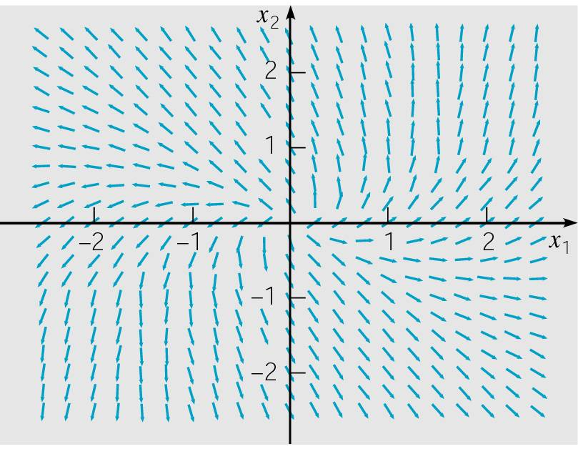
Example 2: Direction Field (1 of 10)
Consider the homogeneous equation x' = Ax below.
A direction field for this system is given below.
Substituting x = ξe^{rt} in for x, where r is A’s eigenvalue and ξ is its corresponding eigenvector,
the previous example showed the
existence of only one eigenvalue,
r = 2, with one eigenvector:

Slide 5
Example 2: First Solution; and Second Solution, First Attempt (2 of 10)
The corresponding solution x = ξe^{rt} of x' = Ax is
Since there is no second solution of the form x = ξe^{rt}, we need to try a different form. Based on methods for second order linear equations in Ch 3.5, we first try x = ξte^{2t}.
Substituting x = ξte^{2t} into x' = Ax, we obtain
or

Slide 6
Example 2: Second Solution, Second Attempt (3 of 10)
From the previous slide, we have
In order for this equation to be satisfied for all t, it is necessary for the coefficients of te^{2t} and e^{2t} to both be zero.
From the e^{2t} term, we see that ξ = 0, and hence there is no nonzero solution of the form x = ξte^{2t}.
Since te^{2t} and e^{2t} appear in the above equation, we next consider a solution of the form

Slide 7
Example 2: Second Solution and its Defining Matrix Equations (4 of 10)
Substituting x = ξte^{2t} + ηe^{2t} into x' = Ax, we obtain
or
Equating coefficients yields Aξ = 2ξ and Aη = ξ + 2η, or
The first equation is satisfied if ξ is an eigenvector of A corresponding to the eigenvalue r = 2. Thus

Slide 8
Example 2: Solving for Second Solution (5 of 10)
Recall that
Thus to solve (A – 2I)η = ξ for η, we row reduce the corresponding augmented matrix:

Slide 9
Example 2: Second Solution (6 of 10)
Our second solution x = ξte^{2t} + ηe^{2t} is now
Recalling that the first solution was
we see that our second solution is simply
since the last term of third term of x is a multiple of x⁽¹⁾.

Slide 10
Example 2: General Solution (7 of 10)
The two solutions of x' = Ax are
The Wronskian of these two solutions is
Thus x⁽¹⁾ and x⁽²⁾ are fundamental solutions, and the general solution of x' = Ax is

Slide 11
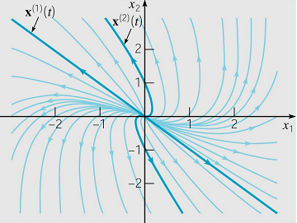
Example 2: Phase Plane (8 of 10)
The general solution is
Thus x is unbounded as t → ∞, and x → 0 as t → -∞.
Further, it can be shown that as t → -∞, x → 0 asymptotic
to the line x₂ = -x₁ determined by the first eigenvector.
Similarly, as t → ∞, x is asymptotic to a line parallel to x₂ = -x₁.

Slide 12
Example 2: Phase Plane (9 of 10)
The origin is an improper node, and is unstable. See graph.
The pattern of trajectories is typical for two repeated eigenvalues with only one eigenvector.
If the eigenvalues are negative, then the trajectories are similar but are traversed in the inward direction. In this case the origin is an asymptotically stable improper node.

Slide 13
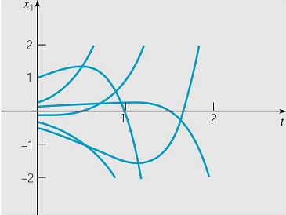
Example 2: Time Plots for General Solution (10 of 10)
Time plots for x₁(t) are given below, where we note that the general solution x can be written as follows.

Slide 14
General Case for Double Eigenvalues
Suppose the system x' = Ax has a double eigenvalue r = ρ and a single corresponding eigenvector ξ.
The first solution is
x⁽¹⁾ = ξe^{ρ t},
where ξ satisfies (A-ρI)ξ = 0.
As in Example 1, the second solution has the form
where ξ is as above and η satisfies (A-ρI)η = ξ.
Since ρ is an eigenvalue, det(A-ρI) = 0, and (A-ρI)η = b does not have a solution for all b. However, it can be shown that (A-ρI)η = ξ always has a solution.
The vector η is called a generalized eigenvector.

Slide 15
Example 2 Extension: Fundamental Matrix Ψ (1 of 2)
Recall that a fundamental matrix Ψ(t) for x' = Ax has linearly independent solution for its columns.
In Example 1, our system x' = Ax was
and the two solutions we found were
Thus the corresponding fundamental matrix is

Slide 16
Example 2 Extension: Fundamental Matrix Φ (2 of 2)
The fundamental matrix Φ(t) that satisfies Φ(0) = I can be found using Φ(t) = Ψ(t)Ψ⁻¹(0), where
where Ψ⁻¹(0) is found as follows:
Thus

Slide 17
Jordan Forms
If A is n x n with n linearly independent eigenvectors, then A can be diagonalized using a similarity transform T⁻¹AT = D. The transform matrix T consisted of eigenvectors of A, and the diagonal entries of D consisted of the eigenvalues of A.
In the case of repeated eigenvalues and fewer than n linearly independent eigenvectors, A can be transformed into a nearly diagonal matrix J, called the Jordan form of A, with
T⁻¹AT = J.

Slide 18
Example 2 Extension: Transform Matrix (1 of 2)
In Example 2, our system x' = Ax was
with eigenvalues r₁ = 2 and r₂ = 2 and eigenvectors
Choosing k = 0, the transform matrix T formed from the two eigenvectors ξ and η is

Slide 19
Example 2 Extension: Jordan Form (2 of 2)
The Jordan form J of A is defined by T⁻¹AT = J.
Now
and hence
Note that the eigenvalues of A, r₁ = 2 and r₂ = 2, are on the main diagonal of J, and that there is a 1 directly above the second eigenvalue. This pattern is typical of Jordan forms.

