Slide 1
Boyce/DiPrima 10th ed, Ch 7.6:
Complex Eigenvalues
Elementary Differential Equations and Boundary Value Problems, 10th edition, by William E. Boyce and Richard C. DiPrima, ©2013 by John Wiley & Sons, Inc.
We consider again a homogeneous system of n first order linear equations with constant, real coefficients,
and thus the system can be written as x' = Ax, where

Slide 2
Conjugate Eigenvalues and Eigenvectors
We know that x = ξe^{rt} is a solution of x' = Ax, provided r is an eigenvalue and ξ is an eigenvector of A.
The eigenvalues r₁,…, r_{n} are the roots of det(A-rI) = 0, and the corresponding eigenvectors satisfy (A-rI)ξ = 0.
If A is real, then the coefficients in the polynomial equation det(A-rI) = 0 are real, and hence any complex eigenvalues must occur in conjugate pairs. Thus if r₁ = λ + iμ is an eigenvalue, then so is r₂ = λ - iμ.
The corresponding eigenvectors ξ⁽¹⁾, ξ⁽²⁾ are conjugates also.
To see this, recall A and I have real entries, and hence

Slide 3
Conjugate Solutions
It follows from the previous slide that the solutions
corresponding to these eigenvalues and eigenvectors are conjugates conjugates as well, since

Slide 4
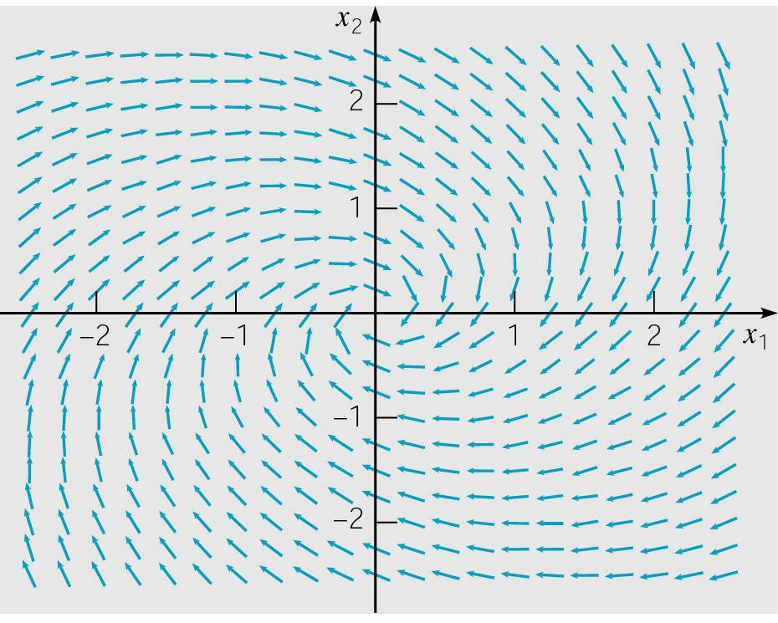
Example 1: Direction Field (1 of 7)
Consider the homogeneous equation x' = Ax below.
A direction field for this system is given below.
Substituting x = ξe^{rt} in for x, and rewriting system as
(A-rI)ξ = 0, we obtain

Slide 5
Example 1: Complex Eigenvalues (2 of 7)
We determine r by solving det(A-rI) = 0. Now
Thus
Therefore the eigenvalues are r₁ = -1/2 + i and r₂ = -1/2 - i.

Slide 6
Example 1: First Eigenvector (3 of 7)
Eigenvector for r₁ = -1/2 + i: Solve
by row reducing the augmented matrix:
Thus

Slide 7
Example 1: Second Eigenvector (4 of 7)
Eigenvector for r₁ = -1/2 - i: Solve
by row reducing the augmented matrix:
Thus

Slide 8
Example 1: General Solution (5 of 7)
The corresponding solutions x = ξe^{rt} of x' = Ax are
The Wronskian of these two solutions is
Thus u(t) and v(t) are real-valued fundamental solutions of x' = Ax, with general solution x = c₁u + c₂v.

Slide 9
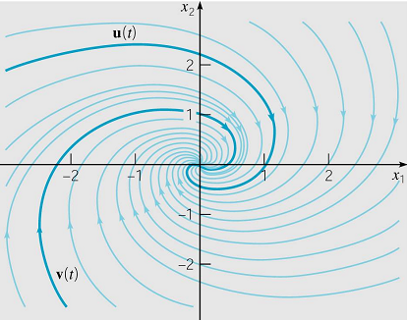
Example 1: Phase Plane (6 of 7)
Given below is the phase plane plot for solutions x, with
Each solution trajectory approaches origin along a spiral path as t → ∞, since coordinates are products of decaying exponential and sine or cosine factors.
The graph of u passes through (1,0),
since u(0) = (1,0). Similarly, the
graph of v passes through (0,1).
The origin is a spiral point, and
is asymptotically stable.

Slide 10
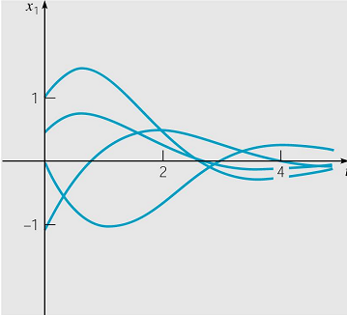
Example 1: Time Plots (7 of 7)
The general solution is x = c₁u + c₂v:
As an alternative to phase plane plots, we can graph x₁ or x₂ as a function of t. A few plots of x₁ are given below, each one a decaying oscillation as t → ∞.

Slide 11
General Solution
To summarize, suppose r₁ = λ + iμ, r₂ = λ - iμ, and that r₃,…, r_{n} are all real and distinct eigenvalues of A. Let the corresponding eigenvectors be
Then the general solution of x' = Ax is
where

Slide 12
Real-Valued Solutions
Thus for complex conjugate eigenvalues r₁ and r₂ , the corresponding solutions x⁽¹⁾ and x⁽²⁾ are conjugates also.
To obtain real-valued solutions, use real and imaginary parts of either x⁽¹⁾ or x⁽²⁾. To see this, let ξ⁽¹⁾ = a + i b. Then
where
are real valued solutions of x' = Ax, and can be shown to be linearly independent.

Slide 13
Spiral Points, Centers,
Eigenvalues, and Trajectories
In previous example, general solution was
The origin was a spiral point, and was asymptotically stable.
If real part of complex eigenvalues is positive, then trajectories spiral away, unbounded, from origin, and hence origin would be an unstable spiral point.
If real part of complex eigenvalues is zero, then trajectories circle origin, neither approaching nor departing. Then origin is called a center and is stable, but not asymptotically stable. Trajectories periodic in time.
The direction of trajectory motion depends on entries in A.

Slide 14
Example 2:
Second Order System with Parameter (1 of 2)
The system x' = Ax below contains a parameter α.
Substituting x = ξe^{rt} in for x and rewriting system as
(A-rI)ξ = 0, we obtain
Next, solve for r in terms of α :

Slide 15
Example 2:
Eigenvalue Analysis (2 of 2)
The eigenvalues are given by the quadratic formula above.
For α < -4, both eigenvalues are real and negative, and hence origin is asymptotically stable node.
For α > 4, both eigenvalues are real and positive, and hence the origin is an unstable node.
For -4 < α < 0, eigenvalues are complex with a negative real part, and hence origin is asymptotically stable spiral point.
For 0 < α < 4, eigenvalues are complex with a positive real part, and the origin is an unstable spiral point.
For α = 0, eigenvalues are purely imaginary, origin is a center. Trajectories closed curves about origin & periodic.
For α = ± 4, eigenvalues real & equal, origin is a node (Ch 7.8)

Slide 16
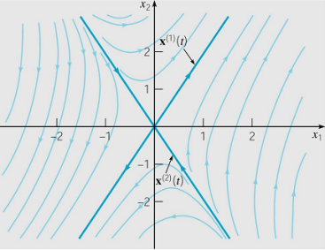
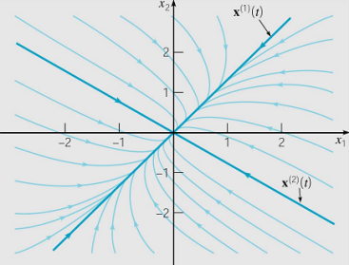

Second Order Solution Behavior and Eigenvalues: Three Main Cases
For second order systems, the three main cases are:
  Eigenvalues are real and have opposite signs; x = 0 is a saddle point.
  Eigenvalues are real, distinct and have same sign; x = 0 is a node.
  Eigenvalues are complex with nonzero real part; x = 0 a spiral point.
Other possibilities exist and occur as transitions between two of the cases listed above:
  A zero eigenvalue occurs during transition between saddle point and node. Real and equal eigenvalues occur during transition between nodes and spiral points. Purely imaginary eigenvalues occur during a transition between asymptotically stable and unstable spiral points.

Slide 17
Example 3: Multiple Spring-Mass System (1 of 6)
The equations for the system of two masses and three springs discussed in Section 7.1, assuming no external forces, can be expressed as:
Given , , the equations become

Slide 18
Example 3: Multiple Spring-Mass System (2 of 6)
Writing the system of equations in matrix form:
Assuming a solution of the form y = ξe^{rt} , where r must be an eigenvalue of the matrix A and ξ is the corresponding eigenvector, the characteristic polynomial of A is
yielding the eigenvalues:

Slide 19
Example 3: Multiple Spring-Mass System (3 of 6)
For the eigenvalues the correspond-ing eigenvectors are
The products yield the complex-valued solutions:

Slide 20
Example 3: Multiple Spring-Mass System (4 of 6)
After validating that are linearly independent, the general solution of the system of equations can be written as
where are arbitrary constants.
Each solution will be periodic with period 2π, so each trajectory is a closed curve. The first two terms of the solution describe motions with frequency 1 and period 2π while the second two terms describe motions with frequency 2 and period π. The motions of the two masses will be different relative to one another for solutions involving only the first two terms or the second two terms.

Slide 21
Example 3: Multiple Spring-Mass System (5 of 6)
To obtain the fundamental mode of vibration with frequency 1
To obtain the fundamental mode of vibration with frequency 2
Plots of and parametric plots (y, y’) are shown for a selected solution with frequency 1
Plots of the solutions as functions of time
Phase plane plots

Slide 22
Example 3: Multiple Spring-Mass System (6 of 6)
Plots of and parametric plots (y, y’) are shown for a selected solution with frequency 2
Plots of and parametric plots (y, y’) are shown for a selected solution with mixed frequencies satisfying the initial condition stated
Phase plane plots
Plots of the solutions as functions of time
Plots of the solutions as functions of time
Phase plane plots

