Slide 1
Boyce/DiPrima 10th ed, Ch 6.6: The Convolution Integral Elementary Differential Equations and Boundary Value Problems, 10th edition, by William E. Boyce and Richard C. DiPrima, ©2013 by John Wiley & Sons, Inc.
Sometimes it is possible to write a Laplace transform H(s) as H(s) = F(s)G(s), where F(s) and G(s) are the transforms of known functions f and g, respectively.
In this case we might expect H(s) to be the transform of the product of f and g. That is, does
H(s) = F(s)G(s) = L{f }L{g} = L{f g}?
On the next slide we give an example that shows that this equality does not hold, and hence the Laplace transform cannot in general be commuted with ordinary multiplication.
In this section we examine the convolution of f and g, which can be viewed as a generalized product, and one for which the Laplace transform does commute.

Slide 2
Observation
Let f (t) = 1 and g(t) = sin(t). Recall that the Laplace Transforms of f and g are
Thus
and
Therefore for these functions it follows that

Slide 3
Theorem 6.6.1
Suppose F(s) = L{f (t)} and G(s) = L{g(t)} both exist for
s > a ≥ 0. Then H(s) = F(s)G(s) = L{h(t)} for s > a, where
The function h(t) is known as the convolution of f and g and the integrals above are known as convolution integrals.
Note that the equality of the two convolution integrals can be seen by making the substitution u = t - τ.
The convolution integral defines a “generalized product” and can be written as h(t) = ( f *g)(t). See text for more details.

Slide 4
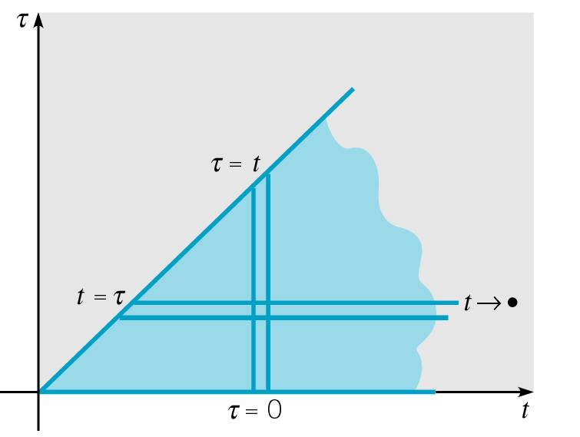
Theorem 6.6.1 Proof Outline

Slide 5
Example 1: Find Inverse Transform (1 of 2)
Find the inverse Laplace Transform of H(s), given below.
Solution: Let F(s) = 1/s² and G(s) = a/(s² + a²), with
Thus by Theorem 6.6.1,

Slide 6
Example 1: Solution h(t) (2 of 2)
We can integrate to simplify h(t), as follows.

Slide 7
Example 2: Initial Value Problem (1 of 4)
Find the solution to the initial value problem
Solution:
or
Letting Y(s) = L{y}, and substituting in initial conditions,
Thus

Slide 8
Example 2: Solution (2 of 4)
We have
Thus
Note that if g(t) is given, then the convolution integral can be evaluated.

Slide 9
Example 2: Laplace Transform of Solution (3 of 4)
Recall that the Laplace Transform of the solution y is
Note Φ (s) depends only on system coefficients and initial conditions, while Ψ (s) depends only on system coefficients and forcing function g(t).
Further, φ(t) = L⁻¹{Φ (s)} solves the homogeneous IVP
while ψ(t) = L⁻¹{Ψ (s)} solves the nonhomogeneous IVP

Slide 10
Example 2: Transfer Function (4 of 4)
Examining Ψ (s) more closely,
The function H(s) is known as the transfer function, and depends only on system coefficients.
The function G(s) depends only on external excitation g(t) applied to system.
If G(s) = 1, then g(t) = δ(t) and hence h(t) = L⁻¹{H(s)} solves the nonhomogeneous initial value problem
Thus h(t) is response of system to unit impulse applied at t = 0, and hence h(t) is called the impulse response of system.

Slide 11
Input-Output Problem (1 of 3)
Consider the general initial value problem
This IVP is often called an input-output problem. The coefficients a, b, c describe properties of physical system, and g(t) is the input to system. The values y₀ and y₀' describe initial state, and solution y is the output at time t.
Using the Laplace transform, we obtain
or

Slide 12
Laplace Transform of Solution (2 of 3)
We have
As before, Φ (s) depends only on system coefficients and initial conditions, while Ψ (s) depends only on system coefficients and forcing function g(t).
Further, φ(t) = L⁻¹{Φ (s)} solves the homogeneous IVP
while ψ(t) = L⁻¹{Ψ (s)} solves the nonhomogeneous IVP

Slide 13
Transfer Function (3 of 3)
Examining Ψ (s) more closely,
As before, H(s) is the transfer function, and depends only on system coefficients, while G(s) depends only on external excitation g(t) applied to system.
Thus if G(s) = 1, then g(t) = δ(t) and hence h(t) = L⁻¹{H(s)} solves the nonhomogeneous IVP
Thus h(t) is response of system to unit impulse applied at t = 0, and hence h(t) is called the impulse response of system, with

